Slide 1
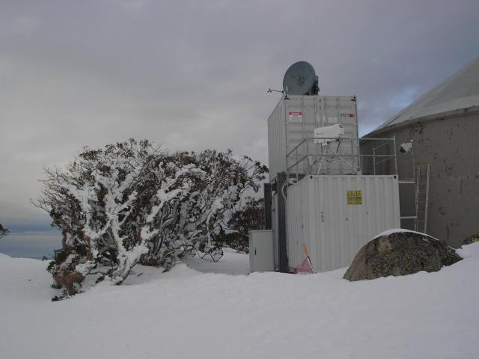
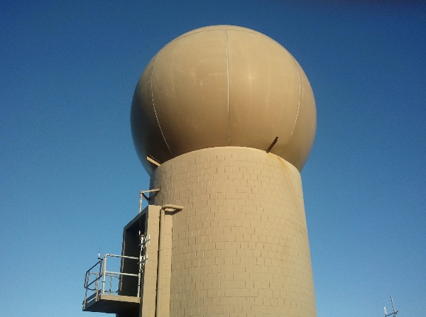
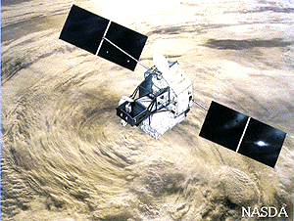
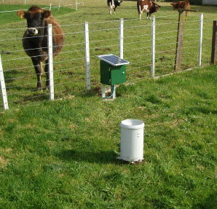
USING RAIN RADAR TO ESTIMATE THE SIZE OF FLOOD EVENTS
Luke Sutherland-Stacey Weather Radar NZ luke@weatherradar.co.nz
Tom Joseph Mott MacDonald
Geoff Austin University of Auckland g.Austin@Auckland.ac.nz
Ken Williams and Nick Brown, Auckland Healthy Waters

Slide 2
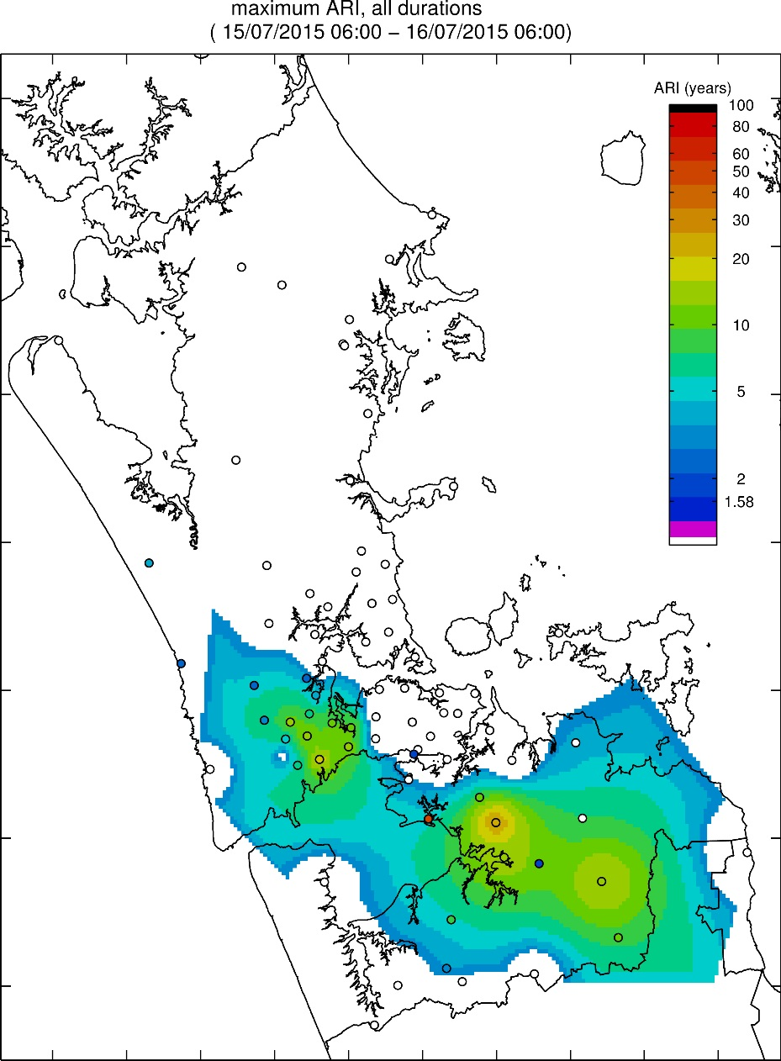
Estimating Flood events with Rain Gauges
Resulting ARI estimates are spatially smooth
Is there more variability between the rain gauge locations which might better explain observed flooding?

Slide 3
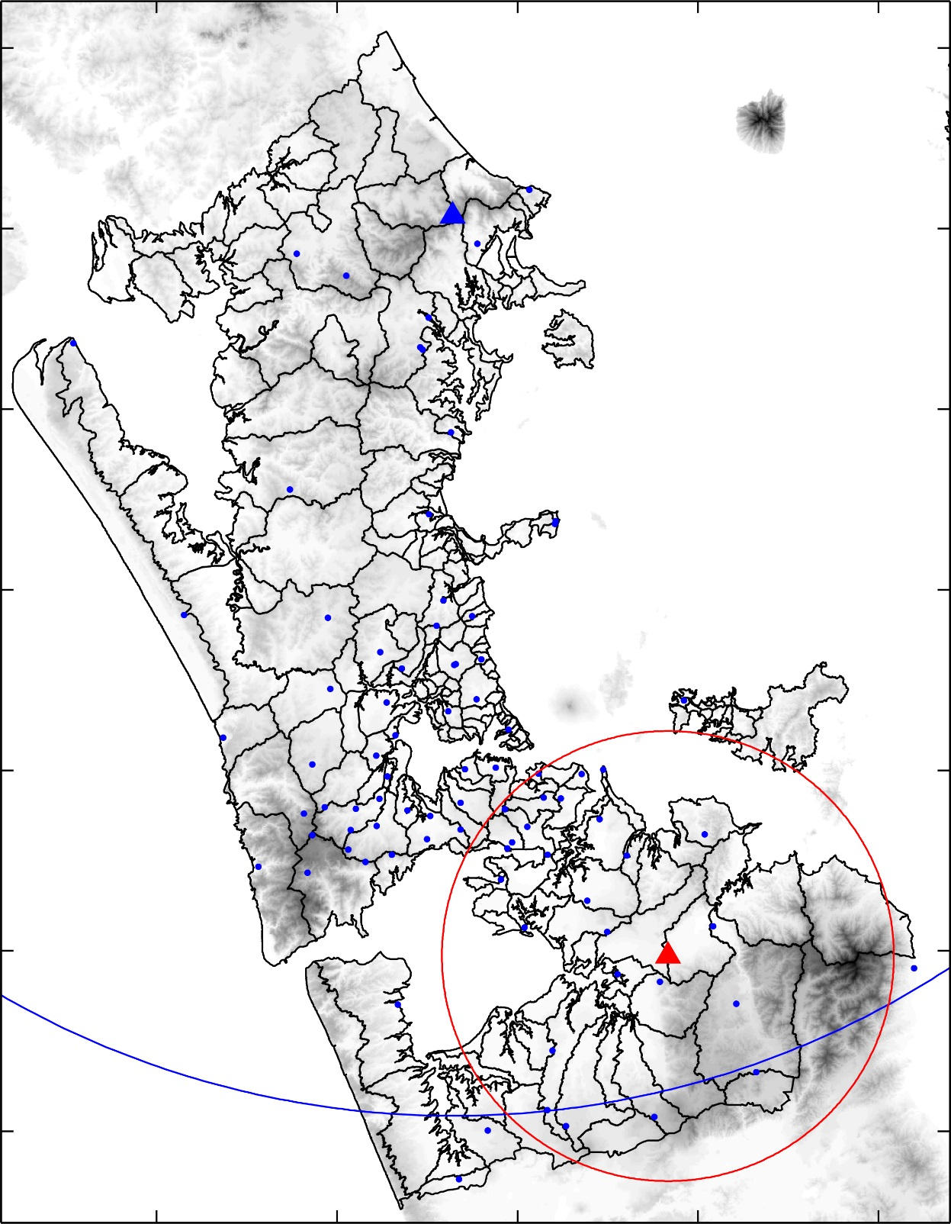
Rainfall Quantification: Observation Systems
Metservice Radar
Two Radar systems are available in Auckland.
NZ Metservice: large permanent radar station
UoA: small (including mobile) research radars
Significant post processing is required to yield good quality radar data
MILSOM, G. et al. Project Storm 2 - A "world class" strategic planning tool. Water New Zealand Conference. 19-21 September, Energy Events Centre, Rotorua 2007.
University of Auckland Field Site (20 km range)
100km Range

Slide 4
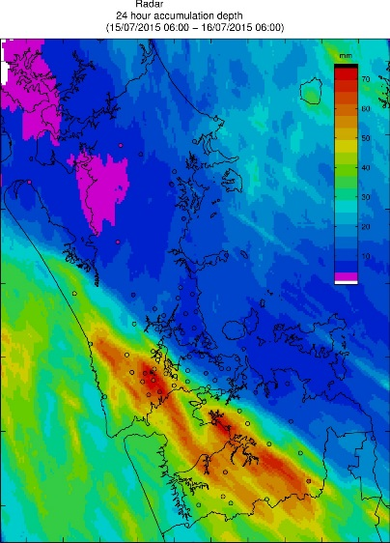
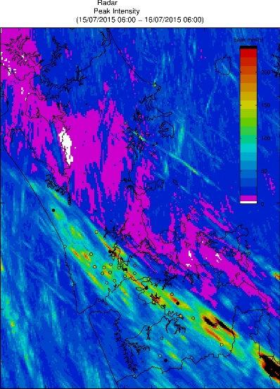
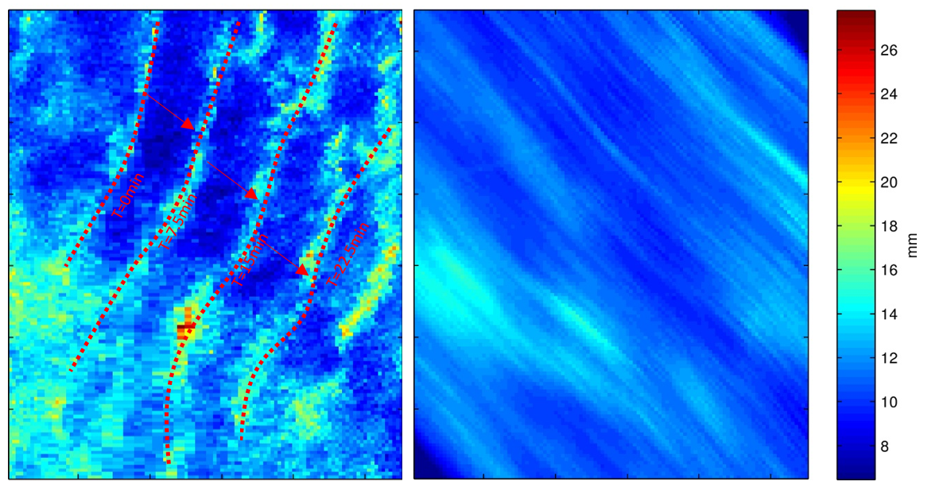
Radar Data preparation
Data handling
Binary manufacturer radar data format
Polar to GIS coordinate system (NZTM) mapping
Automatic QC
Ground clutter (hills, buildings and trees)
2nd trip echoes
Other R/F transmitters
Advection between scans
Radar/Rain gauge correction
Frame n
Frame n+a (0<a<1)
Frame n+1

Slide 5
Post Event Reporting July 2015
Now Auckland Stormwater is investigating the use of Radar for stormwater event analysis.
An event July 2015 is the first to be investigated with this method.

Slide 6
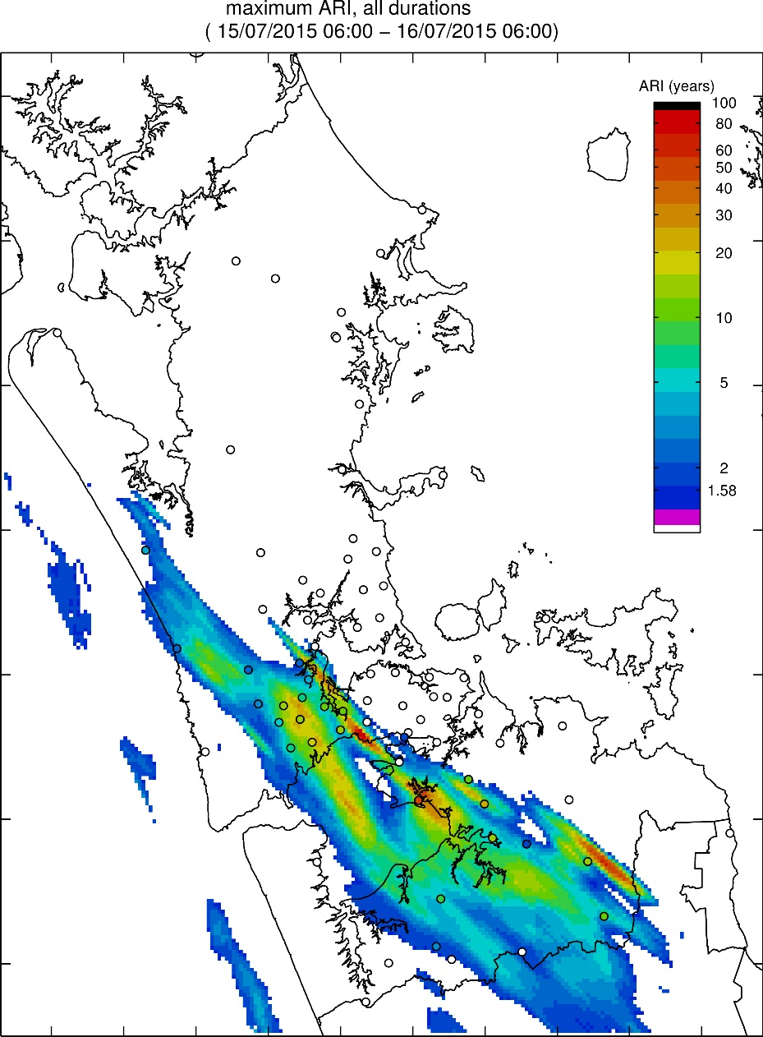
Current Work:
Post Event Reporting July 2015
… and big differences between using rain gauges and radar for calculation of ARI statistics.
Radar
Rain Gauge

Slide 7
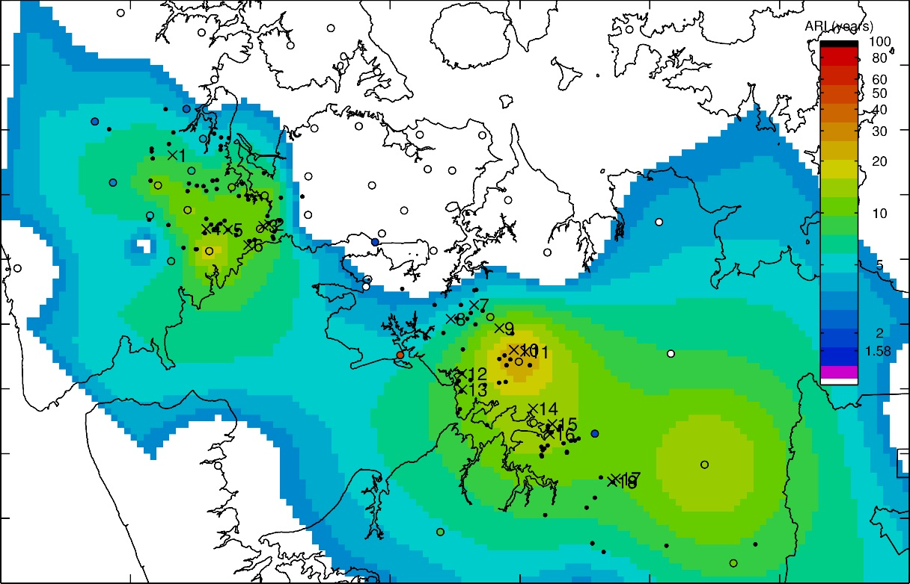
Current Work:
Post Event Reporting July 2015
… which can help to explain the location of Requests of Service.
Non- habitable RFS
Habitable RFS

Slide 8
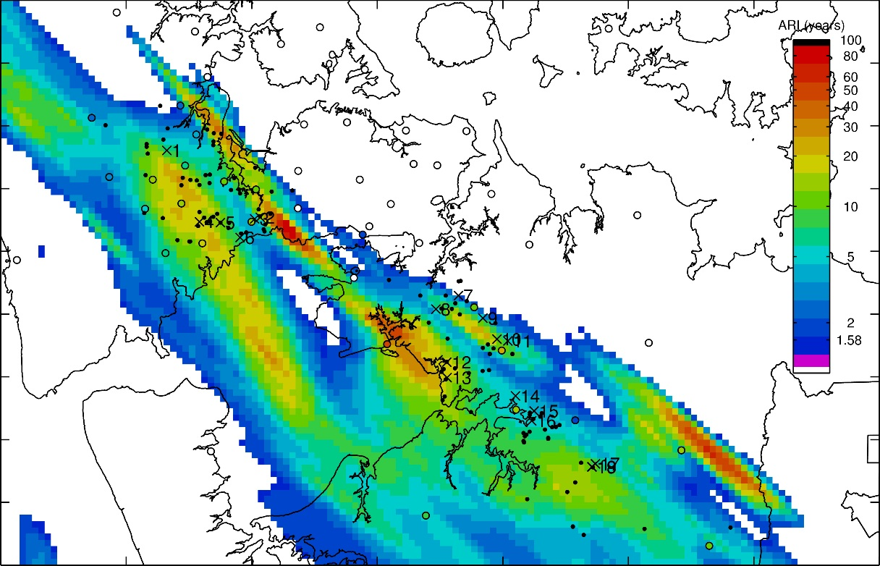
Current Work:
Post Event Reporting July 2015
… which can help to explain the location of Requests of Service.
Non- habitable RFS
Habitable RFS

Slide 9
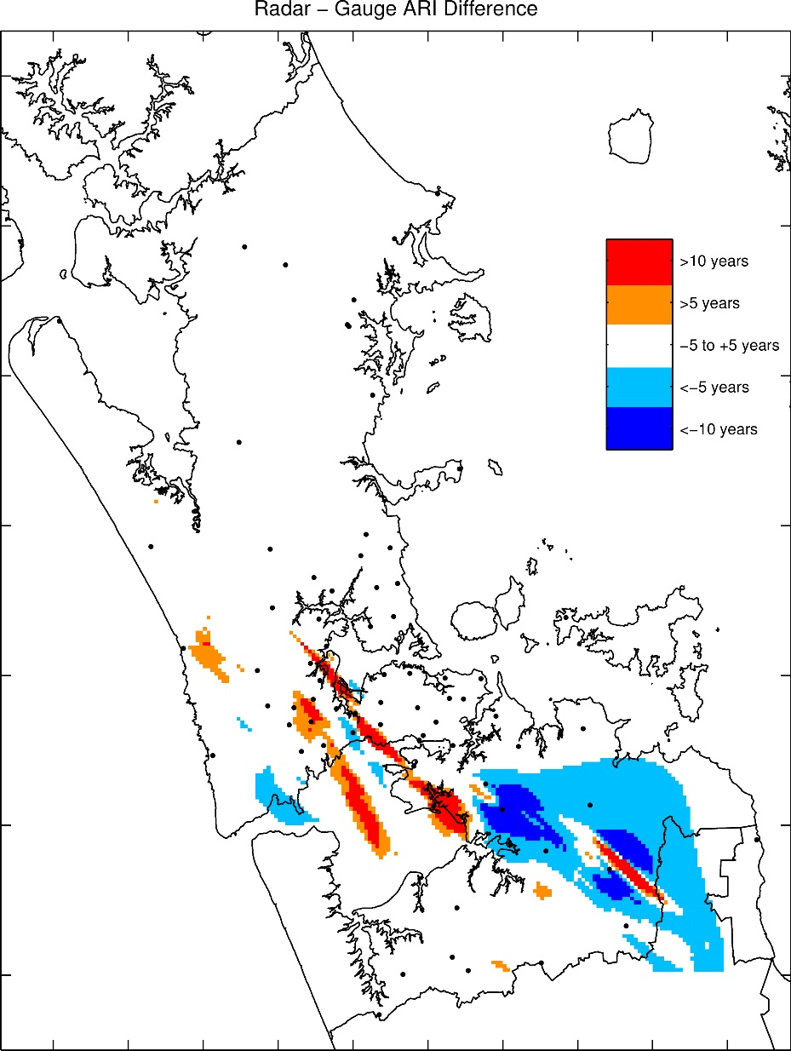
Current Work:
Post Event Reporting July 2015
… and highlights differences between using rain gauges and radar for calculation of ARI statistics…
Radar

Slide 10
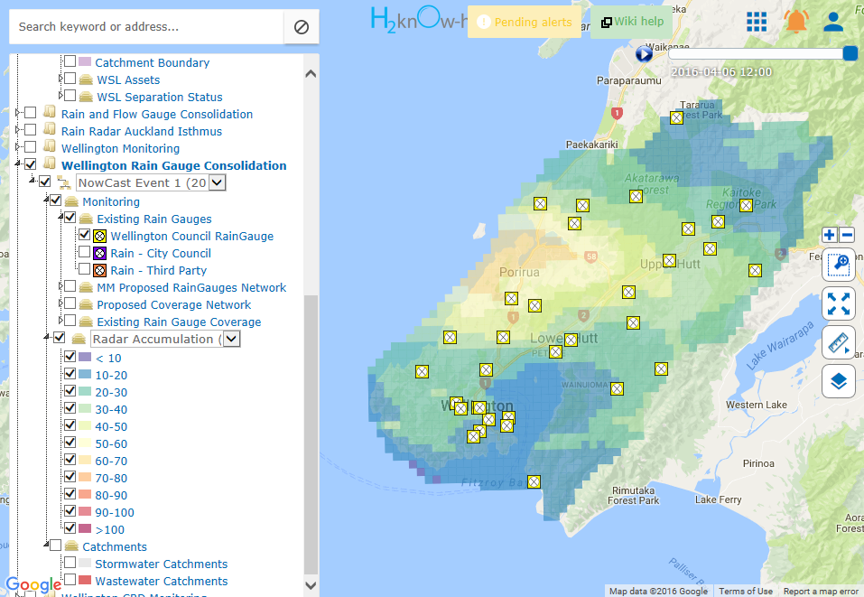
Where to from here?
Operational use of radar data planned. (H2KnowHow interface)
1 hours Radar Nowcasts for operational stormwater management

Slide 11
Where to from here?
Operational use of radar data planned. (H2nOw-How interface)
1 hours Radar Nowcasts for operational stormwater management

