Slide 1
MODELLING SMALL CATCHMENT AND RISKS
Habib Ahsan
Riley Consultants Ltd
March 2019

Slide 2
PRESENTATION TOPICS
What is Small Catchment?
Large vs Small Catchment
What are the possible Risks?
Factors Contributing Risks?
Case Studies
Conclusions
Questions and Answers
Habib Ahsan
Riley Consultants Ltd
March 2019

Slide 3
WHAT ARE SMALL CATCHMENT/PROJECTS
Private Owner
Private Developer
Small Development

Slide 4
LARGE vs SMALL CATCHMENT
Large Catchment | Small Catchment
Council Owned | Private Owner
Planning Leads to Data Collection | No Planning – No Data Gathering
Usually Plenty of Time | Rushing
Usually no Budget Issue | Small Fee
Consider Receiving Environment | Ignore Receiving Environment

Slide 5
GENERAL FACTORS CONTRIBUTING RISKS
Receiving Environment
Inflow/Spills from Upper Catchment
Downstream Boundary Condition
River is the Downstream Boundary
Additional Inflow at Downstream
Inaccurate Boundary Condition
Missing Structures
Missing major Culverts/ Bridges
Missing Stop Bank Information

Slide 6
OTHER CONTRIBUTING FACTORS FOR RISKS
$- Value
Rushing
Inexperience/Lack of Guidance to Modeller

Slide 7
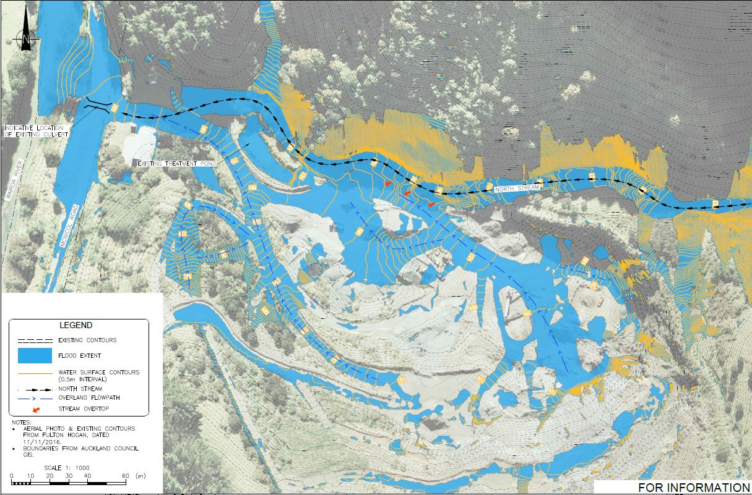
CASE STUDY - CASE 1

Slide 8
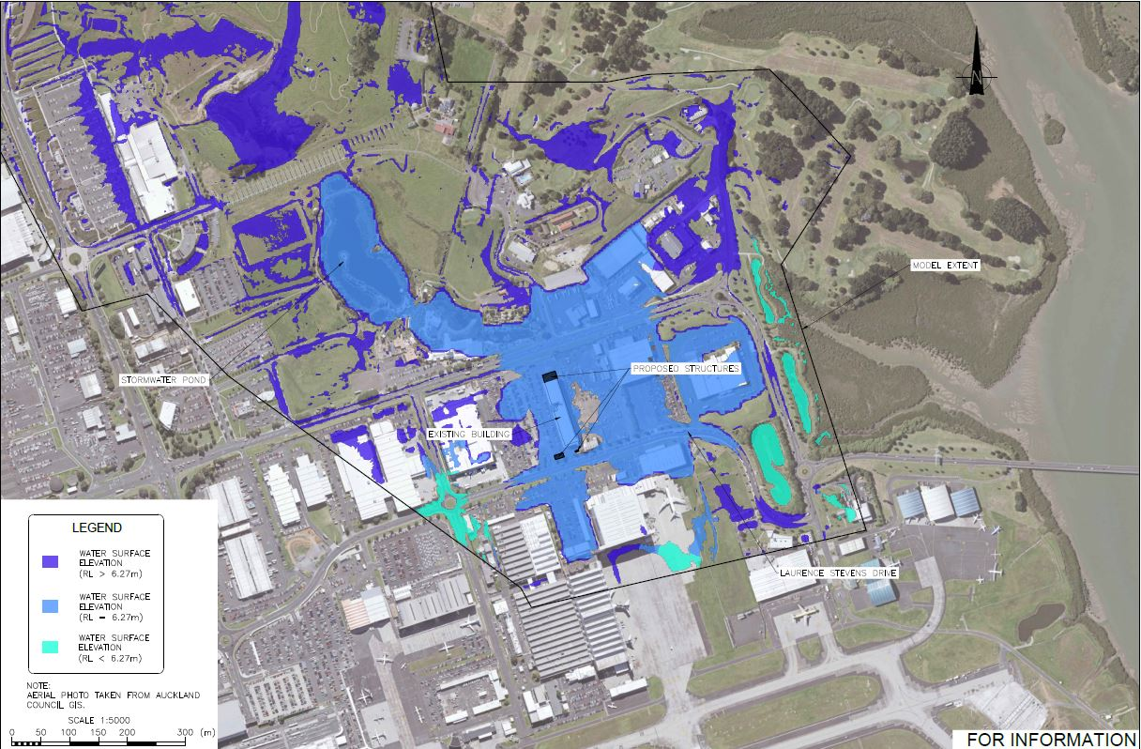
CASE STUDY - CASE 2

Slide 9
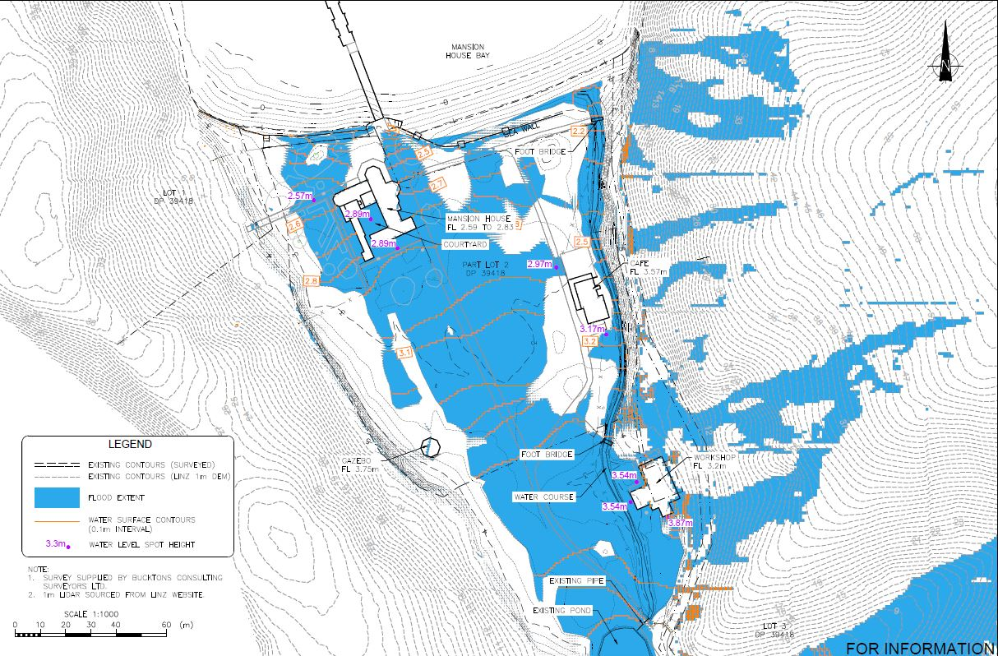
CASE STUDY - CASE 3

Slide 10
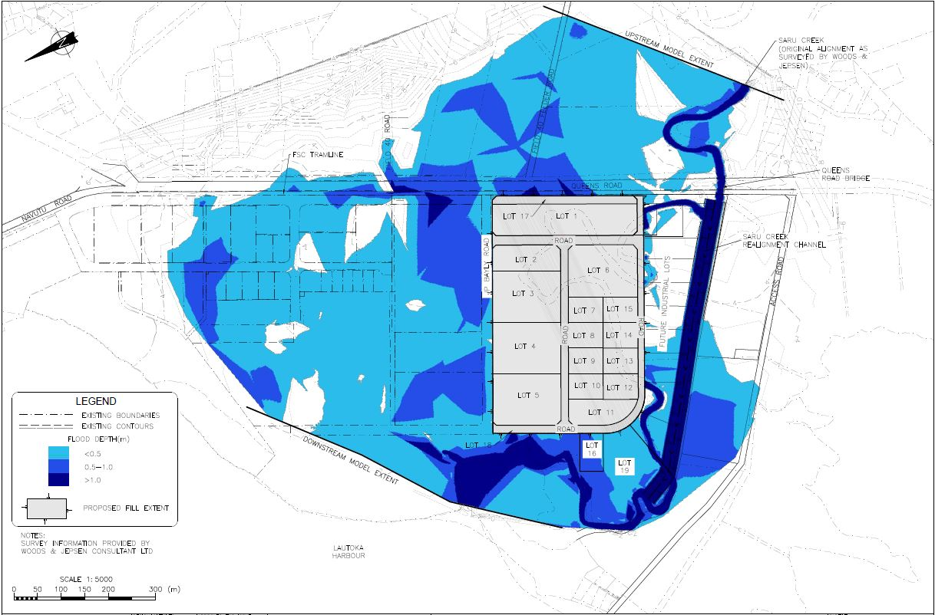
CASE STUDY - CASE 4

Slide 11
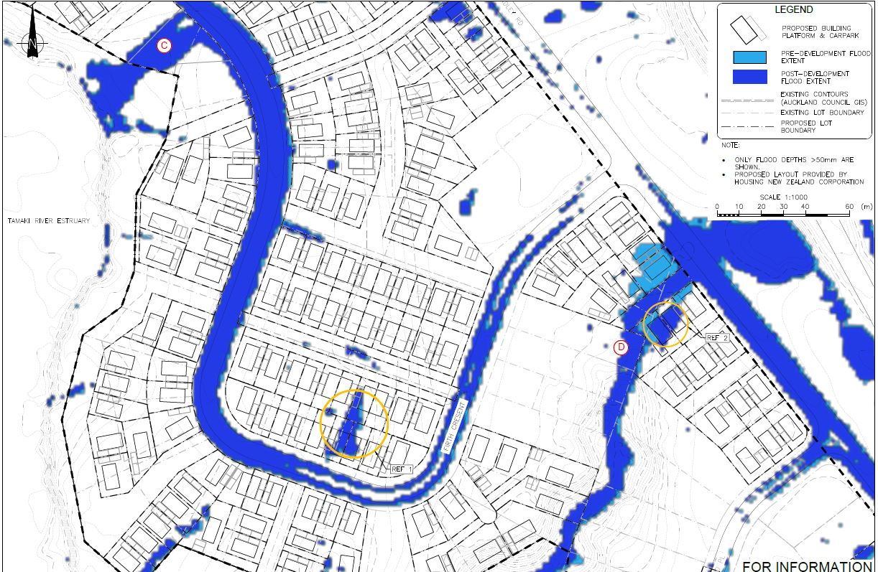
CASE STUDY - CASE 5

Slide 12
RISKS & CONSEQUENCES
Risks
Inaccurate Assessment
May Affect Receiving Environment
Consequences
Client may not accept the Results
Repetition of Works
Delays in Program

Slide 13
CONCLUSIONS /SUGGESTIONS
Use Available Wider Catchment Model
Accurately Define Catchment Boundary
Use Council GIS Database to Identify any Major Structure
Use Google Street View to identify Culverts/Bridges
Identify inflows/Spills from Upper Catchment
Identify Impact of any River flow
Establish Boundary Condition
Extent Downstream Boundary away from Point of Interest
Communicate with Client about Data Requirements and Consequences

Slide 14
Questions and Answers

Slide 15
Modelling Small Catchment & Associated Risks
Thanks for your participation

