Slide 1
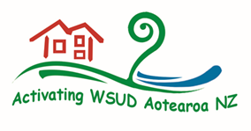
REFLECTING MĀTAURANGA MĀORI IN WATER SENSITIVE URBAN DESIGN
Activating Water Sensitive Design
Dr. Emily Afoa
Troy Brockbank
Water NZ Stormwater Conference
Auckland, 2 May 2019

Slide 2
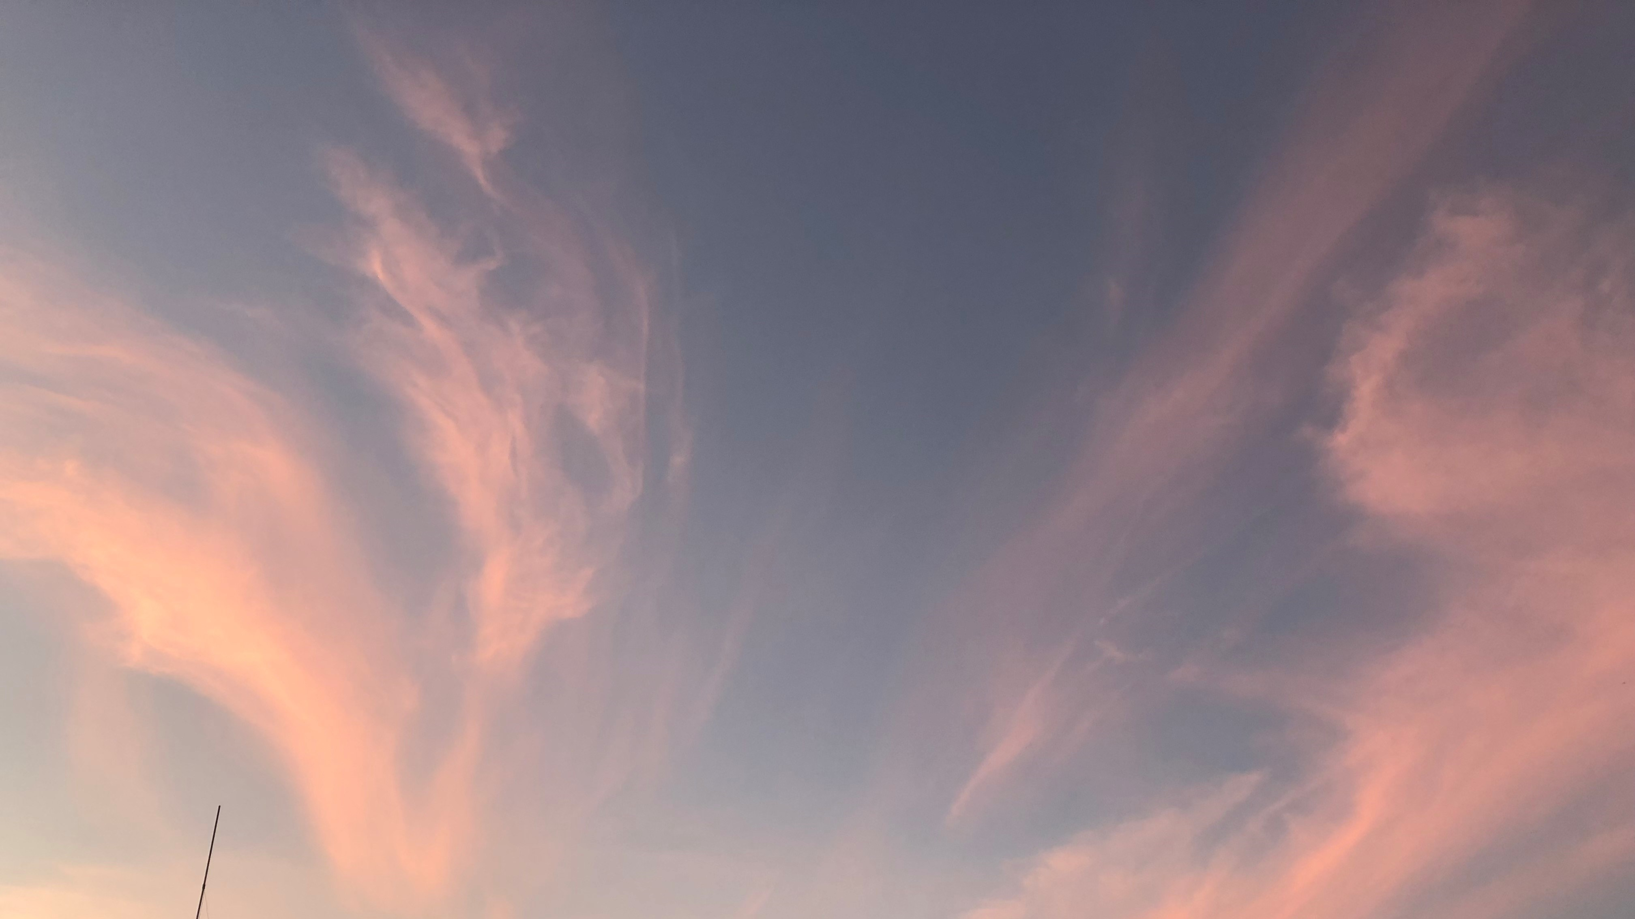
Na te kūkune, te pūpuke
Na te pūpuke, te hihiri
Na te hihiri, te mahara
Na te mahara, te hinengaro
Na te hinengaro, te tūmanako
Na te tūmanako, te wānanga
Na te wānanga, te matau
Hui e, taiki e!
From the conception the increase,
From the increase the thought,
From the thought the remembrance,
From the remembrance the consciousness,
From the consciousness the desire,
From the desire the learning,
From the learning the understanding
Notes:
Karakia
E ngā reo,
E ngā mana,
E ngā karangatanga maha,
Tēnā koutou, tēnā koutou, tēnā tatou katoa.
For those of you who know me, you might be wondering how I come to be standing here presenting this content – I have asked the same question!
Troy has shared this karakia with me. It supports why I stand here presenting to you. It reflects, in this context, my growth of understanding of Te Ao Māori, and hopefully of us all. As an industry, as professionals, I think we are all on a journey to embrace Te Ao Māori – at various stages, with some taking their first steps and some providing the guiding light.
I want to encourage others who might be feeling equally as nervous! Let’s draw on the support of the networks we have available, we can embrace and empower Te Ao Māori in all disciplines represented in our water industry.

Slide 3
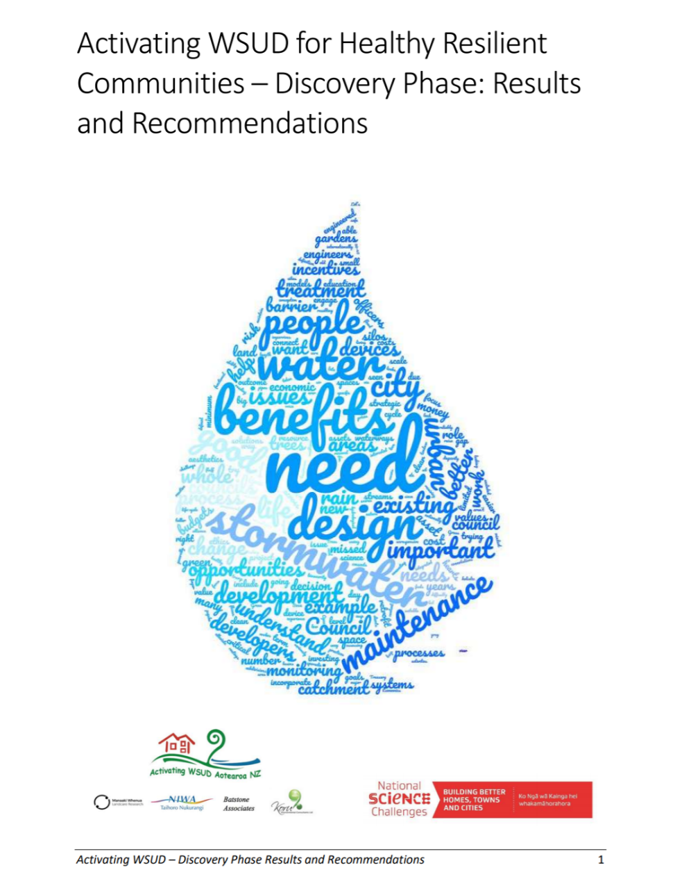
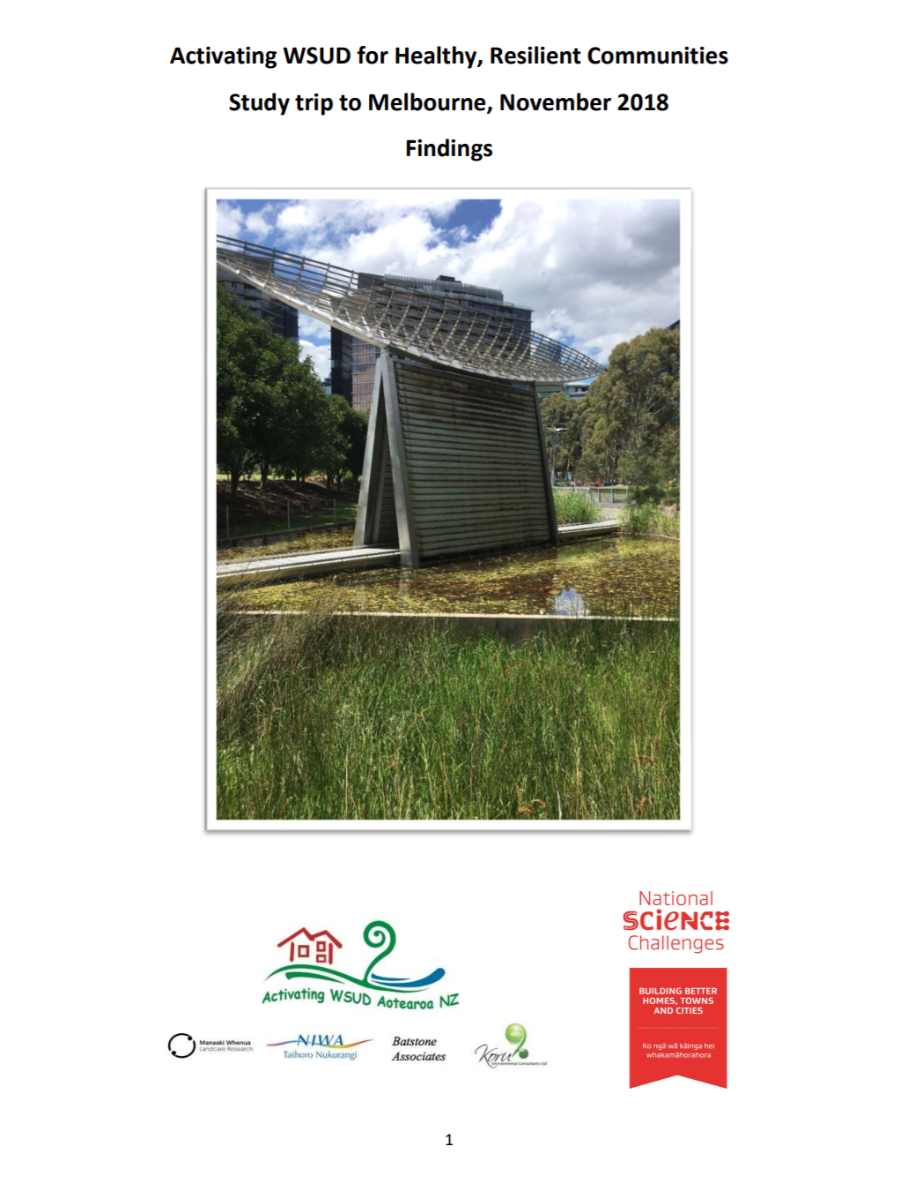
Background
Activating WSUD:
Enhance capability & address current barriers to the uptake of WSUD
Increasing sensitivity to Māori values and aspirations
Culturally Enhanced SW Management – Integration with Te Ao Māori
Notes:
This work is funded by the ongoing research ‘Activating Water Sensitive Urban Design (WSUD) for healthy, resilient communities’ commissioned by the Building Better Homes Towns and Cities National Science Challenge, as presented by Jonathon Moores yesterday morning and workshopped on Tuesday.
Industry engagement as part of the discovery phase research identified an increasing sensitivity to Māori values and aspirations, which spurred this subset of research under the umbrella of the Activating WSUD team.
The work has also grown from Troy’s presentation last year which spoke to water – or wai – from the Māori worldview and his presentation yesterday afternoon presenting Māori values and case studies incorporating te ao Māori.

Slide 4
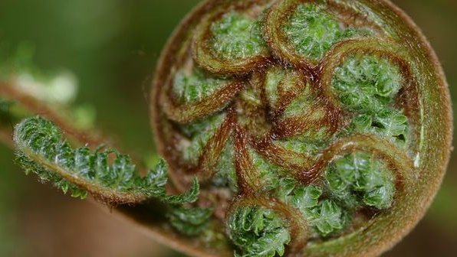
Purpose
How well does WSUD provide for Māori values and uses of water?
Are there opportunities to improve the implementation of WSUD through the integration of Te Ao Māori?
Notes:
This work is intended as a scoping exercise, primarily a literature review of sorts.
Here are two key questions we wanted to address. How can we respect and empower mātauranga Māori as we drive uptake of WSUD.
Keeping in mind the ultimate goal of healthy and resilient communities.
Roles within the water sensitive urban design space are varied, many professions and individuals have the capacity to empower positive change, including town planning, urban design, landscape design, ecologists, engineers, contractors, and residents – the list goes on.

Slide 5
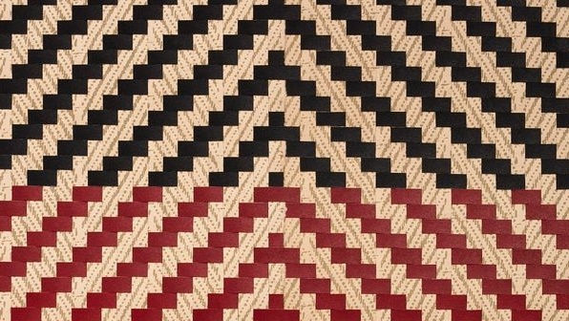
Interpretation
Nā ngā tūpuna ngā taonga i tuku iho
Treasures passed down from our ancestors
Notes:
This presents one interpretation; it reflects our understanding of Te Ao Māori, our experiences and learnings to date, and the learning and experiences of those who support us.
We recognise there is regional variation – so the views presented are not intended to represent the views of all Māori.

Slide 6
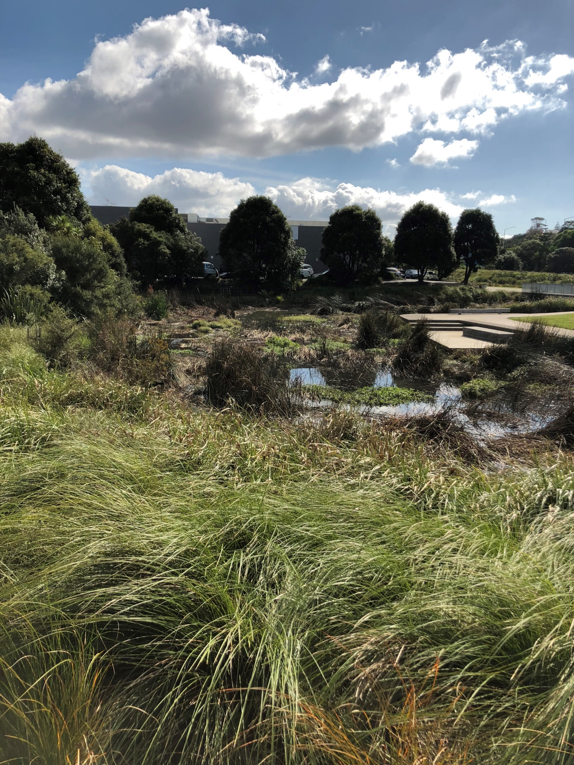
WSUD IN AOTEAROA
Strong focus on SW management & receiving water bodies
Broader than stormwater alone!
Water supply & wastewater sectors
Urban liveability
Amenity & recreation
Community health
Notes:
Before opening the door to Te Ao Māori – it is important we consider what WSUD means in the current NZ context.
Typical concepts:
Source control
Reduce impervious surfaces
Maintain natural drainage systems
Maintain pre-development characteristics
Use water sensitive or green technologies

Slide 7
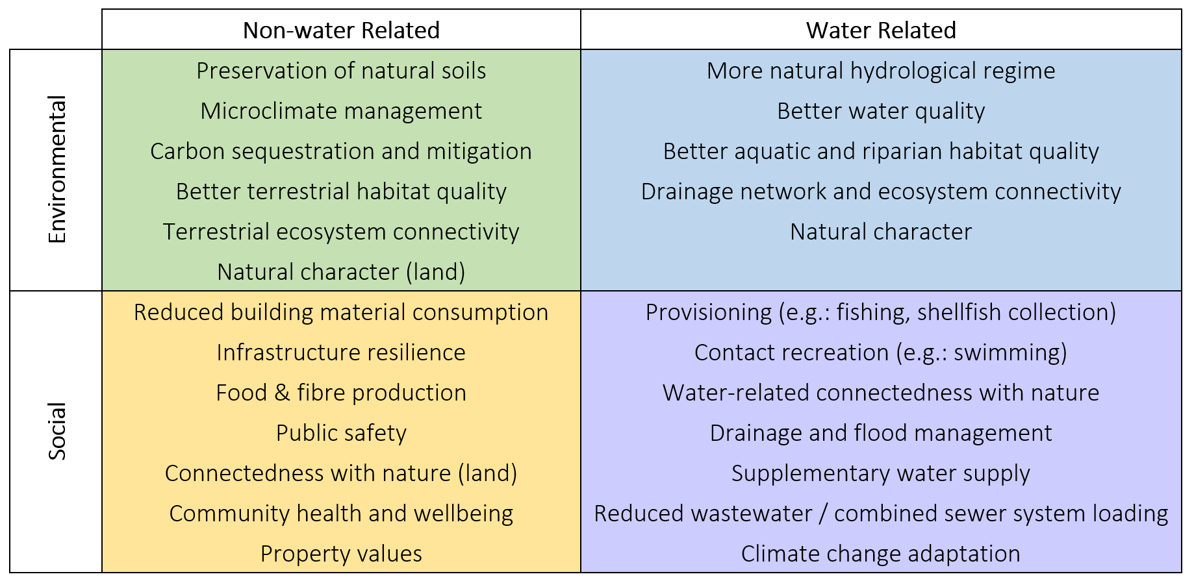
ACTIVATING WSUD
COSTS & Benefits
(Moores et al., 2019)
Notes:
Summary of WSUD Benefits
Broader range of costs & benefits than we typically consider.
No cultural line item, or “slice of the pizza” – integrate culture throughout, not as a separate line item
“More Than Water (MTW)” tool, for comparing potential outcomes under WSUD with those under conventional development approaches
Cautions trying monetise some of the identifies costs and benefits
Presented yesterday by Jonathon Moores.

Slide 8
Te AO Māori
Kōrero tuku iho Creation narratives
Whakapapa Genealogy
Notes:
To understand Te Ao Māori, it is important to understand the foundation upon which a Māori worldview is built.
Creation narratives help to understand whakapapa:
More than just genealogy in the direct sense of bloodlines and family ancestry
At a higher level this is the whakapapa that has been passed down
from the very beginning
to the world of light
to sky father & earth mother
The genealogy of creation begins with Io taketake (the originator) and evolves through different spheres of development until the present day:
I te tīmatanga, kō te kore (In the beginning there was a void) moving to Te Pō (the night/darkness) to Te Ao (the light)

Slide 9
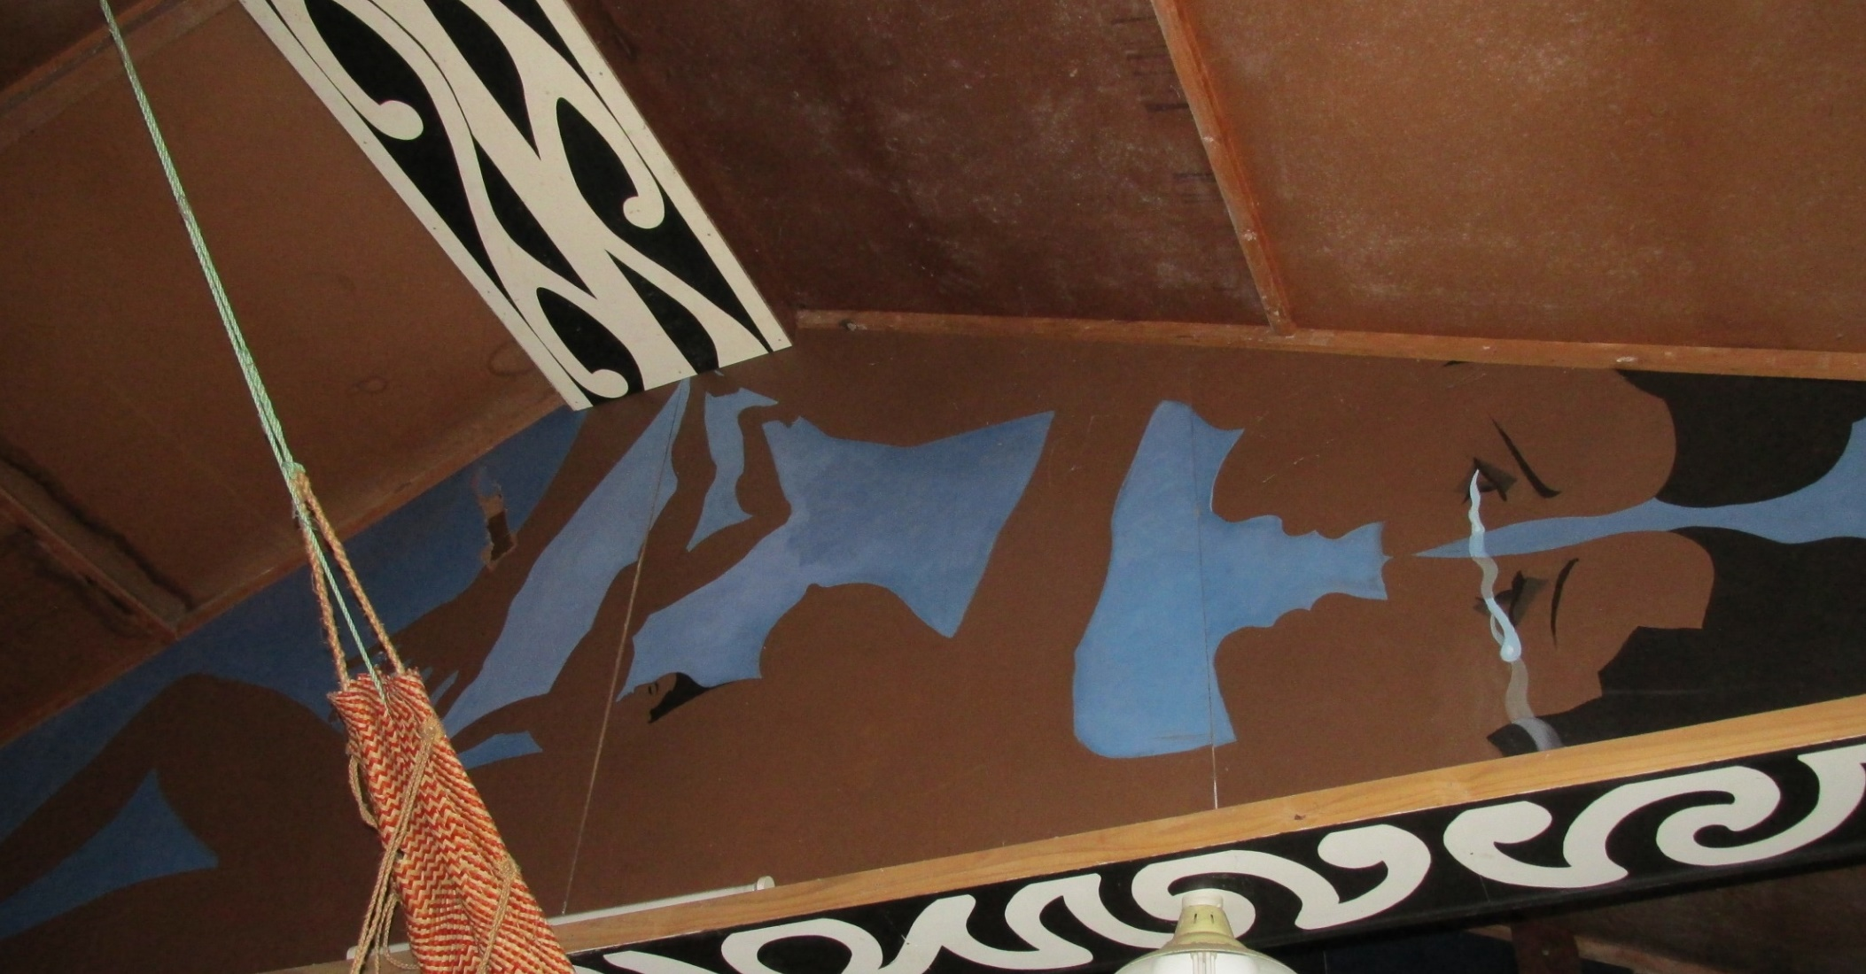
Ngā roimata o ngā atua
The tears of Rangi & Papa
Ranginui
Sky Father
Tāne Mahuta
God of the Forest
Papa-tū-ā-nuku
Earth Mother
Notes:
This picture – of Troy’s marae – depicts the beginning of life:
From Papatūānuku & Ranginui
to the many deities
to us – we ‘the people’ are now in between it all
Kōrero tuku iho – or creation narratives – broadly reference the personification of, and separation of, Papatūānuku (the earth mother) and Ranginui (the sky father) as primal parents and reference to how they were responsible for creating the world in which we, the people, inhabit.
Ko Rangi-nui kei runga - Ranginui is above
Ko Papa-tū-ā-nuku kei raro - Papa-tū-ā-nuku is below
E maringi noa ngā roimata o ngā atua. - The tears of Rangi & papa flow
Uanga ki uta, wai rere ki tai. - Rain from inland, flowing water to the sea.
Ko tātou ngā tāngata kei waenganui. - We the people are in between.
Tihei wa mauri ora!! - Behold, let there be life.

Slide 10
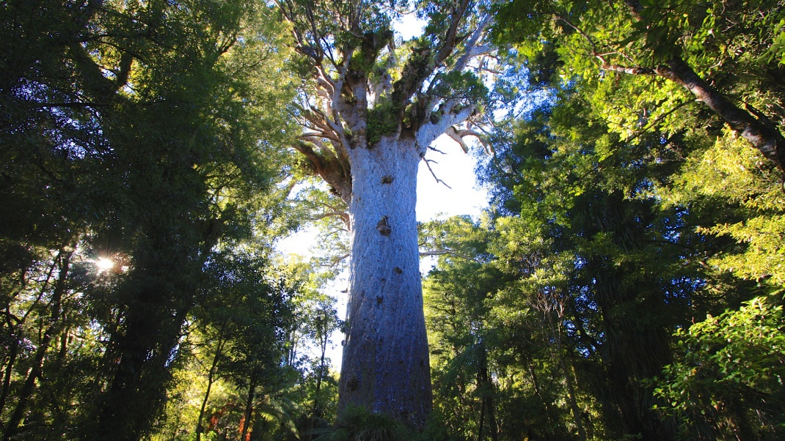
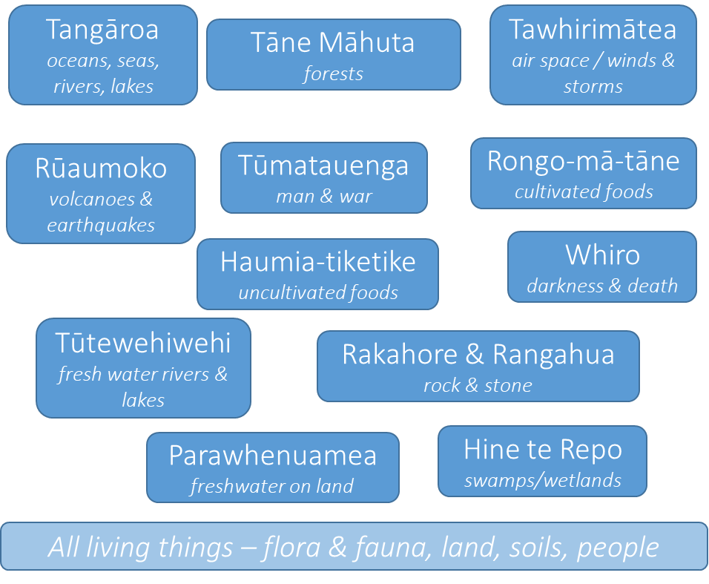
Notes:
The slide demonstrates some of the departmental deities - personified as natural phenomena – come from Papatūānuku and Ranginui.
We ‘the people’ are now in between it all
The children of Papatūānuku do not belong to us, we don’t have dominion over them, but rather we are one of the many children of Papatūānuku.
As part of this ancestry, this whakapapa, it is our responsibility to sustain the physical and spiritual well-being of Papatūānuku, her children, and future generations.

Slide 11
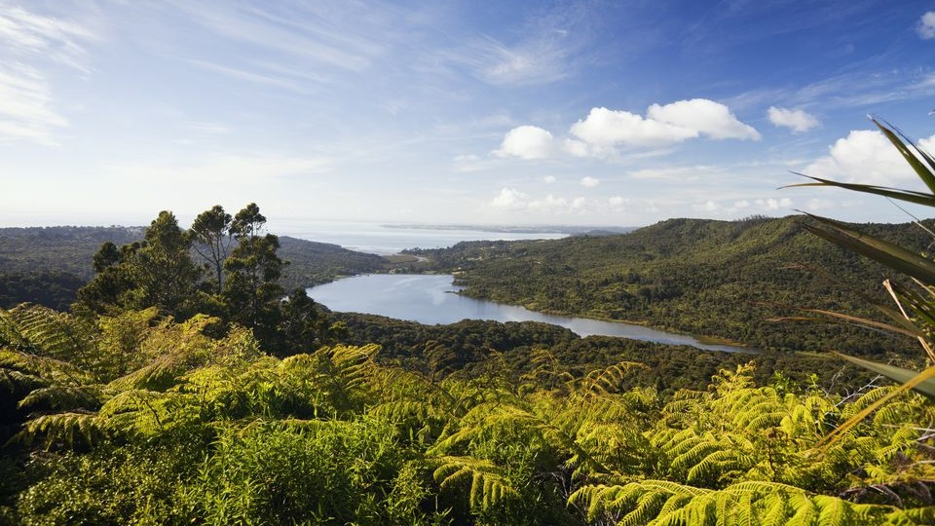
Ko au te awa, ko te awa ko au
Ko au te whenua, ko te whenua ko au
Whatungarongaro te tāngata, toitū te whenua
I am the river, the river is me
I am the land, the land is me
Man perishes, but land remains
Notes:
These whakataukī – proverbs – demonstrate more than a physical connection to the land. It is essential to understand the spiritual connection to our ecosystems.
Kōrero tuku iho – or creation narratives – underpin identity, character, and connection with the broader environment.
We are connected through whakapapa – through genealogical links – back to Papatūānuku (earth mother) and Ranginui (sky father), back to Io Taketake (the originator).
Mātauranga Māori – or traditional knowledge – has been reinforced through whakapapa and kōrero tuku iho which demonstrate interdependencies between land and sea, water and air, flora and fauna, and people and the ecosystem.
It is not only all Māori who are connected in genealogical tables – all things are related by descent and so it becomes difficult to separate aspects of the environment for specific comment without considering them in a broader environmental and intergenerational context.

Slide 12
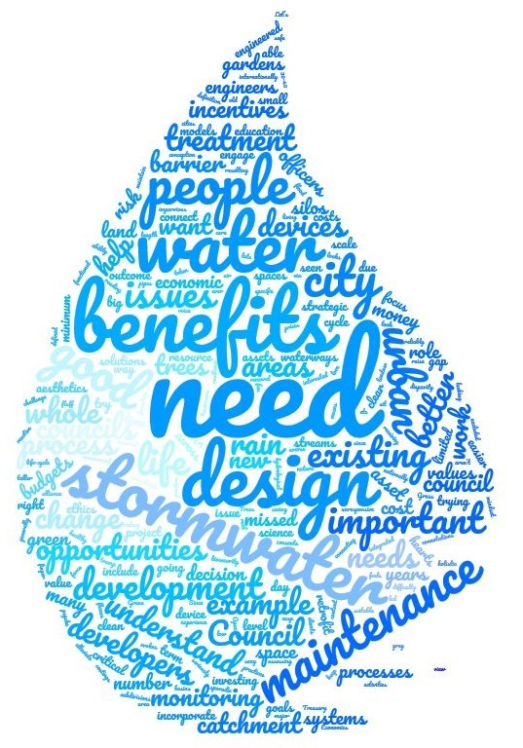
Key Principles?
Notes:
Word cloud has come out of the activating WSUD research – it forms the cover of the phase one research & reflects statements made by workshop attendees on the ‘burning issues’ associated with barriers to the uptake of WSUD.
Through the literature review we identified key values that were frequently presented, shown in the word cloud. It is not intended to reflect any particular weighting of values, and we must also recommend that many of the values are interdependent.
Troy spoke to some of these yesterday in relation to the Te Aranga principles:
Mana – respect for water
Kaitiakitanga – stewardship
Whanaungaganga - connect back to water
Kotahitanga - unity as one industry
Mauri - binding force between physical/spiritual
While I don’t have time to talk to these values individually – these form the underlying principles guiding this scoping exercise.

Slide 13
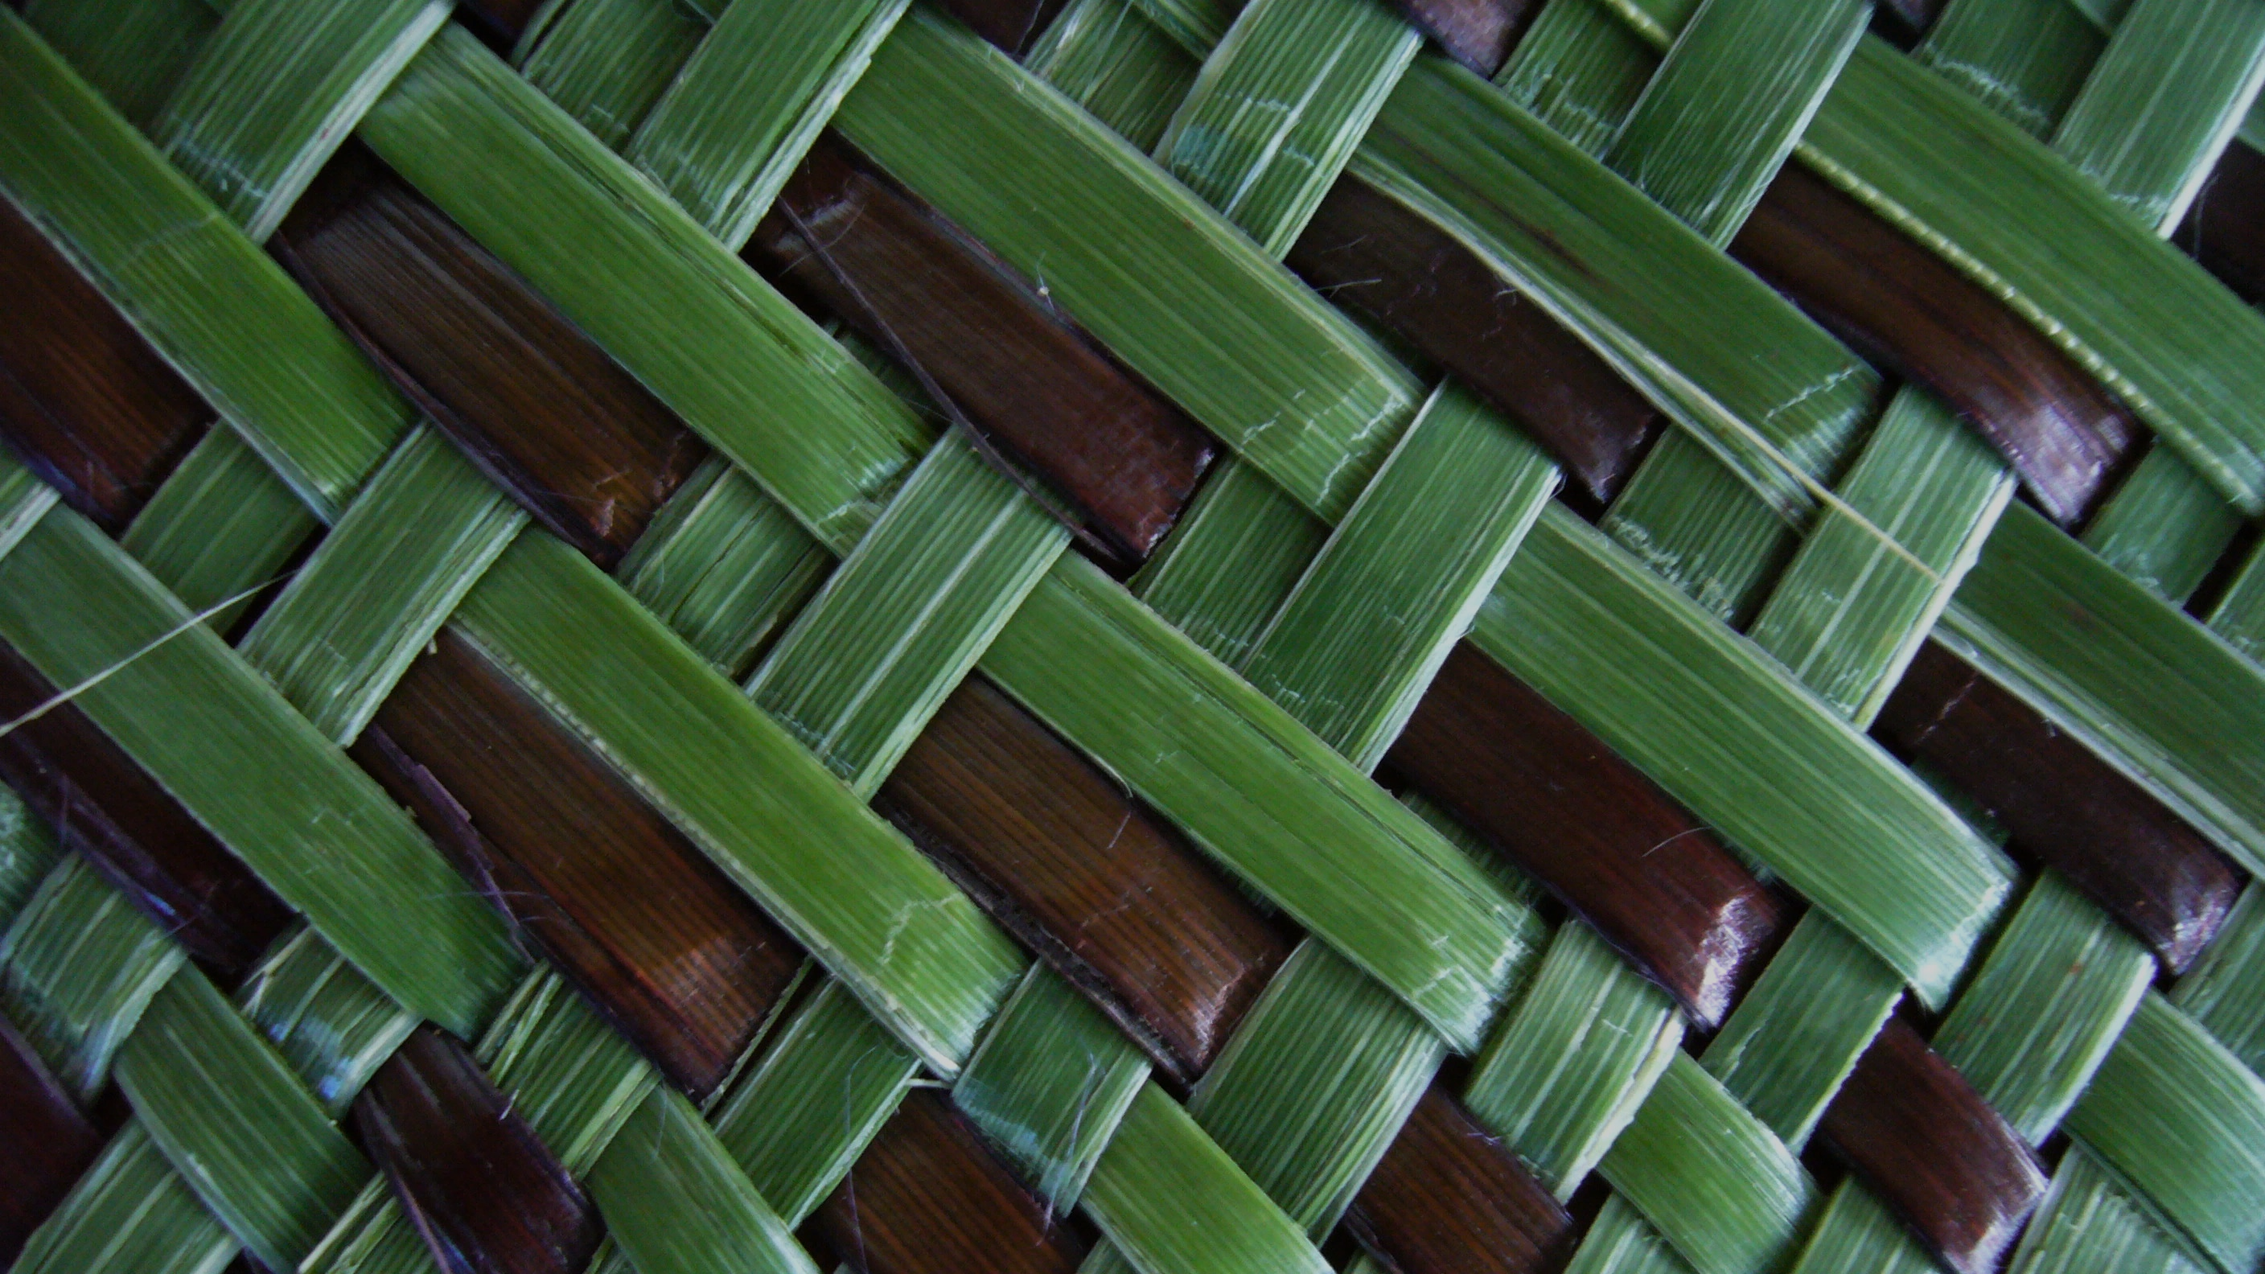
Ka mua, ka muri
We look to the past as we move forward into the future
Notes:
The risk is that we consider these values features of the past, or we do not recognise the validity of traditional knowledge forms, for example oral narratives such as whakataukī.
<whakataukī>
It is important to recognise that these values, and mātauranga Māori – Māori knowledge – are of continuing relevance and can support resolving contemporary sustainable development dilemmas.

Slide 14
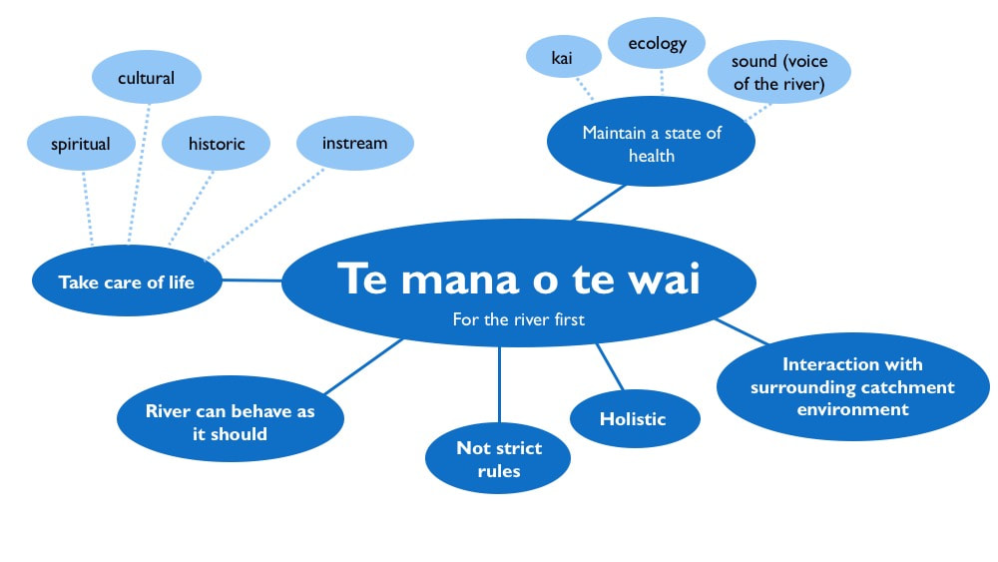
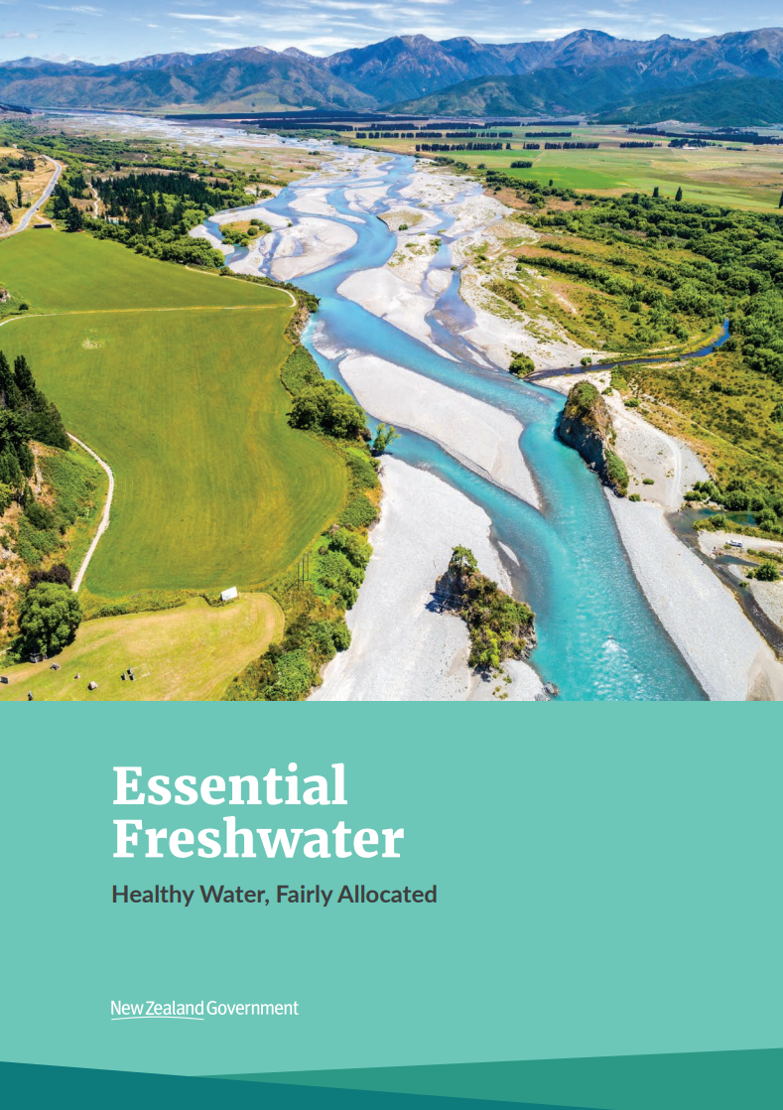
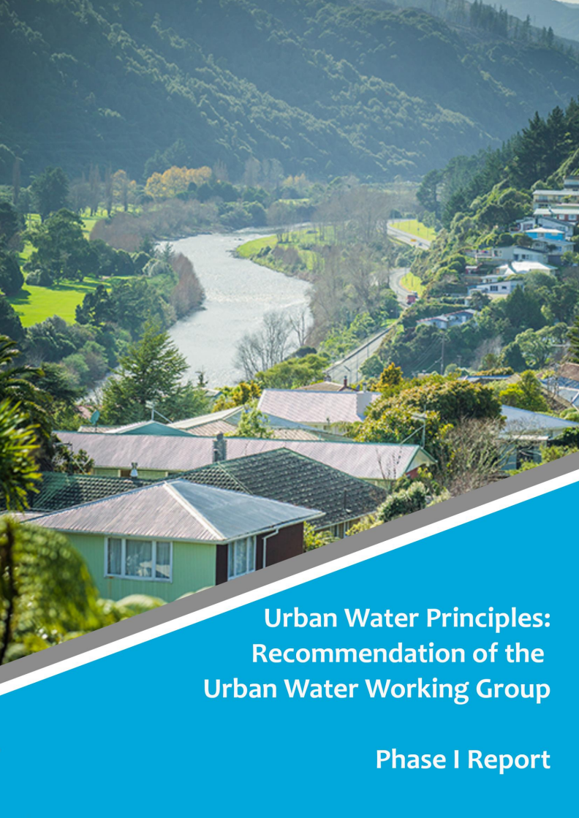
Te Ao Maori & water management
Nationally
Te Aranga Principles
Te Mana o te Wai
Urban Water Principles – Ngā Wai Manga
Essential Freshwater work programme
Regionally
Auckland Council Water Strategy
Iwi/hapū management plans
Notes:
There is significant movement at a range of scales to recognise the relevance, improve understanding, and empower Te Ao Maori in catchment management.
These are some examples only, some of which have been spoken to already here:
Te Aranga Principles
Te Mana o te Wai acknowledges each water body has its own mauri and its own mana which must come first to protect the integrity of the water body
The development of ten urban water principles began with the concept of Te Mana me Te Mauri o Te Wai – we owe the greatest obligation to that which ‘gives us life’.
The priority of the Auckland Council Water Strategy is “Te mauri o te wai ( the life supporting capacity of water)”. This vision puts water at the centre with people, more in line with Te Ao Māori views – recognising an overarching vision of one water. Water in all its different forms is considered in a system-wide view: in rivers and streams, in underground aquifers, in estuaries, harbours and marine areas, and in the three (infrastructure) waters: drinking water, wastewater, and stormwater.

Slide 15
Impacts on Health & Wellbeing
Urban development
Fewer experiences of nature
Notes:
Both of our keynotes yesterday - Dr Dwayne Jones & Prof Chris Digman – spoke to urbanisation of populations, social equity and the importance of considering health and wellbeing in the context of water management.
World Health Organisation definition clearly links health and well-being.

Slide 16
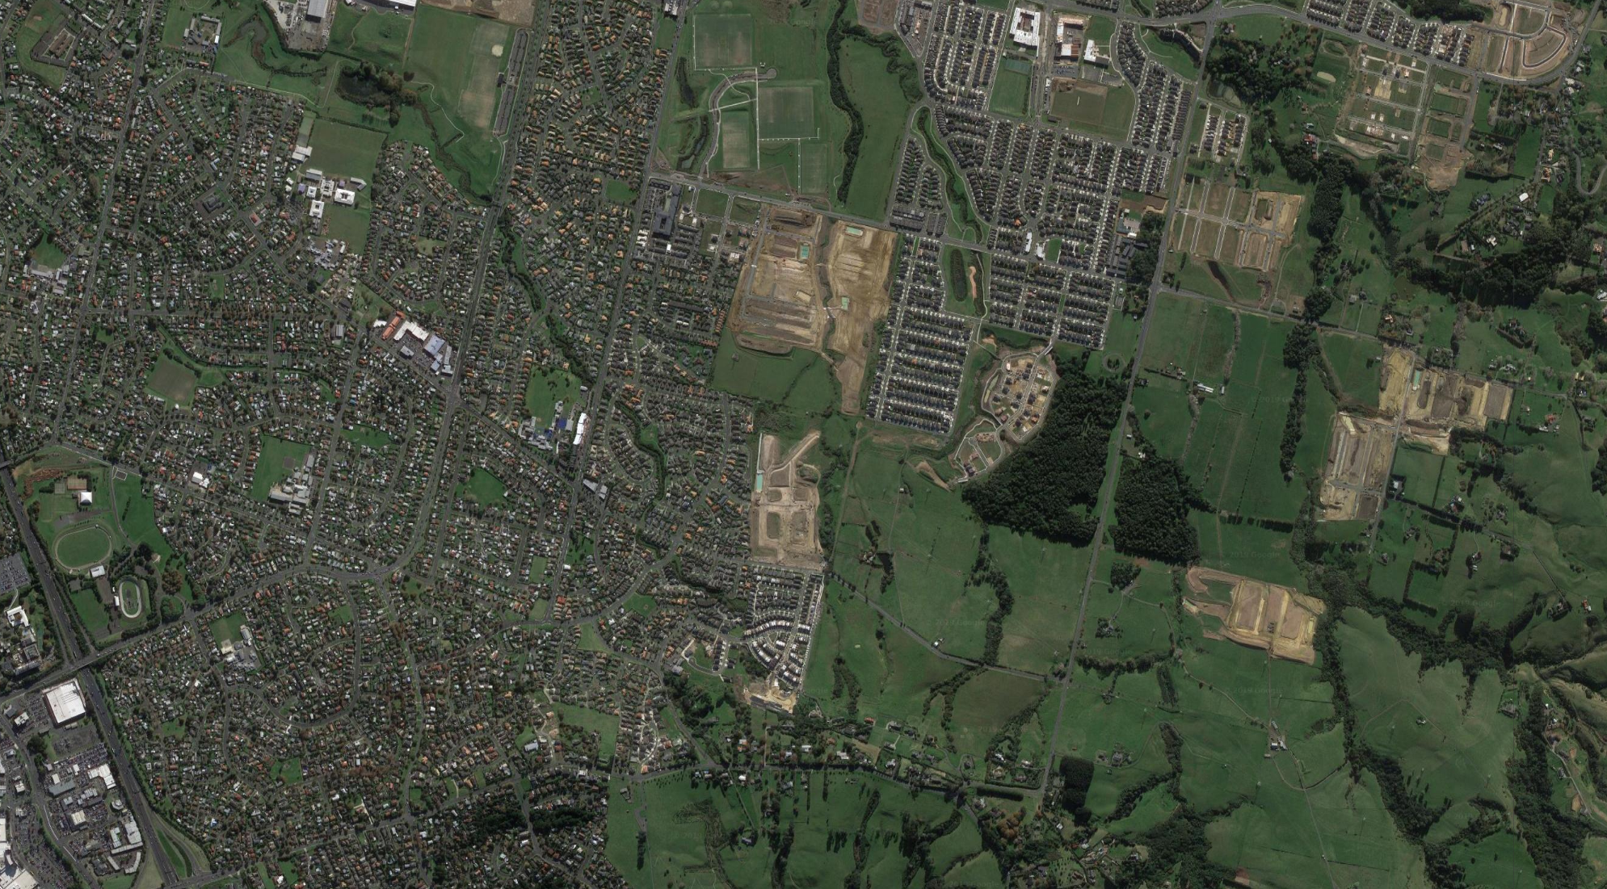
Impacts on Health & Wellbeing
Cumulative exposure to nature
Consistent & positive associations with health indicators
Greater orientation to nature
Better mental health, social cohesion, & physical behaviour
Notes:
Important to tie back into the overarching research – activating WSUD for healthy & resilient communities.
Nature defined to include
blue spaces (access to surface water),
areas smaller than 1 ha,
small scale horticulture (i.e. community gardens),
isolated natural elements (i.e. street trees & green verges)
More consistent & positive associations with health indicators than proximity to a formal “greenspace” alone. Highlighting the importance of supporting the development of a connection to nature across a person's life-course, reversing the urban disconnect. Connection draws back to whakapapa and key Māori values:
Mana - respect to water
Kaitiakitanga - stewardship
Whanaungatanga - connect back to water
Kotahitanga - unity as one industry
Mauri

Slide 17
Ka ora te wai,
Ka ora te whenua.
Ka ora te whenua,
Ka ora te tangata.
If the water is healthy,
The land will be nourished.
If the land is nourished,
The people will be healthy.
Notes:
Humans and ecosystems are inter-connected through whakapapa and the interaction between them is what determines the welfare of both.
We don’t have to compromise development to meet the needs of our growing communities, but we need to develop in a way that ensures our interaction with Papatūānuku – Earth Mother – comes from a place of mutual respect not dominance.
Intensification and urbanisation is affecting more than the natural and built environment – it is impacting our relationship with the environment.
The implementation of WSUD provides a clear opportunity to enhance urban greenspaces and reconnect people with the natural environment .

Slide 18
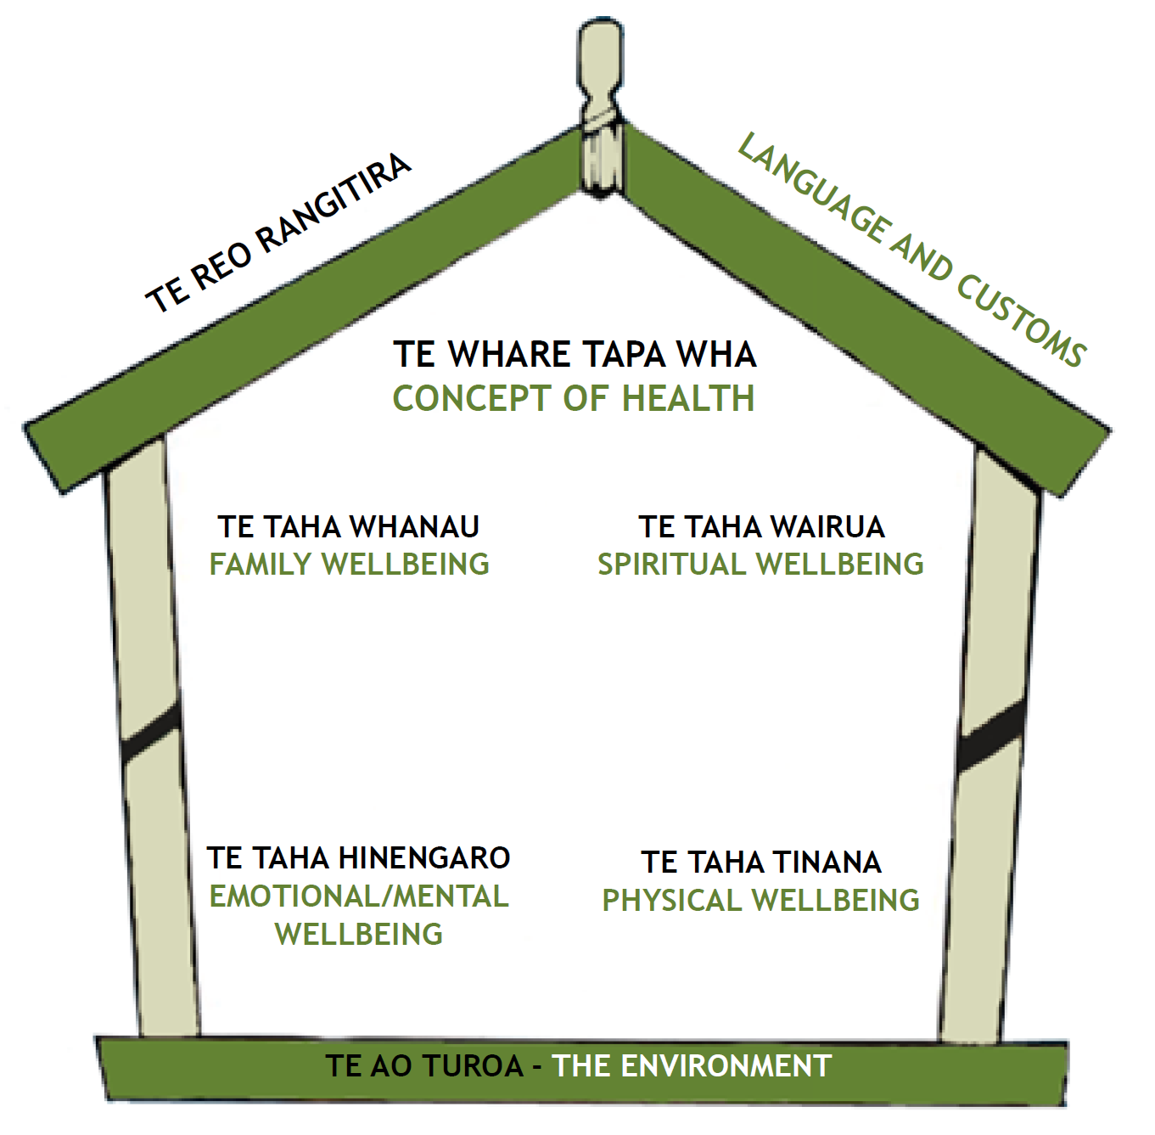
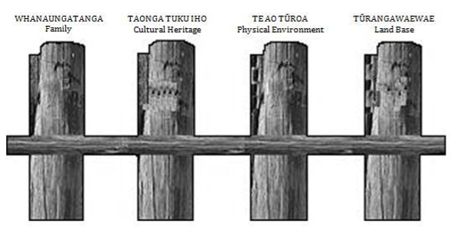
Models of Health & Wellbeing
Principles or practices to maintain mauri & human well-being
Reflect spiritual & physical worlds
Well-being is affected by
access to natural resources
also by their state or condition
Notes:
Te Ao Māori emphasises reciprocal relationships between healthy ecosystems and people’s cultural, spiritual, and physical wellbeing.
A number of holistic models of health and well-being have been proposed, based on Māori traditional knowledge and understanding.
Two examples are:
Te Whare Tapa Whā - to achieve wellbeing all four dimensions must be in balance
taha whānau (extended family wellbeing)
taha wairua (spiritual wellbeing)
taha hinengaro (emotional/mental wellbeing)
taha tinana (physical wellbeing)
Ngā Pou mana (four supports) model - greater emphasis on the external environment
whanaungatanga (the importance of the family)
taonga tuku iho (cultural heritage)
te ao tūroa (the natural environment)
tūrangawaewae (the land base, a place of belonging, standing and identity)

Slide 19
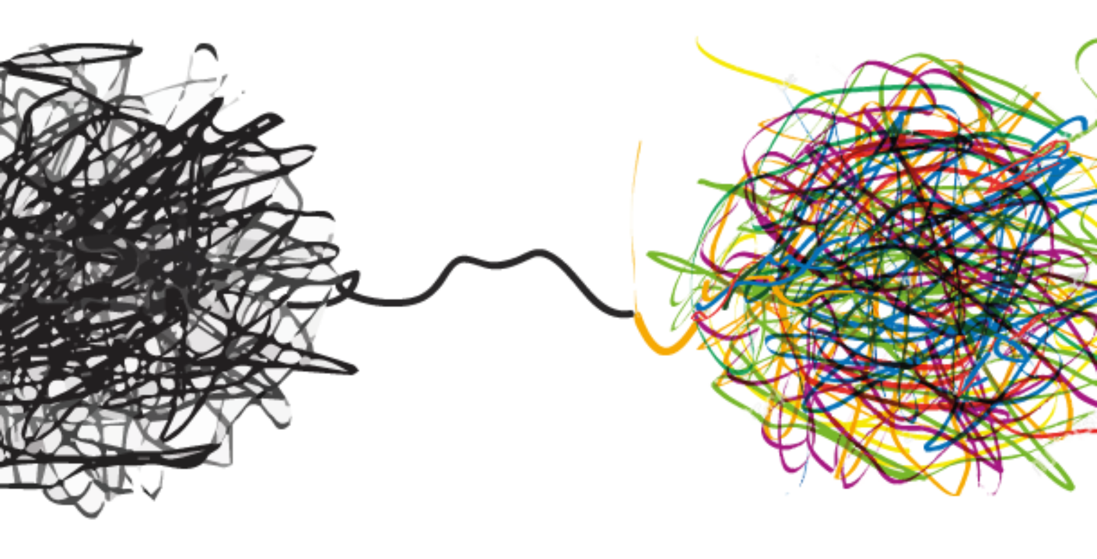
Complex societal & environmental challenges
Wicked Problems
Wicked Problems
Turning to increasingly holistic solutions
Notes:
No single profession can deal with the complexity of change associated with urban development
A water sensitive approach demonstrates a re-alignment between indigenous & non-indigenous thinking
A wicked problem is a social or cultural problem that is difficult or impossible to solve for as many as four reasons: incomplete or contradictory knowledge, the number of people and opinions involved, the large economic burden, and the interconnected nature of these problems with other problems.

Slide 20
ki uta ki tai
We cannot consider elements in isolation We must consider the ecosystem as a whole
mountains
sea
Notes:
Development through a water sensitive lens aligns far more strongly with Te Ao Māori than the traditional western approach.
Holistic approach considering the entire catchment
Harmonic balance
Wellbeing of water is at the forefront recognising,
Ka ora te wai,
Ka ora te whenua.
Ka ora te whenua,
Ka ora te tangata.

Slide 21
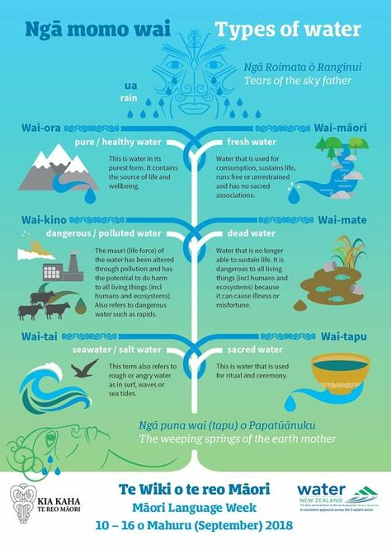
WSUD & Te Ao Māori
Few studies specifically linking WSUD with Te Ao Māori
Strong links to water
Guiding principles of WSUD consistent with Māori resource management
Notes:
WSUD is not a “new approach” – consistent with Māori resource management
The strong cultural link with water and the importance of high-quality waterways within Te Ao Māori offers an opportunity to support the activation of WSUD.
Water has many different meanings – types of water, as Troy presented yesterday
Not specifically linking the two - lots on water, urban design, stormwater & freshwater management

Slide 22
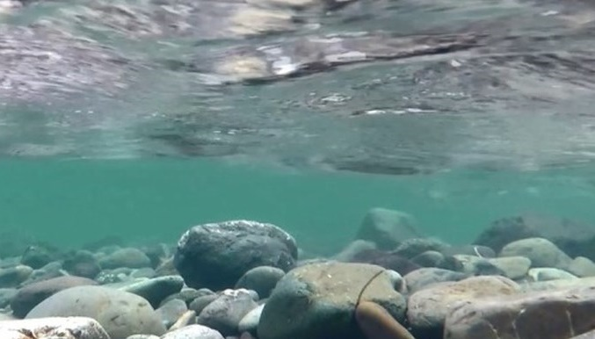
How well does WSUD provide for Māori values & uses of water?
WSUD in NZ
implicitly reflects Maori values
principles are interwoven within the fabric of Te Ao Māori
Recognition & value of Te Ao Māori is becoming more explicit
Notes:
WSUD – healthy & resilient communities
Whakapapa, whanaungatanga, kaitiakitanga, manaakitanga, and mātauranga Māori.
Recognition & value of Te Ao Māori is becoming more explicit – i.e. in the Urban Water principles
Often compartmentalised
Continue moving forward
Story telling, rather than scientific numbers alone – can we swim in the rivers, can we eat from them?

Slide 23
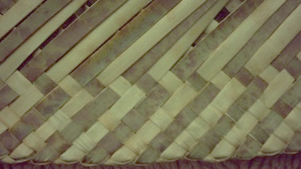
Are there opportunities to improve the implementation of WSUD through the integration of Te Ao Māori?
Inclusiveness of different perspectives
Worldviews may run parallel, overlap, or remain unique
Provide opportunity for mātauranga Māori to enrich contemporary scientific thinking
Capacity building – empowering knowledge for everyone!
Notes:
Integration is not the aim – through this process, reframed the question.
Remove compartmentalisation of mātauranga Māori – and marginalisation to a ‘cultural objective’
Recognise the holistic values reflected in Te Ao Māori benefit the wider community as a whole.
Bridge the two world views - not necessarily overlapping, but bringing together take the best from both to complement one another.
Widen our horizons – recognise where they remain unique, where they overlap, where they run in parallel
This isn't just for Māori, empowering every one of us - as practitioners, as companies, and as policy makers, across disciplines.
Need to work together to solve wicked problems, need to reconnect with one another and our natural world.

Slide 24
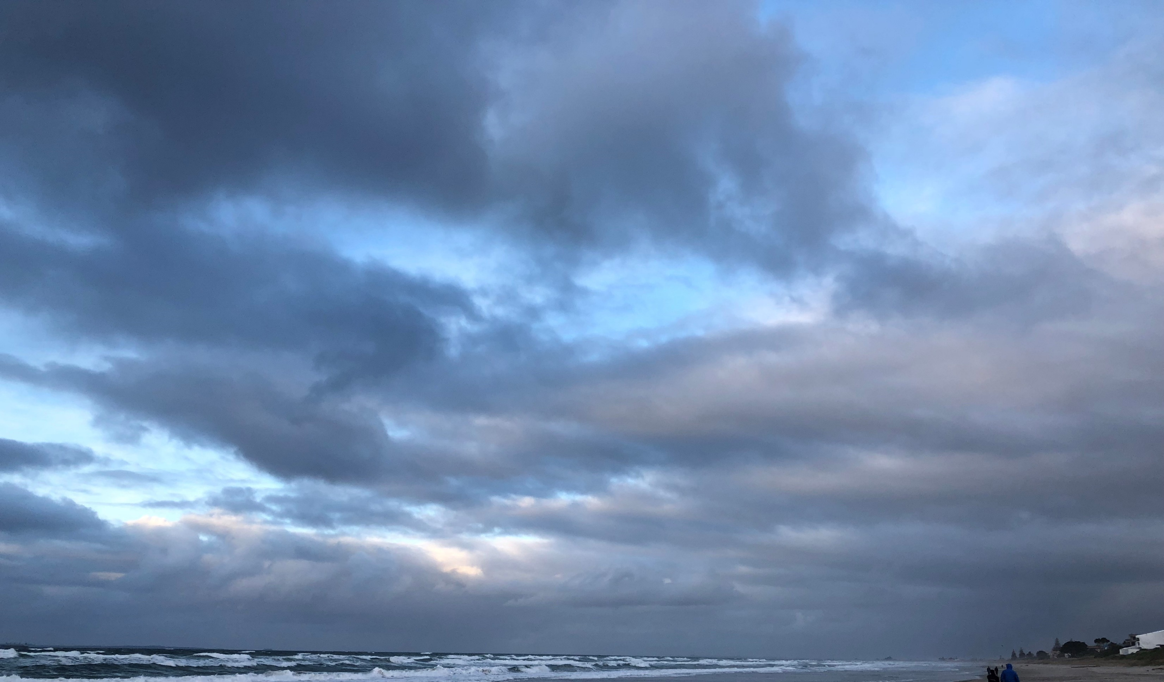
Kua tawhiti kē tō haerenga mai, kia kore e haere tonu.
He nui rawa ō mahi, kia kore e mahi tonu.
We have come too far, not to go further.
We have done too much, not to do more.
Tā Hemi Henare, 1989
Notes:
As professionals within the industry, we each have a choice around how we respond – what can each of us do – to embrace, to empower, Te Ao Māori in WSUD in Aotearoa?
It can be daunting – fear of mispronunciation, of not understanding tikanga, embarrassment that you don’t know enough. I say this speaking from experience!
I think – as I journey along this path – it is most important that we naturalise Te Reo, we embrace the Māori worldview and increase our knowledge.
This is knowledge for everyone, whether Māori or not – understanding fundamental principles will enhance ability to communicate through projects and ensure progress comes from an informed position.
So – I challenge you to step outside your comfort zone. It could be as simple as starting with place names! If you are fortunate enough to be at the informed end of the spectrum – help others, and be empathetic to their fears or shyness!
If I can stand up here, way out of my comfort zone – we all can! No reira….

Slide 25
Ngā mihi nui ki a koutou!
He pātai?
Thank you very much!
Questions?
Notes:
Māori culture recognises that environmental care has integral links with the mauri (life force) of the environment and concepts of kaitiakitanga (stewardship). Te Ao Māori (Māori world view) links the roles and health of people to the protection of the wellbeing of the environment, through the intrinsic relationship between people, water, and Te Ao Tūroa (the natural environment). Integrating core water sensitive design values with mātauranga Māori (indigenous knowledge) and principles of tikanga Māori (traditional indigenous practices) provides a holistic, culturally enhanced approach to protecting our water for future generations, more in line with natural hydrological water cycle processes, and inherently providing for enhanced socio-cultural outcomes in addition to environmental stewardship.

