Slide 1
A new Model for waste stabilization ponds
Presented by: Kevan Brian

Slide 2
Presentation Overview
Contributors/Acknowledgements
Current approach
What is in lagoon models already
What is in the new model
Results
When and where can you get it?

Slide 3
Contributors/Acknowledgements
Dr Dwight Houweling (Dynamtia – Quebec Canada)

Slide 4
Current Approach
Ministry of Works Guideline 1984 (84kgBOD/ha/day)
Waste stabilisation ponds design manual (Mara 1983)
Oxidation Pond Guidelines 2005 (NIWA, MFE and NZET)
Modelling?
Notes:
Oxidation Ponds – lots of these in NZ – simple to run, relatively low maintenance. Lots of these types of plants are being replaced by high rate processes
When it comes to optimizing or trying to work out how to get better quality what are the tools we currently have?

Slide 5
Current Approach
Why Model?
What if scenarios on performance
Optimisation ideas
Understanding of process fundamentals
Planning and future capacity investigations
Notes:
Why would you model a lagoon system and what tools are there to do this?

Slide 6
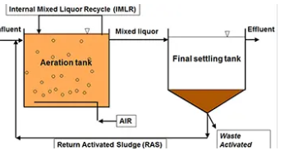
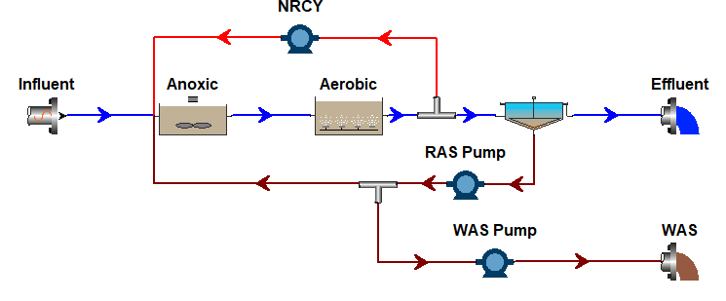
Current Approach
Activated sludge processes are well served in by simulation models. These are based on the ASM series.
Modelling software available for activated sludge:
BioWin
GPSX
WEST
SUMO
Simulation models are very good for mass balances over activated sludge plants and widely used in design
Notes:
Shallower tanks for ground conditions at TK
N2O in general
Power consumption for road to net zero
40/20/20 principles and how to do more with less

Slide 7
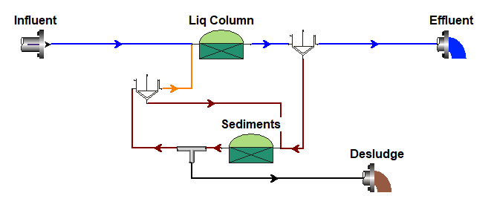
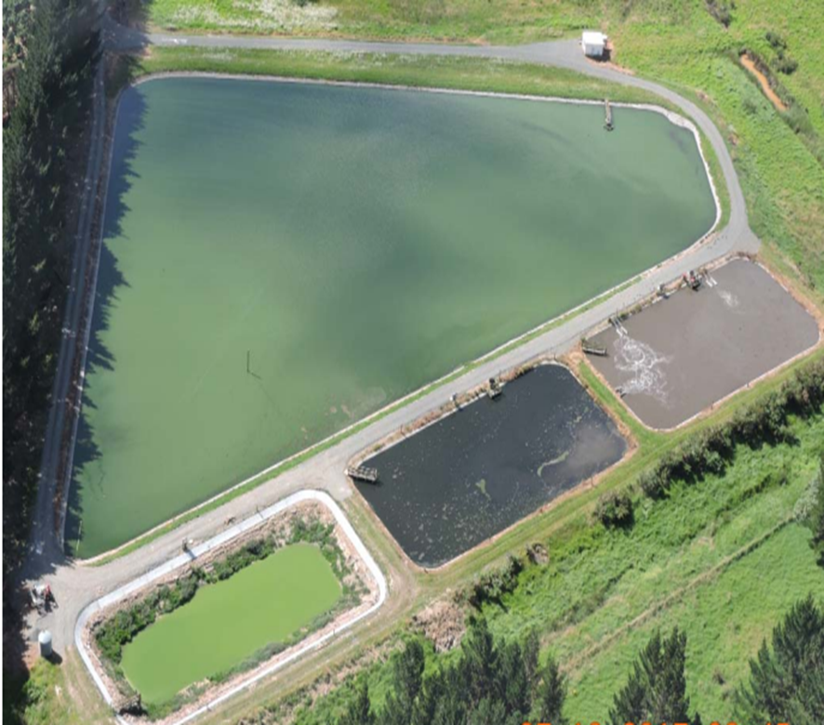
Current Approach
“Frankenstein models” made up of activated sludge, digestion and clarification models
No Models for shallow lagoons like in NZ
Idealised reactors
No Algae
Aeration based on AS process
Are these any good?
Notes:
Shallower tanks for ground conditions at TK
N2O in general
Power consumption for road to net zero
40/20/20 principles and how to do more with less

Slide 8
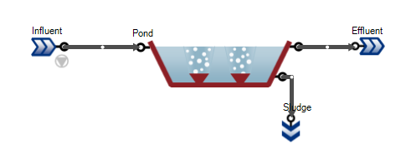
What was in SUMO already?
Looks like a pond model
However:
Do NZ ponds have a metre of ice on top in winter?
Do we discharge to frozen rivers?
Are our Ponds 4.5 m deep?
Do our Ponds have subsurface aeration
Come on Dwight surely we can do better than that!!
Notes:
Shallower tanks for ground conditions at TK
N2O in general
Power consumption for road to net zero
40/20/20 principles and how to do more with less

Slide 9
Model Overview
Surface aeration
Stripping
Heating/cooling
evaporation
Transport model: fluxes to connect water column to sediments
ASM framework + algae
Full model transparency (open source)
Variable volume
Biokinetic Reactions
Water chemistry
Sedimentation
Benthic feedback
Scour
Variable volume
Biokinetic Reactions
Water chemistry
Notes:
Shallower tanks for ground conditions at TK
N2O in general
Power consumption for road to net zero
40/20/20 principles and how to do more with less

Slide 10
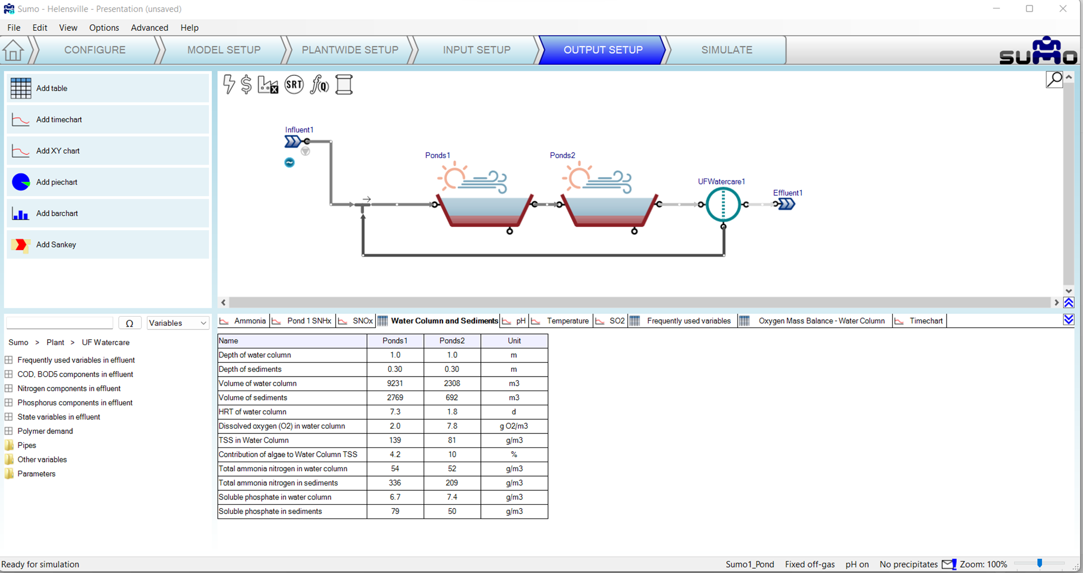
Model Overview
Notes:
Shallower tanks for ground conditions at TK
N2O in general
Power consumption for road to net zero
40/20/20 principles and how to do more with less

Slide 11
What is in the new model?
Key additions to model:
Algal growth based on sunlight
Benthic feedback between sludge and liquids
Water chemistry improvements
Notes:
Shallower tanks for ground conditions at TK
N2O in general
Power consumption for road to net zero
40/20/20 principles and how to do more with less

Slide 12
What is in the new model?
What does having algal growth in the model improve:
Assimilation of nitrogen into algal biomass
Better prediction of lagoon pH (algal takes CO2 from the water increasing pH)
Oxygen transfer from algal growth and aeration
Ammonia Stripping
Notes:
Shallower tanks for ground conditions at TK
N2O in general
Power consumption for road to net zero
40/20/20 principles and how to do more with less

Slide 13
What is in the new model?
Main goals of the model:
Improve understanding of mechanisms for N removal
Allow the user to look at scenarios
Improve sludge accumulation prediction and effects
Demonstrate “uphill” aeration
Calculation of methane release for GHG estimations
Predictions of N2O generation from nitrification
Notes:
Shallower tanks for ground conditions at TK
N2O in general
Power consumption for road to net zero
40/20/20 principles and how to do more with less

Slide 14
What is in the new model?
Main goals of the model:
Improve understanding of mechanisms for N removal
Allow the user to look at scenarios
Improve sludge accumulation prediction and effects
Calculation of methane release for GHG estimations
Notes:
Shallower tanks for ground conditions at TK
N2O in general
Power consumption for road to net zero
40/20/20 principles and how to do more with less

Slide 15
What is in the new model?
Notes:
Shallower tanks for ground conditions at TK
N2O in general
Power consumption for road to net zero
40/20/20 principles and how to do more with less

Slide 16
Oxygen Balance
Oxygen Produced by Algae
Oxygen “Produced” by Surface Transfer
Oxygen released by sediments
Oxygen “Produced” by Surface Aeration
Notes:
Shallower tanks for ground conditions at TK
N2O in general
Power consumption for road to net zero
40/20/20 principles and how to do more with less

Slide 17
Nitrogen Balance
N released from Sludge
N stripped to atmosphere
TN denitrified
N removed via settling
Notes:
Shallower tanks for ground conditions at TK
N2O in general
Power consumption for road to net zero
40/20/20 principles and how to do more with less

Slide 18
pH and Dissolved Oxygen
pH
pH
DO
DO
Notes:
Shallower tanks for ground conditions at TK
N2O in general
Power consumption for road to net zero
40/20/20 principles and how to do more with less

Slide 19
Sediment Depth
Water depth
Water depth
Sludge depth
Sludge depth
Notes:
Shallower tanks for ground conditions at TK
N2O in general
Power consumption for road to net zero
40/20/20 principles and how to do more with less

Slide 20
Methane Emissions
Methane Emissions
Notes:
Shallower tanks for ground conditions at TK
N2O in general
Power consumption for road to net zero
40/20/20 principles and how to do more with less

Slide 21
Where can I get it?
SUMO 22 just released and includes this new pond model
The “out of the box” model is based on a NZ pond
Happy Modelling!

Slide 22
A new Model for waste stabilization ponds
Presented by: Kevan Brian

