Slide 1
Challenges, Lessons and Methods for Leaving a Residual Impact
Jessica Hamilton (Jacobs) and Ian Baker (Christchurch City Council)
Notes:
Thank chair for introduction
Introduce yourself – name, title, company, location
Introduce Ian, title and Christchurch City Council
Thanks to Ian for co-presenting and sharing his experiences as part of this thought piece
We’re here today to talk about the addition of chlorine to existing networks, using Christchurch City Council’s experience to put some context around this.
Chlorine is very commonly used around the world in drinking water treatment and here in NZ
The recent change in regulation here in NZ mandating residual disinfection means that the addition of chlorine to networks that haven’t previously been chlorinated is something that other water suppliers around the country may also be facing.
Aim is that this presentation provides some insight into the key considerations that are of use when working through the process of adding chlorine into existing systems

Slide 2
Agenda
The theory
Why chlorinate?
What is a free available chlorine residual?
Possible impacts on the water supply system
Chlorine start-up considerations
The practice
Christchurch City Council (CCC)
Why are WE chlorinating?
Timeline of implementation
How was it implemented?
Actual impacts
Lessons learned for the start-up phase
Notes:
we will be starting with the theoretical side of things, which I am going to talk us through.
Covering questions like why chlorinate, what is a residual, what are some of the possible impacts on a water supply system and key pre and post start-up considerations
Ian is then going to share some of Christchurch City Council’s journey in working through the process of adding chlorine into the system, sharing why chlorine has been added, the timeline over which this has happened, how it was done and very valuably some of the key lessons learned

Slide 3
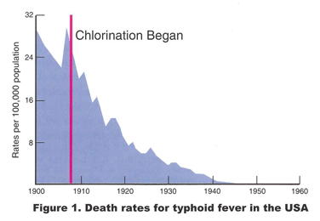
Why chlorinate?
The primary motivator is to provide safe drinking water.
Source: Water Conditioning & Purification International Magazine (2000). The Chlorination of Drinking Water: Benefits, Issues and the Future
Notes:
Why chlorinate – the answer is simple, to provide safe drinking water.
Chlorination is one of the tried and tested tools that is used to do this.
This figure here on the screen says it all.
In USA, due to water pollution, typhoid deaths reached 30 deaths per 100,000 population in the 20th century.
You’ll see here on the figure that chlorination of the water supplies started in the early 1900s.
Following this we clearly see a dramatic reduction in typhoid deaths
This is a pictorial demonstration of why we chlorinate

Slide 4
What is a free available chlorine residual?
A low level of chlorine that remains in water after the initial dosing and can prevent microbial regrowth and recontamination throughout the distribution system.
Free available chlorine residual
Chlorine added
Chlorine consumed
Combined chlorine residual
Total chlorine residual
Notes:
Chlorine can be dosed to provide primary disinfection and/or residual disinfection.
For the purposes of this presentation the focus is on residual disinfection
What is a chlorine residual? – this is a low level of chlorine that remains in the water after the initial dosing
What does chlorine residual do dosed to prevent microbial regrowth and help prevent recontamination throughout the distribution system. Its one of the barriers between our treatment plant and the consumers tap.
How is a residual achieved?
An initial concentration of chlorine is added to the water
Some of this chlorine is then consumed through reactions with organic and inorganic compounds in the water
What we are left with then is total chlorine residual which is a combination of free available chlorine and combined chlorine
Combined chlorine is the concentration of chlorine combined with organic and inorganic nitrogen compounds in the water
Free available chlorine is the concentration of chlorine available for disinfection. This is our residual!

Slide 5
What is a free available chlorine residual?
Source: IXOM Watercare Inc, (2021). Breakpoint Chlorination Curve
Notes:
Here is a plot showing what we’ve talked about on the previous slide and achieving a free available chlorine residual
You will see chlorine dose along the bottom axis and total chlorine residual on the vertical axis
The key takeaway is it is important to find the right chlorine dose which we can do by understanding a bit about the chlorine breakpoint
Why do we want to reach breakpoint?
There are a couple of reasons for this
If we sit to the left of the breakpoint there is the chance of creating taste and odour issues for consumers
The second is we haven’t actually got any free available chlorine until after this point so have not achieved the free chlorine residual that we are targeting
It should be noted that the shape of the valleys and hills will change based on the concentrations of ammonia, metals and organics but it will always follow a similar pattern
For example ground water with low organics may expect the peak to be lower than a surface water source high in organics.

Slide 6
Possible Impacts on the water supply system - Corrosion
As an oxidising agent chlorine can be corrosive in water leading to material damage or component failure.
Uniform Corrosion (Dissolved Metals)
Pitting Corrosion (Copper Pipe)
Metal pipe
Copper pipe
Corrosion scale
Dissolved metal
Pit cap
Pit
Notes:
We also want to consider some possible impacts on the water supply infrastructure
By adding chlorine we are creating a change in the water chemistry.
Chlorine is considered to be a corrosive agent in water
When thinking about our pipes particularly those that are metal we are interested in corrosion
Two different types of corrosion can occur as you can see here with the most common being uniform.
Uniform corrosion takes place over larger areas of the metals surface, whereas pitted corrosion is more localised
Corrosion in both of its forms can cause metals either in dissolved or particulate form to enter the water.
This can cause both aesthetic and health related problems as well as material damage to our infrastructure.
It is good to have an awareness of corrosion and the effect it can have on the system.

Slide 7
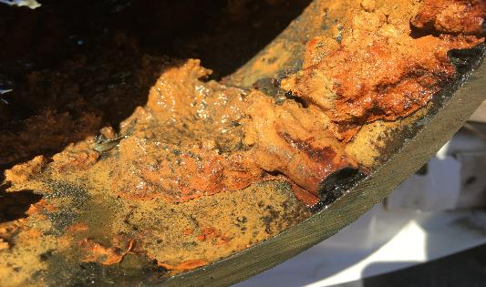
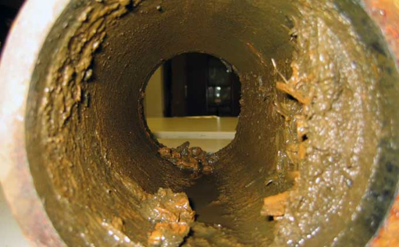
Possible impacts on the water supply system - Solubilising legacy deposits and sloughing of biofilm
Chlorine can solubilise scale and legacy deposits resulting in the release of metals, minerals and sediments which may cause aesthetic issues and health concerns.
Deposits
Sediment
Pipe scale
Notes:
Some other possible impacts on the water supply system are solubilising of legacy deposits and the sloughing of biofilm
As mentioned on the previous slide the addition of chlorine to the system results in a change in water chemistry
Pipes which have been in service for a period of time may contain scale, legacy deposits, sediment and biofilm some examples of which you can see here on the screen behind me.
These scales, films and deposits can be organic and inorganic
In a similar manner to corrosion the occurrence of solubilising of legacy deposits or sloughing of biofilms can result in the release of things like metals, minerals and sediment into drinking water again causing aesthetic issues like the discolouration of water and potentially health issues depending on the type of deposits and biofilms.

Slide 8
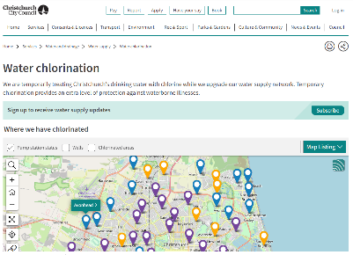
Pre and post chlorine start-up considerations
Water Quality
Network Flushing
Communication
Restore chlorine residual
Remove sediment & deposits
To clean pipes
To move water
Reduce water age
Remove biofilm
Get rid of dirty water
Prevent deposition
Notes:
We now know a bit about why we chlorinate, what a free available chlorine residual is, which side of the breakpoint chlorination curve we want to sit on and some of the possible impacts on a water supply system
Taking this into account there are some key start-up considerations which are applicable both pre and post chlorine start-up
The first consideration is water quality, an understanding of the water quality prior to adding chlorine can help to understand the chlorine demand and also what deposits etc might expect to solubilise or mobilise in the pipes through the addition of chlorine
Post chlorine start-up water quality testing can be used to check whether any by-products of concern have formed and whether anything has been solubilised (i.e. lead).
The second consideration is pre-chlorine network flushing which can be used to hydraulically clean the pipes,
It helps to remove any of the scales, deposits or films which are hydraulically mobile
Post start-up flushing issued to move water through the network and ensure the chlorine residual is spread around the entire network
Last and definitely not least is communication, drinking water is a sensitive topic and the addition of chlorine can impact taste, odour and colour if the expectations around this are unmanaged these can erode public trust
Ian is now going to take us through the practice, by sharing some of the experience gained by Christchurch City Council.

Slide 9
Challenges, lessons and methods
The theory
Why chlorinate?
What does chlorine residual do?
Possible impacts on the water supply system
Chlorine start-up considerations
The practice
Christchurch City Council (CCC)
Why are WE chlorinating?
Timeline of implementation
How was it implemented?
Actual impacts
Lessons learned for the start-up phase
Notes:
Kiaora koutou, good afternoon
I’m Ian Baker, and I’m the person that puts the chlorine in the water in Christchurch… you’re welcome
My presentation mirrors Jess’s and… sorry there are a lot of slides, so strap in

Slide 10
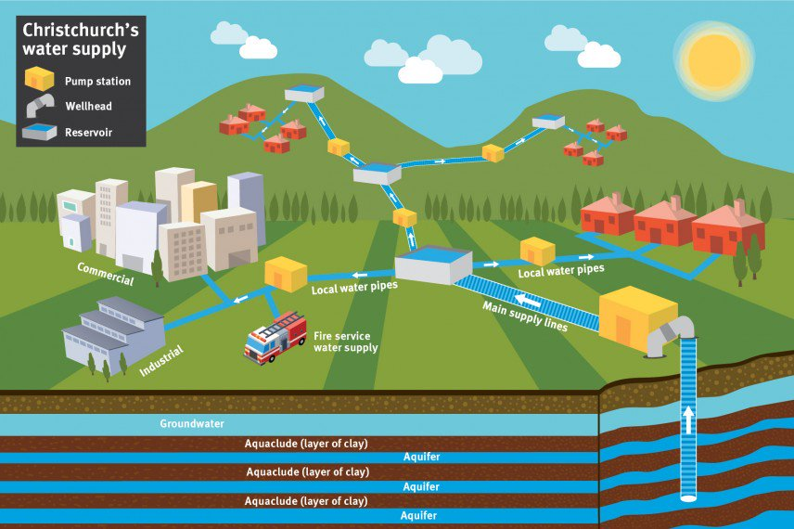
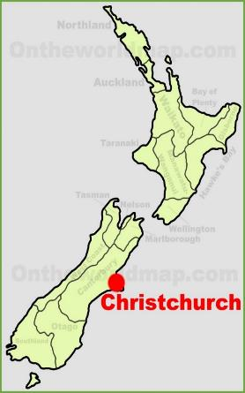
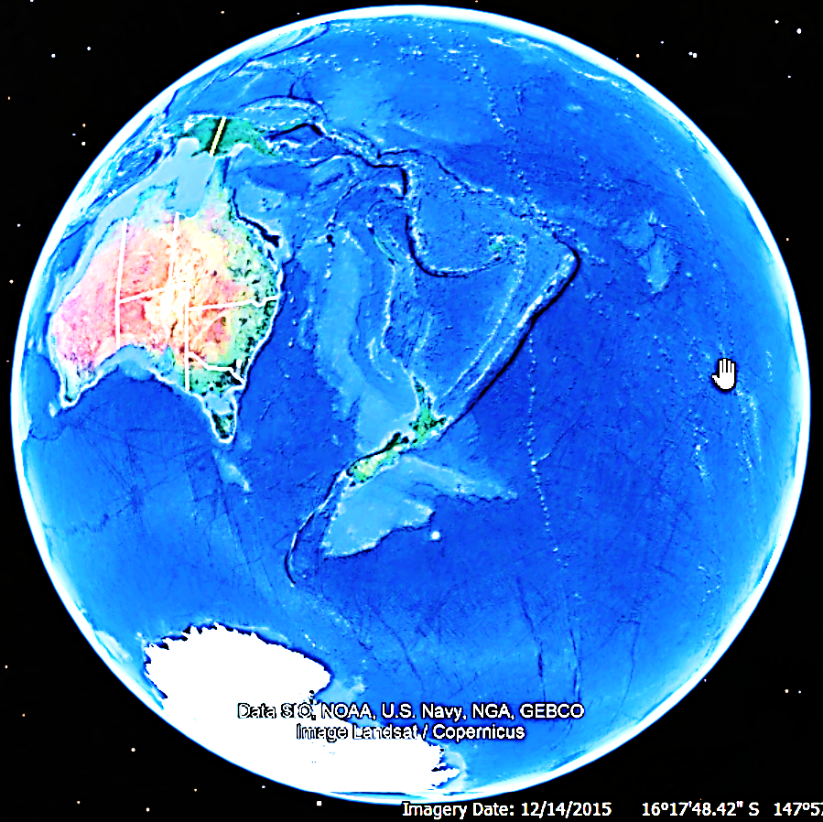
Christchurch City Council Orientation
You are here
Notes:
This is Christchurch’s place in the world. The view of the globe highlighting the length of our supply chains AND why it’s so hard to buy 50 of anything
Christchurch sits on a layer cake (or, if you prefer, a lasagne) of 7? Aquifers, which tilt up from the sea to recharge zones NW of the city
These aquifers are famous in New Zealand for their purity BUT… how does Christchurch city council, as the water supplier, capture that purity and maintain it in the distribution network

Slide 11
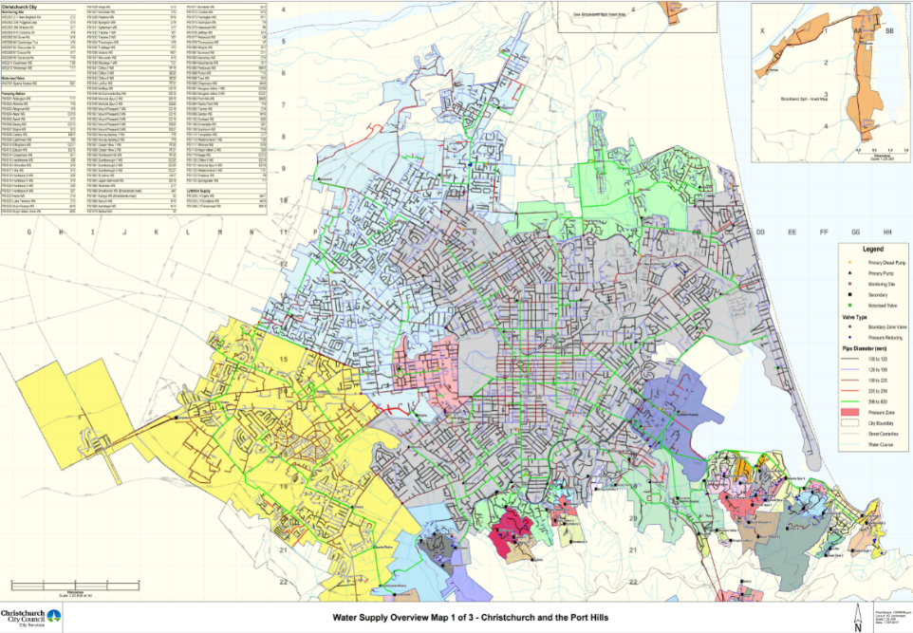
Christchurch City Council Supply zones
Notes:
Especially when our network is a bit “special”
CCC incorporated in 1862 and their first order of business was to drill wells to supply the central city (shown in grey) not far from here
This slide shows a patchwork of surrounding former local councils, who have amalgamated with the city council over the years since
These boundaries now form the city’s “separate” water supply zones
Each zone was built, or added to, at different times, by different municipal engineers, to different standards, with different materials and one legacy of that is they now operate at different pressures
All in all we have 150+ wells, 50+ pump stations, 70+ reservoirs and about 3300 km of pipe in the ground

Slide 12
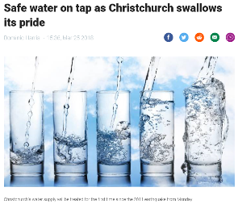
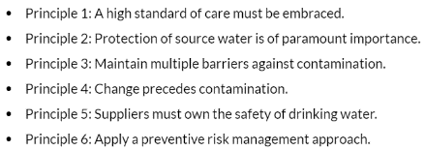
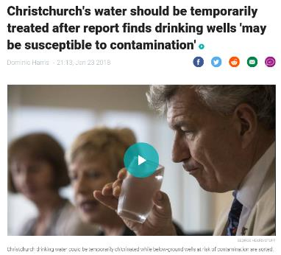
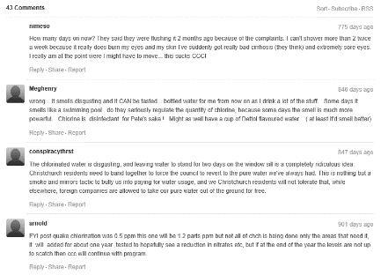
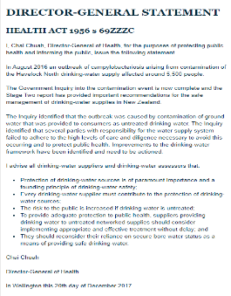
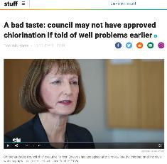
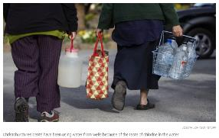
Why are WE chlorinating?
The Employer provided the following resolution at a Council meeting on 25 January 2018:
“Approve the installation of temporary chlorination for up to 12 months at all 56 pump station sites within the Christchurch City Water and Brooklands/Kainga water suppliers….until the Drinking Water Assessor and Medical Office of Health agree that temporary chlorination can cease”
12
Notes:
Why are WE chlorinating?
Well… chlorination in Christchurch has become a regulatory, technical and socio-political hot potato
The simplest answer is… successive regulators have strongly recommended it
The technical answer is… it is still the most effective method of managing risk in a compromised network; it is also in in line with the third and last of the six principles of drinking water safety
And the socio-political answer is, that Christchurch City Council remains committed to reducing and removing the chlorine residual from its water supplies via an ambitious improvements programme

Slide 13
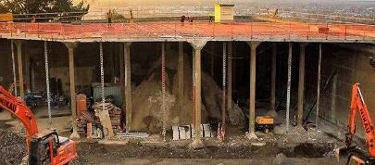
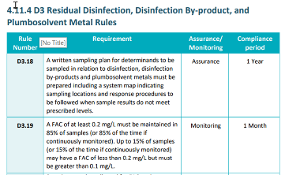
Timeline of implementation
Notes:
This is not our first rodeo
The 2011 earthquake led to emergency chlorination, for a year or so… longer for the east side
Loss of secure bore water status in 2017 caused us to install temporary chlorination to mitigate the risk of below ground wellheads
And, the water services act has recently caused us to improve the resilience of those temporary systems, to provide a permanent standby chlorination capability to support exemption applications, or to dose continuously if required

Slide 14
How was it implemented?
Notes:
How was it implemented?

Slide 15
How was it implemented?
In a hurry
Notes:
In a hurry, always in a hurry, usually on a Friday afternoon and often just before Christmas
And it really IS hard to buy 50 of anything at short notice in the southern hemisphere
We have also challenges beyond the sheer number of pump stations

Slide 16
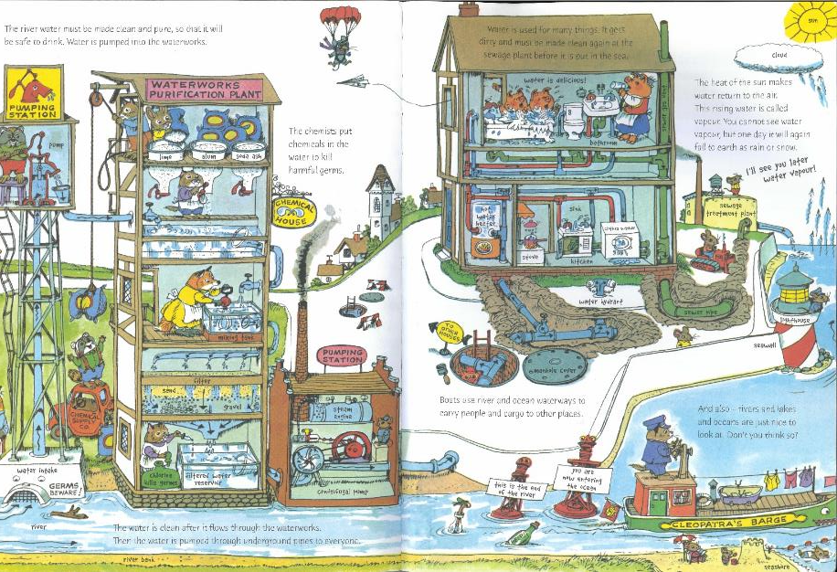
How was it implemented?
Scarry, R (1968)
Notes:
I’ll let Richard Scarry “illustrate” my point
Loads of detail here; look the chemical handlers are even wearing PPE
This water treatment plant may be run by small mammals, but it does have particle removal, primary disinfection and a chlorine residual in the network

Slide 17
How was it implemented?
Scarry, R (1968)
Notes:
Christchurch city doesn’t have that

Slide 18
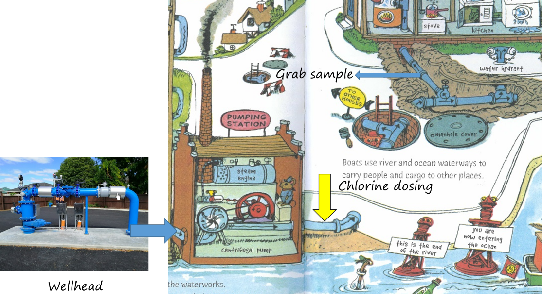
How was it implemented?
Notes:
We ONLY have this bit in the city
(Mostly) above ground wellheads, feeding surface pumps or pumping direct to network
Currently about half of our pump stations are injecting 13% Sodium Hypochlorite (at network pressure) into the discharge main at a convenient spot (usually a flow meter chamber)
Mixing, contact time and sampling all happen in the reticulation
And consumers can be as little as 2 minutes travel time (by tube) from their local pump station

Slide 19
How was it implemented?
Notes:
So our process is this…
Flow paced dosing and manual scaling, based on grab samples

Slide 20
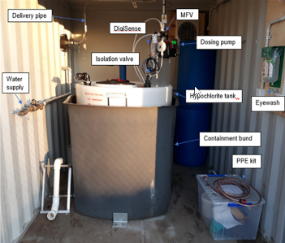
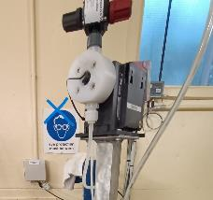
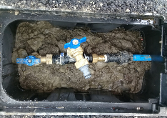
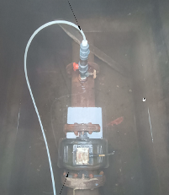
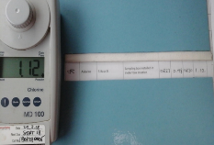
How was it implemented…
Notes:
And looks like this…
Locally produced bunded tank, Grundfoss DDA dosing pumps & withdrawable injection quills and very manual grab sampling
It’s all brought together by a cloud based monitoring, alarming and reporting system from local firm PiP IoT
And due to the rapid implementation… this all sits outside council systems such as SCADA

Slide 21
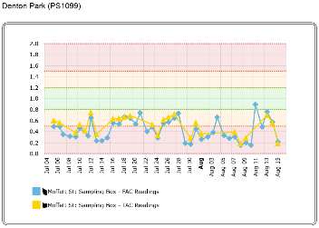
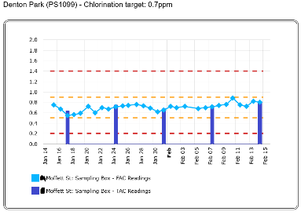
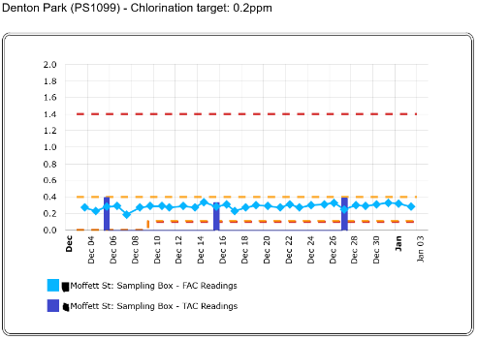
Chlorine dose and control
Notes:
Despite this, we have gained a good level of control
For example, here is Denton PS through the years…
Here reaching its target dose only ONCE in six weeks
Here, after improving mixing and finding a better sample point, it’s doing OK
And finally here we can “play tunes” on the dosing pump and the residual responds in a linear fashion to the applied dose – an indicator we are above break point!

Slide 22
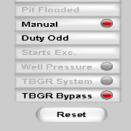
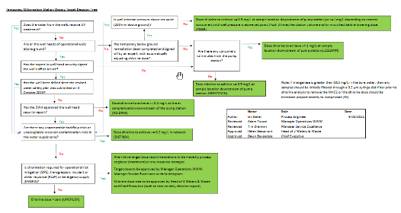
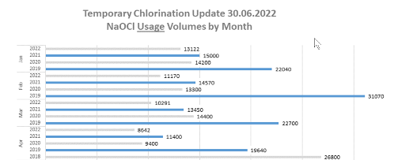
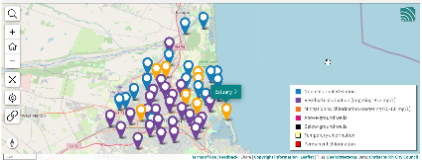
Dose reduction and removal
Notes:
We also have a system of checks, balances, priorities and reporting that drive the stated aim of reducing or removing the chlorine residual
It could be argued this actually gives effect to Te Mana o te Wai; in that it respects the water, minimises the impact of treatment AND reflects the wishes of some parts of the community

Slide 23
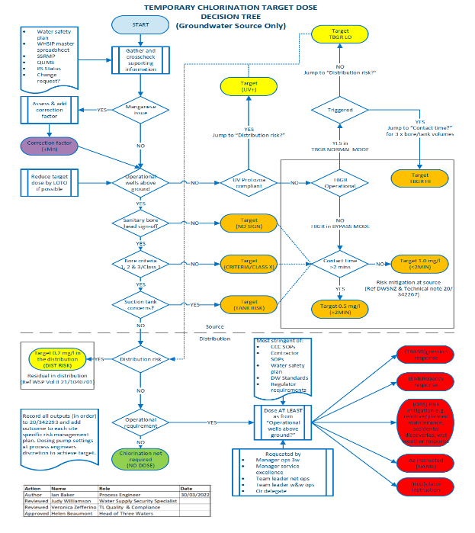
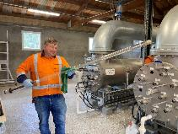
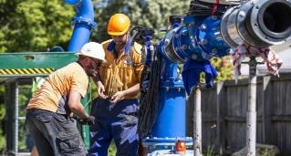
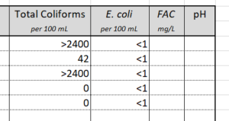
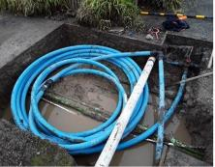
Dose reduction and removal
Notes:
There is a risk and evidence based chlorine dose decision tree included in our current water safety plan, which allows removal of the residual if certain criteria are met…
…with the residual being reinstated or increased if, as here, risk becomes a reality

Slide 24
Lesson learnt
Notes:
Now Jess has shown you this slide
And Ray McMillan shared this proverb… during the pre-conference session

Slide 25
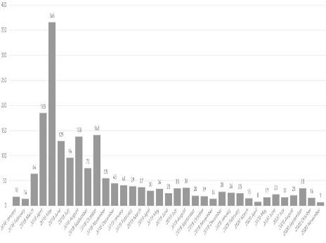
Lesson learnt – times change
Notes:
I have added this similar curve for comparison
This is logged calls to the CCC call centre, where chlorine was name checked
They’re not all complaints…

Slide 26
Lesson learnt – times change
Public health
Public wellbeing
Notes:
So here, public health contrasts with public wellbeing
Now we aren’t dying so much (in the developed world at least); we can think about and express how we wish to live
Logged calls peaked at 366 per month in May 2018, the month by which all the temporary chlorination units had been turned on
This quickly reduces to double figures, and has been in single figures for the last year
I’m going to use these calls as an indictor of how Christchurch was impacted by chlorination
Let’s look at a breakdown

Slide 27
Lessons learnt – taste and odour
Notes:
As of going to press, there are 2148 logged calls, over 4.5 years
They cover taste & odour, requests for information, allergies and sensitivities etc
Other… seems to be mainly goldfish

Slide 28
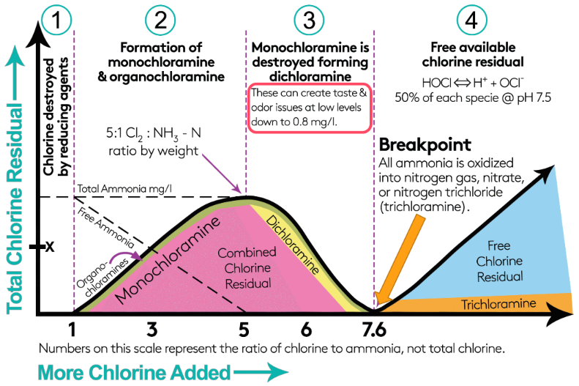
Lessons learnt – taste and odour 1
Notes:
Taste and odour concerns make up 40% of the calls
Let’s look to that breakpoint curve as a potential source
Are people tasting chlorine by-products?
Well, we've actually been lucky with the characteristics of our water

Slide 29
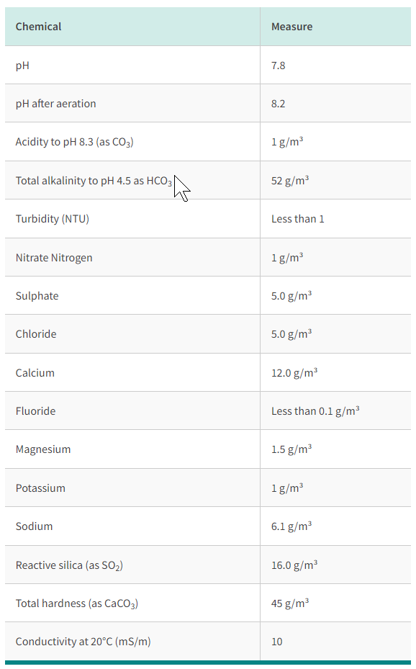
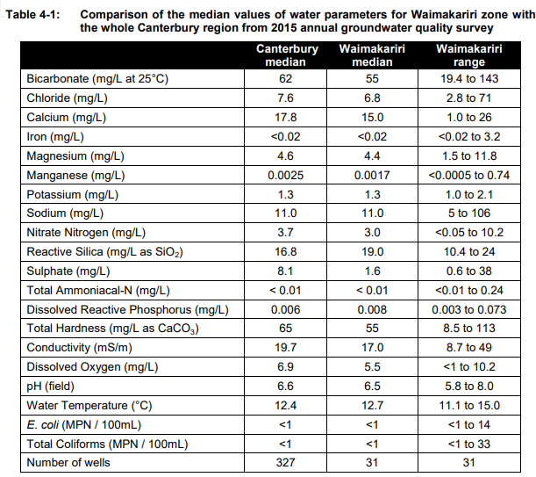
Christchurch City Council Water quality
Notes:
There is little naturally occurring ammonia
Little dissolved carbon, phosphorous or nitrate to grow biofilms that then might later decay (in CCC bores, at least )
Basically we have biologically stable water

Slide 30
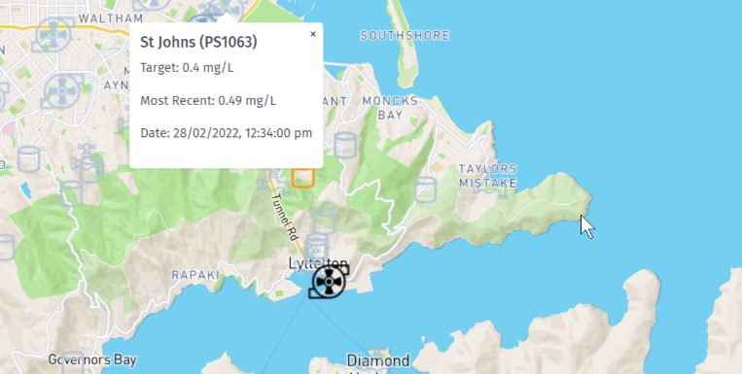
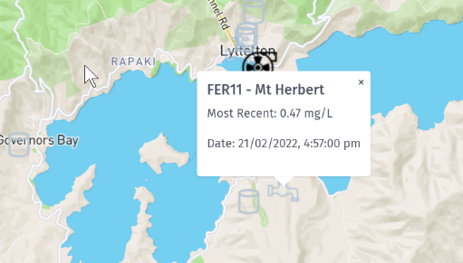
Lessons learnt – demand
Notes:
And our chlorine demand is low
Here St Johns PS supplies Mt Herbert 12km away with little or know drop in FAC enroute

Slide 31
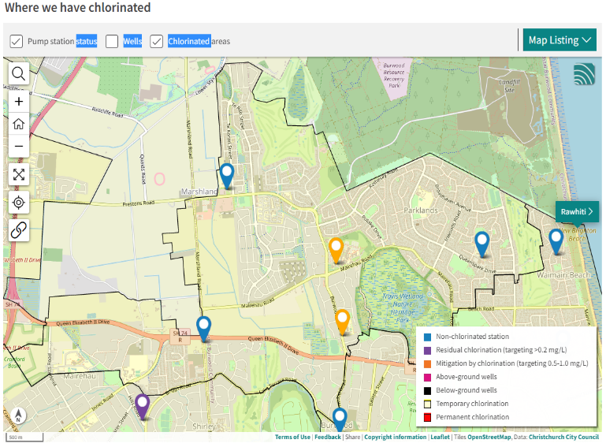
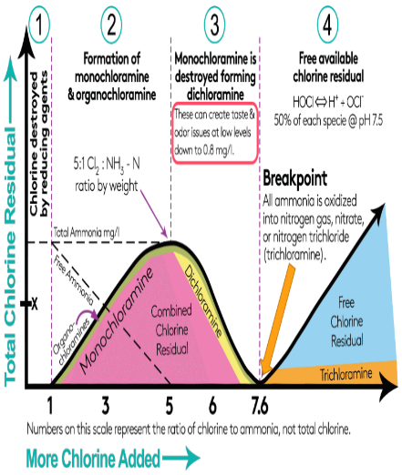
Lessons learnt – taste and odour 1
Notes:
All that said, if there is any reaction with naturally occurring ammonia (or any produced from the decay of bio-films) then a perverse consequence of our removing chlorine at some pump stations is unchlorinated water (in blue) meets chlorinated water in (yellow) and can put us below breakpoint in the reticulation i.e. the dreaded zone 3 of the curve here, here and here
At these points there is not enough residual to kill bacteria, but just enough to cause complaints

Slide 32
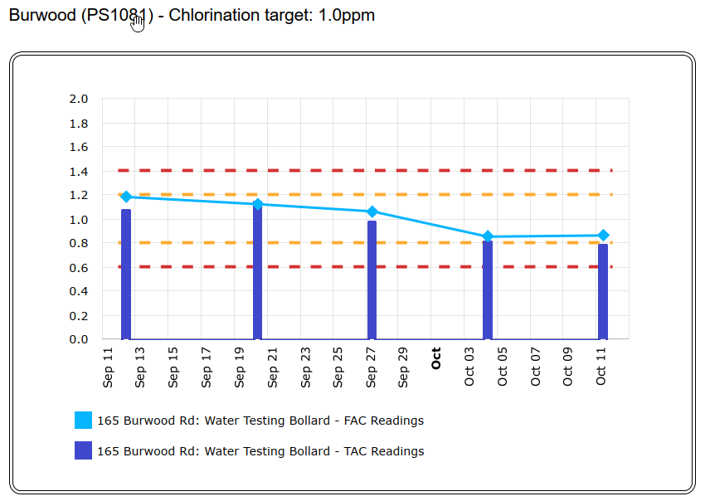
Lessons learnt – taste and odour 2
https://www.canada.ca/en/health-canada/services/publications/healthy-living/guidelines-canadian-drinking-water-quality-guideline-technical-document-taste.html#fn11
Notes:
Next question... Are people actually tasting “chlorine”
Some people (maybe 3%) are super tasters and can detect chlorine at almost homeopathic levels
Some organoleptic studies have shown that 0.8mg/L might be a sweet spot… more than enough residual to kill bacteria, not so much you are overwhelmed with complaints
Operators might find this by trial and error for their particular water
I’ve included a great Canadian reference here

Slide 33
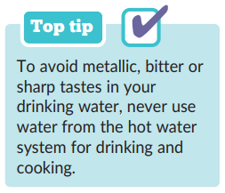
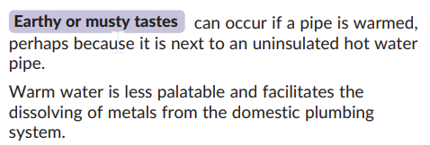
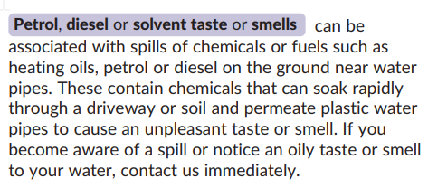
Lessons learnt – taste and odour 3
https://www.wessexwater.co.uk/help-and-advice/your-water/water-quality/taste-and-odour
Notes:
Are people tasting something else? Something more obvious?
Other taste and odour issues can be confused with, blamed on or exacerbated by chlorine
I’ve stood in the shower thinking “blimey, I’d best go and check the dose at my local PS; then remembered I’d just come back from the swimming pool
Another great reference here from Wessex Water

Slide 34
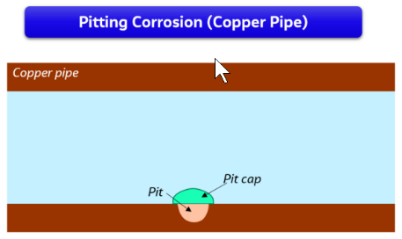
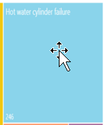
Lesson learnt – corrosion 1
Notes:
Let’s look at corrosion, briefly
15% of calls refer to hot water cylinder or element failures
Here, we've been unlucky with the characteristics of our water

Slide 35
Christchurch City Council Water quality
Notes:
pH is at the higher end
Alkalinity is low
Water is soft
And the langelier saturation index is typically below -1
Which is why…

Slide 36
Lesson learnt – corrosion 1
Christchurch has historically had issues with hot water cylinder and element failure. Certain areas of the city, such as Cashmere, have been affected more than others.
Pitting has been associated with chlorinated, high pH, low alkalinity waters (Sarver and Edwards 2012) and Microbial Induced Corrosion (Burleigh, Gierke, Fredj & Boston 2014)
It can be influenced by iron sediments in the tank (Kral 2018) and impurities in materials and surface contamination by carbon from the annealing process
This said, anecdotally failures are more frequent, but figures are hard to come by.
Notes:
Anecdotally, failures became more frequent; but the figures are hard to come by
Here we see an example of pitting and note that…
Christchurch has historically had issues with hot water cylinder and element failure. Certain areas of the city, such as Cashmere, have been affected more than others.
Pitting has been associated with chlorinated, high pH, low alkalinity waters
It can be influenced by iron sediments in the tank
…and impurities in materials or surface contamination for instance carbon from the annealing process
Finally this letter…
“The topic of copper corrosion is debated around the world and there exist many opinions on what is the cause. There are many factors that may contribute to copper corrosion but it is unproven in what proportions these factors (such as bacteria, installation quality, workmanship, materials, flow velocity, pH and water aggression) affect the corrosion.”
Which is standard template letter from the City Water & Waste Unit in 2004, long before chlorination

Slide 37
Lesson learnt – corrosion 2
Notes:
There is also an effect on pump station infrastructure
But remember this is full strength hypo… for six years of service
Localised to the injection quill at the top and…
…a dribble on the invert
removable spools would help here

Slide 38
Lessons learnt – solubilising legacy deposits
Notes:
There is little evidence of solubilising legacy deposits
We do have pipe scale obviously though the left hand photo Is not chlorine related
And here is the RTS of a chlorinated station where flushing was incomplete
I can think of one other site where long flushes were needed (for two weeks) to get a residual past the pipe wall demand of a length of galvanised pipe

Slide 39
Lessons learnt – sloughing of biofilms
“Contact regarding dismay to council decision. Suggest alternative. Feel comments on Carcinogens, though true, were misleading. Suggest use of Chlorine Dioxide which can be switched off when no longer needed, selective in what it attacks and can remove biofilms. Supporting documentation attached.”
“Your chlorination is too strong. I have lived in Auckland and London both cities which chlorinate their water supplies. The smell and taste I get from Christchurch chlorination is pungent. Filling the bath caused my bathroom to smell worse than the swimming pools and we can no longer drink the water. It has been more than 2 weeks since you started your chlorination and yet the smell/taste has not reduce/improved as you suggested it would as the biofilm is broken down in the pipes. This is appalling, please advise for how much longer we should expect this temporary chlorination to continue?”
“Biostability is defined as the inability of water or a material in contact with water to support microbial growth in the absence of a disinfectant” (van de Kooij 2000)
Notes:
As stated before, the empirical evidence is we have little biofilm growth and bio-stable water
I can only find two mentions of biofilms in the logged calls
I quite like complaints with supporting documentation
And this one seems more about what has been communicated… which brings me to…

Slide 40
Lesson learnt – managing expectations and perceptions
“An HRV installer reported that safe levels of chlorine should be between 0-15%, ours was at 42%. He stated this was a risk to our health and is undrinkable and unsafe. I am extremely concerned with this, not just for our property but for our surrounding area in Shirley.”
“Look all this chlorine in the water has made so many people sick and it's you guys that have done this sort your f%$&* shit out your ment to help people not f$%%^ make them sick this is beyond ridiculous”
“Believes chlorineation can remove lime from old cyclinders and holes may show up. Is it happening just with copper cylinders or old high pressure glazed steel cylinders too? Has recently been getting a heavy dose of chlorine. I imagine water is being diverted from Keyes Road as other wells are out of service. When is that likely to stop for me? As ECAN has a river flows database could I have as city water flows database so as to figure when not to use much hot water and get chlorinated into my cylinder?”
“The water in XXXXXXX is frankly disgusting right now. You have put far too much Chlrine into our water !!!! I have consequently suffered a number of concerning physical health problems. Please not try telling me this is my perception !! I am a multi qualified and experienced Registered Nurse and NOT a scaremonger. Please remove or modify this poison from our water. Thanks XXXXX”
Notes:
I’m showing these not to poke fun, but to highlight the expectations and perceptions they contain… and the rabbit holes that people can go down…
Obviously, these numbers just don’t make sense, but they are believed
This heavy dose of chlorine comes from Keyes PS, which has never been chlorinated
I am the most hated person in Christchurch, it’s OK, I’m OK
…but “Nurse calls disinfection poison” does make me a bit sad… those aren’t kisses by the way, that’s just where I crossed the name out

Slide 41
Lessons learnt – human stories
Notes:
But mostly these are human stories.
And some, particularly the asthma, the eczema, the poverty and those that hint at loneliness are heart breaking
We are right to aim to reduce the applied residual as much as possible

Slide 42
Lessons learnt – human stories
Notes:
Bill Bayfield shared this at the pre-conference
“We are wai… Wai is us”
People and water are connected… there is an understandable sense of loss in the community around chlorinating a previously unchlorinated supply

Slide 43
Lesson learnt – some things stay the same
Notes:
Photo on the right is from Havelock North
The challenge for Christchurch City’s water safety planning process is to balance all these lessons learnt and to juggle that regulatory, technical and socio-political hot potato

Slide 44
Ten point plan for a smooth start-up
Design stage - removable spools to contain corrosion (mixing, contact time and analysis also built in)
Communication – starts the conversation
Education – informs that conversation
Pre-flushing – to remove biofilms and sediment prior
Choose the correct dose
Dose higher at first and…(0.8mg/L is a sweet spot for us)
…run a co-ordinated start-up flushing programme
Reduce to final target dose
Dose entire zones and keep that dose stable
Keep communicating and responding to customers
Notes:
To summarise, if you ARE firing up chlorine dosing in the next month
Read slide if time…
Tena koutou, thanks for listening
Questions are welcome
Come on up Jess

Slide 45
Challenges, Lessons and Methods for Leaving a Residual Impact
Jessica Hamilton
Jessica.Hamilton@jacobs.com
Ian Baker
Ian.Baker@ccc.govt.nz
Notes:
Questions

Slide 46
Want to continue the conversation?
Come and say hello to the team at the Jacobs booth, location #125
Notes:
Jess sales pitch

