Slide 1
How to Water Your Precinct
Western Sydney Aerotropolis Growth Area
Albert Ho & Samantha Morris
Notes:
Story of collaboration, foresight and investment ($6B) by the Australian government.
To deliver the Western Sydney International Airport and
Supporting infrastructure to unlock adjacent precincts for residential, education, business and employment development
But first I’d like to acknowledge our Sydney Water partners who couldn’t be here today to deliver this presentation with us. Obviously, we worked very closely together as well as with stakeholders to facilitate this great vision.

Slide 2
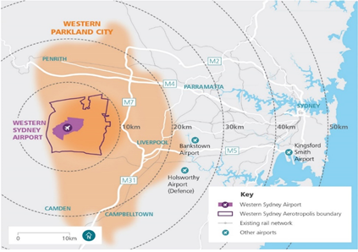
Western Sydney Aerotropolis Growth Area (WSAGA)
Located 45km outside of Sydney CBD
11,200 hectares
100,000 new residential dwellings
Estimated 200,000 jobs
Notes:
The Western Sydney Aerotropolis Growth Area, or WSAGA precinct, embodies the opportunities presented by the new airport, located about 45km west of Sydney CBD.
At a whooping 11,200 hectares
projected to support 200,000 jobs and 100,000 new dwellings.

Slide 3
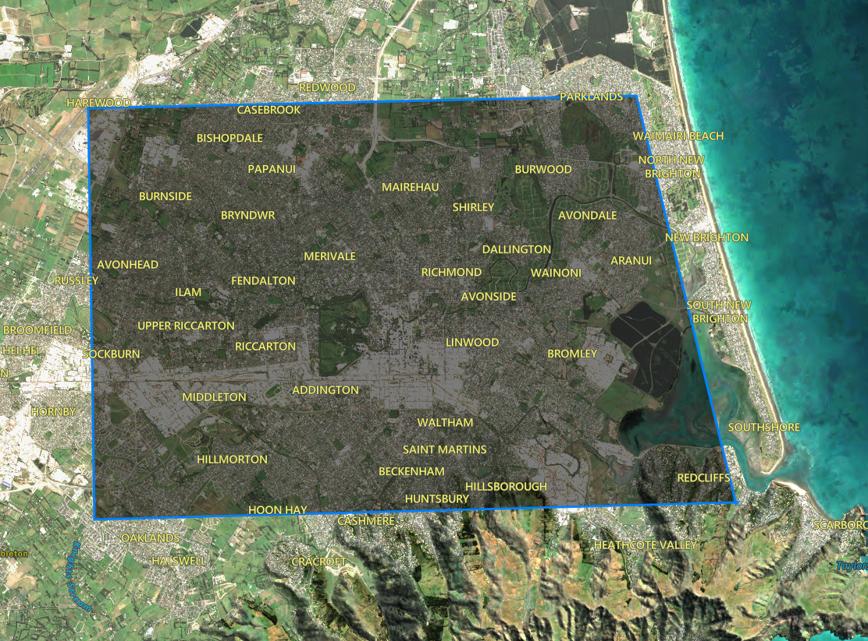
~120 KM^2
Notes:
So lets put this challenge in to context:
11,200 ha or 112km2…. That’s most of the land mass of CHC

Slide 4
Jobs
225,000 Jobs
200,000 Jobs
~90% Jobs in Christchurch
Christchurch
WSAGA
Notes:
200,000 jobs, that’s about 90% of the CHC workforce as recorded in the 2018 census

Slide 5
Dwellings
150,000 Dwellings
100,000 Dwellings
~70% Houses in Christchurch
Christchurch
WSAGA
Notes:
And 100,000 new dwellings is about 2 /3 of the current local residential dwellings
So that’s the challenge.

Slide 6
Opportunity
How would you build your water system from scratch?
Notes:
Lets flip this into an opportunity… if you had the opportunity to build a potable water system from scratch for your home town… or home city. How would you build it?
If you were presented with the opportunity to re-imagine your city's water system, how would you design it?
I know how I would do it. I would use this opportunity to co-create an integrated water strategy with developers, local authorities and other utility providers to deliver:
water sensitive
Resilient
cost-effective
water infrastructure
Here’s Sam to teach you “how to water your precincts”.

Slide 7
Presentation Summary
Background and Objectives
Servicing Options
Methodology and Findings
Preferred Option

Slide 8
Background and Objectives

Slide 9
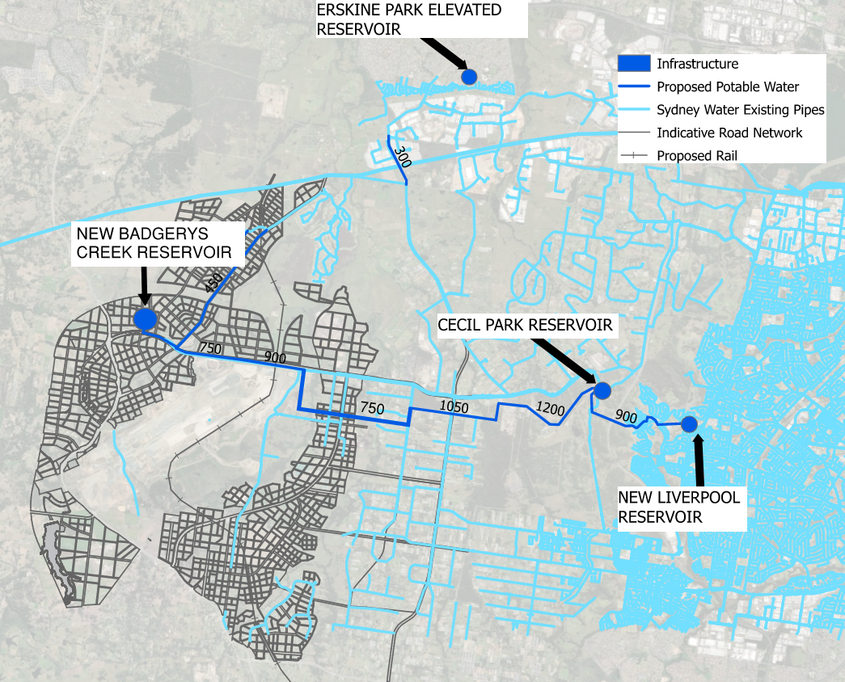
Background and Objectives
Notes:
How will we provide water to a mini chch in 2056?
I want to acknowledge the uniqueness of this project, traditionally when we design water supply systems it may be for a small development with 10 houses which then sprawls outwards into a suburbs and cities over a hundred or so years. This means that infrastructure will have to be removed and replaced as the development grows, which is a reactive approach to growth. Instead we were able to be proactive with our design approach which we can be with the foresight of range in topography and limitation of the network at the beginning of the projects life.
We did have boundary conditions for this assessment, we knew what size and where the trunk infrastructure was going to go which are the dark blue lines in the figure. We also knew that there is going to be a new reservoir called Badgerys creek reservoir, which is proposed to service precents within WSAGA where possible. The location of this was fixed, but we had influence over how large the reservoir needed to be to service the Precints within WSAGA. The reservoir provides storage locally, so if the supply from Cecil Park was interrupted, there was a back up supply for resilience sized to 2/3 MDD. Additionally, the Reservoir acts as a pressure break in the system due to the high elevation of the existing Cecil Park Reservoir with respect to the ground level of the precincts. The philosophy behind the design is that water will flow from the existing Cecil Park Reservoir to the new Badgerys Creek reservoir via gravity, and finally service the Precincts of WSAGA via gravity from the new Badgerys Creek Reservoir where possible. The aim is to reduce the amount of extra infrastructure and energy required in the system in the way of booster pumps etc. However, this option will not work for all precincts due to having a range of elevations, we will discuss the servicing options shortly. But first, lets look at what information we needed to make informed decisions of how to service a precinct.

Slide 10
Methodology and Findings

Slide 11
Methodology and Findings
1. Precinct Growth and Demand
2. Static Head Assessment
3. Zoning
4. Decision Making Process

Slide 12
1. Precinct Growth and Demand
Population Forecast - How many people and employees need water?
Developer Information
Indicative road layout
Land use
Growth Forecast
User Growth Intelligence (UGI)
Table 1: Precinct Demand
Ultimate 2056 Demand (ML/d)
Precinct | Res ADD | Non-Res ADD | Total ADD | Res MDD | Non-Res MDD | Total MDD
Mamre Road | 0.00 | 9.57 | 9.57 | 0.00 | 15.31 | 15.31
Agribusiness | 0.90 | 5.65 | 6.55 | 2.07 | 9.21 | 11.28
Aerotropolis Core | 3.82 | 5.51 | 9.34 | 7.27 | 9.69 | 16.95
Badgerys Creek | 0.00 | 3.72 | 3.72 | 0.00 | 5.99 | 5.99
Northern Gateway | 1.62 | 3.75 | 5.37 | 3.08 | 7.48 | 10.56
 | 6.34 | 28.20 | 34.54 | 12.41 | 47.69 | 60.10
Design Rates - How much water is each person and employee using ?
Notes:
So now we will look at what information informed our decision making process
So firstly we needed to look into the population forecast of WSAGA, which is essentially how many people and employees need water ? We got insight from developers through indicative layout plans and projected growth forecast, which informed us of how the land was going to be used within the Precinct and for how many dwellings/employees. ADD MORE BEEF HERE
To fill the gaps we used UGI information. UGI is Sydney waters internal projection of how Sydney will grow. This was less detailed than the information we received from developers, so developer information was our first preference of data.
So now we roughly know what the land is going to be used for and for how many houses or employees, we need to look into what design rates to use, which is essentially how much water each person or employee is using per day. We used evidence based demands from other regions of Sydney which have similar water consumption characteristics such as similar land use type and access to recycled water.
When we multiply our population forecast by the demand rates, we have calculated the amount of water required to service the precincts under a Max day scenario.

Slide 13
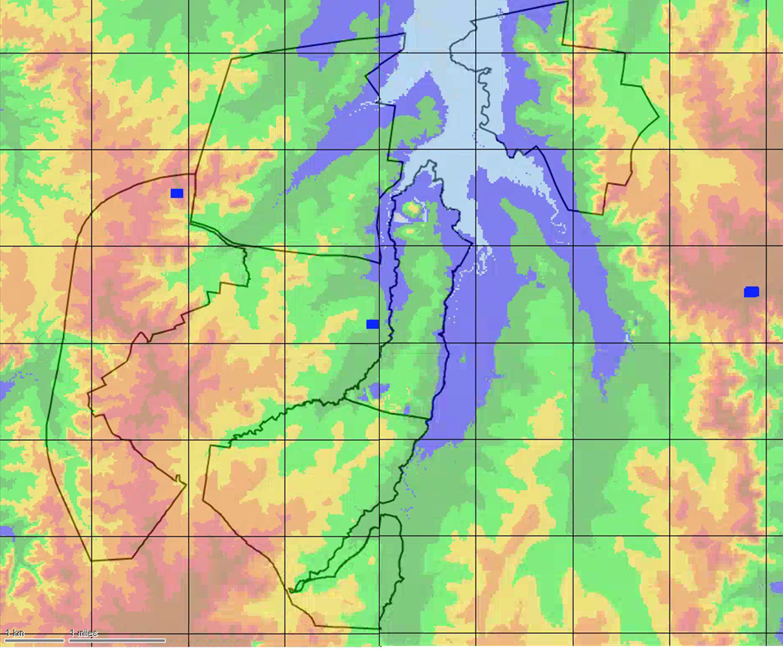
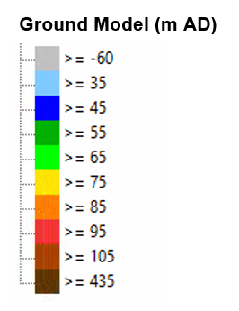
2. Static Head Assessment
Review of static head from reservoirs vs. precinct elevation
Target level of service (pressure):
20m – 60m
(WSA 03 - Water System Planning Guideline)
New Reservoir servicing elevation range:
~53m – 93m
(Not accounting for headlosses)
Some zones fall outside the servicing range of the New Reservoir
Northern Gateway
36.1m - 85.6m
Mamre Road
32.4m - 94.5m
Badgerys Creek Reservoir
TWL: 113m
Badgerys Creek
36.5m - 76.2m
Cecil Park Reservoirs
TWL: 160m
Agribusiness
57.9m - 109.1m
Aerotropolis Core
52.8m - 96.4m
Notes:
We conducted a static head assessment which is essentially looking at the elevation of the top water level of the reservoir and the elevations of the precinct.
Sydney water have planning guidelines of the level of service required for drinking water which is that he pressure must be between 20-60m pressure at all times.
So with this in mind, we could at a high level understand the servicing range of the Reservoirs via gravity. So for example, the new Badgerys Creek reservoir which has a top water level of 113 m, if we minus 20m (which in the minimum pressure) we can understand the upper limit of elevation of the precinct that can be serviced by the Badgerry creek reservoir via gravity, whilst maintaining 20m pressure in the system at all times. Immediately we identified that there were some precincts that were outside of the servicing range of the Badgerys creek reservoir via gravity. This led us to do a refinement of zoning.

Slide 14
3. Zoning
Zoning of precincts based on elevation (and proximity to reservoir)
Servicing options assessment required for:
Agribusiness Northwest
Agribusiness South
Aerotropolis Core South
Mamre Road East
Northern Gateway
36.1m - 85.6m
Mamre Road East
51.4m - 94.5m
Badgerys Creek Reservoir
TWL: 113m
Mamre Road West
32.4m – 78.3m
Agribusiness Northeast
59.0m - 85.8m
Cecil Park Reservoirs
TWL: 160m
Badgerys Creek
36.5m - 76.2m
Agribusiness Northwest
57.9m - 105.5m
Aerotropolis Core North
52.8m - 77.4m
Agribusiness South
61.5m - 109.1m
Aerotropolis Core South
59.2m - 96.4m
Notes:
So we broke up the precincts further based on their topography. The Precincts that couldn’t be suppled from Badgerys creek via gravity are identified in red. This lead us to look into alternative servicing options aside from gravity feeding from the Badgerys creek reservoir.
Ultimately, this network will work as one, so we focused on servicing based on topography rather THAN DEFINED ON PRECINCT BOUNDARYS .
Ultimately zoning is indepdentant of the Precinct Boundary’s. Within a Precinct, there could be multiple servicing options the cross precinct boundaries based on elevations.

Slide 15
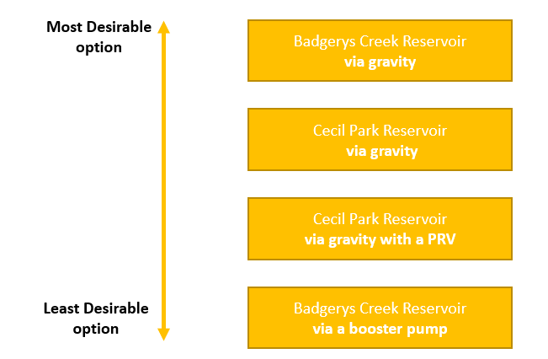
4. Decision Making Process
Resilience – local storage and takes demand off Cecil Park
No additional energy
Higher head compared to Badgerys Creek Res
Existing asset
No additional energy
Existing asset
Minimal additional energy
Requires additional energy & maintenance
Hydraulic rollercoaster
Notes:
So again, we prioritised options which relied of gravity as opposed to adding booster pumps in the system. So from most to least desirable it goes, gravity feeding then supply with a booster pump.
We then created a decision making process, keeping in mind the way we are prioritising the options.
So firstly, as I explained previously the first option to consider is can the Precinct be serviced by Badgerys Creek Reservoir via gravity. So in other words, is the elevation of the precinct less that 93m ? If the answer to that question is yes, and once we consider the impacts of headloss throughout the pipe if the elevations of the precinct, less headloss was still less than 93m, the Precinct can be serviced by Badgerys Creek Reservoir via Gravity. We prioritised this option as we wanted to reduce the load and risk on the existing Cecil Park Reservoir. Our second option is to utilise the Cecil Park Reservoir which is ~40m higher in elevation than the Badgerys Creek Reservoir. So our next question is can I be serviced from Cecil Park Reservoir via gravity ? This is our second most desirable option as it is relying on gravity as opposed to only relying on boosting the water from the Badgerys Creek Reservoir. IN some cases, the pressures were too high when serviced by Cecil park via gravity, above the 60m limit as per Sydney waters. So we have a third option to service the Precinct from Cecil Park Reservoir with a pressure reducing valve. And finally if all else fails, the precinct can be boosted from Badgery creek reservoir. This is our last option considered due to the extra maintenance and energy required for a booster pump
This is a very simplified version of the decision making process we undertook, we had extra complexities to consider in such at network connectivity. but for the purpose of sharing our methodology

Slide 16
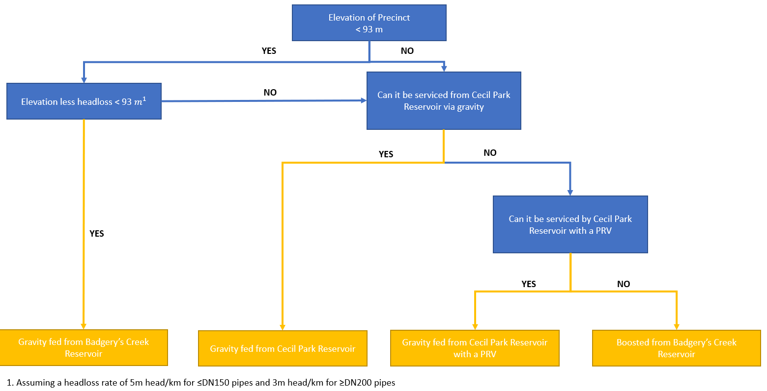
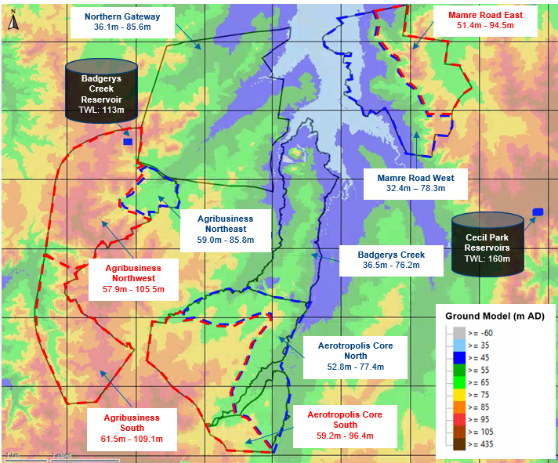
4. Decision Making Process
Most desirable
Least desirable
Notes:
So firstly, as I explained previously the first option to consider is can the Precinct be serviced by Badgerys Creek Reservoir via gravity. So in other words, is the elevation of the precinct less that 93m ? If the answer to that question is yes, and once we consider the impacts of headloss throughout the pipe if the elevations of the precinct, less headloss was still less than 93m, the Precinct can be serviced by Badgerys Creek Reservoir via Gravity. We prioritised this option as we wanted to reduce the load and risk on the existing Cecil Park Reservoir. Our second option is to utilise the Cecil Park Reservoir which is ~40m higher in elevation than the Badgerys Creek Reservoir. So our next question is can I be serviced from Cecil Park Reservoir via gravity ? This is our second most desirable option as it is relying on gravity as opposed to only relying on boosting the water from the Badgerys Creek Reservoir. IN some cases, the pressures were too high when serviced by Cecil park via gravity, above the 60m limit as per Sydney waters. So we have a third option to service the Precinct from Cecil Park Reservoir with a pressure reducing valve. And finally if all else fails, the precinct can be boosted from Badgery creek reservoir. This is our last option considered due to the extra maintenance and energy required for a booster pump
This is a very simplified version of the decision making process we undertook, we had extra complexities to consider in such at network connectivity. but for the purpose of sharing our methodology

Slide 17
Servicing Options

Slide 18
Servicing Options
Aerotropolis Core South
Notes:
So now that we understand what our servicing options are, and why we are prioritising some over other, lets go through an example together

Slide 19
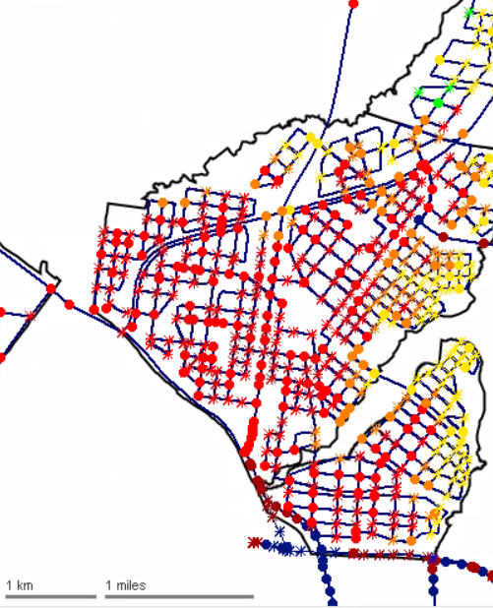
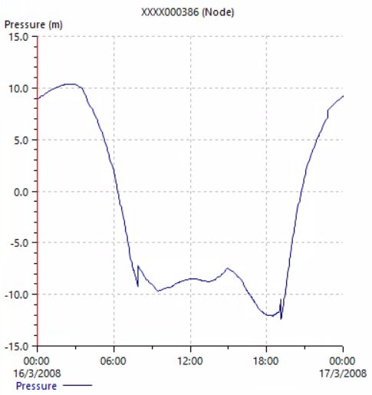
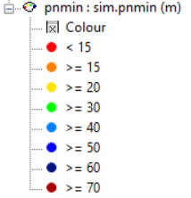

Slide 20
High Elevation Areas within Precinct can be gravity fed via Cecil Park Reservoir. But pressure too high at lower elevations

Slide 21
High Elevation Areas within Precinct can be gravity fed via Cecil Park Reservoir. But pressure too high at lower elevations

Slide 22
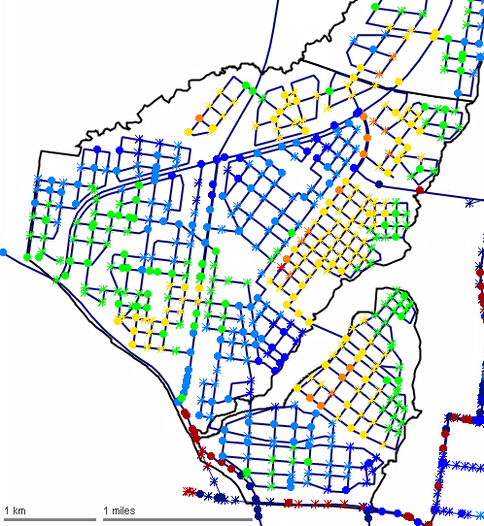
PREFERRED OPTION
PREFERRED OPTION
Notes:
So in this example, we could have in theory booster pumped the Aetropolis Core South Precinct from the Badgerrys creek reservoir. However, through the lens of trying to reduce the amount of additional infrastructure and added energy, we were able to avoid relying on a booster pump by capitalizing on the elevation of the existing Cecil Park Reservoir.
In a traditional development, this high level understanding of servicing range to this extent would not be known. So it is likely that if this approach wasn’t taken, the precinct would likely have to be serviced by Badgerrys Creek Reservoir with a booster pump which is less desirable solution.

Slide 23
Servicing Options
Agribusiness South
Notes:
So now that we understand what our servicing options are, and why we are prioritising some over other, lets go through an example together

Slide 24
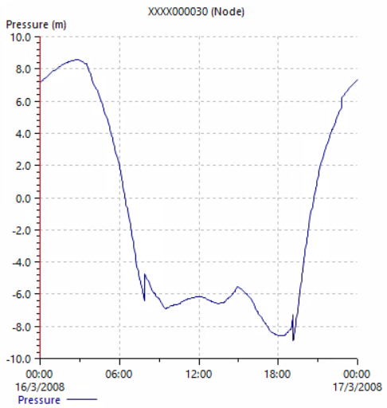
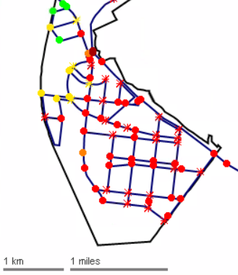

Slide 25
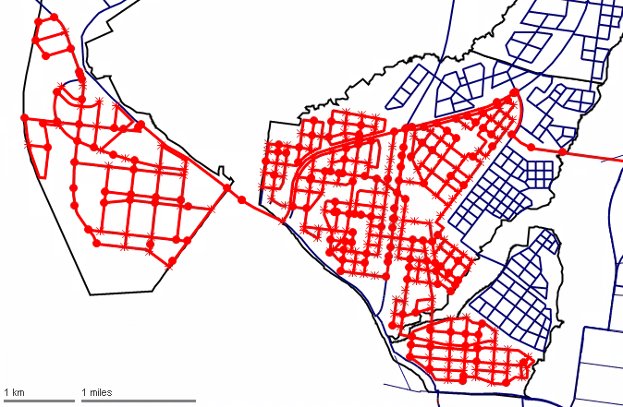
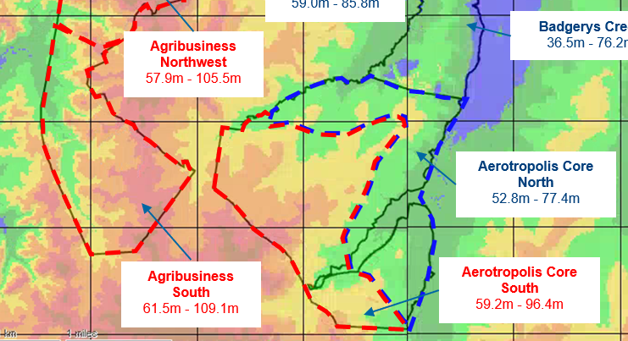

Slide 26
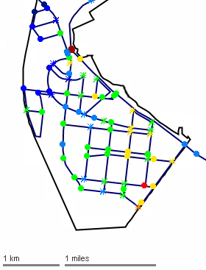
PREFERRED OPTION

Slide 27
Preferred Option

Slide 28
Preferred Option
PRV
Northern Gateway
36.1m – 85.6m
Mamre Road (West)
32.4m – 67.4m
Mamre Road (East)
51.4m – 94.5m
Dividing Valves
Badgerys Creek Reservoir
TWL: 113m
Agribusiness (Northeast)
59.0m – 85.8m
Badgerys Creek
36.5m – 76.2m
Airport Reservoir
TWL: 67m
Cecil Park Reservoirs
TWL: 160m
Booster pump
Dividing Valve
Airport
Aerotropolis Core (North)
52.8m – 77.4m
Agribusiness (Northwest)
57.9m – 105.5m
Dividing Valve
Dividing Valve
Aerotropolis Core (South)
59.2m – 96.4m
Agribusiness (South)
61.5m – 109.1m
PRV
Dwyer Road

Slide 29
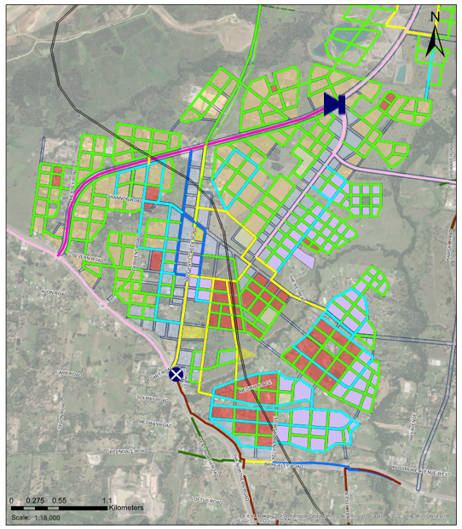
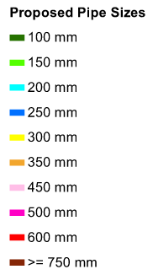
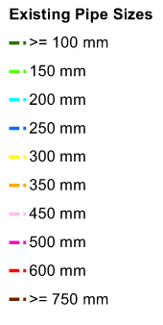
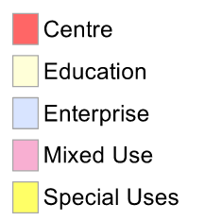
Scheme Plans
Aerotropolis Core South
New Reservoir
Dividing Valve (or no pipe)
Booster Pump
Pressure Reducing Valve

Slide 30
Notes:
Thanks for listening, we were presented with the question, how will we water WSAGA ?
I know I’d do it, through
Collaboration with Developers to build foresight into how the Precinct would ultimately use water (one source of truth)
water sensitive
Resilient
cost-effective water infrastructure
To Best practice

