Slide 1
‘Smart Water starts with you!’ Behaviour change, community outreach & collaboration
by Michelle Templeton

Slide 2
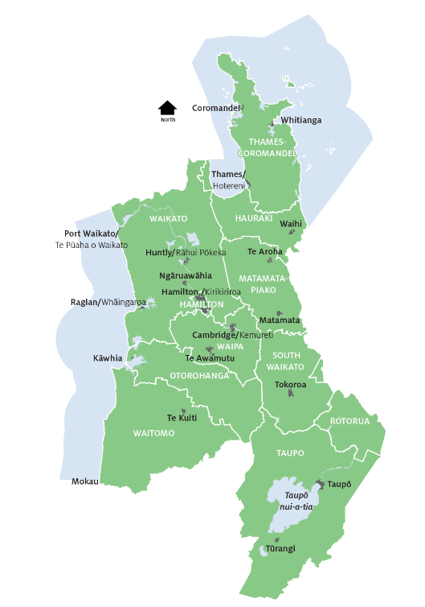
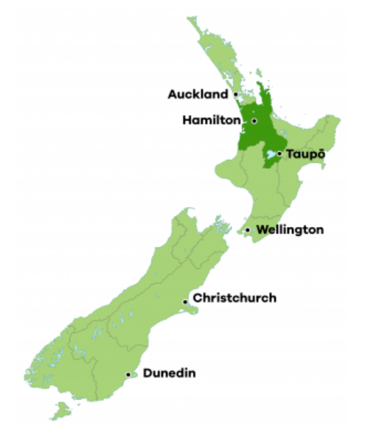
About Co-Lab & Smart Water

Slide 3
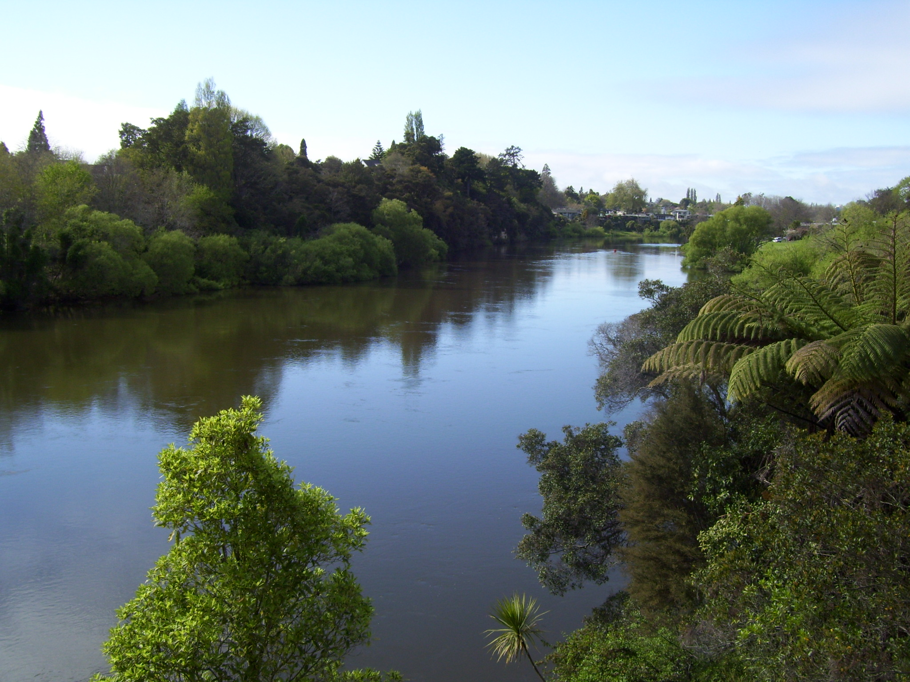
Smart Water Campaign – Mission & Aim
Our Mission
Water is considered and used as a precious resource by Hamilton, Waipā and Waitomo communities.
We uphold principles of Te Ture Whaimana and Te Mana o te Wai
Our Key Aims
Increase understanding of water from source to tap
Everyday water saving habits are adopted and normalised
Water is valued as a precious resource
Behaviour change
Community-based social marketing approach
Identify barriers and overcome them using psychological techniques
Help foster long-term change to how people use water

Slide 4
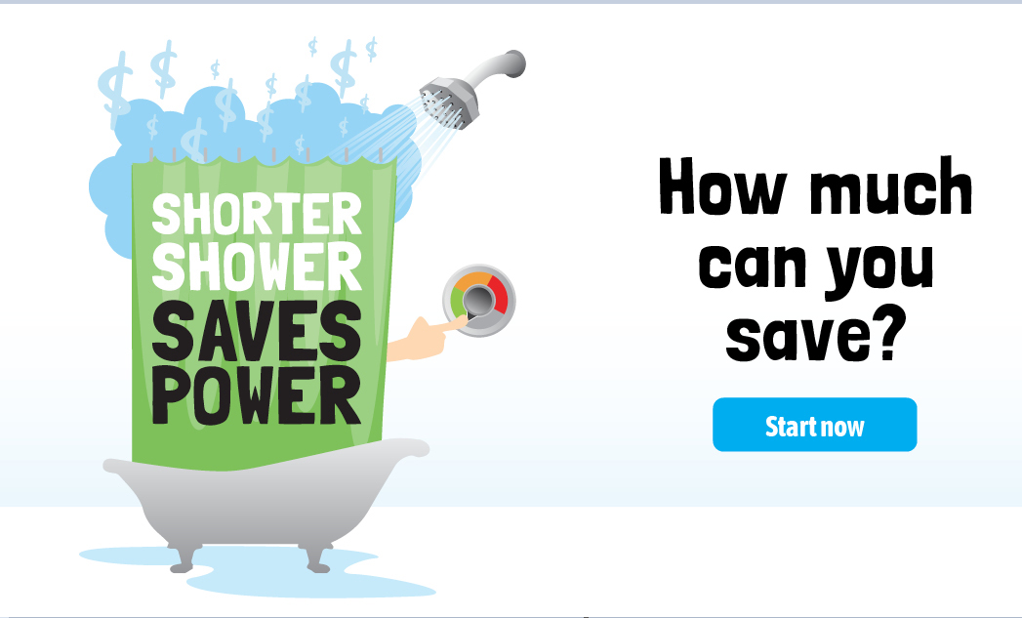
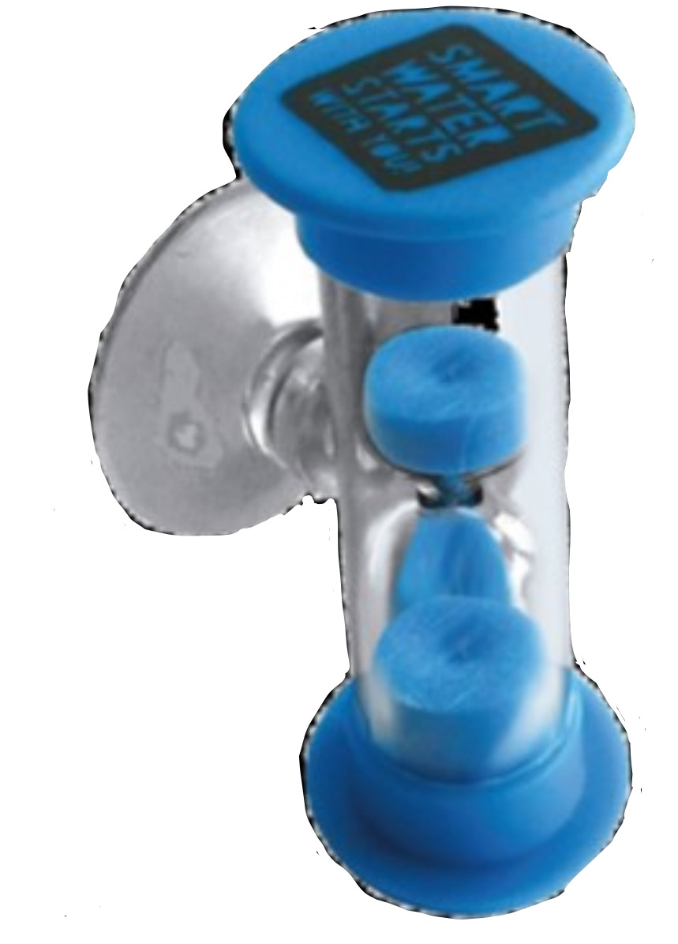
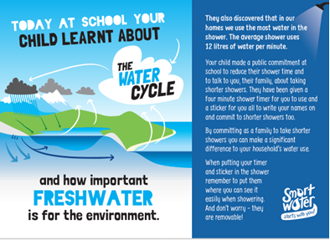
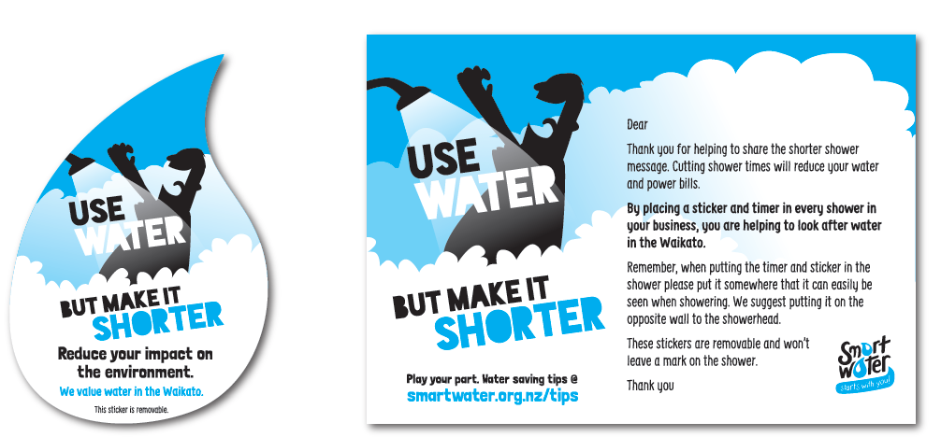
What we do - Year-round messaging
Year split into quarterly themes e.g. Autumn – ‘Encouraging shorter Showers
Community
Schools
Workplace
88% of people feel they are more aware of their power use

Slide 5
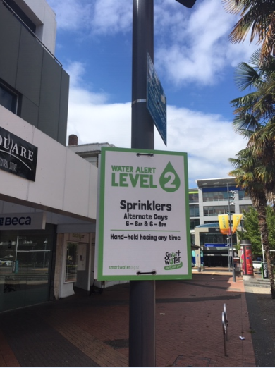
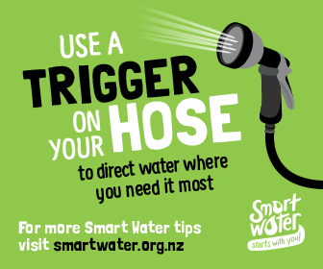
What we do – Summer demand management

Slide 6
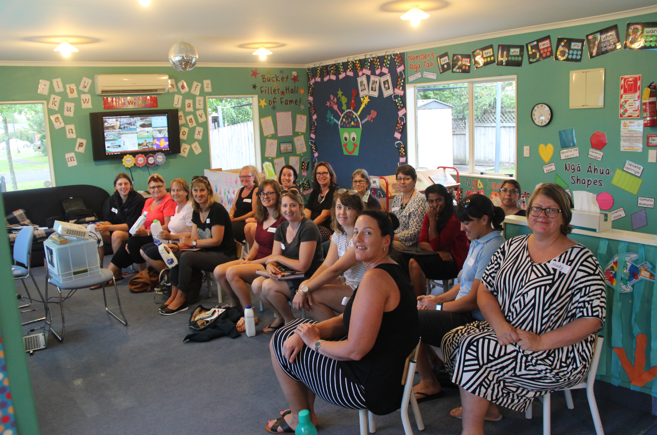
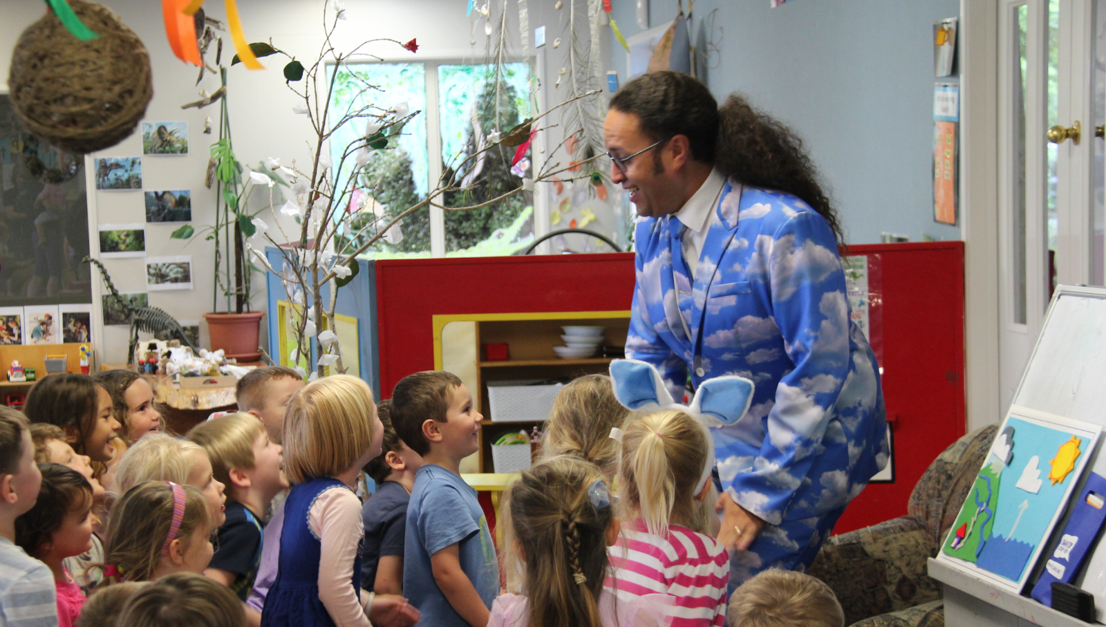
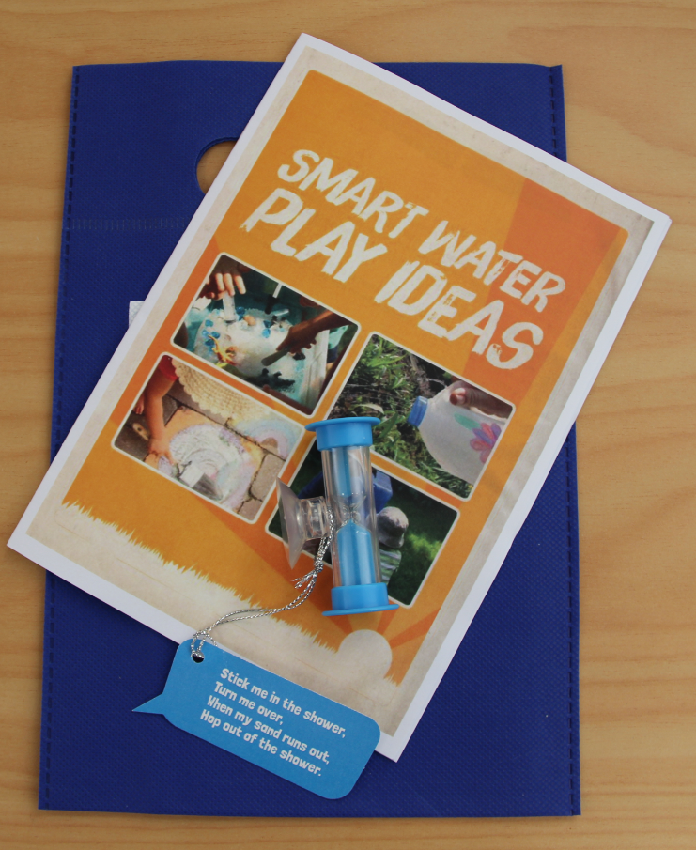
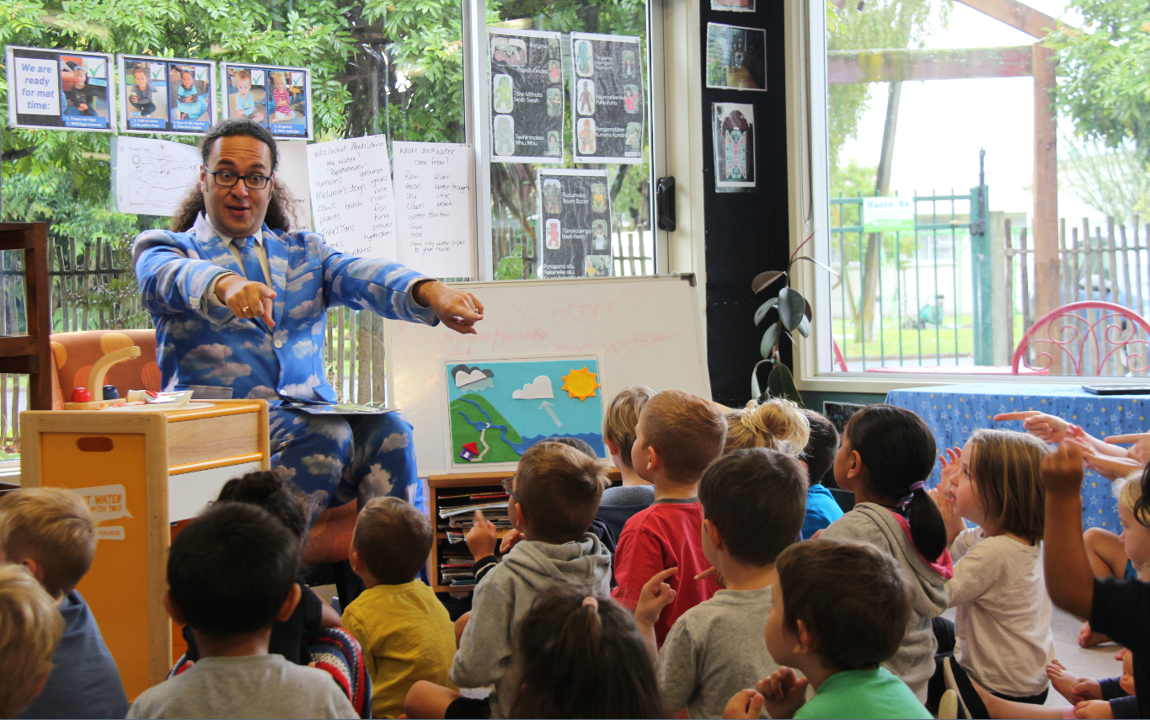
Community outreach
18 smart water shows targeted at 3-5 year olds

Slide 7
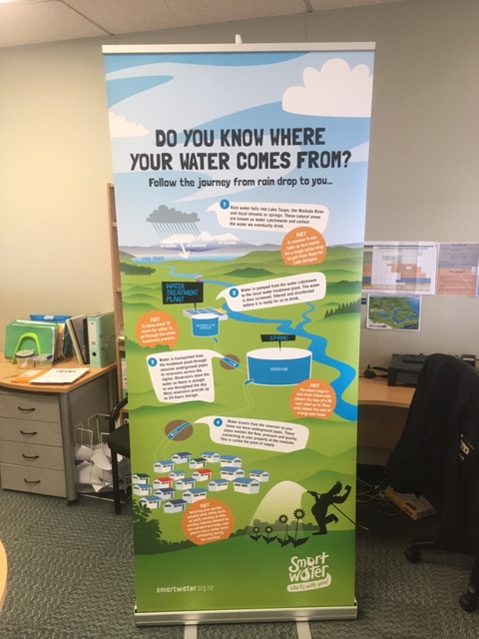
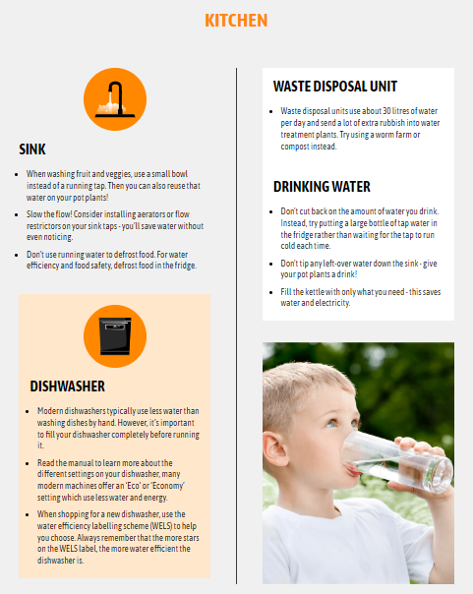
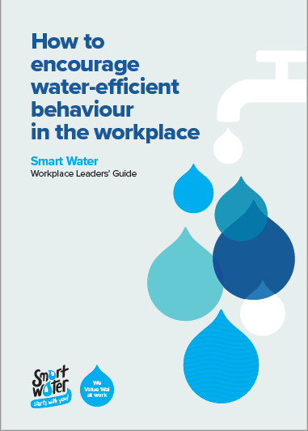
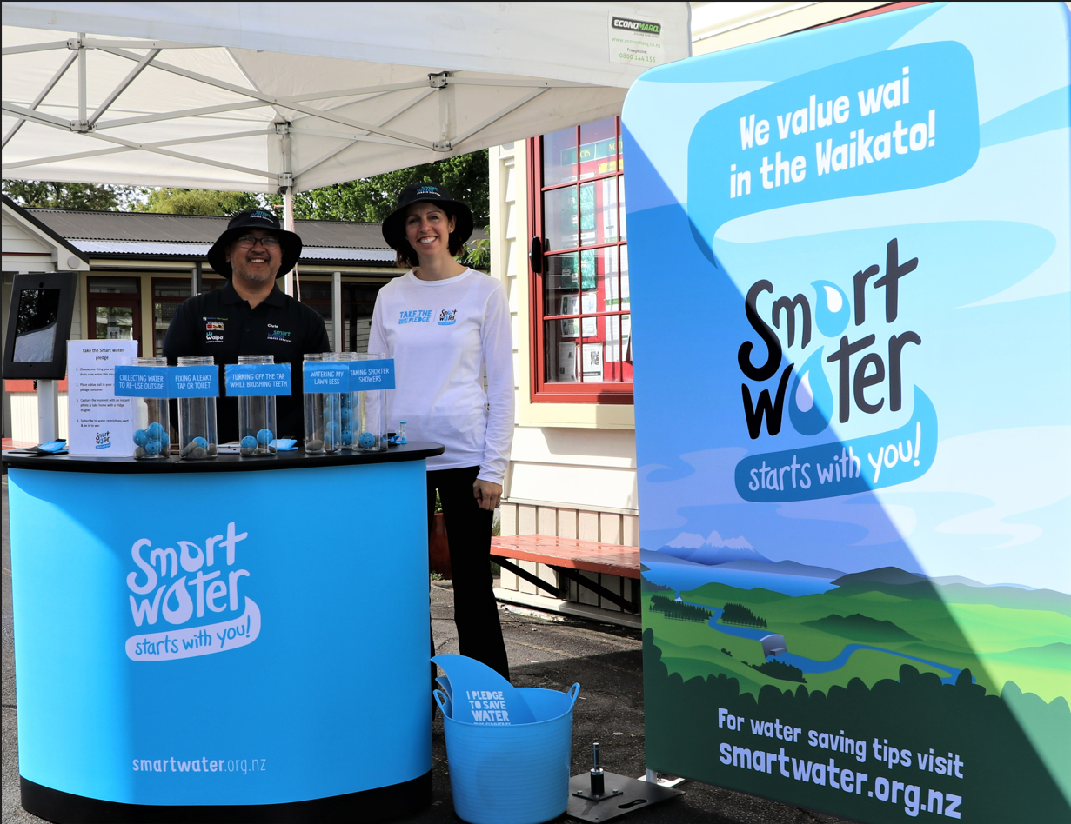
Community outreach

Slide 8
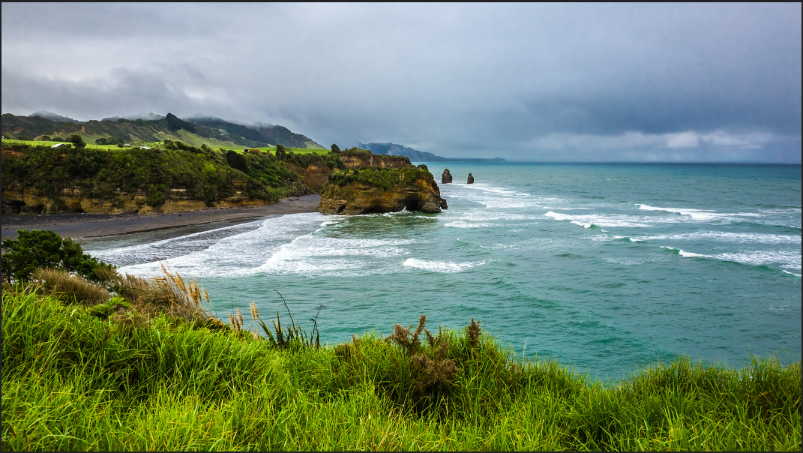
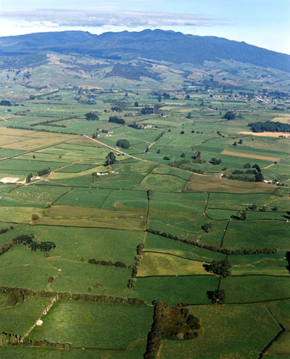
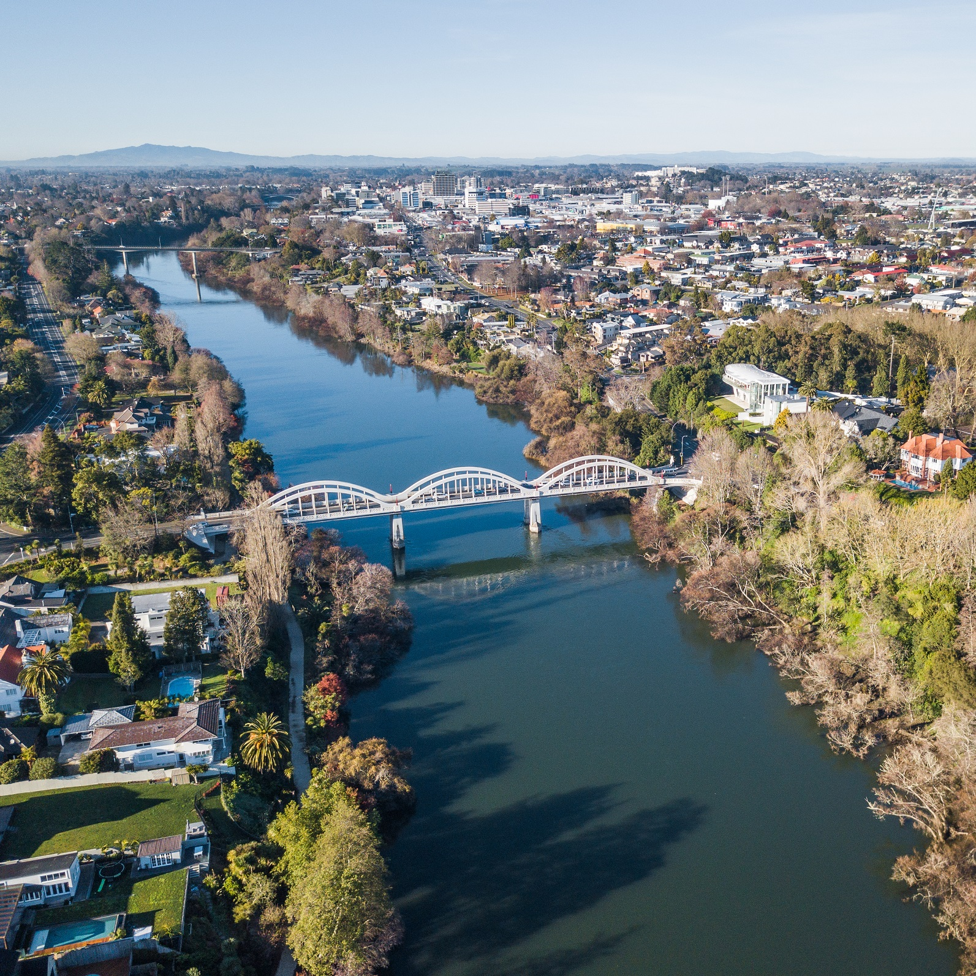
Collaboration - Each council is very different/diverse

Slide 9
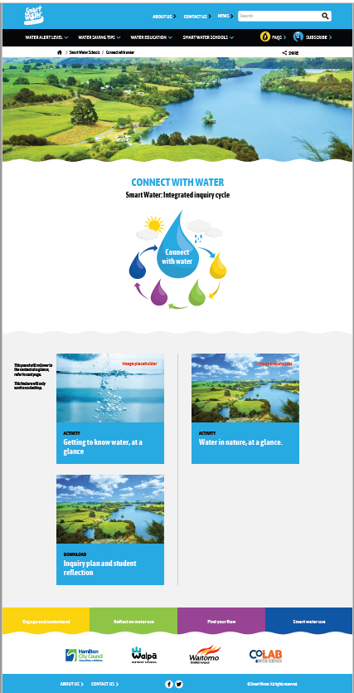
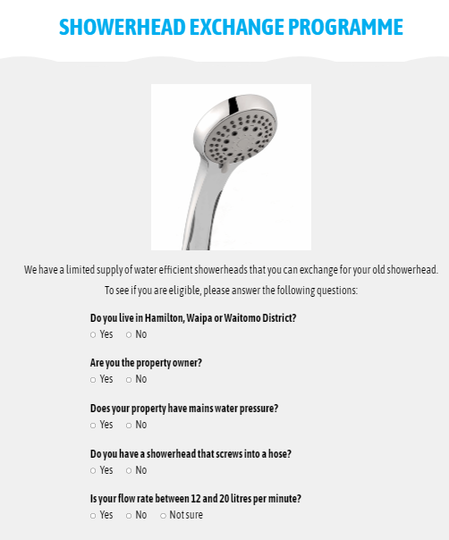
Choose campaigns & educational resources that work for all

Slide 10
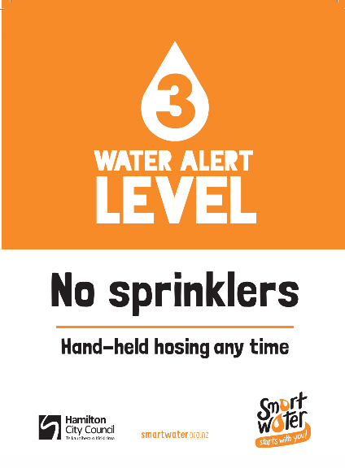
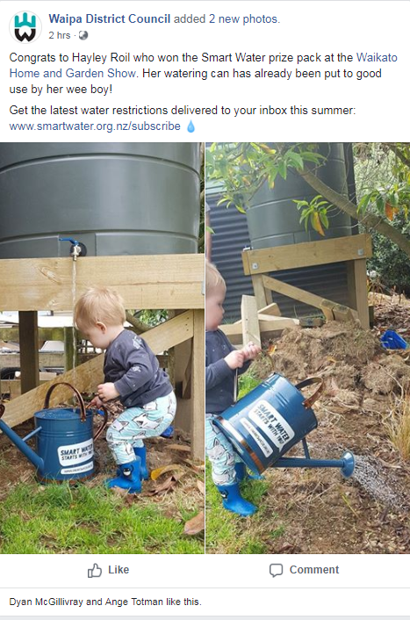
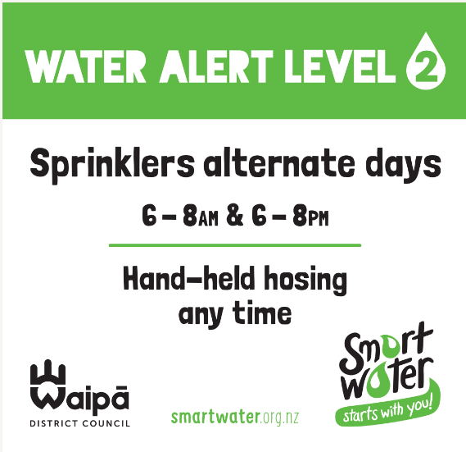
Tailored marketing material

Slide 11
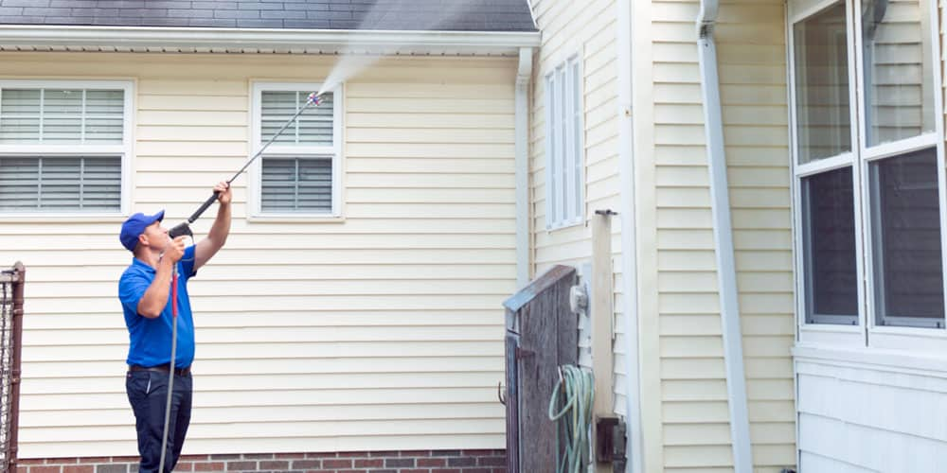
Collaboration – Working with multiple people takes time
Labour weekend radio campaign

Slide 12
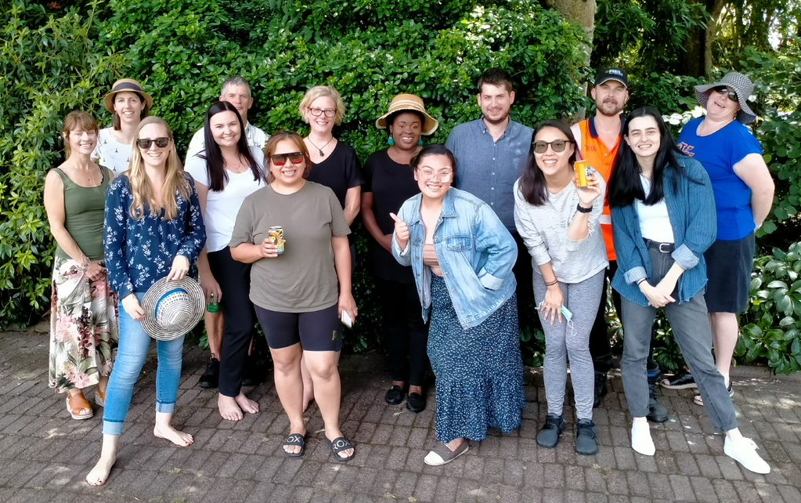
Campaigns are better
“There are no two ways about it – having input from different perspectives ALWAYS makes our campaigns more relevant, more impactful and more fun”

Slide 13
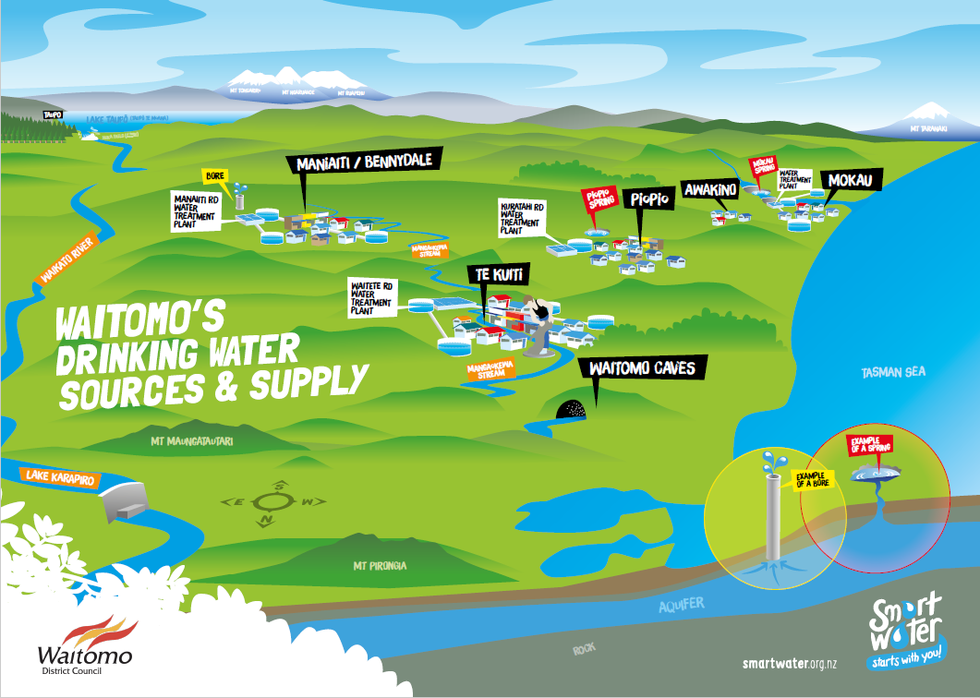
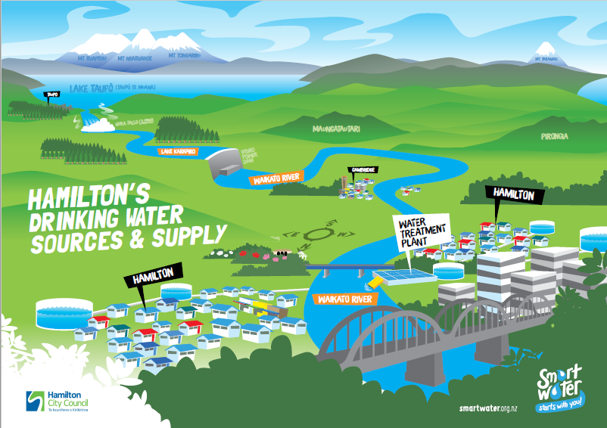
Collaboration – Water supply pressures & demand are so different

Slide 14
Supportive network enabling problem-solving & sharing of ideas and experience

Slide 15
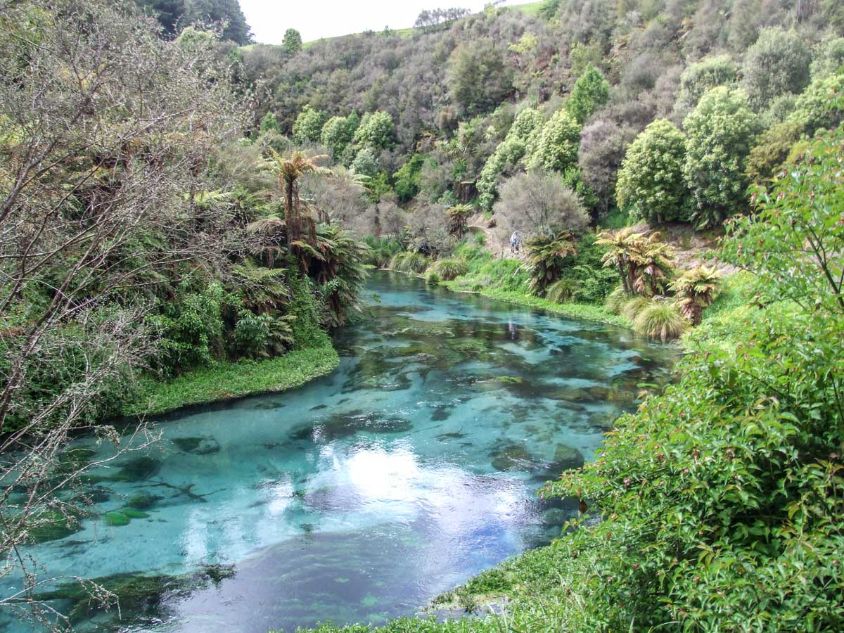
Valuing water
“Just because you value water doesn’t mean you save water in practice or follow water-efficient habits.”
Understanding and appreciating where water comes from
How it gets from source to tap
How much it costs
How much is used for different activities
Experiencing water shortages or extreme weather patterns
Cultural values

Slide 16
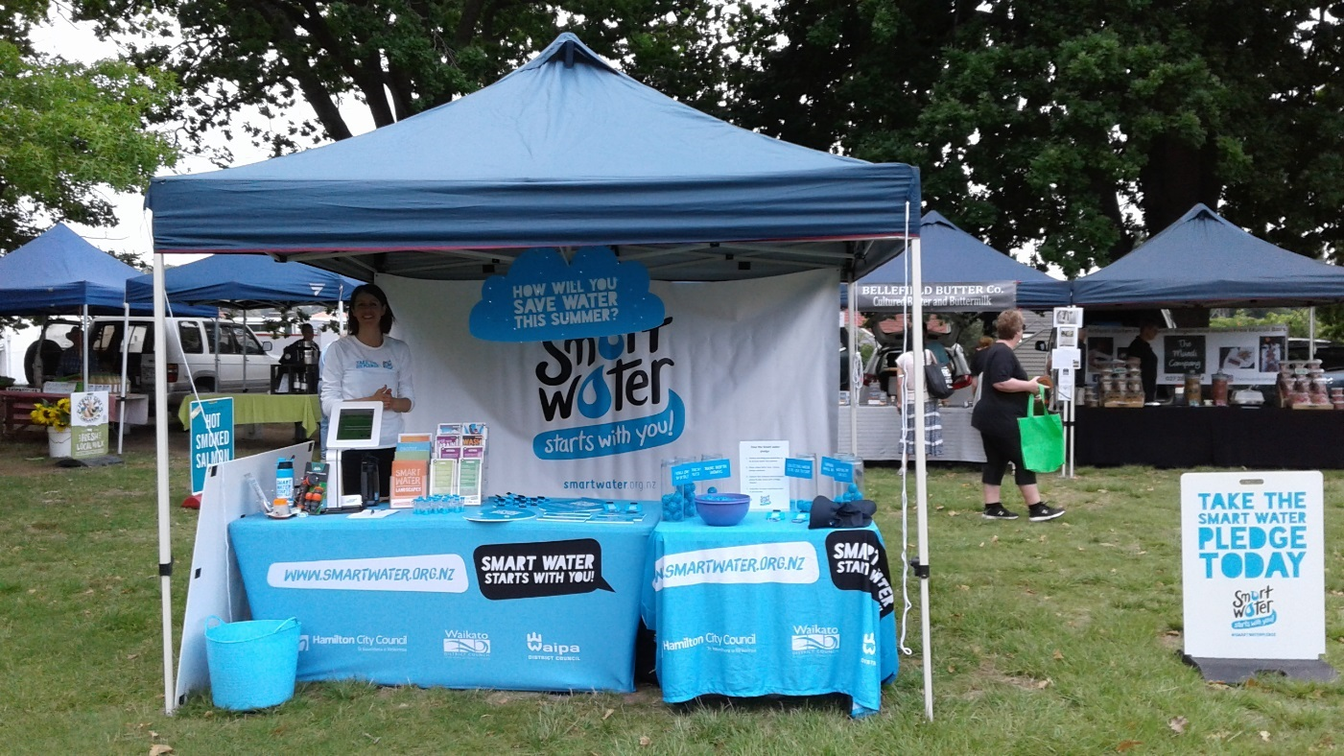
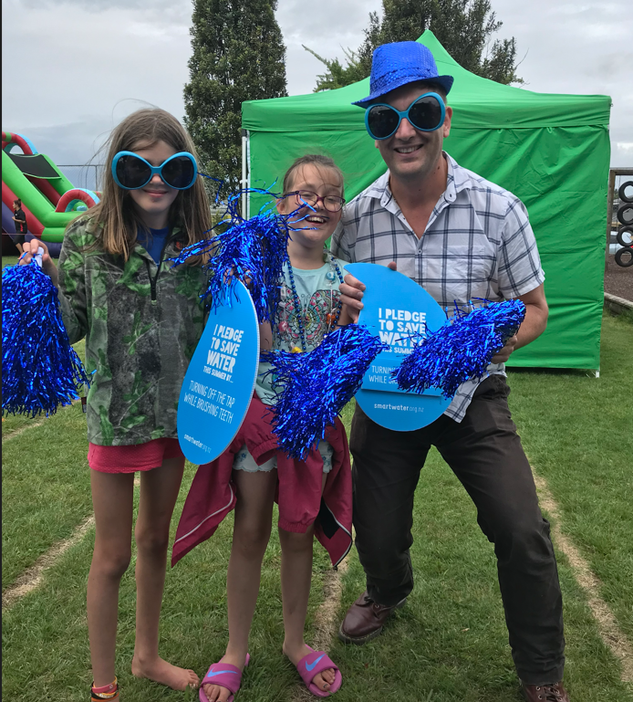
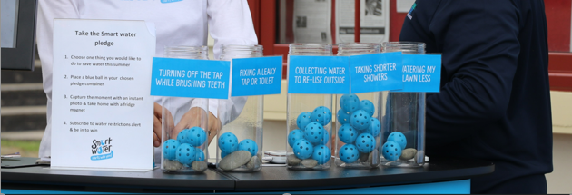
Behaviour change

Slide 17
Encouraging kiwis to value water
Have a strong branding
Engage behaviour change & water conservation expertise
Facilitate trusted and productive relationships & share best practice
Understand your target audience
Make it simple, friendly and engaging
Provide a suite of tools and resources
Thank you. Any questions?

