Slide 1
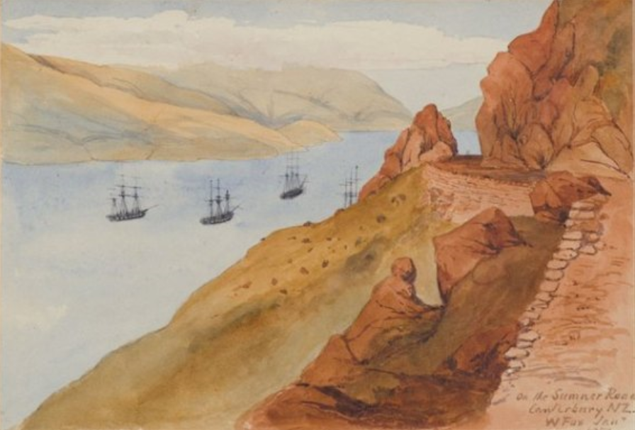
Sumner Road: Between a Rock and a Hard Place
2019 Stormwater Conference
Angela Pratt
Image Source: www.peelingbackhistory.co.nz
Notes:
Before I start I just wanted to get a show if hands if you:
Any those who know where Sumner Road is and why this road is so important?
And who has either driven or ridden Sumner Road since it reopened at the end of March?
Well hopefully you will all learn something today then.
Between a rock and a hard place. I personally can’t think of a better way of describing the project I am going to talk to you about today.
A narrow road perched on a rocky cliff with stunning views of the ocean.
A challenging environment for a challenging project.
A road which I used to cycle along several times a week on my road bike, and can now do again.
A road pummelled by the Canterbury Earthquakes.
Not just any road. A particularly special road to many Cantabrians, and to me.
Sumner Road – Between a Rock and a Hard Place

Slide 2
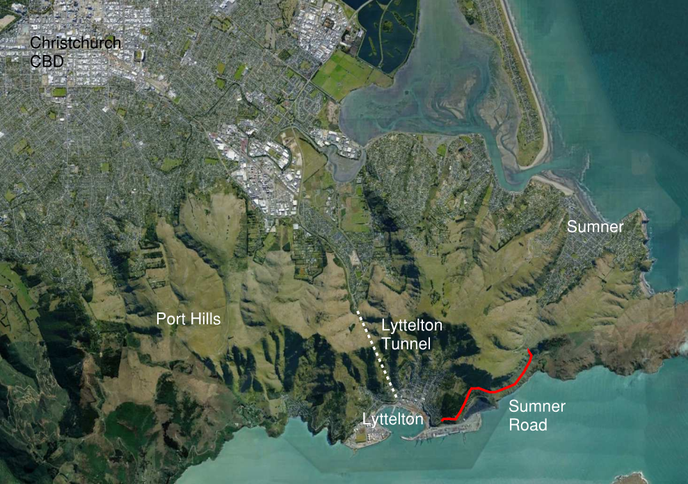
Location
Image Source: Google Earth
Notes:
Sumner Road is located between Lyttleton and Sumner, to the south-east of the city of Christchurch.
Sumner Road is one of two main transport routes between the Lyttleton Port and Christchurch, the Lyttelton Tunnel and Sumner Road. Sumner Road is a particularly important link as it provides a route for vehicles that are oversized or carrying dangerous goods which can’t be transported through the Lyttelton Tunnel. Summer road was also used extensively by cyclists (including myself) and by tourists as a scenic drive.
During the Canterbury Earthquakes, Sumner Road suffered severe damage as a result of rockfall, cliff collapse and mass movement hazards and was closed in 2011. Large rain storms in 2014 also mobilized a number of debris flows, causing further damage. The drainage systems along the road also suffered damage.
In the time since it was closed the vehicles carrying dangerous goods have required a specific closure to enable access to the tunnel or to drive a much further route via Gebbies Pass to Christchurch, adding cost to goods coming into and out of the Port. Reopening the road, which occurred at the end of March this year, therefore represents a very important project to the Canterbury and national economy.

Slide 3
Historical Road
Evans Pass
Notes:
Sumner Road was originally constructed in the 1850’s as the main path over the Port Hills between Lyttelton and Christchurch. Even then it was called a treacherous road as it winded its way across the steep and rocky hillside between Lyttelton and Evans Pass, above Sumner. This old aerial photo shows its original zig zag route up to Evans Pass.

Slide 4
Old Sumner Road and Sumner Road
Old Sumner Road
Notes:
It was later rebuilt in a location higher up the hill (shown in Read). The original route is mostly still there and is now called Old Sumner Road (shown here in green).

Slide 5
Presentation Overview
Project background
Earthquake damage
Geotechnical hazard mitigation measures
Main stormwater features
Key design challenges
Key components, focussed on stormwater aspects
Notes:
I firstly want to give an overview of my presentation

Slide 6
Sumner Road Project
Contractor: McConnell Dowell
Contractor’s Designer: Beca
Client: Christchurch City Council
Funders: CCC and NZTA
My role involved leading the design of the stormwater systems for:
Rockfall risk mitigation
Road rehabilitation
Notes:
The Sumner Road Rockfall remediation project was awarded to McConnell Dowell in 2016 under a design build contract arrangement.
Beca were engaged by MCD to be their designers for the project.
Sumner Road itself is owned and maintained by the Christchurch City Council however given the importance of the road, NZTA have also made a significant contribution to the costs.

Slide 7
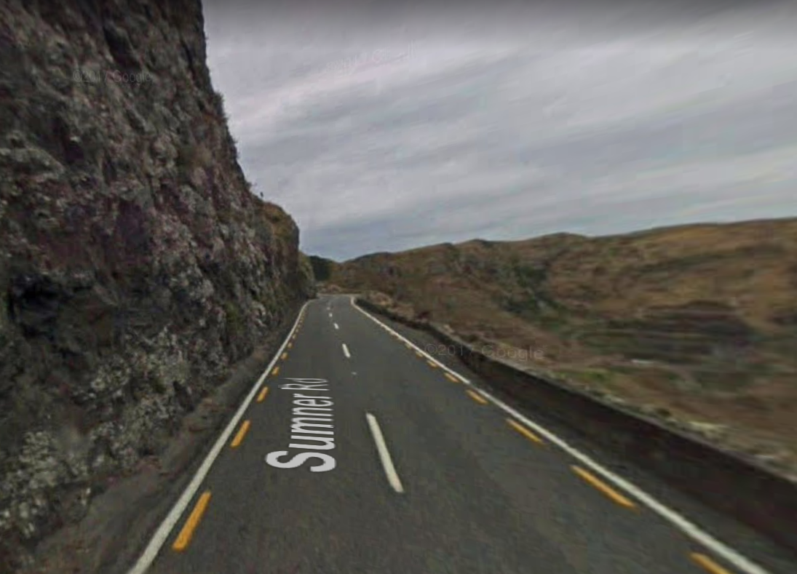
View of Pre-Earthquake Road
Source: Google Streetview
Notes:
View of pre-earthquake road from Google Streetview.
Old road has cliffs on one side and rock walls on much of the other
Narrow road
Regularly had rocks falling from above, especially during and after rainfall

Slide 8
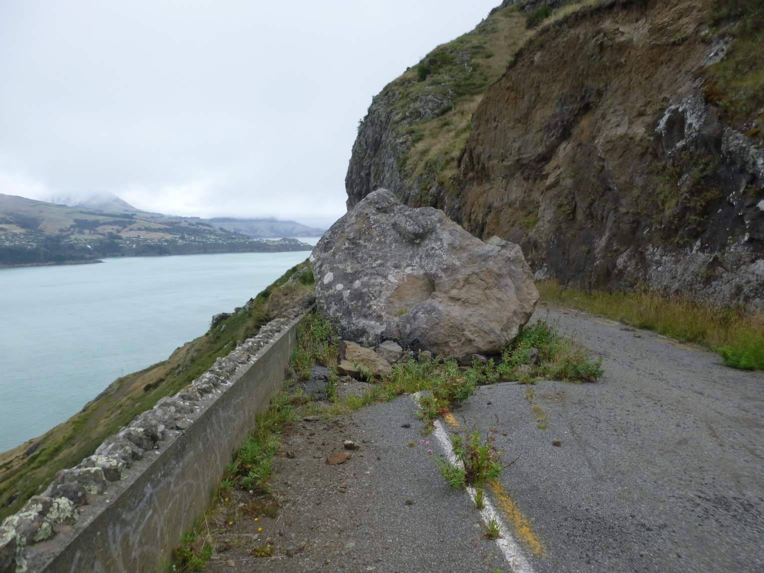
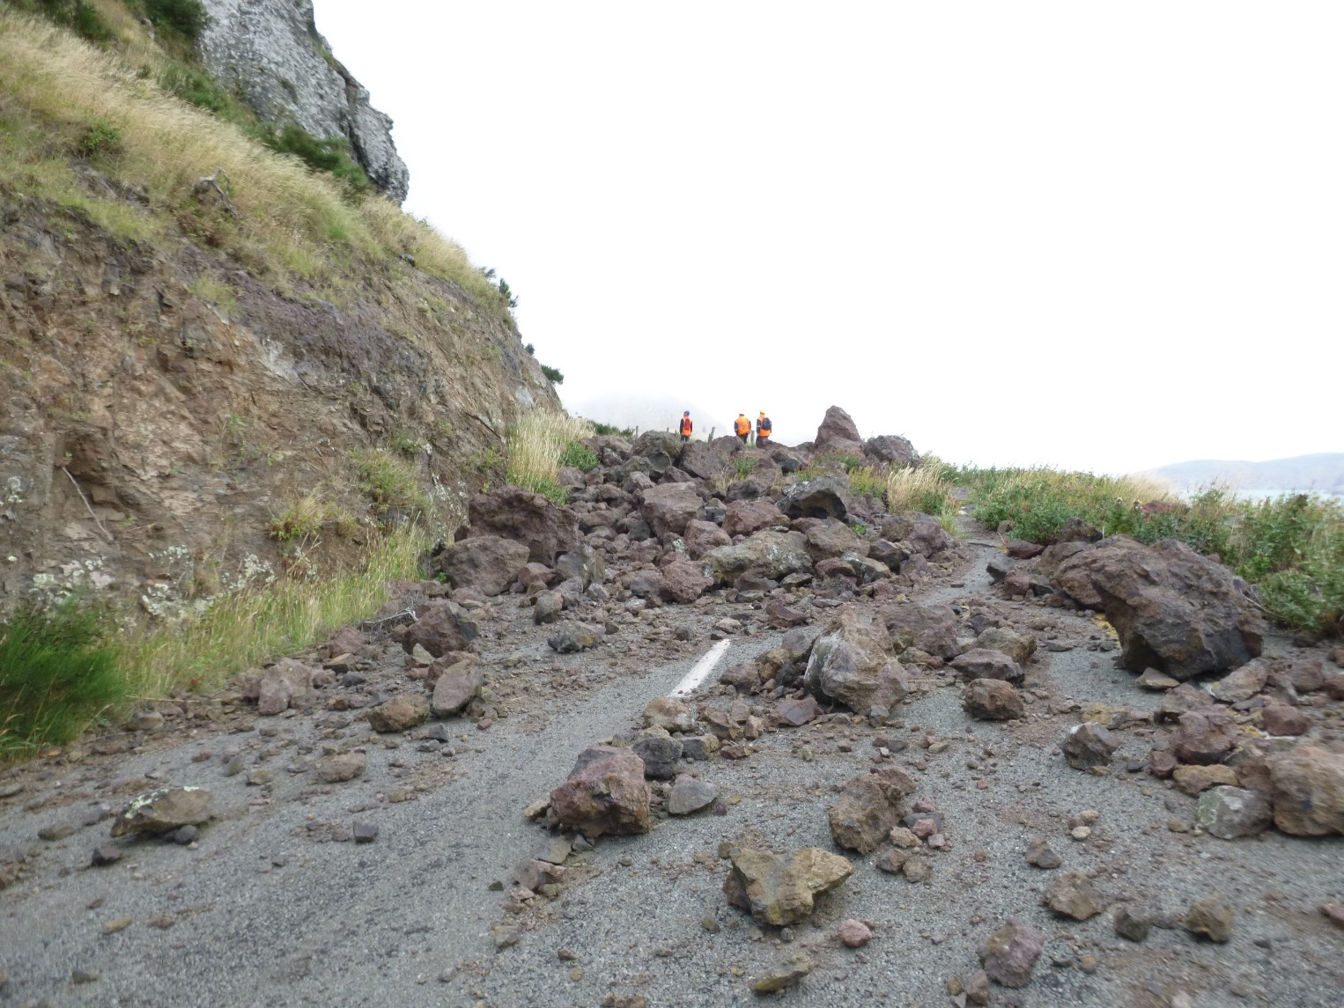
Earthquake Damage
Notes:
Photos taken during one of my first site visits in 2016.
Rock about a lane width in diameter
A number of locations where smaller rocks fell

Slide 9
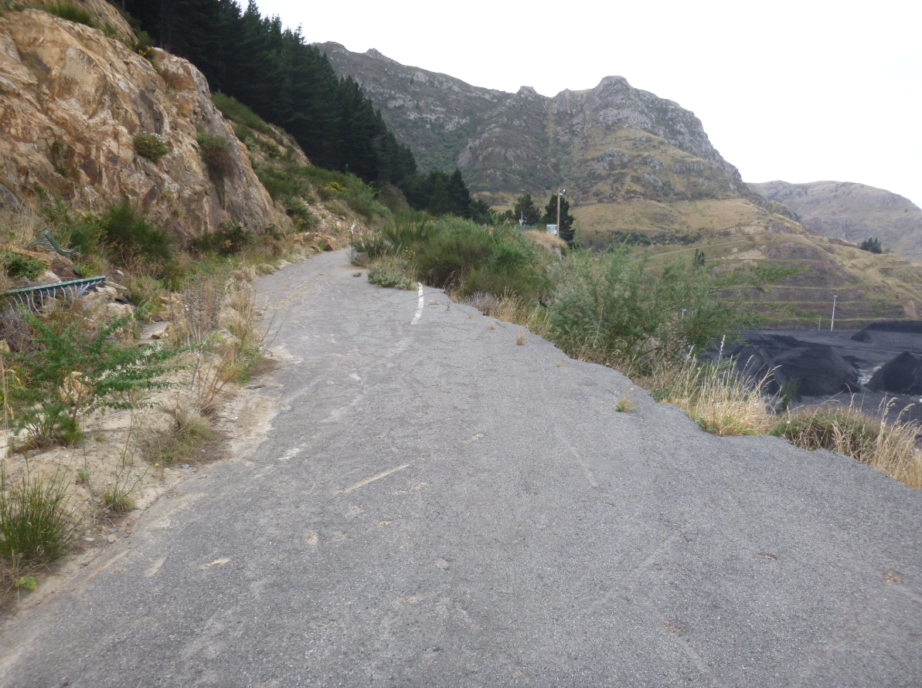
Road Centreline
Notes:
Retaining walls collapsed and moved
Retaining wall at Windy Point which took out more than one lane of the Road.

Slide 10
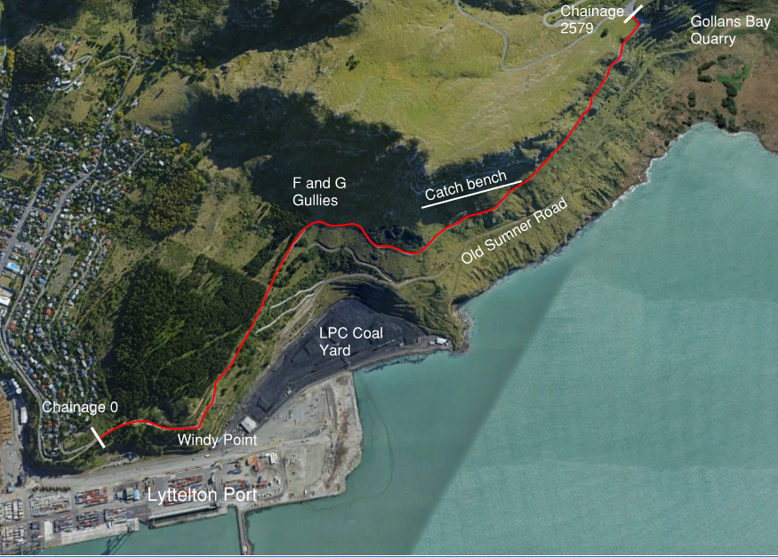
Notes:
Prioject extends from Lyttelton in the south-east to Evans Pass.
Below southern section is the Lyttelton Port Company land as well as their coal storage yard.
Alongside Evans Pass is the Gollans Bay Quarry which I will talk about later.
Below the whole site is land owned and used by Lyttelton Port Company:
Port
Coal Yard
Gollans Bay Quarry below Evans Pass.

Slide 11
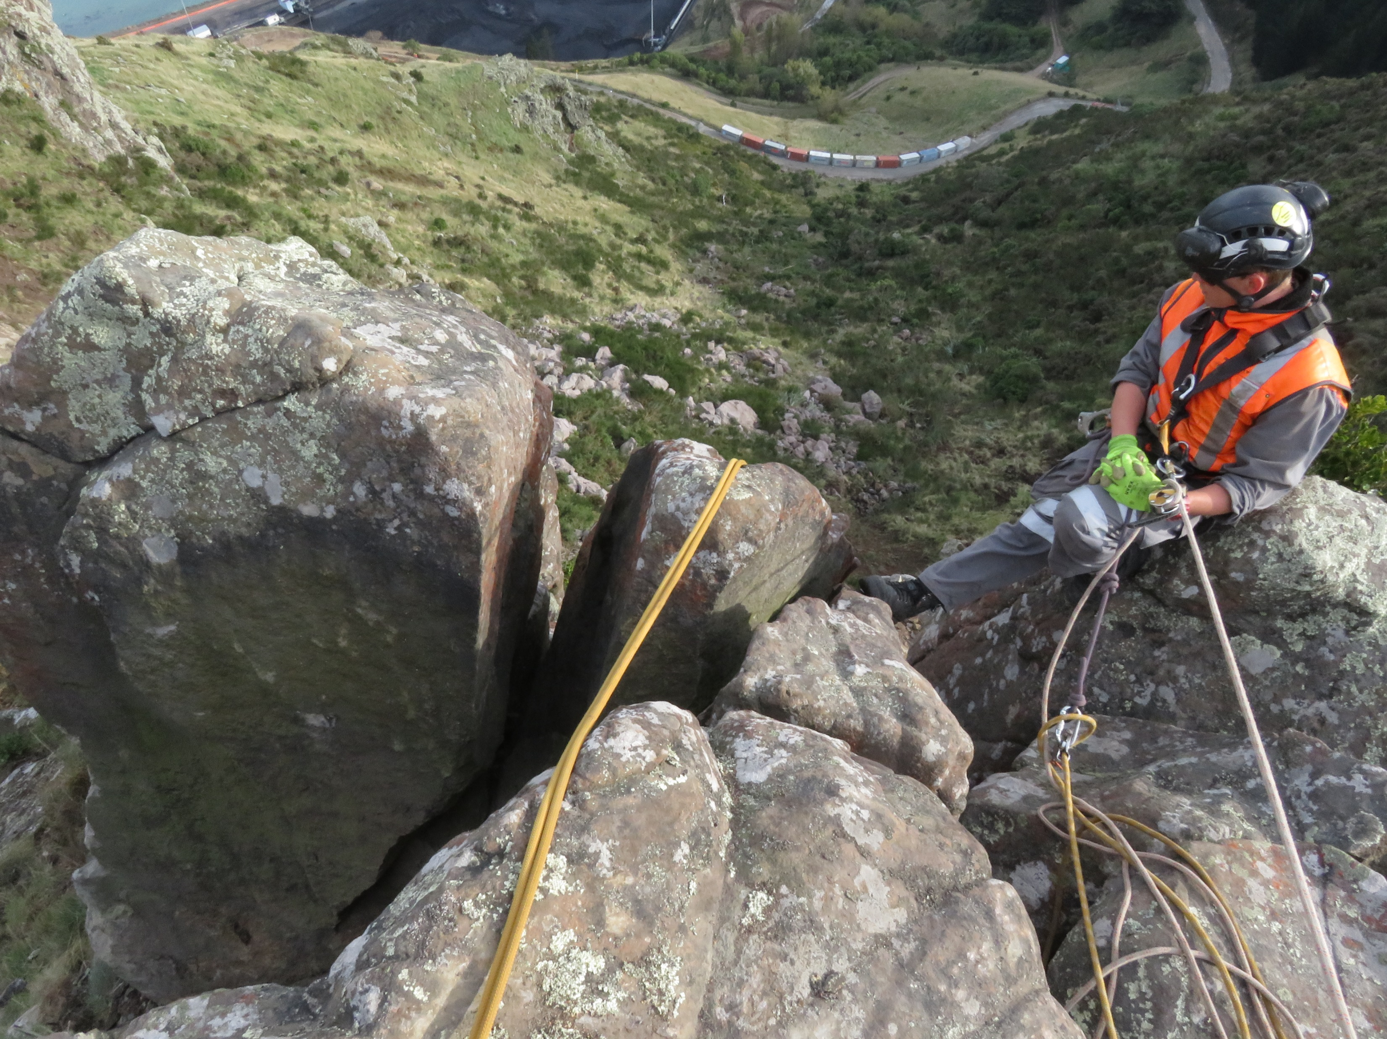
Geotechnical Hazard Mitigation
Rockfall Embankment
Rock Scaling
Rock Cut
Notes:
Rock scaling – manual removal of rocks or blasting of rocks via specialist operators abseiling off the top of the bluffs
Windy Point- Rock cut back into the hillside and the road realigned to avoid building a significant retaining wall to support the road
Rockfall embankment – 7m high, 55 m long rock embankment
Catch bench –catch rocks which can fall from the cliffs above.

Slide 12
Catch bench
35 tonne excavator
Catch bench
Sumner Road
Image Source: McConnell Dowell
Notes:
Photo during construction of the catch bench
400m long 8 m wide bench
Designed to capture 95% of the rocks that fall from above. Still a rockfill hazard area.
Outer bund to retain rocks that may bounce
Bench grades towards the cut face as well as downhill towards Sumner Road.
Scale- In red is a 35 tonne excavator
Stormwater: concentrates flows in the order of 650L/s in a 100 year event from bench and catchment above.

Slide 13
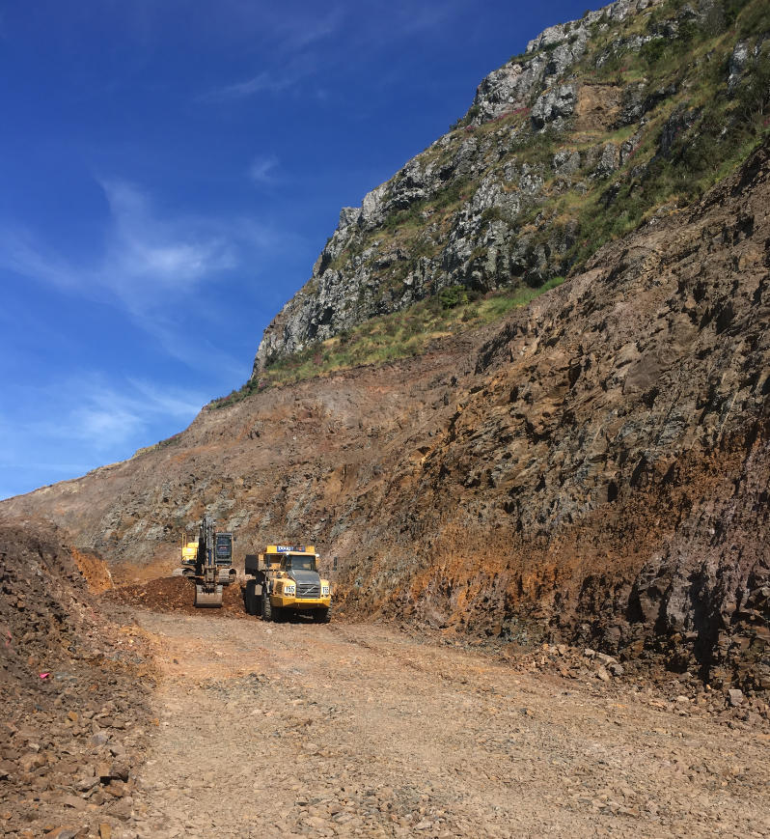
Notes:
View of catch bench prior to the construction of the drainage system.

Slide 14
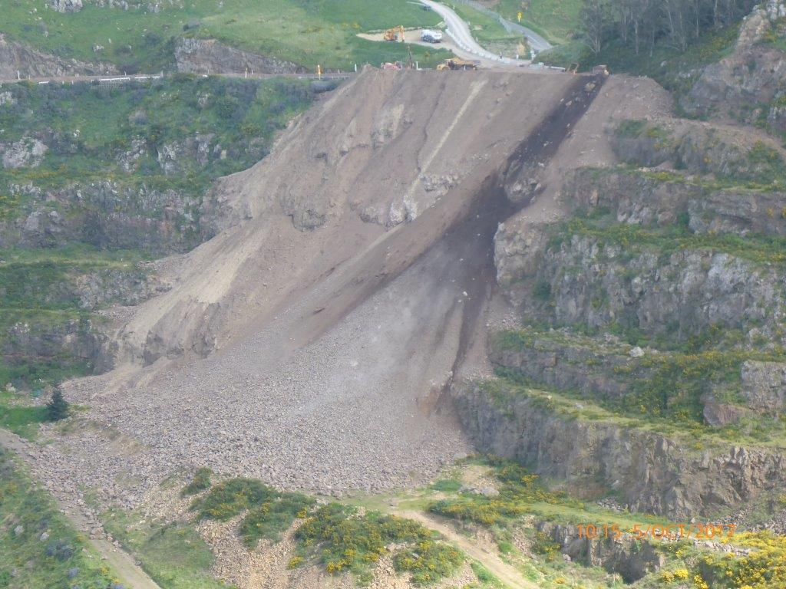
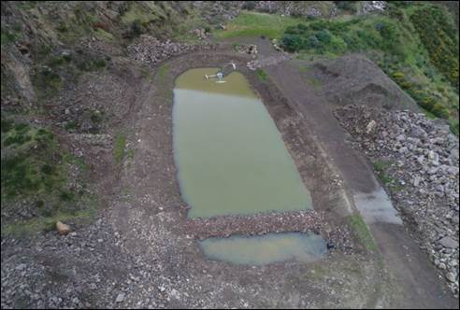
Sumner Road
Evans Pass
Sediment pond in base of quarry
Gollans Bay Quarry
Image Source: Doug Hood Mining
Notes:
100,000m3 of rock excavated to create the bench. This was transported up to the top of road, where it was tipped off the edge into Gollans Bay Quarry.
A sediment pond was constructed in the base of the quarry to manage the discharge of sediment to the harbour below.

Slide 15
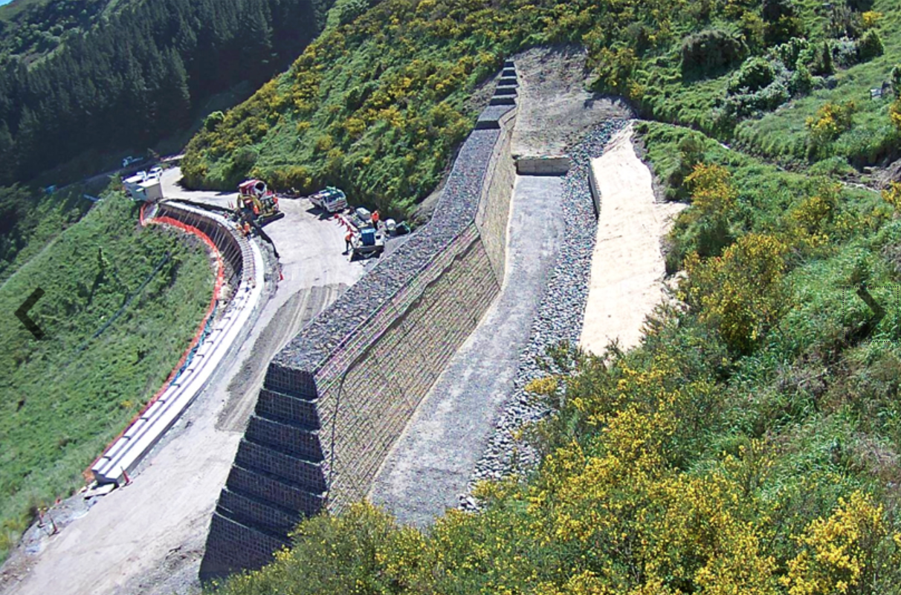
Rock Embankment
Image Source: McConnell Dowell
Notes:
Rockfall embankment to catch rocks from the cliffs above
Need to convey flow from gully above.
Blockage risk so couldn’t have inlets behind the bund
Channel around and inlet structure into culvert under the road.

Slide 16
Stormwater Design
New Assets:
Catch Bench
Flumes
Pipes/Channels
Rockfall Embankment
Rock Cut
Notes:
In terms of the stormwater design for the project, will most of the existing assets damaged, a range of new assets needed to be designed.
Later I will go into more detail on:
Catchbench drainage
Rockfall Embankment drainage
Pipes
Flumes and associated energy dissipation structures
Other Assets
Ch100 U channel
Channels the full length of the road
Kerb along parts of the outside of the road.

Slide 17
Key Design Challenges
Multi-disciplinary design environment
Narrow road
Large concentrated flows in several places
The need to mimic pre-earthquake flow patterns
Steep slopes
Highly erodible loess soils
Managing cycle safety
No or minimal maintenance required
29 Retaining walls (1 to 5m high) to manage drainage along/over
Notes:
Design in this environment has required detailed understanding of and collaboration with other disciplines. Changes to one aspect of the design can cause significant issues for another discipline.
Geotechnical, pavements, roading design/road safety, structural and stormwater design
Narrow- minimal room for fitting in structures in a lot of places
Large flows on steep highly erodible slopes- a recipe for issues without careful management
Mimicing pre eq flow patterns. LPC have been upgrading Old Sumner Road to access their quarry, requiring that we keep discharge locations as similar to existing as possible.
Loess soils- key feature is that with concentrated flows or exposed soil, readily erodes due in part to their low permeability. Prone to rills, gullies and tunnel gullies, as can be seen in a number of locations along the road.
Cycle safety, a key component of the design.
Maintenance- particularly the catch bench but the remainder of the road remains a rockfall risk area so minimal or no maintenance was key
Retaining walls – 29 of them ranging in size between 1m high and about 5m high. Managing stormwater drainage over and along these was a critical component

Slide 18
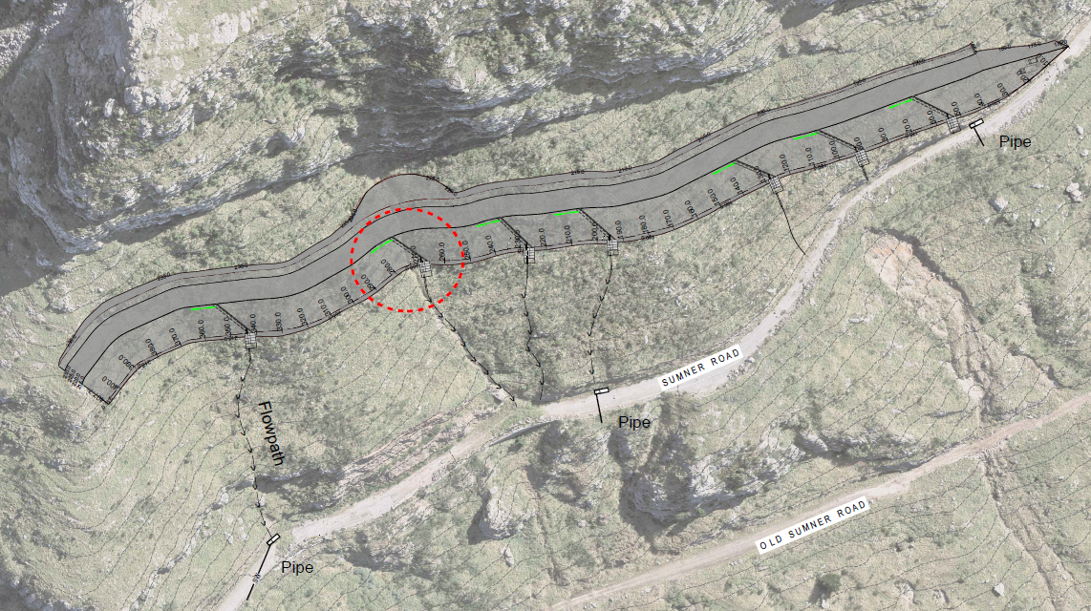
Catch Bench
Notes:
Distributing flow as per pre earthquake
Needed to discharge down the slopes below without compromising the rockfall mitigation outer bund
650L/s in a 100 year event

Slide 19
Catch bench drainage
Catch bench face
Outer bund reinstated with gabions
Porous trench lined with Concrete Canvas
Porous bench/trench
Subsoil pipes x 2
Solid pipe under bund
Notes:
0.5m of crushed rock bench
Porous trench to pick up stormwater flow through and along bench
Discharge under the bund and onto slopes below

Slide 20
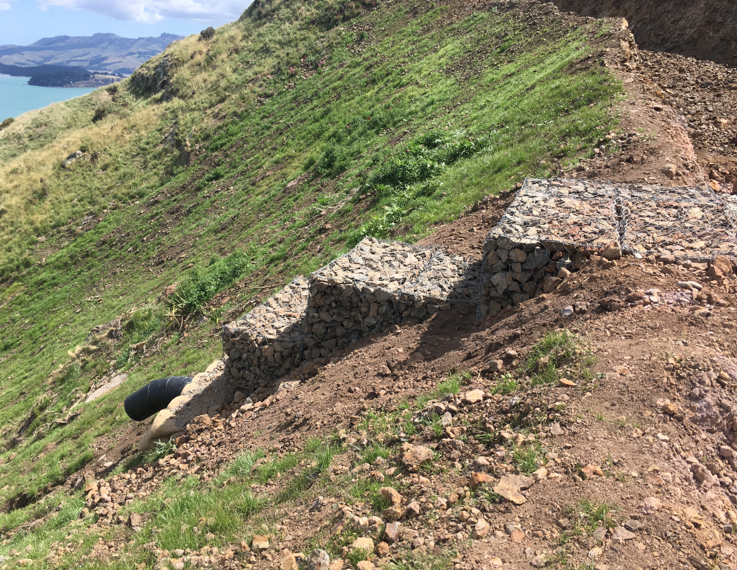

Slide 21
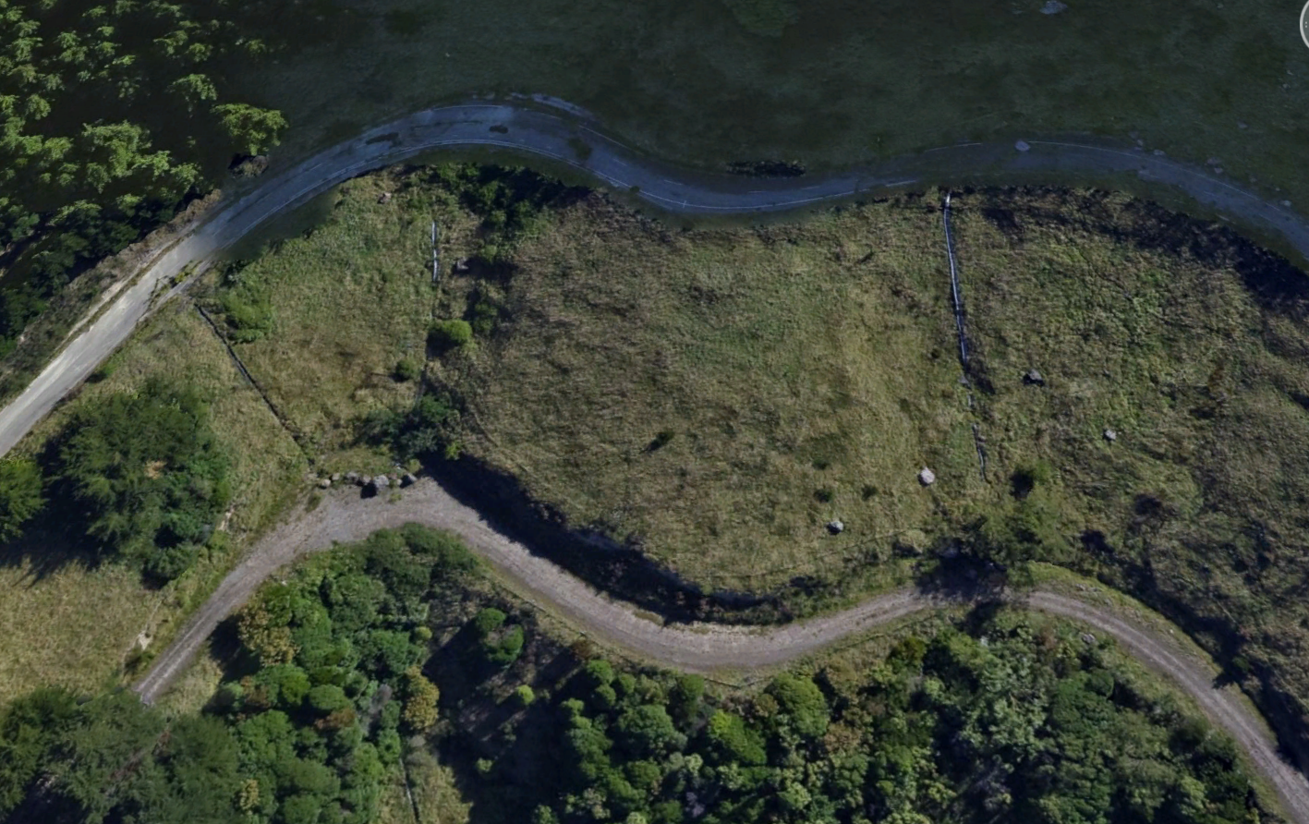
Flumes
Sumner Road
Existing Flume Locations
Existing Channel
Old Sumner Road
Notes:
In central part of the road there are two large gullies where three existing flumes conveyed flows from culverts under Sumner Road down Old Sumner Road below. Into channel along side.

Slide 22
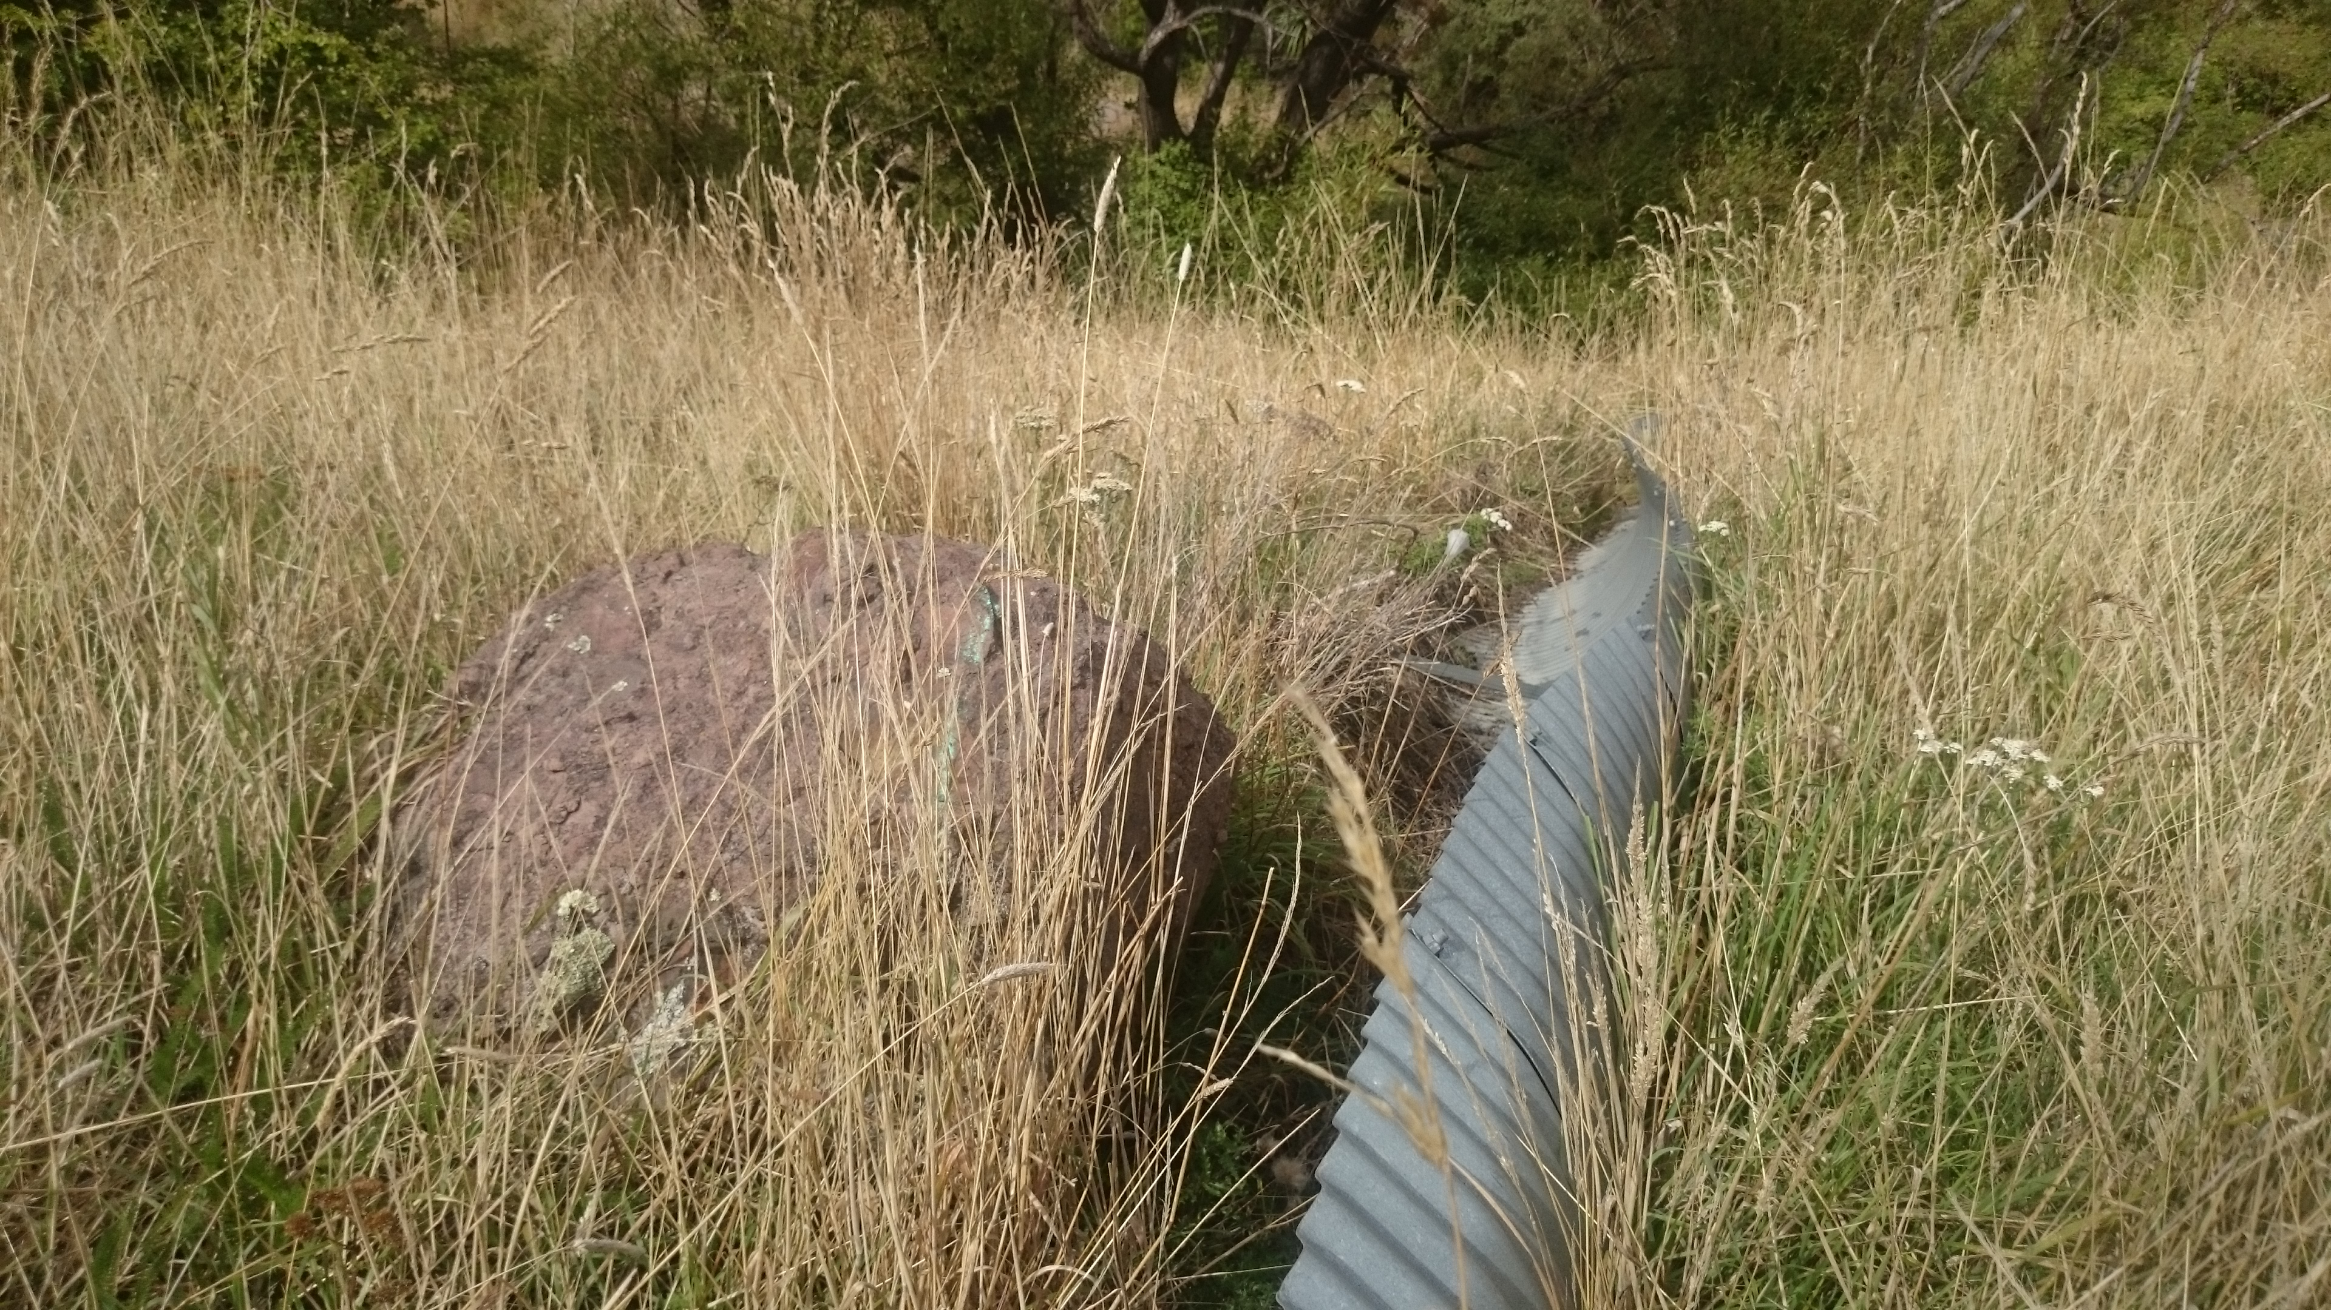
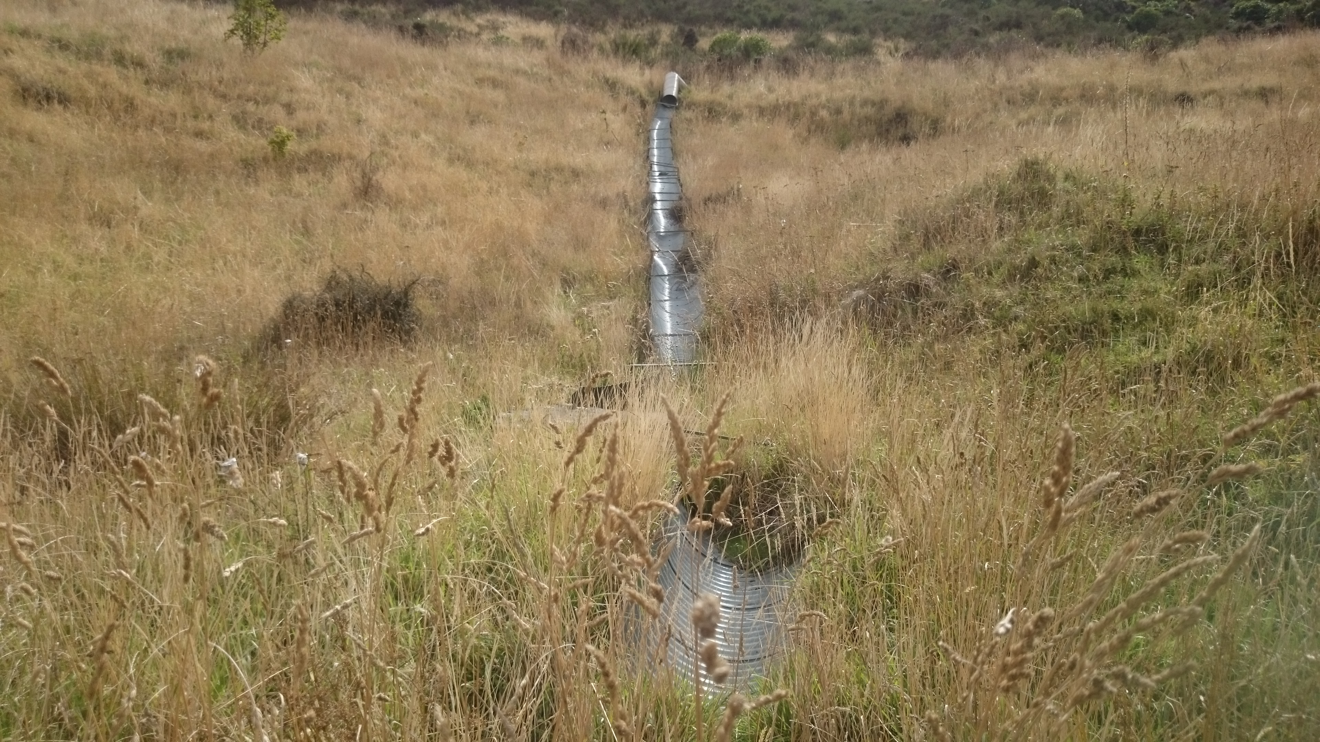
Existing Damaged Flumes
Notes:
Existing flumes were corrugate galv held by a basic waratah system
Flumes warped in the earthquake and were damaged by rocks. Leaking then caused erosion issues underneath.
Erosion also occurred as water seems to have funnelled along the underside
Wanted an above ground rigid structure more capable of withstanding earthquake movements.

Slide 23
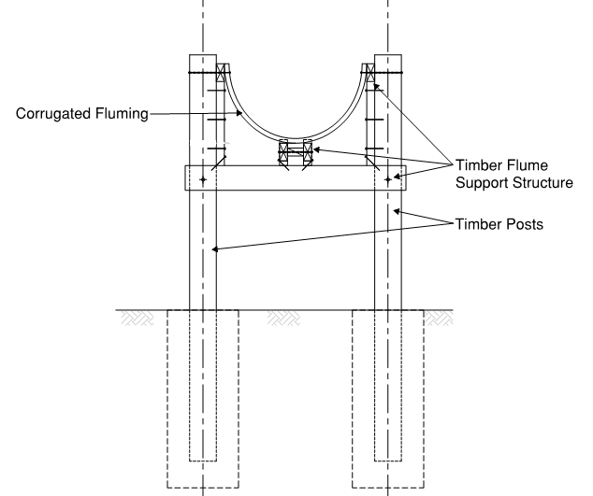
Flumes
Notes:
Material selection
Galvanised flume. Alternative PE was expected to be subject to 10 times higher thermal expansion, making it hard to pin at the sides for rigidity.

Slide 24
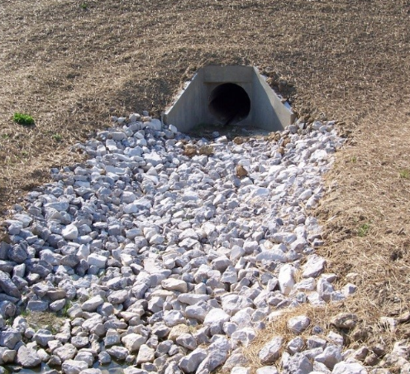
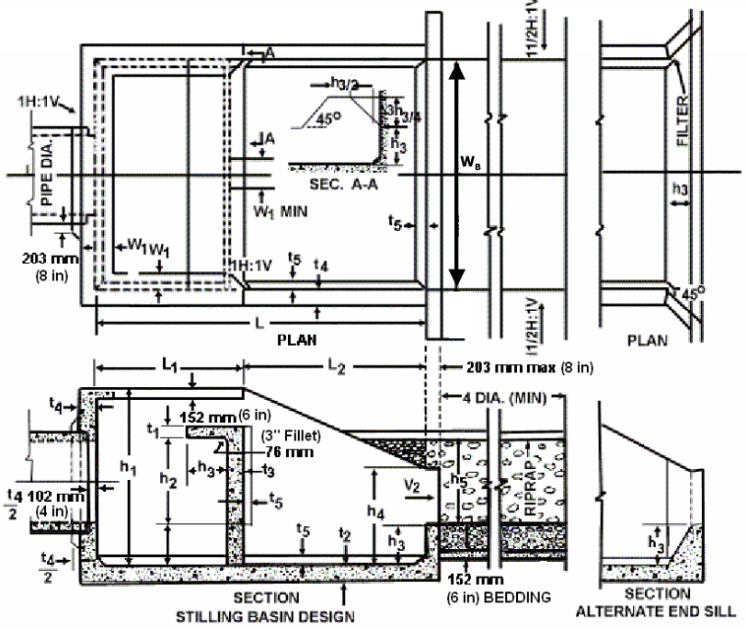
Energy Dissipation Structures- Traditional
Rip Rap
(Fr < 3)
Stilling Basin
Baffle Blocks (Fr <1)
Notes:
Design of Energy Dissipation Structures
600L/s in a 5 year event- Velocity of 7m/s
Selection based on Froude Number.
Rip rap- placement of appropriately sized road at discharge point. Not recommended for Froude number greater than 3.
Baffle Blocks- wedges of concrete or rock in a channel- number, size and spacing specific to location. Not recommended for Froude number greater than 1.
Stilling basin – concrete block with an internal wall which creates a turbulent flow with water coming out over the wall
Our flumes had FR between 4 and 6:
Needed substantial structure along the lines of a stilling basin.
Needed flow to exit structure perpendicular to flume direction and so that flow could pass through it from channel in which it sits.
Designed a bespoke structure

Slide 25
Final Structure
Flow
3 culverts joined
Pipe stub in side of culvert
Flow
Notes:
Final design included three concrete culverts (contractor used manholes) on their sides.
Flume entering through side.
Flow from existing channel can also flow through.

Slide 26
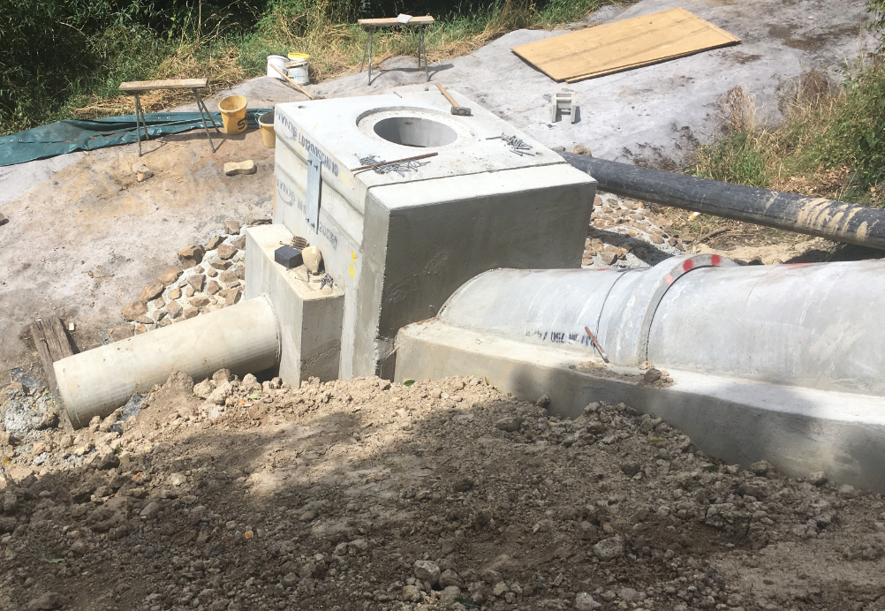
Alternative Energy Dissipation Structure Design
Sealed manhole
Longer inlet pipe stub
Flexible flume will connect here
Notes:
In another location further down Sumner Road, the Energy Dissipation Structure discharged flow onto a Lyttleton Port Company bench.
In addition to dissipating energy LPC requested that the flume discharge into a flexible flume to take it further down the bench.
To generate enough head to drive to flow into this flexible pipe, we lengthened in the inlet pipe stub and sealed the manhole structure.

Slide 27
Large Capacity Inlet Structure
High inlet capacity: 200L/s +
Narrow
Cycle safe
Shallow: Minimal rock blasting
Debris Management: Back entry
Notes:
Upper part of the road needed to replace existing culverts and discharge into the same/similar locations as pre earthquake. Due to climate change and higher rainfall intensities, we needed to discharge approximately 200L/s at each culvert.
Needed a pipe inlet structure that fitted a constrained environment.

Slide 28
Proprietary Inlet Structures
Checked each structure using HEC-22
Capacity based on longitudinal grades and road cross-fall
Sag location = higher inlet capacity
Maximum capacity stated by suppliers is often for a sag
Recommend checking these yourself
A number of proprietary structures had capacity but none met other site constraints
Notes:
Had a detailed look at all the proprietary inlet structures on the market.
Checked each using HEC-22 – a design guide written by the US Federal Highways Administration
This highlighted that maximum stated capacity is normally for a sag situation where you have higher head and hence higher inlet capacity.
Checking these yourself as the inlet capacity can often be much less for a specific situation.
Based on our specific constraints none of these structures could work and hence we did our own design which included a grate and a back entry

Slide 29
Grate Inlet Capacity
Notes:
Designed based on HEC 22 guideline- Urban drainage systems
Capacity of grate is a function of its length, the flow and road longitudinal fall and cross fall. Some frontal flow and some side flow.
Similarly, the back entry inlet capacity relates to the back entry length and the road long fall and cross fall.

Slide 30
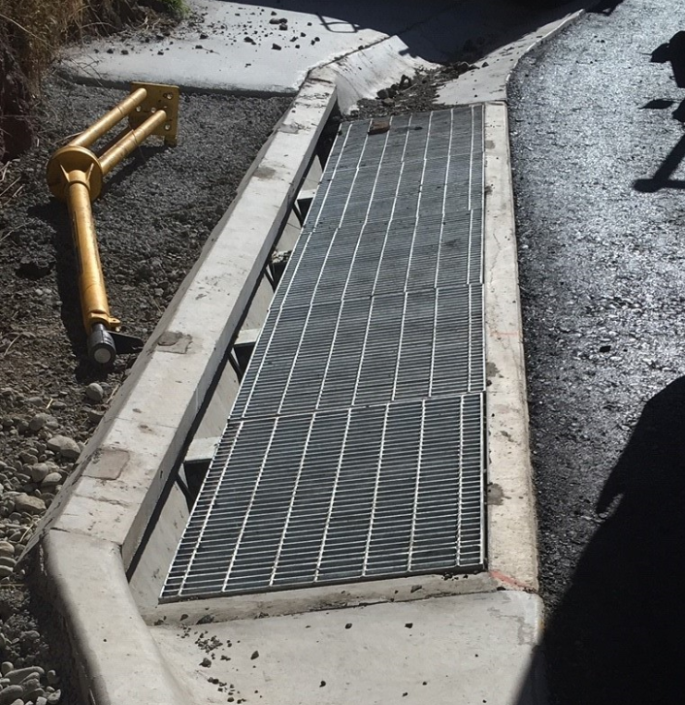
Final Product

Slide 31
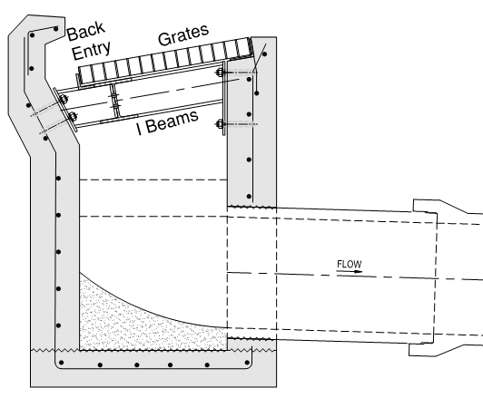
Long-section
Cross-section
Notes:
Accounting for blockage risk – resulted in a 5m long structure given it could only be 600mm wide.
Needed Structural input

Slide 32
Summary
Complex and constrained environment
A range of design challenges
Multi-disciplinary collaboration
Key geotechnical hazard mitigation measures
Rock scaling
Catch bench
Rockfall embankment
Key stormwater features
Catch bench drainage
Flumes and energy dissipation structures
Large capacity inlet structures

Slide 33
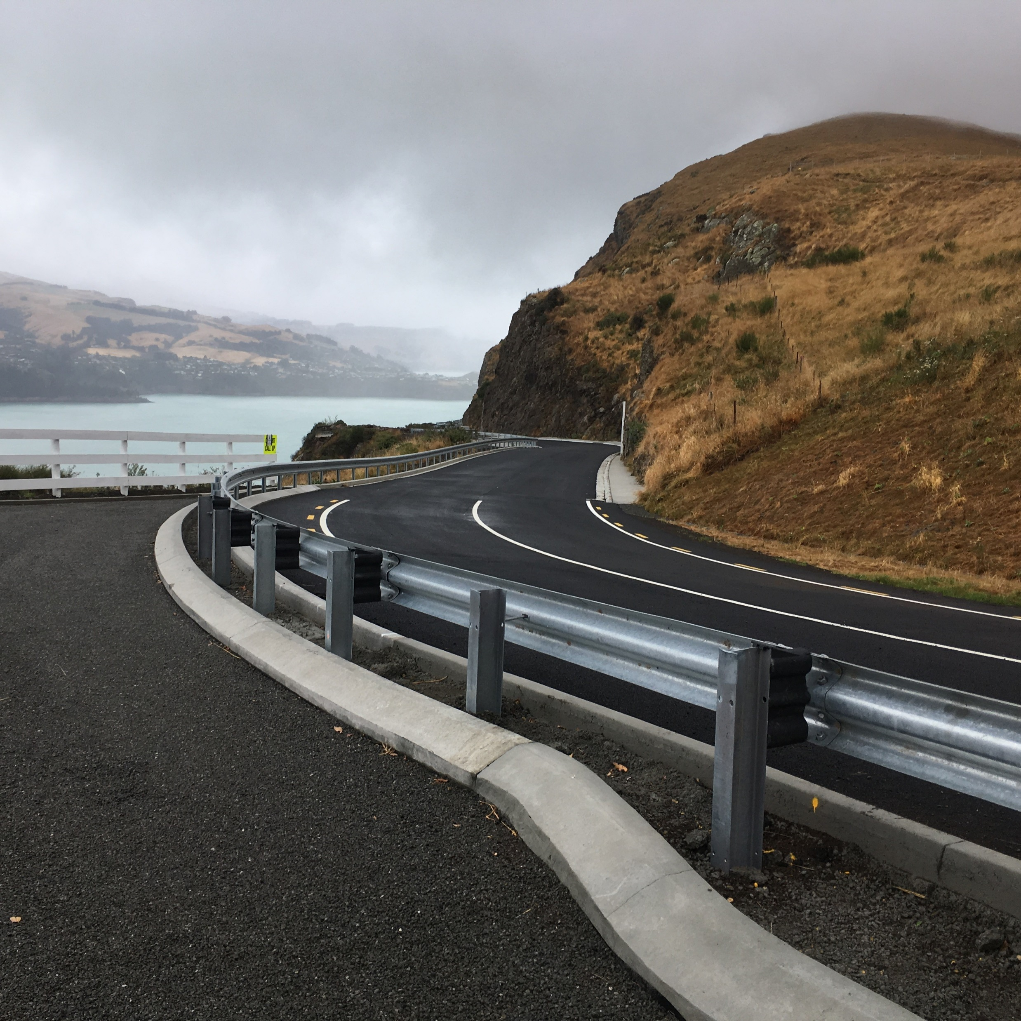
Conclusions
An important road brought back to life
No or minimal maintenance
A safer road
Remember there is still a rockfall risk!
View along Sumner Road from Evans Pass.
Notes:
This key project to Canterbury
- Brought an important road back to life
- Is robust and requires minimal or no maintenance
- Safer for traffic including cyclists
I am really passionate about this road and really proud of my contribution.
I have ridden it quite a few times already and look forward to many more years of riding along it.

Slide 34
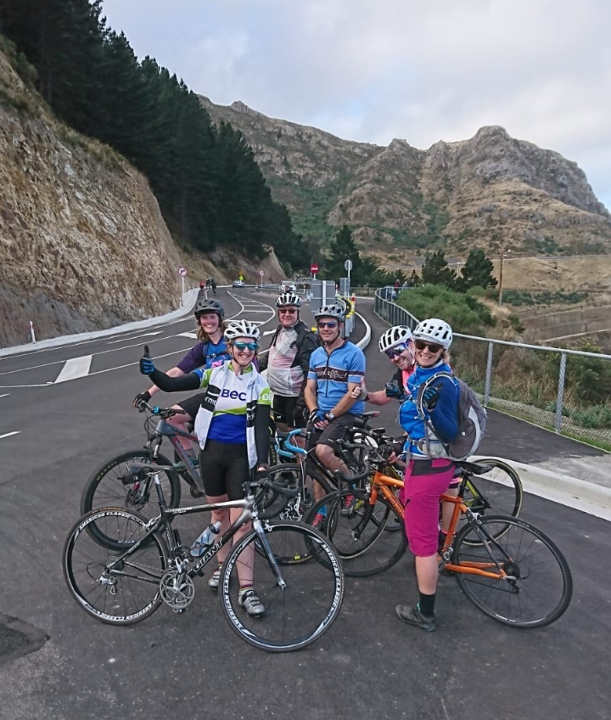
Any questions?
angela.pratt@beca.com
ME☺

