Slide 1
Waikato Stormwater Management Guidelines Brian Richmond and Megan Wood

Slide 2
Guidelines
Two new WRC guidelines released July 2018:
Waikato Stormwater Management Guideline
Waikato Stormwater Runoff Modelling Guideline
Key drivers:
National Policy Statement for Freshwater
Vision and Strategy for the Waikato River
Waikato Regional Policy Statement
Healthy Rivers: Proposed Plan Change 1

Slide 3
Why new guidelines?
Replace use of Auckland Council guidance TP10 and TP108 in the Waikato
Important that WRC has own guidelines relevant to the Waikato Region
Reflect Waikato conditions: soils, receiving environments, rainfall, drainage areas, regulatory framework
Ability for WRC to update guidelines as required
Important that guidelines are used across the region to ensure consistency with design practice

Slide 4
Waikato Stormwater Management Guideline
Builds on TP10 and guidelines prepared for Bay of Plenty Regional Council, Hawkes Bay Regional Council, Tauranga City Council and NZTA.
Prepared by Earl Shaver (author of the above guidelines)
Urban focused
Provides guidance to engineers, planners, developers and contractors in selecting, designing, constructing and maintaining stormwater management systems for urban growth.
Promotes a low impact / water sensitive design approach

Slide 5
Objectives
Primary objectives:
Removal of contaminants from stormwater
Reducing peak discharges
Reducing stormwater runoff volumes
Prevention rather than mitigation:
Low impact design (minimise earthworks, reduce impervious areas)
At source control of contaminants (swales, bioretention, soakage)
Treatment train approach
Protect and enhance existing natural features (gullies, streams, wetlands)
Promotion of stormwater management through integration with development:
Incorporate existing natural site features
Limit site hydrological change
Integrate stormwater management into the built form

Slide 6
Design criteria
Generally the same as TP10 with some extras discussed in the next slides
Water quality treatment is always required
Extended detention is required if discharging to a watercourse vulnerable to erosion
Flow attenuation is required as follows:
In the upper half of a catchment provide peak flow attenuation for the intermediate events (2 and 10 year ARI events)
In the lower half of a catchment, flow attenuation generally isn’t required for the intermediate events depending on downstream conditions
If there is downstream flooding, attenuate to 80% of the pre-development peak flow for the 100 year ARI event

Slide 7
Differences to TP10
Stormwater management to be based on receiving environments
Focus on low impact design (low impact design scoring matrix)
New volume control criteria
New water quality treatment criteria for lake catchments
Contaminant load model included to be used to assess sites
Re-vegetation included as a stormwater management practice
Soil conditioning is included to mitigate soil compaction
Various new sections: industrial sites, rural drainage areas, rural residential development and retrofitting stormwater into existing built up areas.

Slide 8
Receiving environment management prioritisation
Receiving system | Flooding issues | Stream erosion issues | Water quality
Streams | May be a priority depending on location within a catchment | High priority if the receiving stream is a natural, earth channel | High priority
Rivers | Generally not an issue | Generally not an issue | High priority
Floodplains | Peak flows need to be considered downstream of development | Channel stability is considered as an issue of concern | Moderate priority
Wetlands | High priority | High priority | High priority
Ground | Not an issue depending on overflow | Not an issue | High priority
Karst areas | High priority | Not an issue | High priority
Estuaries | Not an issue | Not an issue | High priority
Harbours | Not an issue | Not an issue | Moderate priority
Open Coast | Not an issue | Not an issue | Moderate priority
Lakes | Could be an issue if increased stormwater runoff increases lake water levels, even temporarily. | Tributary and outlet channel stability needs to be considered | High priority
Geothermal areas | Not an issue | Not an issue | Protecting existing land cover in areas adjacent to geothermal areas

Slide 9
Low impact design scoring matrix
Tool to encourage uptake of low impact / water sensitive design
Scoring matrix to be submitted with consent application
Different scores earned depending on:
Use of source control (water reuse, minimising earthworks, reducing impervious surfaces, protecting existing natural features)
Use of LID stormwater devices (infiltration, revegetation, bioretention, swales and filter strips)
Use of traditional mitigation (wetlands, ponds, proprietary devices)
Developments need a score of at least 15* to be acceptable (highway projects to score at least 8). *Target varies depending on site characteristics and design criteria.

Slide 10
Implementation elements | Typical components | Maximum Individual score | Total score for each item
Source control maximised | Water reuse | 0-4 depending on % of runoff capture
 | Site disturbance reduced from a conventional development approach | 0-3 depending on % of runoff capture
 | Impervious surfaces reduced from a traditional approach | 0-3 depending on % of runoff capture
 | Use of building or site materials that do not contaminate | 0 or 1 for residential 0-3 for commercial or industrial
 | Existing streams and gullies located on site (including ephemeral) are protected and enhanced. The entire stream other than possible crossings shall be protected to qualify for points. | 0 or 3
 | Riparian corridors are protected, enhanced or created | 0-3
 | Protection and future preservation of existing native bush areas | 0-2 depending on percentage of site area
LID stormwater practices used | Infiltration practices to reduce runoff volume | 0-6 depending on % of runoff capture
 | Revegetation of open space areas as bush | 0-3 depending on % of site covered
 | Bioretention | 0-6 depending on % of runoff capture
 | Swales and filter strips | 0-3 depending on % of runoff capture
 | Tree pits | 0-6 depending on % of runoff capture
Traditional mitigation | Constructed wetlands | 0-4 depending on % of runoff capture
 | Wet ponds | 0-1 depending on % of runoff capture
 | Innovative devices | 0-1 depending on % of runoff capture
 | Detention ponds (normally dry) | 0
 | Stormwater management is designed to be an integral and well considered part of the urban design | 0-2
Total score
LID
scoring
matrix

Slide 11
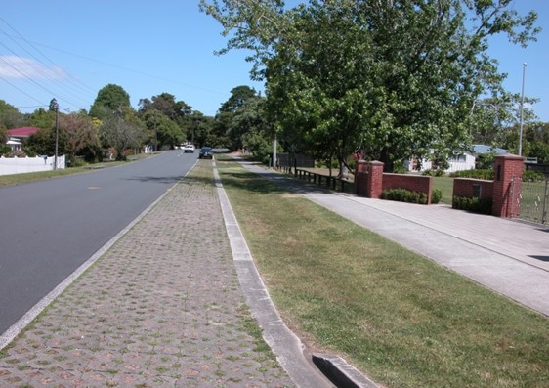
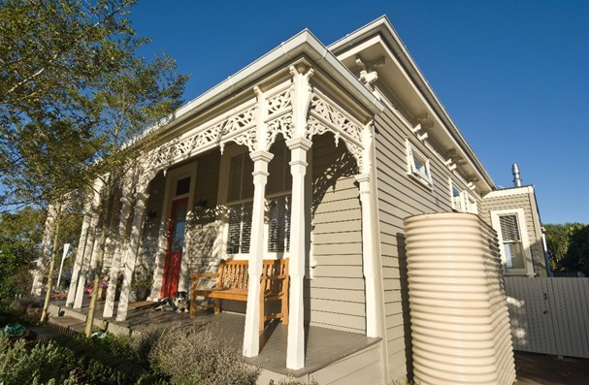
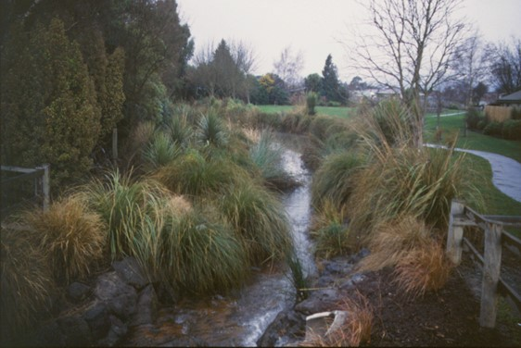
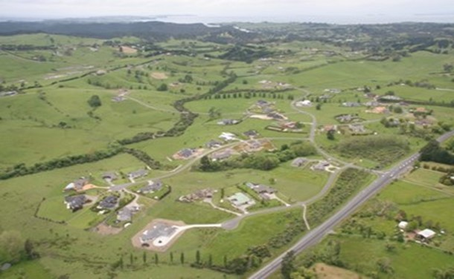

Slide 12
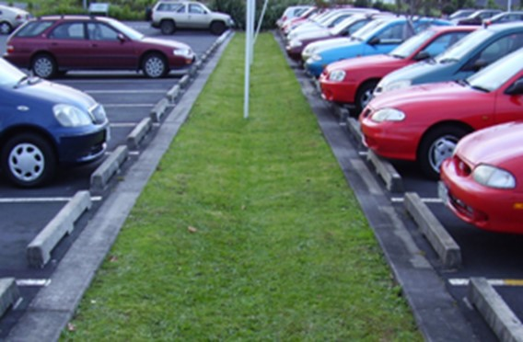
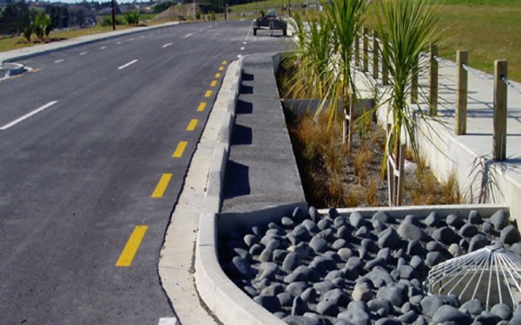
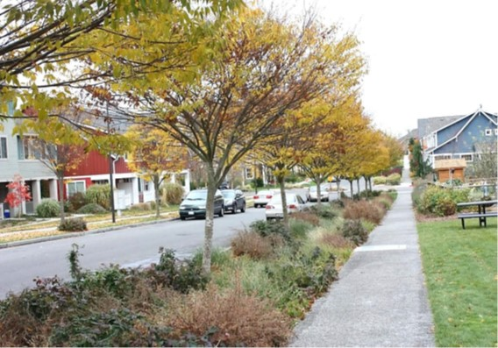
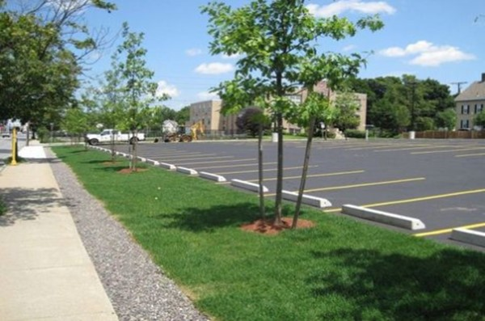

Slide 13
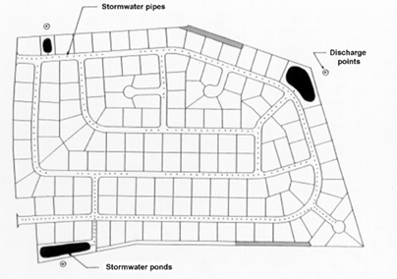
Low impact design scoring
142 lots, average lot size 1,000m²
Reduced impervious areas and earthworks, swales, infiltration and vegetation retained
Scores 20 points
142 lots, average lot size 2,000m²
Piped reticulation and stormwater ponds
Scores 2 points

Slide 14
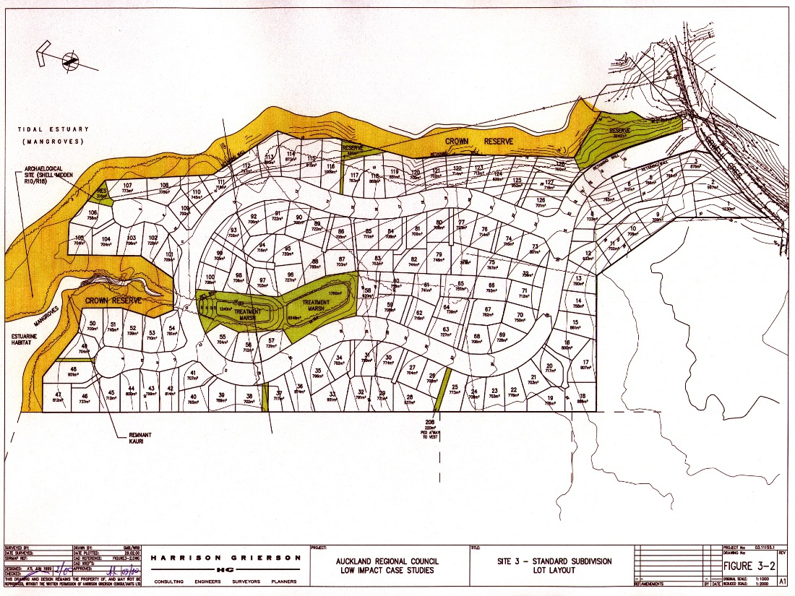
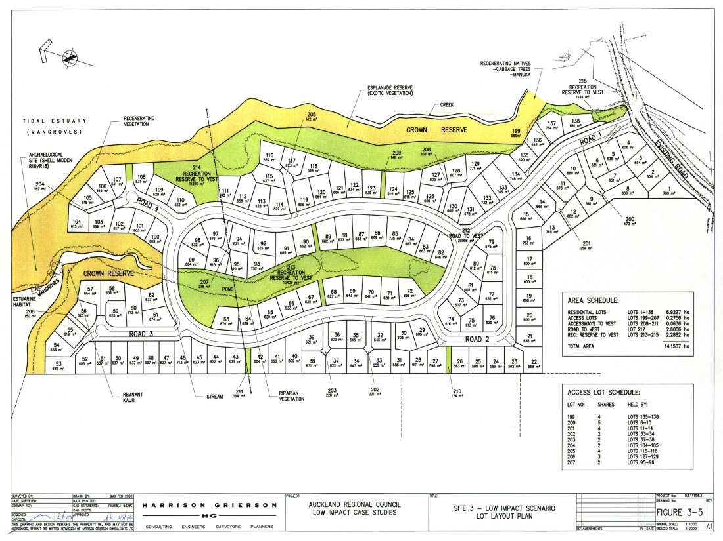
Low impact design scoring – urban setting
138 lots, average lot size 651m², 7.6ha of earthworks, site imperviousness 51%, two wetlands
Scores 16 points
128 lots, average lot size 766m², 9.6ha of earthworks, site imperviousness 69%, wetlands Scores 5 points

Slide 15
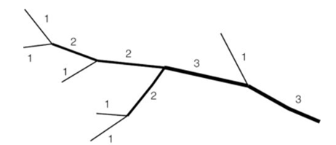
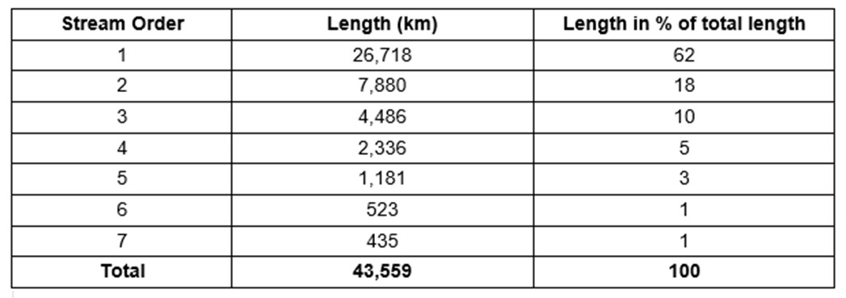
Streams and rivers in the Waikato

Slide 16
Volume control criteria
New volume control criteria applies when extended detention is required to mitigate stream erosion potential
Volume control criteria: Retain the initial abstraction volume to offset impervious areas
The initial abstraction volume is the amount of rain that soaks to ground before the rainfall turns to runoff. This has changed in our Waikato guideline compared to TP108.
If pervious areas aren’t being remediated to reinstate permeability, need to retain initial abstraction volume for the whole site (pervious and impervious areas)
Retention: reuse, soakage, bioretention

Slide 17
Water quality treatment in lake catchments
In the Waikato we have lakes, in varying condition
Most are peat lakes which are nutrient enriched from historical and existing land use
Adequate water quality treatment is required in lake catchments to ensure that lake condition doesn’t deteriorate
New water quality treatment criteria: Two devices in series are required for lake catchments
To achieve nutrient removal the first device should rely on aerobic removal processes (swales, filter strips, bioretention). The second device should focus on nutrient removal via denitrification in an anaerobic environment (wetlands, bioretention to a lesser extent).

Slide 18
WRC rural drainage areas
A section on WRC administered rural drainage areas is provided
WRC administers 92 drainage areas across the region. District councils also administer their own drainage areas.
Informal drainage networks that have developed over time to primarily manage groundwater, to enable farming of land.
The land and drainage networks are privately owned. WRC manages the networks on behalf of the landowners who pay a targeted rate for the service.
Level of service: runoff from a 10 year ARI event is drained within 3 days to avoid pasture loss

Slide 19
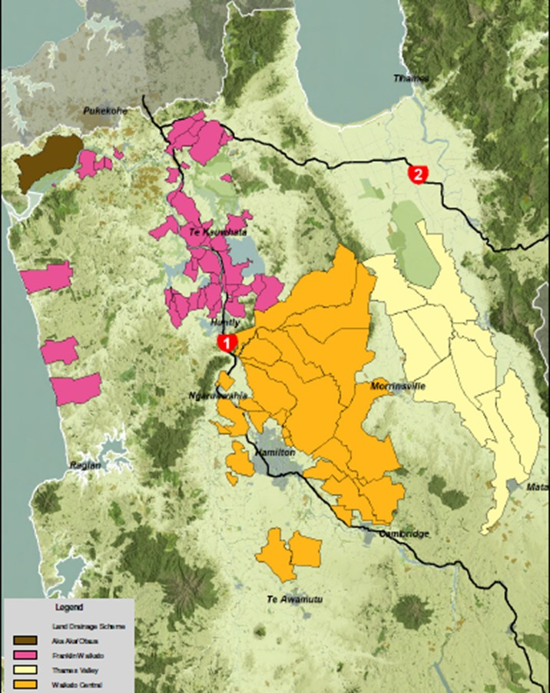

Slide 20
Rural drainage areas
Rural drainage systems not designed for urban flows
Some are located where urban areas are expanding hence difficulties arise
Guideline outlines the issues to be considered, and provides design criteria for urban growth proposing to drain to WRC administered rural drainage areas and information requirements.
Design criteria:
Total volume of runoff for the 10 year ARI event to match pre-development runoff volume
Runoff depth released for the 10 year ARI event to have an extended detention time of 72 hours
Water quality treatment to be provided

Slide 21
Waikato Stormwater Runoff Modelling Guideline
To be used to assess site hydrology
Based on Auckland Council’s TP108 but more Waikato specific
Written by Earl Shaver and reviewed by lead author of TP108
Changes made based on updated information from the USA
More up-to-date, robust and scientifically correct for the Waikato
Soil testing is required to determine the soil group
The assessment of initial abstraction has changed
Time of concentration calculation has changed

Slide 22
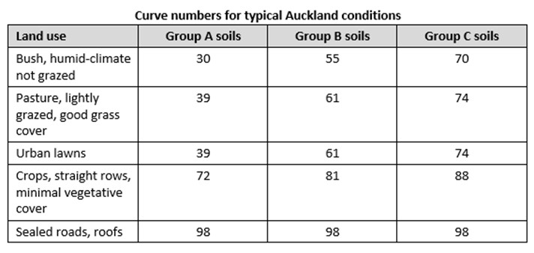
Hydrological soil groups
Four soil groups are provided in the Waikato guideline (A - D)
This table is not used in the Waikato guideline. Soil testing is required to determine soil group.
Soil group depends on site conditions:
Soil type
Infiltration rate
Depth to impermeable layer
Depth to water table

Slide 23
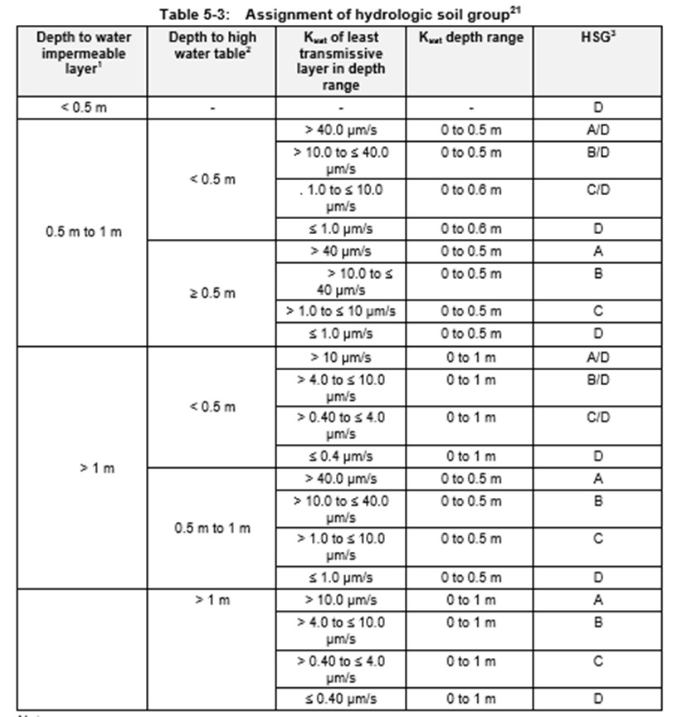

Slide 24
Initial abstraction
Initial abstraction is the amount of rain that soaks to ground before the rainfall turns to runoff
For Auckland soils it was determined that it was appropriate to have constant values of 0 for impervious or 5mm for pervious surfaces
The Waikato has a wider variability in soil types hence initial abstraction is to be determined using the following equation:
Where storage is calculated using the same equation as in TP108:

Slide 25
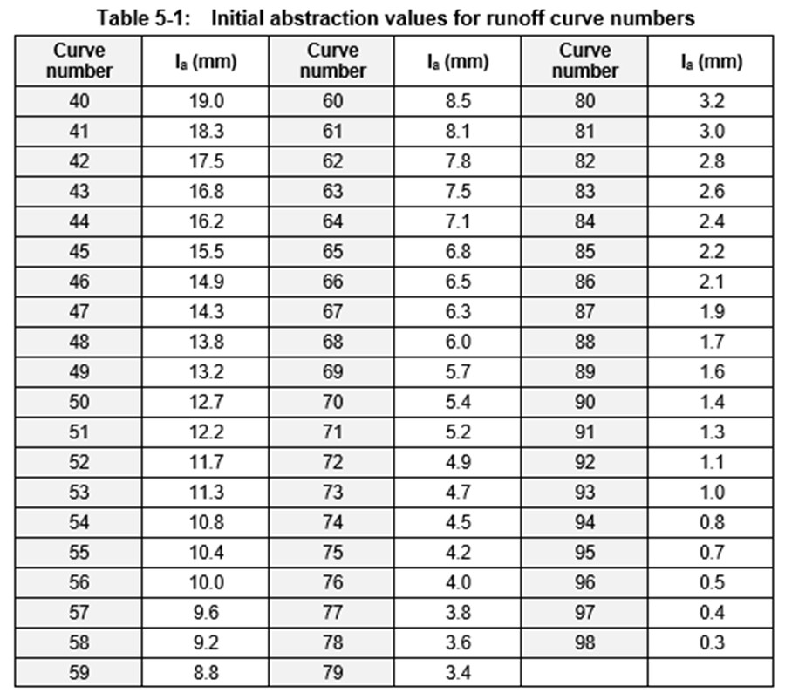

Slide 26
Initial abstraction
Important change in the context of stream channel erosion and links back to the new volume control criteria
Retention of stormwater that more closely represents pre-development conditions means less work done on the stream channel boundaries during rainfall events
Less channel erosion, particularly during smaller frequent events
More accurate representation of initial abstraction is important for assessing peak flows and runoff volumes
Shows more clearly how site imperviousness and soil compaction can affect stormwater runoff

Slide 27
Time of concentration
TP108 provides a regression calculation to assess time of concentration in Auckland, calibrated for Auckland conditions
WRC’s guideline requires that time of concentration is assessed using first principle calculations
Assess the individual flow segments at the site, determine T_{c} for each segment and add them all up (T_{c} = T_{t1} + T_{t2} + T_{t3} … T_{tx})
Equations are provided for the different types of flow: sheet flow, channel flow, road channel flow, piped flow.

Slide 28
Best practicable option (BPO)
BPO approach is emphasised throughout the Waikato Stormwater Management Guidelines
Using BPOs and following guideline design criteria provides the clearest pathway to gaining a consent
Guidelines are not statutory, outline recommended approach.
If a practitioner wants to use an alternative methodology, there is scope for WRC to consider it. However the practitioner must be able to demonstrate that it is robust and provides comparable outcomes when compared to the approach outlined in the guidelines.

Slide 29
Engagement
WRC undertook a number of workshops with practitioners during guideline development to provide information and to receive feedback
Targeted consultation was undertaken on certain sections for specific feedback
Both guidelines were peer reviewed internally and externally
The guidelines were released as draft for comment before release in July 2018
WRC is currently undertaking workshops with TAs to discuss guideline implementation and to seek feedback
Guidelines are being revised this year to make any needed tidy ups, for reissue before end of the year.
Comments can be provided on the guidelines via the WRC website, or email Brian or Megan
Both guidelines are being used across the region instead of TP10 and TP108 with good feedback to date

Slide 30
General comments
Waikato regulatory framework requires a change in how stormwater is managed
We need to protect and enhance waterways and waterbodies in our region
Need a shift away from the conventional approach: bulk earthworks and carving up sites into maximum lot yield with lots of impervious surfaces and a wetland at the bottom of the hill.
Conventional approaches are not providing adequate resource protection
We are generally seeing an improvement in what is being proposed for stormwater management in the Waikato which is good to see
Good feedback on both of the guidelines

Slide 31
Questions?

