Slide 1
Water New Zealand Conference
23 February 2022
Notes:
Tēnā koutou katoa
Nō Ingarangi ōku tipuna.
I whānau mai ahau i Ghana, Africa.
Heoi, i tipu ai ahau i raro i te maru o Taranaki Maunga,
Ki te taha o Waiongana iti awa, i raro i te mana o Te Atiawa.
Kei Te Whanganui-a-Tara au e noho ana ināianei me taku hoa Rangatira, Maggie.
Ko wai ahau? Ko Bill Bayfield, te Tumu Whakarae o Taumata Arowai.
I’m Bill Bayfield, the Chief Executive of Taumata Arowai, the new water services regulator for Aotearoa
It’s a pleasure to have this opportunity to speak to you today
This is a significant moment in time
I’ve spent the bulk of my career in local and central government working with the water services sector and in environmental management.
What I’ve seen is that critical three waters services can often be taken for granted – out of sight out of mind.
As a sector – It’s our chance to lift the performance and shine a light on these critical services - as a CE of a dedicated water services regulator - it’s a huge privilege to play a role in this.

Slide 2
Ko wai, ko au, ko tātou
Ko te wai ahau, ko ahau te wai.
He whakaaturanga tātau nō te wai.
Ko te ora te wai ko te ora o te tangata.
He taonga te wai me tiaki.
Ko wai tātou.
Ko wai tātou.
I am wai, wai is me.
We are reflections of our wai.
The health of te wai is the health of te tangata.
Wai is a taonga that must be protected.
Ko wai tātou.
We are wai. Wai is us.
Notes:
The heart of our mahi is very simple – it’s simply about people and water – tangata and wai – and their connection to one another.
It’s about making sure that everyone in Aotearoa can turn on their tap and trust what comes out is safe to drink. I think everyone can agree with that!
This whakatauki speaks to the heart of our role in the kaupapa of protecting the health of te wai and the health of te tangata, in balance; ko wai, ko au, ko tatou.
Each of us serve as a reflection point between tangata and wai to highlight the reciprocal relationship between the two.

Slide 3
Building the plane while flying it
Notes:
For the last year our aim has been to build a regulator that makes it as easy as possible for the sector to achieve that goal of safe water for everyone.
From our establishment in March 2020 till the commencement of the Water services Act 2021 in November we were intensely focused on getting ourselves ready to become ‘operational’.
Our small team worked very hard. And anyone that’s had the experience of starting a company can appreciate the learning curve that must take place.
It was like building a plane in mid-flight as our guiding legislation (the Water Services Act) was still taking shape and the three waters reform was constantly changing the environment below us – every week the specs shifted, and we had to pivot in a new direction.
But our orientation stayed the same – to build a regulator with te Ao Māori and the health of both tangata (people) and wai (water) at the heart. A modern regulator with a uniquely Aotearoa feel about it.

Slide 4
Our whakatauki
Karangahia ngā ope – Be the voice of welcome
Whāngaia te iwi – Sustain the people
Ka hoki kōmuri ngā whakaaro kia anga whakamua te titiro Turn our minds to the past to determine our way forward
Notes:
Having a te ao Māori perspective woven into the fabric of our organisation is important to us. We want to live and breathe our values intrinsically – and this is a both a challenge and an opportunity as we build our plane.
We’ve been really lucky to have been supported in this mahi. In particular by Shane Te Ruki, Lyn Harrison, Gannin Ormsby and Kura. Through them we were gifted whakatauki and wisdom that guide the way we work as a regulator.
These are our whakatauki that guide the way we want to be in the sector:
To be real and human – to welcome, to listen and respond.
To sustain the sector, with guidance, support and encouragement
To turn our minds to the past to determine our way forward – looking back to the Havelock North incident and others like it helps us to keep our focus on what’s important – it helps us keep our focus broad - to learn from overseas, to learn from our mistakes and others, and to track a careful path forward.
These are our promises to the sector and you should hold us to them.

Slide 5
Thanks for all your support
Notes:
Since November last year, when we went live as the water services regulator, we’ve been able to look up and out to the sector. We quickly realised that we’ve been treated and engaged incredibly generously and positively.
I’ve worked for a lot of regulatory roll-outs and I’ve never known such support.
Everywhere I turn I see the level of expenditure that people are either promising to deliver or delivering to upgrade drinking water supplies and lift the standards.
With such support from the sector, I think our job will be more about assisting and supporting suppliers and only occasionally needing to enforce compliance.
At the same time, we’re realising the size of the task and the complexity. Made even more complex by COVID, and the pace of change in the form of reforms we are facing as a nation.
But the water sector is well connected and coordinated. We’re up to the task! We’re extremely grateful to Water New Zealand for the part you play in keeping everyone together.
It’s a pleasure to work with people that are so willing and to have such a strong common goal. That’s a recipe for success. And it makes our job a pleasure.

Slide 6
Registering drinking water supplies
1,995 registered supplies were migrated from the Ministry of Health to Hinekōrako, our online self-service portal
Each supplier needs to log in to complete their registration with us
100% large suppliers registered
We’re working through re-registering 1,200 small registered suppliers
Congratulations and thanks for your support!
Notes:
Since we’ve been in operation we’ve navigated a series of challenges with your support
The first was registration. We received almost 2,000 supplies from MoH.
Every supplier needs to log in to our online portal, Hinekōrako, to complete their registration.
Our focus for the first year is large suppliers because they supply the largest populations and present the greatest risk

Slide 7
Verifying drinking water supplies
The data for every supply needs checking and validating in Hinekōrako. This is important because:
Consumers are relying on access to accurate information in the Public Register
Water carriers are relying on supplies to be verified so that they can access Hinekōrako and formally register
Large suppliers are working through their supplies
33% have verified all their supplies
Some are complex, some easy
Small registered suppliers are just starting this
Notes:
The second challenge is verifying supplies. The data we received from MoH was unreliable.
Suppliers need to log into Hinekōrako and check and verify the data for each of their supplies
This is important as it affects others – consumers and water carriers.
For some this is a simple task - for others it's complex
33% large suppliers have verified all their supplies
We’re working with some to overcome technical difficulties

Slide 8
Congratulations to those that have verified 100% of their supplies
As at 9am, 18 February 2021
Chatham Islands Council
Clutha District Council
Gisborne District Council
Gore District Council
Hurunui District Council
Kaikoura District Council
Kapiti Coast District Council
Napier City Council
Nelson City Council
New Plymouth District Council
Opotiki District Council
Ruapehu District Council
Southland District Council
Stratford District Council
Taupo District Council
Timaru District Council
Waimakariri District Council
Waipa District Council
Waitomo District Council
Westland District Council
Whakatane District Council
Whangarei District Council

Slide 9
A balanced regulatory approach
Focusing on protecting public health and supporting the water services sector to improve its performance and environmental outcomes
Assistance and support
Making sure what we ask is as simple, clear and cost-effective as possible
Incentivising good practice
Adjusting our response to the scale and nature of the risk
Notes:
With such a support from the sector, the trick is going to be navigating cleverly so we don’t make wrong turns or mistakes.
We’re taking a balanced and responsive approach – listening and responding.
Making sure what we’re asking is simple, clear and cost effective
Working together to avoid making mistakes or wrong turns
We want to incentivize good practice and dis-incentivize unhelpful behaviours
We will adjust our response to the nature and risk of the supplies we’re dealing with
Keep our eyes on the what’s important – people and water

Slide 10
Unregistered water suppliers
Unregistered drinking water suppliers have plenty of time. Up to four years to register and a further three years to meet the requirements of the Water Services Act 2021.
These timeframes provide an opportunity for Taumata Arowai to work with our unregistered community to understand their needs and circumstances.
Drinking Water Acceptable Solutions will provide ready-made options for certain supply types to comply with the Act.

Slide 11
We need your help to get it right
We are currently consulting on the following proposed documents:
Drinking Water Standards
Drinking Water Quality Assurance Rules
Drinking Water Aesthetic Values
Drinking Water Acceptable Solution for Roof Water Supplies
Drinking Water Acceptable Solution for Spring and Bore Water Supplies
Drinking Water Acceptable Solution for Rural Agricultural Water Supplies
Drinking Water Network Environmental Performance Measures
Your feedback will help to inform our decisions on the content of these documents. Submissions are open until 28 March 2022.
Have your say at Te Puna Kōrero – our engagement and consultation hub
(te-puna-korero.taumataarowai.govt.nz)
This is the first of many consultations.
Notes:
As you may be aware, we’re currently consulting on a number of documents, which will inform our first set of regulations as the water services regulator
The documents are targeted at drinking water suppliers and contain technical content that will guide the way safe drinking water is supplied to people in Aotearoa.
We need your help to shape and guide these documents
This is the first of many consultations – E.g. we can develop further Acceptable Solutions in the future.

Slide 12
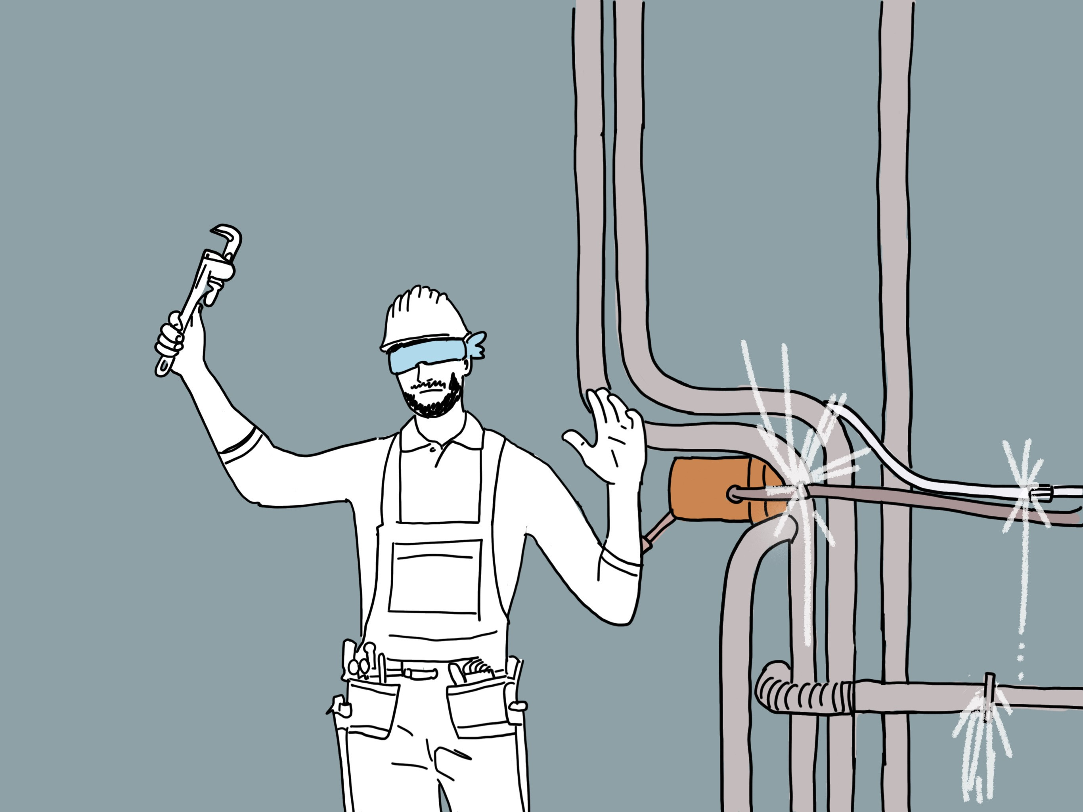
You can’t fix what you can’t see
Notes:
One of the documents we’re consulting on is a discussion paper on Drinking Water Network Environmental Performance, which sets out our proposed approach to commence monitoring the environmental performance of drinking water networks from 1 July this year.
As the picture shows – you can’t fix what you can’t see.
We need to start monitoring and collecting data so we can see what’s going on.
Having data means we don’t have to rely on throwing grass into the wind and hoping for the right outcome. It means we can baseline and measure performance over time to make sure we are all contributing towards a meaningful outcomes that we can all be proud of.
This kind of monitoring and reporting is common overseas. But it has not been here.
I think our proposed approach can make a big difference in protecting the health of te tangata and te taiao.

Slide 13
Next challenge for registered suppliers: drinking water safety planning
All registered suppliers need to submit a Drinking Water Safety Plan or comply with an Acceptable Solution by 15 November 2022
We’re hearing from consumers and iwi that they’re interested in how suppliers are preparing plans and considering source water management
Plans need to incorporate Te Mana o te Wai
We’ll provide templates and guidance for small suppliers
We’re all on a journey!
Notes:
All registered suppliers will need to get their revised drinking water safety plans (under the Water Services Act) to us by 15 November this year.
We’re hearing from consumers and iwi groups that they’re interested in how suppliers are preparing these plans and how they are going to consider and protect source water.
These plans need to incorporate Te Mana o te Wai. This is a journey for all of us to learn how we consider and weave the mana of the wai and tangata into the way we manage and consider water.
What this means is starting the conversation early
We’ll provide templates and assistance – Beca is helping.
There are roles for consultants in this

Slide 14
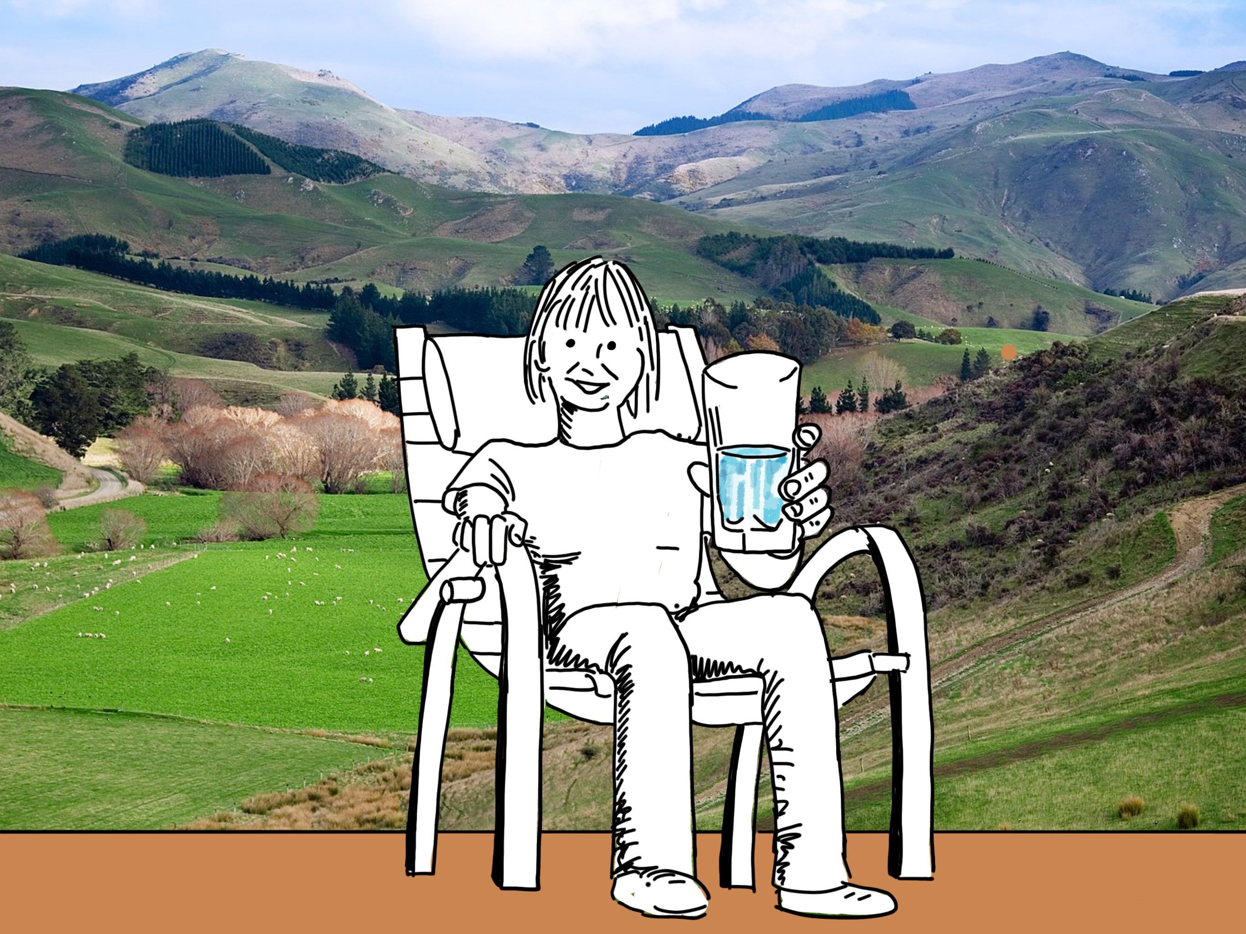
Next challenge for unregistered suppliers

Slide 15
What’s next?
Three waters reform will have a big impact on our kaupapa
Resource Management Act reform
Our wastewater and stormwater functions commence in 2023
We need to work closely with the Department of Internal Affairs, the Ministry for the Environment, local government, iwi and other stakeholders to understand these initiatives and work out how we fit with them successfully.
Notes:
The next challenge on the horizon is wastewater and stormwater. We’ll start engaging with that by the end of this year.

Slide 16
Notes:
That’s a slice of our journey so far – fast and exciting
I want to thank you again for your support
We’re all on this journey, learning together
It’s a pleasure to be supported by such a willing and generous sector
Thanks to Water New Zealand for all the work you do in bringing us together

