Slide 1
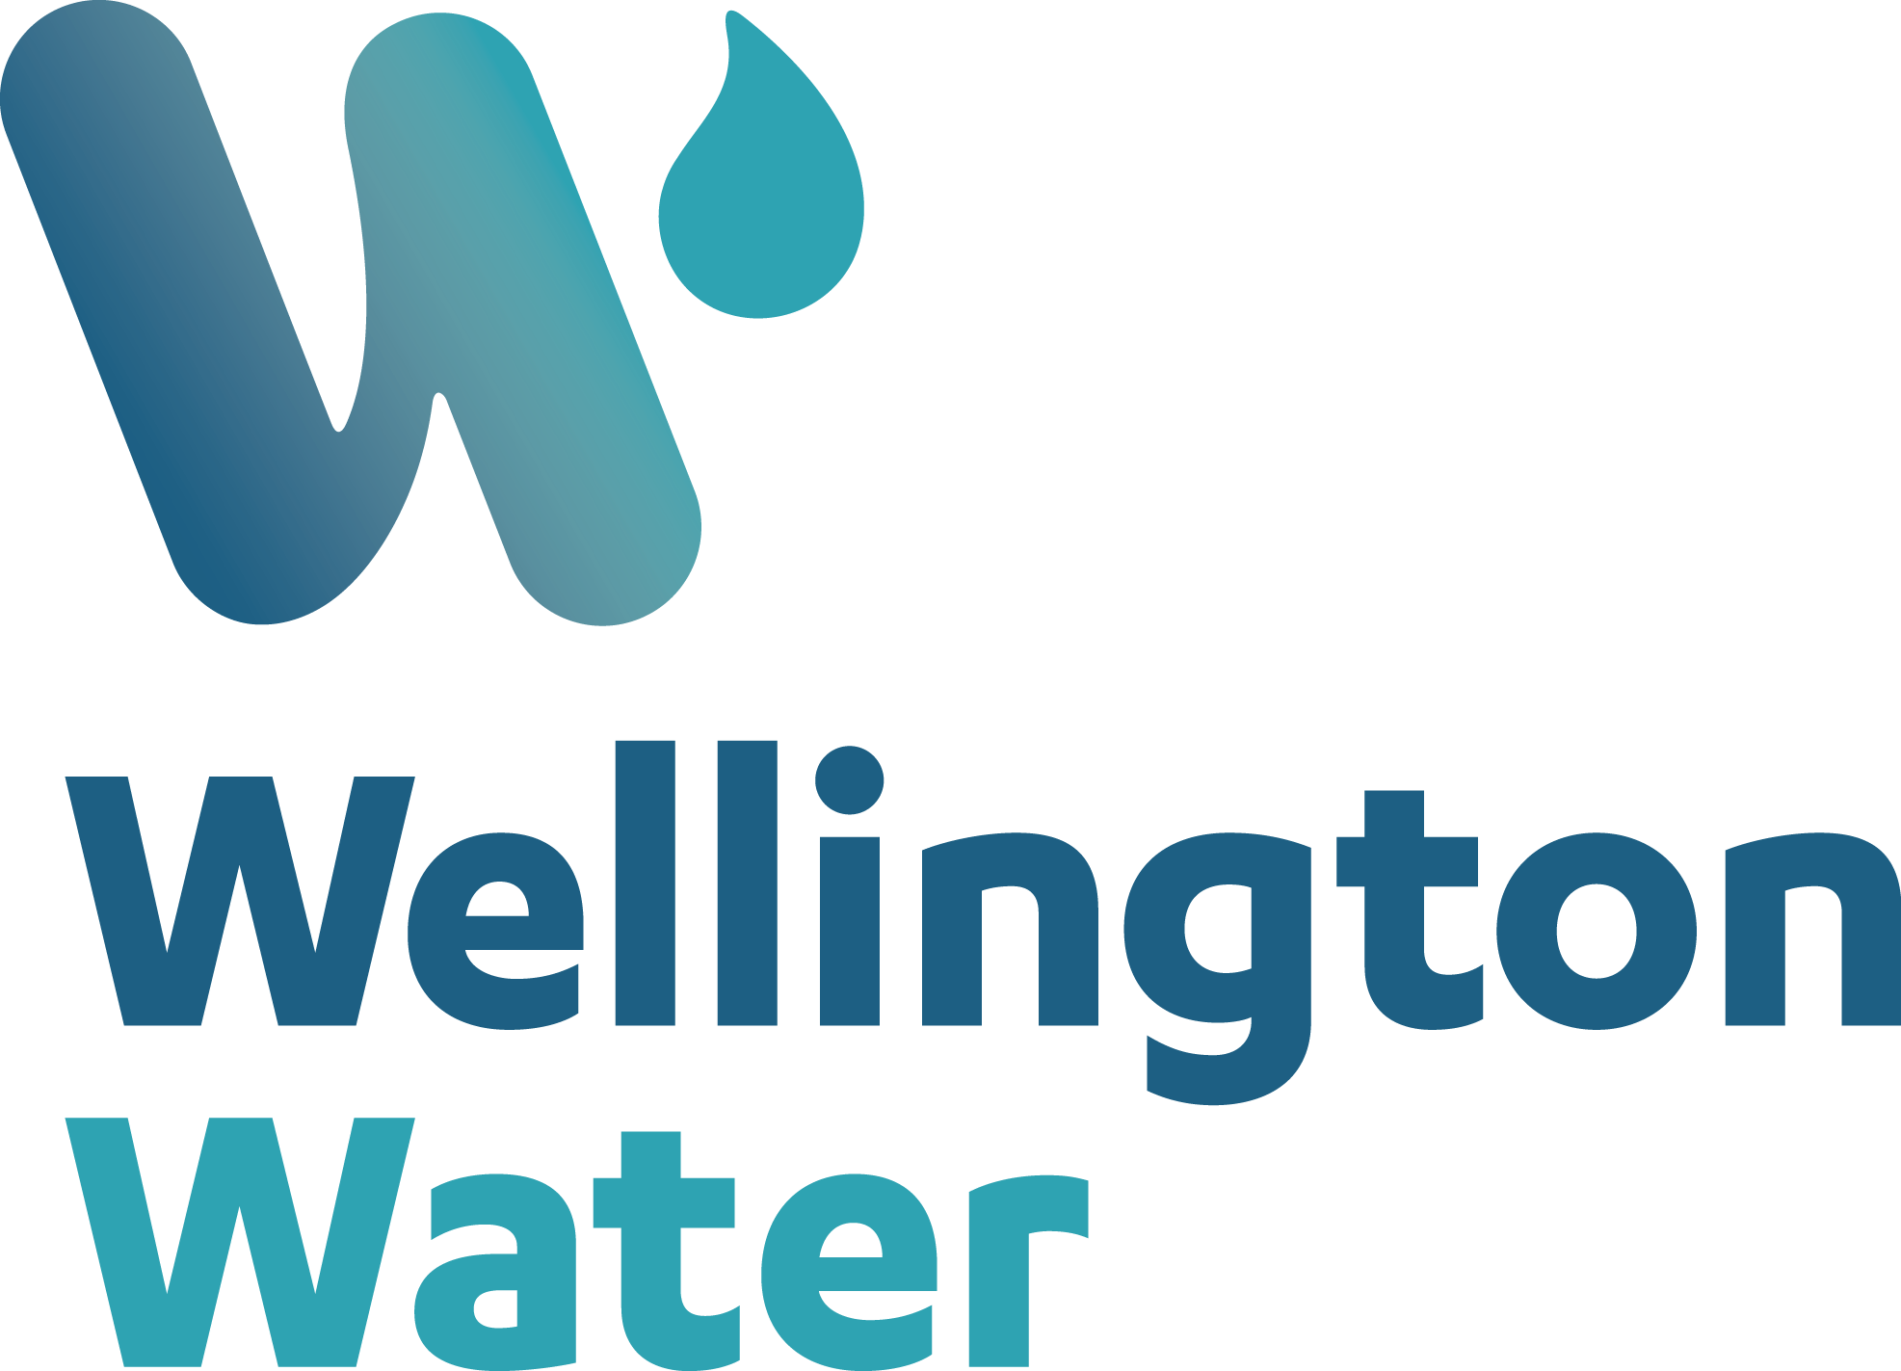
THE BENEFITS OF FORMALISED CONDITION ASSESSMENT PROGRAMMES FOR WATER UTILITIES BASED ON LESSONS LEARNED
Rob Blakemore
Wellington Water
Steve Apeldoorn
ProjectMax

Slide 2
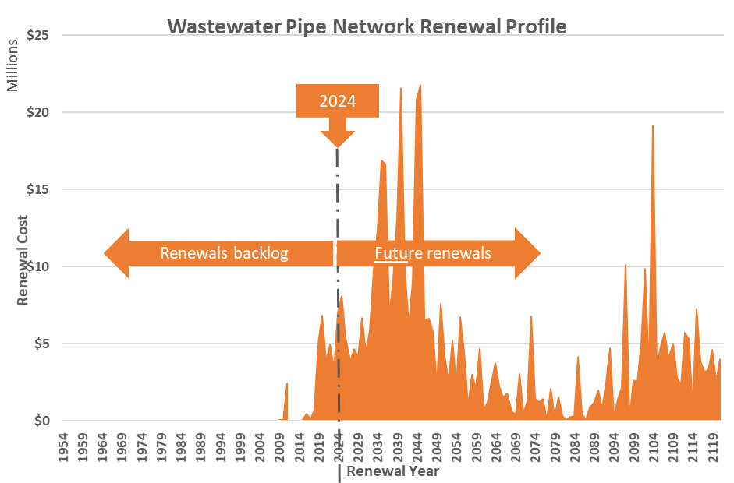
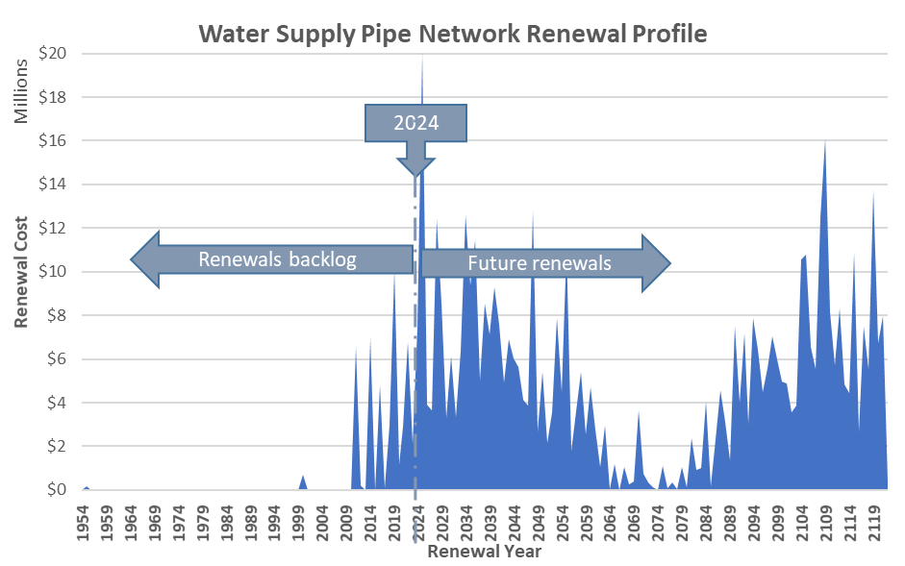
Renewal bow waves – fact or fiction?
Notes:
[Rob] There has been much discussion and even seminars at this very conference about the financial burden that may be imposed on NZ communities from future renewals. It has been described as the renewal bowwave
But is this renewal bowwave real?
Lets have a look at two medium sized councils theoretical renewal challenge for the future in water supply and wastewater
No matter what type of governance structure exists this financial burden (if real) will not go away.
We will be forced to understand with more detail how our assets are deteriorating, what will happen when they fail and how do we eke out the lives of these assets

Slide 3
Key Elements for Planning & Implementation
Notes:
[Rob]

Slide 4
Using Criticality
Criticality factor | Description | Rating range
Duration to repair | Maximum reasonable timeframe for restoration of service for a particular service goal. | 1 – 3
Redundancy or contingency | Whether or not there is an alternative asset or functions available to use in the event of failure of the asset. | 0 - 1
Severity Factor (for unmitigated failure) | The severity of the impact of failure or withdrawal of service of the asset, if not mitigated. | 1 – 3
Exposure level | The number of people, and/or type of environment that could be exposed to adverse impacts if the asset failed and consequently the service was not delivered as per the service goal. The more people affected and the more sensitive the environment gives a higher score and higher criticality. | 1 – 5
Notes:
[Rob] Criticality had to be the basis of prioritising condition assessment.
We had taken the early step of formalising a criticality framework that linked back to our service goals.
For us criticality is a measure of the relative importance of an assets loss of service in its worse conceivable failure mode
For each of the service goals relevant to the asset, the framework requires assessment of four factors – exposure of failure , time to restore service, the level of built in contingency and severity of the impact of service loss. In applying the principles of this framework for all asset types we could determine the very high criticality assets that needed condition assessment

Slide 5
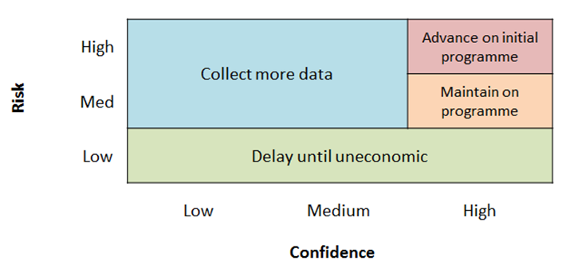
Prioritising Inspection
Notes:
[Steve] When a high inspection rate of the critical assets is not considered to be affordable, then the inspection programme should targeted towards the assets that are expected to be exhibiting the highest likelihood of failure and provides the most valuable information for renewal planning.
In prioritising inspections the assets that fit in the top left-hand corner of this diagram, where the risk is high but the confidence in the asset condition is lowest should the assets of focus for the inspection programme. The concept is based on improving the confidence in the understanding of condition and therefore service failure risk to communities.
This requires that an evaluation or prediction of asset condition is undertaken. This prediction may simply be assessed on the age of the asset, based on the expectation that the oldest assets are more likely to fail in comparison to younger assets. Where organisational knowledge or information, such as repair or failure history is known, then this can also be applied to the risk evaluation.

Slide 6
Prioritising Inspection
Inspection Priority | Age Range | Comment | Qty VHCA (m)
Priority 1 (P1) | >60 years old (or unknown age) | More likely to fail or least known about | 194Km
Priority 2 (P2) | 21 - 60 years old | Not expected to have a high probability of failure | 242Km
Priority 3 (P3) | ≤20 years old | Young pipes that have not yet reached the age where a first health inspection is required. | 37Km
Priority 1 Inspections
Priority 2 Inspections
Priority 3 Inspections
Notes:
[Steve] The Wellington Water pipeline VHCA programme set out three priority layers as described in Table 2.
Inspections were intended to be completed in decreasing order as shown in Figure 5. The highest priority for the VHCA condition assessment project would be to complete all the priority one inspections before the end of the programme. Following completion of priority one, the inspections would then commence with the priority two inspections with the intention of completing as much of these asset inspections as possible prior to the end of the programme as budget and time allowed. While these Priority 2 assets have a very high criticality, due to their relatively young age they were not expected to fail in the short to medium term. Any failures that may occur to the assets within the priority two list would not be expected to be due to age related deterioration. Any uncompleted Priority two inspections would be reprogrammed to be completed in the following financial years. Priority 3 inspections are the lowest risk assets and are intended to only be inspected once Priority 2 inspections had all been completed.

Slide 7
Use of Existing Inspections
Confidence Grade | General Meaning | Type of Information
A | Highly Reliable Recognised as the best method of assessment including verification on site. | Medium/High Resolution screening inspection plus NDT/DT testing Known pipe attributes including duty range, pipe class/wall thickness.
B | Reliable Sound method of assessment but may have minor shortcomings. | Medium/High resolution screening inspections only Known pipe attributes including duty range, pipe class/wall thickness.
C | Uncertain Investigations and analysis may be incomplete or unsupported, or extrapolation from a limited sample for which grade A or B data is available. | Discrete Sampling (NDT/DT) only or Low resolution screening Limited known pipe attributes
D | Very Uncertain Incomplete information or of uncertain quality. May include unconfirmed verbal reports and/or cursory inspection and analysis and not verified by site checks. | Desktop review or Historical test result (where data confidence is not known) Low Resolution analysis/probability of failure assessments
Condition Grade | Confidence Grade
5 | A
4
3 | B
2 | C
1
Notes:
[Steve] Where inspections that have previously been completed these can provide a lot of information for low additional cost - even if they were many years ago. Further inspections of these may or may not be required, dependent on the confidence in the condition information. For critical assets where the condition is known to be poor then the confidence in the condition data must also increase. Therefore, if the confidence in the pipe condition from previous inspections is not sufficient further investigation may be required. Otherwise, the asset could be removed from the inspection list. In general, a higher criticality justifies a greater level of assessment and data quality. The basis of determining the Levels of Data Confidence for inspection data used for Wellington Water was adapted from the NZWWA Infrastructure Asset Grading Guidelines 1999.

Slide 8
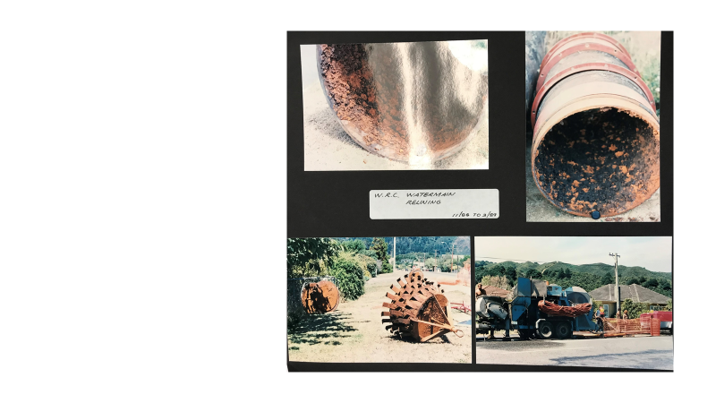
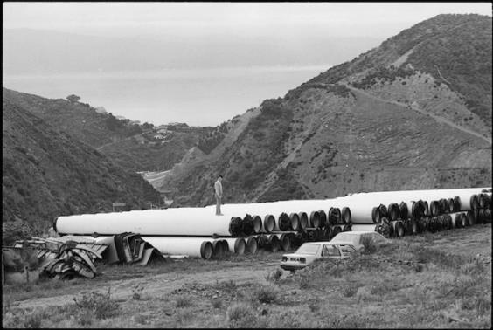
Information from Old Heads
Rob Blakemore, site engineer, standing on top of 800mm steel pipes at Ngauranga Gorge. The pipes are to be part of a 1.2km pipeline from the Featherston/Bunny Street intersection to the corner of Jervois Quay and Taranaki Street, Wellington. Photographed 15 November 1984 by Evening Post staff photographer Ian Mackle
Notes:
[Rob] An early view of asset risk can often be gained by utilising existing information. It can also be vital to gather this information before committing to field inspection. The sort of information that is vital includes status of valve operation, how to take assets out of service, whether access points are actually accessible, date and availability of previous field data and last but not least peer to peer workshops.
Peer to peer workshops involve cross organisational participation of asset planning, experience operators and maintenance personnel as well as external consultants who can bring their experience from elsewhere to the table.
They can and should generate a preliminary assessment of every asset to be assessed

Slide 9
Analysis and Integration of Information
Notes:
[Steve] In general, when planning an inspection programme consideration should be given to the following:
What type(s) of data is required to determine the structural condition, performance and asset attributes.
What constitutes the threshold of when some type of intervention (e.g., maintenance, repair or renewal) is required.
What inspection techniques provide the required data. A single or multiple inspection technique maybe required, including field inspection methods, along with desktop and peer to peer analysis. Efficiency of timing for data collection and cost to provide the highest data confidence possible, for the best value must also be evaluated.
What process is required to analyse the collected data to understand the asset health and make decisions for intervention.
How will the information be collected and subsequently transferred to where it needs to be stored and accessed.

Slide 10
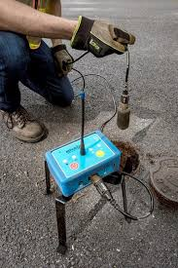
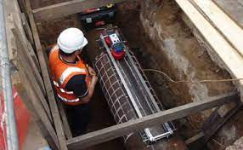
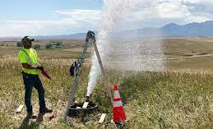
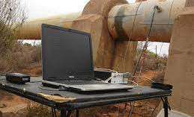
Selecting Technologies
Notes:
[Steve] Which technologies should be used is dependent on what information is needed to assess the health of condition of the particular asset. This will vary dependent on:
Pressure or gravity
Pipe Material
Size
Length
Operating pressure
Flow depth (minimum flow depth)
Whether pipe can be taken out of service or not
Availability of access points
Location of the asset to other services and structures
A review of all of the technology that is available in the marketplace should be undertaken. Considering the resolution of the results, accuracy track record and whether additional, supporting technology would be required.
The WWL VHCA programme utilised several different technologies – a tool kit of different methods. This was because the assets materials, pressured and lengths and network accessibility varied substantially and no single approach would be suitable.
Availability to NZ should be considered. Covid 19 response occurred during the VHCA inspection programme and some technology originally planned was not able to be used and alternative methodologies had to be considered for some of the programme.

Slide 11
Lessons Learned
key considerations to avoid failure

Slide 12
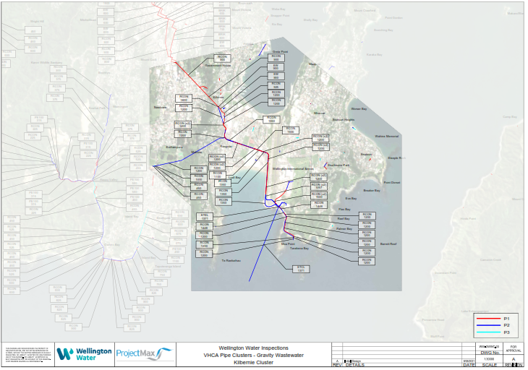
Planning
Notes:
[Rob] Clearly communicated priorities and understanding of what is intended to be achieved across the project team and all stakeholders will ensure that when changes occur as a result of changes to the budget or scope that what is most important is still delivered.
Develop predictor tools (i.e. refine the peer-to-peer approach based on new data) to enable the design of successive programmes and future maintenance programmes. This approach will help direct field assessment to where it provides most benefit
Selecting the right type of contract for implementing and managing the programme is important for managing any change.
Early contractor involvement and pre-inspection investigations to fully define the scope of assets to be inspected and accurately inform appropriate inspection technologies, quantities and any enabling works required, (e.g., installation of inspection points or tapings, civil works to enable access for inspections, shutdowns, and traffic management, etc.) is critical for achieving the programme and budget, particularly so for pressure pipes.

Slide 13
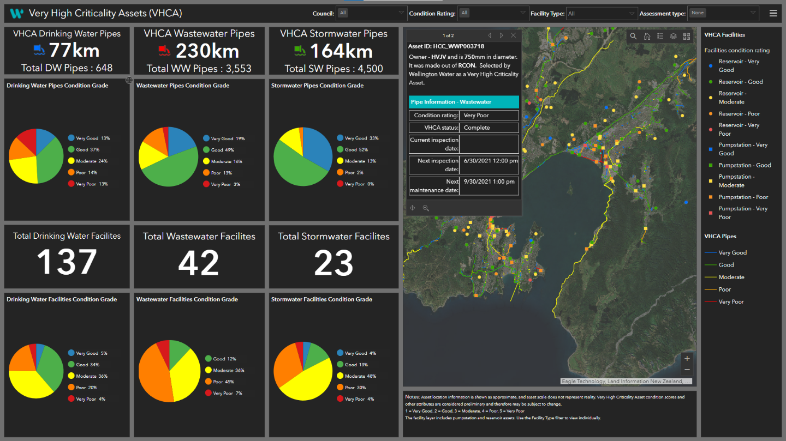
Management
Notes:
[Rob] A condition assessment programme of significant scale requires strong project management. Without it, windows of opportunity to access the network can get lost, and costs can blow out
Early risk identification at asset level is vital for a condition assessment programme. To understand these risks communication between asset owner, operator, maintainer, road controlling authorities, field contractors and data analysts is vital. The role of the project manager in this environment must come with high communication skills.
Risk management plans at an early stage of the programme will enable this communication.
Inevitably compromises and alternatives will be needed – and these must be programmed and managed.

Slide 14
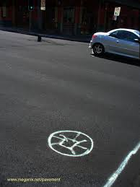
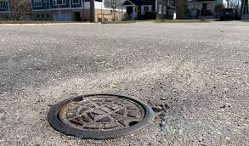
Access to Networks
Notes:
[Rob]
Early planning and ‘buy-in’ between project and client operation teams is necessary to ensure that any shutdowns and stand overs etc. that need to be accommodated can be programmed with sufficient time and the importance of the inspection is well communicated.
Poor understanding of network access limitations and poor planning will have an impact on the success of the project. Time is needed to address this aspect before launching into a contract.

Slide 15
Skills
Notes:
[Steve]
Use of appropriately trained and experienced resources provides high quality outcomes. Inclusion of collaborative training prior to the start of the inspections and during the initial stages of the inspections, aimed to ensure all team members understand any specific workflows reduces quality assurance issues from the start.
Managing inspection programmes such as the Wellington Water pipeline VHCA is complex and challenging and requires enough resources to project manage both the contract and the investigations. This needs to be accepted and funded appropriately for both the client (utility) and the inspection contractors. Consideration as to this aspect needs to be given when setting up and evaluating tenders.

Slide 16
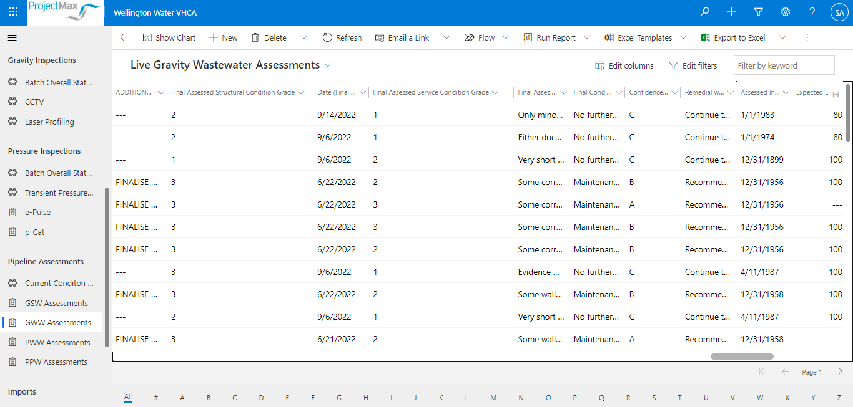
Technology
Notes:
[Steve] Inspection programmes generate a lot of information that will need to be accessed by people across the project team, checked, assessed and eventually imported into the relevant asset management system. Utilising an easily accessible but capable database to collect and process the information is important for ensuring a successful delivery, particularly for a complex multi-asset class inspection programme. The Wellington Water VHCA programme used a Microsoft based system call CriNITA that was specifically designed to collect and manage this type of data. A lot of resource needs to be assigned to this aspect of the programme.
Clearly defined deliverables and any workflows for the deliverable submission is important. A data delivery specification was developed as this programme evolved.
With large scale or complex inspection programmes the utilisation of a GIS/mapping solution to capture and report the inspection status of each asset and any issues
In terms of Inspection technology it is important that if technology is planned to be sourced from overseas that alternative technologies are considered if circumstances result in the equipment not being able to enter the country or timining does not line up with the inspection programme.

Slide 17
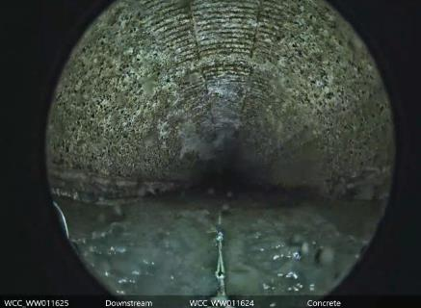
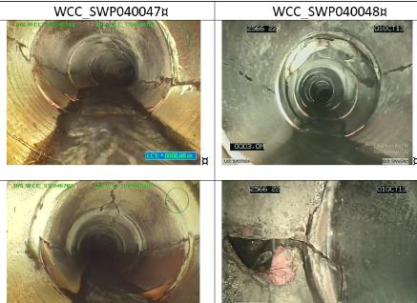
Reflections
Notes:
[Rob/Steve] The theoretical renewals profile at Wellington Water is daunting to the point that it could be overwhelming. A risk based approach to planning is our only alternative. Condition assessment of critical assets is a fundamental starting point.
Once a programme is committed communication about the programme and ownership of the need for the programme across an organisation will reap benefits. This includes communication to political, managerial, system support and operational people. It takes a lot of effort but it is worthwhile
The programme has had some immediate direct benefits where the assessment has resulted in early intervention that would have otherwise resulted in dramatic failure
We have formalised our approach to intervention and condition assessment to enable better maintenance programmes and future assessment programmes through the production of intervention guides that will be controlled documents in our asset management system. Moving forward we know we need to be confident about the condition of our high and very high criticality assets so we can intervene before it is too late and we end up with more unacceptable and damaging failures

