Slide 1
Kathryn Jessamine
Getting to Acceptable
Drinking Water Solutions for Smaller Water Supplies
Notes:
Kia ora koutou
Thank you for coming along this afternoon to hear me talk about the development of the acceptable solutions

Slide 2
Expanded Definition of Water Supplies
Sportsgrounds and other recreational facilities
Shops, cafes and other businesses
Groups of houses <25
And many more!
Networked farm buildings
Schools & community centres
Notes:
The Water Services Act 2021 has redefined who is a water supplier. Previously only networked supplies > 25 were regulated. Now the definition has removed the lower population limit and extended the definition to also include self supplies in situations where water is supplied to other (basically everyone except domestic self supplies)
Many individuals and organisations of various descriptions now find themselves water suppliers. They are likely to be unfamiliar with the regulations, have limited experience with drinking water principles and technology, have a basic understanding about risk, and be unwilling to spend much money on drinking water treatment that they haven’t considered necessary until now.
These supplies are likely to be small and have a different risk profile to municipal and other networked supplies. Taumata Arowai estimate that there could be in the order of 75,000 unregistered supplies which potentially could benefit from a targeted approach to regulatory compliance.

Slide 3
What is an Acceptable Solution?
Notes:
An acceptable solutions approach is already used in the Building Act 2004 (section 24) to demonstrate compliance, and Taumata Arowai wanted to develop a similar regulatory tool to provide a simplified method of compliance for smaller and lower risk drinking water supplies.
The Acceptable Solutions set out a specific approach to providing safe drinking water, including testing, maintenance and verification requirements. This gives the water supplier and Taumata Arowai confidence that the supply is effectively managing risks to drinking water safety. Use of an Acceptable Solution replaces some (but not all) of a supplier’s obligations under the Water Services Act 2021 and the new drinking water regulations (standards, rules and aesthetic values) developed by Taumata Arowai.
Use of an Acceptable Solution is optional, and suppliers may choose to use another method of achieving compliance with legislative requirements.

Slide 4
Balancing Act
Low cost
Simple
Easy to operate
Widely applicable
Reliable
Robust
Effective
Notes:
Coming up with an approach that works for these smaller suppliers requires balancing of a number of different factors: Smaller suppliers are sensitive to cost and would prefer a simple solution that is easy to operate, requires minimal maintenance and paperwork and is widely applicable across a range of situations. But from a technical point of view, it is challenging to design something that meet the needs of these smaller suppliers whilst still providing a robust and effective treatment solution as there are a number of competing priorities at work – safety, effectiveness, cost, and complexity.
The WSA allows TA to prepare AS that are proportionate to the scale, complexity and risk profile of the water supply. Taumata Arowai have used this risk management approach to balance the risk to public safety from inadequate treatment of a water supply against the cost and complexity of the proposed systems. It is also worth considering that the adoption of Acceptable Solutions will result in an improvement of the management of drinking water risk overall. This is particularly true for water supplies with no existing treatment, but also applies to water supplies that have existing treatment units, but not the management procedures around operations, maintenance and monitoring that form part of the Acceptable Solutions. From this point of view, it is preferable that the Acceptable Solutions are utilised by suppliers, as opposed to suppliers trying to ‘dodge the rules’ because the systems are too complex or too costly to run.

Slide 5
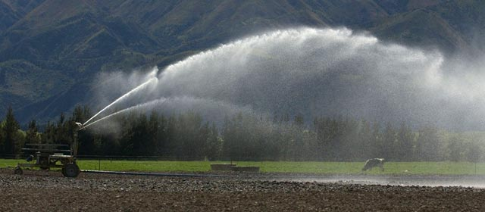
Mixed Use Rural
https://teara.govt.nz/en/irrigation-and-drainage
Notes:
Three types of AS have been developed. The first is for mixed use rural water supplies. These were previously known as rural (or rural agricultural) water supplies. The water provided in rural agricultural supplies is primarily intended for agricultural purposes and is not generally considered safe for people to drink without treatment. Taumata Arowai estimates there could be 300-500 rural agricultural water supplies in the country, with each one supplying between 10 to 2,500 people each.
Typically, mixed used rural schemes are constant (trickle) flow and have onsite storage of water. Treatment is often limited, sometimes settling and/or filtration and sometimes chlorination, but generally these types of supplies have not been treated adequately to comply with previous DWSNZ. It is not economic to treat the entire mixed use scheme to a potable level.
Source waters for rural agricultural supplies can vary greatly and because of the agricultural land use, there can be at higher risk of contamination, particularly for surface water sources.

Slide 6
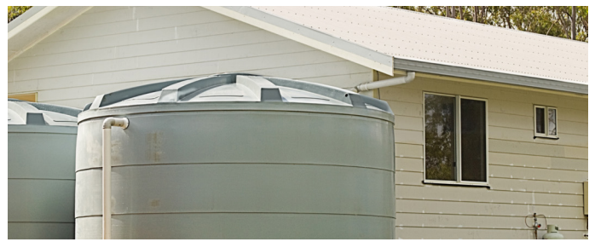
Rainwater
https://d39d3mj7qio96p.cloudfront.net/media/documents/BRANZ-Facts-HRG-1-Rainwater-harvesting-systems.pdf
Notes:
The second type of AS is for roof water supplies. Rainwater collected from rooftops is a common source of drinking water worldwide. Provided that the roof and collection pipework is kept clean, rainwater is generally considered to be of good quality compared to other natural water sources. The primary sources of contamination for these types of water supply are from animals accessing the roof area and vegetation accumulation in guttering and pipework. Taumata Arowai estimates there are between 10,000 and 30,000 roof water supplies in New Zealand, including many marae.
The size of roof water supplies is limited by the amount of water that can be collected, and typically these sorts of supplies are single buildings with relatively small populations, like household dwellings, or standalone buildings with a commercial function such as a café, office or shop.
Roof water supplies pose a relatively low risk to health due to the self-limiting number of people able to served by a single supply, and the relatively good, and consistent, quality of the source water, provided some basic maintenance is carried out. Although quantity can be an issue if not enough storage is provided or in areas or times of with low rainfall.

Slide 7
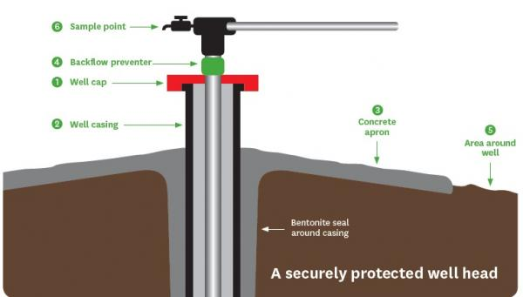
Bores and Springs
https://www.hbrc.govt.nz/services/water-management/bore-security/
Notes:
The third type of AS is for bore and spring supplies. Bore and spring water is generally considered to be of a more consistent higher quality than surface waters, and groundwater from confined aquifers generally has low levels of microbiological and/or chemical contamination, provided the bore and bore head protect from contamination from the surface. However, this is not universally true. For example, water from geothermal springs is not suitable for drinking. It is uncertain how many of these supplies currently existing in New Zealand.
Some springs may also have a high risk of contamination that other bore waters, particularly where the water is drawn from a spring-fed pool or stream (rather than from the spring itself). Interconnectivity with surface water sources can also affect the quality of bore water. E.g. Shallow bores or those located close to rivers sometimes demonstrate elevated turbidity following freshes. Groundwater can be contaminated by leaky sewers, intensive farming and other industrial process without a corresponding increase in turbidity.
Groundwater and springs water supplies are common in New Zealand (and overseas), The types of water supplies could include small community networks, commercial enterprises, community centres, marae, campgrounds, and groups of houses.

Slide 8
Development Process
Initial Development
Socialisation with user reference groups
Update
Public consultation
Final update
Published
Review by user reference groups
Notes:
The AS have been tested widely in the industry during their development. Initially, a set of acceptable solutions was prepared for socialisation and review by Taumata Arowai’s user reference groups.
Updated acceptable solutions were then presented in January this year for public consultation. The consultation period finished in March.
More than 150 submissions were received across the three acceptable solutions. Common concerns from submitters were around costs of compliance, transition timeframes and an increased regulatory burden. Submitters were also keen for the acceptable solutions to be less prescriptive and for there to be more flexibility in them – this was interesting as it was assumed that a more prescriptive approach would be preferable, a more flexible approach puts much more responsibility on the water supplier to confirm what they are doing adequately manages risk, but this is also in line with the overall approach that Taumata Arowai are taking towards compliance across all supplies (not just acceptable solutions).
Taumata Arowai took all this on board and made some fairly substantive changes to the acceptable solutions which were published on Friday. You can check them out on TAs website.

Slide 9
Components of an Acceptable Solution
Catchment
Contamination risk
Treatment
Cartridge Filtration
UV Disinfection
Distribution
End point treatment
Management
Testing
Maintenance
Water Supply Characteristics
Source water quality
Acceptable solution type
Population
Notes:
Now I’m going to get into some of the detail of the contents of the AS. A multi-barrier approach has been used in the development of the Acceptable Solutions. The first set of barrier are the limits of application of the Acceptable Solutions, i.e. to exclude water supplies with a risk profile that exceeds the capacity of the acceptable solution to manage. This could be supplies with large populations or poor quality source waters or source waters at high risk of contamination. The next set of barriers are treatment ones – two stage cartridge filtration and UV disinfection. A shift to end point treatment reduces risks in the distribution system, nevertheless both the springs and bores and mixed use rural require BFP which acts as a final barrier to contamination.
Management processes and procedures are not barriers but provide an important assurance step and suppliers are required to demonstrate that testing, operation and maintenance activities are occurring as a check that the other barriers are working effectively.

Slide 10
Water Supply Characteristics
Acceptable solution | Population Limit
Roof water | Up to 500 people base population in a single building or group of buildings
Springs and bores | Up to 500 people base population in a single building or group of buildings
Mixed use rural | No limit on base population 50/50 split of water for agricultural/horticultural and domestic use
Notes:
A water supply must meet a number of requirements for the AS to be applicable.
Roof water and spring and bores supplies have a base population limit of 500 people. There is no limit for mixed use rural, but there must be a minimum of 50% use of water for agricultural purposes.
There are also some other limits around population:
The base population limit for a single building served by an end point treatment system is 500
The base population limit for more than one building (up to three) served by a single end point treatment unit is 100 people – because there is an increased distribution risk.
Base population can be exceeded for up to 60 days a year, but extra monitoring is required.

Slide 11
Managing Catchment Risks
Source water must be tested for a range of parameters before the Acceptable Solution can be adopted
Source water quality must meet the manufacturer’s requirements for the use of their equipment
Pre-treatment is required if source water is of insufficient quality
Extra requirements for use of the Springs and Bores Acceptable Solution
Notes:
Before the acceptable solution is adopted, the source water must be tested for a range of parameters to ensure safety of water and also to determine its suitability for cartridge filtration and UV disinfection. The responsibility is on the supplier to confirm that the source water quality meets the manufacturers requirements – no presecriptive limits for turbidity of UVT (for example) are set in the AS.
If a chemical determinand exceeds the MAV, or the source water quality is insufficient for cartridge filtration and/or UV disinfection pre-treatment must be installed
Springs and Bores Acceptable Solution also requires:
Protection of the headworks, Exclusion of farm animals No impact from contamination sources e.g. septic tanks, offal pits, contaminated land, No geothermal water
Noted that Acceptable Solutions are focused on the risks of microbiological contamination and are not suitable for water supplies with chemical or radiological contaminants. Likewise, the Acceptable Solution is not intended to remove taste or odour from the raw water. Taste and odour in the raw water may make it unpleasant to drink, but do not necessarily indicate the water is unsafe.

Slide 12
Treatment
End point treatment
Two stage cartridge filtration; 20 micron and 5 micron
Validated UV disinfection
Distribution
End point treatment
Backflow prevention for springs and bores and mixed use rural
Notes:
Treatment in all three acceptable solutions is the same and is an end point treatment unit consisting of two stage cartridge filtration and UV disinfection. This is a commonly used and proven effective combination of treatment equipment. Cartridge filtration is selected as a pre-treatment unit but is also be an effective method for removal of micro-organisms, solids and the reduction of turbidity. UV disinfection is then used for the inactivation of viruses, bacteria and protozoa. To maintain effective disinfection using UV, turbidity and UV transmissivity must be kept within the operating parameters of the unit. This combination of treatment technologies is affordable and widely available. Validation of UV disinfection equipment is required to provide assurance, to both the water supplier and Taumata Arowai, that the equipment installed is of good quality and will be effective. End-point treatment minimizes the distance between the treatment of the water and the consumer, reducing the risk of contamination in the distribution network and therefore the need for residual disinfection. The reduced population limits for groups of buildings served by a single end point treatment unit also reflect this link between distribution network and risk of contamination. Backflow prevention is also required at the connection points for supplies using the Spring and bores and mixed use rural acceptable solutions. It is not considered such a risk for roofwater supplies which are much less likely to be in a network.

Slide 13
Management
Operation and maintenance is the responsibility of the drinking water supplier
Documentation and records
Training
Attendance
Treated water monitoring
Notes:
Operation and maintenance is the responsibility of the drinking water supplier
The supplier must keep and maintain documentation including description of the of the water supply, incident and emergency response procedures, maintenance and inspection schedules and records
Adoption of an Acceptable Solution is considered to meet the requirement for a water supply to have a water safety plan, therefore no separate water safety plan is required.
People that maintain or operate the supply must be competent and receive adequate training to understand the emergency and incident management procedures and how to comply with the acceptable solutions
The AS also sets out treated water monitoring requirements an it’s noted that Taumata Arowai will still receive notifications directly from lab in case of exceedance

Slide 14
Compliance Options
Acceptable Solutions
Very small supplies <25
Small supplies 26-100
Medium Supplies 101-500
Large supplies >500
Summary
Notes:
This diagram shows some of the compliance options available to suppliers. water suppliers have a choice how to comply and acceptable solutions provide an alternative option particularly for supplies that fall in the very small, small and medium size ranges.
To summarise, developing the acceptable solution Taumata Arowai have had to weigh up the needs of smaller suppliers against the public health risks posed. It has been a balancing act to come up with the right mix of limitations, treatment solutions, and management procedures to come up with a solution that may not be perfect but is ultimately acceptable to most.

Slide 15
Questions/Pātai
kathryn.jessamine@beca.com

