Slide 1
The role of Taumata Arowai
in relation to Stormwater
19 May 2022
Bill Bayfield | Chief Executive

Slide 2
Ko wai, ko au, ko tātou
2
Ko te wai ahau, ko ahau te wai.
He whakaaturanga tātau nō te wai.
Ko te ora te wai ko te ora o te tangata.
He taonga te wai me tiaki.
Ko wai tātou.
Ko wai tātou.
I am wai, wai is me.
We are reflections of our wai.
The health of te wai is the health of te tangata.
Wai is a taonga that must be protected.
Ko wai tātou.
We are wai. Wai is us.
Notes:
Your mihi plus Ko wai, ko au, ko tātou

Slide 3
What we will cover today
3
Who are we and what do we do?
Our role relating to stormwater as we currently see it
What our role might be, dealing with uncertainty and considering opportunities
Pātai / questions
Opportunity to answer any further pātai / questions you might have
Notes:
Bill

Slide 4
Who are we and what do we do?
4

Slide 5
The new water services regulator
5
Taumata Arowai became the new water services regulator on 15 November 2021.
While most of the Water Services Act 2021 came into effect on 15 November 2021, provisions relating to stormwater and wastewater are delayed until 4 October 2023.
The new arrangements represent a comprehensive reform of the status quo and are designed to give people the confidence that their water is safely managed.
Our role relating to stormwater and wastewater is very different to our role as regulator of drinking water.
Notes:
Became the new water services regulator on 15 November 2021.
So far, our focus has been on drinking water with provisions to stormwater and wastewater delayed until 4 October 2023.
But I am not here to talk about drinking water, I’m going to talk about stormwater.
Our role relating to stormwater is very different that our role as regulator of drinking water.

Slide 6
Our role in the water system
6
Notes:
This is the current water system regulatory and policy landscape.
Taumata Arowai is a vital part of the service delivery part of the Three Waters Reform but we are not leading this.
We have an oversight role to protect the environment from the impacts of wastewater and stormwater.
Regional councils are the regulators of stormwater.

Slide 7
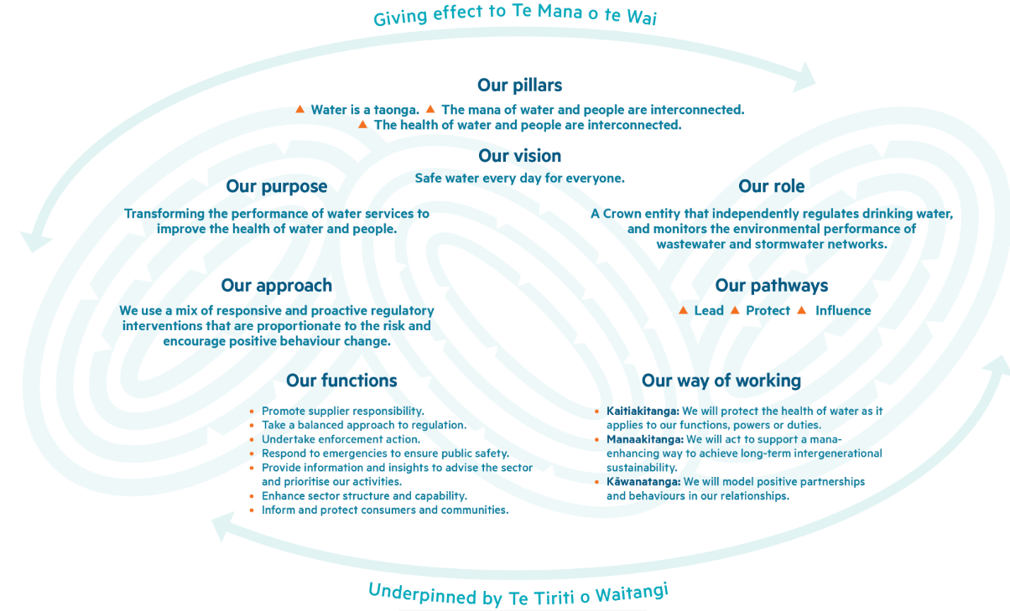
We take our lead from Te Mana o te Wai
7
Notes:
A key objective and a requirement of the Water Services Act is for Taumata Arowai to give effect to Te Mana o te Wai, to the extent it applies to our functions and duties.
The principles of Te Mana o te Wai are about restoring and preserving the health, wellbeing, and balance between water, people, and environment.
We aspire to being a leader in giving effect to Te Mana o te Wai throughout the design of Taumata Arowai. Our strategic framework, includes our ways of working and illustrates this

Slide 8
Our role relating to stormwater
8

Slide 9
We’re not the front-line regulator of stormwater
9
Regional councils are the front-line regulator for stormwater. Local Authorities are currently the primary operators of the publicly owned stormwater networks.
We’ll work in partnership with Regional Councils to support their role as the regulator and improve national consistency.
We have an oversight role for stormwater which includes monitoring and reporting in relation to environmental performance.
Our role is to shine a light on the environmental performance of stormwater networks.

Slide 10
What we’re responsible for
From 4 October 2023, we will be responsible for:
Setting stormwater measures and targets.
Publishing an annual report on the environmental performance of stormwater networks.
Establishing a public register of stormwater networks.
We will not be responsible for:
Front-line regulation of stormwater networks’ environmental performance.
Setting standards for stormwater (as we will do for wastewater).
Requiring / reviewing stormwater management plans.
10

Slide 11
What does the Water Services Act say?
11
A stormwater network operator is:
A local authority, council-controlled organisation or subsidiary of a council-controlled organisation, or anyone that operates a network (or part of) on behalf of these organisations
A government department
The New Zealand Defence Force.
A stormwater network is:
Infrastructure and processes that are used to collect, treat, store, reuse, or discharge stormwater in an urban area by or on behalf of a stormwater network operator.
The proposed water service entities legislation is to provide for the transfer of local authority assets and roles in the delivery of urban stormwater to the entities.
Notes:
What does our legislation say?
The Water Services Act 2021 defines what a stormwater network operator and stormwater network is.
Examples: excludes Waka Kotahi and rural networks.
It’s expected that Water Service Entities will take over the requirements under the Water Services Act from councils.

Slide 12
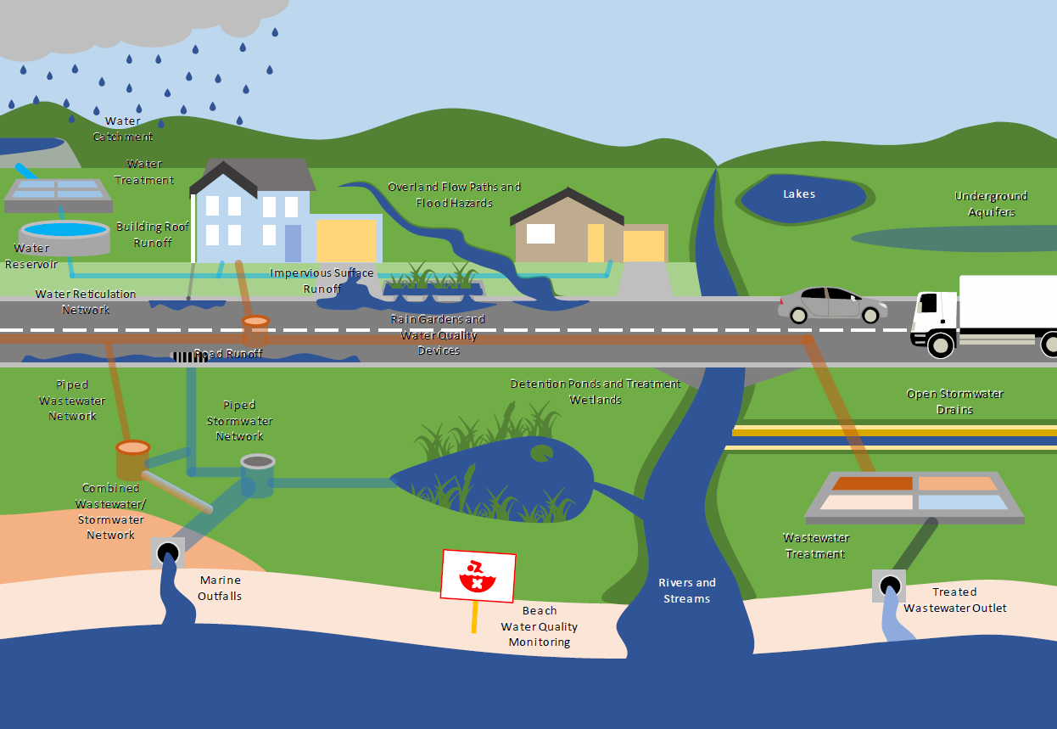
What does an urban stormwater network mean?
12
What size is an urban stormwater network?
Image: Auckland City Council
Notes:
Under the Act, urban area means (zoned urban within plan).
There is an ongoing discussion about what assets get transferred to the water services entities. Ideally, we only want to include assets managed in urban areas.
We don’t expect to have an oversight role in rural stormwater.
This means we don't capture:
- rural drainage schemes
- stormwater networks operated by government departments outside of urban areas, for example stormwater management at a DoC campground in a national park
- we also don't capture stormwater on private land or stormwater managed by state owned enterprises (e.g. KiwiRail) or Crown Agents (e.g. Waka Kotahi or Kāinga Ora)
We do capture:
- An urban area is defined by the WSA as an area identified in a district plan or proposed district plan as being primarily zoned for residential, industrial or commercial activities, together with adjoining special-purpose and open-space zones, however described: but does not include an area zoned primarily for rural or rural-residential activitities, however described.
- this means we capture the piped network in urban areas where it is operated by a network operator, as well as treatment devices, such as wetlands and stormwater retention devices operated by a network operator.

Slide 13
A public register for stormwater networks
13
There is currently no national public register of stormwater networks.
Not all stormwater networks have Resource Management Act discharge consents.
We’ll establish a public register of stormwater networks but there is no requirement to do this until 4 October 2023.
Stormwater assets will be recorded as they are transferred to the water service entities.

Slide 14
When should we start?
2022
October 2023
July 2024
14
Taumata Arowai commences stormwater monitoring and reporting role
Water service entities commence
Why instigate a stormwater regime 6 months before the water service entities are commencing?

Slide 15
Current uncertainty around stormwater
15
We’re thinking about stormwater sooner than anticipated largely because of the Three Waters reform and the creation of the new water service entities.
4 October 2023 is not that far away and uncertainty exists.
Our partnership with Regional Councils
Lack of registration and consents
Lack of clarity around size of urban stormwater networks
What will be the targets and measures for stormwater?
When will our regime come into action? 1 July 2024?
What does our annual report look like and what will it cover?
Notes:
We understand stormwater is complex and there are some uncertainties:
Looking ahead, regional councils and TLA’s will still have a role to play.
Don’t know where some of these things will land but the next six months will be a telling time.
Even after the water services entities launch, there may still be some uncertainty.

Slide 16
What might the reforms hold for us?
16
In the next couple of months we’ll see considerable debate through Three Waters and Resource Management Act (RMA) reforms.
Will the role of the water service entities be expanded to integrate stormwater management beyond the urban network?
Will the water services legislation be aligned with the RMA legislation?
Will this mean an expanded role for Taumata Arowai, or a lesser role?
Having recently tackled the task of establishing Taumata Arowai, should the water service entities and economic regulator be established and allowed to succeed.
Perhaps then DIA in conjunction with the Ministry for the Environment, the Regional Councils, water service entities and Taumata Arowai can undertake the development and delivery of an integrated stormwater management regime.

Slide 17
Pātai | Questions?
Wai ora. Tangata ora.
Healthy water, Healthy people.
17

