Slide 1
Aaron Prince
PRESSURE PIPE CONDITION
RIGHT PIPE, RIGHT TEST

Slide 2
Presentation Outline
Introduction
Selecting the pipes to inspect
Defining the information required about the selected pipes
Canvassing available inspection methods for each pipe
Proven technologies
ePulse
p-CAT
Pressure Transient Monitoring
Questions from the crowd
Notes:
We have a very exciting half hour ahead of us, this is what I’ll be presenting

Slide 3
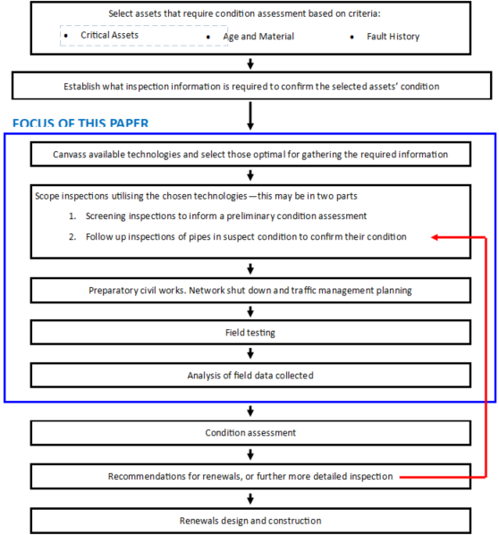
Notes:
The presentation will move through this flow chart which is in the paper, shows the steps in an inspection and assessment program
It’s important to methodically target inspection effort to the right assets
I’ll start off by talking about selection of assets for testing- which ones do we really need to know about?

Slide 4
Select assets that require condition assessment based on criteria
Critical Assets or,
Age and Material or,
Fault History
Notes:
Critical assets are those assets that the utility can’t afford to fail
You might wonder why there is a beast on this slide. It’s to show that critical assets will often be the most difficult to access places- steep terrain, highways, railways, under private land with locals restricting access
Age, material and fault history will trigger assets for inspection

Slide 5
Establish what inspection information is required
Remaining useful wall thickness
Stress on the pipe
From internal pressure
From external loads
From corrosive wastewater
From corrosive soil
Notes:
Next is to work out what needs to be known about the pipes.
The useful wall is the thickness that still has useful structural integrity. On AC pipes the inside will go like weetbix, but it’s the intact wall that provides strength. Similar for corrosion on metallic pipes
Corrosive wastewater significantly reduces the life of a pipe, and measures can be taken to pre-treat if this is tested
If no testing is carried out you can only do a low confidence health assessment based on material and age. With good inspection information a high confidence assessment will allow justifiable renewal decisions to be made

Slide 6
Canvas available technologies
Select the best methods for gathering the required information
Often more than one type of test will need to be done on each pipe
Inspections may be done in two stages
Screening inspections on all selected pipes
Secondary more detailed inspections on pipes found to be at risk during screening
Notes:
There are many methods advertised. None is suitable for every pipe type. Many are unproven, even less are proven in NZ
Normally combine pipe wall thickness with induced pressure monitoring or static pressure.
Inspections may be done in two stages, screening inspections followed by targeted more detailed inspections

Slide 7
ePulse
Primarily used on drinking water distribution mains
Measures the remaining wall thickness and detects leaks
Metal, AC and concrete
An evolution of leak detection correlator technology
Notes:
There are three technologies I’ll be presenting which are extensively used in NZ over the last 18 months.
First is ePulse
Measures the average remaining wall thickness between the test points
Ideal in distribution network with fire hydrants as it requires sensors placed on fittings at 60-200m intervals.
Cannot test plastic pipes.
Here Ashwin is lowering magnetic sensor to rest on a hydrant
Hydrants boxes often full of water so we use an empty coffee cup to bail it out

Slide 8
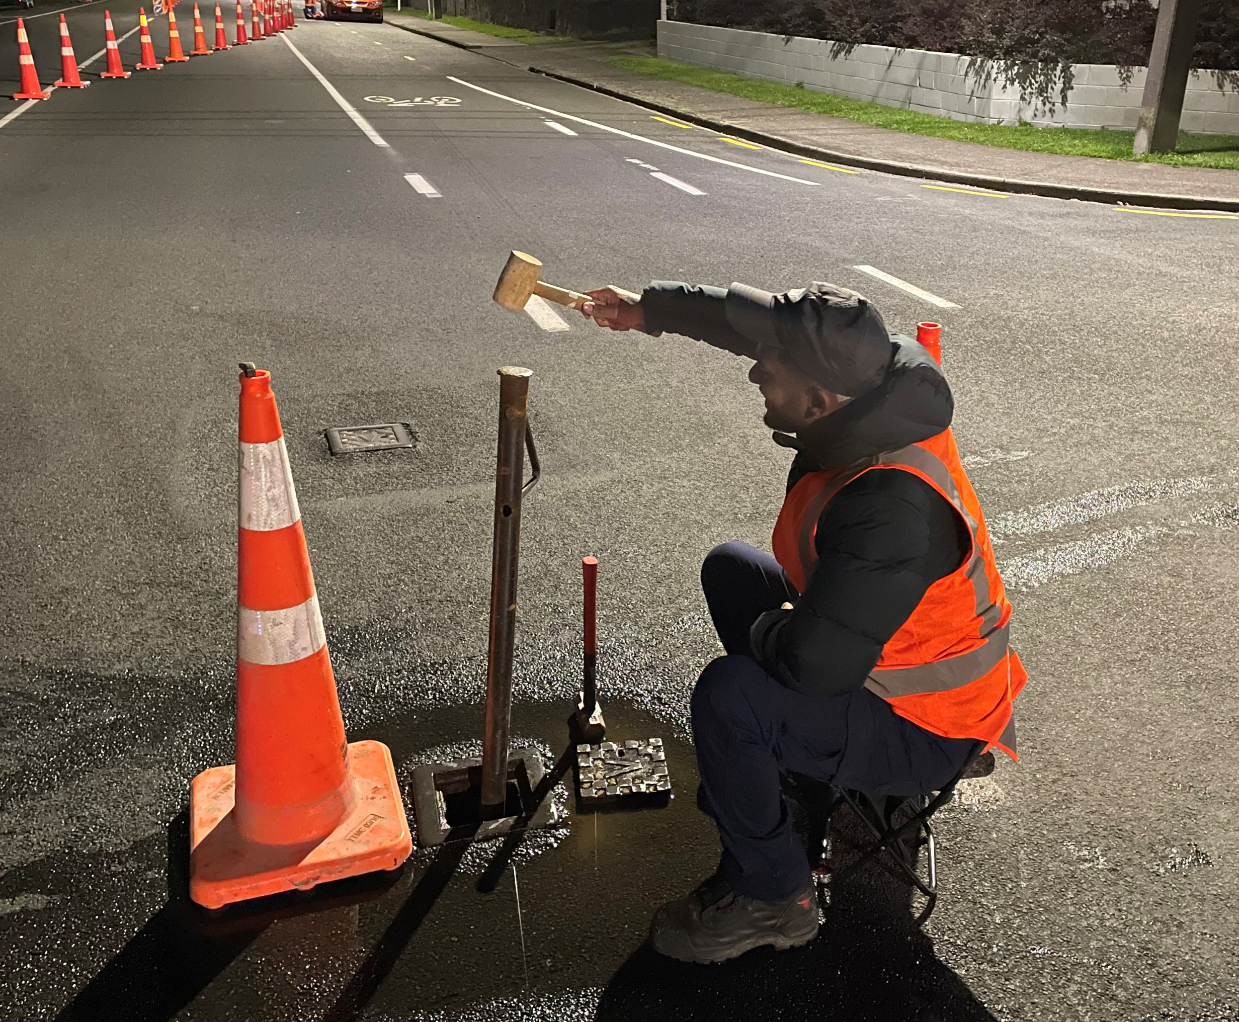
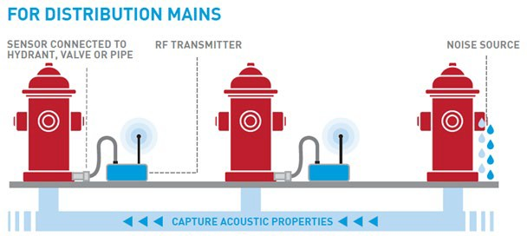
ePulse
Notes:
Sensors are placed on the pipe or a metallic fitting. The two to the left.
Acoustic waves are produced by tapping lightly on the fitting to the right. These waves are recorded by the sensors.
These are sent away for analysis.
The time taken for the waves to travel between the sensors varies depending on the pipe material, length, inside diameter and water properties. These inputs allow the analysts to calculate the average inside diameter between the two sensors.
Network is left in normal operation.
Normally done daytime, only at night if on busy roads

Slide 9
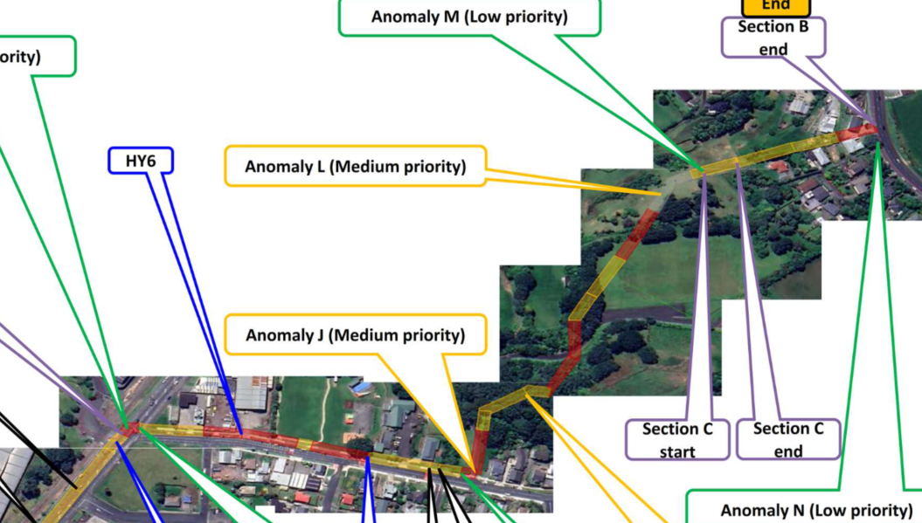
P-CAT
Primarily used on water trunk mains and long sewer rising mains
Measures the remaining wall thickness in 10m long segments
Metal, AC and concrete
Notes:
Works on clean or dirty water
Can test long stretches of pipe
Requires minimum 200kPa residual pressure
Gold standard test, as it defines remaining wall in 10m segments remediation can be targeted
Will pick up other anomalies such as half closed valves, unknown fittings

Slide 10
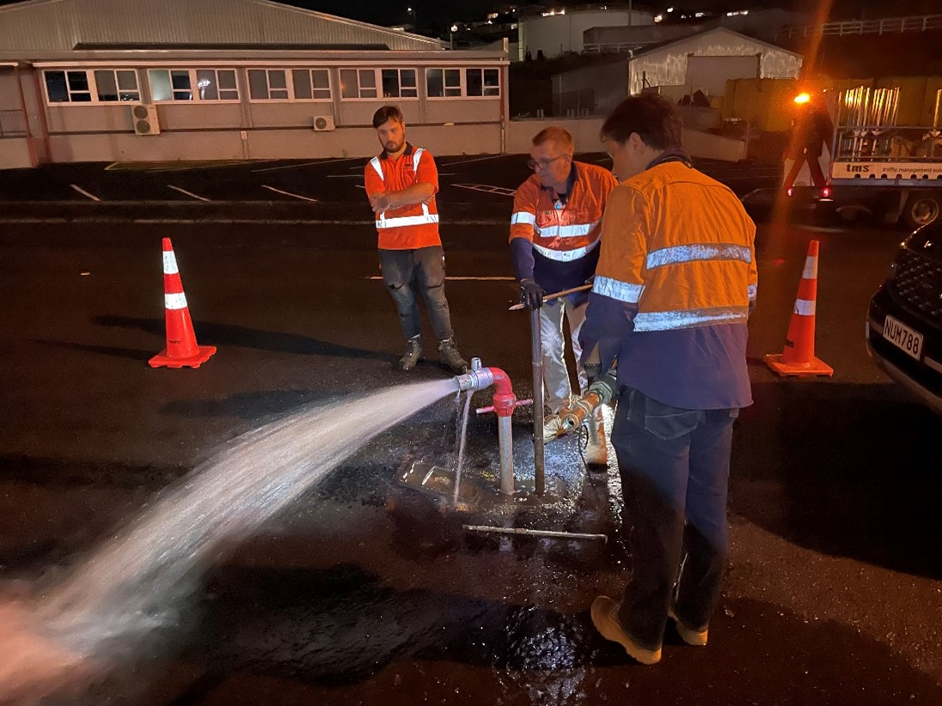
P-CAT
Notes:
Picture shows testing being carried out at night in New Plymouth. Work is often carried out at night when demand is low and traffic light
Network can be left in normal operation, but closing laterals gives more accurate analysis.

Slide 11
Pressure Transient Monitoring
Measures the pressure in microsecond intervals
Calculate the Cumulative Pressure Induced Stress caused by short pressure peaks and troughs
Tells us the peak pressures in the pipe, which is required to assess if the pipe in it’s current condition is likely to fail
Both water pipes and sewer rising mains
Notes:
This technology is now well established in NZ, but included today as it is an important compliment to the first two described.
Good monitors measure the pressure 180 times per second
Monitoring will identify valves closing too quickly, pump stop or large users, which can be rectified
The peak pressure might only occur for a fraction of a second over a week of monitoring, but this should be used for calculation of factor of safety

Slide 12
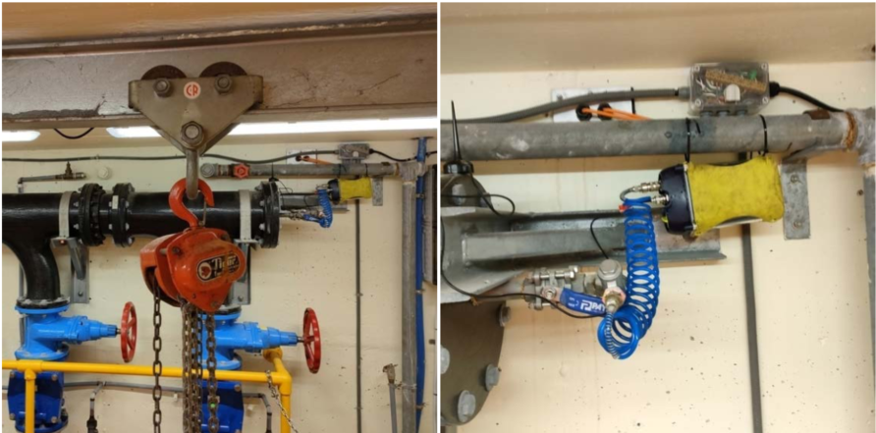
Pressure Transient Monitoring
Notes:
Pressure transient monitor installed in a pump station.
The units are commonly placed in fire hydrant boxes or valve chambers.
The flexihose connects the monitor to the water column
Left in place for at least a week to pick up weekday and weekend pressure changes.
Can be viewed live on a dashboard via cellular connection

Slide 13
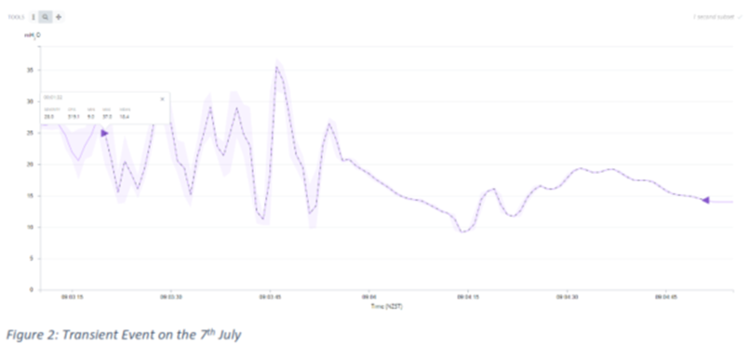
Pressure Transient Monitoring
Notes:
This transient event is 28m from peak to trough within a second. It was caused by a pump starting or stopping suddenly. The recommendation was to install soft starters or variable speed drive to reduce the risk of damage to the network

Slide 14
Secondary information gathered during testing
Normally a pre-inspection of the test site will be carried out, where asset type and location is surveyed- air valves, hydrants, chambers.
This information has a lot of value and should be added to council database and GIS
Notes:
It’s not surprising any more when information is missing from utility records. When inspecting pipes effort should be made to utilise new as built information and add it to GIS of other records

Slide 15
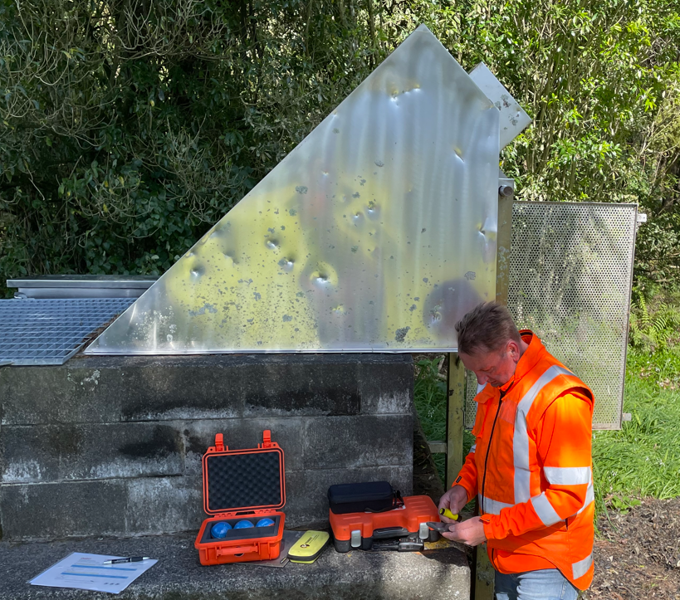
Other promising technologies
Pipers – can test any pipe material
Notes:
If time allows
Pipers are balls that pass through pipe. Can be used on any material including plastic pipes. Detects leaks, air pockets and sediment. Successfully used in New Plymouth in September. Identified one suspected leak which will be investigated, along with mitigation for air in the pipes

Slide 16
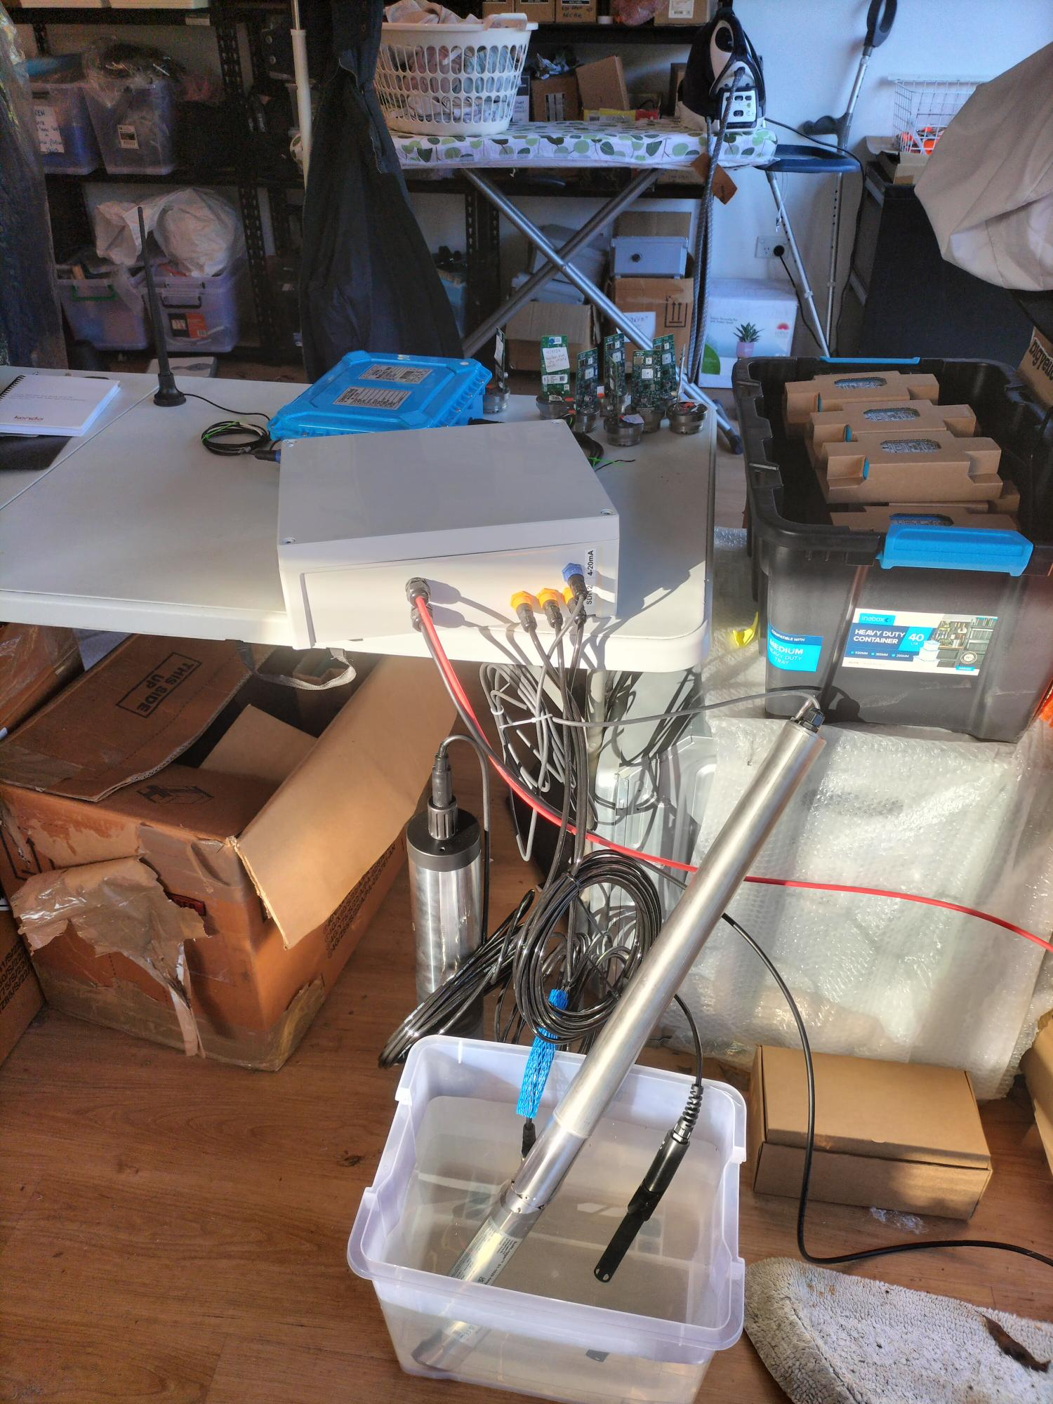
Other promising technologies
“Sniffer”wastewater multisensor
M-nodes
Notes:
If time allows
Please ignore my colleagues dirty laundry in the background
Sniffer will be on display
Sniffer tests chemical makeup of wastewater over a month. Allows mitigation to be implemented such as aeration in pumpstation or dosing to reduce sulphides and slow pipe corrosion.
Allows more precise calculation of corrosion rate.
M-nodes are listening devices placed on water network. Algorithm defines location of suspected weakness in network. Annual repeat maps out changes

Slide 17
What can the industry learn from this?
Key take aways
Stimulus funding enabled full scale rollout of these new technologies by several different utilities
Training up technicians has been a key component of successful testing
If true critical assets are chosen expect extensive enabling work.
Representative samples tested allows extrapolation to pipes not able to be inspected.
Notes:
You’ll notice I’ve snuck in the blue slide template sent to me by Water NZ to spice up the presentation a little.
We would not have got as many km tested if it had not been for stimulus finding
By the third project the technicians have learnt most of the pitfalls. They gather good quality sound files for analysis, and so our % success rate improves dramatically
Focus on technicians sharing knowledge to provide redundancy
Critical assets will be more difficult to inspect due to accessibility issues
We always deal with incomplete information. Any inspection is better than no inspection, results can be extrapolated to similar pipes if necessary

Slide 18
Conclusions
Traditional test method has been coupon sampling
Methods described provide evidence of remaining wall thickness and pressure stresses
Information gained over entire segment, not just a spot sample
Repeat testing shows deterioration over time.
Plastic pipe inspection difficult as acoustic sound waves don’t travel far down the pipe
Notes:
Traditional methods have been cost prohibitive. Coupon sampling involves cutting a section out of a pipe and inspecting it, then repairing the hole.
This gives only a spot sample of pipe condition, so needs to be repeated along the pipe to gain an understanding of condition.
Combining wall thickness with stresses on the pipe allows remaining life and factor of safety to be calculated.
Methods can be easily repeated- once first test has been carried out repeating the test in five years is easier as the test plan is ready and any special fittings that might be needed to attach test gear to the pipes already prepared.
The Elephant in the room – plastic pipe inspections – are difficult as acoustic waves don’t travel well down plastic pipes.
Asset managers should not embark on renewals unless the asset is known to be in poor enough condition so correct and justifiable decisions can be made.

