Slide 1
FEASIBILITY STUDY
USING TREATED WASTEWATER FROM MANGERE AND ROSEDALE WWTPS FOR SPORTS-FIELDS IRRIGATION IN AUCKLAND
SARISHA HURRISUNKER

Slide 2
NZ Context
Cultural Significance to Māori
International Guidelines
Effluent Data Analysis and Results
Environmental and Public Health Risks
Next Steps
OUTLINE

Slide 3
DROUGHT
AUCKLAND’S DROUGHT MOST EXTREME IN MODERN TIMES
NIWA 22 MAY 2020

Slide 4
-30% BY 2030
AUCKLAND COUNCIL'S COMMITMENT TO REDUCE WATER CONSUMPTION

Slide 5
Auckland Council
Community Halls
5%
Buildings
18%
Community Facilities
Average Water Use
Irrigation
45%
Toilets & Change Rooms
14%
Aquatic Centres
15%

Slide 6
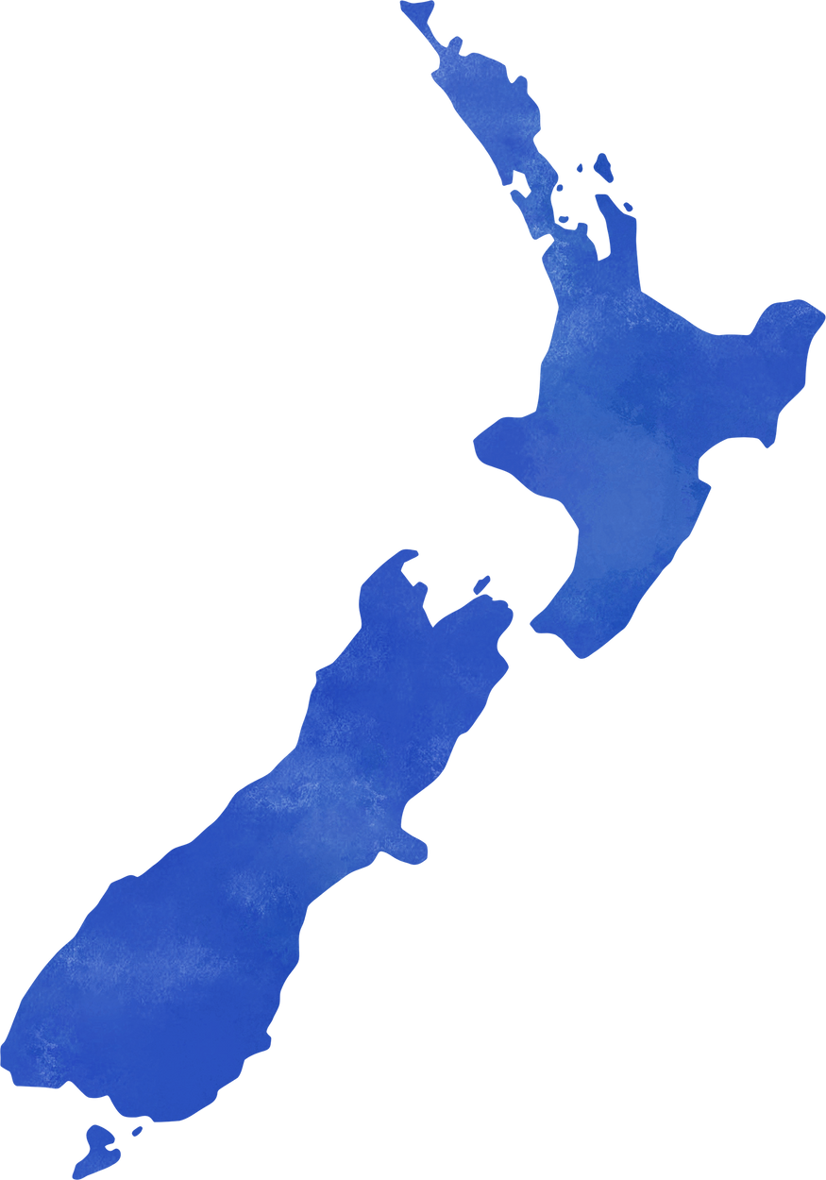
ROTORUA
NEW ZEALAND
193ha Whakarewarewa Forest Scheme
LAND BASED DISCHARGE SCHEMES
OMAHA
Omaha Beach Golf Course (OBGC)
Jones Road Sites (JRS) - Eucalyptus and Native Plants
THAMES COROMANDEL
Mercury Bay Sports Field

Slide 7
"Ko te wai te ora ngā mea katoa"
Water is the life giver of all things

Slide 8
International Guidelines
 | USEPA | AGWR CLASS A | NSW
PH | 6 - 9 | - | 6.5 - 8.5
BOD (mg/L) | < 10 | < 20 | < 20
Turbidity (NTU) | ≤ 20 | ≤ 20 | ≤ 20
Residual Chlorine (mg/L residual) | 1 | 1 | 1
Faecal Coliforms (FC/100ml) | No Detectable | - | -
Escherichia (E-coli/100ml) | - | < 10 | < 10

Slide 9
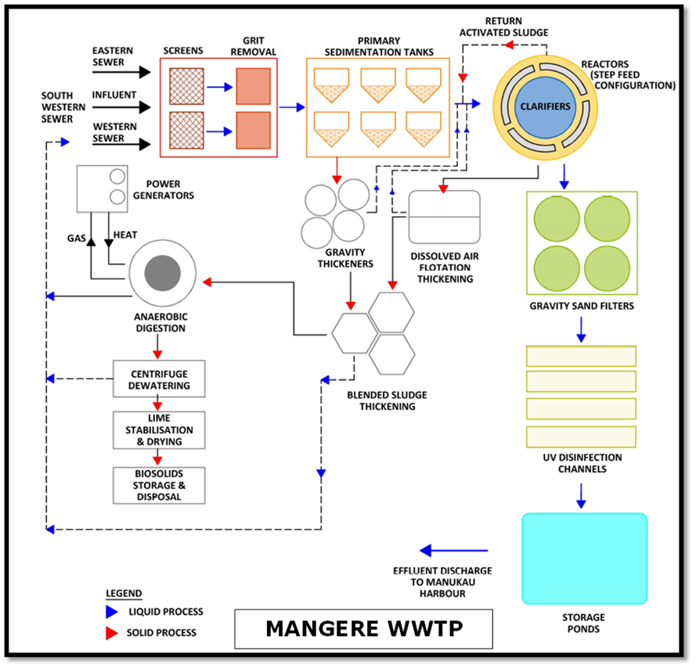
MANGERE
WWTP

Slide 10
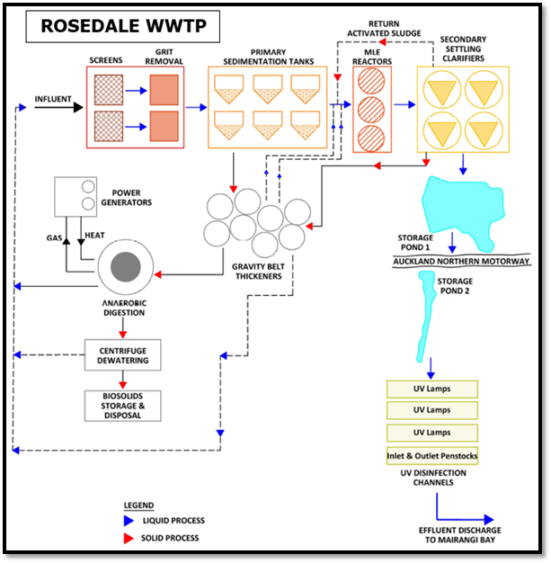
ROSEDALE
WWTP

Slide 11
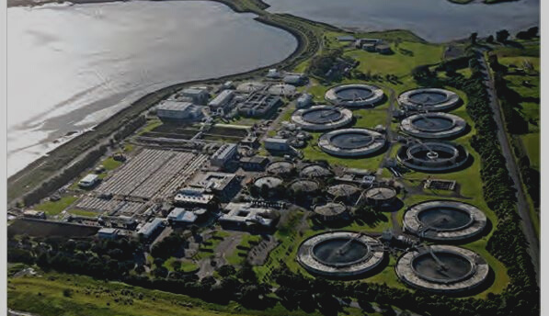
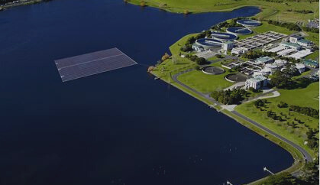
Mangere WWTP
CMAS + MLE
Rosedale WWTP
MLE

Slide 12
DATA SOURCE
Historical Records
Test Data
Effluent Data
Analysis & Results
HISTORICAL RECORDS
22 July 2016 to 21 July 2021
TEST DATA
Samples 12 August 2021
Results 2 September 2021

Slide 13
GENERAL CHRACTERISTICS
 | MANGERE | ROSEDALE | NSW
BOD (mg/L) | 2.4 - 4 | 0.8 - 1.5 | < 20
Total Nitrogen (TN) mg/L | 7.7 - 9.5 | 8.2 - 9.9 | 5 - 50
Total Phosphorus (TP) mg/L | 2.3 - 2.8 | 2.7 - 3.2 | 0.5 - 10
pH | 7.2 - 7.4 | 7.2 - 7.9 | 6.5 - 8.5
Total Dissolved Solids (TDS) mg/L | 480 | 450 | 600 - 1000

Slide 14
PATHOGENS
 | MANGERE | ROSEDALE
Faecal Coliforms (cfu/100ml) | 31 | 11.2 - 301
Enterococci (cfu/100ml) | < 1.6 | 40 - 70
MITIGATION MEASURES
Collect and Analyze additional data
Review existing process performance and optimisation
Identify opportunities for additional treatment controls

Slide 15
SALINITY
 | MANGERE | ROSEDALE | NSW
Electrical Conductivity (dS/m-¹) | 0.545 | 0.545 | 0.65 – 1.3
Sodium Adsorption Ratio | 4.9 | 4.5 | 10 – 18

Slide 16
 | MANGERE | ROSEDALE | NSW
Arsenic (As) mg/L | 0.0017 | 0.0018 | 0.1
Cadmium (Cd) mg/L | <0.00005 | 0.000221 | 0.01
Copper (Cu) mg/L | 0.0015 | 0.0035 | 0.2
Iron (Fe) mg/L | 0.058 | 0.099 | 0.2
Lead (Pb) mg/L | 0.00028 | 0.000439 | 2.0
Manganese (Mn) mg/L | 0.065 | 0.038 | 0.2
Nickel (Ni) mg/L | 0.0078 | 0.00365 | 0.2
Zinc (Zn) mg/L | 0.051 | 0.02975 | 2.0
HEAVY METALS

Slide 17
TRACE ORGANIC COMPOUNDS
 | MANGERE | ROSEDALE | METHOD DETECTION LIMIT
Diuron μg/L | 0.3 | 0.7 | 0.1
Terbuthylazine μg/L | 0.3 | 4.2 | 0.1
Mecoprop (MCPP) mg/L | 0.00015 | 0.00051 | 0.00010
Triclopyr mg/L | 0.00012 | 0.00043 | 0.00010

Slide 18
ENVIRONMENTAL EFFECTS
SOIL
HEALTH
GROUNDAWATER
CONTAMINATION
RAISE AWARENESS IN COMMUNITY.
Salinity
Heavy Metal Accumulation
Pesticides, Herbicides
Nitrogen, Phosphorus Toxicity
Pathogens
Nitrate
Emerging Contaminants (PFAS)
Presentations are communication tools that can be demonstrations.
Presentations are communication tools that can be demonstrations.

Slide 19
PUBLIC HEALTH RISKS
MITIGATION
MEASURES
DIRECT EXPOSURE TO PATHOGENS, TOXIC CHEMICALS AND EMERGING CONTAMINANTS
RAISE AWARENESS IN COMMUNITY.
Drip Irrigation System
and
Operational Protocols
Presentations are communication tools that can be demonstrations.
Presentations are communication tools that can be demonstrations.

Slide 20
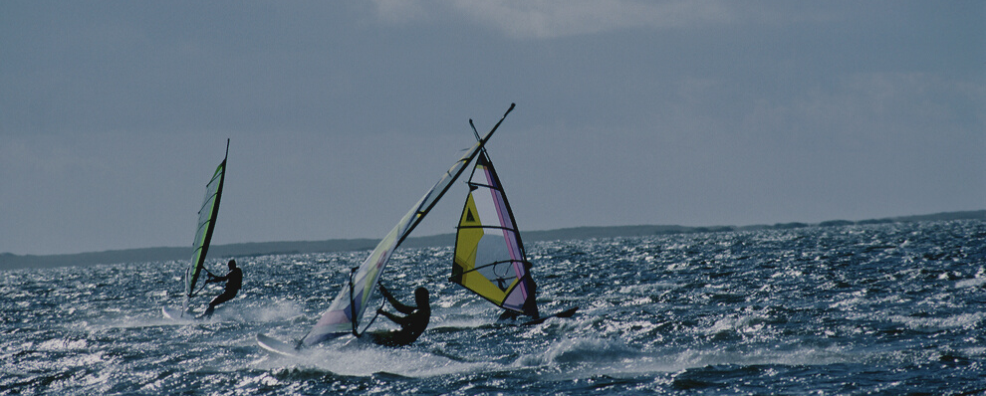
NEXT STEPS
MĀORI ENGAGEMENT
NATIONAL RECYCLED WATER REUSE GUIDELINES
PILOT PROJECT
Progress pilot project at Rosedale WWTP
Te mana o te wai
Te mauri o te wai

Slide 21
Thank You

