Slide 1
Three Waters Reform: The story so far and what’s coming up next

Slide 2
Aims of the reforms
To significantly improve safety, quality, resilience, accessibility, and performance of three waters services. This is critical for:
economic growth and employment
housing and urban development
adapting to the impacts of climate change
mitigating the effects of natural hazards
public health and wellbeing;
environmental outcomes
The Government also wants to ensure it delivers on Treaty-related obligations, including by improving outcomes for iwi/Māori in relation to three waters service delivery and upholding Te Mana o Te Wai.
Notes:
Last year, the Government took a decision to proceed with the reforms to create 4 water services entities. These entities will have joint iwi and local government oversight, balance sheet separation from councils, public ownership, and will deliver stormwater, drinking water and wastewater services.
Due to constraints and challenges facing current council-operated three water services, many of New Zealand’s communities are dealing with unacceptable outcomes from their three waters services.
Government’s proposals seek to address four root causes that have contributed to these persistent and systemic problems:
Limited opportunities to achieve benefits of scale
Significant affordability challenges
Misaligned incentives for critical water infrastructure decisions
Lack of effective oversight and stewardship for the three waters sector
The reforms also present wider opportunities to improve the outcomes mentioned on this slide for New Zealanders by addressing widespread, systemic issues.

Slide 3
High-level timeline
2017-2020
Understanding the case for change
2021
Policy development and testing reform options
2022
Policy refinement and Transition activities
2023
Establishment and Transition
2024
New entities go live 1 July 2024
Notes:
To briefly discuss where we have come from over the last three years and signal where we are heading over the next three years:
Beginning following the Havelock Nth disaster the three waters reviews found significant system wide challenges. However, these issues have been known about for many decades, particularly in the interaction between water infrastructure and things like housing, economic development and growth.
In 2020, Central and Local Government partnered in the governance and oversight of the reform programme. This included building a greater understanding of the case for change and options analysis.
Historically, there has been a poor information base about New Zealand’s three waters infrastructure, assets and operations. During 2020 and 2021, the Department worked with councils to build a substantial body of analysis and evidence on the sector
This research undertaken with international experts and thoroughly peer reviewed found:
An investment requirement of between $120bn - $185bn for New Zealand’s three waters services over the next 30+ years
Potential to achieve efficiencies in the range of 45% over the 30 year period could be achieved through reform
The Reforms could result in an additional 5,800 to 9,300 jobs and increase in GDP of between $14b to $23b in NPV terms over 30 years
This work showed the clear case for change: that the status quo is unsustainable and widespread reform is the only option to address the root causes of the challenges facing the future delivery of these services.

Slide 4
2022 - Another big year for the Three Waters Reform Programme
Concurrent policy and transition activities are underway
Policy refinement
3x Working Groups on outstanding areas of reform.
An ambitious legislative programme.
Transition
Setting up four Local Establishment Entities.
Working with the sector to transition to the new system.
Ongoing local government, iwi and industry engagement will underpin this work
Notes:
By the end of 2021 we had reached a point where broadly the case for change was well understood by those in the local government and water sector, if not well understood by the wider public.
All parties agree the status quo cannot continue and reform is needed in one form or another. Last year Cabinet took decisions to proceed with the reforms on a legislated all-in approach.
With this decision, the early, ‘no regrets’ transition work can shift gear this year to start the enormous job of setting up these entities to take over service delivery on 1 July 2024.
However, there remain areas of the reform proposals which we continue to work in partnership with local government and iwi to ensure we get these right and all parties can have confidence in the reforms ability to achieve the outcomes for communities across NZ.
To be clear, ‘refinements’ do not mean a complete rethink. The reforms are still expected to proceed to the timeframes of hitting 1 July 2024, which is critical for alignment with planning processes.
On the next two slides I will delve deeper into a bit of a roadmap of what 2022 will look like for each of these areas as this is an area we often get questions on. ENZ will make these slides available to you for future reference.

Slide 5
Three Waters policy indicative 2022 roadmap
Policy Refinement
Planning Interface Technical Working Group
Findings anticipated mid-2022 and ongoing as required
Working Group on Governance, Representation and Accountability
Findings expected end of February for Ministerial consideration
Rural Supplies Technical Working Group
Findings anticipated mid-2022 and ongoing as required
informs
Indicative 2022 roadmap
Exposure draft currently available for Working Group consideration (and online)
Water Services Entities Bill 1
Introduced mid-2022
Select Committee consideration of submissions
Water Services Entities Bill 2
Introduced late-2022
Select Committee consideration of submissions
Legislation
Notes:
The policy refinement approach of 2022 is guided by the Heads of Agreement entered into between the Government and LGNZ, and the principles of partnership we have developed over the last few years. However this will be undertaken within the government’s bottom lines for reform of:
Treaty Partnership
Good Governance
Public ownership; and
Balance sheet separation from councils
Working Group on Governance, Representation and Accountability
This includes members from local government and iwi working together to refine the reform proposals in relation to Governance of the new entities, representation of local government, iwi and communities, and accountability arrangements.
These areas are arguably the most contentious areas of the reforms.
The findings and recommendations of this group are expected by the end of February for Ministers to consider refinements to the reform proposals.
Planning Technical Working Group – will focus on how the 3 waters system will interact with the future resource management system.
The scope of the group is to provide advice to DIA to support policy development related to the intersection between the role and functions of the new Water Service Entities and the resource management system
Rural Supplies Technical working Group – will focus on how the new entities will work together with rural suppliers and communities to achieve service outcomes. – this group will have an initial report back around April to inform the legislation, but will continue to work together through other matters as required.
Legislative programme will need to implement Government decisions and this will be informed by the policy refinements and working group findings.
This includes the Select Committee process which will be open for submissions.
I encourage Engineering NZ members, as sector experts, to look out for this legislation and consider making submissions on this at the appropriate time – we will keep ENZ informed of this as it progresses.

Slide 6
Transition focus areas for 2022
Transition Workstreams
Focus areas for 2022
Governance and Appointments
Local Establishment Entities (LEE) Boards and Chief Executives in place
Commercial and Legal
Data discovery with councils
Transition reference groups established
National and local working groups established across all workstreams
Data and Digital
People and Workforce
Finance and Corporate
Asset Management, Operations and Stormwater
Notes:
The Transition work will really begin to ramp up so as to set the entities and industry up for success on 1 July 2024.
The this slide provides a high level look at some of the core workstreams for the transition work. A further detailed Transition Information Pack is available on our Website for more information about this work.
Not to delve into too much of this but some areas I expect will be of interest to this audience that I will note in these workstreams include:
Governance and appointments
Commercial and legal
Data and digital
People and workforce
Finance and corporate
Asset management, operations and stormwater
Alongside these workstreams, there are also overarching programmes of work relating to Iwi/Māori, Working with the Sector, and Customers.
DIA’s National Transition Unit is in the process of setting up working groups and reference groups which will involve people from across the sector helping to design the new system and we strongly encourage you to get involved if you can.

Slide 7
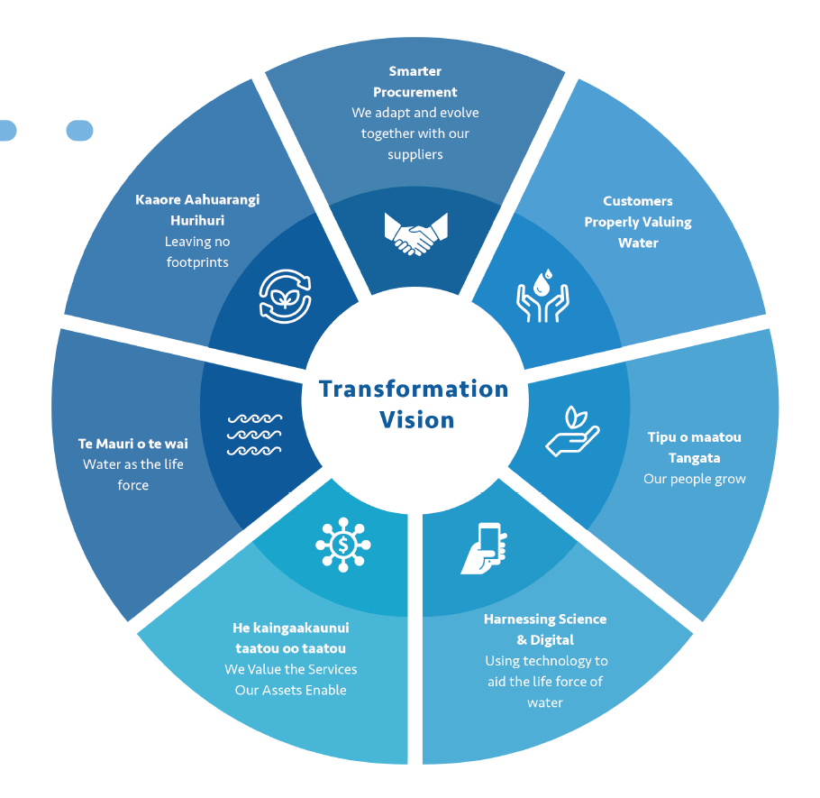
Industry transformation
Notes:
This is a once in a lifetime opportunity to transform how we deliver our water services
The model for the Water Service Entities will be different from what we have now
Te Mana o te Wai at the heart
Customer focused
Benefiting from increased investment, scale and levels of collaboration
Contribution and development of the water workforce
Last year the Department commissioned Deloitte to undertake an assessment of the industry and economic impact of reforms.
The overall findings of this research has found that the reforms could result in an additional 5,800 to 9,300 jobs and increase in GDP of between $14b to $23b in NPV terms over 30 years
This study found the reforms present opportunities for the industry while noting areas to be cognisant of.
Acknowledging workforce limitations and opportunities to address these:
We acknowledge that the water sector is experiencing a workforce shortage, exacerbated by border restrictions and a growing demand for infrastructure delivery.
Issues with workforce availability are not unique to New Zealand. Globally the sector is experiencing challenges with an aging workforce and a step up in the skills required as new technologies and regulations have been introduced.
Reform provides an opportunity to take a more proactive and longer term approach to addressing challenges including:
Building career opportunities and coherent training and development.
Moving the industry structure from the current fragmented approach to procurement will also help to address where there is a wariness about resourcing up to meet that demand due to a concern as to the potential for a “boom/bust” cycle of investment.
In the longer term a combination of a better articulation of career opportunities, the changing nature and increased sophistication of the roles/emerging roles available and the scale of the investment going into the water sector creates the prospect of elevating the status of a career in the water sector with a flow through to the ability to attract both domestic and international talent.
Industry Transformation:
DIA are working with the water industry to develop an industry transformation strategy. A draft of this strategy is expected to be released in the coming months for industry consultation in the coming months.
This strategy will outline a roadmap on several different timeframes, including low-hanging fruit that we can tackle during the transition process over the next 28 months, as well as longer term opportunities that the new water services entities will be tasked with embracing alongside the sector once they are in operation.
Wide sector impacts
Analysis has shown that the reforms will have a significant impact on a wide range of industries.
Engineering, consulting and advisory firms – will need to scale up their investment in operations and employees.
Contracting firms expect to see bigger workforces and a higher focus on compliance areas given the new regulatory environment. International firms may draw on offshore expertise and technology but will still need to deploy significant numbers of people on the ground.
Materials and equipment providers are already scaling up in some cases in preparation for reform. Over time, increased investment in the sector is likely to result in an acceleration in the deployment of new technologies, which will flow through to operational efficiencies.
Supply chain certainty:
The scale of the investment pipeline is likely to be attractive for new entrants, particularly major organisations with a significant presence internationally which are not currently present in New Zealand. Industries with an existing presence in New Zealand are likely to scale up their local operations as they gain greater confidence in reform.
There are also likely to be significant benefits of supply chain scale – including greater standardisation of parts and materials, and greater purchasing power, as well as the availability of greater specialisation

Slide 8
Three Waters Reform Programme
Three Waters - Transition Technical Workstream
February 2022
IN CONFIDENCE
Not Government Policy
Notes:
Kia ora, my name is Lorraine Kendrick, I am the Chief Technical Advisor in the National Transition Unit – 3 Waters and I am here today to provide you with an overview of the Technical workstreams, Asset management, Operations and Stormwater, known as AMOS and how they will relate to Planning the infrastructure pipeline and creating new national guidelines.

Slide 9
1. Technical workstreams
IN CONFIDENCE
Not Government Policy

Slide 10
Technical workstream - AMOS
Asset Management - 3 waters (incl primary stormwater system)
The Asset Management workstream will focus on understanding the current approach to asset management of the water assets across local authorities, determine an appropriate asset management framework and approach going forward, and ensure each Entity has an Asset Management Plan in place by 1 July 2024.
Operations - 3 waters
The Operations workstream will focus on the continuing delivery of the 3 water services and a smooth transfer of all operational functions to the new water service entities. It will identify any non-standard operations so risks and liabilities can be proactively managed.
Stormwater (interface land functions)
The Stormwater workstream will define the future arrangements for the transfer of stormwater assets and management of stormwater systems and infrastructure;
managing the interface between the roles and functions of the proposed water services entities, local authorities, mana whenua, transport providers, and regional councils to work together to manage stormwater systems and functions; and
an approach and timeframe for the transfer of responsibility for managing stormwater from local authorities to the water service entities.
Agreement overview
10
Notes:
The Three Waters National Transition Unit has been created to execute the Government’s decisions on Three Waters reform through a consistent and coordinated nationwide approach to transition.
The NTU is separate from, but works closely with, the team responsible for leading the three waters reform programme and legislation.
There are three workstreams in the technical area that will work closely with the water sector and councils in standing up new sustainable three water systems and supporting the transition to the new water service entities.
The Asset management workstream will focus on understanding the current approach of asset management of water assets across all councils and will work with councils to develop an asset management framework to have Entity AMPs in place for the transition
The Operations workstream will focus on continuing the delivery of the 3 water services and assisting a smooth transfer of all operational functions to the new water service entities.
The Stormwater workstream for the interface land functions will define the future arrangements of stormwater assets and management of the stormwater systems and infrastructure.

Slide 11
AMOS – Engagement with the Sector
DIA National Transition Unit
Asset Management Workstream
Operations Workstream
Stormwater Workstream
Agreement overview
Stormwater Reference Group
AMOS Transition Reference Group
Council Interface Managers
Local Transition Teams
Technical Working Groups
(National and Local)
Customer
11
Notes:
The AMOS workstreams will be guided by an AMOS Transition reference group who will:
Ensure the asset management, operations, and stormwater workstreams are informed by those supporting the transition at a local and regional level
Critically assess the need for and review the progress of the asset management, operations, and stormwater technical deliverable workstreams with key LEE, WSE, and Council asset management, operations, and stormwater staff, and
Support DIA and provide and/or help source expertise as required through the establishment, transition, and implementation change process.
A Stormwater Reference Group is being established, to inform the DIA 3 Waters Transition Unit work program for transferring Stormwater to the new entities. The purpose of this group is to provide a sounding board for the NTU stormwater work programme and provide industry connections into each of the entities.

Slide 12
Transition Operating Model
National Workstreams
Transition Reference Groups
(National)
4. Transition Reference Groups are advisory bodies that provide advice at the request of the NTU Workstream leads. These are a “testing ground” for critical feedback on the Transition.
National Transition Unit (NTU)
Local Establishment Entity (LEE)
1. Pre-LEE, NTU supports the formation of a Local Transition Team with councils in each entity area. Once LEE established primary responsibility for the Local Transition Team transfers over/gets absorbed
Local Transition Team
Councils in Entity X
National Working Groups
5. National Working Groups are set up by Workstream Leads to work on National Transition Activities.
Councils can release staff to work on these working groups and will be compensated where their role is significant.
Local Working Group 1
2. Local Transition Team forms Local Working Groups consisting of subject matter experts
Councils release staff to participate in the Local Working Groups.
There will be compensation for those who are substantially engaged in non-BAU work.
Local Working Group 2
Local Working Group 3
Local Working Group 4
3. National Workstreams leads engage with Local Working Groups who are accountable to the NTU where their role is to deliver on Transition outcomes
Strong focus on local collaboration and local ownership of the work.
Local Working Group 5
Local Working Group n
(accountability)
Ensure delivery of BAU water services
Notes:
The AMOS team will partner with Iwi to ensure that Te Mana o te wai is integral to everything we do in the three waters activities as we work together to achieve environmental goals for freshwater management.
Collaborating with councils will be key to the delivery of the AMOS work programme over the next 2 years, the role of the Local Establishment Entities moving forward through transition will be
Delivering the transition from councils to water services entities (WSEs).
Seconding in council workers where necessary to lead and participate in AMOS activities
Preparation for activities of WSEs after 30 June 2024.
Making decisions on transition matters, including undertaking appropriate engagement.
The NTU is responsible for allocating which transition tasks are undertaken by it and which are undertaken by the LEEs
Through the technical workstream we aim to
Providing certainty that supply chain is not going to stall
Faith in continuing to secure labour force on supplier’s side
Continuing to invest in equipment and plans
Setting up industry for 5-10-30 years – Providing opportunity for innovation.

Slide 13
2. Asset Management
IN CONFIDENCE
Not Government Policy

Slide 14
Asset Management – Key activities
National Three waters Code of Practice for design and materials standards
National Level of Service and Performance Framework
Asset data standards and process for transition to Water entities
Investment Decision and Prioritisation Framework
Asset Management plan and infrastructure framework
Growth development, connection approvals Framework
Entity Draft AMP’s ready for consultation by June 2023
Entity AMPS finalised by June 2024
Agreement overview
14
Notes:
The key deliverable of the asset management workstream will be the development of Entity Asset management plans.
The AMP’s will be developed by the Local Establishment Entities coming together with the multiple asset management plans already in existence.
The Asset management workstream will develop national guidance such as:
National three waters code of practice which Noel Roberts will discuss further.
National Level of Service Performance Framework
Consistent asset data standards for transition
Asset management plan and infrastructure framework
Growth development and connections approval framework.
Utilising these guidance documents will assist in pulling together the various asset management plans which will consider how to optimise the spend profile and where things can be smoothed.
The entity Asset Management Plans will have Funding Plans conjointly developed ready for consultation alongside councils LTP’s in the 12-month period Jul-23 though to Jun-24. The iterative AMP work with Finance for the Funding Plan will address issues round affordability with the timing of proposed projects adjusted should any “smoothing” of AMPs and capital and renewals works programmes be required.
The development of Entity management plans will give early confidence to the wider three waters sector (consultants, product and material suppliers, and contractors) that there will be no investment hiatus (as happened in Auckland in 2010) and the market can have the confidence that the current level of market activity and expenditure will continue at the same or even higher levels. The expectation being that the wider three water sector can continue to invest in people, plant and processes knowing there will be ongoing demand for their goods and services

Slide 15
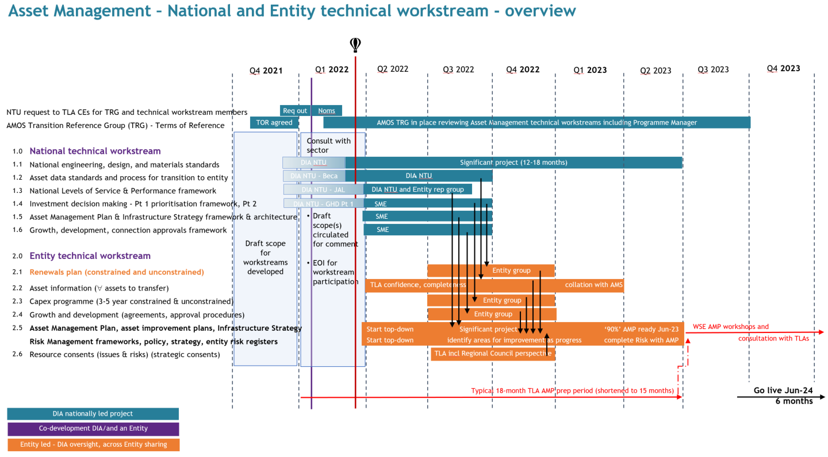
IN CONFIDENCE - NOT GOVERNMENT POLICY
Notes:
I will not go into too much detail on this slide as it hard to see but I have included it as it shows an overview of the work programme showing activities occurring at both a national and local level

Slide 16
3. Operations
IN CONFIDENCE
Not Government Policy

Slide 17
Operations – Key activities
3 Waters Compliance Readiness Framework
National Framework - Consents Governance
National Guideline - Alignment / Extn. of 3 Waters Contracts​
National Guideline - Procurement 3W Services & Infrastructure
Bio-Solids Management - Schedule of Existing Arrangements ​
Commercial Agreements (e.g. Water and Trade Waste)
National Laboratory and Sampling Services (LSS) Schedule​
Non-Standard Operations - Stocktake and Management Framework
Agreement overview
17
Notes:
The Operations Workstream is responsible for the transfer of all operating functions from councils to the water service entities and will work closely with the local establishment entities and councils to ensure a smooth transfer.
Key deliverables for the operations work stream focus on:
Compliance
Guideline for alignment and/or extension of 3 water contracts that may expire during this transition period, this also provides the opportunity to continue investment, improve workforce capacity and resilience and enable efficiency gains.
Guideline for Procurement of 3 water services and infrastructure – provide a framework of fundamental principles that will guide WSEs with future procurement, it will address broader outcomes, social procurement, localism, maori/pacific business
Biosolids management – this provides opportunities for transformation as scale does matter when it comes to investigating options for beneficial reuse of biosoilds
Laboratory and sampling services to understand current arrangements and capacity across the sector
Non-standard operations.

Slide 18
Operations – Key activities
Operating Technology - SCADA / Telemetry Operations Requirements
National Pro-Forma for SLAs
Develop Framework for H&S and Environmental reporting
Quality Management systems
Emergency / Risk Management Processes
Entity Operations Model / Cut over Plan
Agreement overview
18
Notes:
Operating technology – Scada – The working group for OT is being set up which has representatives from rural, provincial and metro councils for each entity along with suppliers who will work closely with the AMOS team and the NTU Data and Digital team to provide clarity on the OT functionality necessary for smooth operational transition.
Proforma for SLA’s
At a local level the AMOS team will work with local establishment entities and councils to:
Develop Framework for H&S and Environmental reporting
Emergency/Risk management processes
Entity operations model – Working with councils develop a Cut over plan which will provide a framework to ensure that all operating functions are transferred in full to the WSE’s.

Slide 19
Operations Overview – National and Entity Technical Workstream Deliverables
NTU request to TLA CEs for TRG and technical workstream members | AM Transition Reference Group (TRG) - Terms of Reference
AMOS Transition Reference Group (TRG) - Terms of Reference | TLA CEs request for Technical Working Group members
 | National technical workstream
1. | Operations Compliance Risks – Status Schedule​
2. | 3 Waters Compliance Readiness Framework
3. | National Framework - Consents Governance
4. | Schedule of 3 Waters Contracts
5. | National Guideline - Alignment / Extn. of 3 Waters Contracts​
6. | National Guideline - Procurement 3W Services & Infrastructure
7. | Bio-Solids Management - Schedule of Existing Arrangements ​
8. | Commercial Agreements (e.g. Water and Trade Waste)
9. | National Laboratory and Sampling Services (LSS) Schedule​
10. | Non-Standard Operations - Stocktake
11. | SCADA / Telemetry Operations Requirements (for D&D)
12. | National Pro-Forma for SLAs
 | Entity technical workstream
a. | Biosolids - Identify opportunities regional beneficial reuse
b. | Identify arrangements for Commercial Agreements to transfer
c. | Identify LSS arrangements
d. | Management Framework – Non-Standard Operations
e. | Develop framework for H&S and Environmental reporting
f. | Quality Management systems
g. | Stocktake of Emergency / Risk Management Processes
h. | Entity Operations Model / Cut over Plan
Q4 2021
Q1 2022
Q2 2022
Q3 2022
Q4 2022
Q1 2023
Q2 2023
Q3 2023
Q4 2023
Req out
Noms
TOR agreed
AMOS TRG (and Programme Manager) in place reviewing Operations technical workstreams
Draft Terms of Reference for workstreams developed
Consult with sector
Draft TOR circulated for comment
EOI for workstream participation
Legal, Policy
Legal, Policy, Transformation
AMOS TRG, Digital
Legal, Policy, AMOS TRG
Entity, Legal, Policy
Draft Entity AMPs prepared
Ongoing AMP workshops
Interface with other Workstreams
Go live Jun-24
6 months
DIA Nationally Led Project
Co-development DIA/and an Entity
Entity Led – DIA oversight, Across Entity sharing
Notes:
Similarly, I have provided a slide showing an overview of the Operations workstream deliverables at National and local levels which has been covered by the previous slide.

Slide 20
4. Stormwater
IN CONFIDENCE
Not Government Policy

Slide 21
Stormwater landuse interface – Key activities
Confirmed methodology Framework & Approach for which Stormwater Assets/Functions/Outcomes will transfer.
Confirmed (all) specific legislative provisions (i.e. powers and functions) required for Stormwater transfer.
Confirmed framework for roles & responsibilities for the interface functions between Regional/Unitary councils e.g. flood risk/life lines.
Principles/framework for future Interface Agreements (inc. SLA’s/MOU’s)
Stormwater Catchment management Plan Framework
Integrated Catchment Management Plan Framework
National Stormwater Modelling Guidelines
Confirm existing Governance arrangements
Agreement overview
21
Notes:
In June 2021, Cabinet agreed that “the water service entities will be responsible for: services and infrastructure relating to stormwater quality and quantity including taking over the related services and assets currently held by territorial authorities (though not including stormwater services and infrastructure related to their role as road controlling authorities)”
This means that primary responsibility for stormwater will be with water services entities, they will have to assess, monitor, maintain, upgrade, and operate the stormwater infrastructure. Water services entities will have to work closely with territorial authorities and regional councils to manage what enters the stormwater system.
A dedicated stormwater team has been set up across the DIA Policy team and the National Transition Unit to develop the future of the stormwater system partnering with councils.
There is a Stormwater Reference Group being set up with representatives from local authority staff from each of the four entities, Taumata Arowai and regional councils. Additionally, two technical working groups are being set up, one from territorial authority stormwater technical staff (including from the roading and parks teams) and one made up of regional council and unitary authority staff working in stormwater and flood management. These groups will work through the detail of transferring stormwater responsibilities to water services entities and what is retained by local government.

Slide 22
Stormwater Overview – National and Entity Technical Workstream Deliverables
Go live Jun-24
6 months
Q4 2021
Q1 2022
Q2 2022
Q3 2022
Q4 2022
Q1 2023
Q2 2023
Q3 2023
Q4 2023
 | National technical workstream
1 | Asset Management, Operations, and Stormwater (AMOS) Transition Reference Group (TRG) Terms of Reference approved and delivered
2 | Confirmed methodology Framework & approach for which Stormwater Assets/Functions/Outcomes will transfer, with timeframes.
3 | Confirmed (all) specific legislative provisions (i.e. powers and functions) required for Stormwater transfer.
4 | Principles/framework for future Interface Agreements (inc. SLA’s/MOU’s) (assets/functions/land not transferred to WSE - critical function SW)
5 | Stormwater catchment management plan Framework
6 | Integrated Catchment Management Plan Framework
7 | Engage with MFE to identify how the stormwater catchment management plans could be integrated into land use planning in SPA, NBA, NES
8 | National Stormwater Modelling Guidelines developed
9 | Confirmed framework for roles & responsibilities for the interface functions between regional/unitary councils in relation to CDEM, e.g. flood risk/life lines.
10 | Confirmed specific interface agreements for the interface functions between regional/unitary councils in relation to CDEM, e.g. flood risk/life lines.
11 | Confirm transitional legislative issues- to identify water service entities as lifeline utility operators in CDEM Act.
12 | Participate in 2022 CDEM Act review to ensure alignment with emergency management response
13 | Confirm existing governance arrangements with SW responsibilities
14 | Performance measurement framework
15 | "National design standards - 3 waters, stormwater (scope to be confirmed with Asset management workstreams)"
 | Entity technical workstream
A | Confirmed Stormwater Assets/Functions that will transfer and associated timeframes
B | Interface SLA agreements (assets/land not transferred)
C | Confirmed existing regulatory requirements for SWMP's, approach to align with SWMP Framework
D | Confirmed approach for how Stormwater catchment management plans will be integrated in land use planning in their catchments
E | Transfer governance arrangements to WSE's
Draft Terms of Reference for workstreams developed
Consult with sector
Draft TOR circulated for comment
EOI for workstream participation
Reginal entity workstream budgets covered by REU/WSE from 1 Jul-22
Interface with other Workstreams
Co-development DIA/and an Entity
DIA Nationally Led Project
Entity Led – DIA oversight, Across Entity sharing
Notes:
I’ll skip past the overview slide showing the deliverables at a national and local level.

Slide 23
5. Policy and legislative requirements
IN CONFIDENCE
Not Government Policy

Slide 24
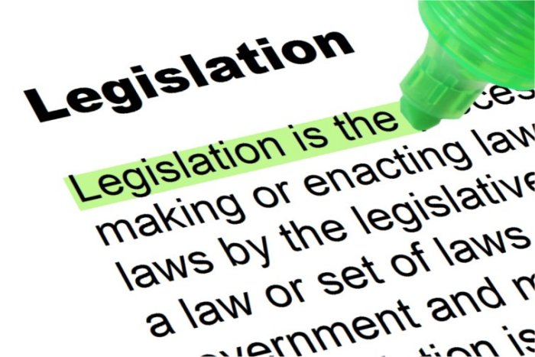
Policy – Supporting the delivery of 3 waters
Potential replacement of Bylaws
Maintenance/renewal/installation of 3 waters assets
Land access
Powers and Functions
Enforcement provisions
Level of service provisions
Retaining existing governance arrangements
Agreement overview
Policy
24
Notes:
The AMOS team is working closing with the 3 waters policy and reform team to input into legislation and policy to enable the water service entities to have the appropriate powers and functions to deliver the three water services. Areas that are being worked on are:
Review of Bylaws
Land access
Powers and functions of the entities
Enforcement provisions
Level of service provisions and
Retention of existing governance arrangements.
That concludes my presentation and I will now hand over to my colleague Noel Roberts who will introduce himself and give you an overview of the National Code of practice for 3 waters.

Slide 25
6. National Design Standards
IN CONFIDENCE
Not Government Policy
Notes:
That concludes my presentation and I will now hand over to my colleague Noel Roberts who will introduce himself and give you an overview of the National Code of practice for 3 waters.

Slide 26
National Engineering Design and Materials Standard (Code of Practise)of practise Project
To create a nationally consistent design of 3 water assets in new developments, growth and intensive housing. Not intended to be a design for drinking water or wastewater treatment plants.
Approaches to
There are currently 45 different council design codes plus NZS 4404:2010 in use across New Zealand.
A collaborative project involving councils, developers and suppliers.
Agreement overview
Code of Practise
26
Notes:
This is a transformative project rather than a transition project but has significant national benefit

Slide 27
National Engineering Design and Materials Standard (Code of Practise)of practise Project
SCOPE
Stormwater / Green infrastructure
SCADA data standard
BIM design standards linked to Asset Data standards (developed further in ver 2)
Commissioning, hand over procedures and inspections
Operations and Maintenance plans
Online and mobile friendly access to code
Drinking water reservoirs (version 2)
Agreement overview
Code of Practise
27

Slide 28
For more information
www.dia.govt.nz/Three-Waters-Reform-Programme
Email: ThreeWatersTransition@dia.govt.nz
IN CONFIDENCE
Not Government Policy

Slide 29
People and Workforce Workstream
National Transition Unit
Water New Zealand Workshop
February 2022
IN CONFIDENCE
Not Government Policy

Slide 30
A people-centred transition
The Three Waters National Transition Unit has been established to:
Ensure a smooth and effective transition to the new water services entities through completion of transition activities.
Ensure the new entities are able to commence their operations successfully, while managing risks and minimising the disruption to consumers.
Leverage the transition for strategic transformation opportunities.
Improving outcomes for the water itself (te mana o te wai), and the environments and communities that depend on it, will depend significantly on the people who govern, lead, work for and partner with the four Water Services Entities.
The workforce principles outlined by the Government are core to the kaupapa of the NTU - placing the people who work in local government water service delivery at the centre of transition.
Their wellbeing is paramount, and their engagement across the transition process is essential.
Agreement overview
People and workforce
30

Slide 31
People & Workforce Workstream
In line with this purpose, the people & workforce workstream will:
Undertake workforce analysis and planning required to enable a smooth and effective transition.
Manage the allocation of activities between the NTU and establishment entities, deliver the activities allocated to the NTU, and oversee the delivery of activities allocated to the entities.
Have primary responsibility for the delivery of organisational design of the entities and the establishment of terms and conditions of employment through collective bargaining and the standardisation of individual employment agreements.
Hold the relationship with unions and engagement with staff affected by the transition.
Work closely with local government organisations (as current employers), unions and the existing workforce on the transition activities, staff retention and wellbeing.
Agreement overview
People and workforce
31

Slide 32
Organisational design and roles in the Water Service Entities
The organisational structure of the WSEs will include all current roles that “primarily undertake functions that will be transferred to the entities” and are not senior managers
The design of the senior management structure and detailed design of the WSEs will be led by the NTU
Detailed design will focus on:
The work that is currently undertaken by staff whose role is “partially water” with roles included to undertake this work
Additional functions and capabilities arising from the reform and the transformation strategy that are identified as priorities
There will be wide engagement on organisational design, including opportunities for the active participation of staff whose roles are affected by the change
This process will require significant cooperation with councils and CCO employers to:
Ensure the process is informed by accurate data
Enable staff affected by the change to have a say in the change
Achieve the aim of giving staff clarity about how their role is affected and their opportunities in the entities as early as possible
Prioritise staff wellbeing throughout the change
The immediate priority is to gather information needed to prepare for change, hence the recent People & Workforce information request; and to establish the relationships on which active engagement depends.
Transfers will be on ‘core terms’, which are (overall) no less favourable current terms and conditions of employment, but otherwise on standardised terms and conditions:
Criteria for what constitute a role that 'primarily undertakes functions that will be transferred' will be developed by the NTU, in consultation with the establishment entities and local authorities;
NTU will develop, in consultation with the establishment entities, standardised terms and conditions of employment to be offered to transferring employees;
Collective agreements will transfer unless they are replaced by new agreements before Day 1;
No redundancy compensation payable when an offer of transfer is made in through this process;
Employees who only partially undertake functions that will be transferred to the new water services entities will not be automatically eligible to transfer.
Agreement overview
People and workforce
32

Slide 33
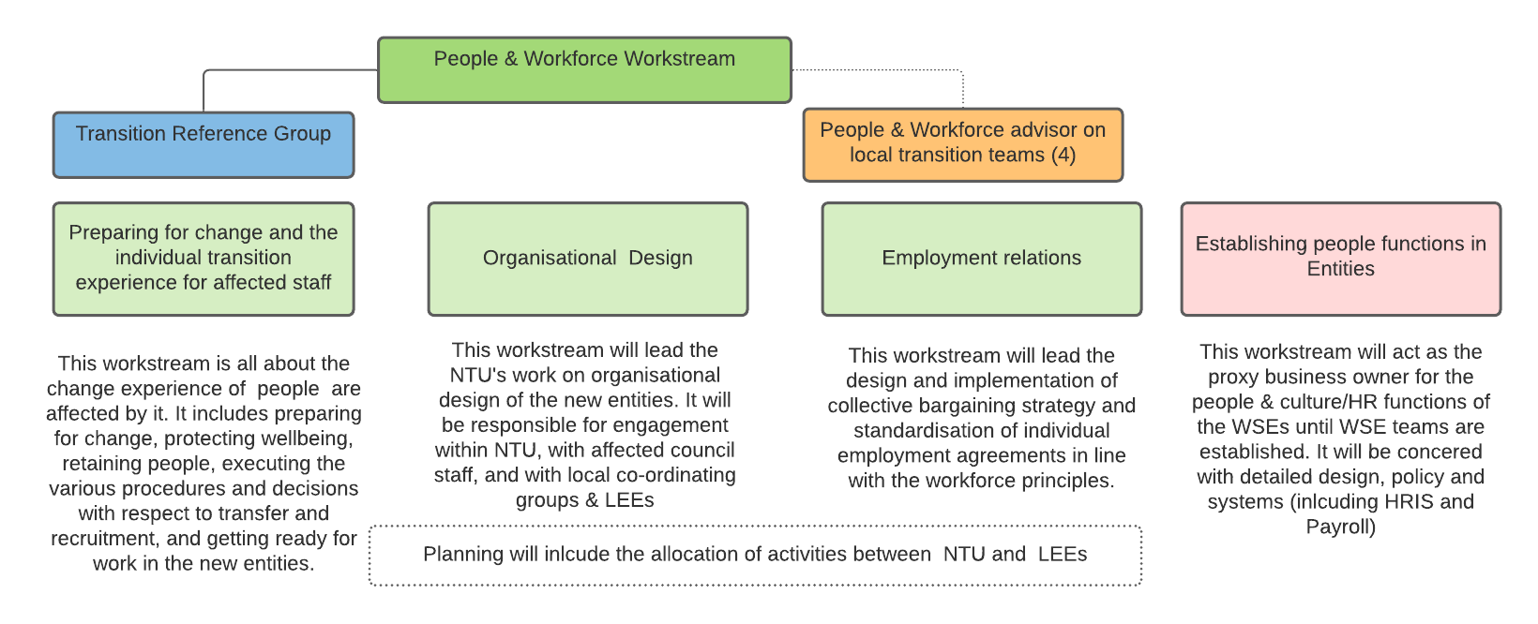
Workforce workstream – overview of activities
Agreement overview
People and workforce
33

Slide 34
People & workforce transition reference group
Vision and Outcomes
The vision of the People and Workforce Transition Reference Group is for the transition of the three waters workforce to the water service entities to be achieved through high levels of engagement among staff, current employers, unions, new entities and the national transition team.
The outcome sought by the group is for the entities and their staff to be ready to deliver water services in line with the objectives of the reforms. This means retaining and developing the three waters workforce, creating good jobs, workplaces and work systems, and ensuring staff wellbeing is a priority throughout transition.
Membership (Roles & Responsibilities)
All members of the Group will have first-hand knowledge of the three waters workforce. The members will include Chief People Officers, or their equivalent, or senior specialist staff, from local government organisations.
As a group, they will have expertise across the following areas:
change management
organisational design
industrial relations (including collective bargaining)
learning and development
The membership will cover a geographically diverse range of local government organisations from both urban and rural communities.
Agreement overview
People and workforce
Purpose
The purpose of the Group is to:
Inform planning: to ensure that the workforce transition plan, including guidelines for implementation, is informed by those involved in supporting the transition at a local level​
Prioritise staff wellbeing: propose approaches to monitor and develop responses to staff wellbeing issues that arise through transition​
Review communications: to Local Government, affected staff, unions and other relevant stakeholders ​
Provide and/or help source expertise: as required through the transition for staff transition and organisational design related activities
Lead key activities on behalf of the national transition unit (NTU)
Meetings
The Group will meet fortnightly on either Teams or Zoom. The timing of the meeting will be finalised once the members are agreed. There are likely to be specialist sub-groups established, with up to two days a week during shorter periods required for these processes.
34

