Slide 1
JOHN KOUMOUKELIS
COMBINING THE USE OF ENGINEERED
AND NATURAL PLANTS IN ACTIVATED
SLUDGE SYSTEMS

Slide 2
OVERVIEW
Bio-Film Based Technologies
Benefits
Combined Use with Natural Plants
Case Studies in Europe

Slide 3
100 Years of Activated Sludge
The activated sludge process has just turned 100 years old
In the last three decades, various new technologies or processes have been developed (MBR, MBBR etc)
Drivers for these new technologies include energy reduction, nutrient removal, water reuse and managing physical constraints

Slide 4
Bio-Film Based Technology
Growth of a thin layer of biomass on a carrier
The carrier can be either fixed or suspended
In conjunction with an activated sludge process

Slide 5
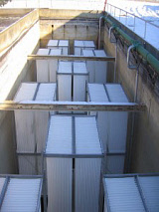
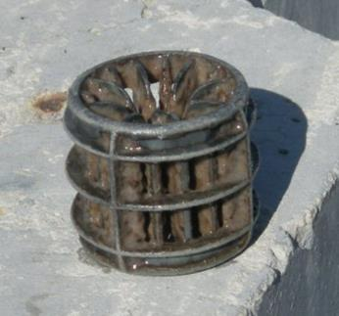
Bio-Film Based Technology
IFAS = Integrated Fixed Film
Activated Sludge (FIXED)
MBBR = Moving Bed Bio-Reactor (SUSPENDED)

Slide 6
Bio-Film Based Technology
Key Advantages
High surface area/low footprint reactor size
High amount of biomass available – robust against peak flows, less solids washout
Bio-film contains anoxic/aerobic layers
Retrofit to existing reactors to increase capacity or performance

Slide 7
Bio-Film Based Technology
Combining IFAS with Natural Plants
Wetland based processes are well proven; but the process has a high footprint
Natural plants (marsh plants) provide a high surface area for biomass to grow on
What happens if you could combine both?

Slide 8
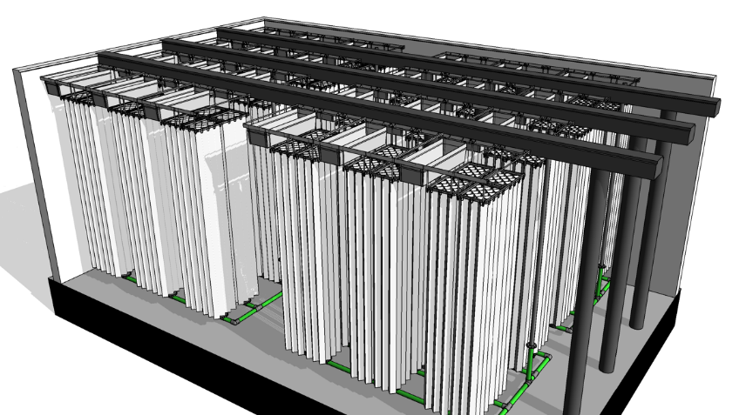
General IFAS System

Slide 9
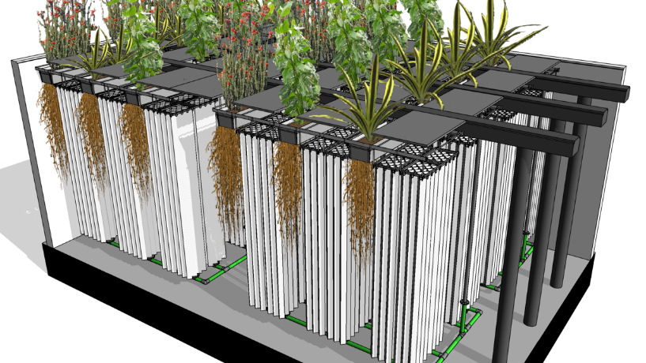
Combined IFAS With Natural Plants

Slide 10
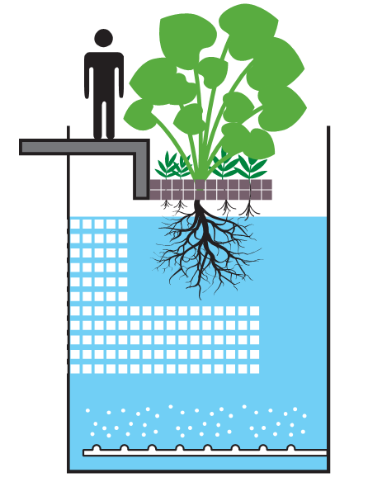
Organica FCR Reactor
Walkway and plant supporting rack
Plants on the supporting mesh
Activated Sludge
in suspension
Root zone (up to 1.5m)
As fixed film carrier
Engineered supporting media

Slide 11
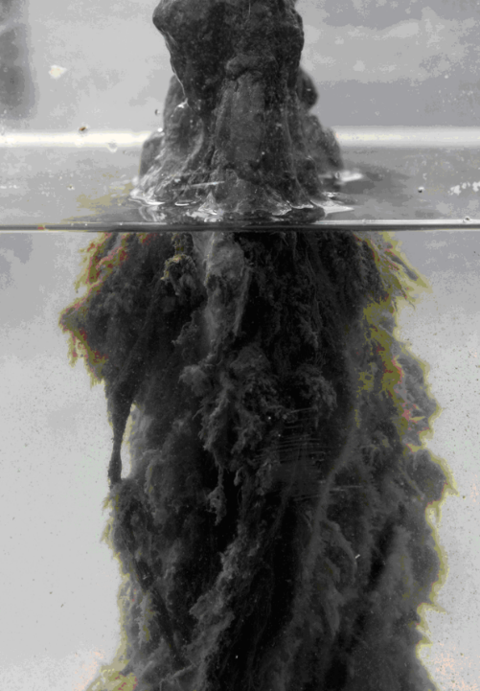
The Outcome
The plant roots interact with biomass, by
providing enzymes and organic acids
A very robust biomass is produced, that contains 3000+ species as opposed to 400 – 500 that is typically produced in an activated sludge process
High resistance against shock loads and storm events
Low footprint, like any other IFAS/MBBR or MBR
Unique ecosystem that eats itself, reducing sludge production
Low “free” MLSS reduces aeration demand
Ability to support cray fish and other life

Slide 12
Reactor Zones

Slide 13
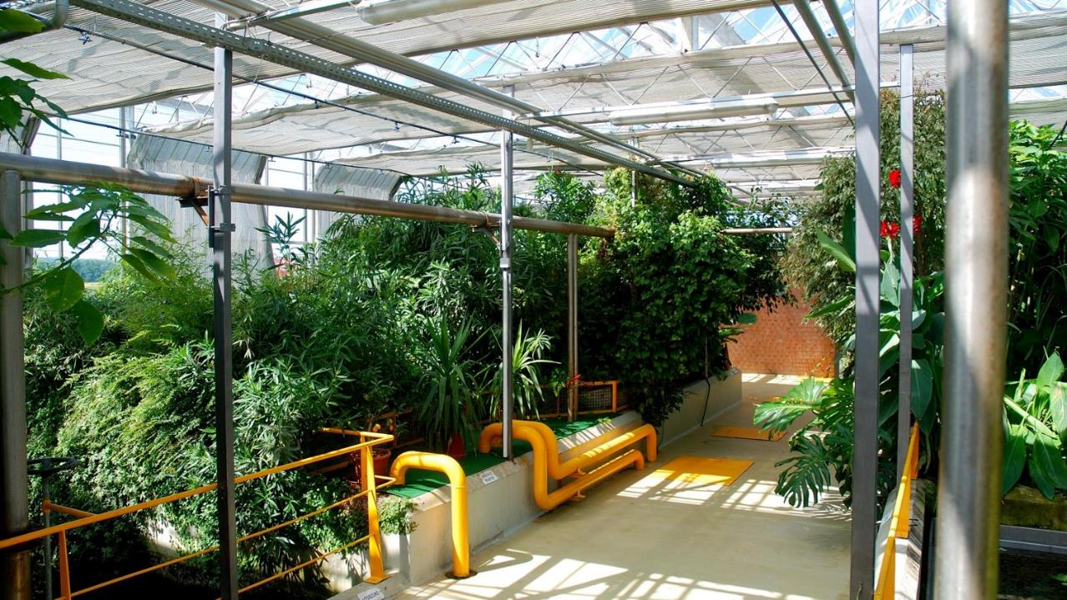

Slide 14
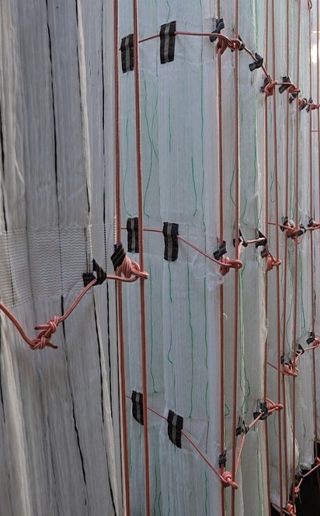
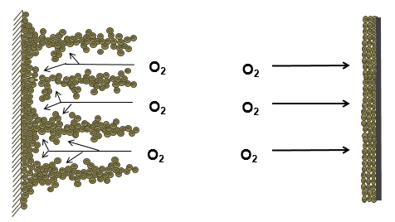
Open Biomass Structure
The engineered loose spiral matrix is designed to work in conjunction with the plant roots.
Organica FCR Biofilm Loose Spatial Matrix
Conventional Fixed Film Biofilm Structure
25 – 30 mm
Biofilm Structure
0.3 – 0.5 mm
Biofilm Thickness

Slide 15
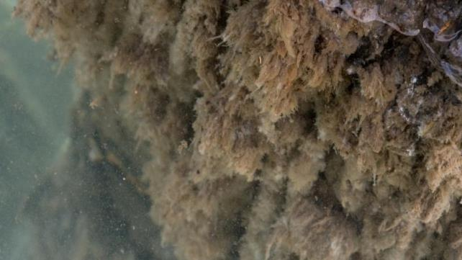
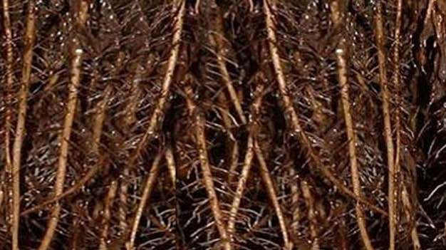
Natural and Engineered Media
12,000m² surface area per m³ of reactor space
Loose special matrix biofilm provides excellent mass transfer

Slide 16
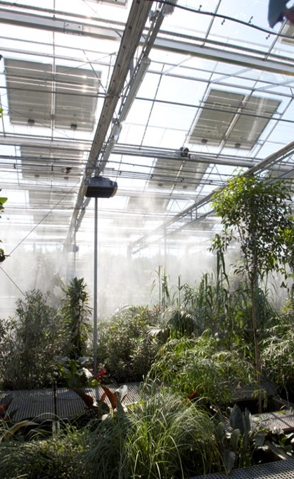
Improved O₂ transfer
The low SS in the reactor provides a high alpha value which significantly improves oxygen transfer

Slide 17
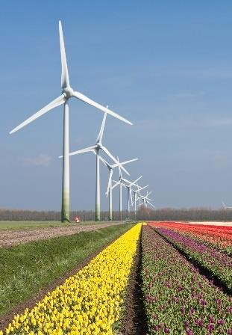
Lower Energy Demand
This improved oxygen transfer efficiency requires far less energy than alternative technologies

Slide 18
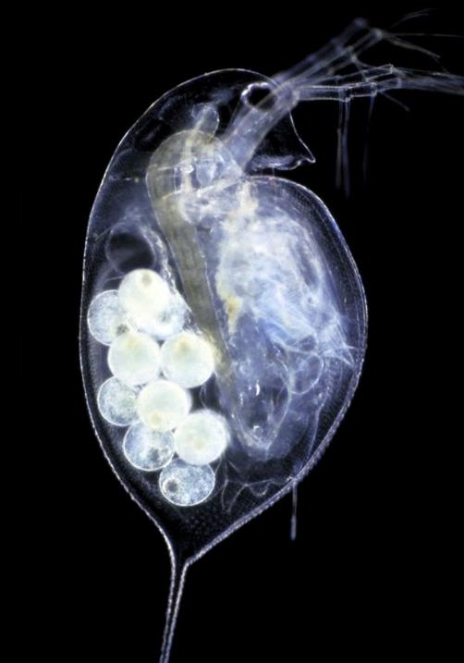
Diverse Ecosystem
The system contains a highly complex ecosystem:
Bacteria
Protozoa
Worms (Nematodes, Rotatoria)
Mollusc (Mussels, Snails)
Arthropod (Crayfish)
Plants
Fish

Slide 19
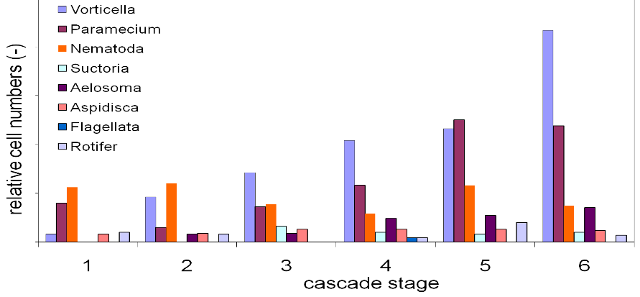
Distinct Ecosystem In Each Phase

Slide 20
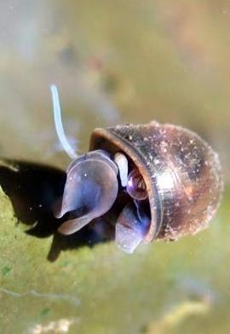
Diverse Ecosystems
The Organica FCR with its diverse ecosystems results in lower volumes of sludge

Slide 21
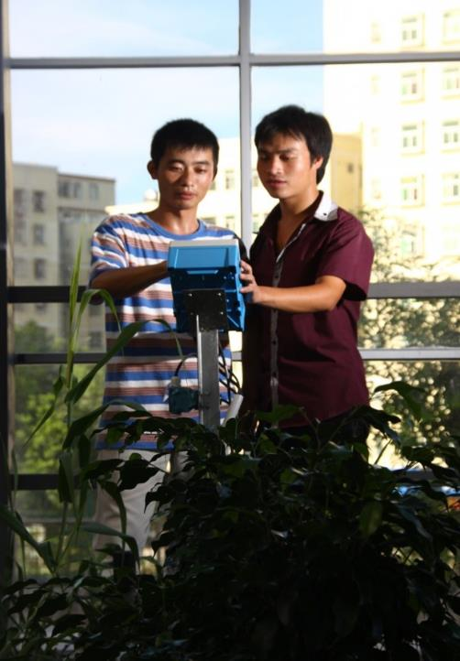
Complete Cost Comparison
Due to the high oxygen efficiency and low sludge generation, the overall operating cost of an Organica plant is quite significantly less

Slide 22
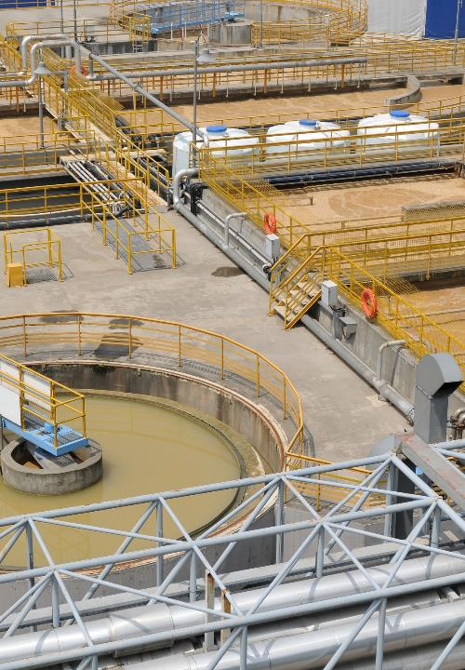
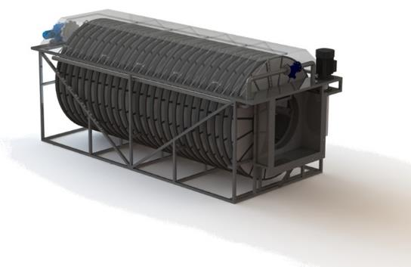
No Need For Clarifiers
Because of the low MLSS in the final reactor, the solids can be removed by a disc filter as opposed to a clarifier.

Slide 23
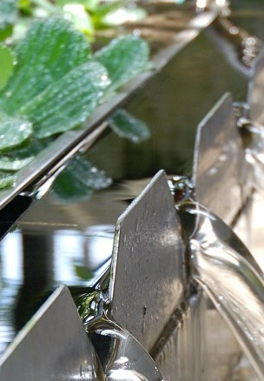
Performance
As well as any biological process (ie BNR etc)
Can be sized for TN = 5 and BOD < 10 mg/L
Minimum odour issues
Requires a tertiary stage for high level water for reuse

Slide 24
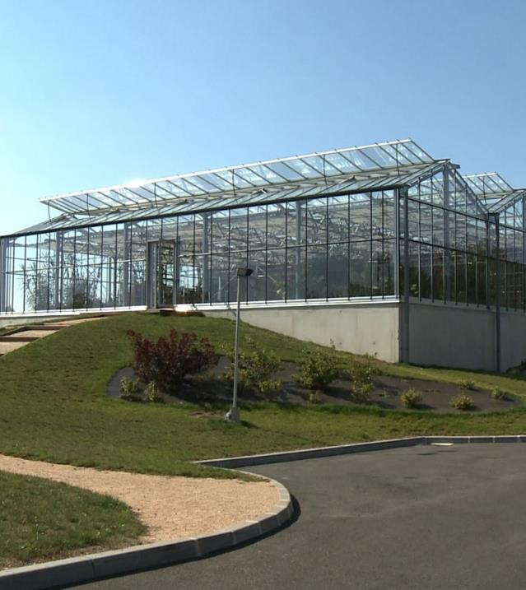
Le Lude STP - France
6000 PE, 0.85 MLD
Parameter | Influent | Effluent | Limit
COD | 703 | 37 | 125
BOD | 390 | 6 | 25
TKN | 61 | 8
TN | 91 | 6 | 15
TP | 12 | 0.7 | 4.8
TSS | 511 | 8 | 35

Slide 25
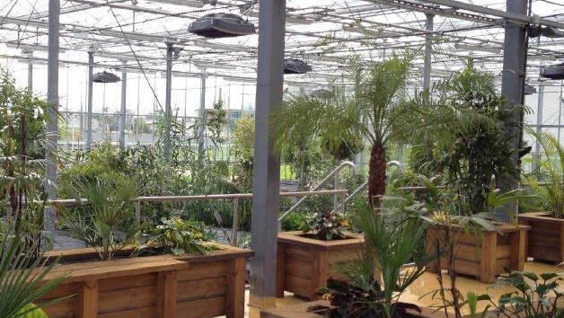
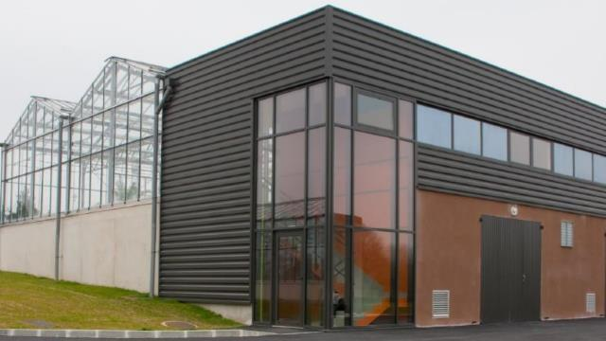
Operators Feedback
1 x main operator with 1 x standby operator
Commissioning and Performance achieved after 3 months
5hrs /day, 5 days/week required for operation
Garden upkeep twice per year
Regular MLSS sampling as per typical A/S plants

Slide 26
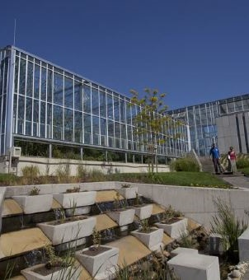
South Pest STP - Hungary
500,000 PE, 80 MLD
Parameter | Original Load (t/d) | New Load (t/d) | Difference (%)
COD | 42.7 | 70.8 | +65
BOD | 25.4 | 35.4 | +40
TSS | 15.2 | 30.7 | +102
TKN | 3.8 | 5.3 | +40
TP | 0.6 | 0.94 | +57

Slide 27
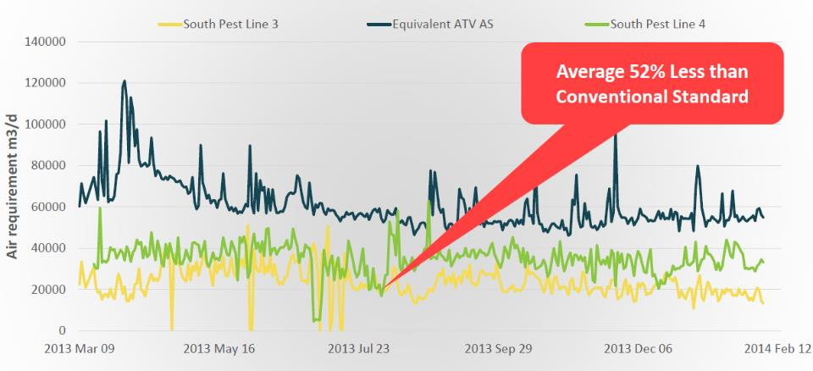
South Pest STP - Hungary
On commissioning, with existing load – Air Demand reduced 52%

Slide 28
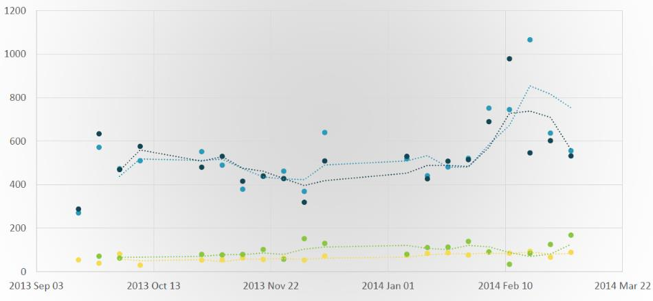
South Pest STP - Hungary
COD removal was 80%

Slide 29
Installation of the IFAS Modules and Plant Rack Supports

Slide 30
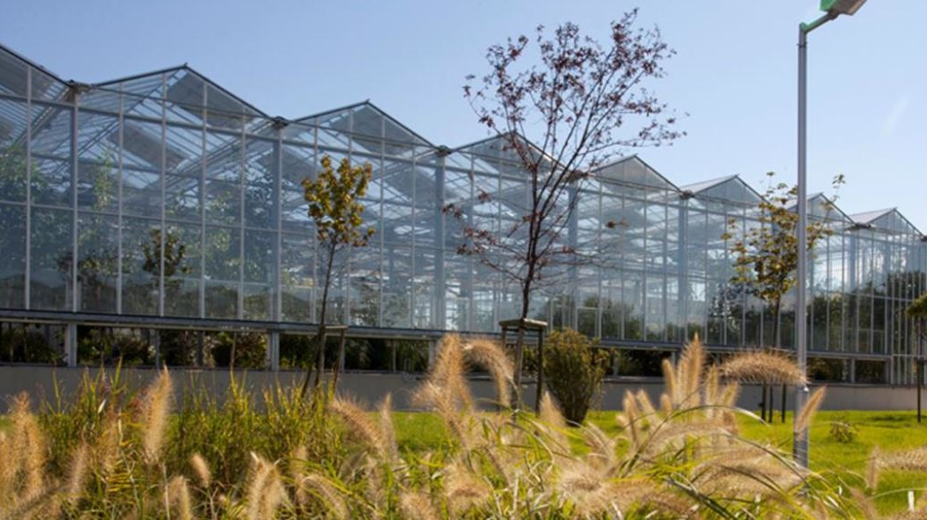

Slide 31
Conclusion
IFAS/MBBR solutions offer benefits such as reduce footprint and ability to handle shock loads
Combined use of IFAS + Natural Plants provides numerous benefits as well as a sewage treatment plant that looks like a garden
Full scale installations in Europe, Asia and Nort America by Organica Water have demonstrated stable operation and have changed community views with regard to sewage treatment, leading to enhanced community engagement and even shortening of buffer zones
The system is ideal for integrating sewage infrastructure into dense urban landscapes

