Slide 1
Water Conference NZ
Pipe Alignment Tool: Optimising Servicing Strategies for Unconnected Properties
Andrew Liese BE(Hons) Computer Systems

Slide 2
Background
Yarra Valley Water
7,000 high risk properties to be connected into the network.
Many More “Low Risk”
6 Weeks
Automated Approach?
Notes:
Who are YVW
YVW Pricing Submission Requirements
Project Scope
They own and manage over 20,000 kilometres of water and sewer mains, servicing over 2 million people.

Slide 3
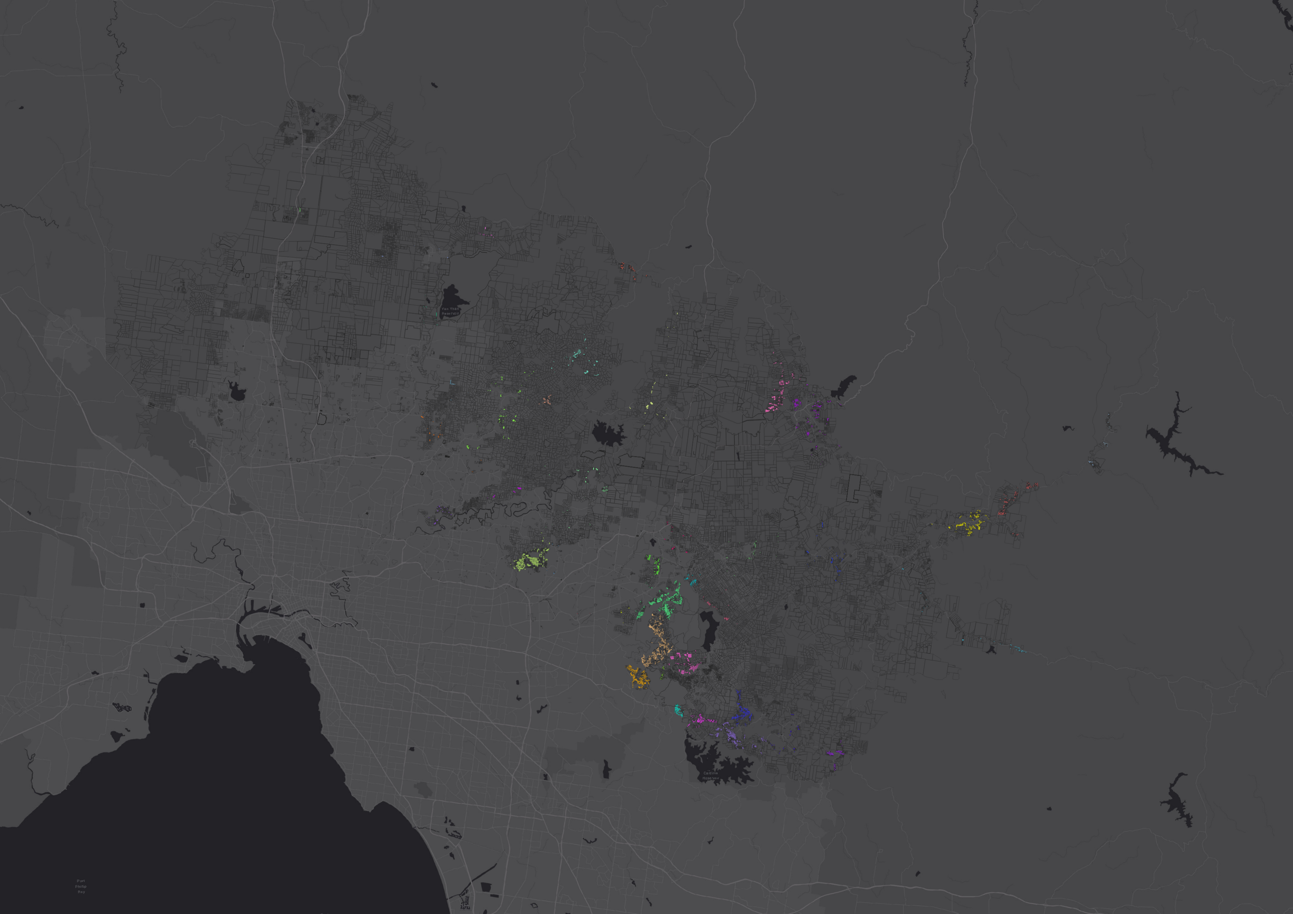
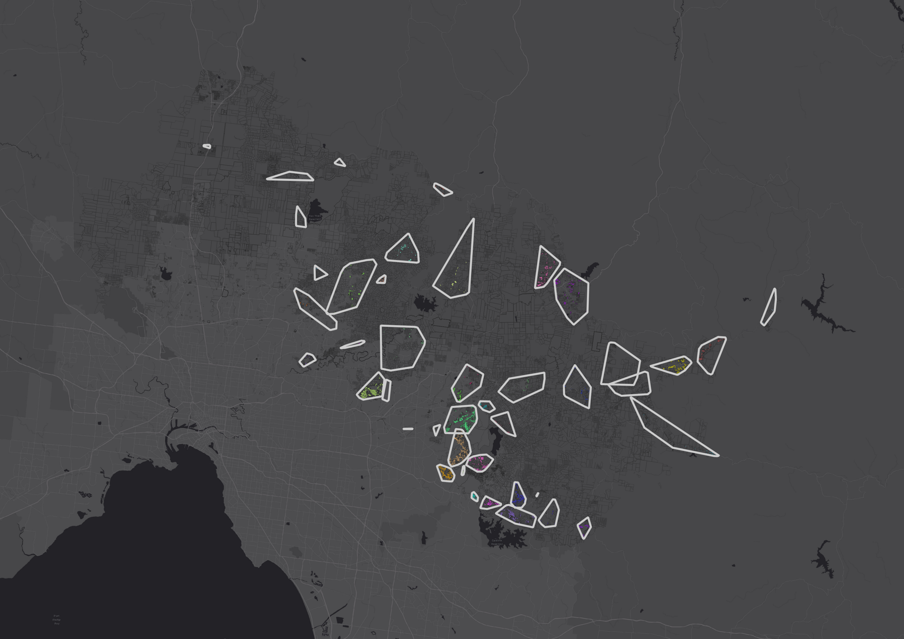
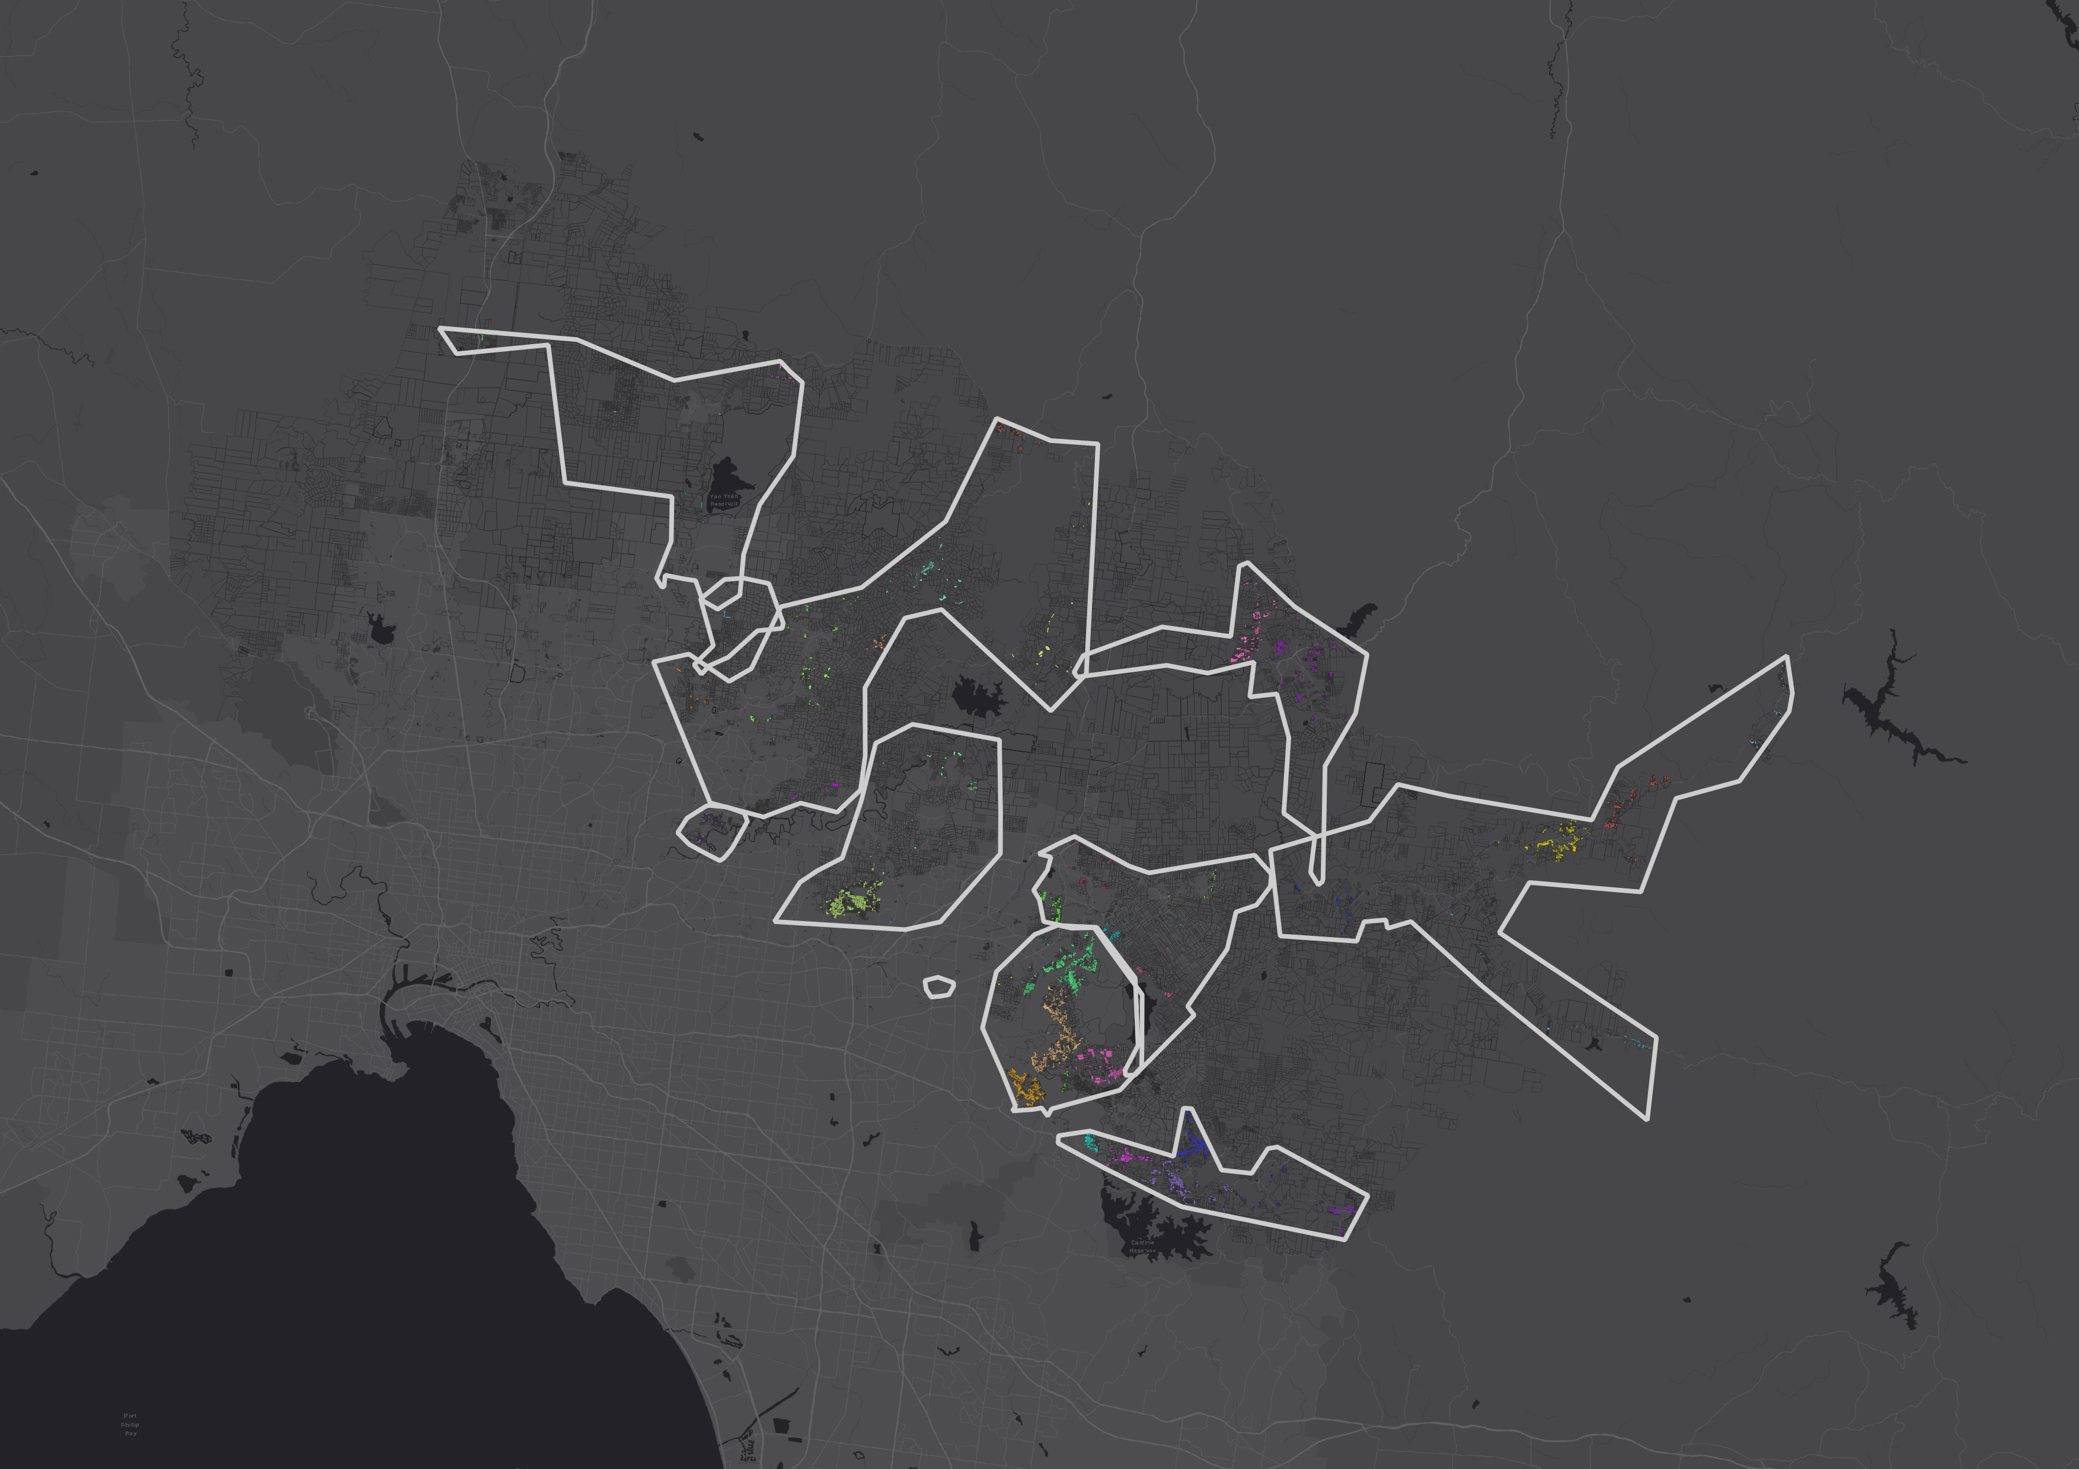
Notes:
Who are YVW
YVW Pricing Submission Requirements
Project Scope
They own and manage over 20,000 kilometres of water and sewer mains, servicing over 2 million people.

Slide 4
Automated Approach?
Replicate Detailed Traditional Approach
Replication of Engineering Judgement
Replicate a couple of broad strokes?
Building center points as connections
Follow Road

Slide 5
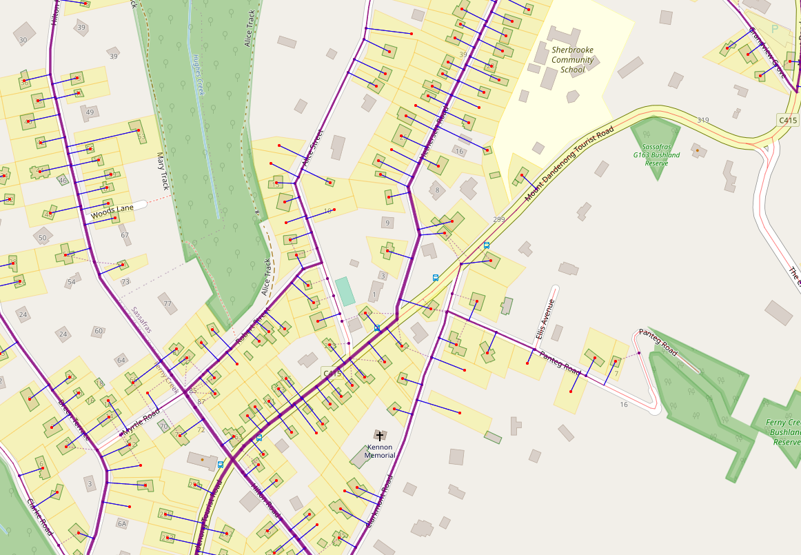
Automated Approach?

Slide 6
Lessons Learnt
Network Constraints
Gravity
Pressure
Rising Main
Parcel Low points
Overall For Gravity
Building Adjacent for pressure
Soil Types
Cost

Slide 7
Haves and Have Nots
We Have | Don’t Have
Parcels – with risk values | Detailed LiDAR
Roads Layer (OSM) | Soil Composition
Existing Sewer Nodes | Cost Tables
Building Footprints

Slide 8
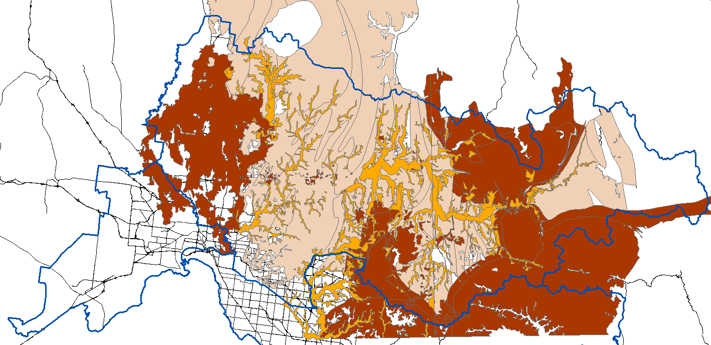
Ground Conditions
VicMap Geology layer GEOL250
Granite
Siltstone
Clay

Slide 9
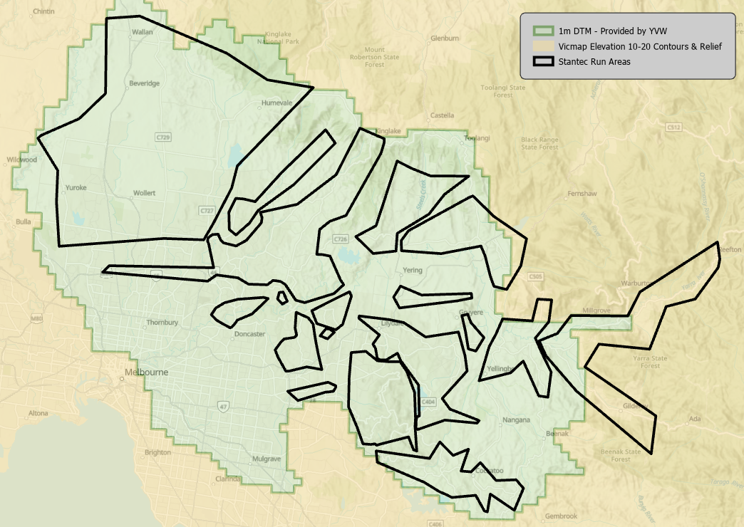
LiDAR Availability

Slide 10
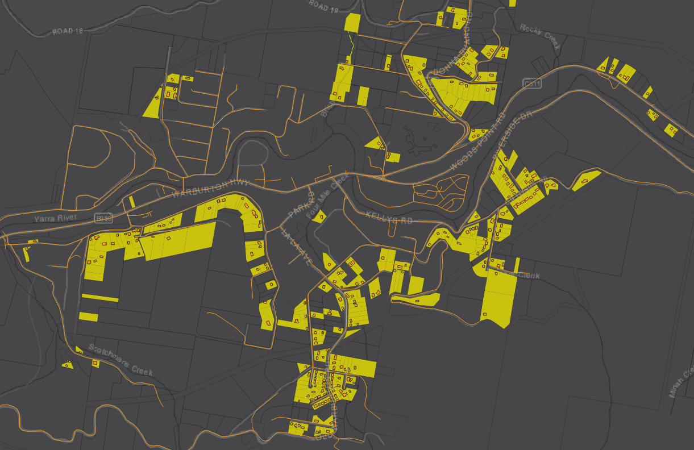
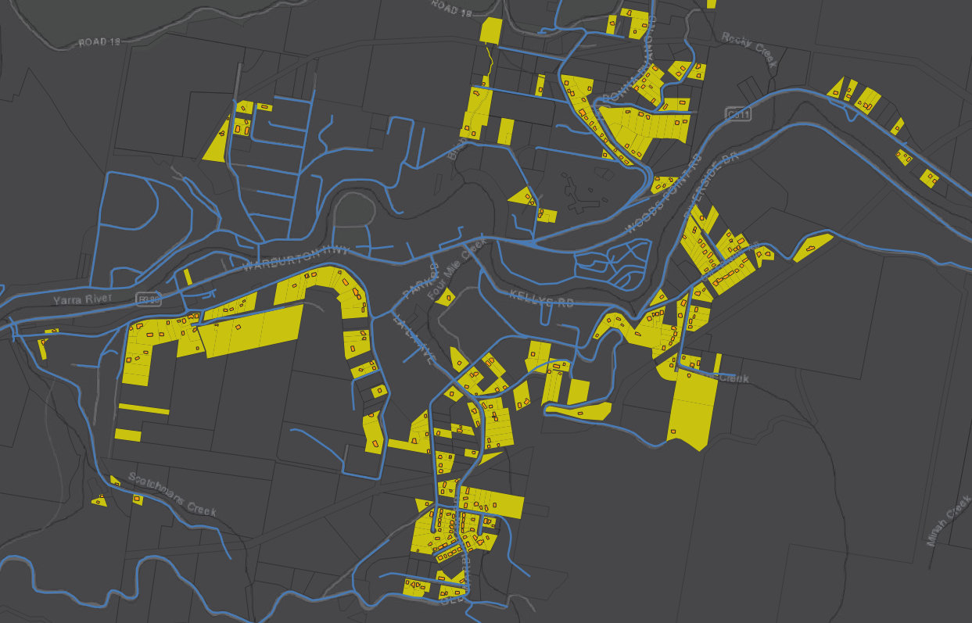
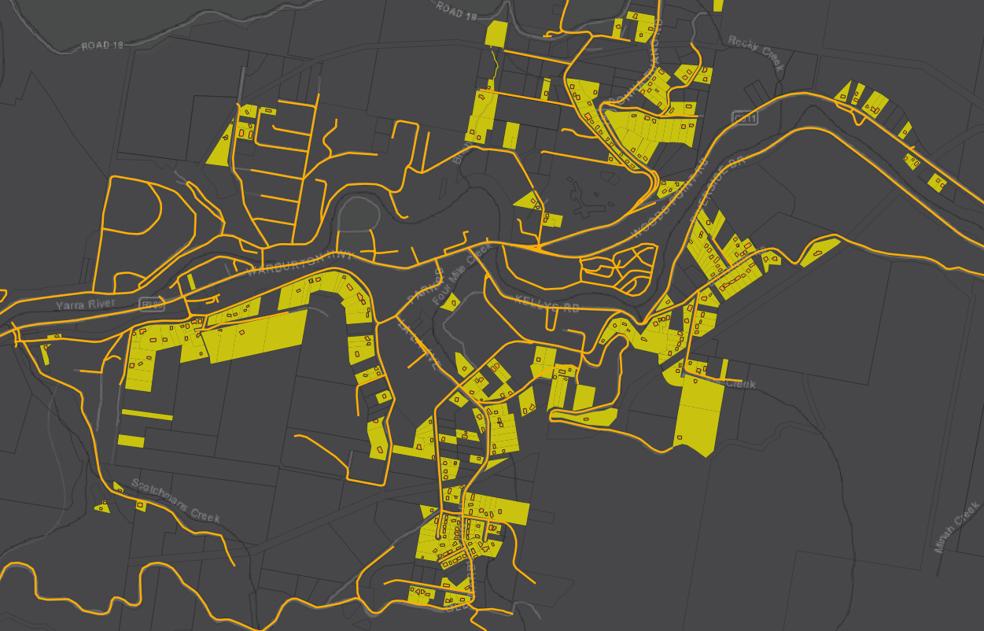
Methodology
Overview
Roads as Potential Pipes
Shortest Path
Each segment has 2 pipes
Improvements
Gravity flows downhill
Assign Cost
Add Pressure and RM
Connect Gravity to RM
Allow ‘Dig Deeper’ Method

Slide 11
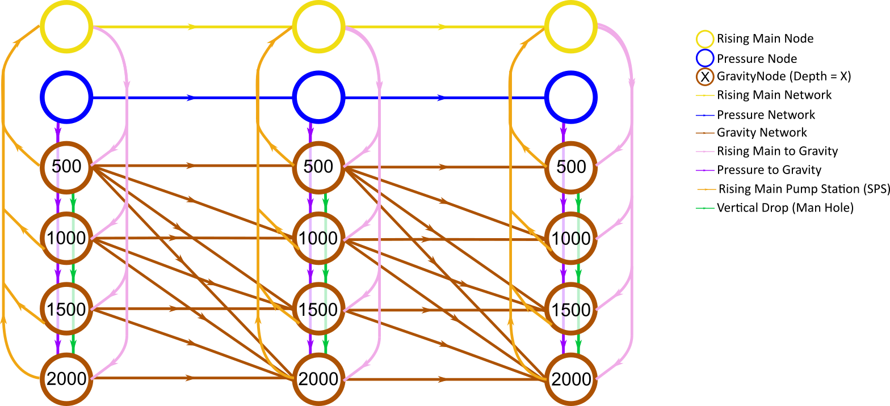
Upstream
Downstream
Higher
Elevation
Lower
Elevation

Slide 12
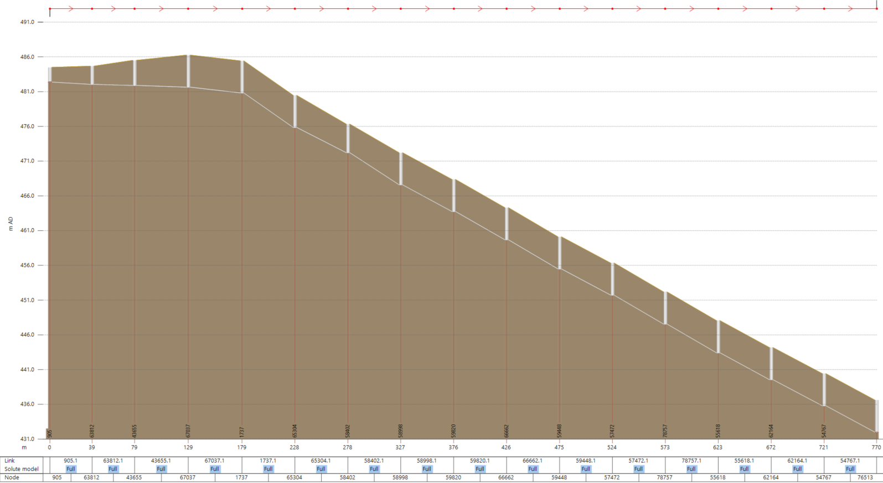
Outcome / Delivery
Wins!
Last Minute Scope Change
All High Risk Properties Connected
Around 3.5k Low Risk as well
Pipe Sizing
Model Compatible
But….
RM Pump Station Placement
Booster Station placement
5% - 10% Manual Work
Still Mostly Pressure

Slide 13
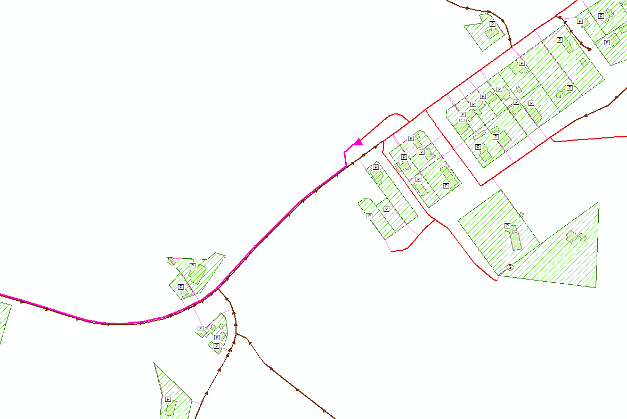
Pressure networks into gravity networks
Gravity into Pumping Station into Rising Main
Rising main flow direction
Pressure and rising main in same street
Pressure network flows back towards pumping station

Slide 14
Future Work
Already re-used in NZ and Australia
Ongoing developments for scenario comparisons
Same Client came back with expanded scope
Refining to better reflect Engineered Solution

Slide 15
Questions?

Slide 16
Without change there is no innovation, creativity, or incentive for improvement. Those who initiate change will have a better opportunity to manage the change that is inevitable.
William Pollard

Slide 17
Extra For Experts

