Slide 1
Māori Engagement and our Wai
Te Kaunihera-ā-Rohe ō Ngāmotu
Kelsey Tamaiparea - Three Waters Engagement Lead
Notes:
Mihi/Pepeha
Tēnā koutou kātoa, he mihi ki te iwi e tau nei, Ngai Tahu tēnā koutou.
Ki a tātou e tau nei, kia ora.
Me, my whakapapa to Puketapu/Te Pou Tūtaki and my background
6 iwi, multiple hapū. (8 Te Atiawa)
Todays kaupapa

Slide 2
Notes:
Te Ao Māori view vs Engineering view
History of Taranaki not widely known

Slide 3
Notes:
Ngaturei Pa and Pakaraka Pa – amount of disturbance to Pā of Puketapu
Waahi taapu viewer and SASM rules came in 2019 – a little too late for some things
Genuine engagement required to get projects across the line

Slide 4
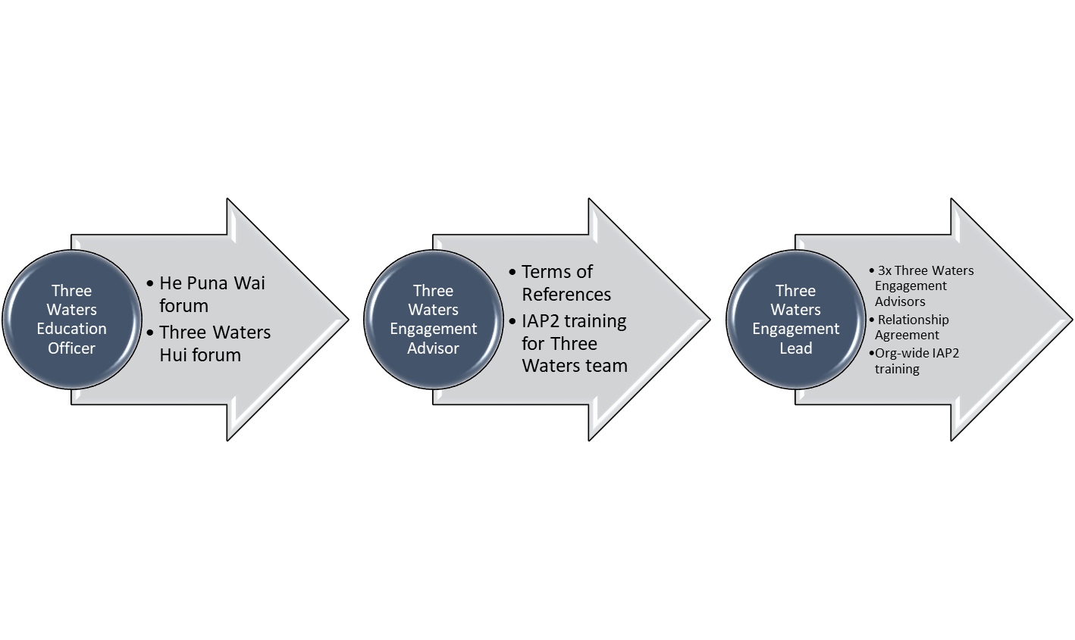
Our Journey
Notes:
Cultural navigator requirement
Helping mana whenua be heard across three water projects vs Helping project managers get projects across the line
Engagement Team – Atawhai Tibble 5 Wais
Relationship Agreement – Hapū trustee representative vs cultural expertise

Slide 5
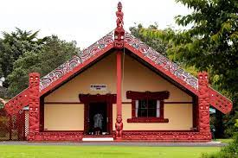
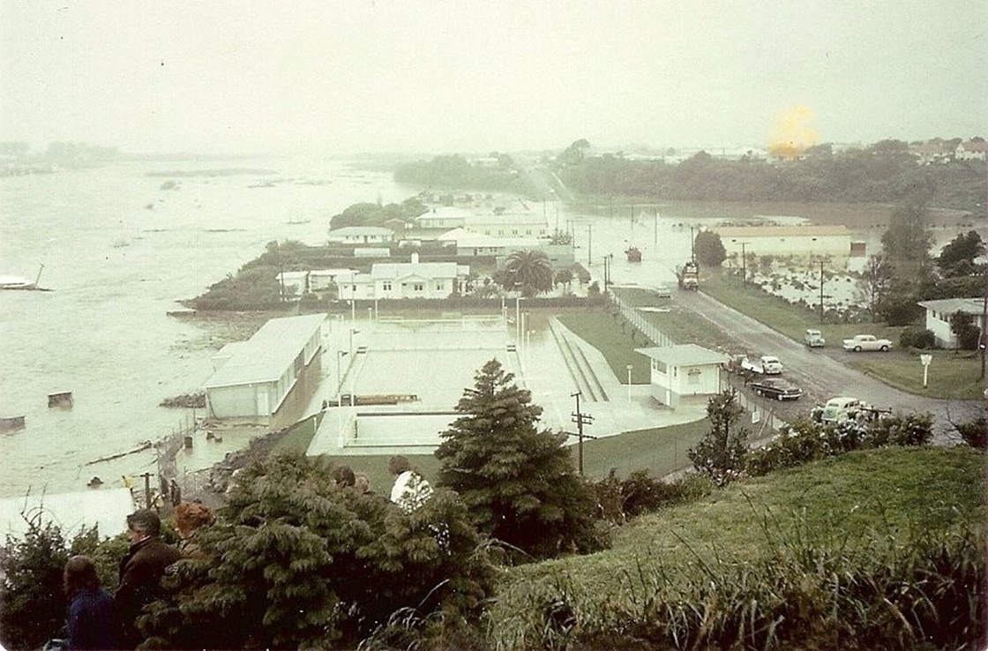
Case Study - Tangaroa

Slide 6
