Slide 1
Source Water Risk Management Area Modelling for Groundwater: Issues and Uncertainties
Helen Rutter
Jane Alexander
Catherine Moore
16 October 2022

Slide 2
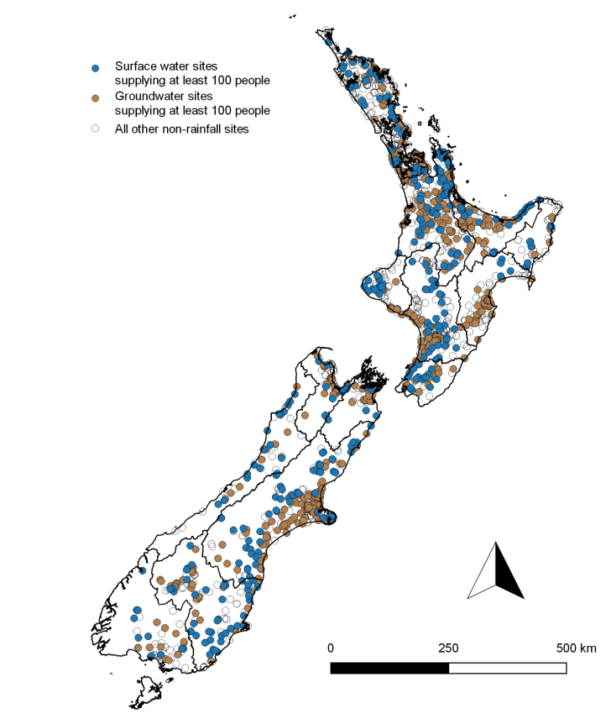
Introduction
Background to SWRMAs
Mapping and modelling philosophy
Approaches to SWRMA delineation
Uncertainty analysis
Model and uncertainty framework

Slide 3
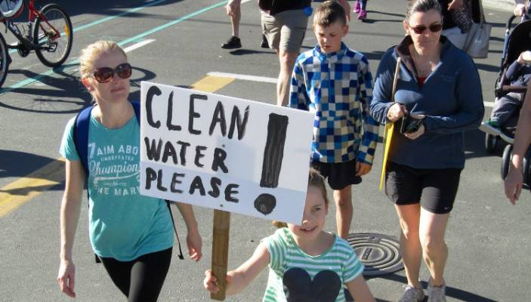
Why the focus on SWRMAs?
Havelock North and drinking water reform
Burden of poor quality drinking water in NZ
40-50 outbreaks per year
34,000 NZ’ers become ill every year
System needs to improve
Drinking Water NES

Slide 4
Six principles of drinking water safety
Water safety principles:
A high standard of care should be embraced
Protection of source water is of paramount importance
Maintain multiple barriers to contamination
Change precedes contamination
Suppliers must own the safety of drinking water
Apply a preventative risk management approach

Slide 5
Groundwater 101
Groundwater sources tap into many different hydrogeological settings
Springs, galleries connected to rivers, shallow wells, deep wells
Different levels of risks associated with each
Not always simple to quantify level of risk
SWRMAs are about risk management
Many different possible approaches to delineation

Slide 6
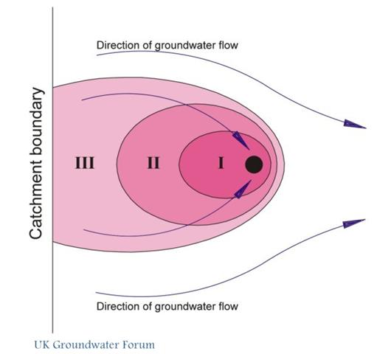
SWRMAs
SWRMA1 – immediate wellhead protection area
May be a radius of between 5 and 30m
Aim is to prevent any contamination immediately entering the well
Strict control of land use activities
SWRMA2 – one-year travel time
Provides time for attenuation of microbial contaminants
Specific land use activities may be controlled
May be no surface expression of one-year travel time
Deep, confined aquifers
SWRMA3 – whole catchment for source
Concern is more persistent contaminants
May need to consider large scale discharges and cumulative effects of small scale discharges

Slide 7
Mapping and modelling philosophy
Balance between protecting human health and maintaining productive land use
“Bad things” that we don’t want to happen
SWRMA is too limited and people get sick
SWRMA is too large and valuable land can’t be used or has limited use
Different SWRMA delineation approaches
Selection of SWRMA approach
Desired level of confidence, available data, numbers supplied
For example, simple default method with demonstratively conservative uncertainty limits may be used initially
If this results in undue land use restrictions, this may be the motivation to move to a more complex model

Slide 8
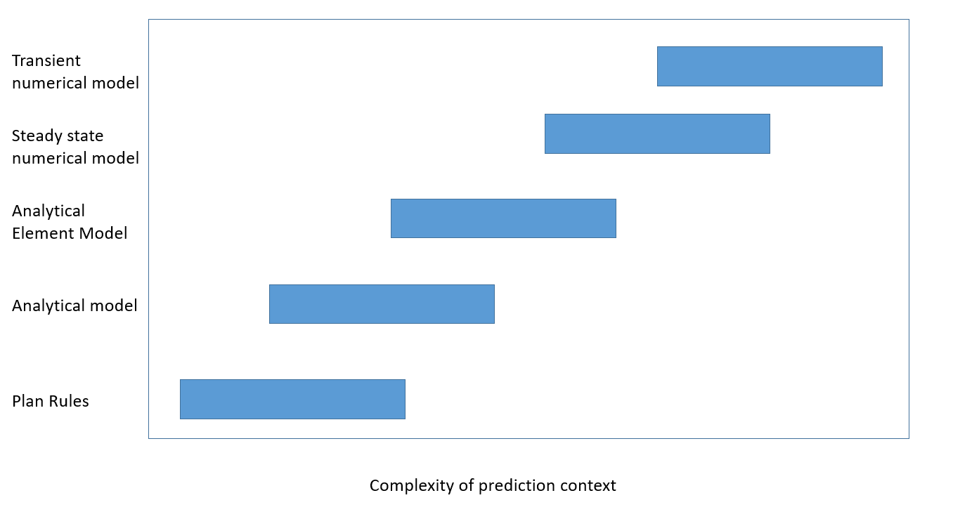
Prediction context – components influencing model approach
Number of people supplied
Pumping rate and hence size of SWRMA
Potentially well depth
Hydrogeological context
Aquifer itself
Prevalence of preferential flow paths
Variability in conditions e.g. changes in flow gradients
Availability of data to inform model parameters
How much can data reduce model uncertainty
Tracer tests, age dating, aquifer tests, stream gauging

Slide 9
Prediction context
Simple – well is screened in homogenous, unconfined sand aquifer and is used to supply two dwellings
Pumping rate low
Boundary conditions can be ignored
Model can be based on expert knowledge and site characterisation
Complex – town supply well screened in alluvial gravels with high permeability transport pathways
Larger pumping rate
Will need to represent more distant boundary conditions (e.g. surface water) and how these could change over time
Will require more complex modelling and assessment of uncertainties

Slide 10
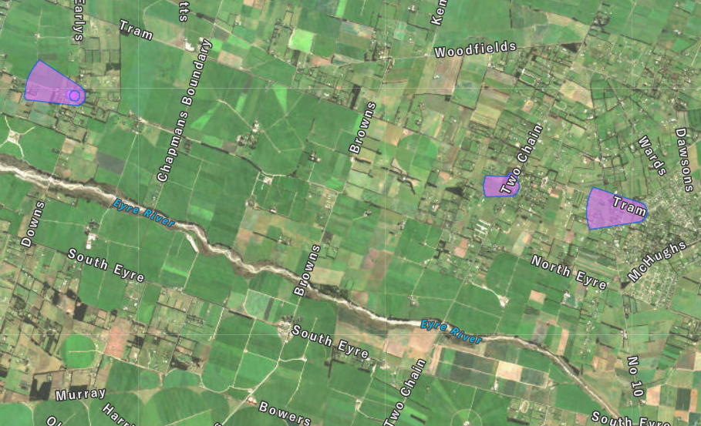
Approaches to SWRMA delineation
Defining the SWRMA
Arbitrary radius/calculated radius
Predefined shape
Analytical modelling approaches
Complex numerical modelling
Simple methods
Complex models
Over-large areas
More refined areas

Slide 11
Simple approaches to SWRMA2 delineation
Arbitrary radius
Fixed radius around the well
Least certain, but easy and inexpensive
2.5km radius is accepted for most aquifers
Calculated radius
Based on abstraction, aquifer parameters and recharge
Bases SWRMA 2 on site-specific information but doesn’t take into account flow direction
Impacts on land use

Slide 12
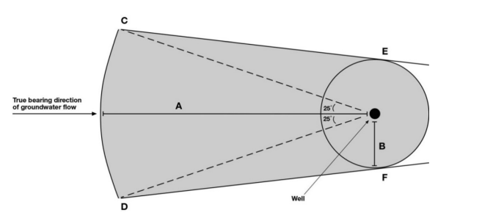
Simple approaches to SWRMA2 delineation
Predefined shape
Dimensions depend on
Well screen depth
Whether confined or unconfined
Control over
Radius of immediate circle around source
Up-gradient distance
For example (ECan)
Deep well (>70m) – radius of 100m
Shallow well (10 – 30m)
Radius 200m
Upgradient boundary 1000m

Slide 13
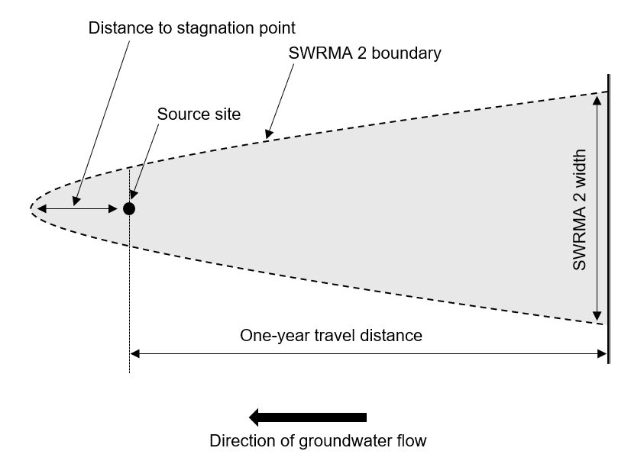
Analytical approaches to SWRMA2 delineation
Calculate contributing area based on constant rate abstraction, flow direction and aquifer properties
Commonly a parabolic area with stagnation point down- and cross-gradient
Analytical equations used to calculate:
Stagnation point
One-year travel distance
Width at up-gradient boundary
Rules of thumb or equations

Slide 14
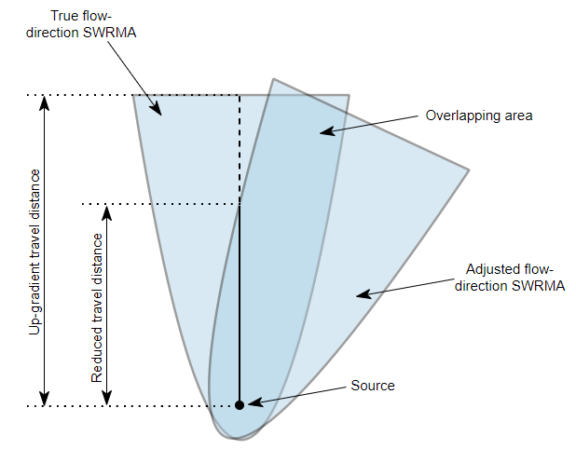
Analytical approaches to SWRMA2 delineation
Input parameters include:
Abstraction rate
Hydraulic gradient
Aquifer hydraulic conductivity
Aquifer porosity
Often don’t have data but sometimes can use proxies
Lack of confidence in parameter values can be accounted for by using conservative parameters and adjusting values e.g. +/- 25%
Uncertainties in flow direction

Slide 15
Numerical approaches to SWRMA delineation
Numerical models can be used to simulate 2D or 3D flow and transport
Accommodate more complex flow and transport
Spatially varying aquifer parameters
Changes between confined/unconfined conditions
Multiple wells
Varying pumping rates
Boundaries e.g. rivers, no-flow boundaries
Built over larger areas and can be used to account for interference from pumping at different locations

Slide 16
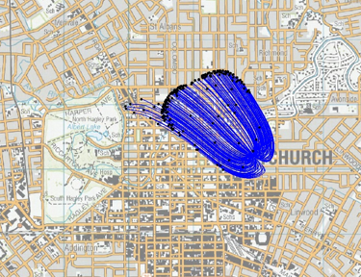
Numerical approaches to SWRMA2 delineation
May be considered where there is need to understand uncertainty clearly, or need to minimise the SWRMA extent
Don’t have to adopt same level of conservatism as simpler models
Require good understanding of hydrogeological setting
Often not developed for SWRMA delineation but using an existing model
“Detached” SWRMAs can occur
As can one year travel time that doesn’t arrive at the surface

Slide 17
Approaches to uncertainty analysis
All SWRMA delineation is based on incomplete knowledge
The SWRMA cannot be determined with certainty
As a result, uncertainty quantification is important
Uncertainty quantification describes how uncertain a prediction is

Slide 18
Model inputs and uncertainty
Four main categories of inputs which have associated uncertainty
Model structure – including geometry and boundaries
Parameters – including hydraulic conductivity and effective porosity
Stress – pumping rates and recharge
Data – piezometric gradient and flow direction
Several approaches to uncertainty analysis
Engineering factor of safety through to complex stochastic analyses

Slide 19
Framework – combining modelling and uncertainty approaches
Prediction context determines appropriate approach to delineation and uncertainty analysis
Pumping rate low (small communities)
Appropriately designed simple models with simple approach to assess uncertainty
For example, safety margin
Check model outputs do not contradict available data or conceptualisation

Slide 20
Framework
Moderate to high pumping rate (large communities to cities)
Low to moderate hydrogeological complexity
Appropriately designed simple models
Moderately complex methods to assess uncertainty
History match if data is available
High hydrogeological complexity
More complex numerical model
More complex uncertainty methods
Use history matching to reduce uncertainty of capture zone

Slide 21
Summary and discussion
Prediction context should drive approach to SWRMA2 delineation and uncertainty analysis
Population served, hydrogeological complexity and data availability
Uncertainty analysis needs to be considered early in the project
Simpler methods may results in larger capture zones
A bespoke SWRMA defined by a numerical model may be better than a “default” area
Essential to have a model that is fit for purpose
Model design may be opportunistic
Using existing model is not necessarily best option
Time-varying nature of aquifer systems, such as potential variation (or errors) in piezometric gradient, needs to be taken into account

Slide 22
Summary and discussion
Detached SWRMAs can occur
Can’t be modelled using 2D approaches
3D modelling allows this to be visualised and understood
Still investigating use of simple and “default” methods in full range of aquifer scenarios in NZ
No modelling approach will be able to 100% accurately model the one-year travel time
Need to safeguard human health whilst avoiding unnecessary land use restrictions
Use of appropriate models and uncertainty assessment will help to achieve this

Slide 23
Helen Rutter
h.rutter@aqualinc.co.nz

