Slide 1
Quantifying the potential impacts of climate change on Auckland’s water resources
WATER NEW ZEALAND CONFERENCE & EXPO | OCTOBER 2022

Slide 2
WHO?
Andrew Lester
Sarah Innes
Lucy Whitelock-Bell
Water Resources Manager
Watercare
Water Resources Engineer
Tonkin + Taylor
Water Resources Engineer
Tonkin + Taylor

Slide 3
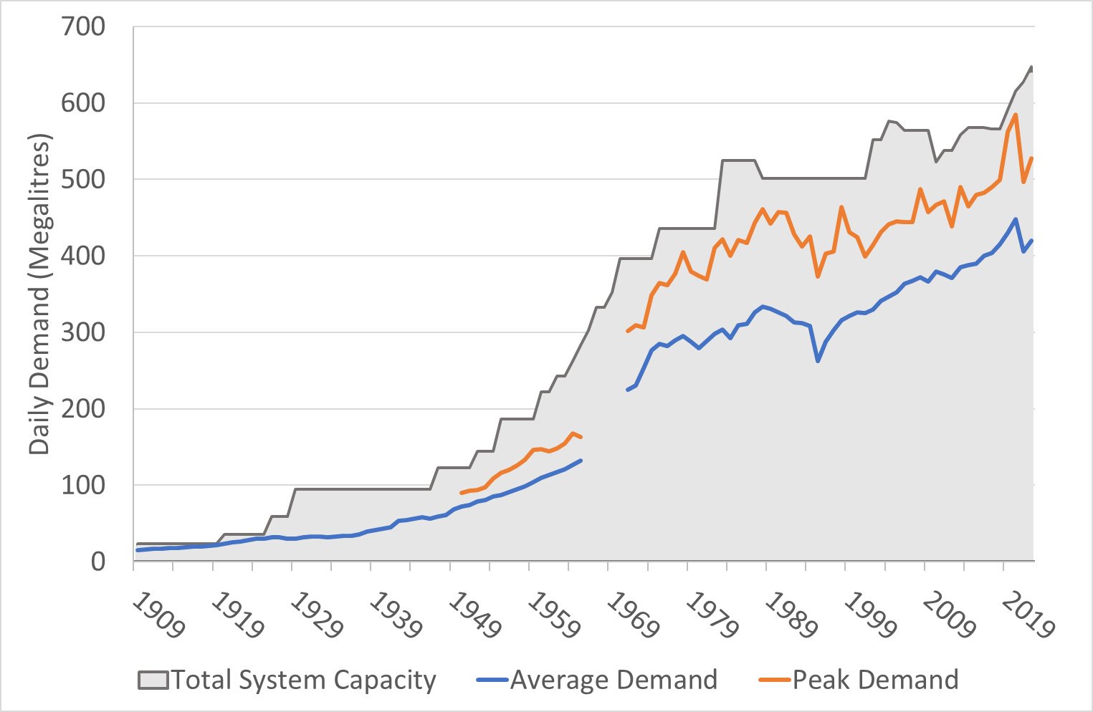
Context
WHY?
Lowest cost sustainable provider
Climate change is happening
Auckland's population is growing
Complex water supply system
Previous climate change studies limited
Partnered with T+T and NIWA

Slide 4
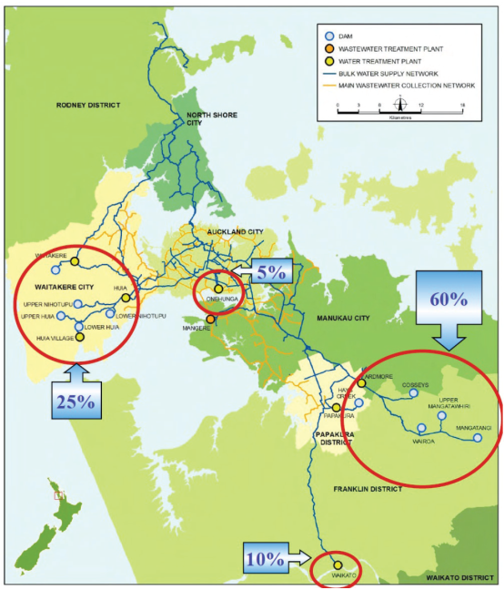
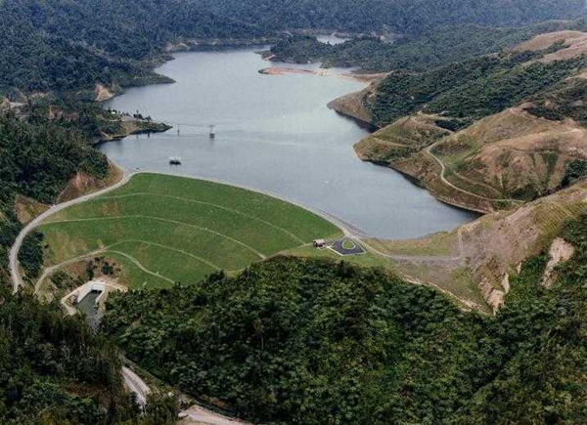
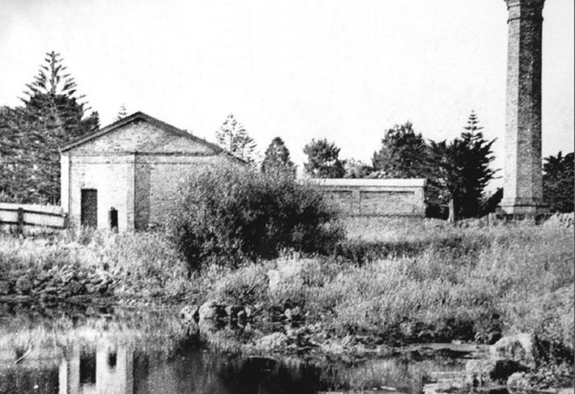
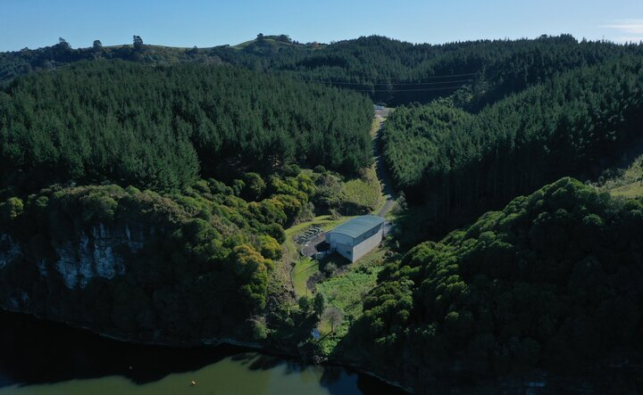
HOW?
The Auckland Metropolitan Water Supply
3%
60%
21%
16%
Notes:
I’m going to talk through our methodology, beginning here with an overview of Auckland’s water supply.
Auckland’s system includes:
10 storage reservoirs across the region,
2 aquifer sources
And 1 run-of-river source (at the Waikato River)
This image shows an example of the typical split of water supply from each source, showing the reservoirs usually providing the majority of Auckland’s water.
But this balance all depends on weather conditions and storage levels.
For example, during a recent drought, the Waikato River provided up to half of Auckland’s water.
This system differs from most large scale systems around the world which are often:
A single source with multi-year storage.
E.g. Warragamba dam which supplies water to Sydney can hold around 5 years worth of Sydney’s demand, but that’s because it’s catchment is bigger than the entire Auckland area.
Auckland on the other hand, has
multiple source types,
much smaller in scale,
all feeding into one supply zone.
Managing all this means that we need a bespoke optimisation model.

Slide 5
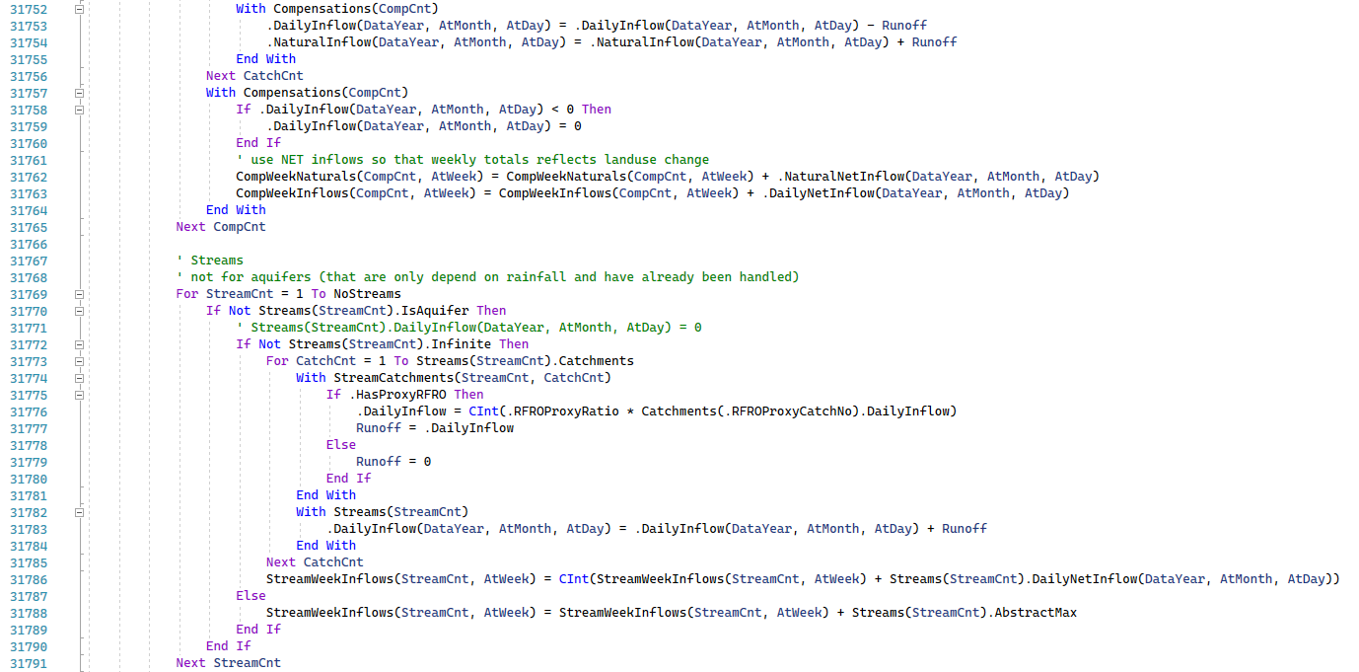
Integrated Source Management Model
HOW?
Notes:
And that is where our Integrated Source Management Model (also known as ISMM) comes into play.
I’m not going to spend too long explaining it,
but we have this bespoke tool which models all the sources working together.
It helps Watercare decide where to take water from on any given day,
balancing the costs of operation against the risk of running out of water.
And it can also be used to assess the future yield of the system.

Slide 6
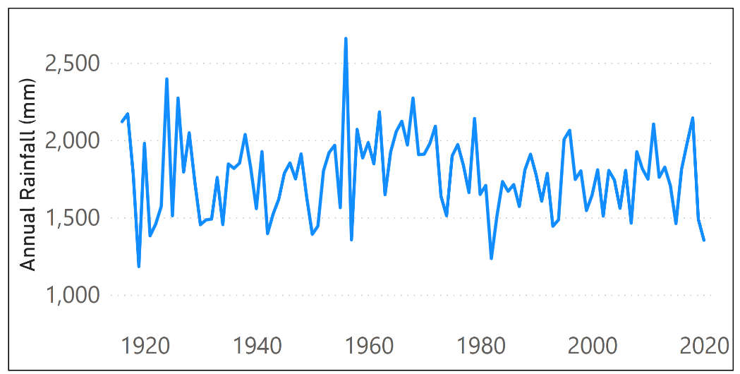
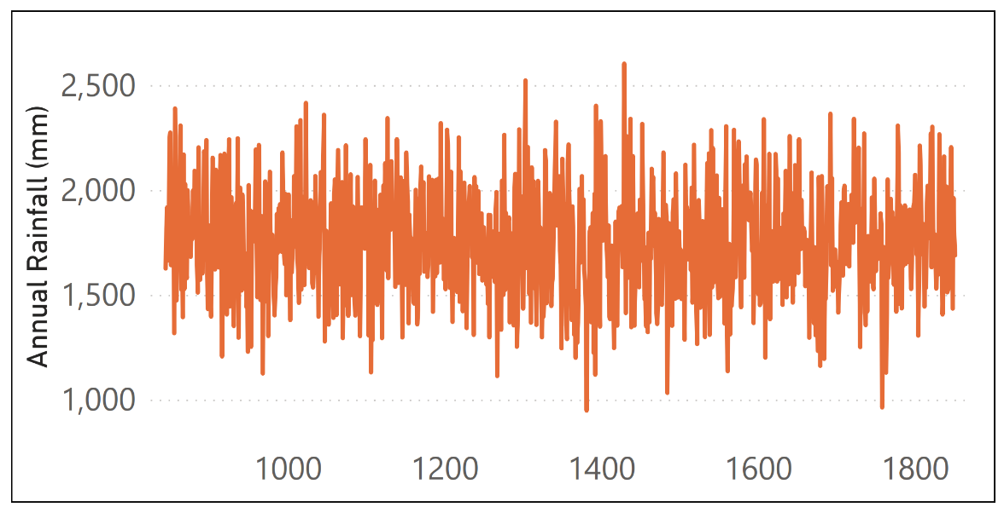
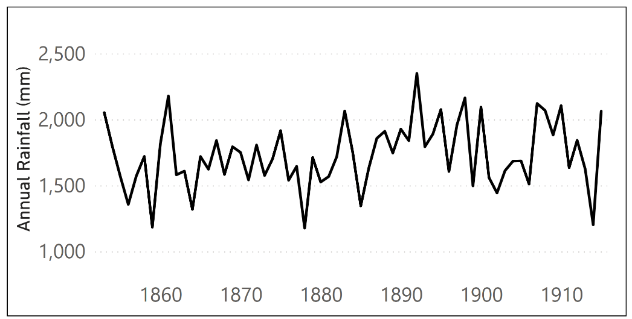
Current Climate Rainfall Inputs
HOW?
160+ YEARS ‘OBSERVED’ RAINFALL DATA
Local gauge rain starting in early 1900’s
GENERATED STOCHASTIC CLIMATE SEQUENCE
STOCHASTIC WEATHER GENERATOR
Co-variant gauge rain from Albert Park back to 1853
1,000+ YEARS OF COMPOSITE RAINFALL DATA…
Notes:
To do all this, ISMM needs a climate to simulate.
For the baseline climate, we use a combination of gauge records (as seen in these blue and black graphs), extending back to 1853, and
Feed this into a stochastic weather generator to generate over 1000 years worth of daily rainfall data (shown in orange).
Stochastic weather generators are used to generate time series of climate variables that have statistical properties similar to those of observed data.
This gives us more climate data to work with (therefore providing us with more drought sequences to work with) which is important for robustly estimating the yield of the system.

Slide 7
Climate Change Projection Data
HOW?
Climate change projections provided by NIWA
Based on UN models ca. 2014
Rainfall, evaporation, temperature
6 Global Climate Models (GCMs) downscaled by NIWA
Modelled Past |  |  |  |  |  | Modelled Future
RCP Past |  |  |  |  |  | RCP 4.5 |  |  |  |  |  |  |  |  |  |  |  | RCP 8.5
1971 - 2005 |  |  |  |  |  | 2040 |  |  |  |  |  | 2090 |  |  |  |  |  | 2040 |  |  |  |  |  | 2090
 |  |  |  |  |  | BCC-CSM1.1 | CESM1-CAM5 | GFDL-CM3 | GISS-E2-R | HadGEM2-ES | NorESM1-M
PAST OR FUTURE?
2 × EMISSION SCENARIOS
2 × TIME HORIZONS
6 × GLOBAL CLIMATE MODELS
24 FUTURE CLIMATE DATABASES
Notes:
But how did we work climate change into the mix?
To do this, we used climate change projections obtained from NIWA.
The currently available projections are based on models from the UN (released in 2014).
A new round of these models were released last year, but these still need to be downscaled for New Zealand.
Projections were provided as daily time series of rainfall, evaporation, and temperature.
Rainfall is the dominant climate variable in Auckland’s catchments so this was given the most focus in our study, but evaporation was also modelled.
This schematic shows a breakdown of the 25 scenarios that we modelled. These comprised of:
A baseline climate and multiple future scenarios.
Each future scenario looked at 2 key emission pathways –RCP 4.5 and 8.5.
Which align with Watercare’s climate change strategy.
Where RCP 4.5 is a moderate scenario where emissions peak and then decline
Whereas RCP 8.5 represents a high emissions scenario where emissions continue to rise.
2 time horizons of 2040 and 2090. These were chosen in alignment with Watercare’s Climate change strategy.
And 6 global climate models, also known as GCMs.
These are the global models that NIWA has downscaled for New Zealand.
This gave us 25 datasets to use to model yields into the future.

Slide 8
Methodology
HOW?
Determine change in rainfall statistics for each future scenario
Apply changes to baseline rainfall via distribution mapping
Stochastically extend each rainfall series
Model yield using ISMM
Notes:
So how did we get from projection data to estimate future yields?
We compared the NIWA projections to the modelled baseline to calculate the changes in monthly rainfall statistics.
We then applied these changes to our historical baseline climate using a technique called distribution mapping.
That left us with 24 unique datasets, one for each future scenario.
We then stochastically extended each of these datasets like we did for the historical baseline shown earlier. This gave us 1,000 years of conditions to represent each of the 24 scenarios.
And finally, we plugged these stochastic datasets for each scenario into ISMM to estimate future yields.
I’ll now hand over to Lucy to talk to these yields and what the future might look like for Auckland.

Slide 9
WHAT?
The metropolitan water supply will be operated to a 1-in-100-year event with a 15% residual storage at the end of the drought event.
The annual average daily demand* that can reliably be provided by a water supply system, while meeting the required security of supply standard.
Watercare’s Drought Security Standard:
Sustainable Yield:
* Seasonal (weekly) profile across the year
Notes:
Start with what sustainable yield means…
What are we trying to estimate the impacts on? The sustainable yield of the system… Which is:
The average daily demand that can be reliably provided by the system, while meeting a particular security of supply standard.
What is Watercare’s security standard?
They must operate the system up to a 1-in-100-year event, without dropping below 15% storage across their reservoirs.

Slide 10
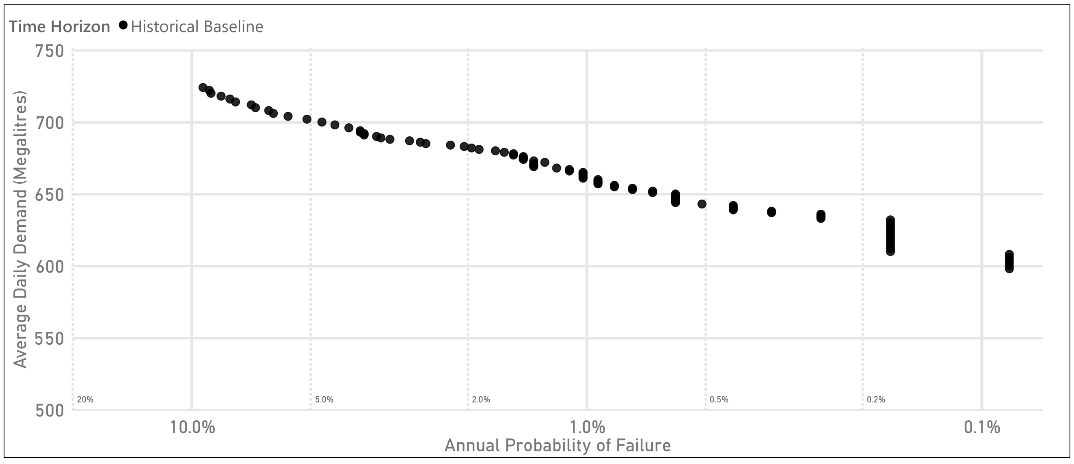
Baseline Yield
WHAT?
Notes:
How do we estimate the yield?
Starting at a relatively low demand level…
We simulate (using ISMM) system operations over the 1,000+ year timeseries
Counting (along the way) how many times failure occurs
Failure being either when:
Un-restricted demand cannot be met
Or when total system storage drops below 15%.
We then increase demand and repeat the process.
Each point on this curve represents one of those thousand-year simulations.
With the x-axis being the probability of failure (NOT TIME!)
High probability on the LHS
Low probability towards the RHS.
For example, looking at Watercare’s DSS…
At the 1 % annual probability mark (equivalent to a 1-in-100-year event)
The system could reliably supply an average demand of 660 megalitres per day.

Slide 11
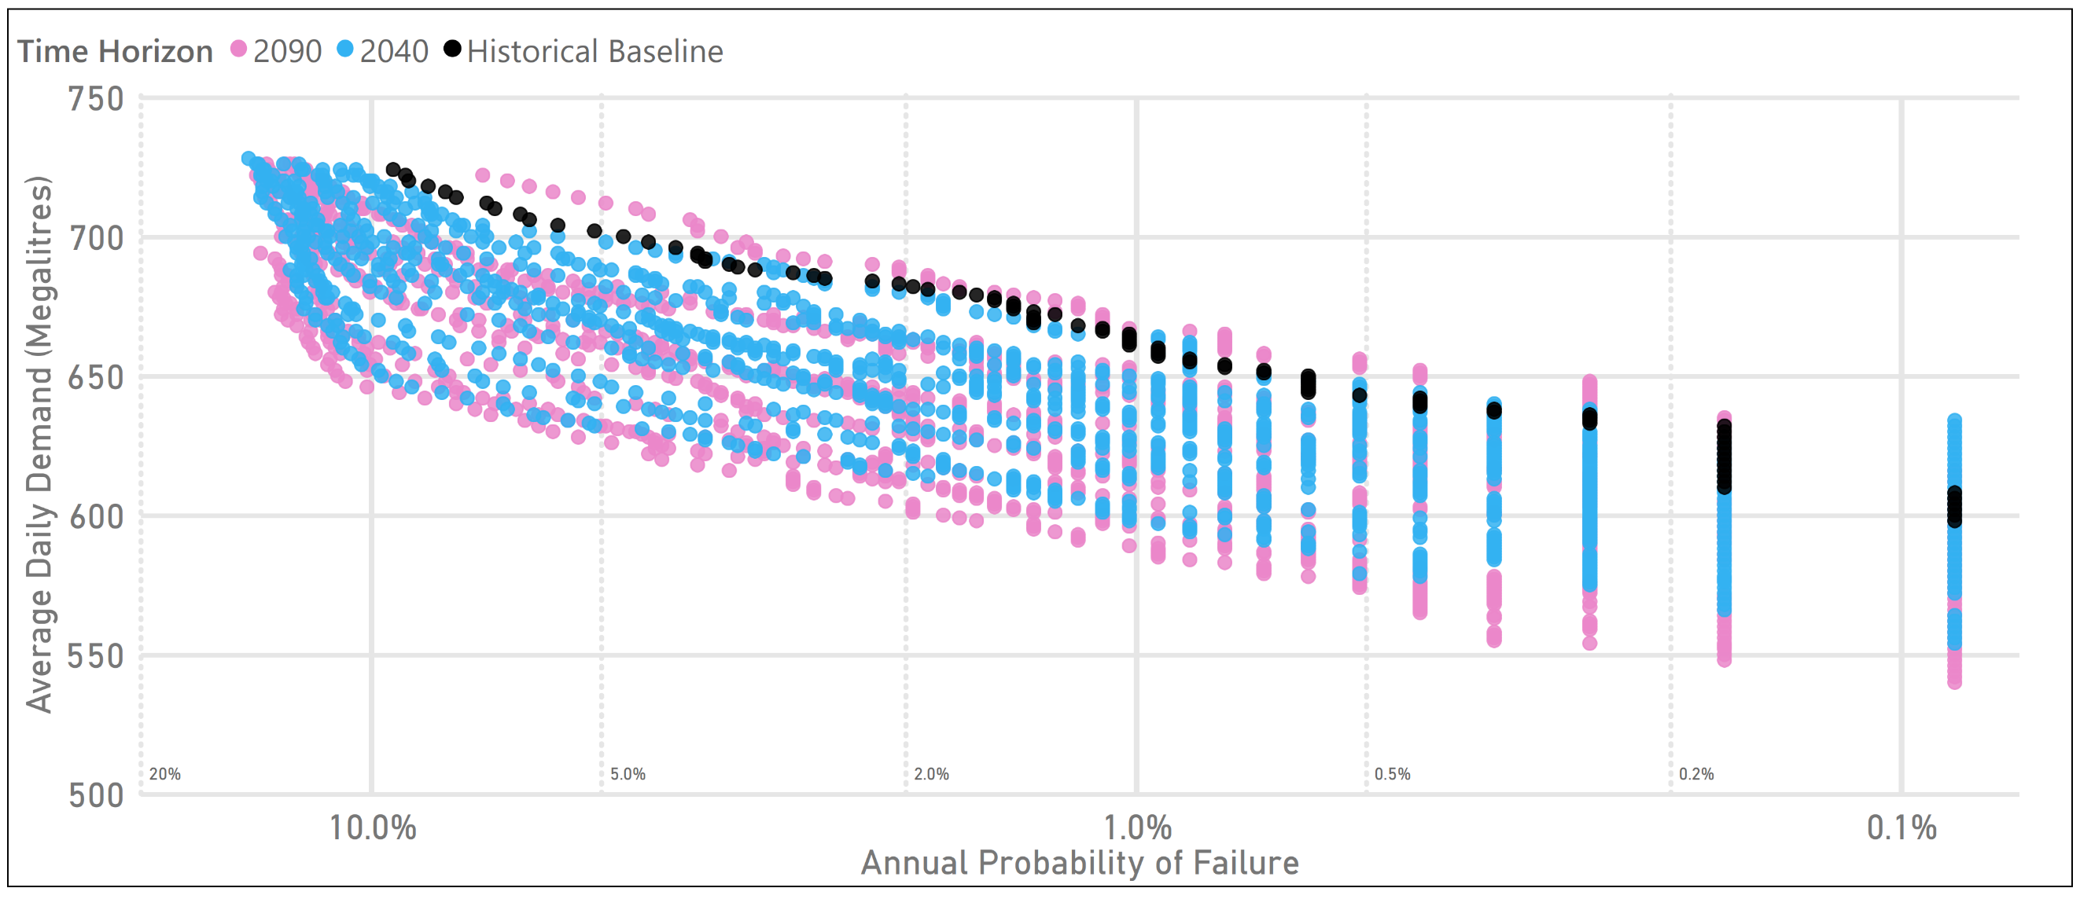
WHAT?
Future Yield – Time Horizons
Notes:
So what does the future yield look like?
This plot presents the future climate results, differentiated by time horizon
2040 in blue
2090 in pink
What we see here is that almost all of the future results are sitting below the baseline (in black)
Meaning they are prediction a reduction in yield.
It is also worth noting that the 2090 results present a slightly wider range of outcomes (or greater uncertainty).

Slide 12
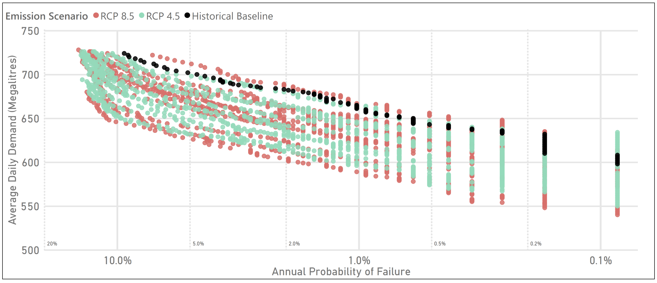
Future Yield – Emissions Scenarios
WHAT?
Notes:
This is the same picture but differentiated by emissions scenario…
The moderate pathway (RCP 4.5) is in green
The high emissions pathway (RCP 8.5) is sitting behind in red
Highlighting by emissions presents a similar picture:
Both RCPs suggest a general reduction in yield
With slightly wider range of results in the higher emissions pathway.

Slide 13
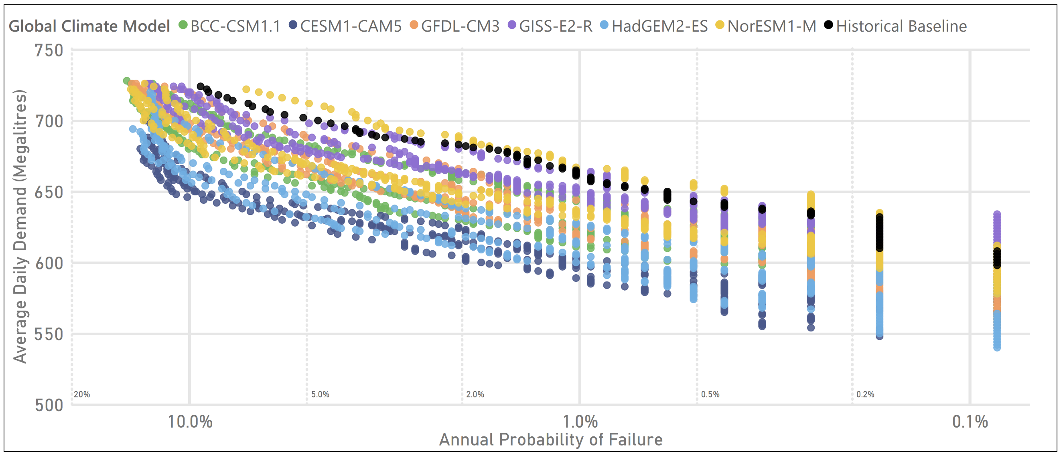
Future Yield – Climate Models
WHAT?
Notes:
Finally, this is what the picture looks like when we differentiate by climate model…
Each colour represents a different global climate model
Here we start to some more bands in the results…
This suggests that the greatest uncertainty (in these modelling results) is stemming from the climate models themselves
Which comes down to how each of them capture/represent climate processes.
This is all a lot of detail, but if we focus on Watercare’s drought security standard,
This is the slice of results we are interested in…

Slide 14
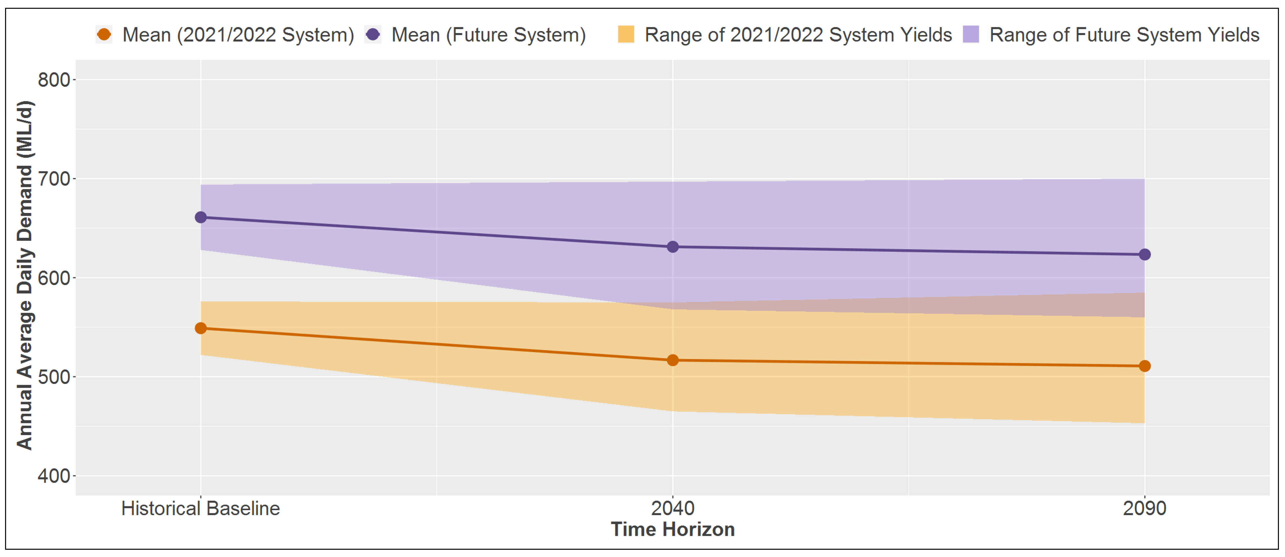
Yield Timeline
WHAT?
±5%
661 ML/d
Range of GCM results ±5%
631 ML/d
623 ML/d
±5%
549 ML/d
Range of GCM results ±5%
517 ML/d
511 ML/d
Notes:
And this is what we see when we zoom in as a time line…
With the historical baseline yield on the LHS
And the 2 future horizons as we move right
Note: we are seeing 2 sets of results in this picture
The orange shows the supply system in its current state
The purple represents a future system configuration with some major infrastructure upgrades in place.
The shaded areas capture the range of yield results
While the solid lines denote the average result.
There are 3 main takeaways:
Looking at the average yields… A 30 ML reduction in yield is expected by 2040
For context, to mitigate this reduction, Watercare would need to bring forward their planned infrastructure upgrades by around 10 years.
A further 10 ML reduction could then be expected by 2090.
The uncertainty/range of results increases the further we project out.
Both system, configurations (orange vs purple) show a similar trajectory over time.

Slide 15
Key Conclusions
WHAT?
Range of possible futures – all equally likely
Both emissions scenarios have similar range of outcomes
Yield reductions expected in next 20 years
A first in NZ for climate change impact modelling
Notes:
Final conclusion:
As a result of the approach/methodology that Sarah has outlined…
For the first time in NZ we were able to predict how CC might affect a complex water supply system.
We are very pleased of this work, it was a huge technical challenge and
Also like to highlight the fact that this assessment (the methodology, the software we’ve built around it) is a living, breathing, dynamic thing.
A lot of our efforts went into future proofing the tool

Slide 16
Next Areas of Study
WHAT?
Sensitivity analysis
Land use changes
Impacts on demand
Update with latest projections from UN
Notes:
What do we want to be looking at next to expand this impact modelling assessment?
Carry out further modelling and analyses to better understand the sensitivities of the system to climate change.
Further interrogate the results to understand the driving climatic forces behind the projected changes in yield.
For example, to investigate if yield reductions are driven more by increasing PET or changing rainfall patterns.
Investigate possible impacts of changes to land use
Literature suggests changes in land use can have a greater impact than climate change
And several of Watercare’s catchments are being restored back to native forest (which is expected to increase runoff in the catchments, could possibly offset CC impacts).
Look to model how a changing climate could impact water demand (both increasing it and changing the patterns of…)
Update this assessment once the latest UN projections are downscaled for NZ. With the method now developed and tool (ISMM) now enabled.

Slide 17
Where To From Here
SO WHAT?
Uncertainty & planning tools
Investment decision making
When is additional capacity required to meet growth?
And how much is needed?
Adaptive pathway planning
Reconfiguration of existing sources
Capture climate change impacts and uncertainties within:
Supply vs demand balance
Headroom
e.g. Onehunga Aquifer
Notes:
Given the findings of this modelling, Watercare now have valuable information to inform:
Updates to their supply/demand balance and assessments of headroom to incorporate these findings
Both change in yield and associated uncertainties.
Note: Supply side climate change impacts not reflected in headroom at present (and headroom allowance insufficient for this scale of impact/uncertainty).
Use these results to inform the investment planning and decisions
Consider the impact of climate change when investing in new or upgraded source and treatment infrastructure.
Will also inform adaptive pathway plans, including thresholds and trigger points, to respond to the expected reduction in yield over the planning period.
A specific example of this is with the Onehunga aquifer source, which may need to be relocated (e.g. retreat) in response to sea level rise impacts.

Slide 18
Quantifying the potential impacts of climate change on Auckland’s water resources
WATER NEW ZEALAND CONFERENCE & EXPO | OCTOBER 2022

Slide 19
Appendices

Slide 20
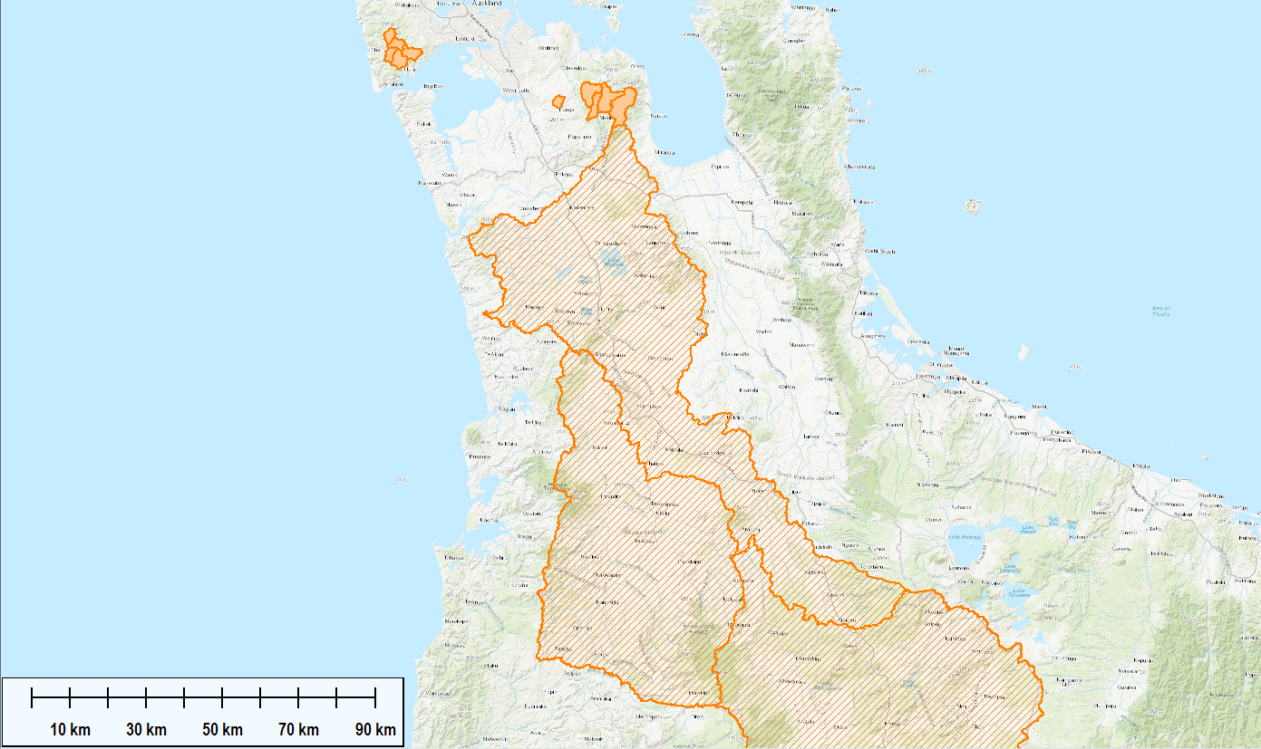
WAITAKERE RANGES RESERVOIRS
~20% of total storage
~21% of water supplied
10 Catchments modelled
HUNUA RANGES RESERVOIRS
~80% of total storage
~60% of water supplied
10 Catchments modelled
ONEHUNGA AQUIFER
~3% of water supplied
1 Aquifer modelled
Lower Waikato Catchment
Pukekohe Aquifer Source
Waikato River Intake
WAIKATO RIVER SOURCE
~16% of water supplied
3 Catchments modelled
ISMM Spatial Coverage
Waipā River Catchment
Upper Waikato Catchment
Notes:
This is a snapshot of the model spatial extends. Each shaded orange area is a separate RFRO model.
If asked: Waikato River is very hard to model (longest river in the country, flow regime dominated by dams upstream, we do our best, but also use flow gauges where available)

Slide 21
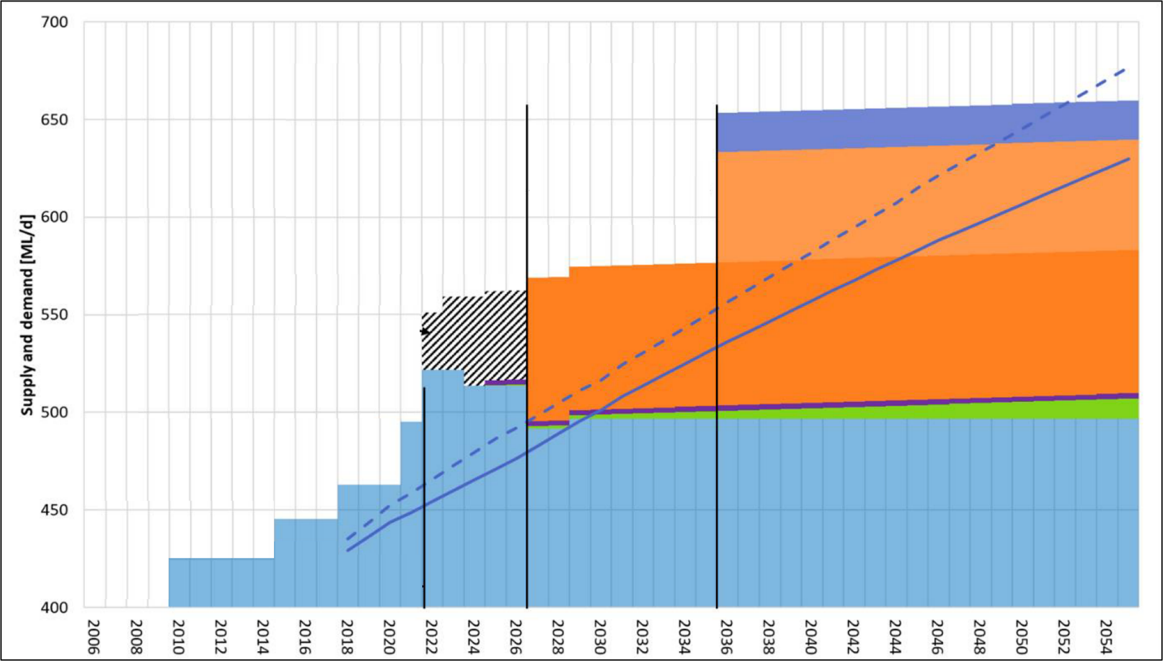
Annual average drought supply / demand balance
Graph sourced from Reed, J (2021). Water source options assessment. Applicant’s Evidence-in-Chief (Watercare Services Limited application to take water from the Waikato River).
Notes:
Another way to think about ISMM in context is with the supply – demand balance:
This balance maps a demand forecast (blue lines) on top of the available supply (coloured bars)
Here the baseline/existing supply is shown in blue bars, with new/projected sources added (in orange and purple) into the future.
As the population grows, and demand increases, new sources are introduced to stay above the line.
And being above the line is where ISMM comes in…
The bigger the space above (i.e. the more the system is in excess supply) the more ISMM can play around (e.g. with saving operational costs).
When approaching the line (i.e. demand getting close to supply), allocation decisions become more about maximising conjunctive, minimising your risk. (Less opportunity/flexibility.)

Slide 22
HadGEM2-ES
CESM1-CAM5
GFDL-CM3
BCC-CSM1.1
GISS-E2-R
NorESM1-M

Slide 23
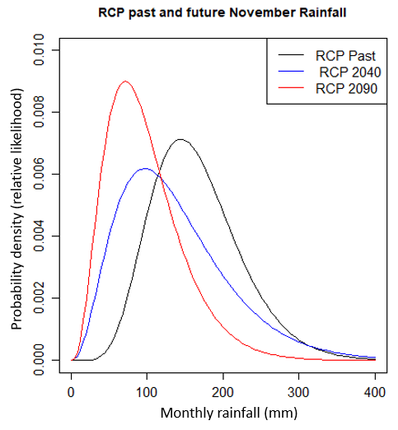
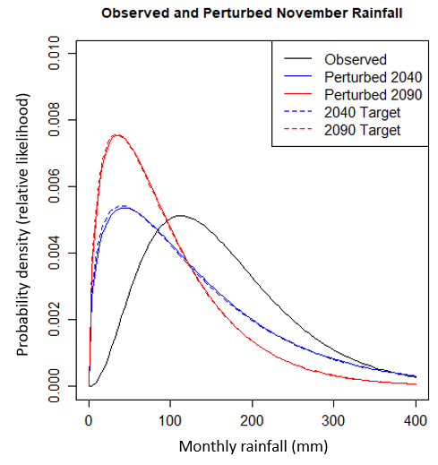
Distribution Mapping Method
Compare gamma distributions
$$Γ\left(α,β\right)$$
Calculate “deltas”
Δ in Shape ($α$)
Δ in Rate ($β$)
Linear transform
$$\overline{X}=m×X+c$$
$$m=\sqrt{\frac{α_{target}{β_{observed}}^{2}}{α_{observed}{β_{target}}^{2}}}$$
$$c =\frac{α_{target}}{β_{target}}−m\frac{α_{observed}}{β_{observed}}$$

Slide 24
The Four Types of Drought
Meteorological Drought
Socio-Economic Drought
Agricultural Drought
Hydrological Drought
Precipitation Deficit
Soil Water Deficit
Surface and Groundwater Deficit
Shorter-term dryness
Intermediate dryness
Longer-term dryness
Duration of Drought
Diagram adapted from Crocetti, L., et al. (2020). Earth Observation for agricultural drought monitoring in the Pannonian Basin (southeastern Europe): current state and future directions. Regional Environmental Change. 20. 123.
Notes:
Some more background theory to keep in mind…
Droughts can be classified into four types, depending on the duration, effects and intensity:
Meteorological
Agricultural
Hydrological
Socio-economic.
The first three types deal with the physical phenomenon
While the last one is associated with the impacts of drought on society.
All types of drought are closely related.
Therefore, oftentimes, it is difficult to distinguish between the different types (and there is no definition or measurement of when one type of drought transforms into another).
A meteorological drought is typically indicated by a period of precipitation deficit over a region of interest.
In combination with increased atmospheric evaporative demand (e.g. by high temperatures, high solar radiation and wind), soil moisture levels may drop and cause agricultural drought, which is reflected in decreased plant productivity.
Ongoing depletion of soil and groundwater reserves may eventually lead to a hydrological drought, which is characterised by a reduced amount of water in streams, lakes, wetlands, reservoirs and groundwater tables.
If these conditions lead to a failure of water resource systems to meet water demands, it is called a socio-economic drought.
Thinking about yield are dealing with those on the right hand side: hydrological and socio-economic drought.
For Auckland’s system, 18 months is the critical stress period.
Shorter periods are not so critical because water stored in the reservoirs serves as a buffer.
Longer drought periods are not seen in the historical records.
For example, the recent drought began around January/February 2020, and recovered by August 2021 (when total system storage approached the 95% mark).

