Slide 1
The NP2M Modelling Factory – Production line to the Future
Part 1 – The Sponsor
Nathan Donald (Watercare)
Thomas Haarhoff (Mott MacDonald)

Slide 2
Network Performance Monitoring and Modelling (NP2M)
6 Year programme of water and wastewater monitoring and modelling
Partnership
Mott MacDonald
Stantec
HAL
GHD
Field Services
Monitoring – Mott MacDonald, Detection Services and FSL
Maintenance – Hydrotech, Citycare and Pipevision
Survey – Tripp Andrews and Galaxie Contractors
Traffic Management - TMNZ

Slide 3
Network Performance Monitoring and Modelling (NP2M)
ECI
Collaboration
Efficiencies
Standardisation
Automation
Focus on Outputs

Slide 4
How Did We Get Here?
Lack of understanding of benefits of monitoring and modelling
Lack of understanding of complexity of monitoring and modelling
Bureaucracy
Resources
Funding

Slide 5
The Light at the End of the Tunnel
A culture shift
Leadership
Nerve Centre
A Procurement Shift
Enterprise Model
TARP
Lot 1 and 2 Partners
Influence over the business
Collaboration

Slide 6
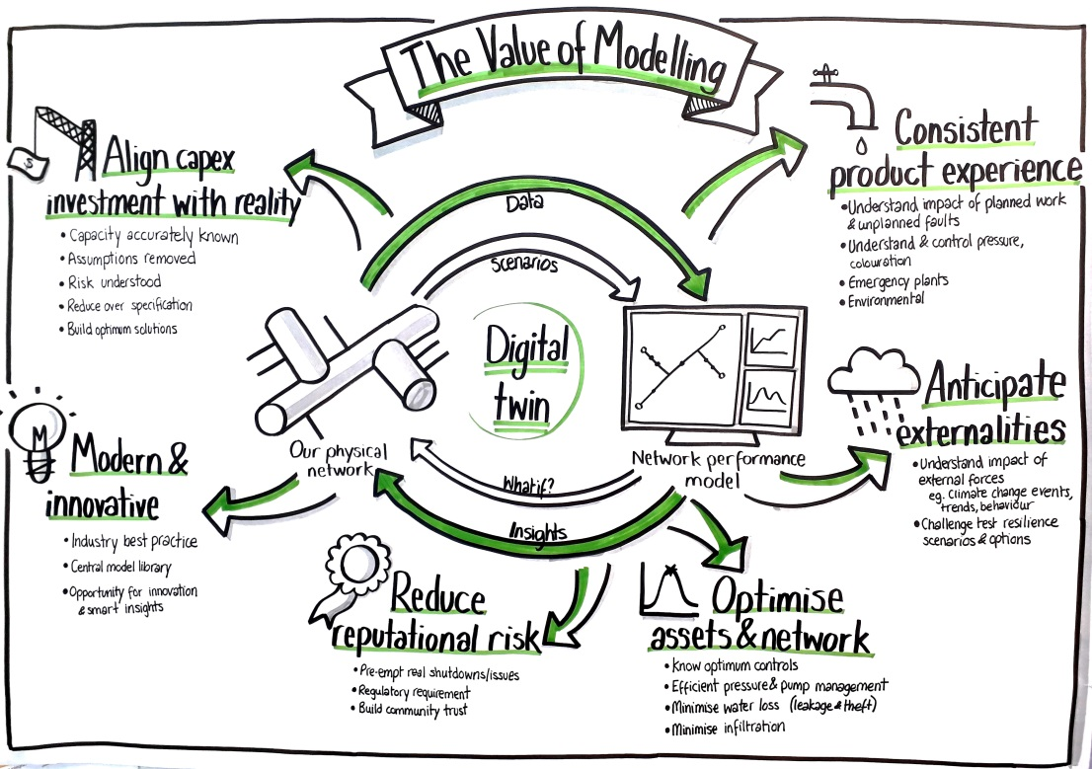

Slide 7
NP2M

Slide 8
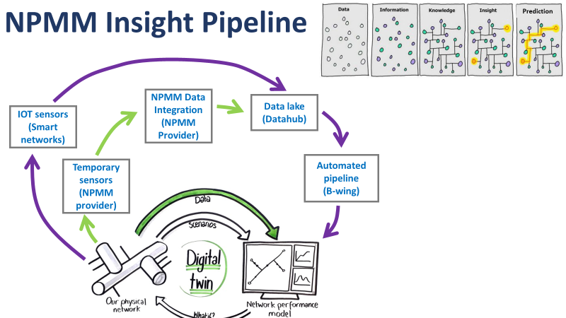
NP2M
(NP2M
(NP2M

Slide 9
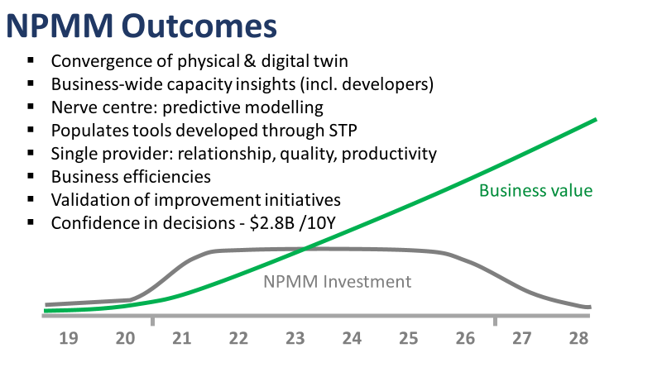
NP2M
NP2M
20 21 22 23 24 25 26 27 28 29 30

Slide 10
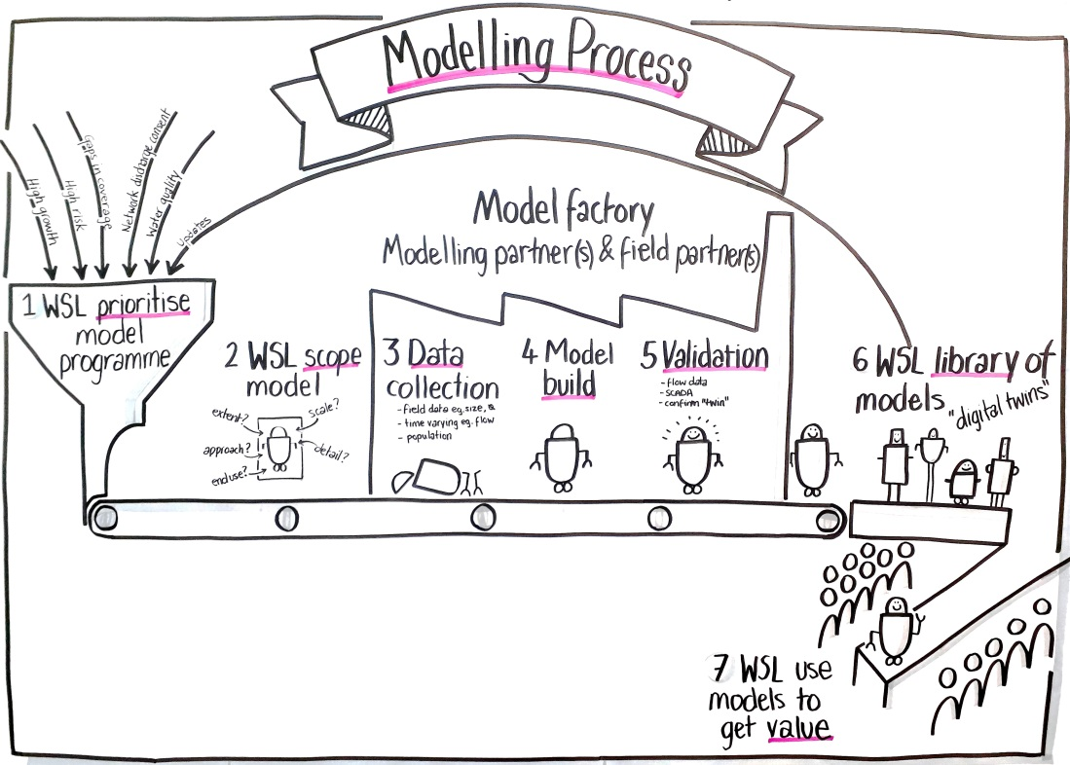

Slide 11
NP2M

Slide 12
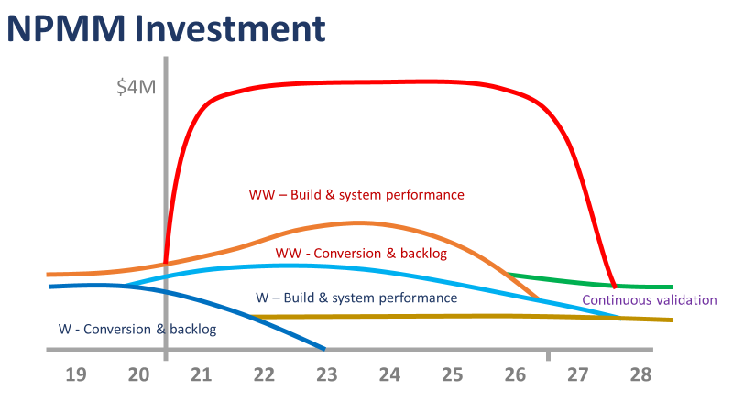
NP2M
$M
Year 2 - 6 Modelling Factory
Year 1 Start Up
20 21 22 23 24 25 26 27 28 29

Slide 14
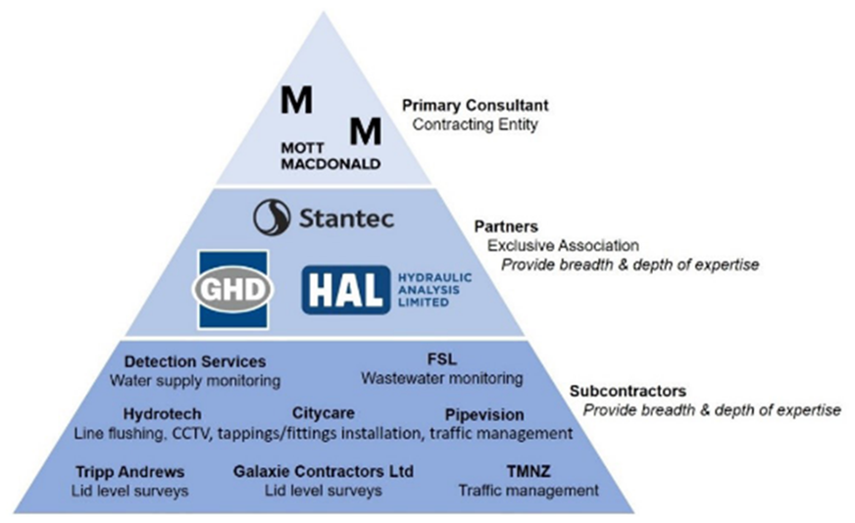
Notes:
I will do this by taking you through the modelling and monitoring process …collaboration.

Slide 15
Fundamental shift
Traditional contract
Collaborative contract
Variation
Variation
Principal
Variation
Adjustment Events (AEs)
Very limited, based on pre-agreed criteria only
Variation
Variation
Establish a “REAL” target outturn cost together and verify
All parties work together to improve performance for mutual benefit
INITIAL
TENDER
Guaranteed minimum cost
Consultant

Slide 16
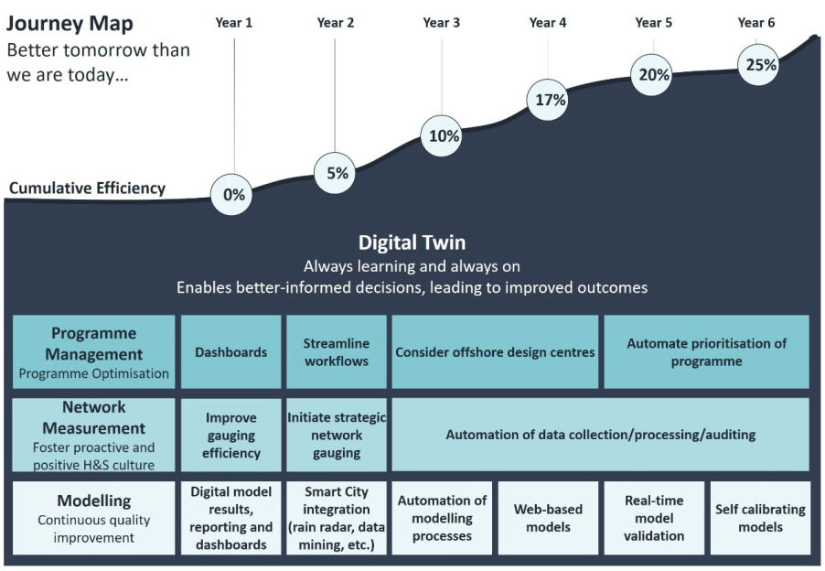

Slide 17
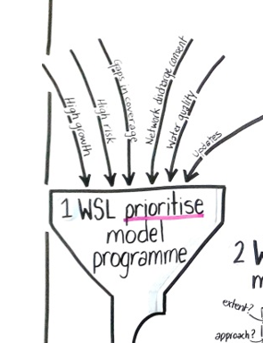
Programme Efficiency
Simplified management structure ‘thin client’
Programme over projects – identified prioritises at a programme level
E.g. Delay Water Models
Agile work principals
In development
Programme dashboard
Streamlined workflows and process
107 Improvements
Notes:
I will do this by taking you through the modelling and monitoring process

Slide 18
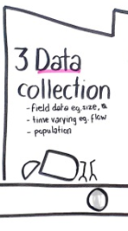
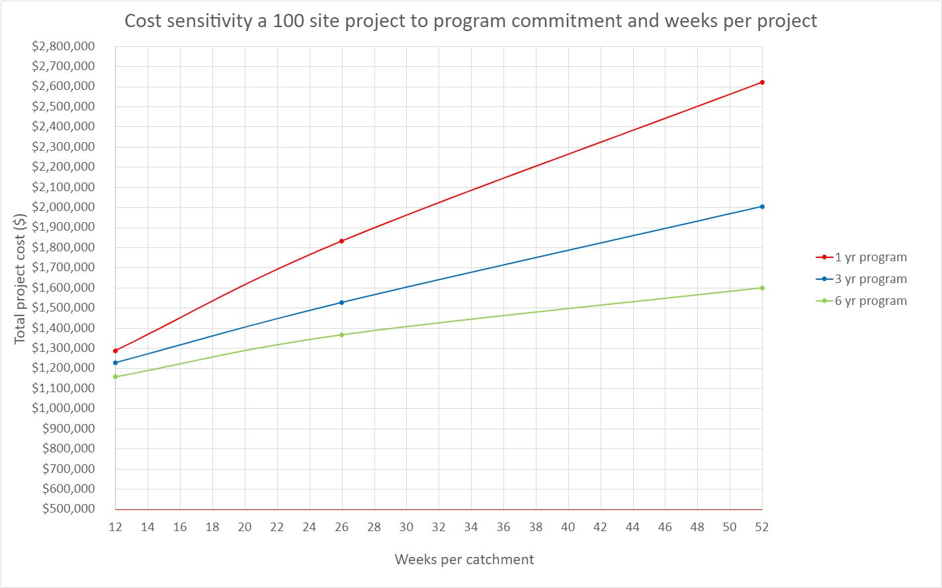
Monitoring
High utilisation
Outcome focused monitoring specifications
In development
Low cost point cloud asset surveys
Automated DA
Roving crew concept
Notes:
I will do this by taking you through the modelling and monitoring process

Slide 19
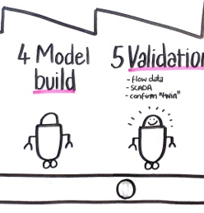
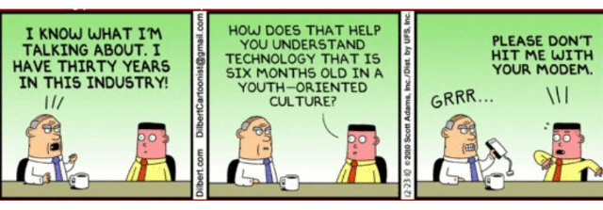
Modelling
Processes focused on repeatability and consistency
Capability building
Streamlined standards
Notes:
I will do this by taking you through the modelling and monitoring process

Slide 20
Digital
Digital strategy targeting low effort high impact initiatives.
Productivity
Process automation
Process improvement
NP2M
Data consolidation
Self service
Business improvement
Cost management
Timeline
Safety
2022
2023
2024 to 2026

