Slide 1
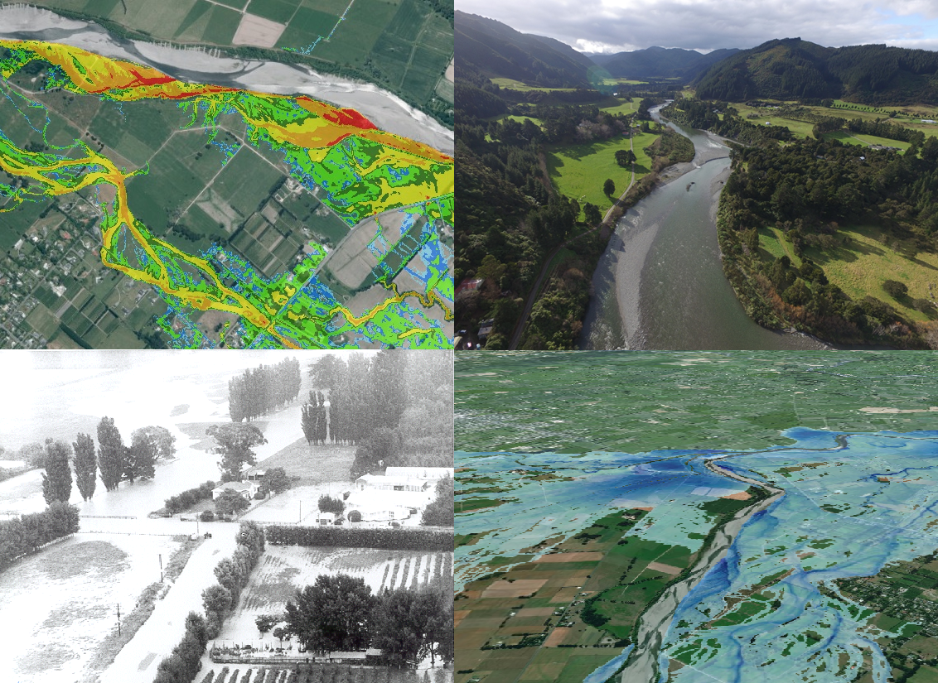
Waiohine River
Model Build / Calibration
Matthew Gardner
matthew@landriversea.com
www.landriversea.com

Slide 2
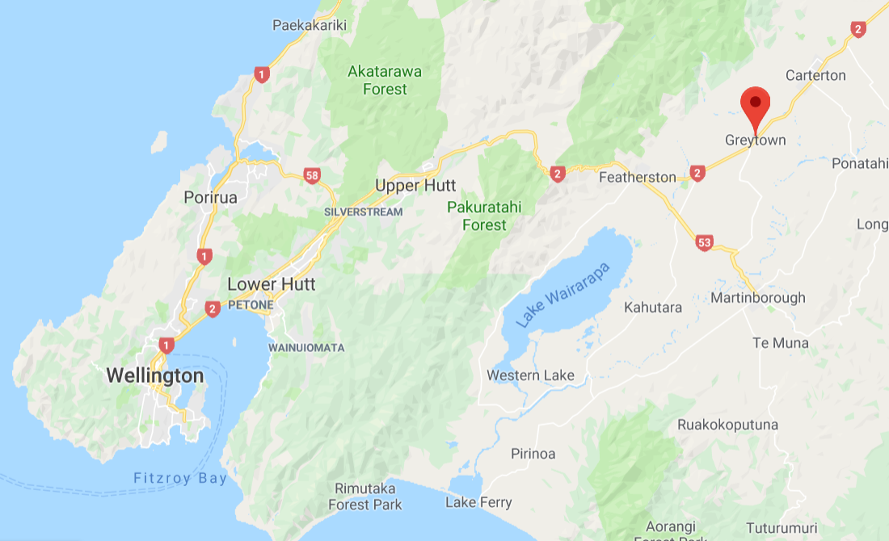

Slide 3
Summary of Project
Job was to upgrade the model to flexi mesh and recalibrate
Tense relationship between council and locals – little trust
Existing model results not accepted by community
Apparent that role was not only modelling, but also diplomacy and relationship building.
Relationship building key to success of project

Slide 4
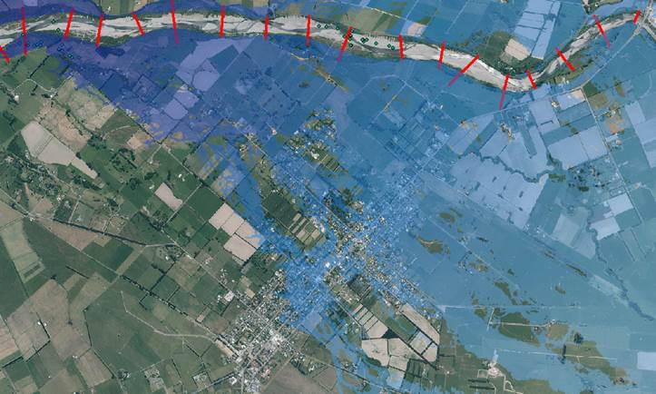
Preliminary Run Mesh Size (90m²)

Slide 5
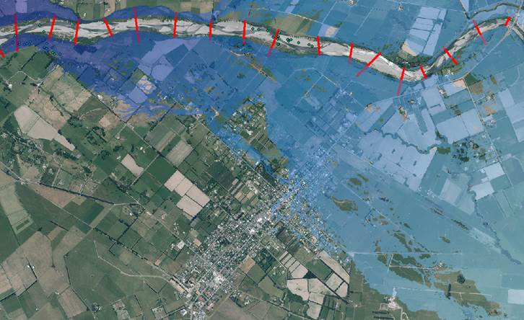
Preliminary Run Mesh Size (8m²⁾

Slide 6
Detailed Model Build
Previous modelling reported that the model did not calibrate as well as desired, due to a number of reasons.
I spent three days walking the floodplain with locals trying to understand the dynamics of the area and to try and find ways to improve the model – took a drone to get a better look

Slide 7
Drone really useful tool for visualising catchment

Slide 8
Mesh Resolution (Original Grid was 100m²)

Slide 9
Point Sources

Slide 10
Original Model 10m Rectangular GRID

Slide 11
Current Model Triangular Flexible Mesh

Slide 12
Calibration continued
Key locals had great recollection of flood events and had lived there for a long time – understood the river well.
Approached Ian Heslop from ECAN as he was are engineer in the Wairarapa for a long time.
Ian gave me a book on the river which contained photos of the 1990’s flood – these were misfiled in GWRC records as 1980 flood!

Slide 13
Small Banks / Features represented as 1D Dikes

Slide 14
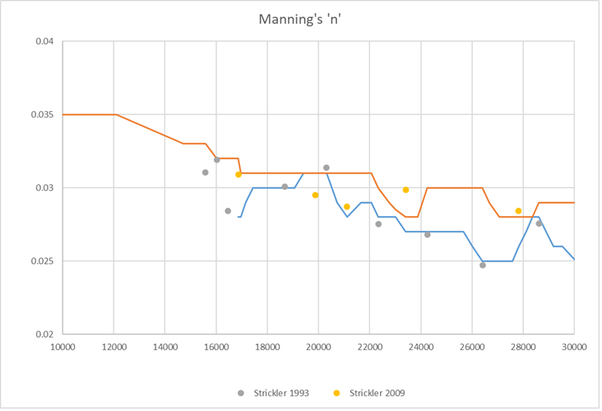
Bed Resistance

Slide 15
1990 Calibration
Large event – 1408m³/s ~20 year event in Waiohine (uncertainty in flow guage)
No record for Mangaterere (gauge installed 1999)
Flood photos found to be mislabelled
Debris Recordings near benchmarks however precise location not certain
Limited details on file

Slide 16
Historic details on record
Frank Robertsons comments at the Advisory Committee were that it was the biggest flood since 1948 – that water overtopped the banks (stopbanks) all the way from Kuratawhiti St to Fullers Bend – that it was the biggest amount of water that he had seen down North Street in 46years.

Slide 17
Darryl Lew Masters Thesis

Slide 18
XS26

Slide 19
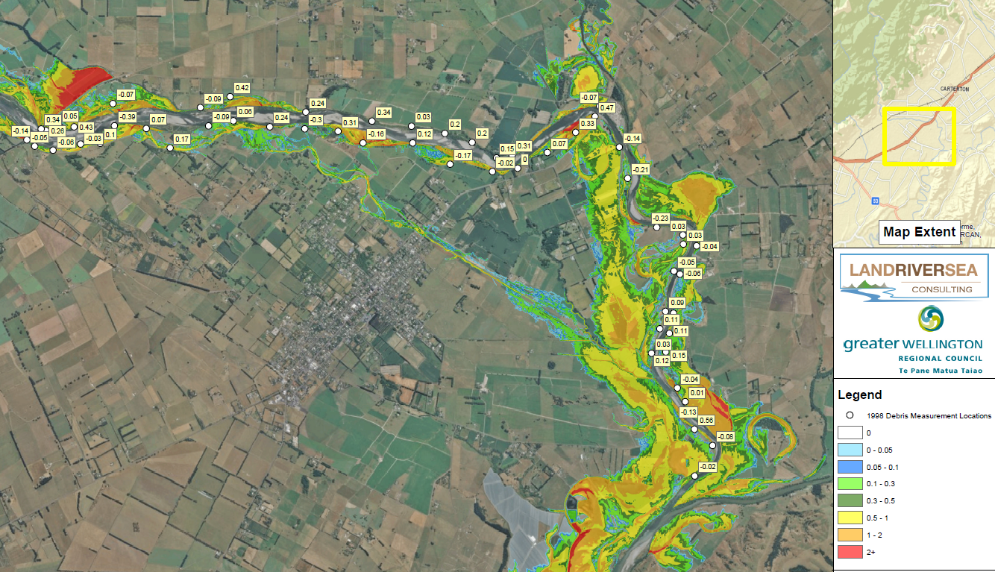
Calibration Results (Jan 1990)
Insert GIS Map

Slide 20
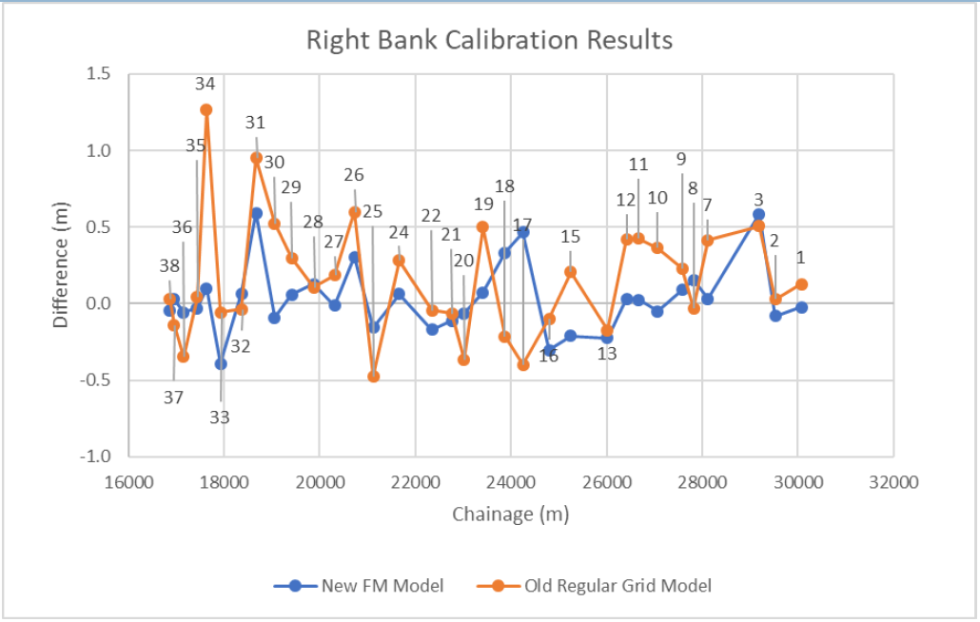
Calibration Results (Longsection)
Average Error New Model = 0.007m
Absolute Average Error New Model = 0.16m
Old Model = 0.19m
Old Model = 0.34m

Slide 21
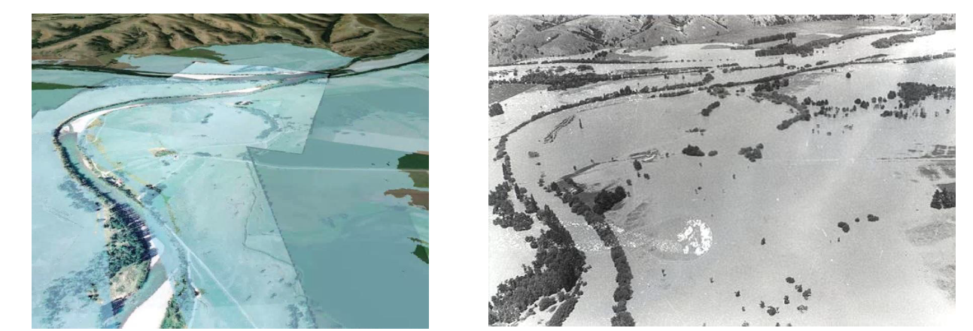
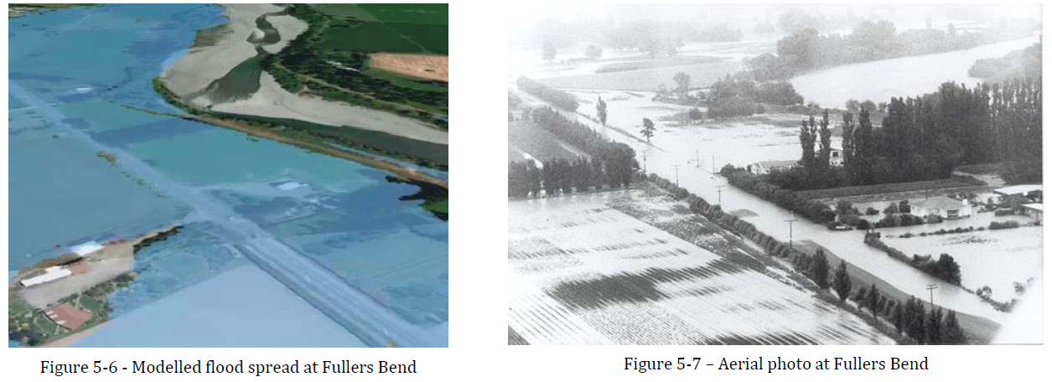
Comparison with flood photos

Slide 22
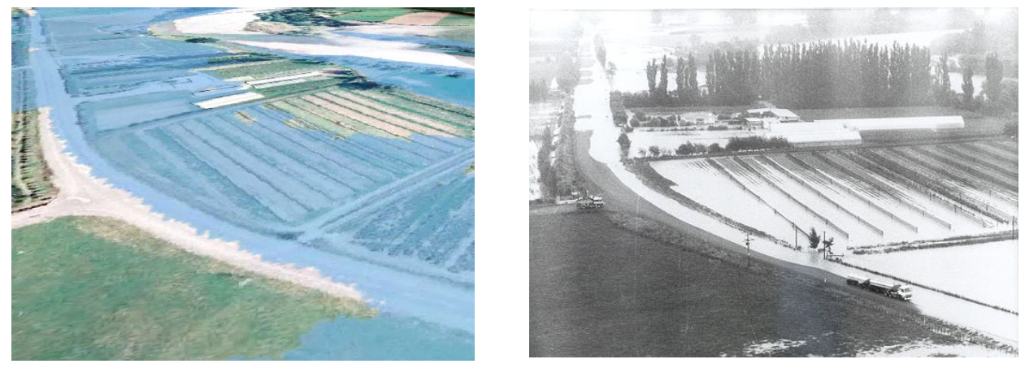
Comparison with flood photos

Slide 23
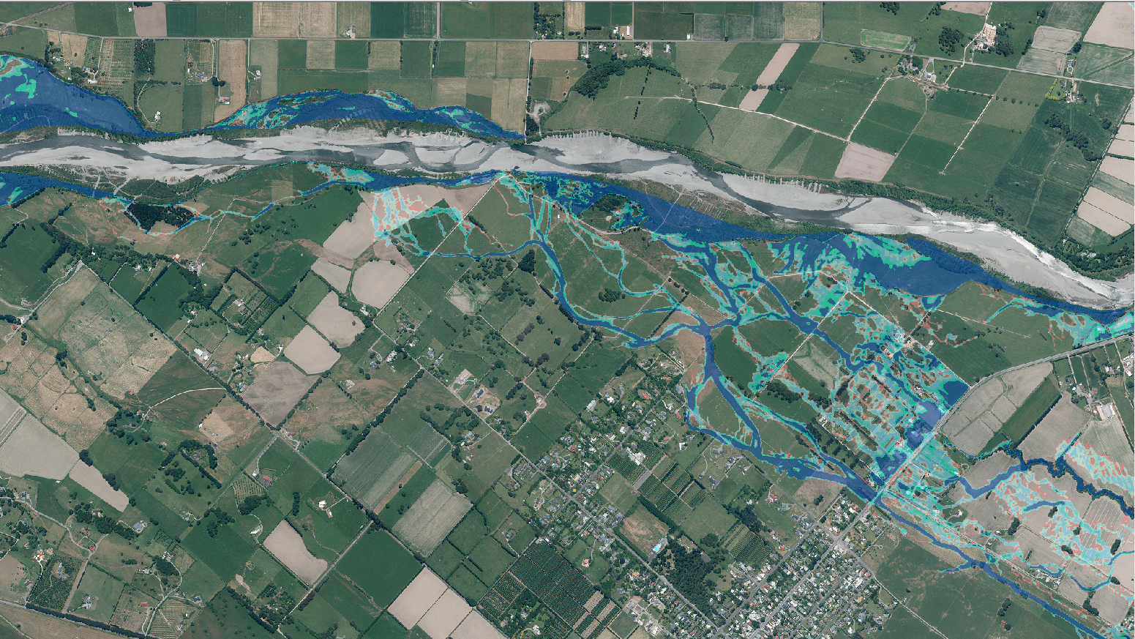
1998 XS

Slide 24
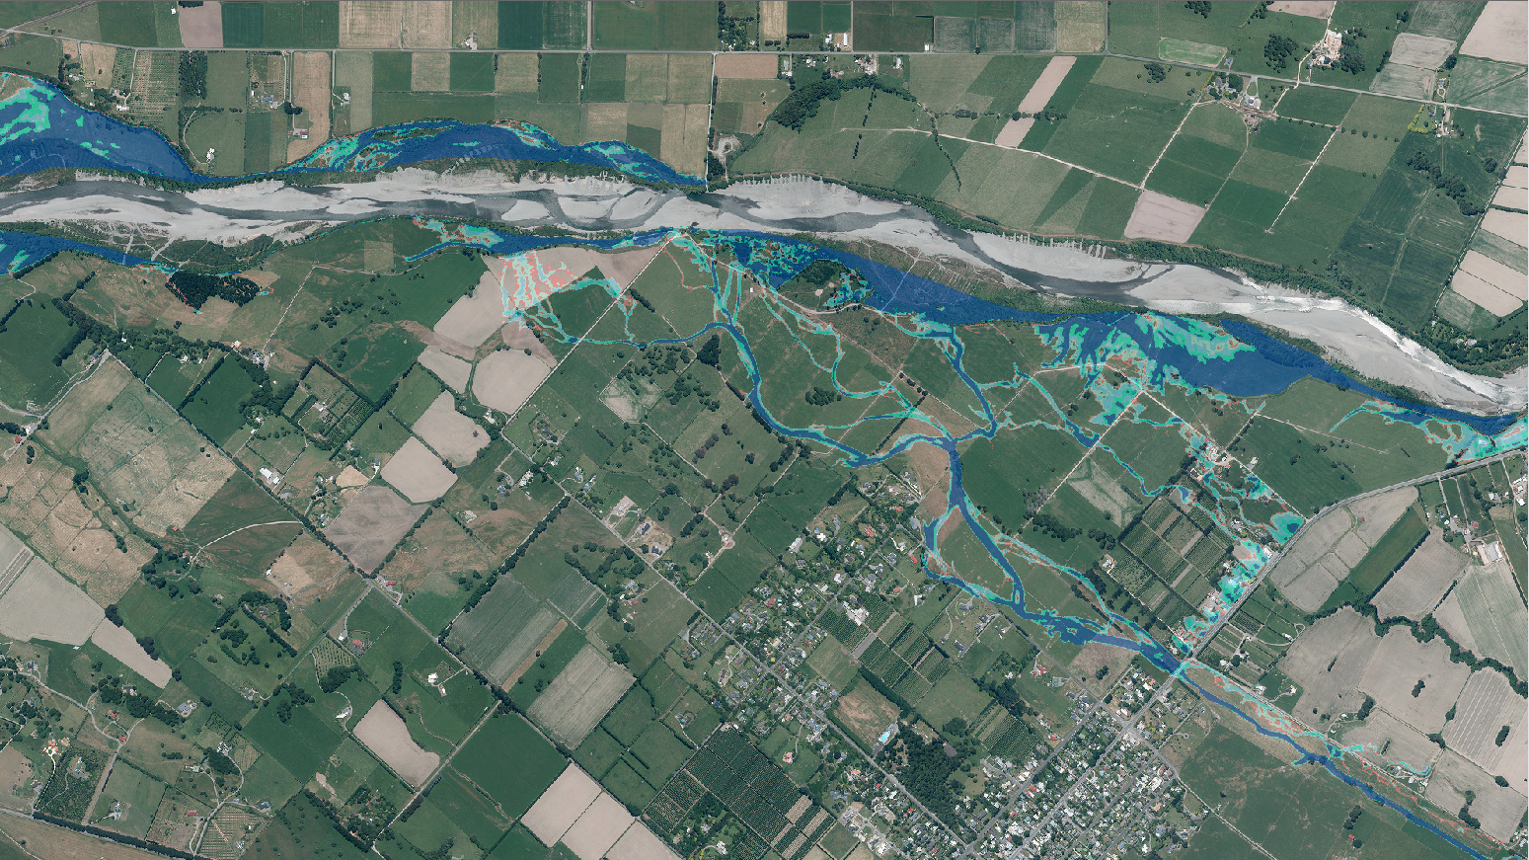
1998 XS 1995 XS25

Slide 25
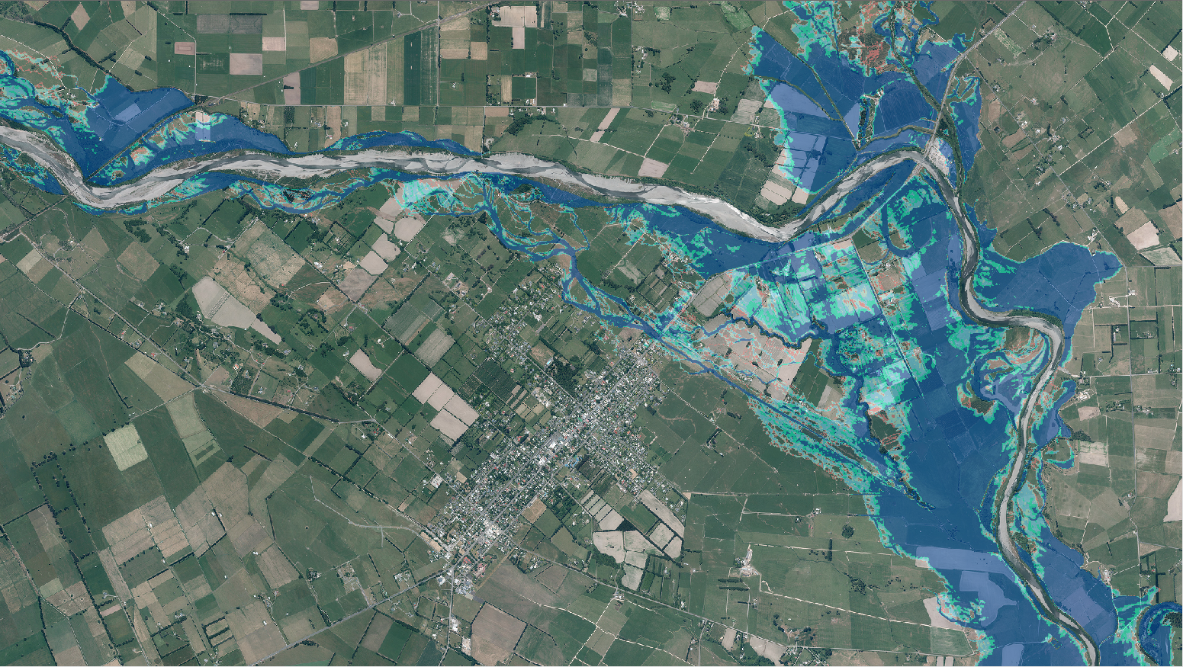
1990 Flood 1990 Channel

Slide 26
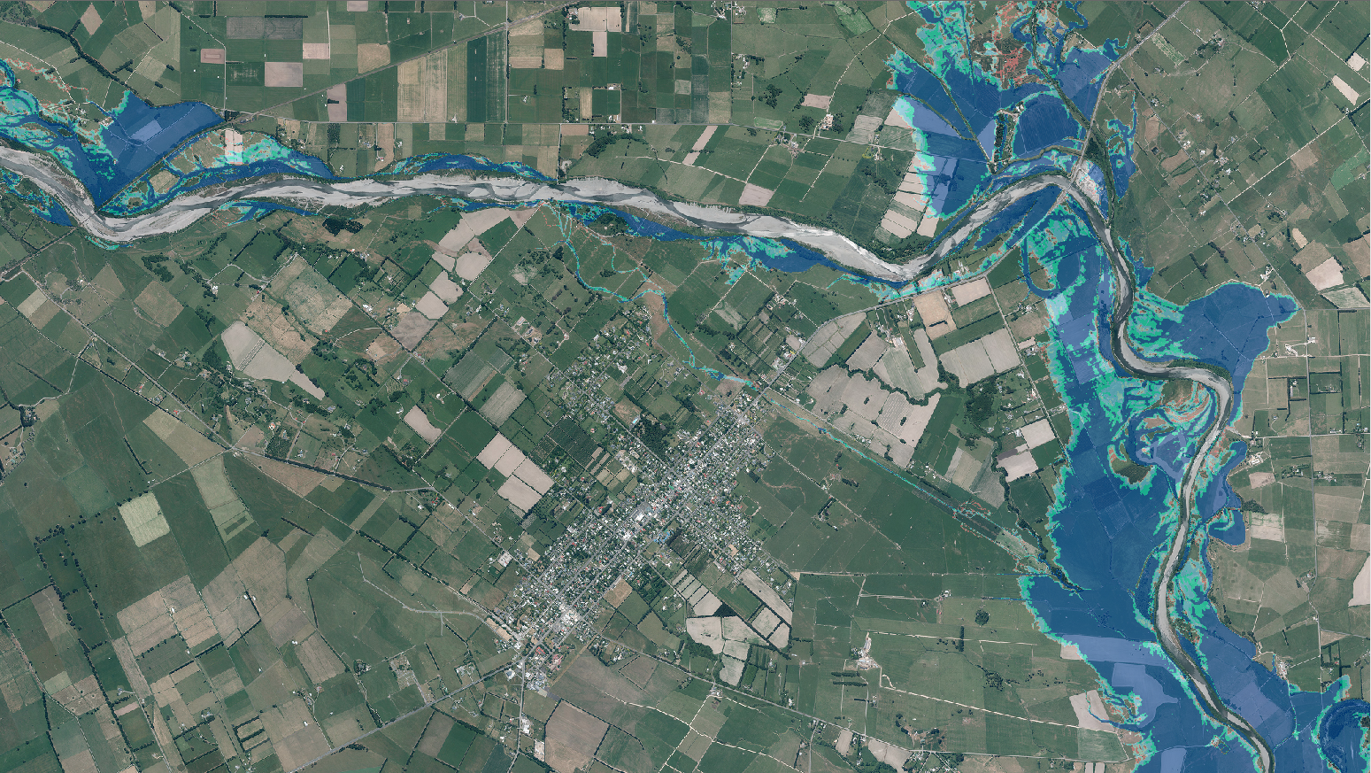
1990 Flow 2013 Channel

Slide 27
Design Runs Sensitivity Tests
Base design runs based on design hydrology and ideal conditions
Looked at a wide range of sensitivity runs
Flow 1500, 1700, 1900 m³/s
Hydrograph shapes, double peak and single peak
Bed levels, localised aggradation
Increased roughness
Bank erosion

Slide 28
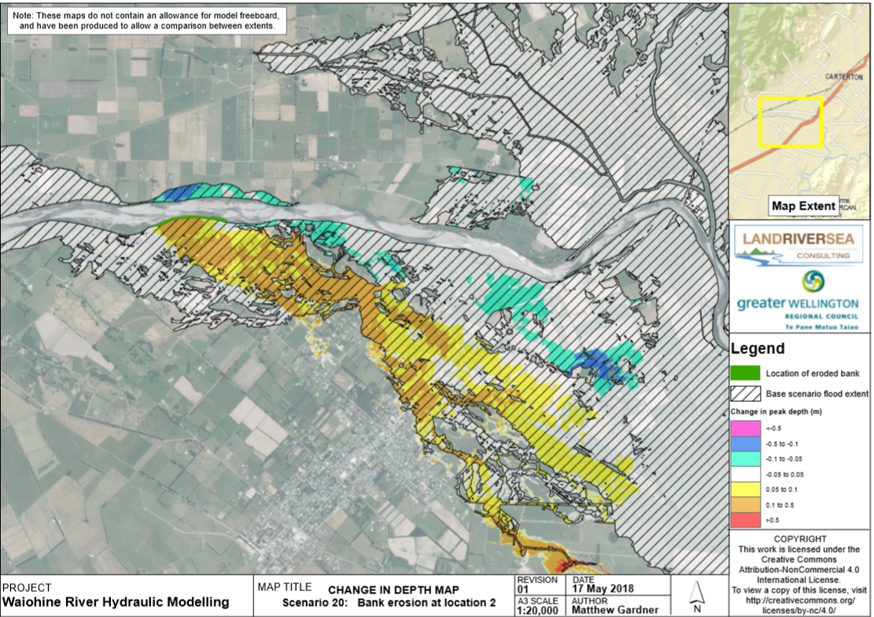

Slide 29
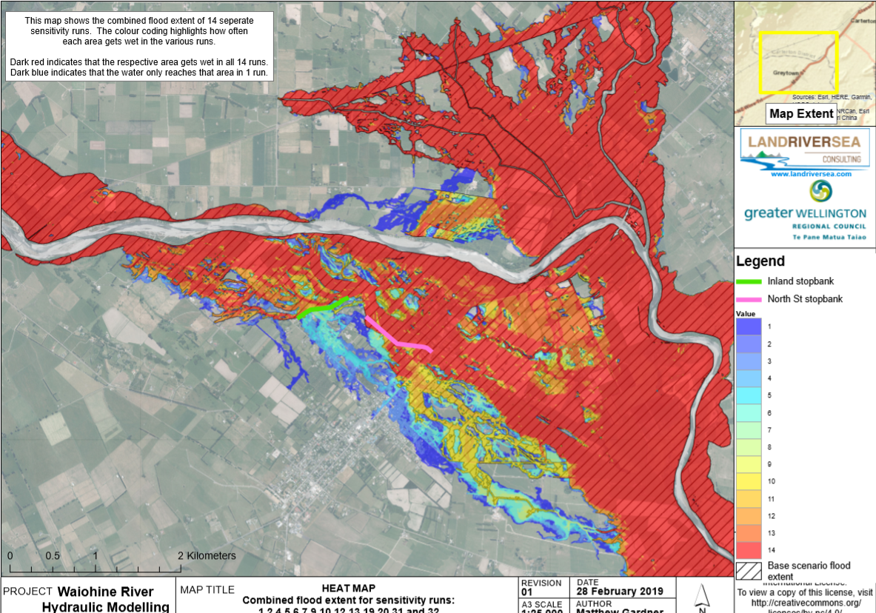

Slide 30
Options analysis
Helped assess a wide range of potential options
Presented results in various formats including
Depth / Change in depth
Speed / Change in speed
Shear Stress / Change in Shear Stress

Slide 31
Summary
Worked closely with community to understand catchment
Built trust and relationships with key stakeholders
Discussed model results along the way with locals, helped them understand model
Tried to calibrate model as close as is realistic to historic events
Used model to learn about sensitivity of river to range of variables
Used sensitivity results as basis of model freeboard / flood sensitive area
Once model is accepted – analysed range of structural options

Slide 32
Questions?
www.landriversea.com
matthew@landriversea.com

