Slide 1
Lyttelton Harbour Wastewater Scheme Removing Wastewater Discharges from the Harbour
Matthew Sheppard – Principal Engineer, Jacobs
Anthony Doherty – Associate Engineer, Jacobs

Slide 2
Agenda
Scheme Overview
Project Timeline
Design Challenges and Principles
Design Response
Project Outcomes
Notes:
Remove orange and put another piccy?

Slide 3
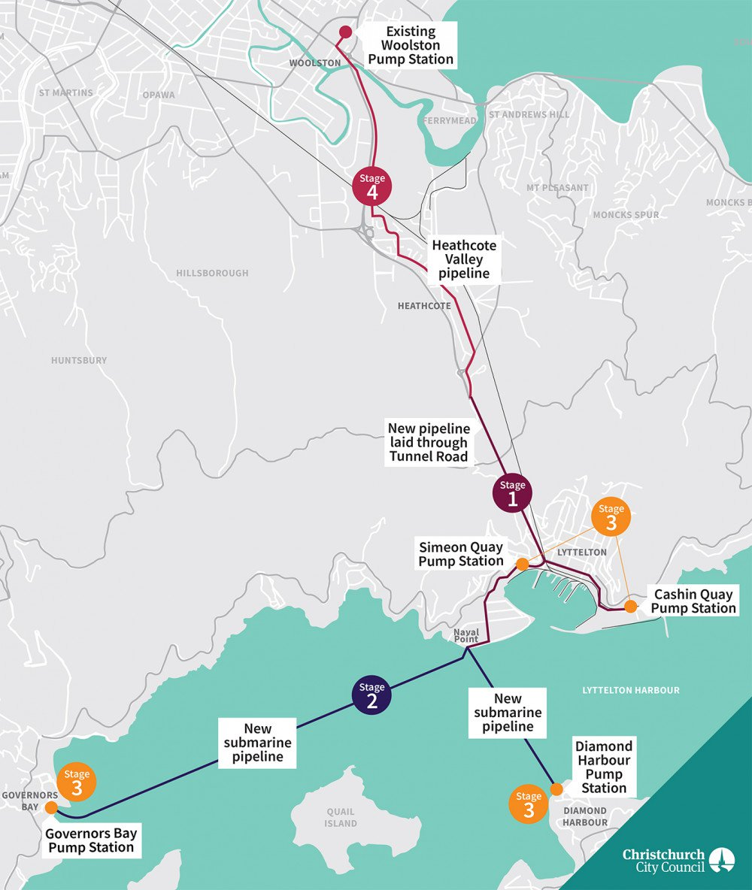
Scheme Overview
Conversion of WWTP’s to pump stations with overflow storage tanks, conveyance to a new Terminal Pump Station and pumped via the Lyttelton Tunnel to Pump Station PS15 in Woolston
Design requirement to reduce overflows to the environment to less than a 2-year ARI
Storage capacity required to meet overflow ARI at 2041 design horizon is 1500 m³ however 3150 m³ provided, equivalent to 2-days storage at average flow
2100 m³ of storage located at Lyttelton and network configured to allow all flows to be directed there and primary treatment provided if required in an emergency
Notes:
The Lyttelton Wastewater Project will remove regular wastewater discharges from Lyttelton Harbour
The elements of the scheme include:
Submarine pipelines connecting Governors Bay (5km) and Diamond Harbour (2 km) to Lyttelton
Decommissioning and converting wastewater treatment plants at Governors Bay, Diamond Harbour and Lyttelton into pump stations with overflow storage tanks
Pressure main (2 km) from the Lyttelton pump / storage facility to the terminal pump station
A new high-head terminal pump station (120 l/s) in Lyttelton to pump wastewater through the Lyttelton road tunnel
Pressure main (2 km) through the Lyttelton road tunnel
Gravity - pressure main (5 km) from the Lyttelton Tunnel to Pump Station PS15 in Woolston with a valve station to control flows

Slide 4
Project Timeline
The Lyttelton Harbour Wastewater project is 25-years in the making, commencing in 1997 with the lodgment of consent renewals for the Governors Bay Wastewater Plant
Since that time there have been many milestones including:
January 2000 – Signing of MOU with Te Hapu o Ngati Wheke (Rapaki) and BPDC
January 2005 - Lyttelton Harbour Basin Wastewater Working Party established as a condition of Diamond Harbour wastewater consent renewals
2007 - Options assessment for management of wastewater in the Lyttelton Harbour Basin
May 2009 – Council decision to proceed with the option to collect and pump wastewater to Christchurch
April 2015 – Jacobs appointed
April 2016 – Environment Canterbury Resource Consents granted (without hearing)
January 2018 – Construction commencement
Anticipated commissioning of the scheme in November 2022 and final project completion in early 2023

Slide 5
Design Challenges and Principles
Key Design Challenges
Conveyance of overflows to storage and back to wet-well
Submarine pipelines across Lyttelton Harbour
High-head pumping from Lyttelton to Christchurch
Pipework in the Lyttelton Road Tunnel ceiling
Reliable scouring of the gravity pressure main
Repurposing of assets
Constrained sites
Planned adaptability
Key Design Principles
Reduce complexity
Incorporate fail-safe design
Incorporate upgradeability
Re-use assets where sensible
Think long term when making decisions
Notes:
Can we add another tall photo

Slide 6
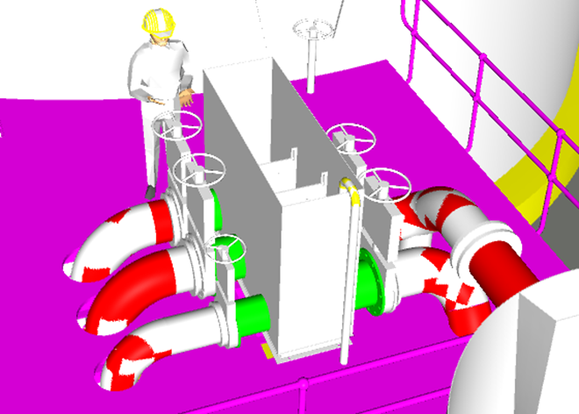
Design Response
Conveyance of overflows to storage and back to wet-well
Use of tall above ground wet-wells that allow water level in wet-well to rise and gravity overflow into the storage tank and gravity flow back to the wet-well
Use of flow splitter boxes to enable simple and fail-safe overflow from wet-well to storage and storage to outfall without level sensing or controlled valve actuation
Use of low-level inlets and trapped high-level outlets on wet-wells and storage tanks to avoid need for mechanical screening of overflows from wet-well and storage tanks
Notes:
Can we add photo of wet well showing elevation and splitter box

Slide 7
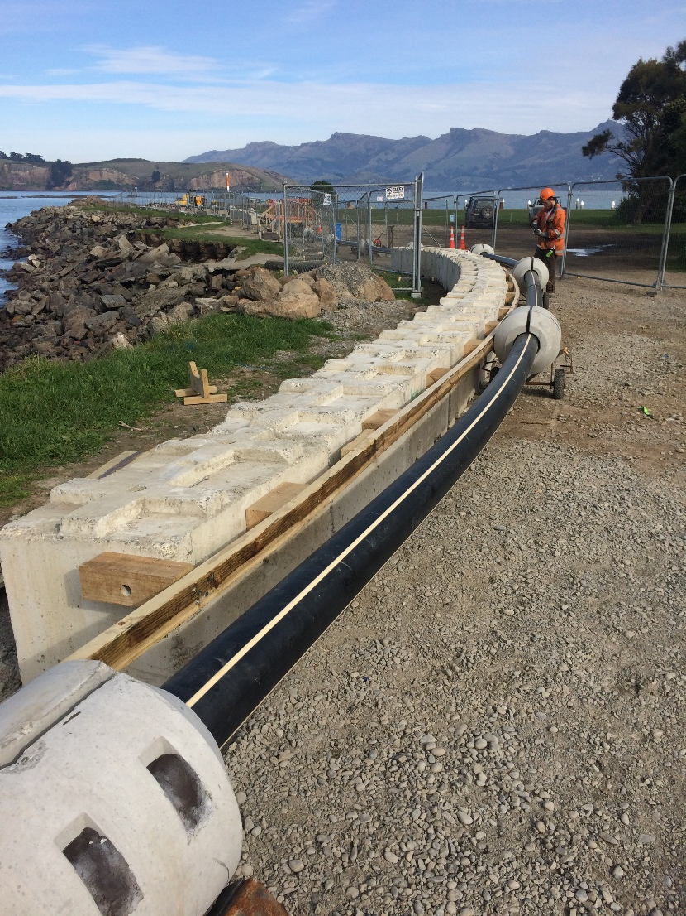
Design Response
Submarine Pipelines Across Lyttelton Harbour
Contract packaging of marine works and appointment of a specialist marine Contractor
Use of PE pipe with pressure ratings two ratings higher than required
Submarine pipelines installed with a minimum cover of 1m across the seabed and with additional rock gabion protection near landfalls
Trenching undertaken by excavator on a barge
Survey of submarine pipeline prior to backfill
Construction through the tidal floats at Governors Bay required a combination of barge mounted excavation during high tides and tracked access on the tidal flats through the low tide.

Slide 8
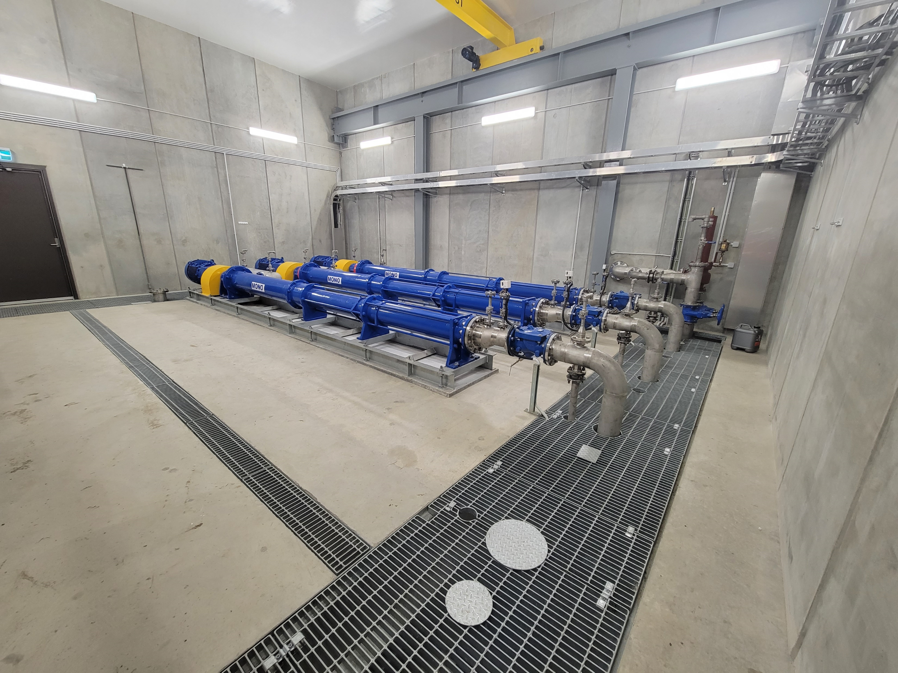
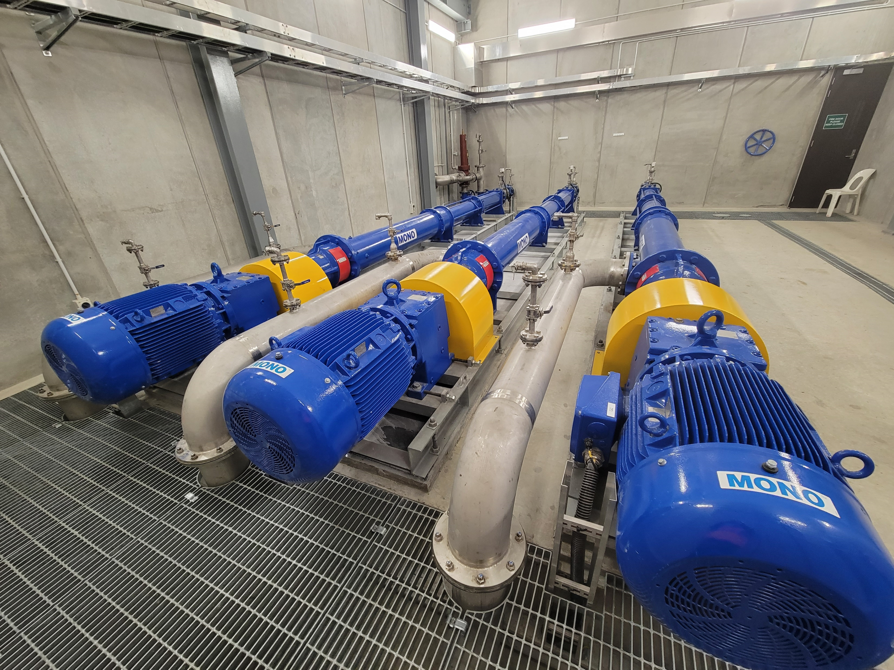
Design Response
High-head pumping from Lyttelton to Christchurch
A pump head of 125m resulting from 50m static elevation and high friction losses to maintain flow rates above 1.0 m/s at minimum pump flow rate
Progressive cavity pumps were selected due to limitations of centrifugal and rotary lobe pumps
The progressive cavity pumps are the largest manufactured by Mono
Use of low velocity “elutriating” intakes to reduce or avoid the transfer of stone into the pump intakes
The high pressure and use of progressive cavity pumps required incorporation of pressure relief valves and rupture discs to relieve high pressure in the system in the event of a blockage, accidental valve closure or pump trip
Notes:
Check minimum flow rate
Add another photo or 3d design render

Slide 9
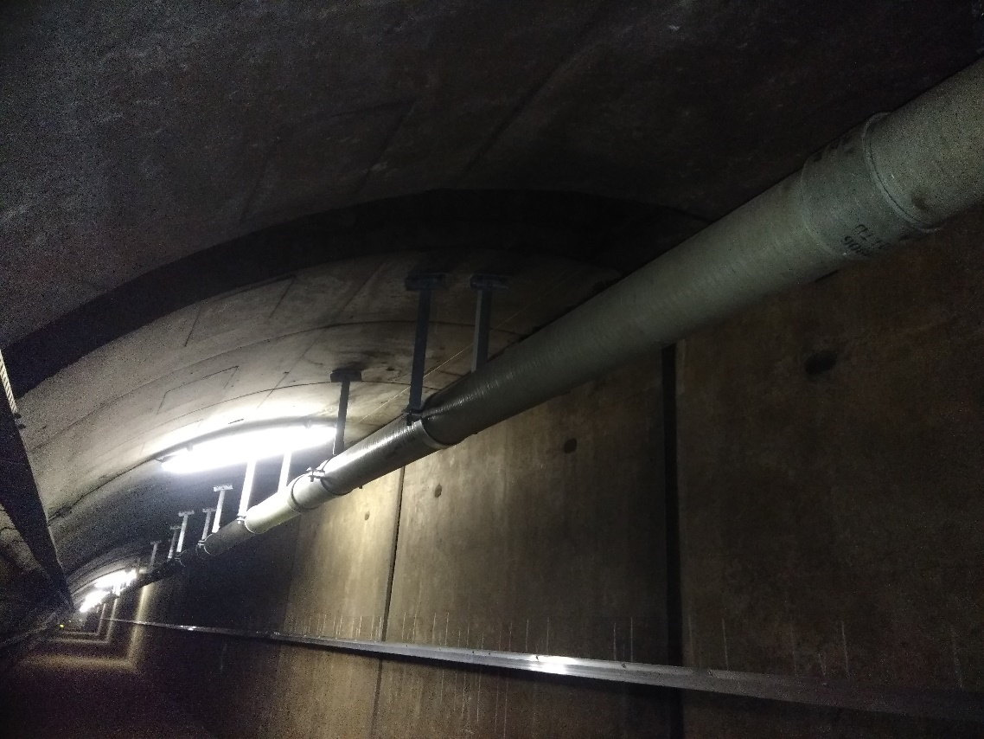
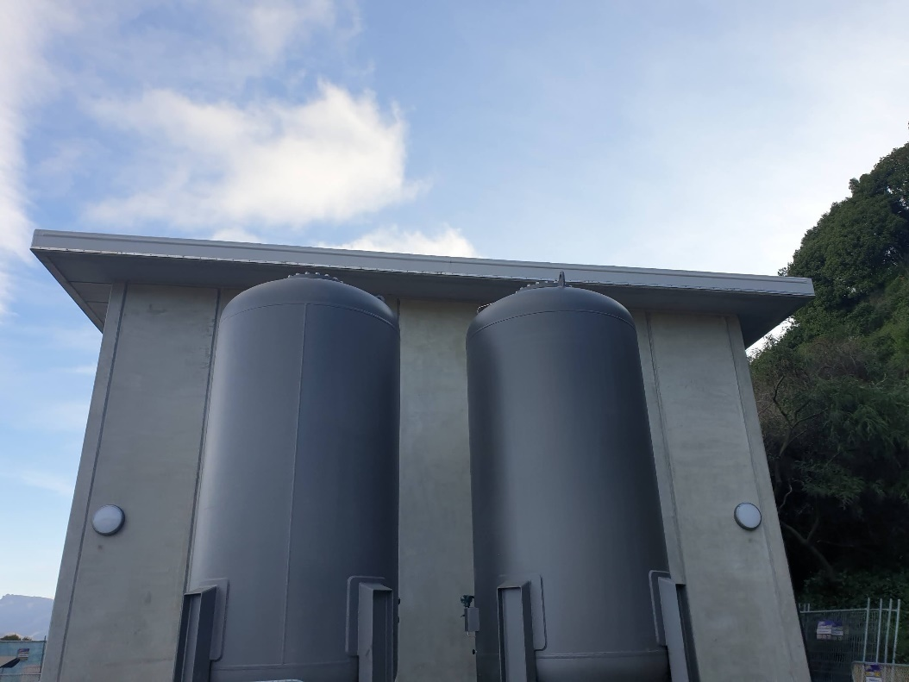
Design Response
Pipework in the Lyttelton Road Tunnel Ceiling
Critical constraints included thermal movement from seasonal or fire related temperature changes, limit of 100 kg/m² loading of the tunnel ceiling, restricted access and importance level IL4 due to criticality of the tunnel
A GRP pipeline using double-bell couplings was used due to the inherent flexibility, light weight, high pressure rating, low thermal response and repairability
The pipe was installed suspended from the ceiling of the tunnel utilizing a bespoke lightweight platform with automated drilling
Utilisation of pressure surge tanks at the Terminal Pump Station to mitigate the risk of pipeline damage or failure under full vacuum conditions that could occur on pump failure
Notes:
Check IL level used for design

Slide 10
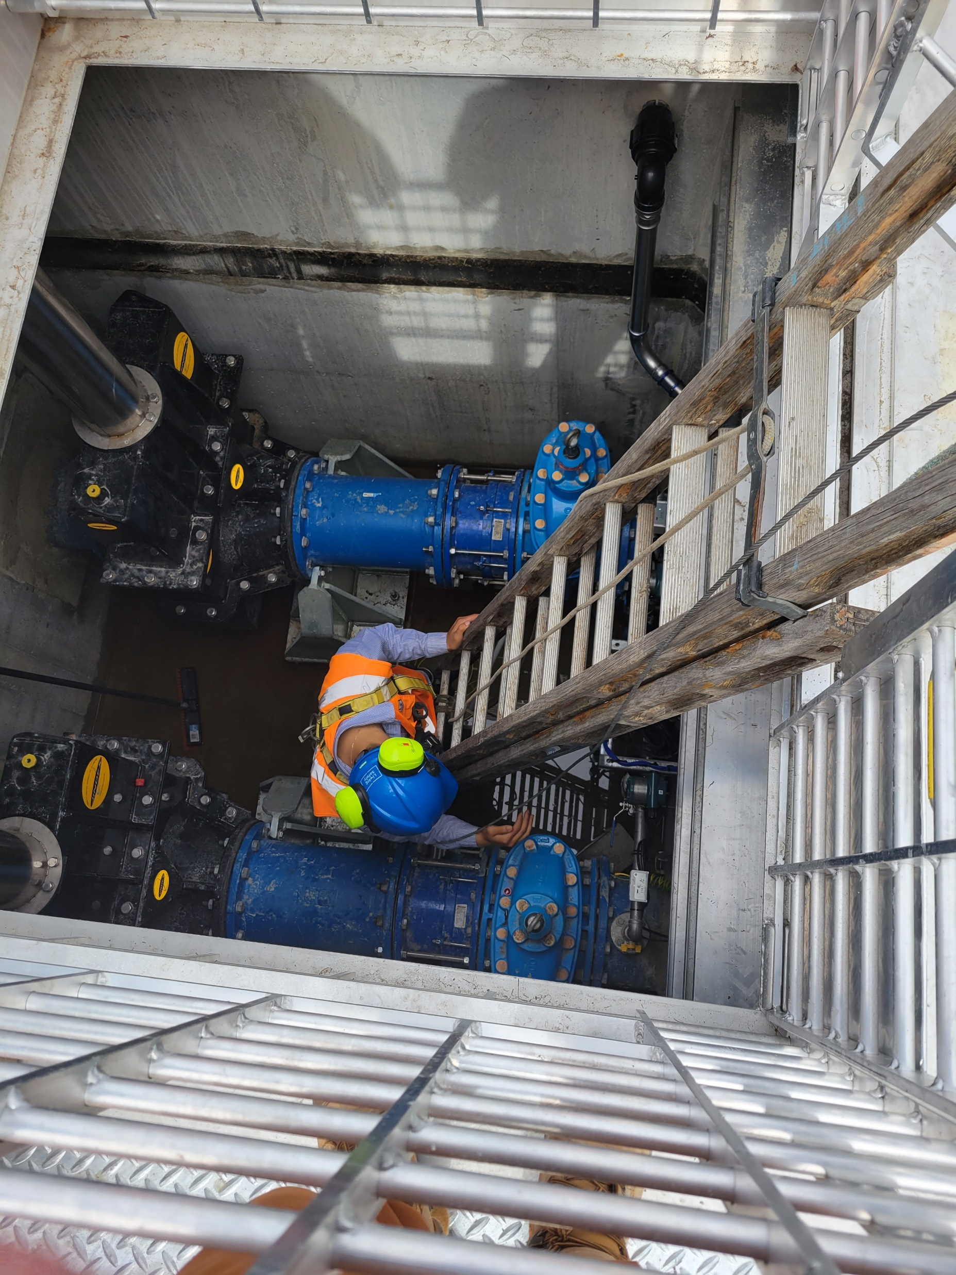
Design Response
Reliable scouring of the gravity pressure main
The pipeline from the Lyttelton tunnel to Pump Station PS15 has a static fall of approximately 60m, resulting in it behaving as a pressurised gravity main.
Uncontrolled flow within the pipe would result in insufficient regular scour velocities with resulting risk of sediment accumulation and slime buildup
A valve station was incorporated so that on valve closing the pipeline can be filled in a controlled manner and on valve opening achieves high-velocity scouring flows
The scouring cycle frequency and fill height is adjustable and interlinked with the terminal pump station and operation is automated
Notes:
Can we find another photo that has a more vertical orientation

Slide 11
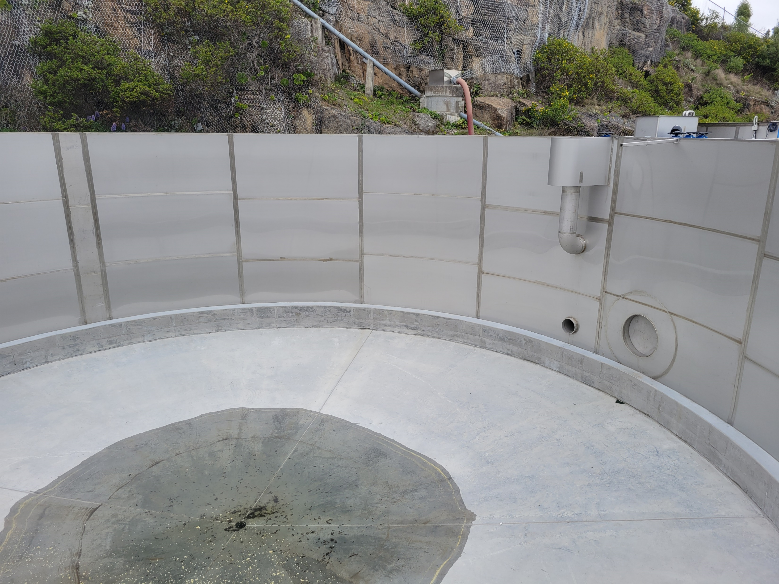
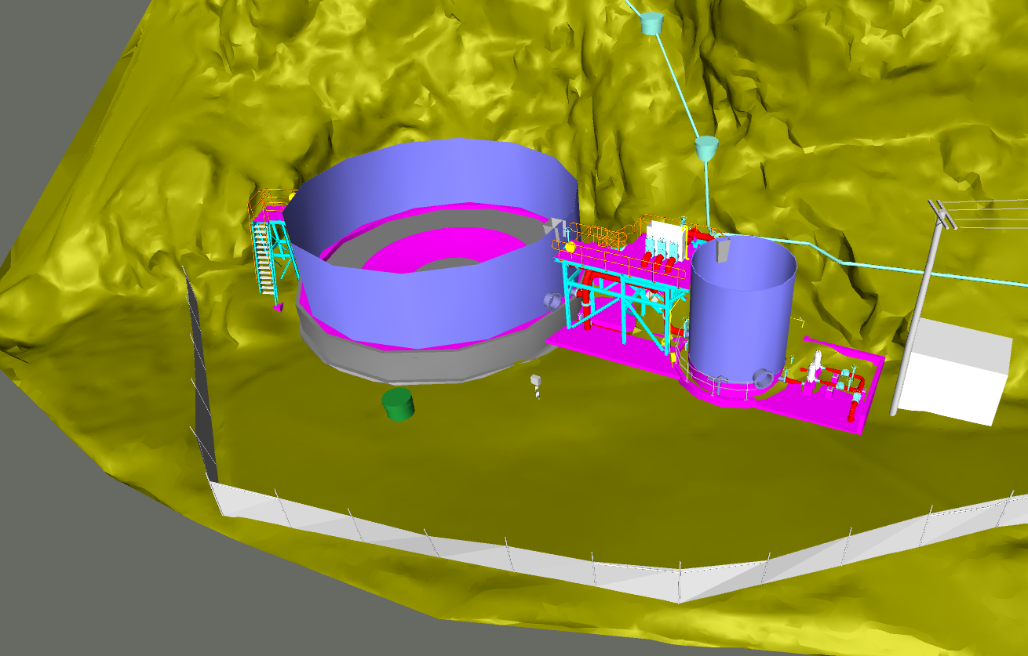
Design Response
Repurposing of Existing Assets
Reuse of concrete treatment tanks as foundations for storage tanks at Diamond Harbour and Governors Bay
Use of concrete treatment tank at Lyttelton as a second storage tank
Constrained sites
Reuse of concrete treatment tanks as foundations for storage tanks reduced demolition and disposal
Use of stainless-steel wet-wells and storage tanks reduced construction complexity and materials transportation
Maximising the capacity of storage installed at Governors Bay and Diamond Harbour sites avoids the need for complex and costly upgrade of storage in the future

Slide 12
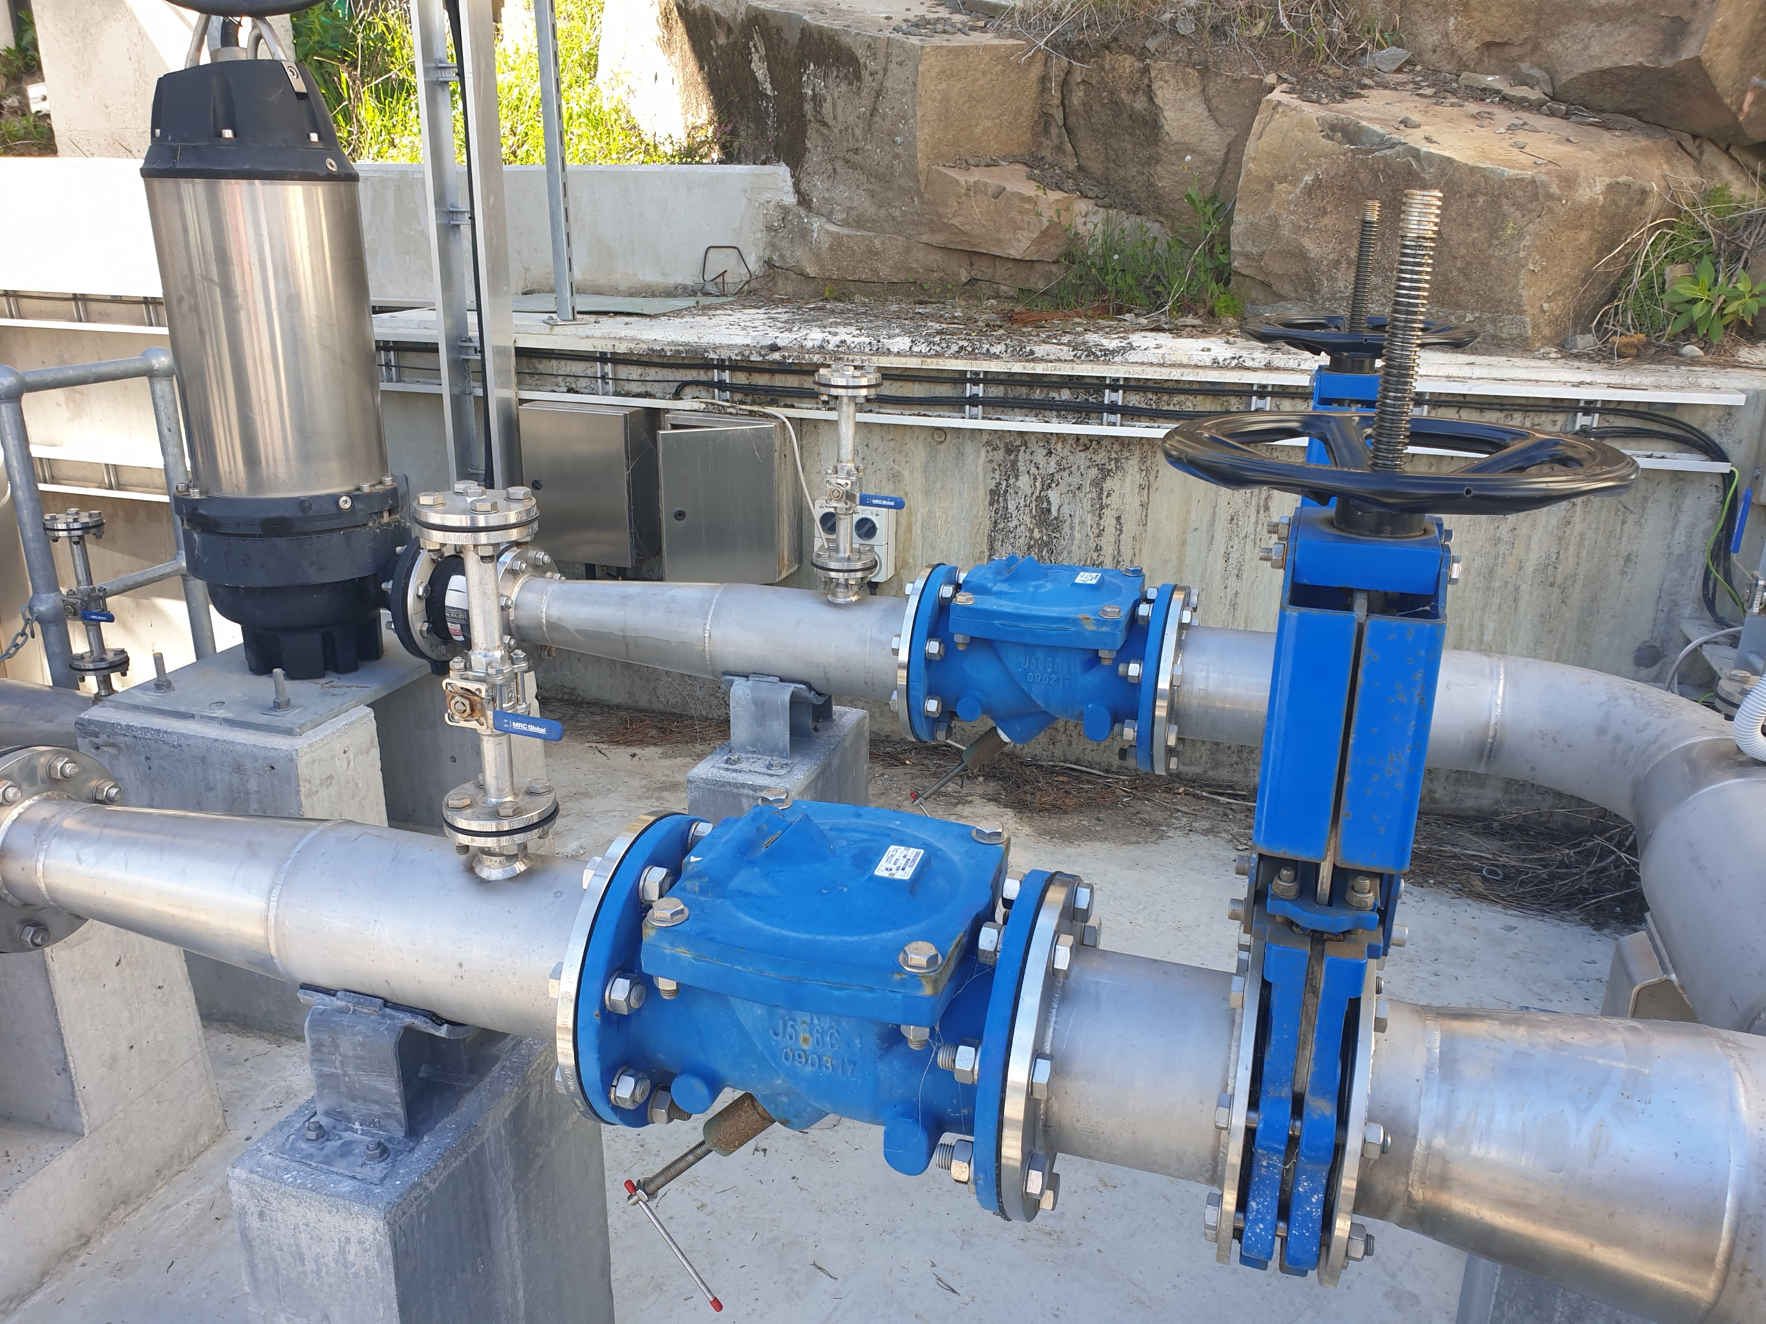
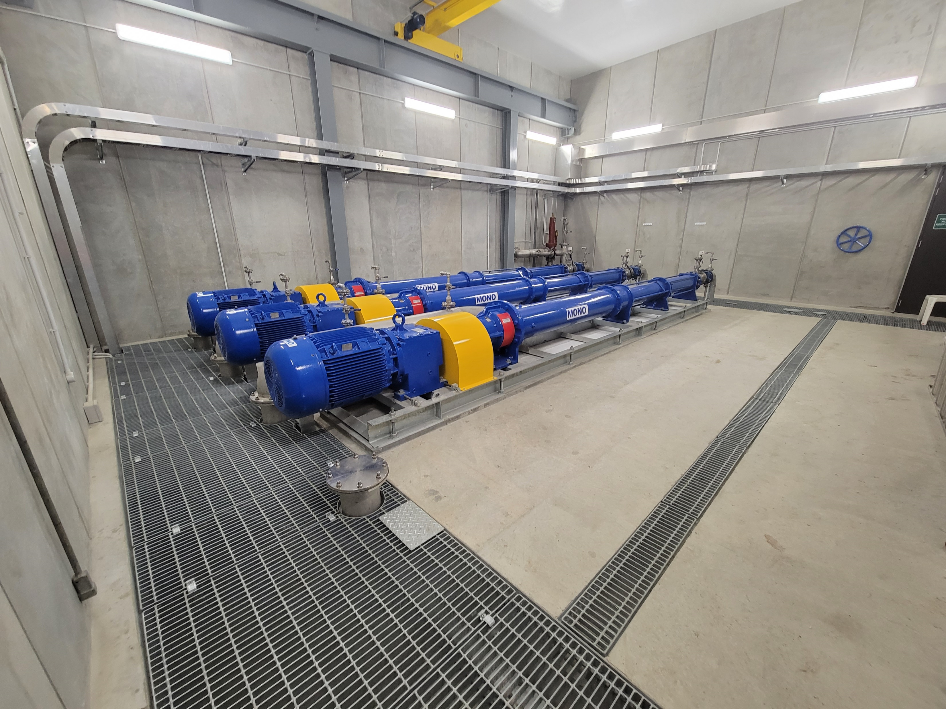
Design Response
Planned Adaptability
Sizing of power supply and pump inlet and outlet pipework to enable installation of larger pumps
Oversizing of pipework between wet-well and storage tanks to accommodate future increase in flows
Use of stainless-steel tanks that can be extended in future
Hydraulic design of pipelines at lower end of velocity / scour range and with an additional pressure rating to enable increased flows
Provision of space and pipework for 4th pump at Simeon Quay Terminal Pump Station
Each pump station / storage facility designed to operate independently but the integration of scheme operations can be automated in future

Slide 13
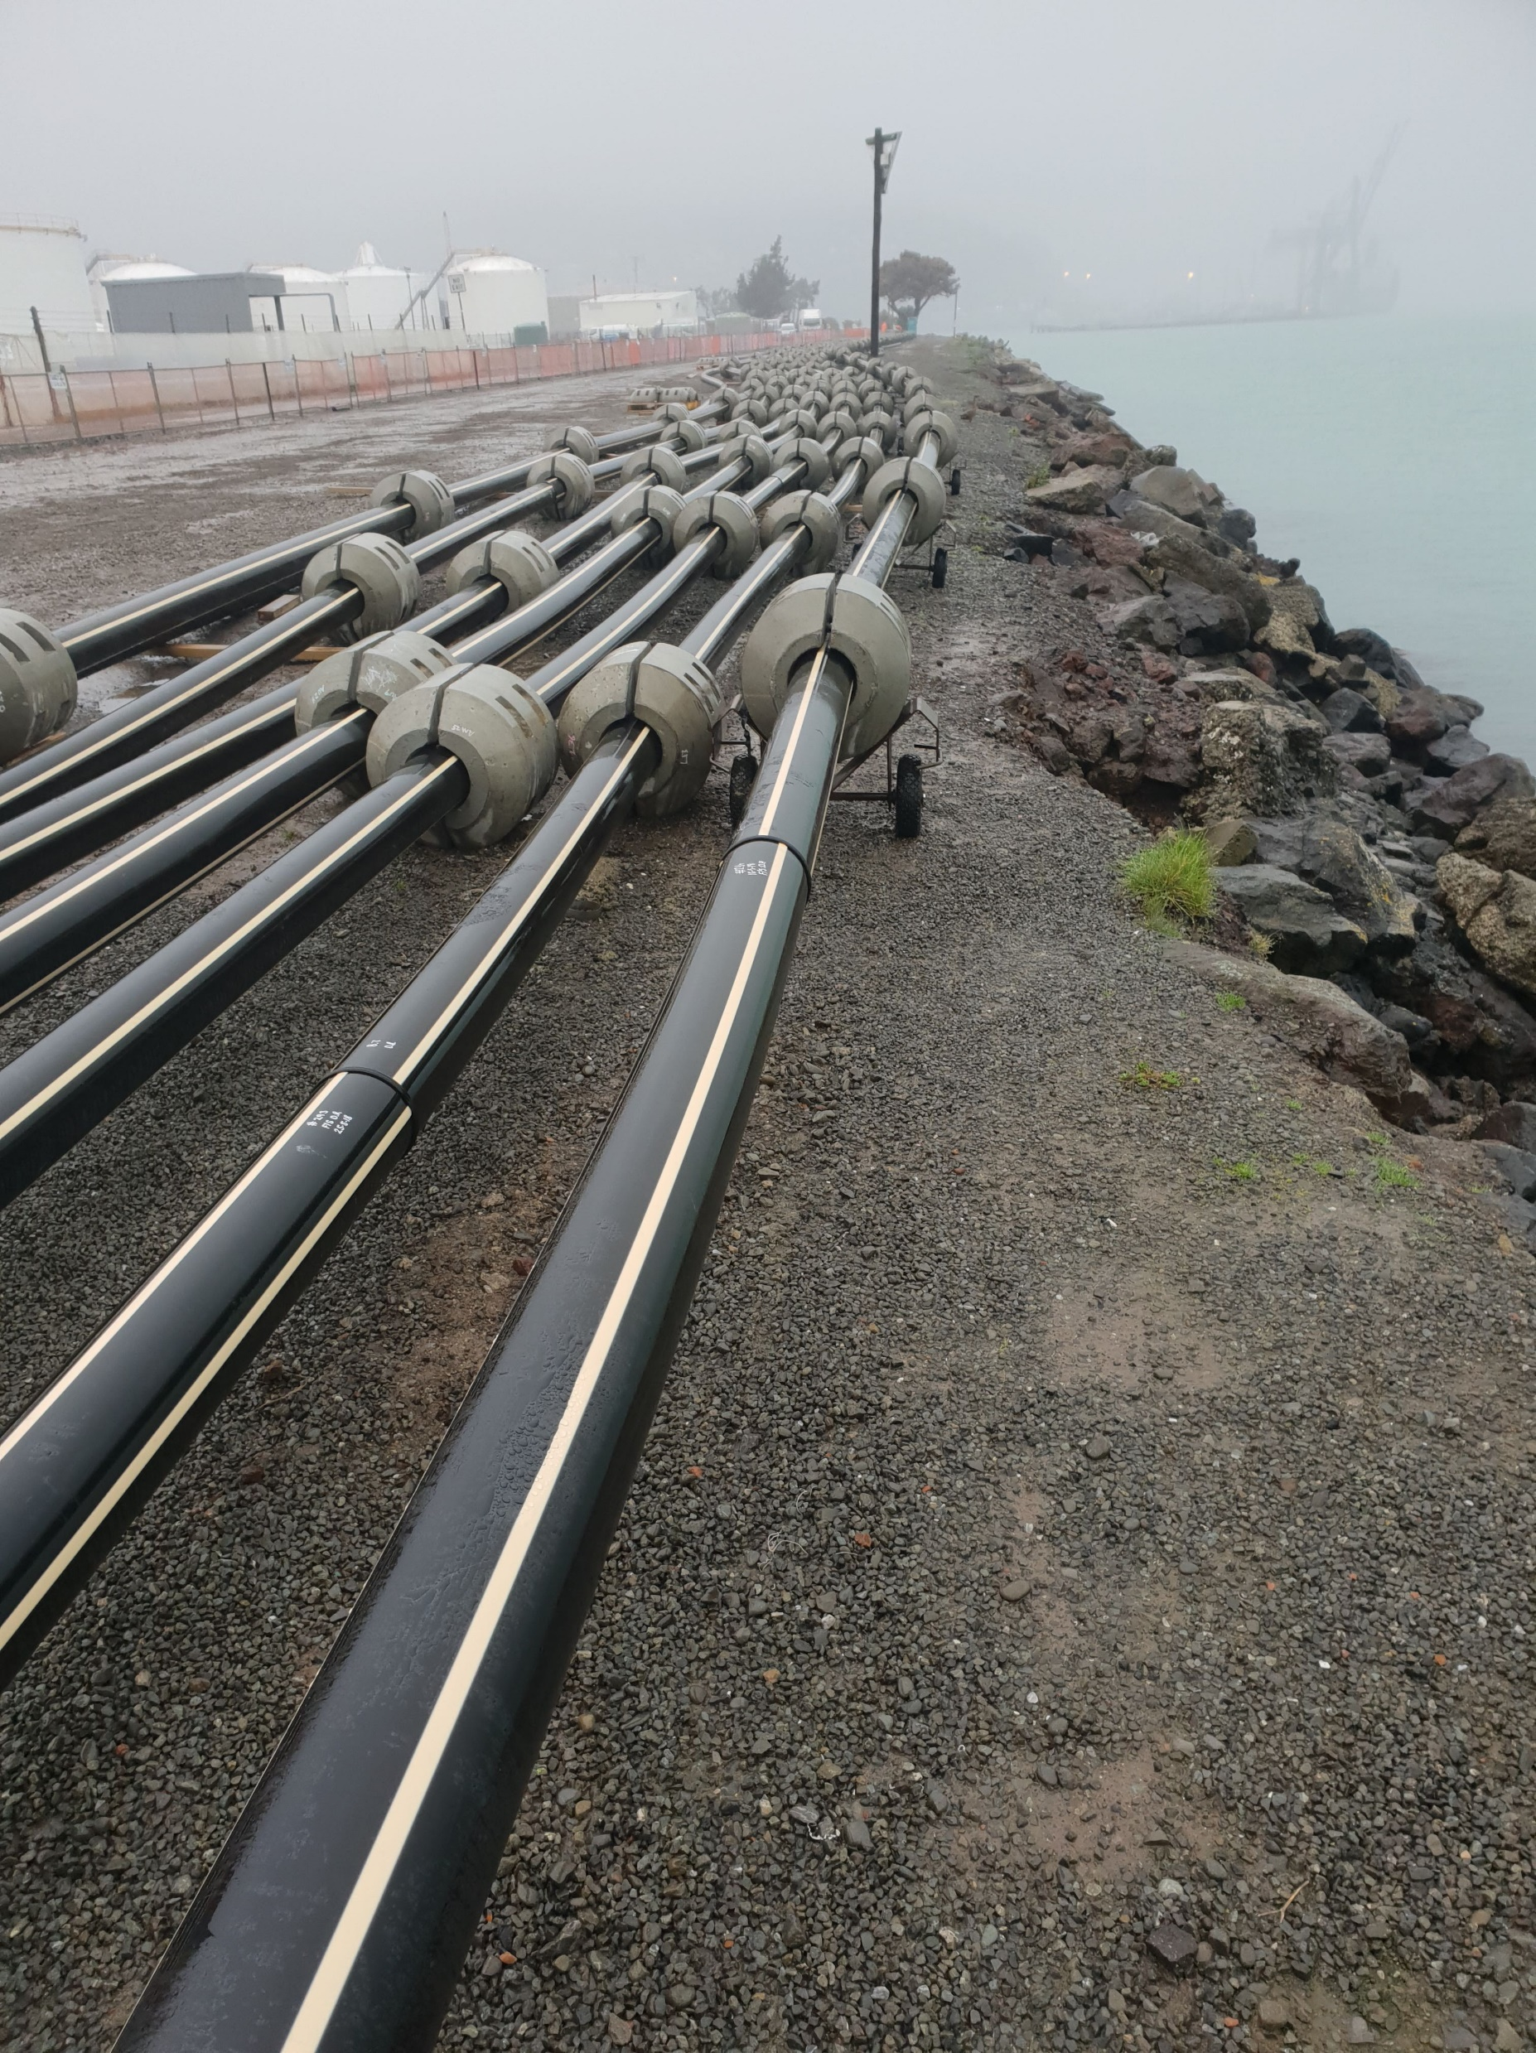
Project Outcomes
When commissioned in November 2022, routine discharges of treated wastewater into Lyttelton Harbour will cease
Cessation of wastewater discharges is an important step in the Whaka-Ora Healthy Harbour Plan to restore the cultural mauri and ecological health of Lyttelton Harbour
Concludes 25 years of stakeholder and Council consideration of wastewater within the Harbour
Concludes 7 years of design, consenting and construction activities
Provides Council a scheme with operational flexibility and significant overflow storage

Slide 14
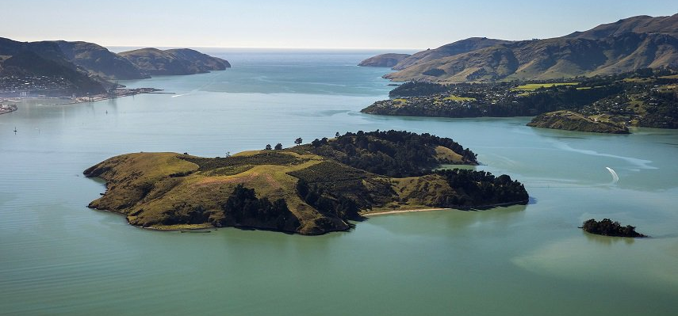
Want to continue the conversation?
Thank You
Matthew Sheppard – Principal Water Engineer, Jacobs
Anthony Doherty – Associate Water Engineer, Jacobs
Come and say hello to the team at the Jacobs booth, location #125

