Slide 1
The Costs of Drought in Urban Water Supply Planning Asaad Y. Shamseldin George Beveridge Theunis F.P Henning. Kobus van Zyl

Slide 2
Purpose of Research
Provide a practical framework for water suppliers to integrate drought costs into water supply planning.

Slide 3
Overview of Presentation
Why assess drought costs in urban areas?
Framework for integrating drought costs in water supply planning
Wellington Water case study
Conclusions and future research opportunities

Slide 4
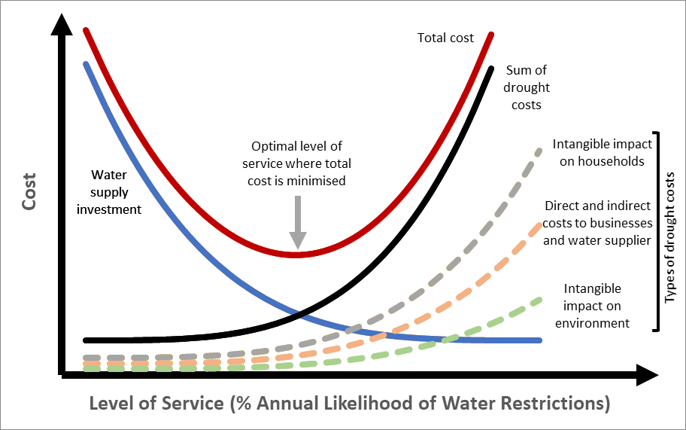
Why assess drought costs in urban areas?

Slide 5
Framework
Inputs:
Water supplier network modelling and cost information
Drought costs – different methods for different types
Short term drought costs – single drought event
Long term drought costs over planning period
Integrate into water supply planning

Slide 6
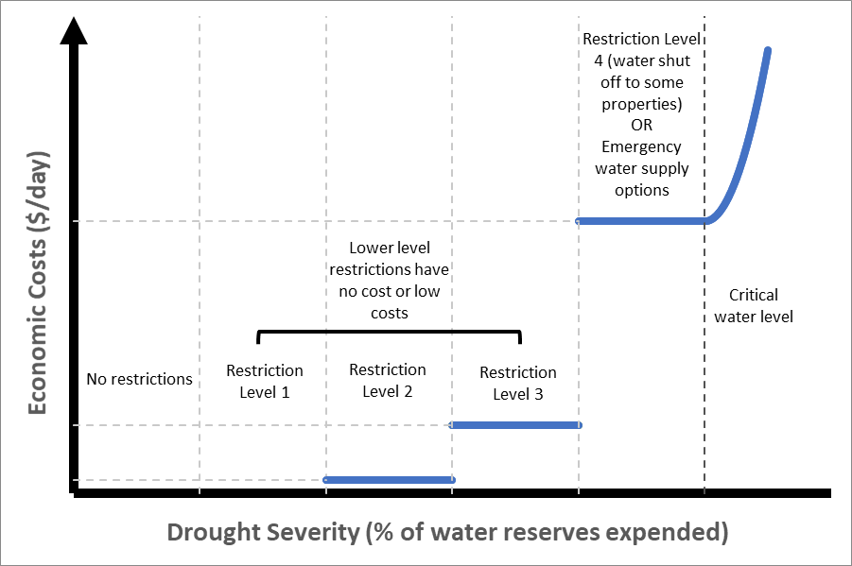
Framework - Costs of a single drought event

Slide 7
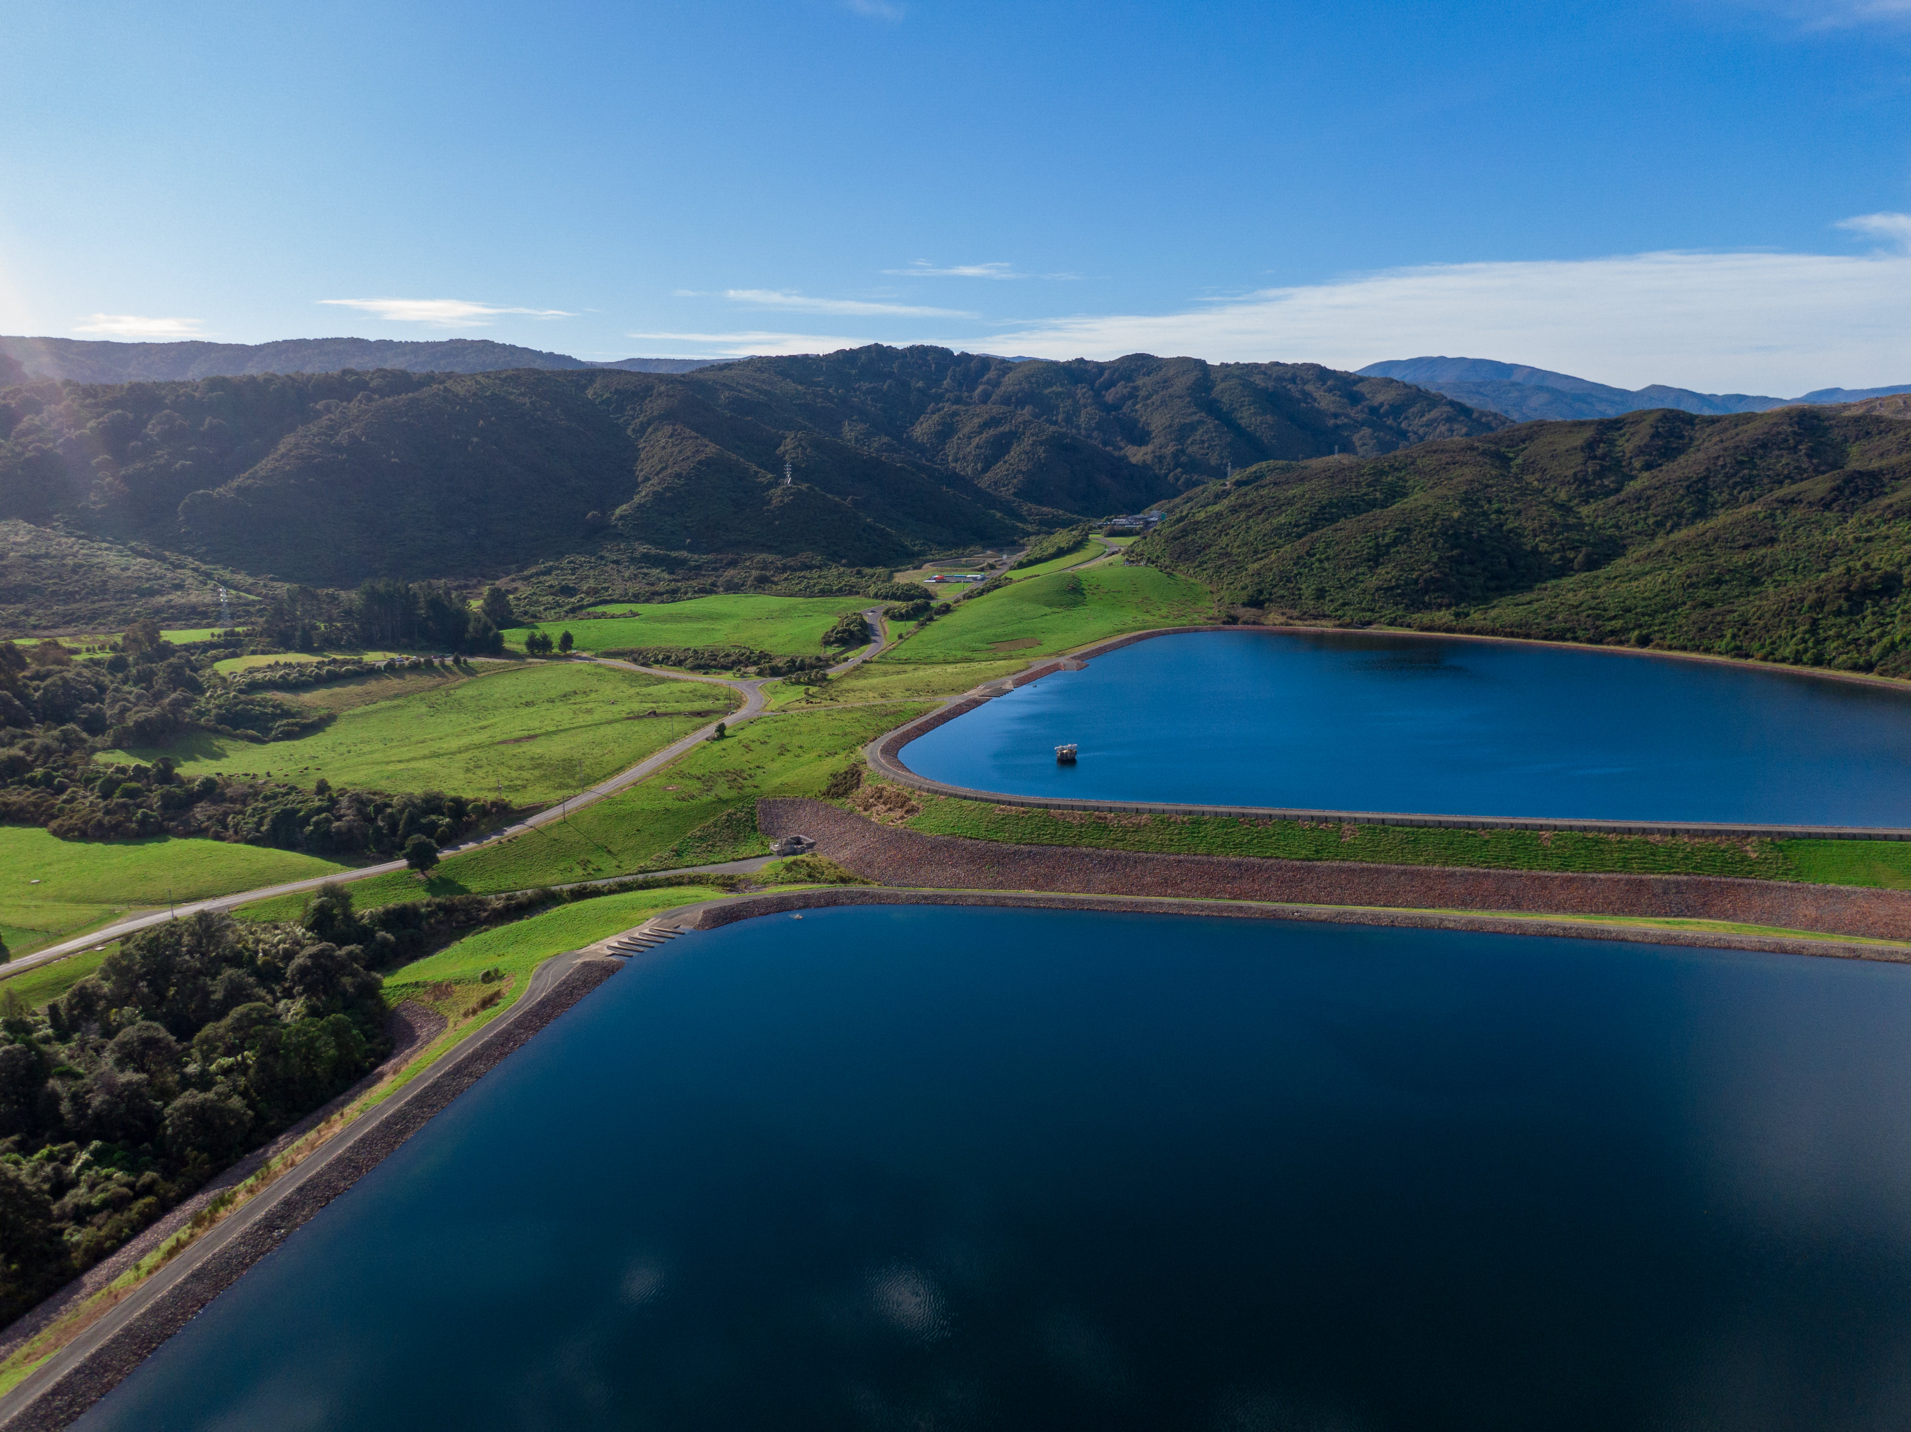
Wellington Water Case Study
Frequent rainfall throughout year and relatively little storage
Current level of service - 2%/1 in 50-year annual shortfall probability
Two different approaches:
Severe restrictions where water is cut off to some customers
Emergency supply

Slide 8
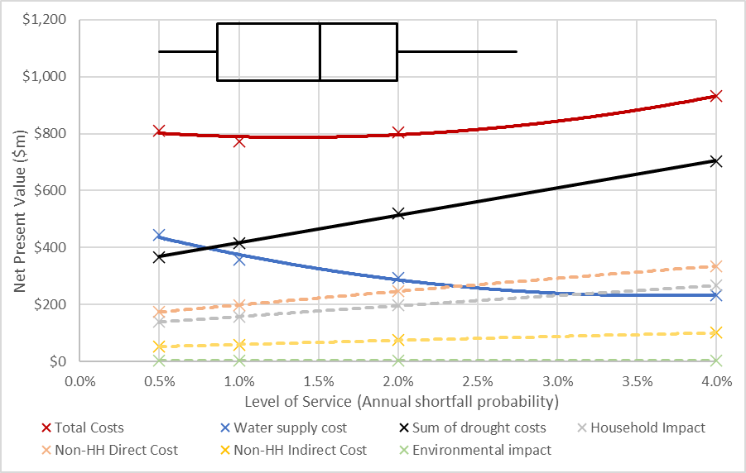
Wellington Water Case Study – Severe Restrictions

Slide 9
Wellington Water Case Study – Severe Restrictions
Largest drought costs are costs to businesses and households
No New Zealand studies
UK studies were applied – similar conditions but Wellington has shorter droughts

Slide 10
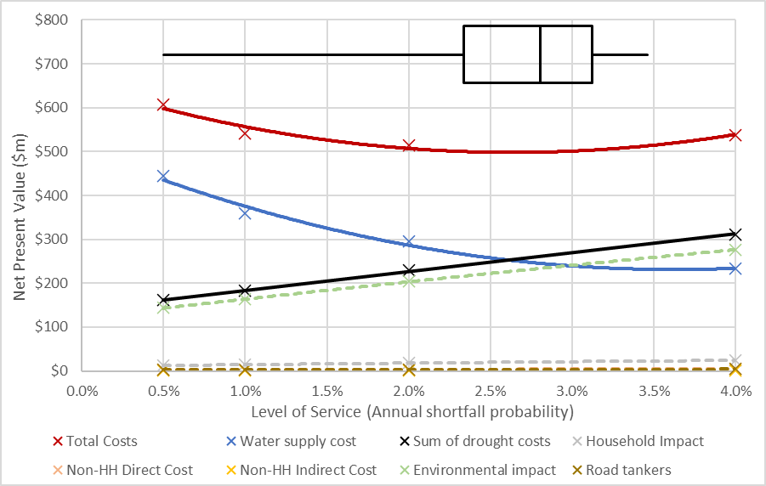
Wellington Water Case Study – Emergency Supply

Slide 11
Wellington Water Case Study – Emergency Supply
Limited emergency supply options due to short drought duration
Trucking water
Abstraction from Hutt River beyond environmental limits
Environmental costs are uncertainty. There are some NZ studies, but may not be fit for purpose

Slide 12
Conclusions and future research opportunities
The framework was successfully applied to Wellington Water’s network
Wellington Water’s current 2%/1 in 50-year level of service sits within the range of optimal level of service results
The trade-off between cutting off water to customers and severe environmental impacts from water abstraction is a difficult one
There are a lack of New Zealand studies into household and businesses willingness to pay to avoid water restrictions
It is challenging to estimate the environmental costs of abstraction beyond environmental limits
Political and reputational impacts were not considered and could be significant

Slide 13
Thank you!
Feel free to reach out
George.Beveridge@wsp.com
Acknowledgements
Wellington Water for providing data for the case study. Specifically Geoff Williams and Julian Fyffe for taking the time to share their expertise on Wellington Water’s network.
Ministry of Business, Innovation and Employment (MBIE), University of Auckland, University of Canterbury and WSP New Zealand for supporting this research.

