Slide 1
Madeline Furness, Ricardo Bello Mendoza, Rolando Chamy
The Biofactory: Life Cycle Sustainability Assessment of Circular Economies of Wastewater

Slide 2
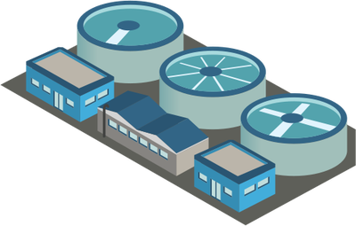
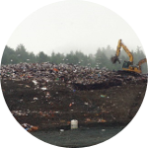
Global Water Challenges
Global integrated water management is a critical issue
+1.89% GDP Investment required in Latin America
~80%
Wastewater treatment infrastructure incurs environmental, social and economic impacts
Emissions
Biowaste

Slide 3
Global Water Challenges
Improving sanitation coverage requires sustainable solutions
~80%
Emissions
Emissions
Biowaste
Biowaste

Slide 4
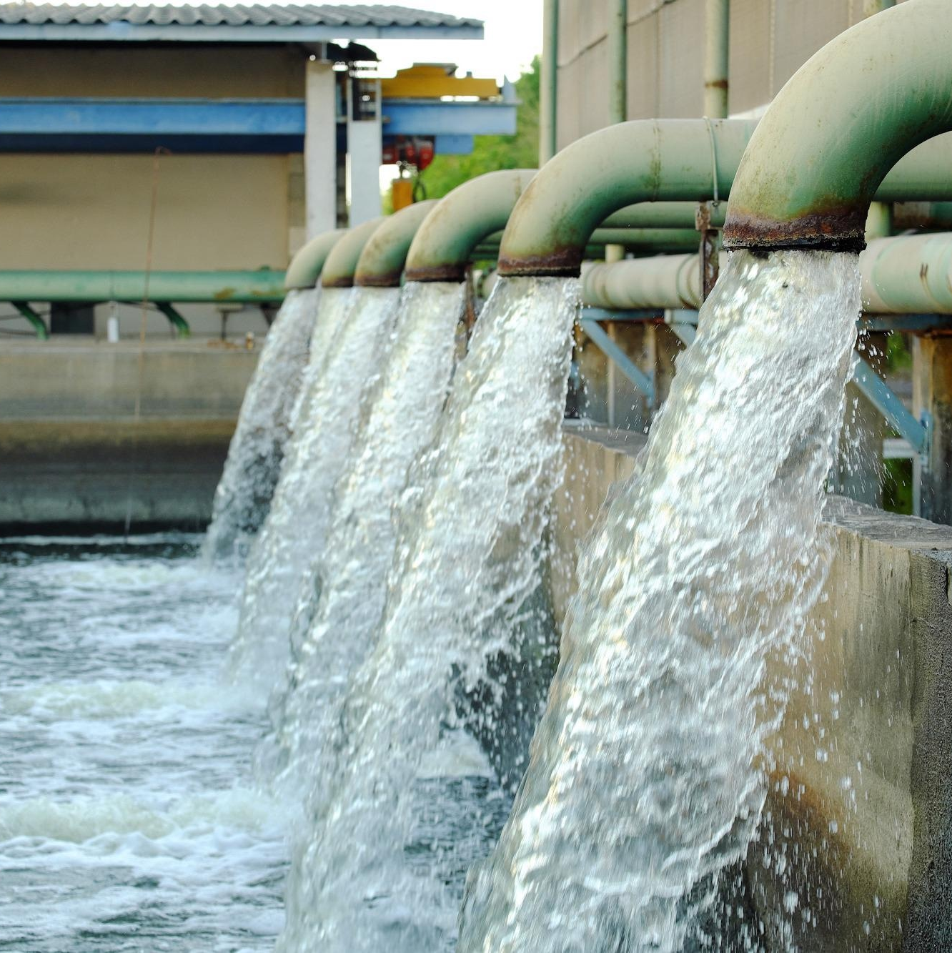
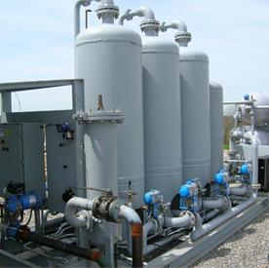
What is a Biofactory? … a Circular Economy
Treated Effluent
Biomethane
Emissions
New Technologies
Fertilizer
Biowaste
Which technologies and treatment configurations are appropriate … ?

Slide 5
How is sustainability measured?
Environment
Life Cycle Assessment (LCA) ISO 14040/44
Society
Social Life Cycle Assessment (SLCA) UNEP SETAC
Climate Change
Radiation
Ozone Depletion
Eutrophication
Acidification
Fossil Scarcity
Water Scarcity
Mineral Scarcity
Ecotoxicity
Human Toxicity
Economy
Life Cycle Costing (LCC)
Working Conditions
Governance
Socio-cultural Responsibility
Environmental Responsibility
Service Quality
CapEx
OpEx
Maintenance
NPV
$$\sum{LCA+SLCA+LCC=Life Cycle Sustainability Assessment (LCSA)}$$

Slide 6
Life Cycle Sustainability Assessment
Goal and Scope
Setting objectives
Geography and Life Cycle
Functional Unit
Setting system boundaries
Interpretation
Identify benefits/ issues
Uncertainty
Decision Making?
Analytical Hierarchy Process – Trade-offs
Develop an LCSA methodology for decision making applications
Present a case study of two Biofactories from South America
LCA
LCC
SLCA
Data Inventories
Material Flow Analysis
Energy Balance
Inventory Parameters
Calculated Parameters
Expert Interviews
Impact Characterization

Slide 7
Goal and Scope
What are the possible sustainability benefits (or consequences) of a transition to a circular economy?

Slide 8
Setting objectives
Scenario 1
Water
Application: Resource recovery and advanced treatment of wastewater for building a circular economy
Reason: Determine the most sustainable treatment technology configuration
Audience: Sanitation industries and LCA academics
What are the sustainability benefits/impacts of transition scenarios for creating a circular economy in wastewater treatment plants?
When comparing two Biofactories in the same region, which plant has better sustainability performance?
Scenario 4
Scenario 3
Nutrients
Sludge
Energy
Biosolids
Scenario 2

Slide 9
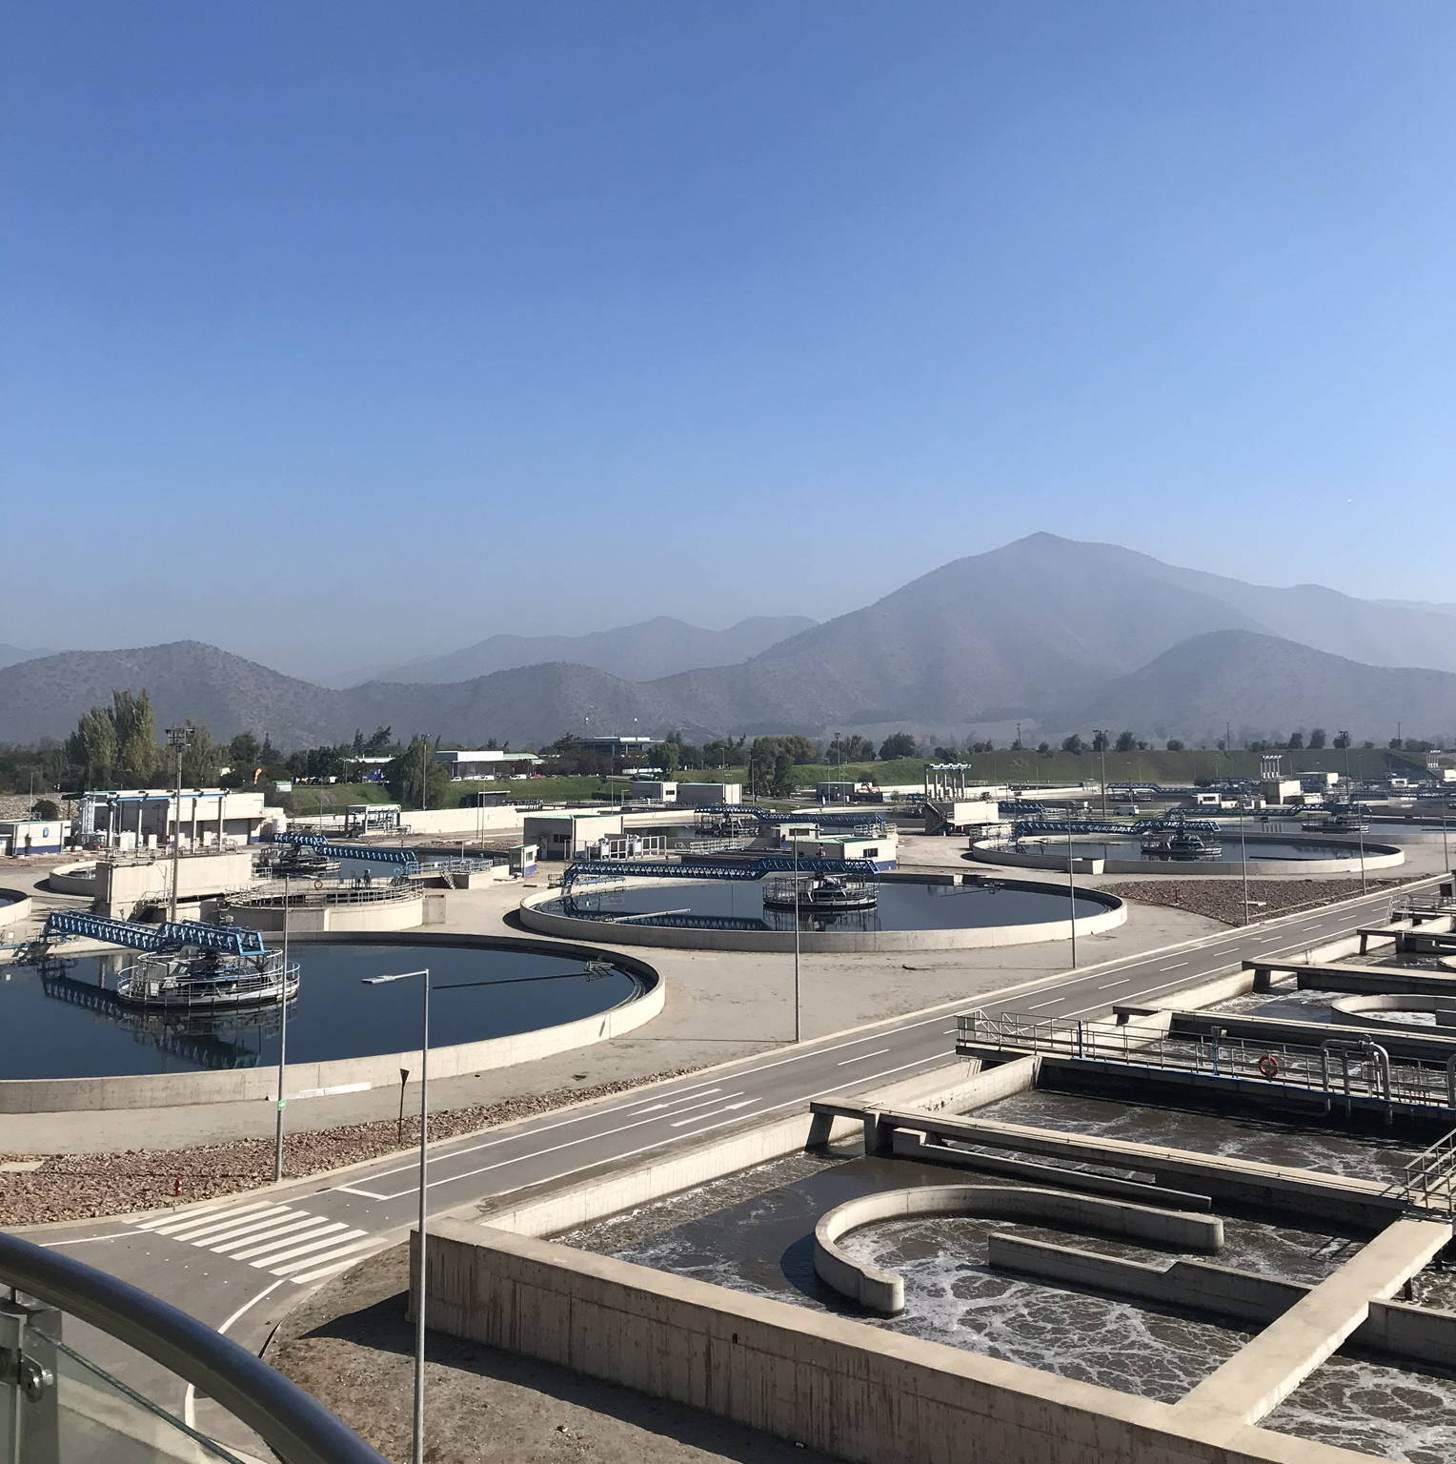
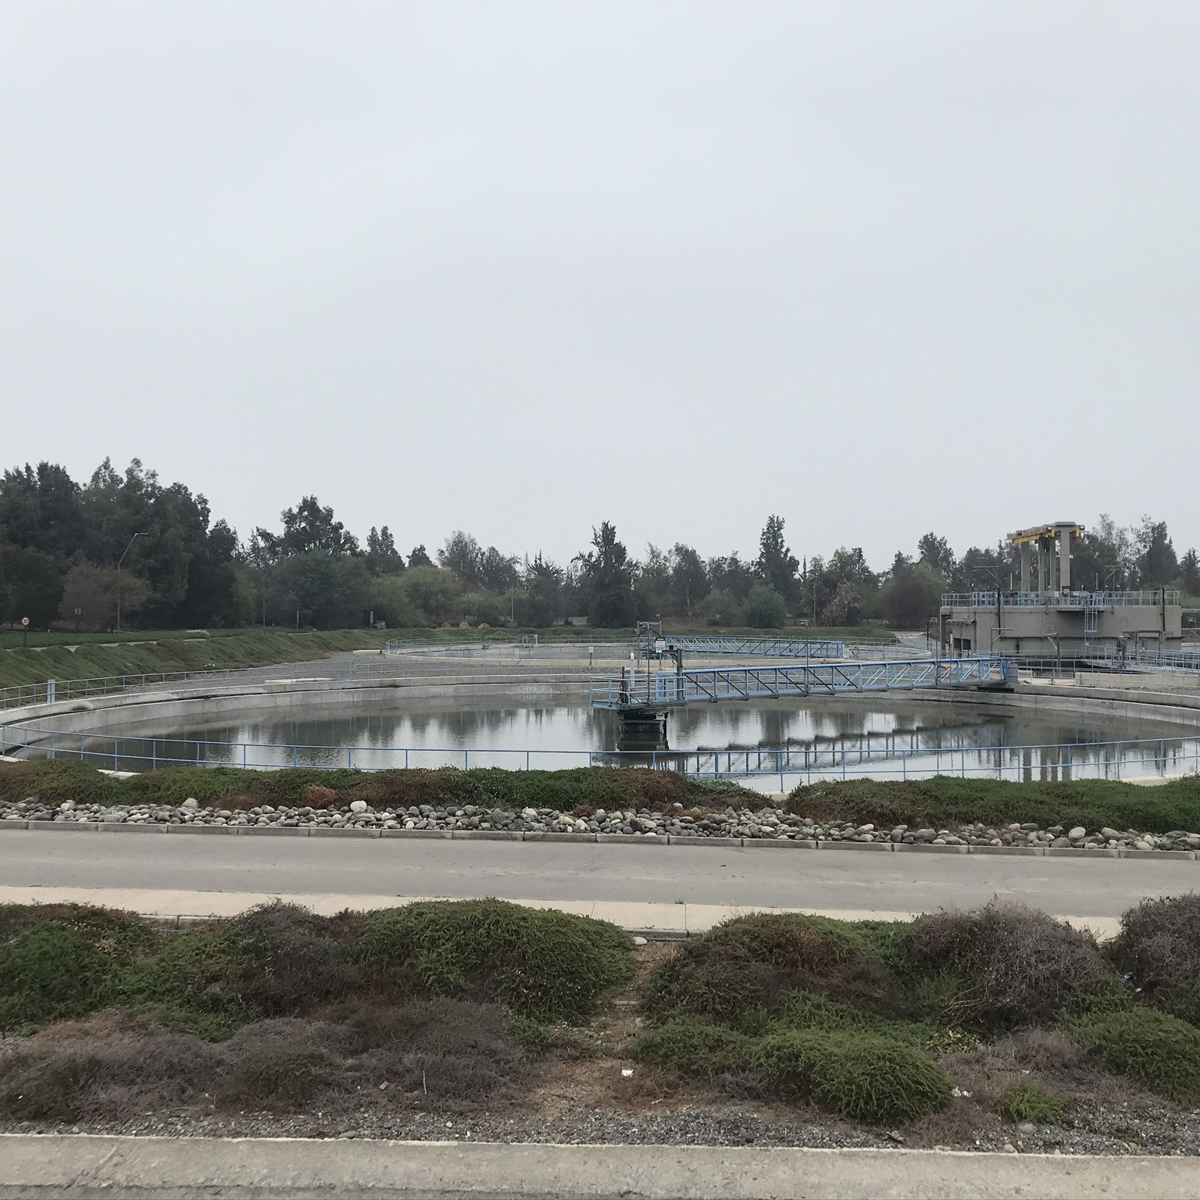
Biofactory 1
783,000 m3/d
3.634.986
Biofactory 2
664,000 m3/d
2.803.860
Geography and Life Cycle
Daily water life cycle
Infrastructure life cycle 20 years
Wastewater Conveyance
Construction
Water Production
Water Consumption
Disposal
Recovery
Operation
Resource Recovery
Energy Production
Energy Consumption
Demolition
Disposal
Biosolids Production
Crop Consumption
Privatized water

Slide 10
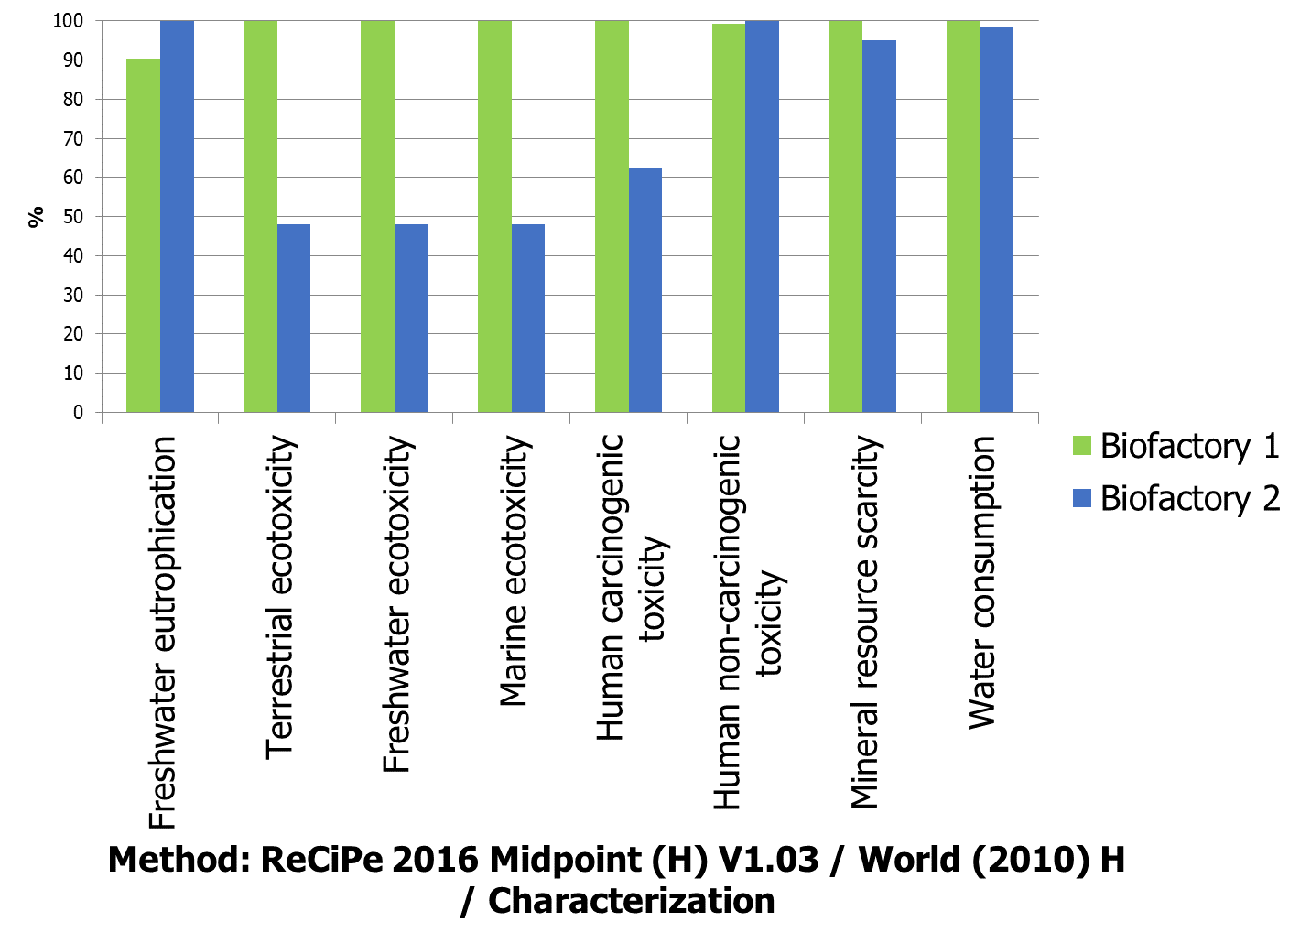
Functional Unit and Reference Flows
1,000,000 Population Equivalent (p.e.)
44,500 kg BOD₅ Treated/ 1 day of operation
Functional Unit | Reference Flows | Products
1,000,000 p.e. / day | kg BOD₅ | Water
Sludge Treated | kg TS/kg BOD₅ | Biosolids
Biogas Energy Produced | Nm3/kg ΔVS | Biogas
Nitrogen Management | kg TN/kg TS | Water Returns

Slide 11
Impact Characterization
Impacts and characterization : ReCiPe 2016 Midpoint (H) V1.03 / World (2010) H (50 years)
Impact category | Unit | €/unit (De Bruynn, S. 2018)
Global warming | kg CO2 eq | 0.06
Stratospheric ozone depletion | kg CFC11 eq | 132.59
Ionizing radiation | kBq Co-60 eq | 0.05
Ozone formation, Human health | kg NOx eq | 0.17
Fine particulate matter formation | kg PM2.5 eq | 74.38
Ozone formation, Terrestrial ecosystems | kg NOx eq | 0.17
Terrestrial acidification | kg SO2 eq | 8.75
Freshwater eutrophication | kg P eq | 2.05
Marine eutrophication | kg N eq | 3.35
Terrestrial ecotoxicity | kg 1,4-DCB | 9.58
Freshwater ecotoxicity | kg 1,4-DCB | 0.04
Marine ecotoxicity | kg 1,4-DCB | 0.01
Human carcinogenic toxicity | kg 1,4-DCB | 0.04
Human non-carcinogenic toxicity | kg 1,4-DCB | 0.04
Land use | m2a crop eq | 0.04
Mineral resource scarcity | kg Cu eq | 8.70
Fossil resource scarcity | kg oil eq | 0.01
Water consumption | m3 | 0.01

Slide 12
Impact Characterization
Impacts and characterization : ReCiPe 2016 Midpoint (H) V1.03 / World (2010) H (50 years)
Impact category | Unit | €/unit (De Bruynn, S. 2018)
Global warming | kg CO2 eq | 0.06
Stratospheric ozone depletion | kg CFC11 eq | 132.59
Ionizing radiation | kBq Co-60 eq | 0.05
Ozone formation, Human health | kg NOx eq | 0.17
Fine particulate matter formation | kg PM2.5 eq | 74.38
Ozone formation, Terrestrial ecosystems | kg NOx eq | 0.17
Terrestrial acidification | kg SO2 eq | 8.75
Freshwater eutrophication | kg P eq | 2.05
Marine eutrophication | kg N eq | 3.35
Terrestrial ecotoxicity | kg 1,4-DCB | 9.58
Freshwater ecotoxicity | kg 1,4-DCB | 0.04
Marine ecotoxicity | kg 1,4-DCB | 0.01
Human carcinogenic toxicity | kg 1,4-DCB | 0.04
Human non-carcinogenic toxicity | kg 1,4-DCB | 0.04
Land use | m2a crop eq | 0.04
Mineral resource scarcity | kg Cu eq | 8.70
Fossil resource scarcity | kg oil eq | 0.01
Water consumption | m3 | 0.01

Slide 13
Setting system boundaries Biofactory 1
Local Community
Workers
Influent Wastewater
Clients
Water Recovery
Workers
Avoided Irrigation Water
Farmers
Nitrification-Denitrification-Anammox
Workers
Anaerobic Digestion
Workers
Upgrading and Biomethane
Workers
Avoided Natural Gas
Gas Company
Crop Production
Farmers
Avoided Fertilizer
Farmers
Biosolids Recovery 25:75
Biosolids Company
Chemical Suppliers
Supply Chain Actors

Slide 14
Setting system boundaries Biofactory 2
Workers
Local Community
Influent Wastewater
Clients
Water Discharge
Workers
SBR-Anammox
Workers
Thermal Hydrolysis Anaerobic Digestion Workers
Ugrading and Cogeneration
Workers
Avoided Energy
Local Energy Company
Crop Production
Farmers
Avoided Fertilizer
Farmers
Biosolids Recovery 13:87
Biosolids Company
Chemical Suppliers
Supply Chain Actors

Slide 15
Data Inventories
What data is required for characterizing sustainability impacts ?

Slide 16
Process Data Inventories
Materials
Avoided Products
Material OpEx
Savings
Value Chain Actor
Value Chain Actor
Energy
Products
Energy OpEx
PROCESS
Income
Value Chain Actor
Consumers
Transport
Emissions
Transport OpEx
Externality
Environmental Component
Economic Component
Value Chain Actor
Local Community
Social Component
Allocation based on mass
Change-oriented (consequential modelling)

Slide 17
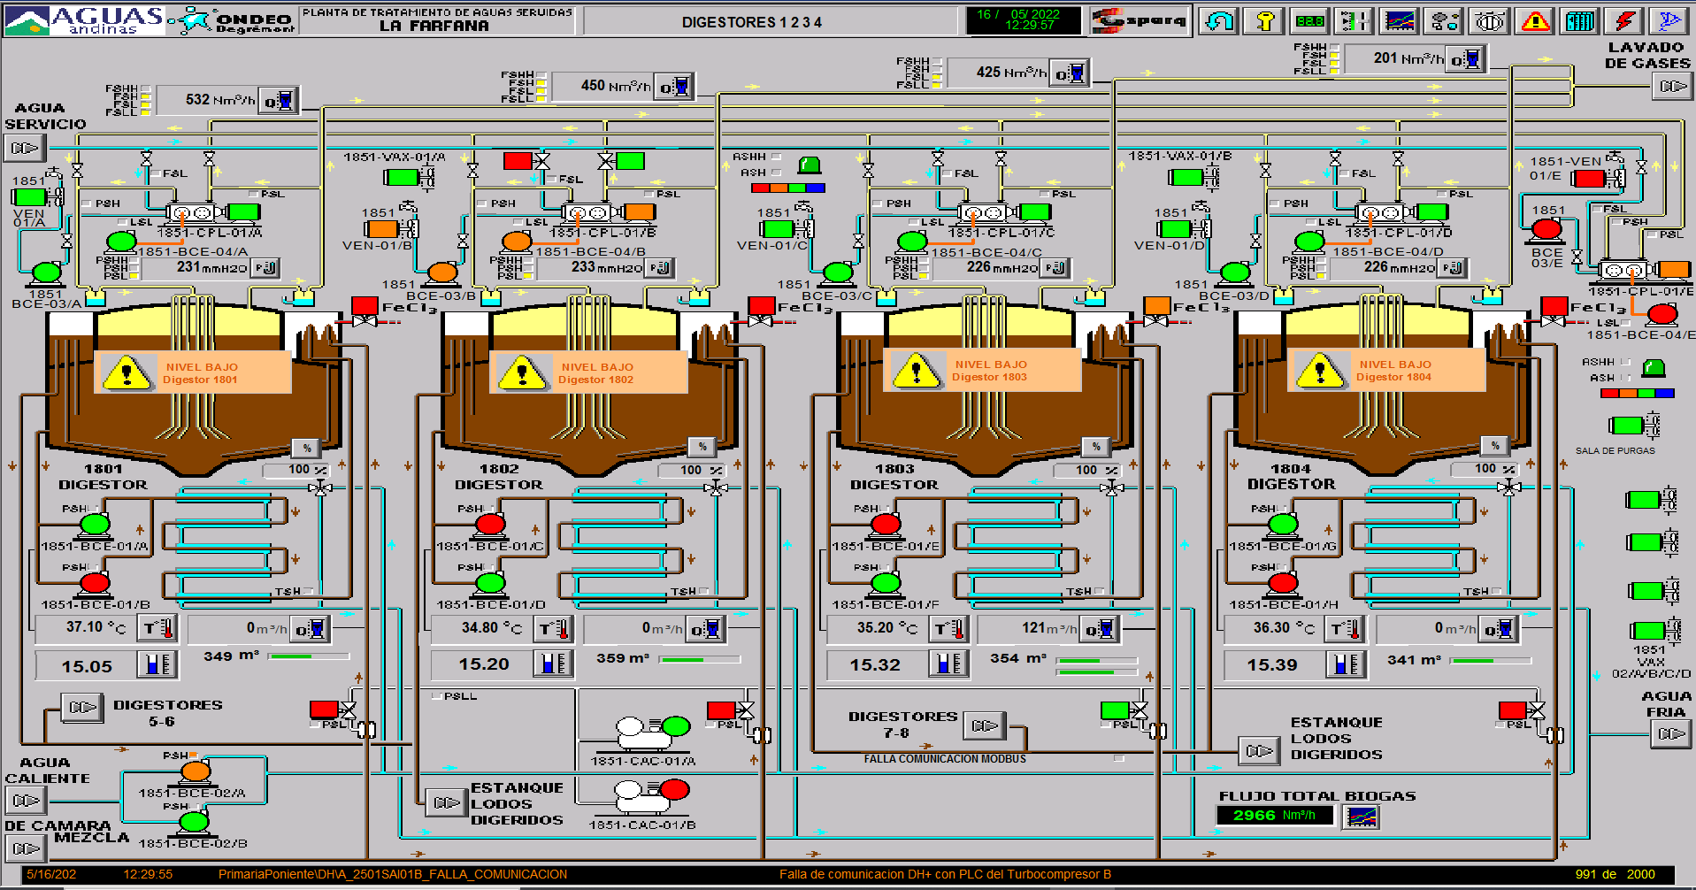
Material Flow Analysis and Energy Balances
Total Solids
Volatile Solids
Total Nitrogen
Total Phosphorous
BOD₅
COD
Heavy Metals
CO2
CH4
H2S
Elementary Flows: Primary Data
Standard Deviations
$$\sum{m_{in}= \sum{m_{out}+∆}m}$$
Energy Demand
Efficiencies
Biogas Density
Calorific Values
$$\sum{E_{in}= \sum{E_{out}}}$$
SCADA, Aguas Andinas, 2019
Cl
O2
FeCl
Polyelectrolytes
MgO
S2O4
HCl
Technosphere Flows: Secondary Data

Slide 18
Inventory Parameters and Calculated Parameters
Atmospheric Emissions
Transport
Avoided Products
Costs
CO2
Biogenic CO2
CH4
Biogenic CH4
CO
NOx
SO2
PM
Distance
Truck Capacity
Truck Weight
Avoided Energy
Avoided Natural Gas
Avoided Fertilizer
Material Prices
Energy Prices
Product Prices
Operational Data
Stakeholder Data
Mass balance
Stakeholder Data
IPCC Databases
Mass balances
Literature

Slide 19
Expert Interviews SLCA
Impacts/Stakeholder | Workers | Value Chain Actors | Local Community | Customers
Working Conditions | Health and Safety Professional Development Equal Opportunities
Socio-cultural Responsibility |  | Promoting Socio-cultural Responsibility | Implementing Corporate Social Responsibility Community Infrastructure
Environmental Responsibility |  | Selection of Sustainable Value Chain Actors Sustainable Production | Compliance with Environmental Legislation Data Monitoring
Governance | Right to Collective Bargaining | Feedback Mechanisms | Feedback Mechanisms | Producer Responsibility

Slide 20
LCA Impact Characterization
Which processes contribute most to environmental impacts?

Slide 21
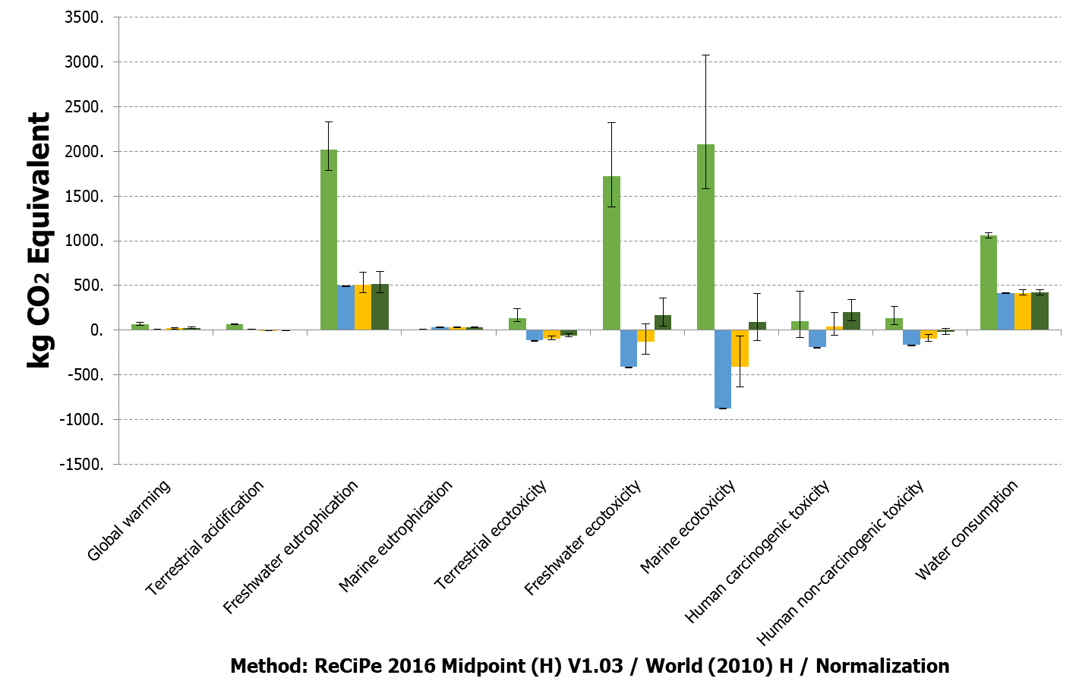
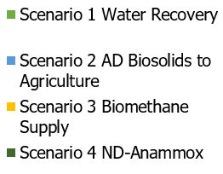
Transition to a Circular Economy Biofactory 1

Slide 22
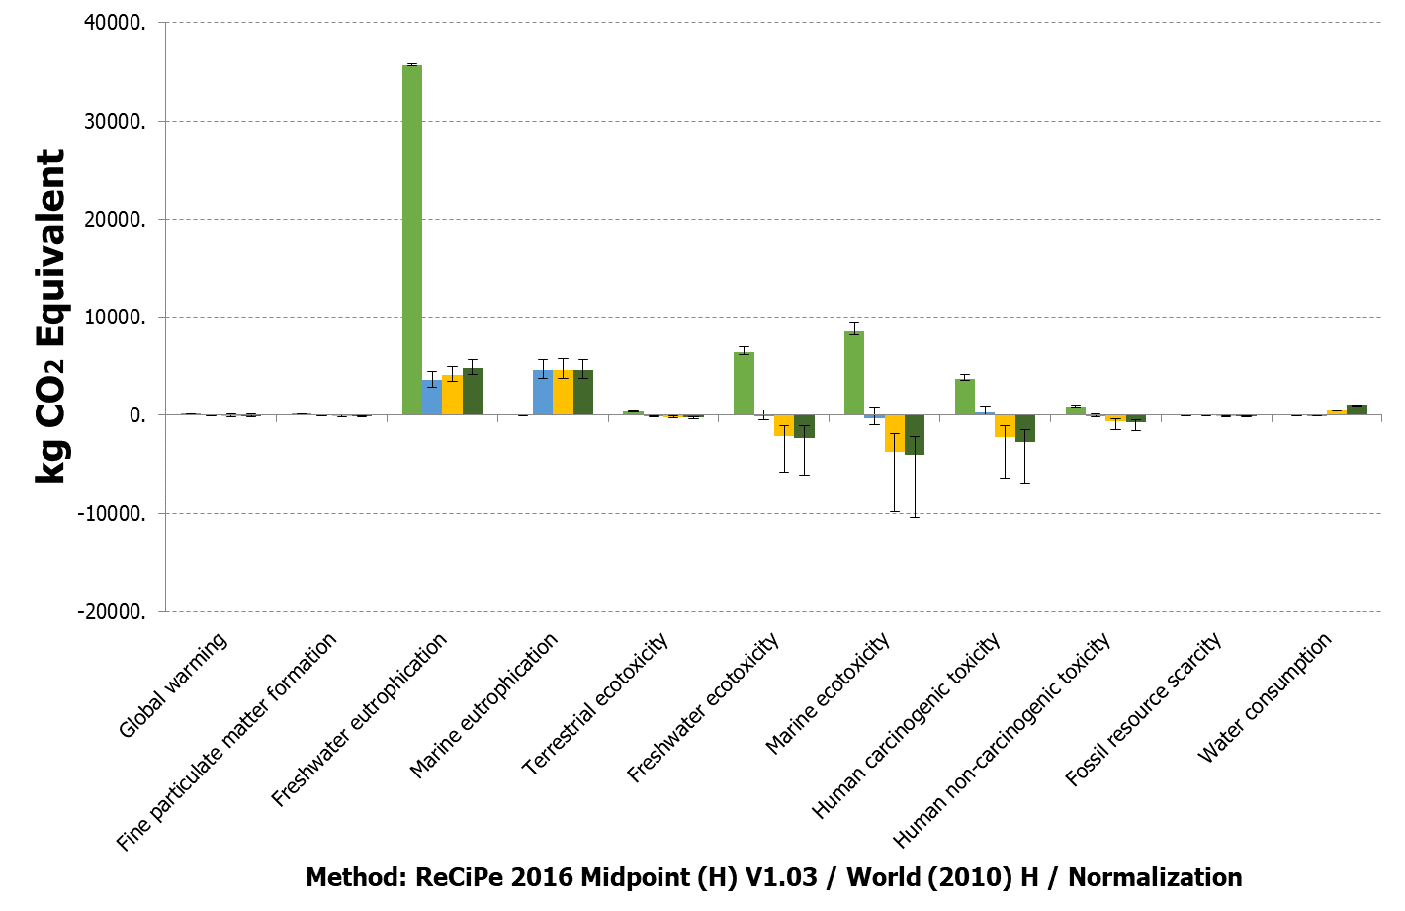
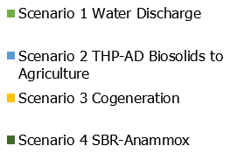
Transition to a Circular Economy Biofactory 2

Slide 23
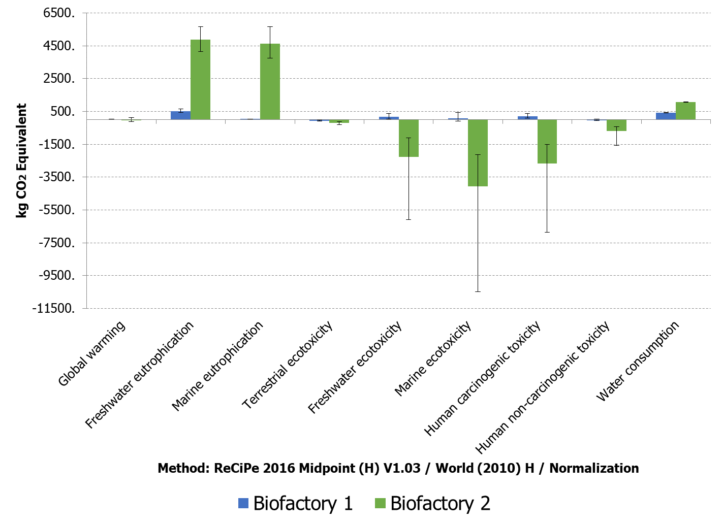
Comparing Biofactory Environmental Impacts and Data Uncertainty

Slide 24
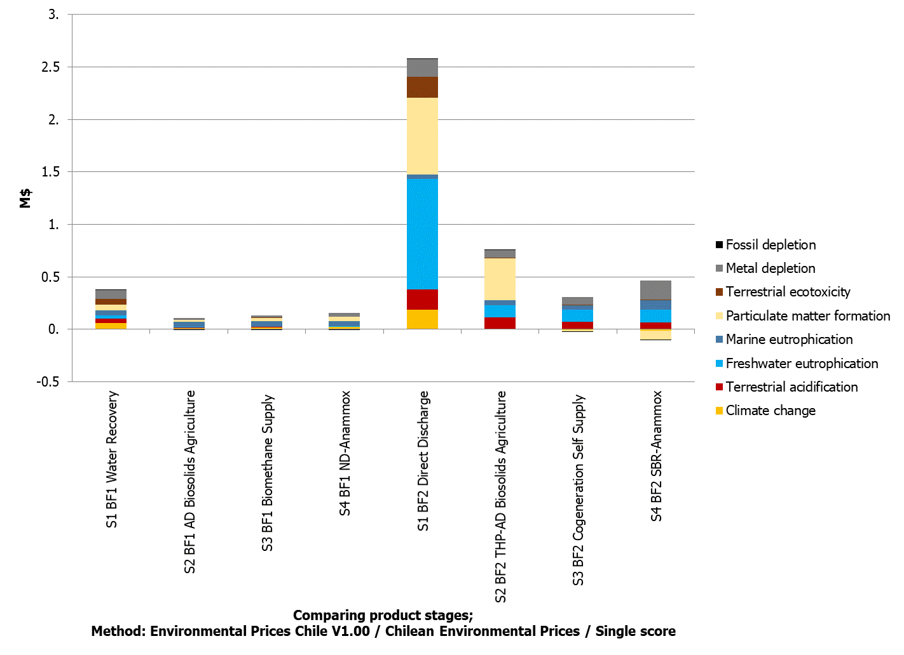
Impact Category Weighting
How do we value environmental impacts?

Slide 25
Interpretation
What decision making parameters and processes contribute to promoting circular economies in wastewater?

Slide 26
Sustainability Trade-Offs
Decision Making Variables | Biofactory 1 |  |  | Biofactory 2
 | Environmental | Economic | Social | Environmental | Economic | Social
Water | Savings in water consumption and contamination | Income | Farmers benefited No market competition for clients | High impact | Income | No market competition for clients
Biosolids | Decreased impact | Cost savings | Farmers benefited | Decreased impact | Cost savings | Farmers benefited
Energy | Increased impact | Income | Natural gas company benefited | Decreased impact | Cost savings and income | -
Nutrients | Increased impact | Cost | Discharge legislation | Increased impact | Cost | Discharge legislation
Technical criteria also relevant

Slide 27
Sustainability Factors
Environmental
Social
Economic
Air
Land
Water
Working Conditions
Environmental Responsibility
Socio-Cultural Responsibility
Governance
Operational Costs
Income
Cash Flow
Analytical Hierarchy Process
Less Important
More Important
Characterization per Process
What trade-offs exists between LCSA decision making variables?

Slide 28
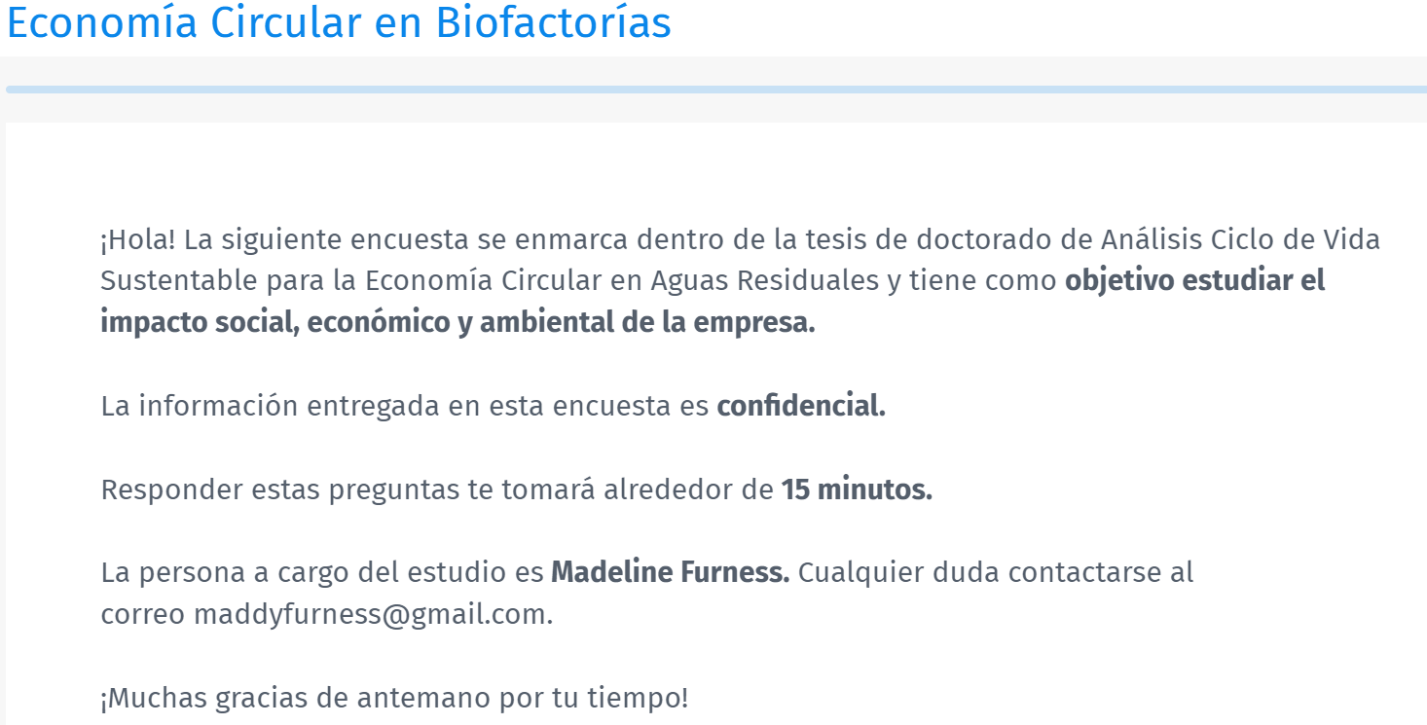
Analytical Hierarchy Process

Slide 29
Decision Making Processes
What is the best way to ensure governance and generate participation in decision making?
AHP usually implemented in person and between decision makers of the system.
Do the opinions of all stakeholders really participate in final decision being made.
Cost saving and incomes opportunity of the CE is the driver for the implementation of new technologies.
Investment in public infrastructure and outreach programs.

Slide 30
Conclusions and Recommendations
The circular economy applied to wastewater treatment in Santiago, Chile, provides a positive case study of the benefits to overall sustainability of the systems. Trade-offs to be further analysed.
This methodology is data extensive, but robust and integral across sustainability parameters.
Analysis of future scenarios to reach net zero impact
Expand water recovery through industrial symbiosis (20% recovery vs 0% recovery – 100%)
Diverting more flare to biomethane, 50% sent to flare
Achieving 100% application of biosolids to agriculture
Improve efficiency of nutrient abatement processes
Applications to real decision-making processes would validate the effectiveness of LCSA as an assessment tool and baseline for data base design.
This could present an opportunity to implement participatory decision making for wastewater infrastructure.

Slide 31
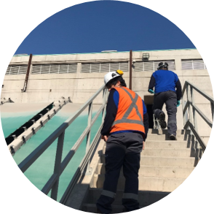
Ka mihi te nui, thank you ¡Muchas Gracias!
Questions?
madeline.furness@pg.canterbury.ac.nz

Slide 32
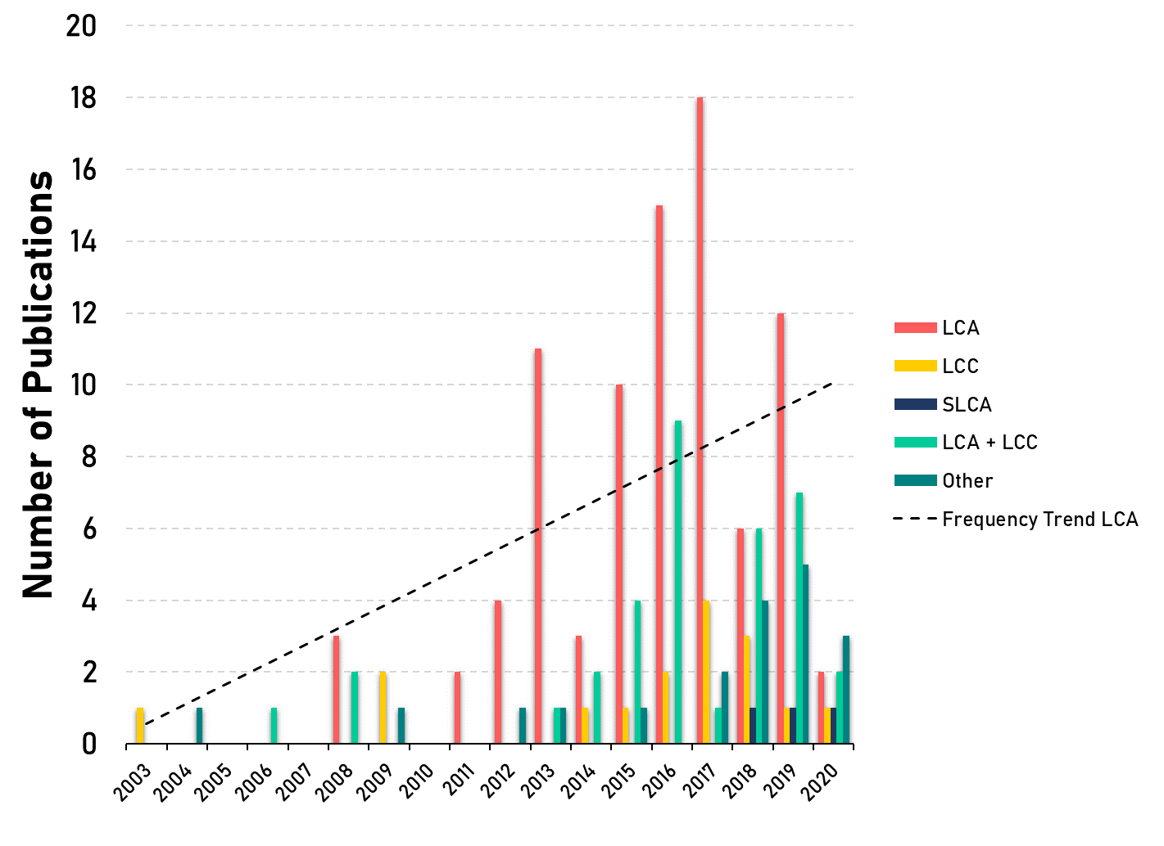
Bibliometric Review: LCSA and Circular Economies in Wastewater Treatment
LCA studies dominate, not addressing integrated sustainability issues
Methodological challenges for multi-product systems
SLCA requires significant development

Slide 33
Biofactory Parameters
Parameters | Biofactory 1 | Biofactory 2
Inflow
Design Flow | 8.91 L/s | 6.87 L/s
Domestic Population Served | 3.634.986 | 2.803.860
Population Equivalent (44.5 g BOD₅/Person/d, kg BOD₅/d) | 161.744 | 124.762
Regulated Industrial Liquid Waste (kg BOD₅/d) | 28.561 | 25.707
Non-Regulated Liquid Wastes (kg BOD₅/d) | 5820 | 42.584
Total BOD₅ kg/d | 196.125 (Q in BOD5 = 252.021 Inc Retornos) | 193.053 (Q in BOD5 = 210.718 Inc Retornos, 180.094 Exc Retornos)
Population Equivalent Including RILES (Regulados) | 4.278.475 | 3.391.637
Population Equivalent Including Total RILES | 4.408.921 | 4.338.270

Slide 34
Characterized impacts Biofactory 1

Slide 35
Characterized impacts Biofactory 2

