Slide 1
GETTING TO THE BOTTOM OF SCUM: A NEW PROCESS FOR THE SEPARATION AND DEWATERING OF CLARIFIER SCUM
Graham Morris and David Grace in association with Chris French and David Taylor

Slide 2
Purpose of the Presentation
Practical rather than academic
Presentation based on lessons learnt from a recent project
Methodology to minimise potential risk associated with incorporating novel technology within an existing WWTP

Slide 3
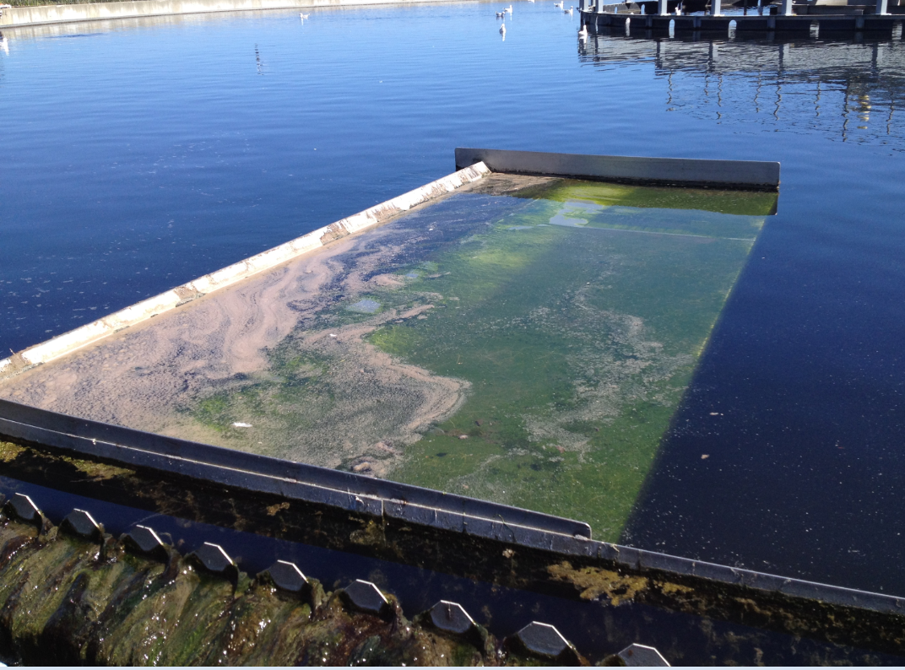
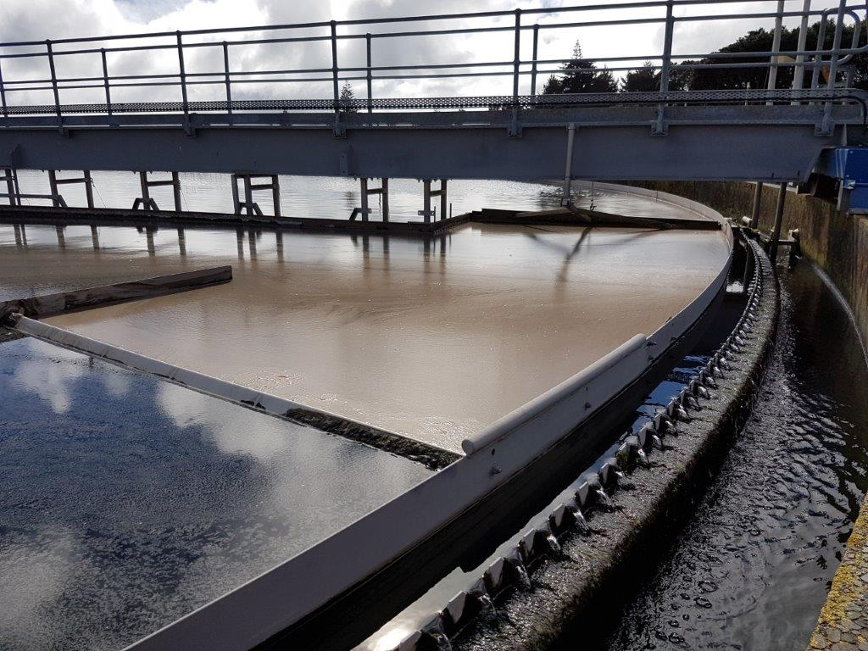
Scum – What is it and issues on site
Notes:
Left is clarifiers on a good day, right is during a storm event with accumulated scum being pushed forward. Current using wet/submersed beaches.
Scum can be described as the floatable matter that may accumulate on water surfaces in the treatment plant process units.
Consists of fats from tradewaste sources, filamentous microbes, foam, and floating solids and debris.
Without intervention, excess scum build-up may occur, leading to carry-over into the clarifier effluent.

Slide 4
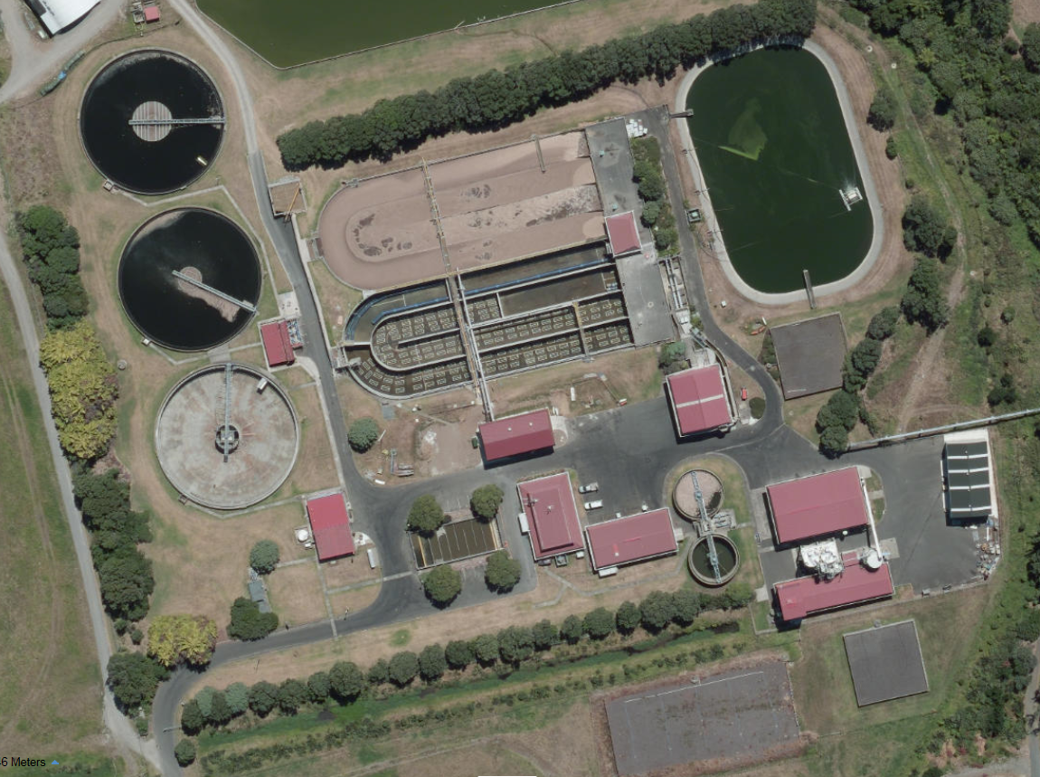
Original Scum Treatment Stream
Notes:
Flow path is clarifiers, scum/was pumpstations and then to the PFTs

Slide 5
Scum – Problem Definition
Excessive carry over water (300m³/d) was introduced into the wasting stream which lead to:
WAS Dilution – 1%DS to approx. 0.6%DS;
Poor thickener performance – 1.4%DS compared to 2%DS;
Hydraulically overloading PFTs – both are required to operate;
Excessive carry over of floating debris and filamentous bacteria from PFTs overflow back to headworks;
Notes:
Excessive carry over water – wet beach system. Overall les efficient to remove scum than dry type

Slide 6
Scum Treatment – Proposed Upgrades
Clarifiers (Wet Beaching System)
Scum
Pumpstation
Scum Separation
Clarifier Flowsplitter
WAS Pumpstation
Picket Fence Thickener
TWAS Storage (converted)
Dewatering
Existing Reconfigured
Thermal Drying

Slide 7
Scum Separation – Technology Review
Key considerations:
Proven NZ track recorded on high fat waste streams – fit for purpose;
Ability to easily clear out any blockages;
Low “Whole of Life” costs;
Baleen Filter was the preferred selection/option;
Notes:
NPDC undertook a review of available technologies which were available at the time;
Other technologies were looked at, GEO Bags, rotating drum screens eg

Slide 8
Baleen Filter – How it works

Slide 9
Baleen Filter – How it works

Slide 10
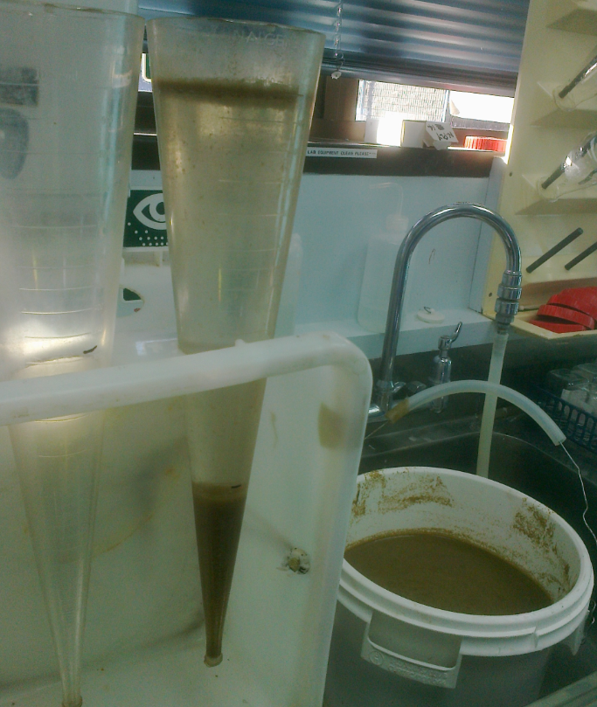
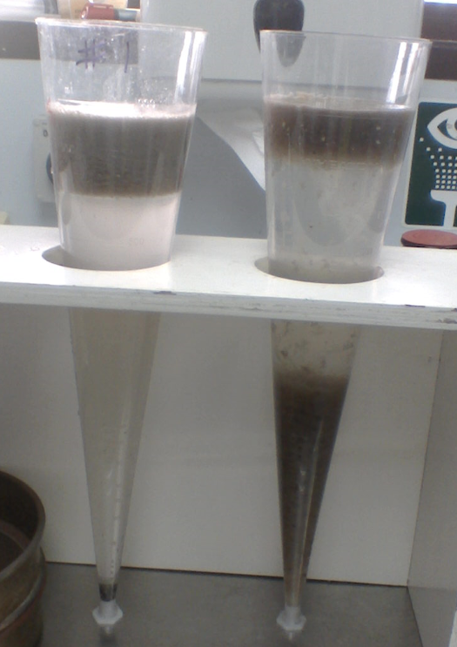
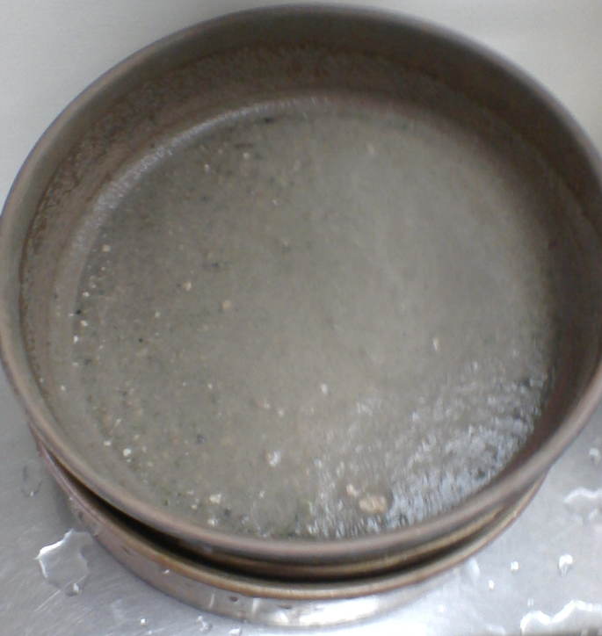
Initial Tests – establishing viability of process
August 2014 Initial Exploratory Bench Trial – No Polymer. Sample from Scum Wetwell
February 2015 Sieve Trial – No Polymer. Sample from Scum Wetwell

Slide 11
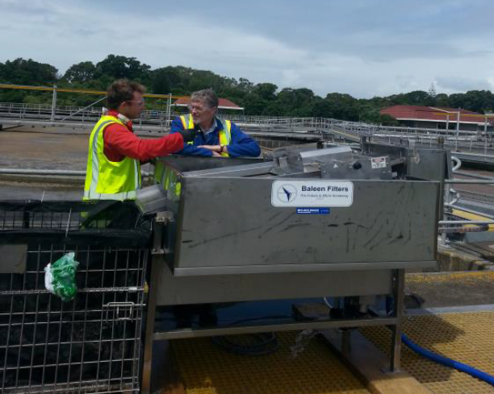
Pilot Trial and Post Optimisation
February 2016 - Pilot Trial, 125 micron filter, no polymer. Test skid from overseas to allow pilot trial.

Slide 12
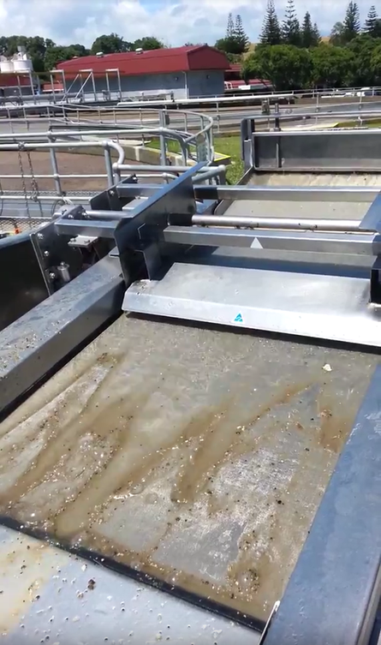
Pilot Trial and Post Optimisation
A pilot trial result indicated the need for polymer to achieve the desired results.
Field polymer trial indicates polymer, in this case Crystalfloc ELH12 cationic polymer, would enhance capture.
Bench trials used to test this.
Polymer Added g active/m³ | % Capture 150 micron filter | % Capture 90 micron filter
No Polymer | 36 | 81 Optimistic
1.2 | 72
2.4 | 85
3.7 | 95

Slide 13
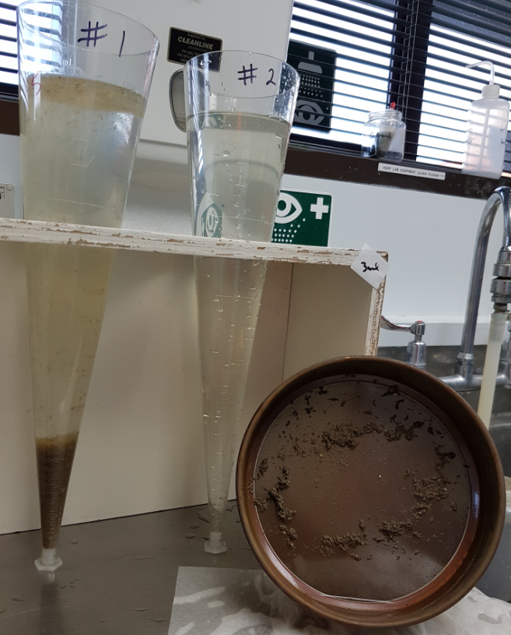
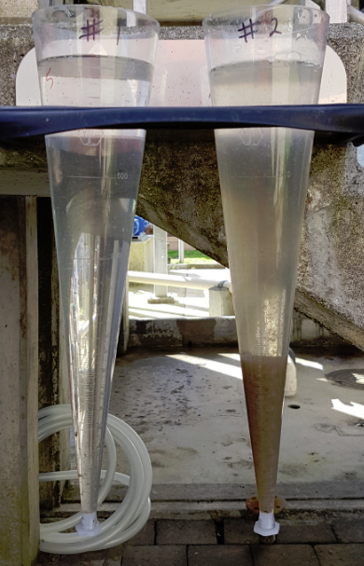
Polymer Addition
August 2017 Polymer Trial – Core Shell 71300 cationic flocculent at 3.2 g/m³. Sample from scum feed line to Baleen.
August 2017 samples from Baleen filtrate and scum feed (3.2 L/sec), polymer dose rate 3g/m³ Core Shell 71300

Slide 14
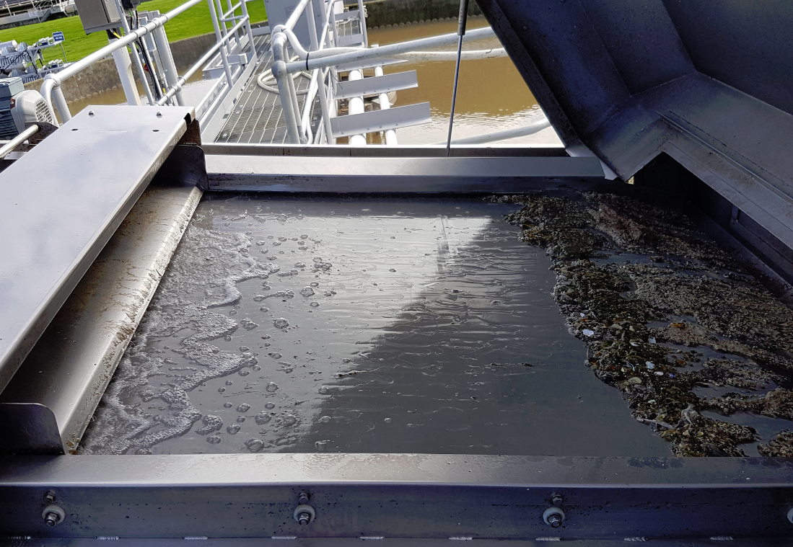
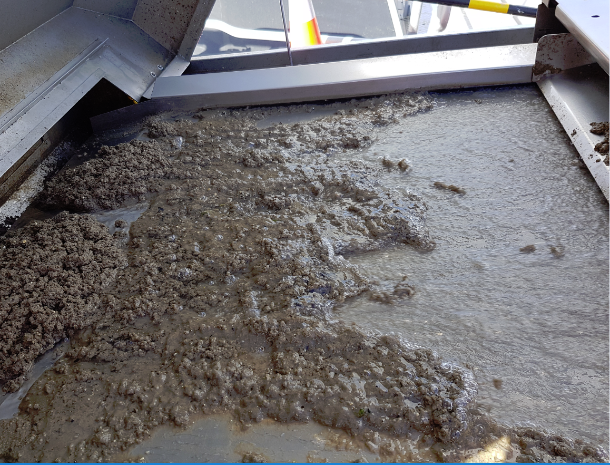
Scum Characteristics Variability
February 2017 operation. Feed rate 3.2 L/s and poly dose of about 5 mg/L active polymer (ELH12). Little scum on clarifiers and no filamentous scum. Predominantly gritty material.
August 2017 operation. Feed rate 3.2L/s and dose of 3 mg/L active polymer (CS 71300). Significant filamentous scum loading from clarifiers due to high rain events causing much scum on clarifier surface.

Slide 15
Equipment Location
Key consideration:
Separated solids will have a tendency to block pipework;
Need to consider how the separated solids are being transferred to down stream process units.
Sufficient clearance area around the Baleen Filter (especially at the front) to allow for screen replacement and servicing (H&S);
Notes:
Need to make sure you explain TWAS carry system

Slide 16
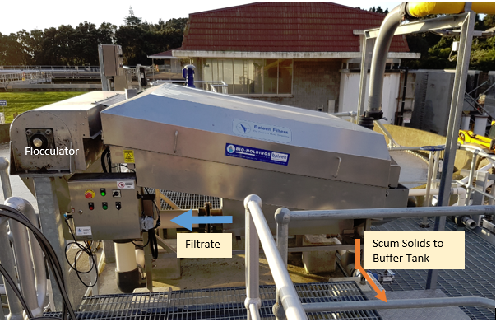
Baleen Filter - Installation

Slide 17
Baleen Filter Site Location

Slide 18
Operation Benefits of Baleen Filter
The removal of 300m³/day of very dilute Clarifier Scum from WAS resulted in:
Deloading of Picket Fence Thickener Tank leading to improved thickening from historic 1.4%DS to 2 - 2.5 %DS;
Significant reduction in carry over from the PFT;
Ability to convert one of the PFTs into a TWAS Buffer/Storage Tank;
Better dewatering on Belt Press from about 14%DS to 16%DS;
Reduction of scum carry over from top of Picket Fence Thickener;
Enabling one Picket Fence Thickener to be used as a Buffer Tank to balance mass flows through plant and allow continuous watering.

Slide 19
Baleen Operation/Maintenance
Automated operation linked to Scum Wetwell;
Can make simple adjustments to tune Baleen Filter operation for changing scum conditions. Spray Water cycle, speed, pressure & duration. Polymer dose;
Once a day inspection and hose down by operations staff;
Monthly grease and chemical wash (10 minute job);
Six monthly service by NZ agent Bioholdings NZ Ltd., Kerry Gibb. Excellent support to date;

Slide 20
Conclusion/Recommendation
Undertake a review of what is available in the market is only the start point;
DATA DATA DATA! - Laboratory testing and pilot trials data provides significant insight and is critical to the implementation of new technology as it reduces risk (Proof of Concept without relying on Sales Reps);
The use of a Baleen filter to separate scum is an economical solution;
Need to develop and maintain a close relationship with equipment vendor – this prevents “empty” promises from suppliers.

Slide 21
Thank you for your time any questions???

