Slide 1
NO LAUGHING MATTER – GLOBAL LESSONS FOR NITROUS OXIDE
Jacobs: Hayden Porter, Amanda Lake, Ariane Brotto, Aprilia Vellacott
²Cobalt Water Global: Jose Porro, Unisense Environment: Mikkel Andersen
Notes:
Going to discuss why N2O or laughing gas is significant in terms of its climate impact and how the Water sector can play it’s part for the climate by addressing these emissions.
Emphasise that it is produced in wastewater treatment.

Slide 2
Acknowledgements
Amanda Lake – Head of Carbon and Circular Economy – Water Europe
Ariane Brotto – Associate Director – Carbon and Energy Consulting
Aprilia Velacott – Technical Director Wastewater Treatment ANZ
Jose Porro – Founder and CEO
Mikkel Andersen – Chief Technology Officer
Notes:
Quantification and Modelling of Fugitive Greenhouse Gas Emissions from Urban Water Systems by the IWA.
Jose was an editor of the book and Amanda and Ariane co-authored a chapter which is a really great resource.
Following the publication Amanda has been hosting a webinar series co-hosted by IWA publishing and IChemE which is free and the recordings are available for anyone that really wants to get into the detail on Wastewater process Emissions. Unisense have also been hosting webinars on the topic.

Slide 3
Agenda
Context and Challenge
Climate Context
The N₂O Challenge
N₂O Production In Wastewater Treatment
Emission Accounting
Lessons Learned
Denmark (and Switzerland) – National Emissions Factor
Netherlands – Mitigation through AI
UK – Path to Net Zero
Mitigation Methods
Conclusions

Slide 4
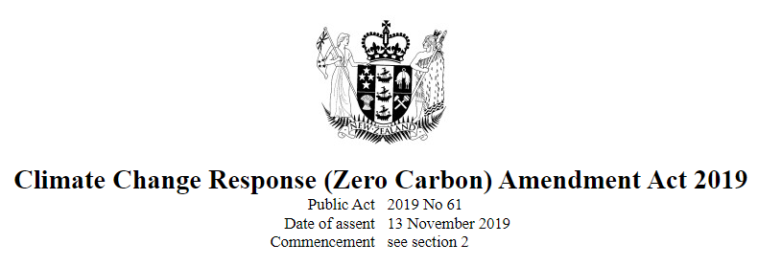
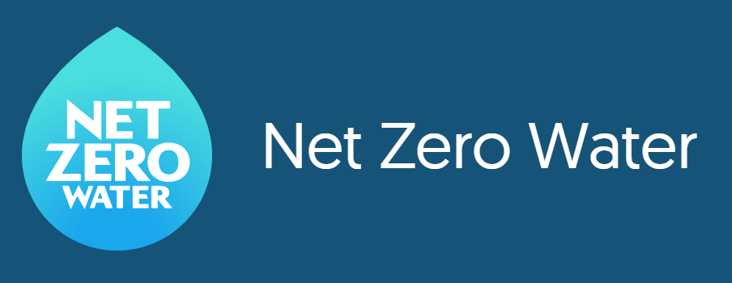
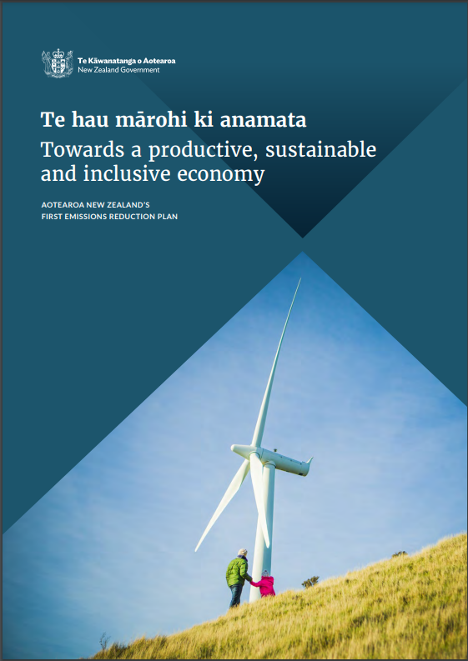
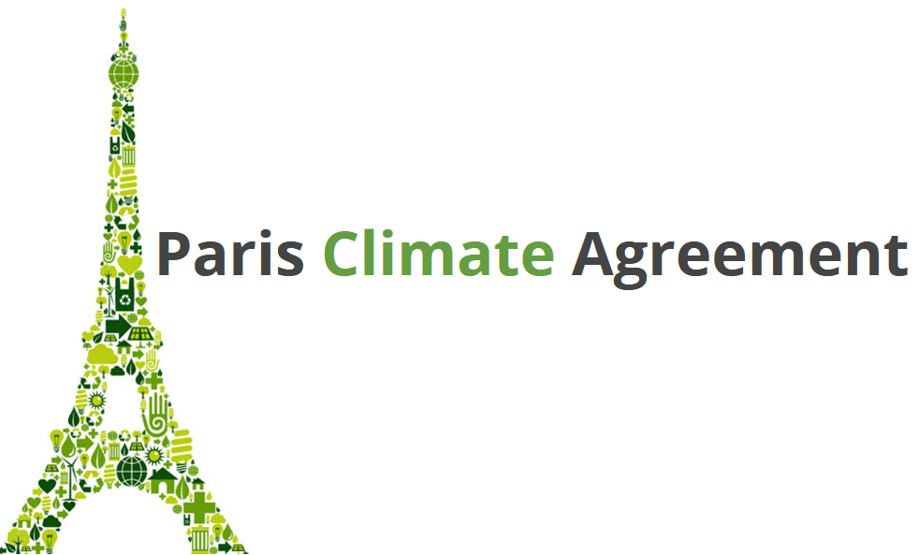
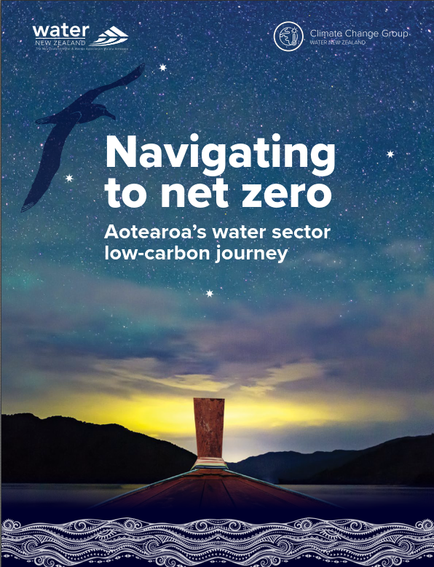
Climate Context – Net Zero Target
Notes:
Climate Change – international action
Local action – legislation
Sector level action and NZ water trajectory
As we are all aware Climate Change is already having a significant impact globally and each year since the globally significant Paris agreement was signed we can see the progressive intensity of it’s impact increasing which further highlights the need for action. The 1.5C target that it talked about also feels like it is rapidly approaching. Here in NZ we are planning towards making our contribution to the global emission reduction plant and on the slide I show our Zero Carbon legislation and National Emissions Reduction Plan.
Globally water utilities are committing to emissions reductions targets to play their part in global efforts to mitigate the effects of climate change. A group of utilities under Water UK were the first to commit to reaching net zero emissions by 2030 and have reported their baseline carbon emissions and ambition for mitigation in public net zero road maps. In our region a group of 13 water utilities across Australia and Watercare have joined the UK utilities in making commitments to reach net zero emissions under the United Nations (UN) Race to Zero campaign.

Slide 5
N₂O Challenge
Global Warming Potential
N₂O has a warming impact 265 times greater than CO₂
Contribution to Council/ Utility Emissions
N₂O can contribute 50%+ of a councils/utility's operational emissions
Emission reduction targets
Uncertainty in quantification and measurement of emission mitigation
Notes:
Wastewater Process Emissions are a contributing factor to nz council emissions
N2O (laughing gas) is a potent GHG around 300 times greater Global Warming Potential than CO2 so a little goes a long way
Understanding where it comes from and how much there is has been developing and recently the quantum we are accounting for is increasing.
Mitigating is still be proven in practice but we have some starting points.
While water and wastewater sector greenhouse gas emissions make up just a fraction of New Zealand’s total emissions, they contribute significantly to the emissions footprints of our local councils who operate these assets. Councils are responding to the global climate crisis and New Zealand’s Net Zero Carbon Act by setting targets to reduce emissions; the three largest councils in New Zealand are targeting net zero emissions by 2050. Focus on direct process emissions of nitrous oxide and methane from wastewater treatment plants is becoming a focus as these emissions can contribute 50% or more of a council’s total emissions.

Slide 6
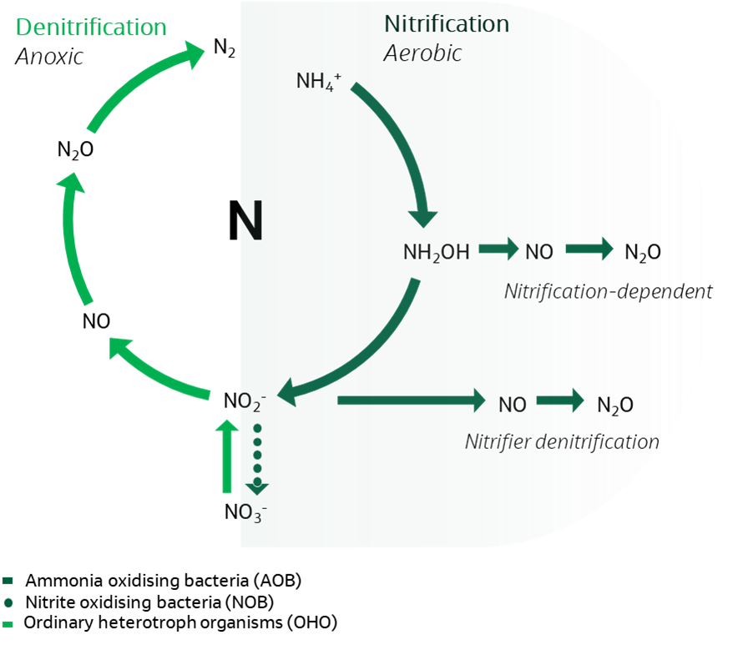
Nitrous Oxide Emissions
Process Triggers
Low oxygen during nitrification
Ammonia loading spike
Nitrite accumulation
High oxygen during denitrification
Low COD:N limiting carbon available for denitrification
Variability in loading and operation
Pathways of nitrous oxide production in the nitrogen cycle
Notes:
N2O production both nitrification and denitrification:
Nitrification has two pathways:
Incomplete HydroxylAmine nitrification which is associated with high DO
as well as nitrifier denitrification which is associated with low DO and Nitrite accumulation in the treatment process.
In denitrification N2O is an obligatory intermediate and the final of four steps is to reduce the N2O to N2 gas so if this final step is limited for some reason then N2O will accumulate. We do therefore have an opportunity for denitrification to act as an N2O sink. However factors like High DO in denitrification, Low COD: N ratio and nitrite accumulation can inhibit that final step of denitrification and cause N2O to accumulate.

Slide 7
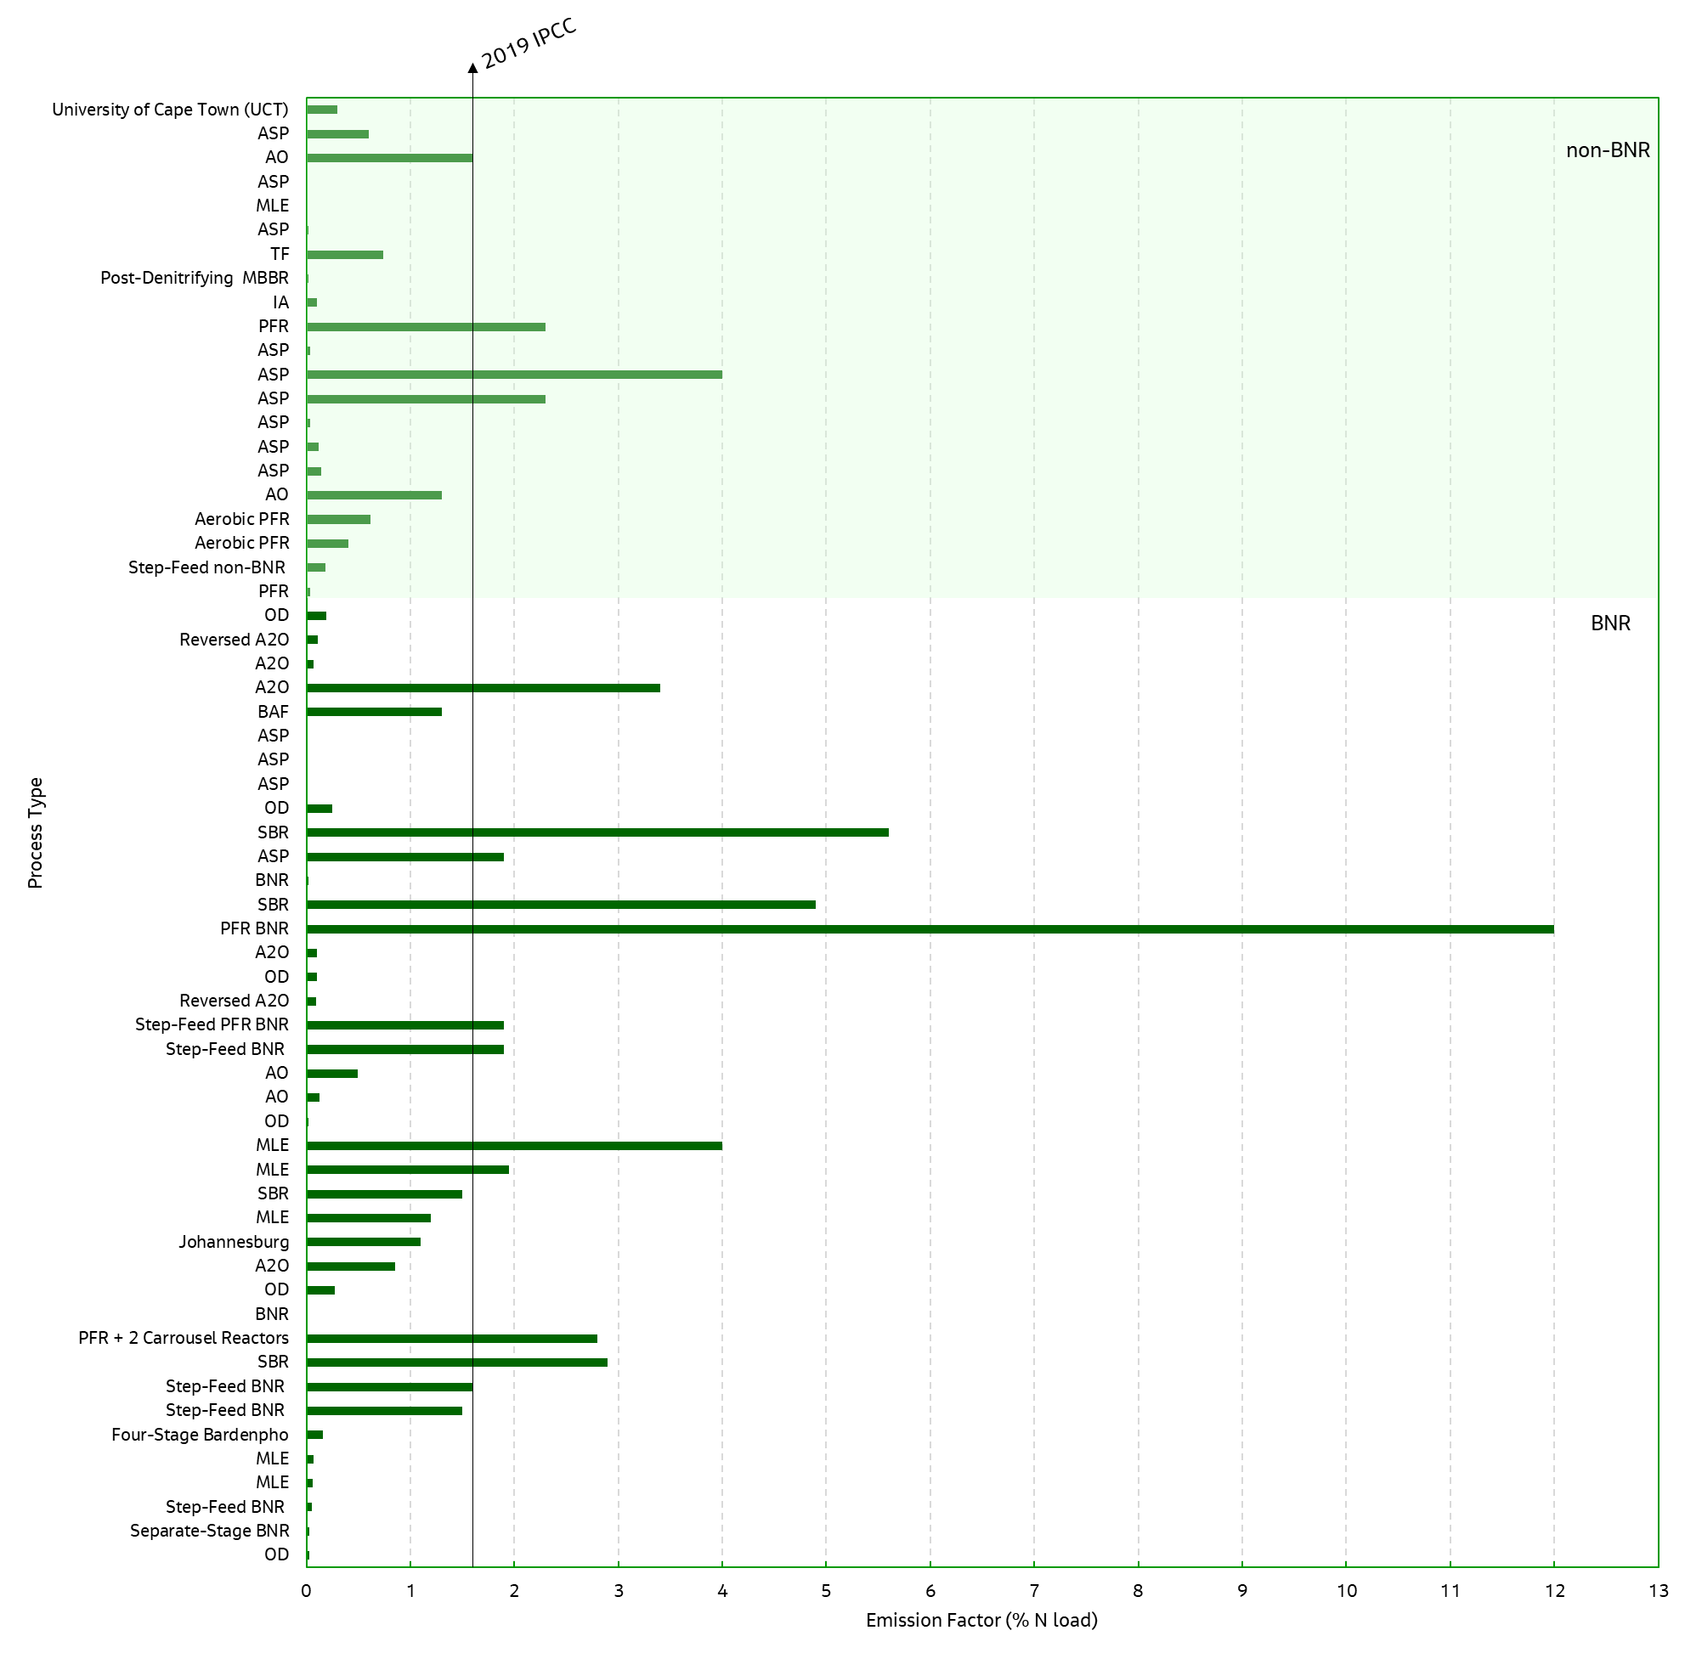
Emission Accounting & EFs
IPCC 2006 Guideline for National GHG Inventories
0.0004 kgN₂O-N/kgN_{influent}
IPCC 2019 Refinement
0.016 kgN₂O-N/kgN_{influent}
Water NZ Guideline 2021
0.010 kgN₂O-N/kgN_{influent}
EFs of N₂O emissions in % N-load (kgN₂O-N/kgN load) from literature review (Vasilaki et al., 2019) and edited by Jacobs to include additional published research (n = 61)
Notes:
Emissions factor method of accounting
IPCC and Water NZ Guidance: Tiered approach – tier one uses generic emissions factors
Single Emission Factor used in Teir 1 approaches – significant variability in emissions
The Water NZ Carbon Accounting Guidelines for Wastewater Treatment (2021) provisionally recommend a fixed emission factor of 1% or 0.01 kgN₂O-N/kgN_{influent}.
This is a significant 27 fold increase from the previously presented IPCC 2006 EF
For councils/council-controlled organisations (CCOs) who have previously reported their emissions using the 2006 IPCC factor, updating their inventories to the new Water NZ guideline will create a significant uplift in their wastewater process GHG emissions.
An example emissions breakdown was provided for

Slide 8
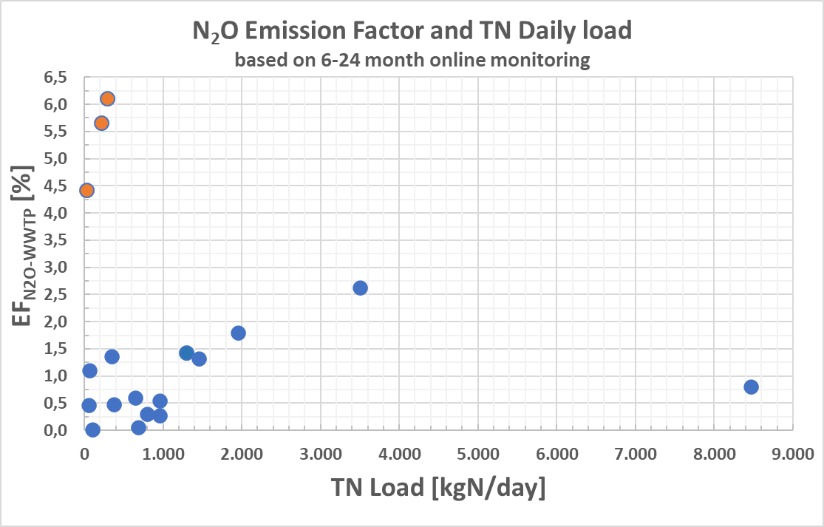
Denmark (and Switzerland) – National Emissions Factor
Denmark
10 WWTPs over ~2 years
Liquid stream N₂O measurement
EF: 0.0084 kgN₂O/kgN
Mitigation efforts have begun
Climate-Neutral 2030 target
Switzerland
14 WWTPs over 6-12 months+ - off-gas monitoring
EF: 0.009 kgN₂O/kgN for N-removal plants
EFs of N₂O emissions from long-term full-scale monitoring in Denmark. Orange dots represent sidestream deammonification processes (Unisense Environment, 2020)
Notes:
Key message: It takes comprehensive, long term monitoring programme across multiple plants to provide meaningful nationwide EF information.
AND work by these progressive utilities are confirming the broader studies which are trending toward a ~1% EF.

Slide 9
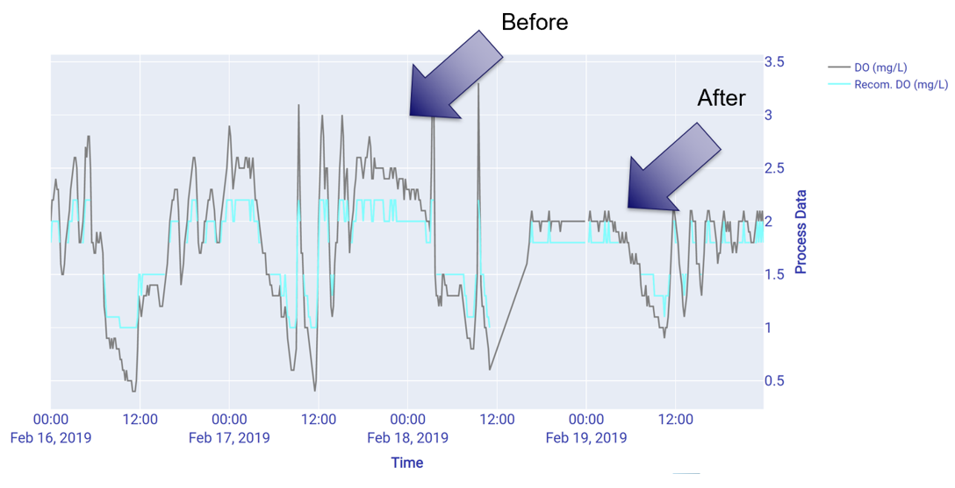
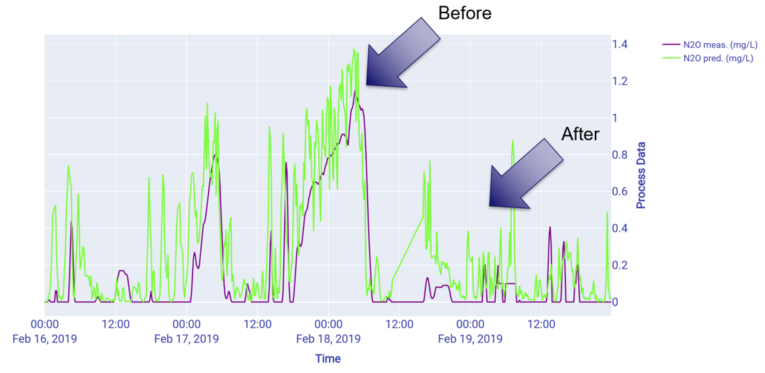
Netherlands – Mitigation through AI
Knowledge–based AI approach using operational conditions to determine N₂O production risk:
Liquid phase N₂O concentration
DO
Ammonia
Nitrate
Trials show up 70% reduction in emissions.
Figure 5A and 5B: N₂O emissions from short term mitigation trial at Land van Cuijk WWTP, Netherlands
Notes:
Mitigation is possible now and can be implemented with the combination of monitoring and control system changes.
Jared Thorpe

Slide 10
UK – Path to Net Zero
2030 Net Zero commitment
Liquid phase N₂O monitoring underway
Researching N₂O emissions from fixed film processes
Collaborating on research for a country level emission factor across multiple treatment process types
Working toward a “Best Practice Guide” for monitoring and mitigation.
Notes:
Key message here is that we have a path to follow and can learn lessons on the way from their efforts but that the key part is to begin on this path as we’ve seen it does take some time to build up the local monitoring data and process unit specifics here in NZ.

Slide 11
New Zealand’s Path To Net Zero
How we can include N₂O emissions on the journey:
Combine efforts on monitoring which is starting to get underway in NZ
Apply best practices and lessons learned globally
Consider our treatment processes: <20% of WWTPs in NZ are activated sludge but they treat more than 60% of the connected population (>70% post Christchurch trickling filter fire)
Large quantity of small pond-based WWTPs – not as well understood
Monitor – mitigate – repeat
Notes:
Refer back to the lessons

Slide 12
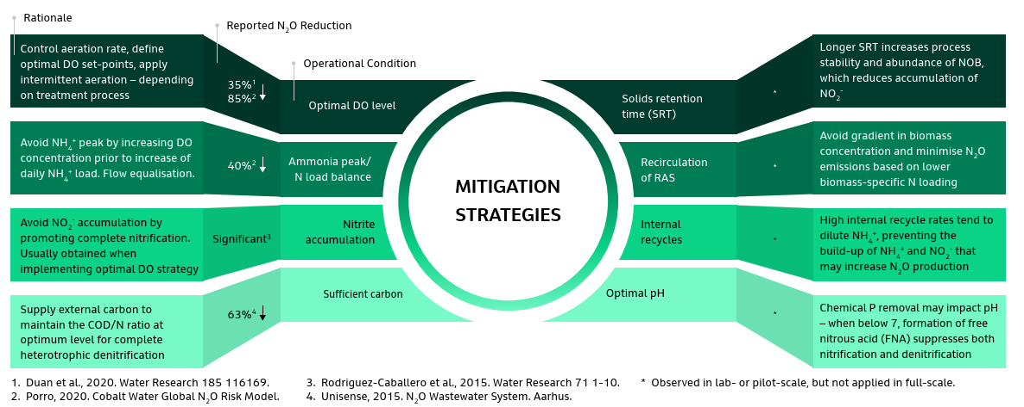
Stepping Stones on The Path - N₂O Mitigation
Notes:
Full-scale implemented mitigation strategies (Figure 3) include DO control – with both high and low DO conditions potentially contributing to N₂O emissions, balancing incoming ammonia peaks and management of carbon for denitrification. Other strategies being trialled include avoiding accumulation of nitrate/nitrite through optimised control and the impact of longer solids retention time (SRT).
Other potential levers for mitigation include the use of recirculation and recycle flows to minimise gradients and provide dilution and pH considerations- as yet these have received even more limited focus.
As we discussed in the Netherlands example these mitigation measures can align with energy optimisation, improved process control and efficiency and have pretty quick pay back periods for any cost incurred.

Slide 13
Conclusions
Tackling climate change requires everyone to play their part – commitments to emission mitigation are an important role the water sector can play
N₂O emissions can make up a significant proportion of a council/water utility emission profile and pose a challenge to our efforts to reach climate targets
We can begin to act and follow the model of others to monitor and mitigate
We are recipients of the global efforts on understanding and mitigating N₂O emissions and can contribute to this body of knowledge as we take steps along the path to net zero

Slide 14
Want to continue the conversation?
Come and say hello to the team at the Jacobs booth, location #125

