Slide 1
Smart Meter Networks – Benefits for Utilities and their Customers
Matt Thomson
Tony Wise
Water New Zealand 2022

Slide 2
My Journey Today
Smart Meters and Advanced Metering Infrastructure (AMI)
Relevance to New Zealand
Benefits to
Water Providers
Customers
Case Studies
The AMI Journey and Keys to Successful Deployment

Slide 3
Smart Cities and the IoT

Slide 4
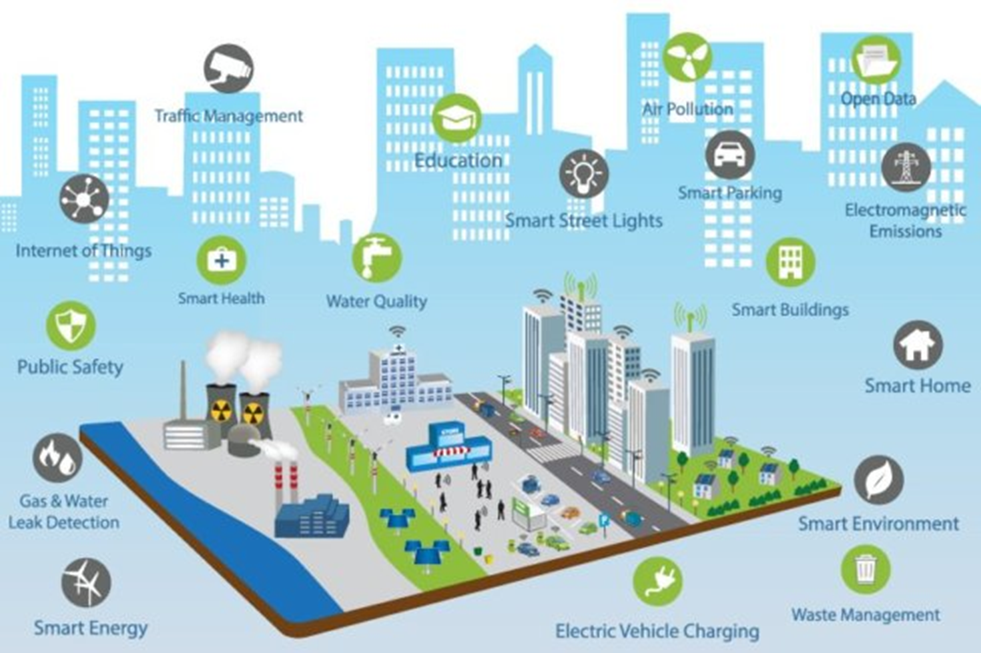
Smart Cities and the IoT
Can you have a Smart City without Smart Water?

Slide 5
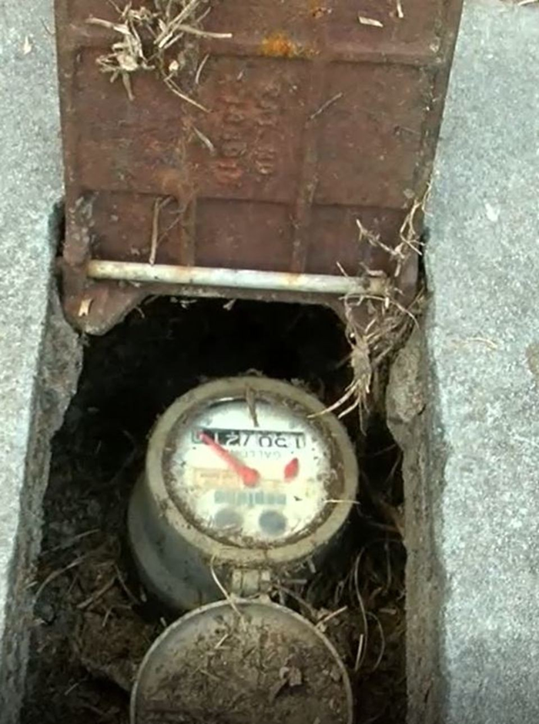
Traditional Water Meters

Slide 6
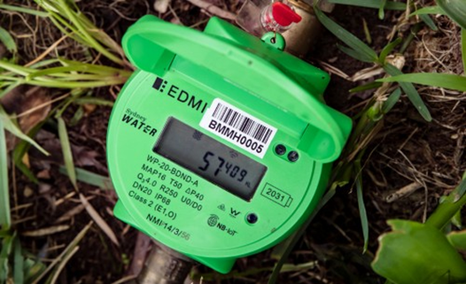
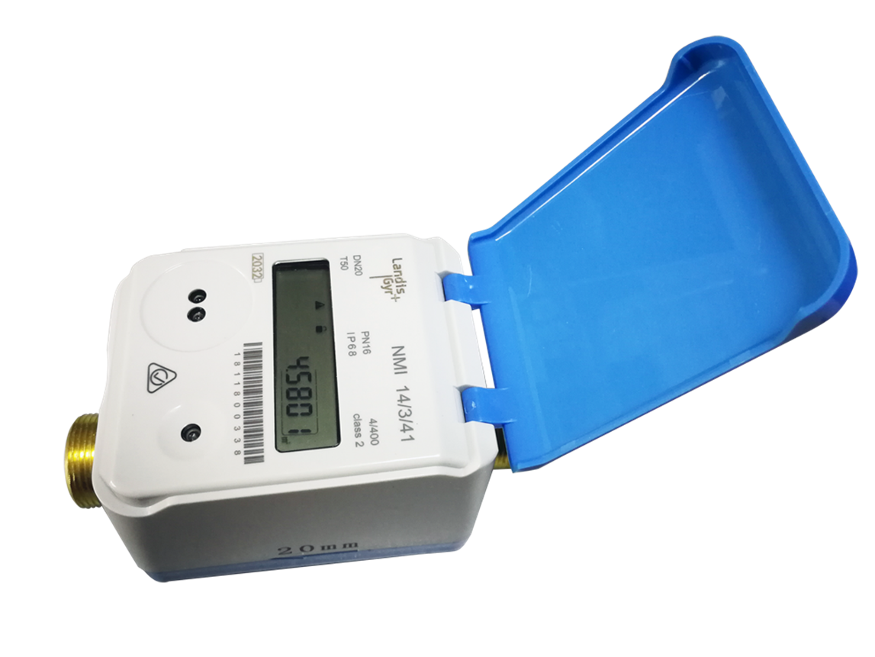
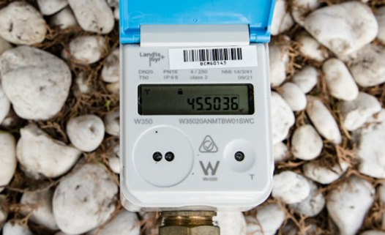
What is a Smart Water Meter?

Slide 7
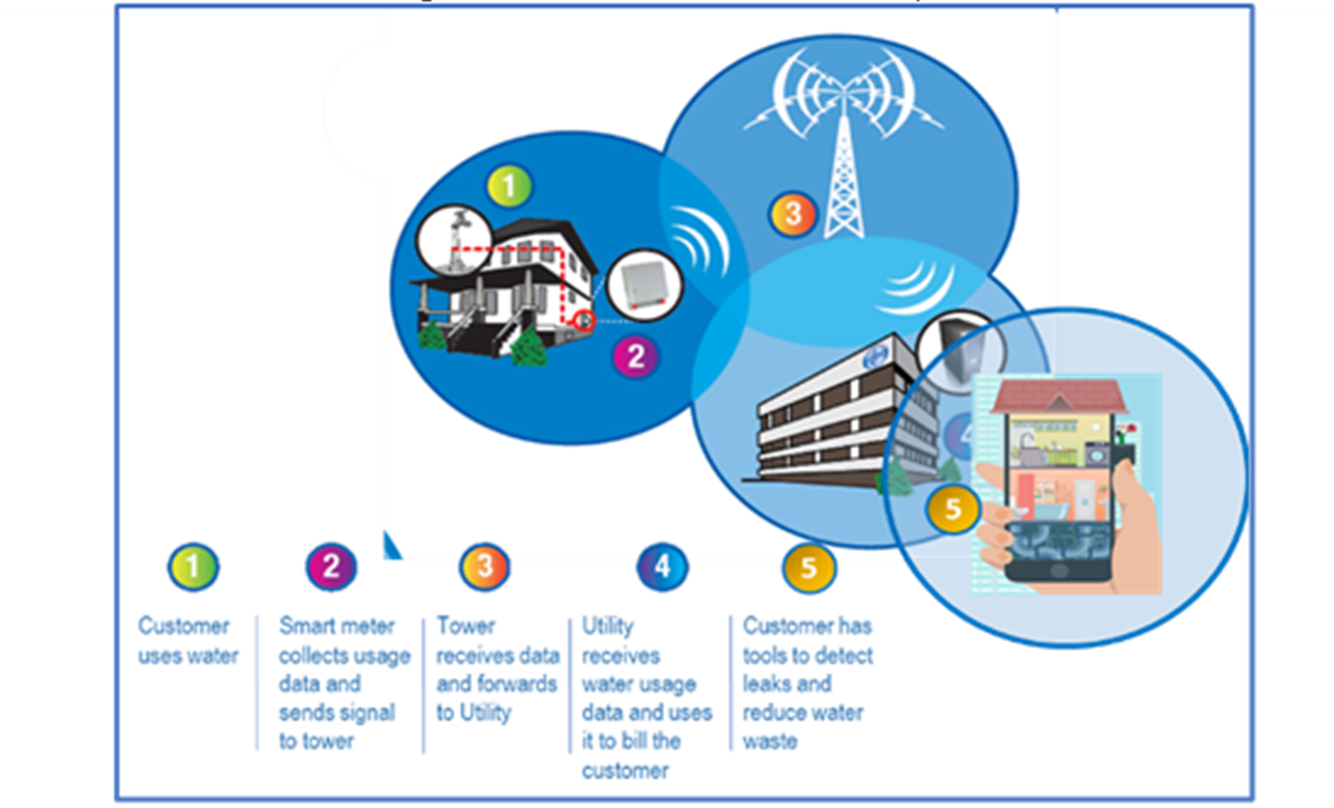
What is Advanced Metering Infrastructure (AMI)?
Notes:
Integrated system of smart meters
Communication network
Data management
Two-way communication between water providers and their customers
Customer apps

Slide 8
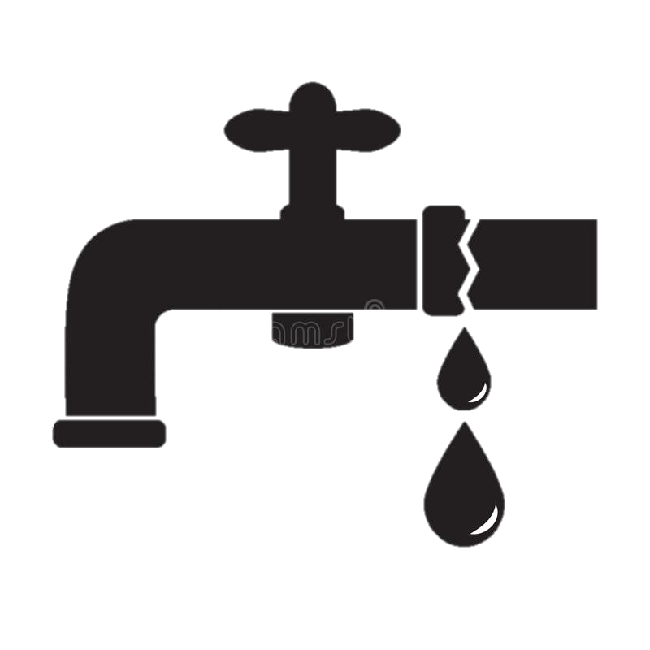
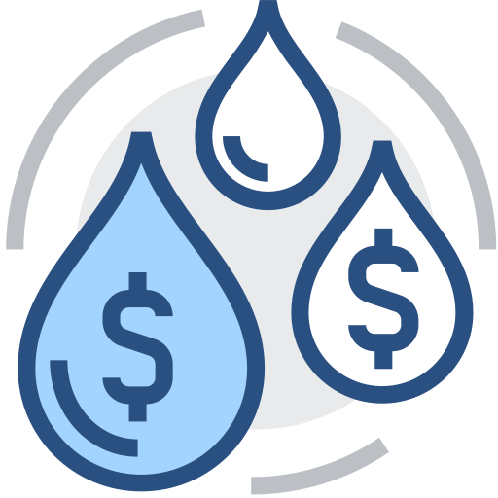
Relevance of AMI to New Zealand – Managing Water Demand
Customer-Side Leaks & Waste
Lack of Informed Consumption
Infrastructure Expansion Needs
Distribution Leaks
Network water loss ranges from 6-31% across the country
The lack of meters reduces the ability to address customer leaks and encourage conservation
Only around 50% of people served by community water supplies are metered
Adding storage and treatment capacity requires time, regional coordination and significant funds (est. ~$34 billion).
Notes:
Metered areas are: Whangarei, Western Bay of Plenty, Nelson, Far North District Council, Hauraki, Selwyn, Kapiti Coast, Tasman, Auckland, Tauranga, Christchurch, Whakatane, Waipa and Central Otago.

Slide 9
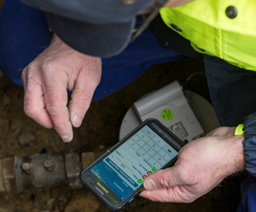
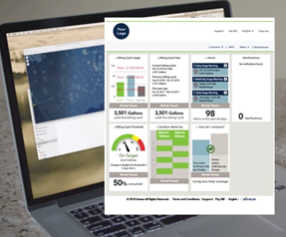
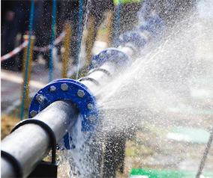
Benefits to Water Providers
AMI enables water providers to operate their systems more efficiently, build a strong relationship with their customers, and actively safeguard the environment
Lower account management costs
Better insight into field conditions for proactive maintenance
Accurate water use data for system planning
Efficient Operations
Environmental Stewardship
Ability to implement effective conservation programs
Reduced water loss
Reduced need for additional storage and facilities
Customer Engagement
Ability to quickly resolve customer issues and disputes
Proactive communication and incentives for customers, based on usage
Fair, transparent, trusted billing and water management

Slide 10
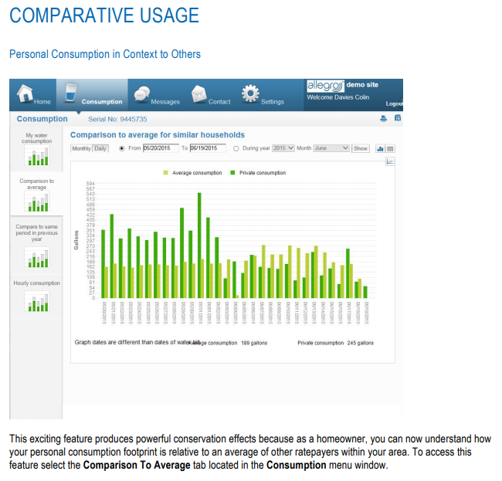
Benefits to Customers
With the addition of software applications, AMI helps customers to make informed choices in line with their water goals and budgets
Manage Use/Costs
Identify Leaks
Conserve
Understand/monitor water use
Identify wasteful appliances or behaviors
Track use over years/seasons
Set budget targets
Get alerts of high use/leaks
Receive instruction on repairs
Apply for leak credits/forgiveness
Set use goals and track progress
Receive tailored conservation tips
Apply for incentives
Compare own use to others

Slide 11
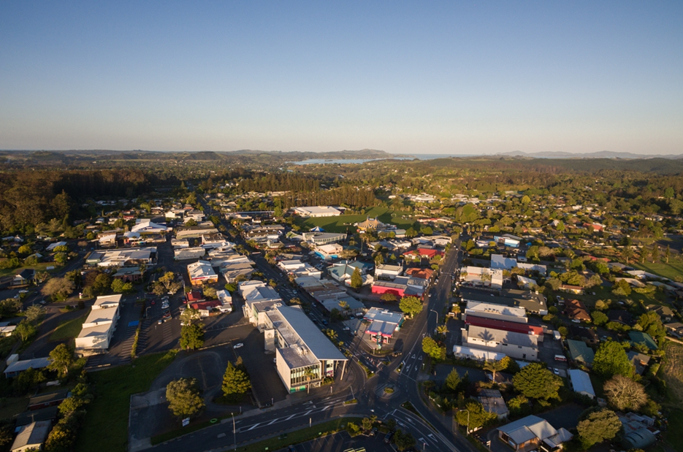
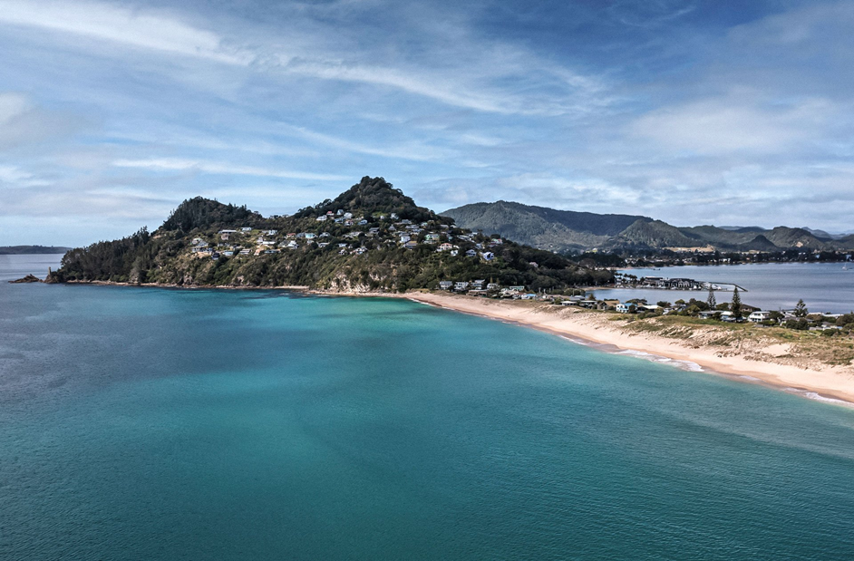
Water Supply Challenges for Small Towns - Kerikeri and Thames Coromandel

Slide 12
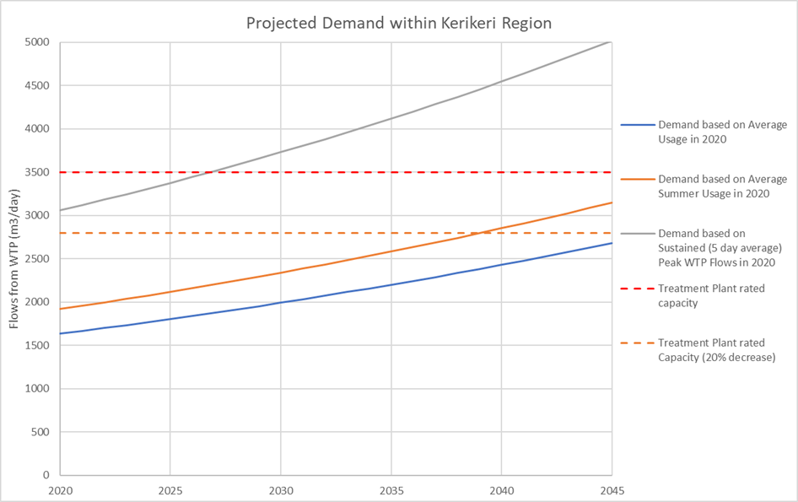
Water Supply Challenges Kerikeri
Sustained (5-day average) peak demand significantly greater than the summer average demand.
Peak 5-day consumption 560 l/p/d compared with 300 l/p/d average
Non-revenue water loss approx. 26%
Reducing demand can take the pressure off existing water sources and delay the need to provide increased treatment capacity

Slide 13
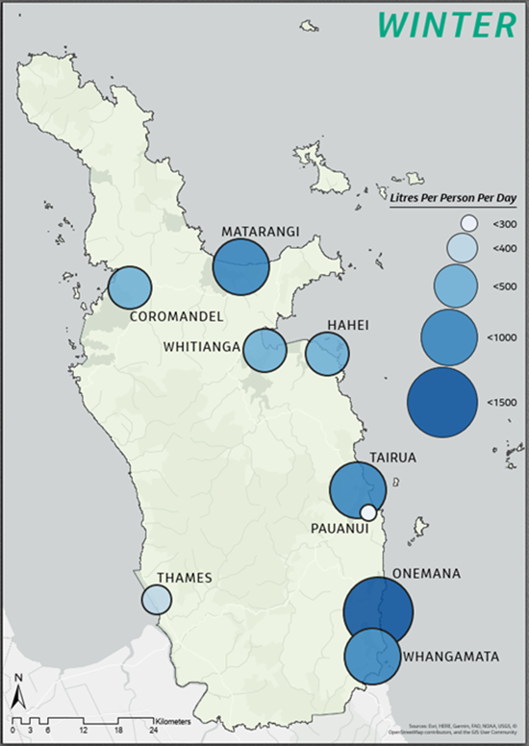
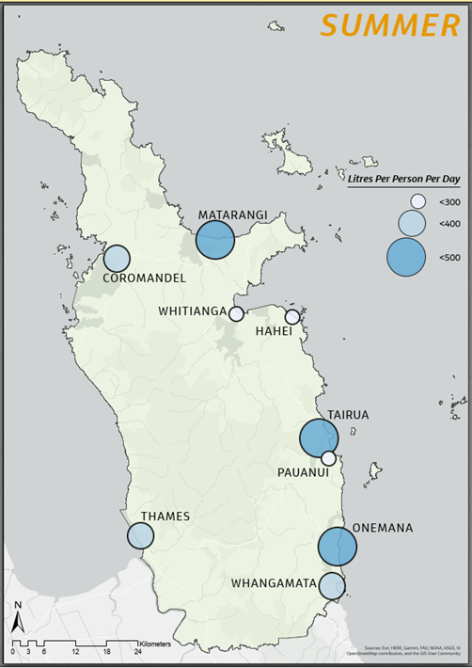
Water Supply Challenges Thames Coromandel
Average summer use greater than 400 l/p/d
Non-revenue water loss up to 40%
Summer water restrictions
Thames, Coromandel and Pauanui metered
Demand management can reduce water restrictions and avoid need for new water sources
Thames Coromandel District Water Consumption - 2019/ 2020
Notes:
Issues across our existing water supplies that relate to water demand include;
1. Huge influx of tourist and holidaymakers to our district
2. Effects of drought conditions limiting our freshwater supplies
3. Loss of water from network in communities with older infrastructure.
4. Limits on the number of new developments that can be connected to our existing supplies.

Slide 14
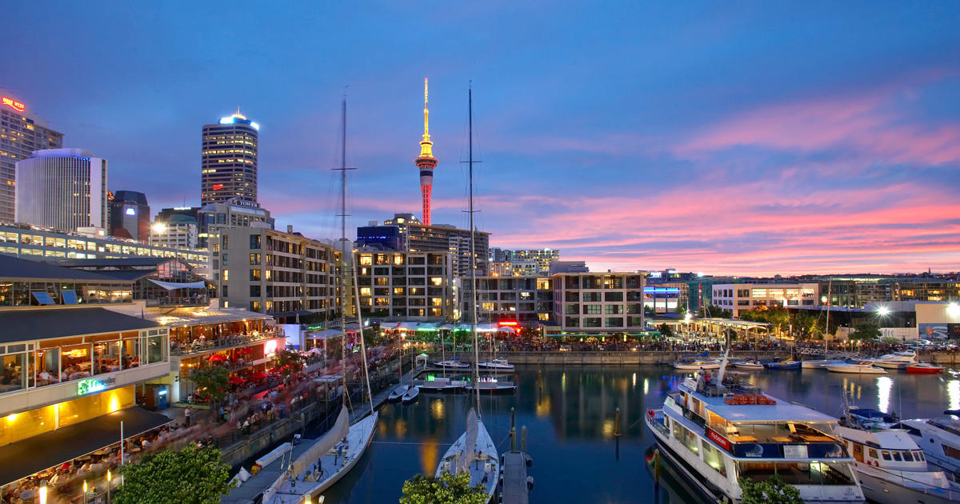
Water Supply Challenges for a City Auckland
Notes:
Auckland Drought
Smart Meter Trials/ Roll out

Slide 15
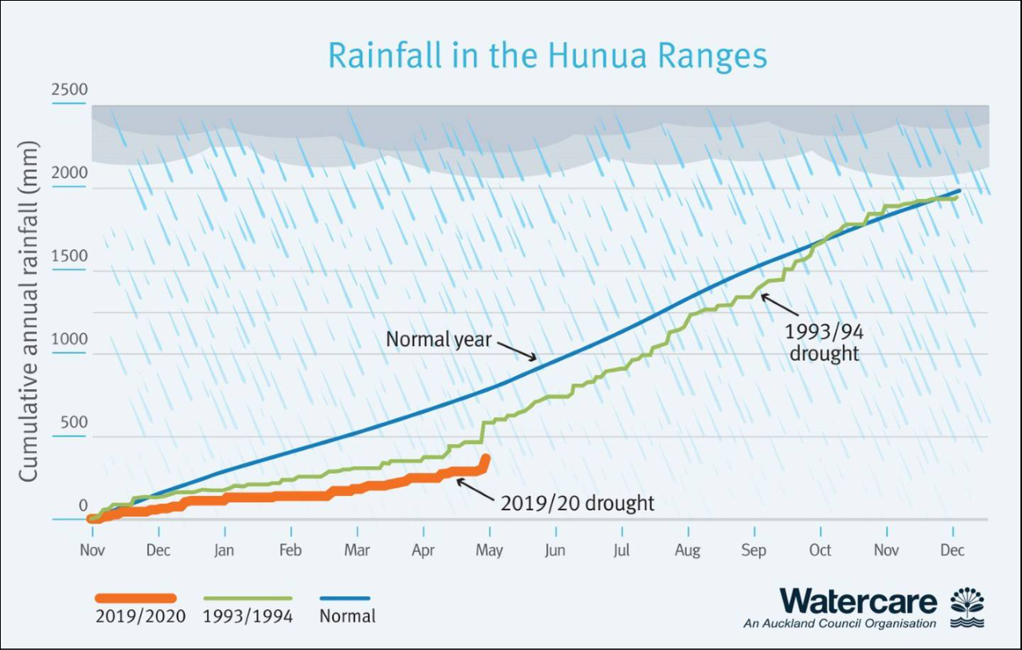
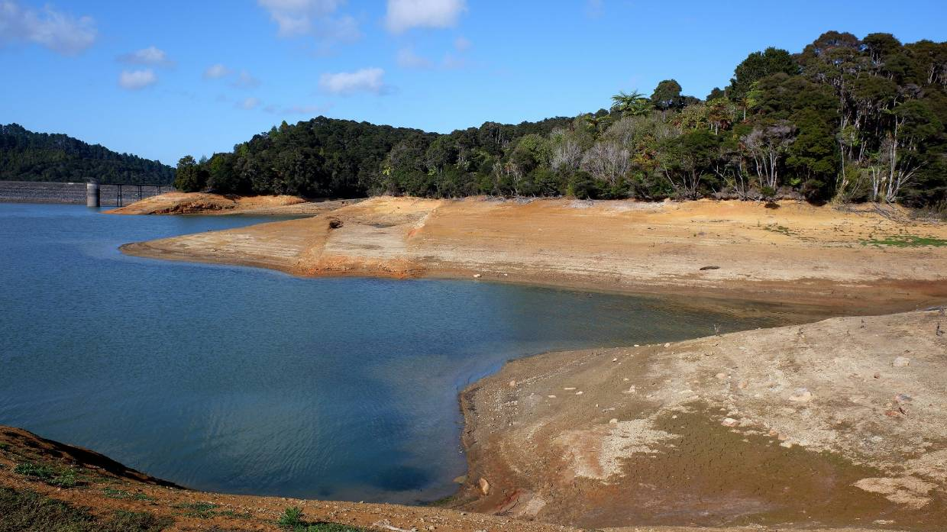
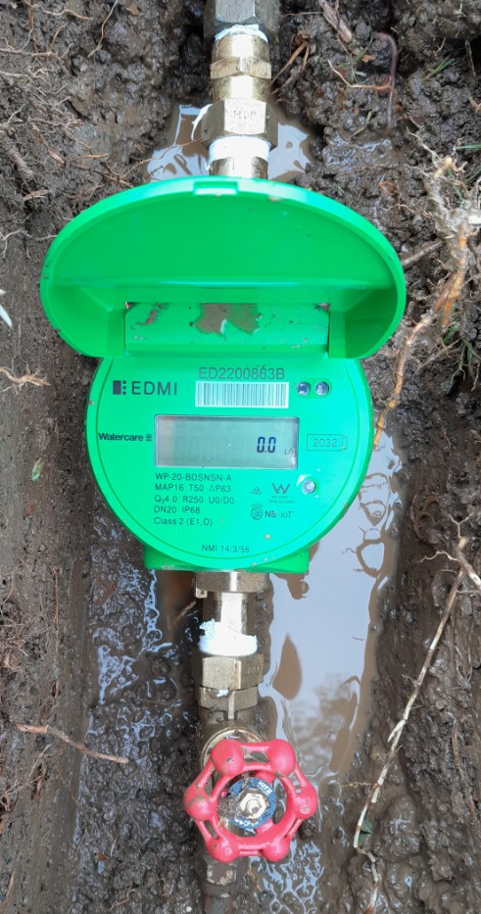
Water Supply Challenges for a City Auckland
Notes:
Auckland Drought
Smart Meter Trials/ Roll out

Slide 16
Water Supply Challenges for a City State Singapore
Notes:
City State
Critical Need - Urbanisation vs very limited Water supply
Jacobs support in AMI
Vision of Future
Jacobs (NYSE:JEC) has been appointed as the Advanced Metering Infrastructure (AMI) Specialist for PUB, Singapore's National Water Agency's Smart Water Meter Programme roll-out in Singapore. The program is a major step in PUB's transition to a smart utility
For the first phase of the Smart Water Meter Programme – which includes the installation of 300,000 automated water meters in new and existing residential, commercial and industrial premises by 2023 – Jacobs will work with PUB to evaluate and advise on meter devices and technology, establish communications protocols and provide insights for enhancing operational efficiency and water saving
PUB will use the water consumption data collected to better understand water demand patterns, improve the predictability and stability of supply, optimize water demand management practices and achieve greater operational efficiencies. The data will also be made available to residents and business owners, providing greater insight into their daily water usage.
By harnessing the power of smart water meter technologies, data analytics, innovative thinking and our extensive project experience, Jacobs is working with PUB to develop more enduring sustainable water management solutions that safeguard this vital resource for the future. This program will clearly set the global standard for other countries to follow."

Slide 17
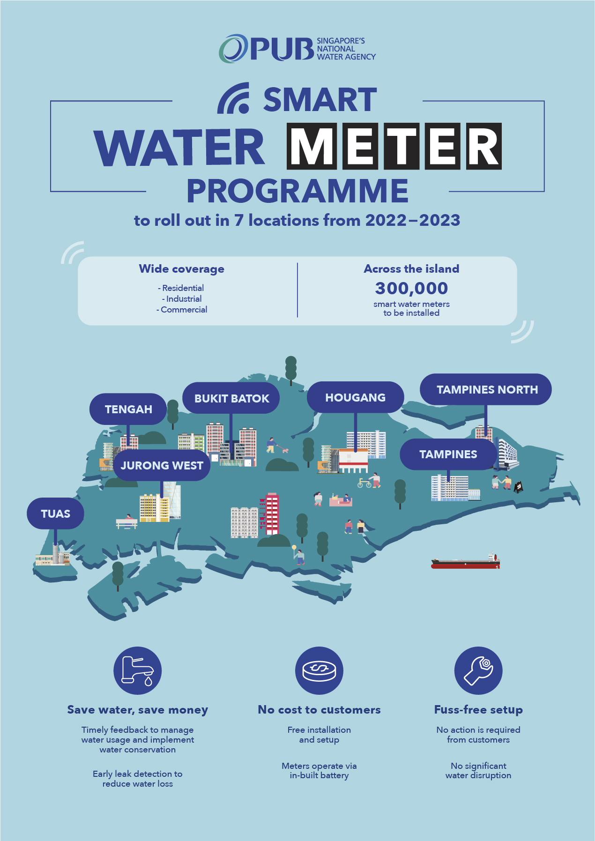
Water Supply Challenges Singapore

Slide 18
The AMI Journey and Keys to Successful Deployment
Planning and deploying AMI requires careful coordination of multi-disciplinary work streams...and addressing issues along the way
Notes:
Planning
Robust Business Case
Procurement – use expert advisors
Data Integration
Transforming you organisation
Communication
Empowering your customers

Slide 19
Summary
Smart Meters and AMI bring water supply into the digital age
Can help NZ’s water providers supply water to their customers more efficiently and sustainably
Can delay or avoid need for new infrastructure and water sources
Most organisations implementing AMI are doing so for the first time
The AMI journey is complex
Customer is key

Slide 20
Want to continue the conversation?
Operationalising Smart Meter Networks - Benefits for Utilities and their Customers
Matt Thomson WaterNZ 2022
Come and say hello to the team at the Jacobs booth, location #125

