Slide 1
The impacts of undocumented stopbanks on flood routing: a Tasman case study
Thomas Wallace

Slide 2
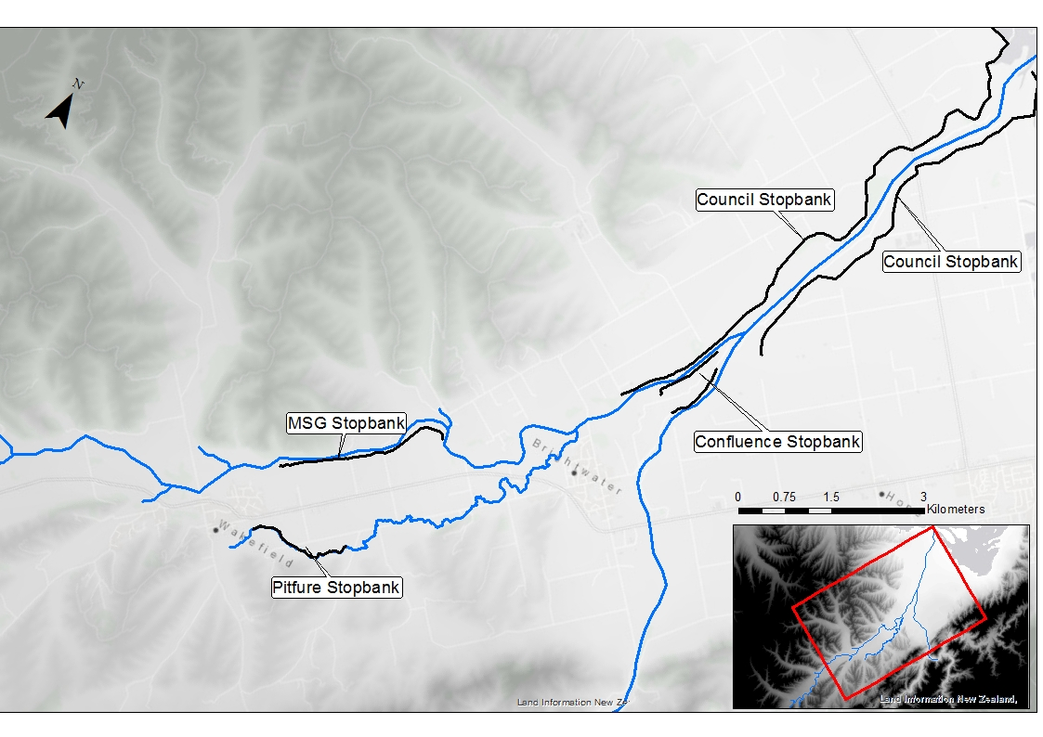
Background
Floods are New Zealand's most frequent and damaging natural event
Currently no nationwide standard for flood protection
Undocumented stopbanks not subjected to formal design, consents, or maintenance
Currently thought to pose a significant and unassessed impact on flood routing
TDC undocumented stopbanks: Main Spring Grove, Pitfure, Confluence
Waimea Floodplain
Notes:
Background
Floods are damaged
100 flood prone communities
No nationwide standard
Construction varied largely depending on
Despite council efforts
TDC Waimea floodplains
Main rivers
Townships and land use
Stopbanks

Slide 3
Objectives
Create a data set of characteristics of the undocumented stopbanks and integrate this with the Tasman's stopbank inventory
Create a computational flood model to carry out flood assessments to determine the impact of the undocumented stopbanks
Scenario | Definition | Documented | MSG | Pitfure | Confluence
D1U1 | All stopbanks present | ✔ | ✔ | ✔ | ✔
D0U0 | All stopbanks removed | - | - | -
D1U0 | Documented stopbanks are removed | - | ✔ | ✔ | ✔
MSG0 | MSG stopbank is removed | ✔ | - | ✔ | ✔
Pit0 | Pitfure stopbank is removed | ✔ | ✔ | - | ✔
Con0 | Confluence stopbank is removed | ✔ | ✔ | ✔ | -
MSGR | MSG stopbank is maintained | ✔ | ✔ ✔ | ✔ | ✔
PitR | Pitfure stopbank is maintained | ✔ | ✔ | ✔ ✔ | ✔
Scenarios Tested
Notes:
Objectives
To documented
Characteristics such as
Whether benefit or harm
Scenarios represented private removal
Scenarios represented private modifications

Slide 4
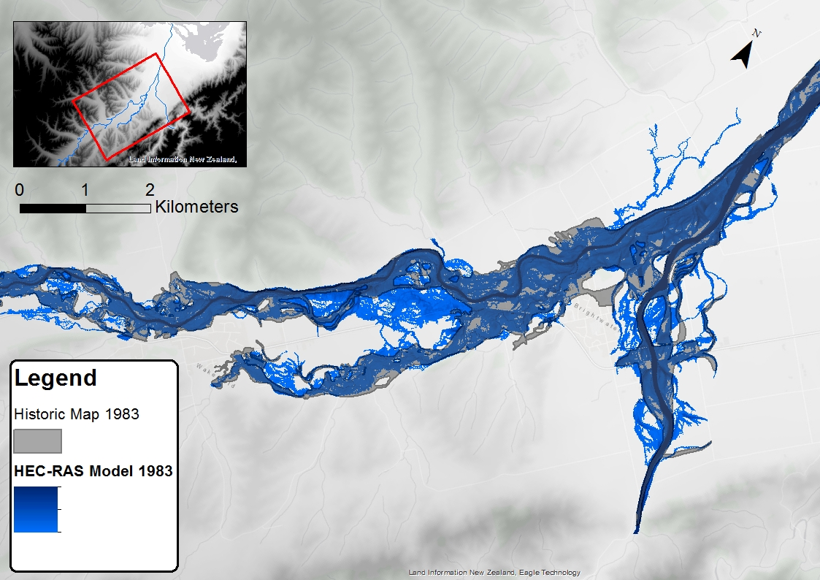
Methods
HEC-RAS full 2D modelling
2016 LiDAR with 2016 interpolated cross section bathymetry
Ungauged tributaries estimated with TM61
2012 LCDB for land use
Calibrated against 1983 flood event
Validated against 2011,1982,1980 events
Calibrated model against historic flood map
Notes:
Methods
Boundary Conditions gauged
Ungauged catchment carry significant flow
TM61 ministry of works
Considers Area, Rainfall intensity, the shape of the catchment, cover, and slope

Slide 5
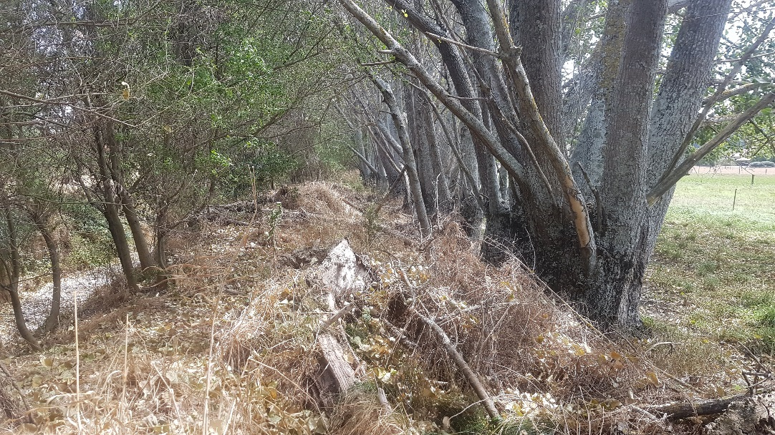
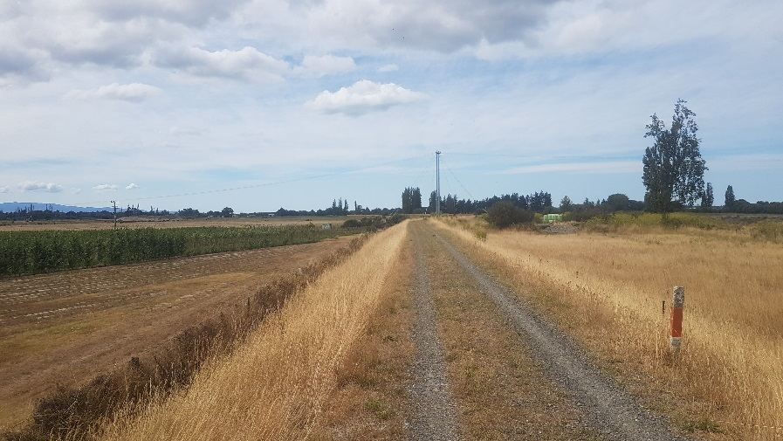
Condition Assessment
 | Height (m) | Cover | Significant Issues
Council | 2.6 | Grasses | -
MSG | 1.2/2.6 | Grasses/ Impenetrable | Woody Vegetation
Pitfure West | 1.0 | Woody Vegetation | Woody Vegetation, Decayed Roots
Pitfure East | 1.0 | Grasses | Erosion of Banks
Confluence Wai-iti | 1.5 | Scrub | Access Roads
Confluence Wairoa | 1.5 | Impenetrable | Woody Vegetation
Typical Pitfure stopbank section
Summary of stopbank condition assessment
Typical Council stopbank section
Notes:
Condition Assessment
Importance of discussions with landowners
Council Stopbanks uniform, ~4 kms survey
Pitfure Stopbank tree
Root ball, are penetrations, seepage, disturb the internal structure
Dead roots voids

Slide 6
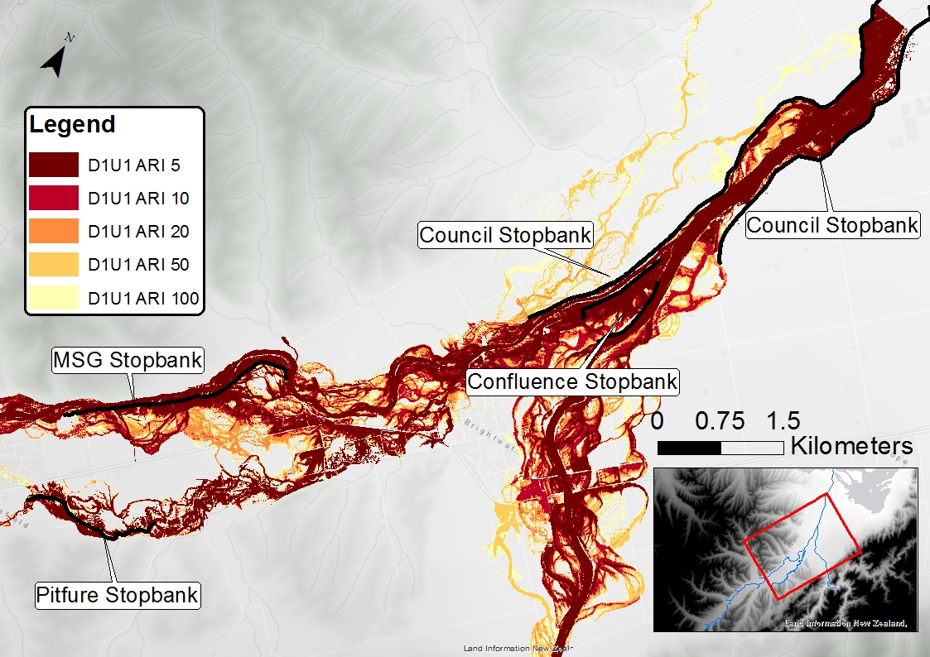
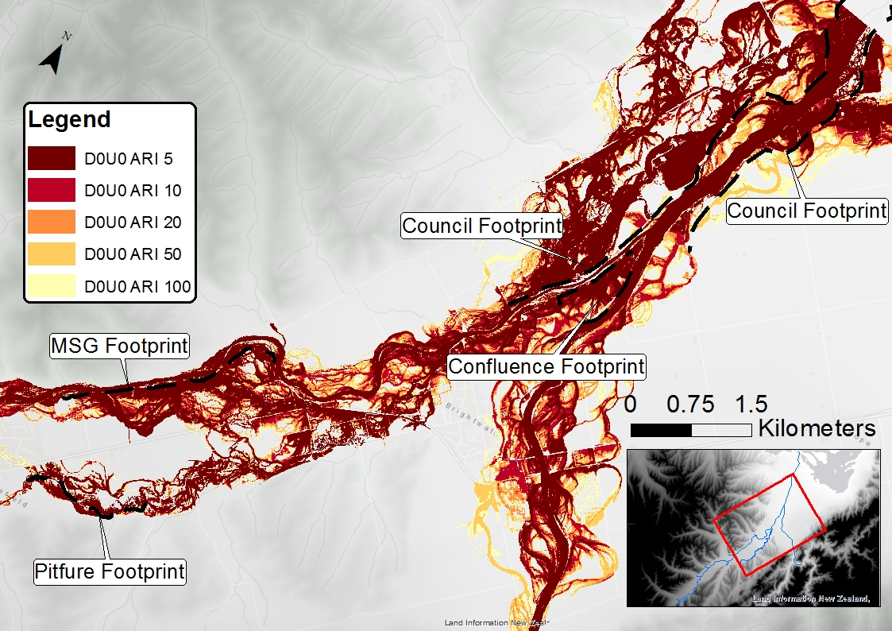
Area Inundated – D1U1 & D0U0
All stopbanks present
No stopbanks present
5 year event: Difference in inundation ~4.1 km² 100 year event: Difference in inundation ~5.8 km²
Notes:
D1U1 & D0U0
Council stopbanks
MSG stopbank
Pitfure stopbank
MSG average depth ~0.6 meters – 100 year
Pit average depth ~0.2 – 100 year
Council average west ~0.5 – 100 year

Slide 7
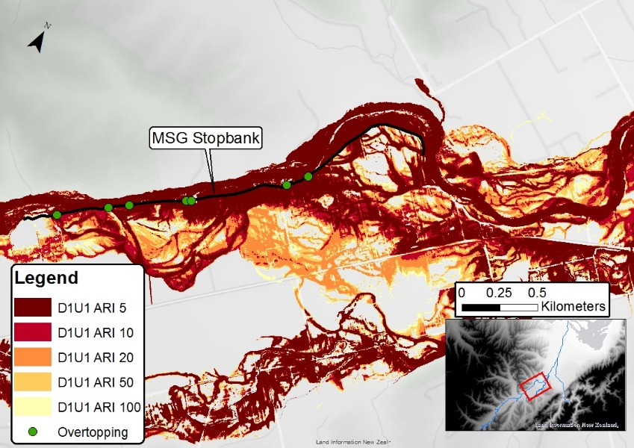
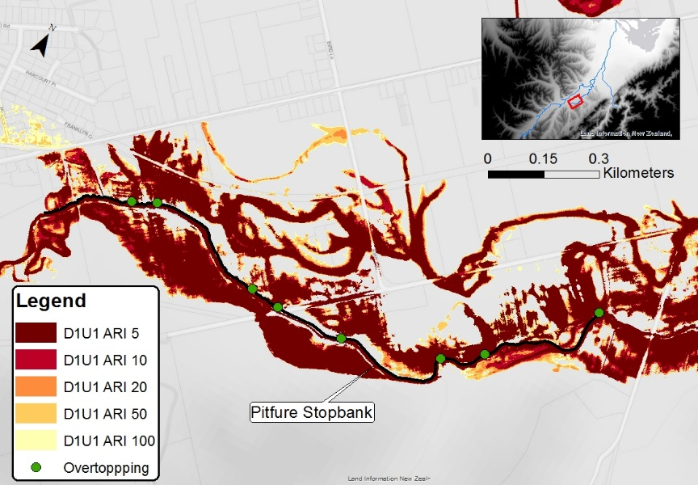
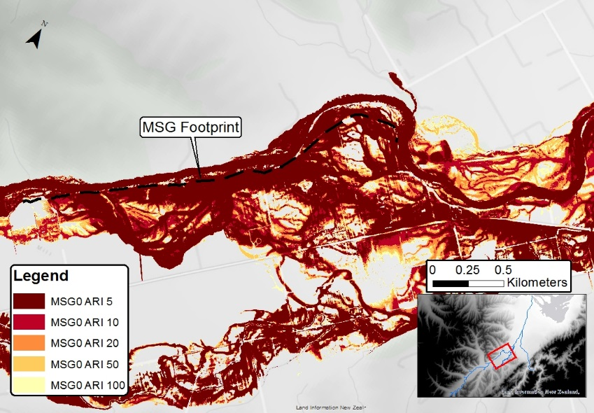
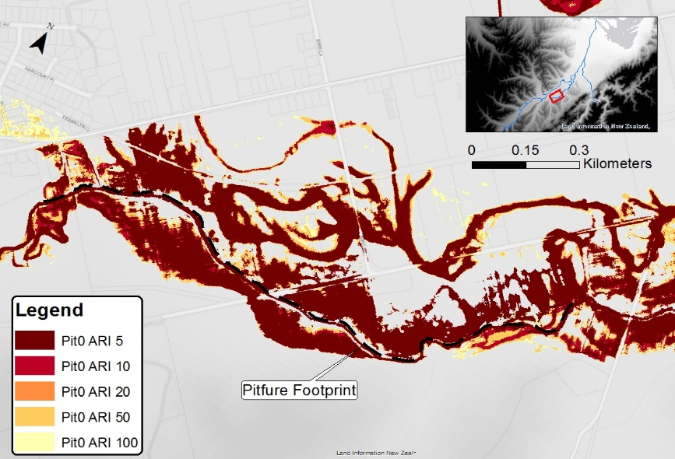
Area Inundated – Removal
5 year event: MSG prevents ~0.43 km² from inundation
MSG stopbank present
Pitfure stopbank present
MSG stopbank removed
Pitfure stopbank removed
Notes:
Removal
MSG overtopping 6 places
100 year is same, effect diminish
Limitation erosion not considered
Pitfure 8 overtopping
Both case water overtopping in undulations
Up to 1.5 MSG, 0.4 Pitfure Benefit of condition assessment

Slide 8
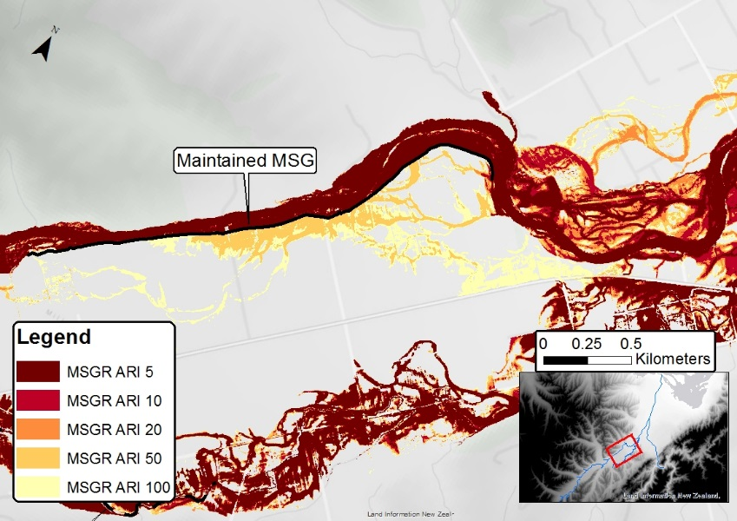
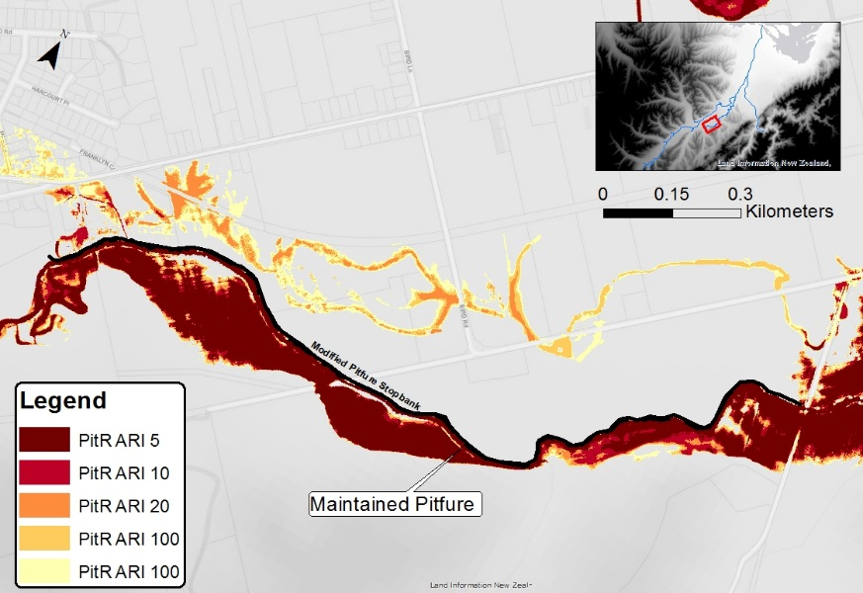
Area Inundated – Maintained
5 year event: MSG prevents ~0.49 m²
Pitfure prevents ~0.16 km²
100 year event:
MSG prevents ~0.77 km²
Pitfure prevents ~0.19 km²
MSG stopbank present
Pitfure stopbank present
MSG stopbank modified
Pitfure stopbank modified
Notes:
Maintained Case
What if they bank were maintained, what are the effect, is there a benefit
MSG 50 year overtop
More flooding at airstrip
Pitfure still floods due to Wai-iti

Slide 9
Riskscape - Impact Assessment
Riskscape used to quantify the damage/human displacement/reinstallment cost to buildings
A major limitation is Riskscape is that its only considered buildings
Currently no quantification of damage to paddocks, bridges, road

Slide 10
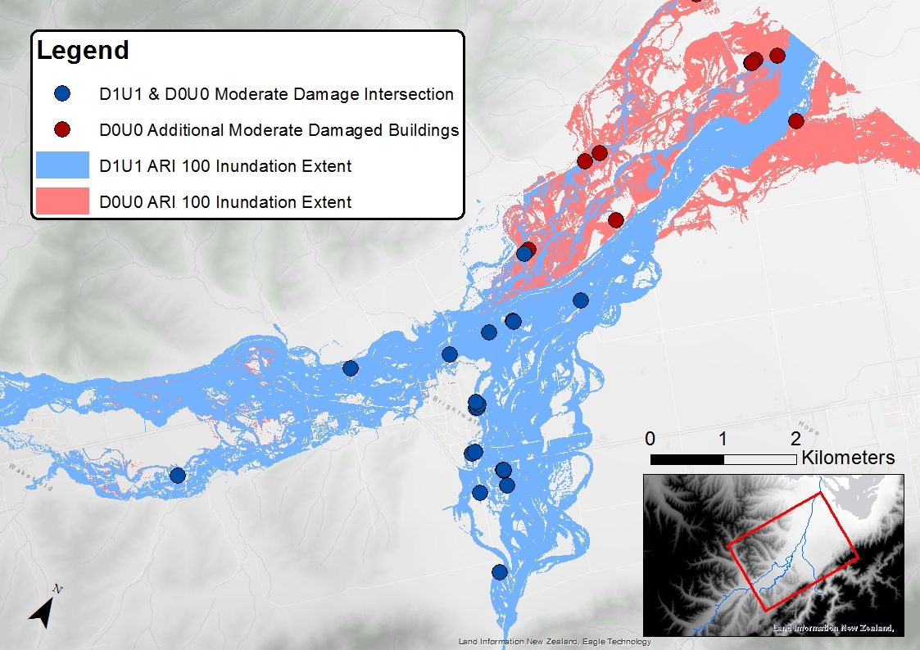
Riskscape – D0U0 & D1U1
Overall increase of moderately damaged buildings of 13 (all stopbanks: 30 buildings)
Overall increase of building reinstallment cost of $1.3 million (all stopbanks: $8.7 million)
These are located mostly west of the council stopbanks
Total Building Damages - ARI 100
 |  | D1U1 | D0U0
Damage Bracket | Up to $50,000 | $380,000 | $530,000
 | Up to $100,000 | $300,000 | $600,000
 | Up to $200,000 | $1,100,000 | $1,500,000
 | Up to $500,000 | $5,200,000 | $5,900,000
 | Up to $1,000,000 | $1,700,000 | $1,700,000
 | Over $1,000,000 | 0 | 0
Moderately damage buildings: 100 year event
Notes:
Riskscape D0U0 & D1U1
Increase in moderate damaged
reinstall cost
Note no additional moderately damaged building near the undocumented stopbanks

Slide 11
Riskscape - Removal
Building damage/costs are the same when all stopbanks are present despite increase in inundation area
Stopbanks are flawed, both the stopbanks have undulations that allow water to pass through
Highlights the importance of the council stopbanks
Notes:
Riskscape removal
Costs are the same as the all stopbanks case
Meaning the presence of stop as it is, is not reduced the impact on building
Because the stopbanks currently are not effective and let water though
So the damaged are the same
Importance of the council stopbank
almost all the difference in damage and cost can be attributed the council stopbanks

Slide 12
Riskscape - Maintained
Building damage/costs are the same when undocumented stopbanks are maintained despite reduction in area (0.77 km² MSG 100 year event)
Area affected has a low density of buildings
Stopbanks were built in 1980s, land cover has changed, more vineyards/orchards
Again, only damage to buildings was considered for impact assessment
100 Year Event | 1996 |  |  | 2012
LCDB | Area (Km²) | Area Percentage (%) |  | Area (Km²) | Area Percentage (%) |  |  | Percent Change (%)
Orchard, Vineyard | 1.9 | 10.5 |  | 2.8 | 15.8 |  |  | +5.3
Township | 0.3 | 1.6 |  | 0.4 | 2.4 |  |  | +0.8
Short-rotation Cropland | 0.9 | 5.0 |  | 1.0 | 5.8 |  |  | +0.8
Paddock | 12.0 | 67.2 |  | 10.7 | 60.0 |  |  | -7.2
Total |  | 17.8
Notes:
Riskscape maintained
What if the stopbanks didn’t let water through, would there be a benefit to the impact regarding building
Despite the reduction in area
Does appear to be a significant reduction in damage/cost
Low density building
Build when…..
Over 16 year see Landcover change
Don’t know model does factor last 7 years of change

Slide 13
Questions?

