Slide 1
Enhanced Methane Production using an Integrated Anaerobic Digestion - Bioelectrochemical System
Afrooz Bayat
Ricardo Bello-Mendoza
Department of Civil & Natural Resources Engineering | University of Canterbury
Te Tari Pūhanga Metarahi, Rawa Taiao | Te Whare Wānanga o Waitaha

Slide 2
Emission reduction target
Global warming is limited to 1.5˚C above pre-industrial levels.
Zero net accounting emissions of greenhouse gases in a calendar year, other than biogenic methane, by 2050.

Slide 3
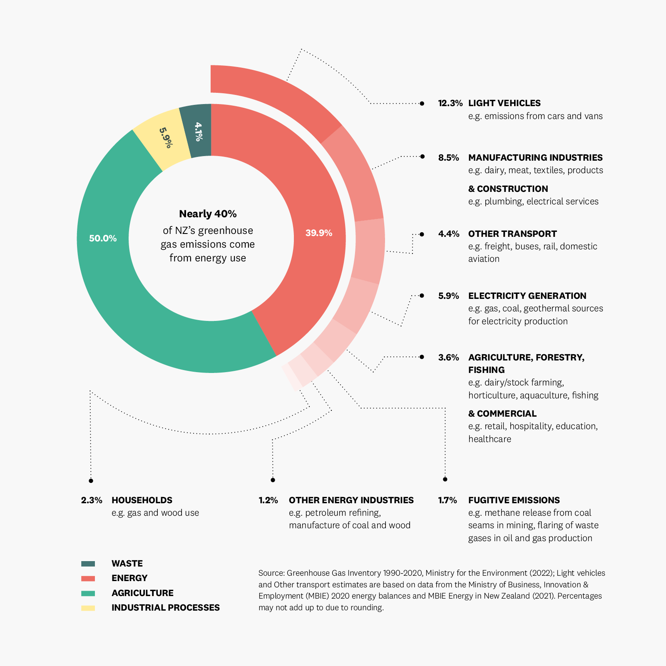
Energy use in New Zealand
In New Zealand, energy use accounts for 40% of the country’s greenhouse gas emissions.
This comprises burning fossil fuels, producing electricity, and transporting.
We can reduce those emissions by making better choices about energy use.
Source: EECA

Slide 4
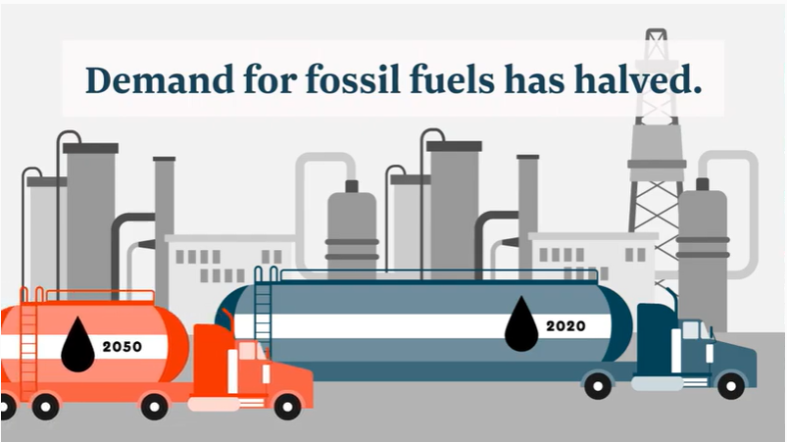
Future of fuels in New Zealand
The demand for fossil fuels must be halved by 2050.
Renewable sources of energy must be implemented for the production of heat and power (EECA and BECA, 2021).

Slide 5
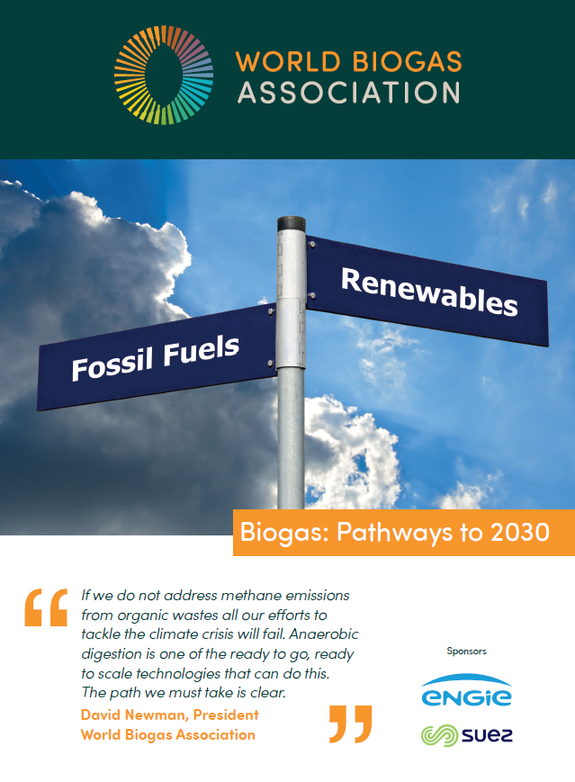
One pathway to provide renewable energy
The world biogas association (2021) highlights the capability of anaerobic digestion as a technology to:
Generate renewable energy,
Abate GHG emissions,
Contribute to meeting waste/wastewater management goals.

Slide 6
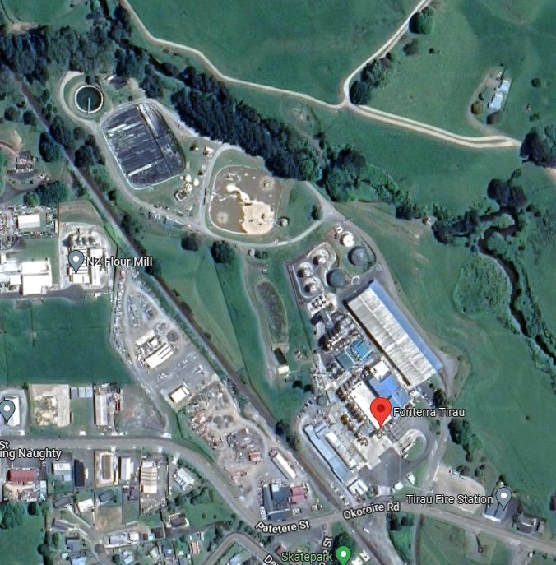
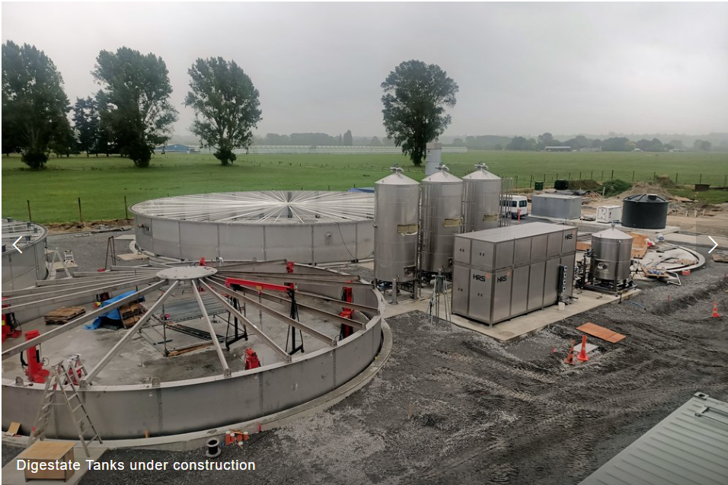
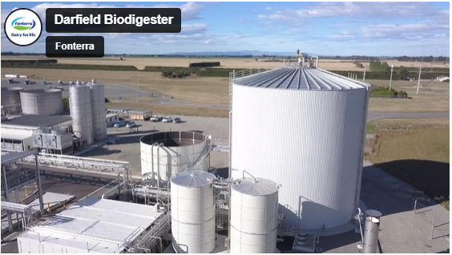
Biogas potential and current situation in New Zealand

Slide 7
Anaerobic Digestion
Biopolymers
(polysaccharides, proteins, lipids, etc.)
Hydrolysis
Biomonomers
(sugar, amino acids, fatty acids, etc.)
Acidogenesis
VFAs
Acetogenesis
H₂, CO₂
Acetic acid
Methanogenesis
CH₄, CO₂

Slide 8
Biogas potential
Substrate | Biogas yield (L/kg VS) | Methane content (%)
Fat | 1000-1250 | 70-75
Protein | 600-700 | 68-73
Carbohydrate | 700-800 | 50-55

Slide 9
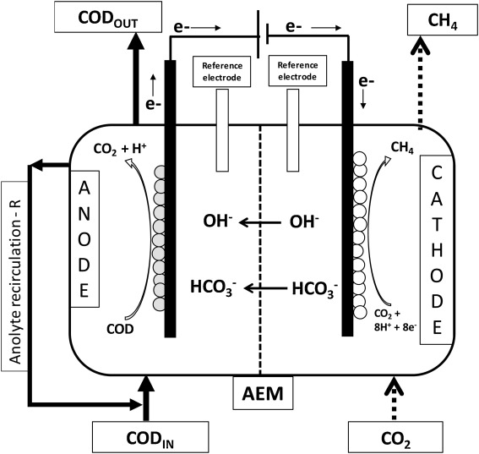
Microbial Electrolysis Cells (MEC)

Slide 10
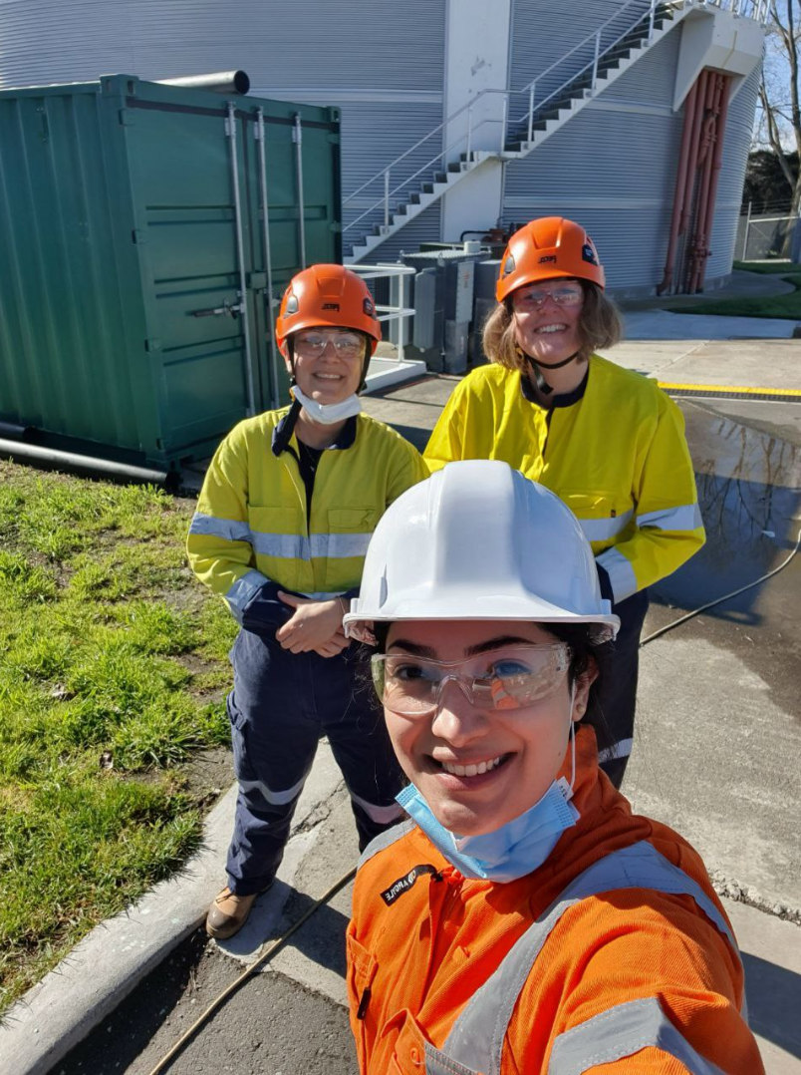
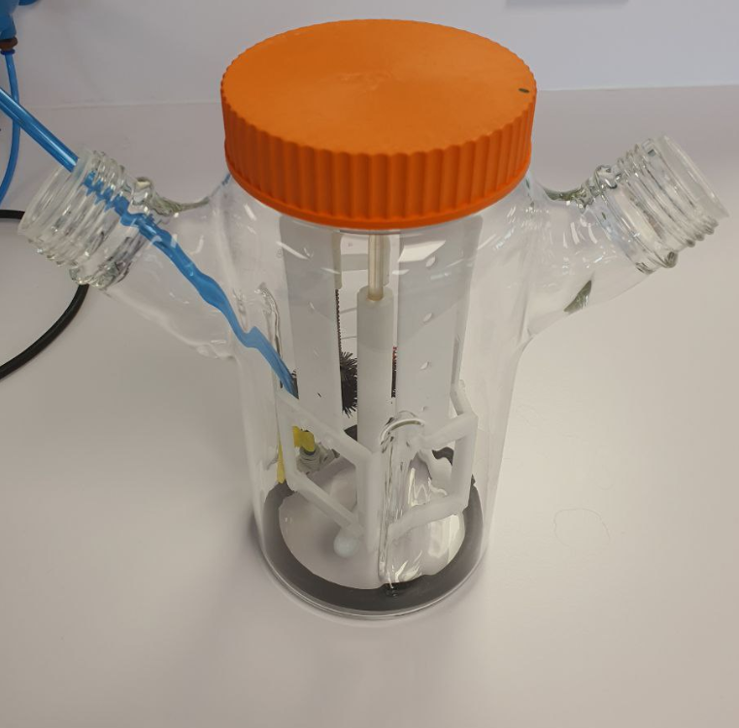
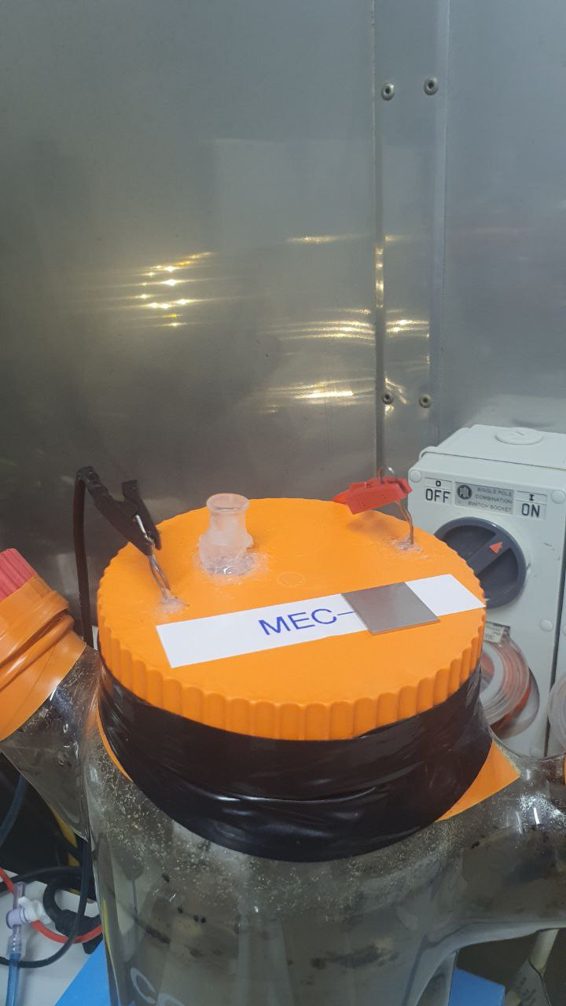
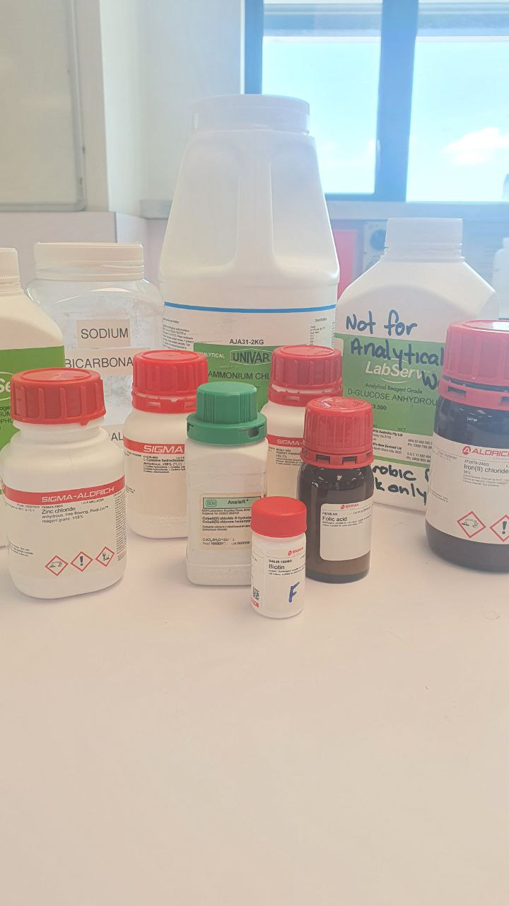
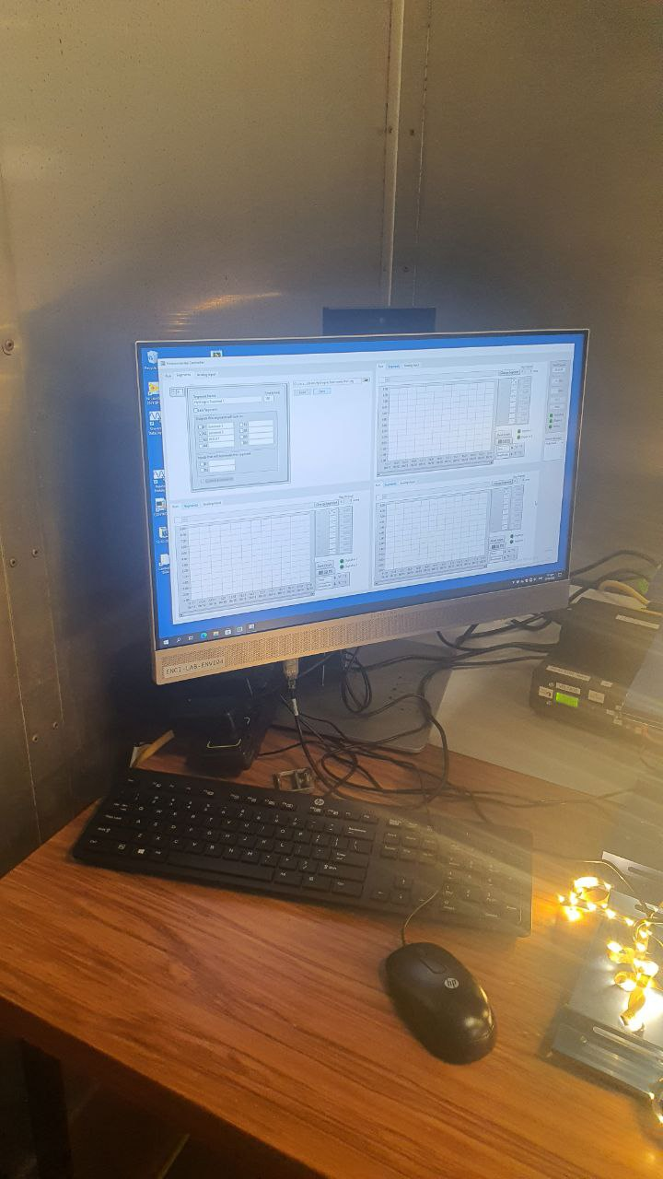
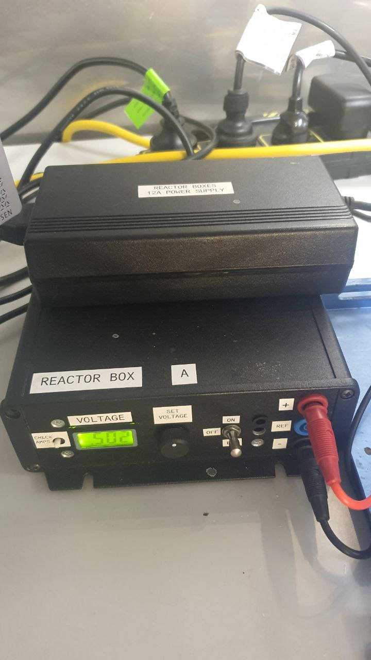
Materials and methods
Anode: ×3 carbon felt + 0.5% pt
Cathode: ×3 carbon brush
Collecting AD digestate from CWTP
Reactor volume: 3L
Working volume: 1.5L
OLR: 0.5 gCOD/day
HRT: 30 days
Substrate strength:
10 gCOD/L
Voltage: 0.5V
Data acquisition system

Slide 11
Results Biogas content & Daily methane production

Slide 12
Methane yield
 | P Maximum methane yield, mL | R Rate, hr⁻¹ | L Lag phase, hour | R squared
AD | 193.6 | 23.9 | 0.19 | 0.991
MEC | 228.2 | 20.0 | - | 0.991

Slide 13
Current in the MEC system

Slide 14
Effluent COD and VFA

Slide 15
Conclusion
The MEC-assisted anaerobic digester had a methane production 17.5% higher than the conventional anaerobic digester.
It also showed greater process stability compared with conventional anaerobic digestion.
The performance of an anaerobic digester (i.e., substrate degradation rate, process stability, and drifting due to system upsets) can be improved with the assistance of a MEC at a voltage as low as 0.5 V.
The external energy requirement can be provided with renewable energy systems such as Microbial Fuel Cells (MFCs).

Slide 16
Thank you !
Questions ?
afrooz.bayat@pg.canterbury.ac.nz
ricardo.bellomendoza@canterbury.ac.nz

