Slide 1
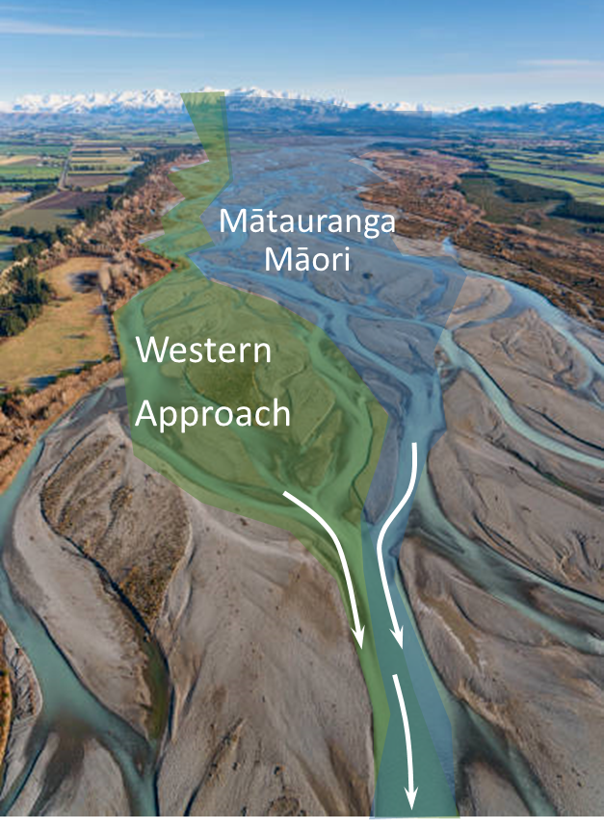
A WAI-INU BLUEPRINT
Murray England | Selwyn District Council
Hugh Blake-Manson | Waugh Infrastructure Management
Water New Zealand 2022 | Ōtautahi
Notes:
Slide delivered by: Murray
Max Time: - minutes
Current Actions: -
ME to insert mihi here

Slide 2
Selwyn District
Notes:
Slide delivered by: Murray
Max Time: 2 minutes
Current actions: ME to check figures and order of delivery
Place and relevance.
Representative of east coast of NZ environments – rapidly changing land use (agriculture-horticulture) with urban expansion. Developing relationship with iwi.
Ki Uta ki Tai “Mountains to Sea” = describe the “blue-nish” of the district
Point to rivers | awa, springs and Te Waihora
Describe the importance of the spring interface, Te Waihora and rivers | awa – everything we do in the wai-inu space has a connection to these freshwater
Scale and complexity is high within wai-inu system and between other water systems (I will raise this again – it links directly to the Water Services Acts Purpose)
NEXT SLIDE

Slide 3
Wai Inu Blueprint The Value
“50 years”
One Water
Strategy
Supports the One-Water Co-Design Strategy
Connects mātauranga māori and european scientific systems
Reveals key risks, uncertainties
Signals actions through data & local knowledge
Highlights critical interactions with other waters - wastewater
“10 years”
Blueprint
Safe Drinking Water
“1-5 years”
Provides evidence for budgets and critical path projects
Notes:
Slide delivered by: Murray
Max Time: 2 minutes
Current Actions: - Murray – needs less text !!
Cover:
Why have a blueprint – there are many other options?
The blueprint is the bridge between the strategic co-design one water approach and detailed critical path programmes and projects. It highlights district wide and geographic challenges and directs investment - where scheme by scheme water satefy plans miss this tactical level thinking.
Its a live document – accessing information and ammending the approach where necessary
HAND OVER to Hugh

Slide 4
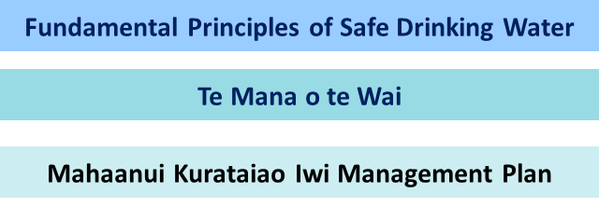
Fundamental Principles
Framework
Notes:
Slide delivered by: Hugh
Max Time: 1 minute
Current Actions: - nil
Tēnā koutou katoa
E mihi ana ki ngā mana whenua
Ko Hugh tōku ingoa
Nō Motukarara ahau
Nō reira, tēnā koutou, tēnā koutou katoa
Cover:
Murray has outlined the position of the blueprint. I will expand on the core elements which is is built on.
Disclaimer - We do not speak for runanga, via co-design they will provide their voice. Over time local application of TMoTW will become clearer.
The Wai-Inu blueprint has its basis in our current interpretation and application of the principles of 6 principles of Te Mana o te Wai and the 6 fundamental principles of safe drinking water.
To determine the framework of the Blueprint, we looked closely at the connections between the 6 principles of both TMoTW and FPSDW – and the MKT IMP statements regarding freshwater sources.
We mapped the common elements and differences between these.
Across all three references there was a clear overlap and focus on the health of people, through protection of awa, springs and Te Waihora.
We used this to determine the Blueprint framework – areas and elements where critical information was required to “shine a light” on current and predicted trends.

Slide 5
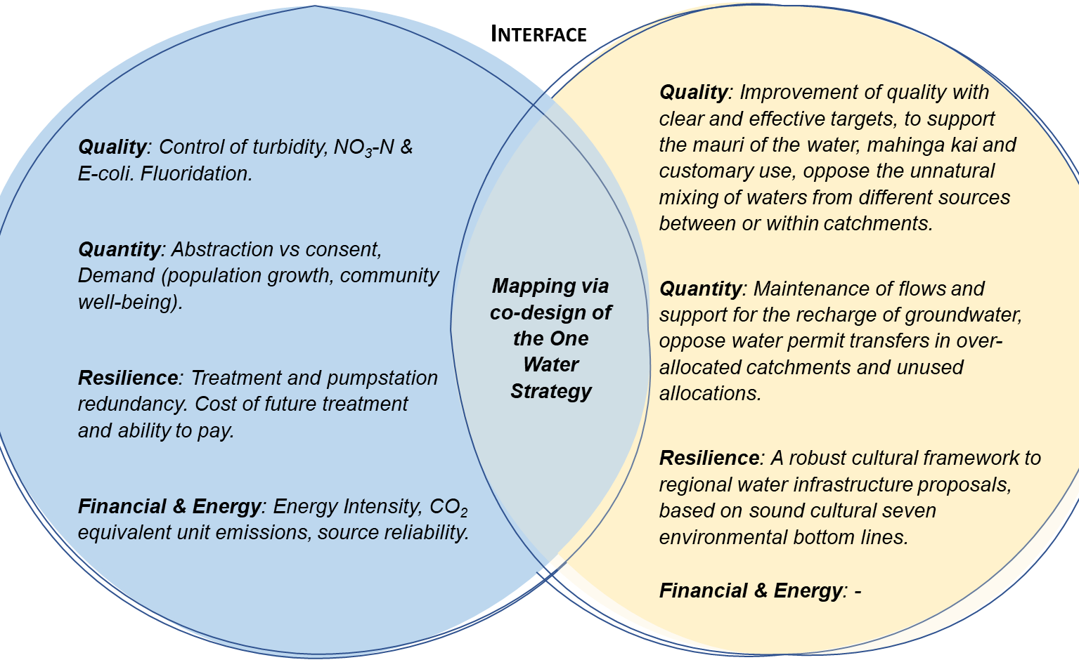
Western Science Approach
Mātauranga Māori Policy Statements
Notes:
Slide delivered by: Hugh
Max Time: 1minute
Current Actions: - nil
Cover:
The areas and elements chosen, consider the convergence of western science and mātauranga māori statements.
So lets look at examples of the analysed data and the associated risk and responses.x
NEXT SLIDE

Slide 6
The Wai-Inu Framework
27 schemes
16 Indicators
4 Aspects
“equal”
Quality
Quantity
Resilience
Financial & Energy
Depth and cross-section
National performance measure aligned
Local and regional factors
Data source confidence B (or greater)
5 geographic areas
Notes:
Slide delivered by: Hugh
Max Time: 2 minute
Current Actions: - nil
Cover:
We had access to millions of data points covering all the water supplies over several decades. This includes qualitative and numerical data. We needed to use this wisely – taking a “simple but no simpler” approach.
We looked at the Purpose of the Act – which talks about responding to risks in a manner proportionate to the scale and complexity of the water supply. So we considered the scale and complexity of the schemes – from source to tap and the interface with ground, surface water and wastewater systems.
There is both
We have noted the significant urban growth – which is occuring in plains areas – which we referr to as the Greater Christchurch grouping of water schemes. Private plan changes infront of Council indicated that some townships boaundaries may be within several kilometres of each other well within 10 years if these plan changes become reality.
Given this high level of complexity, and to ensure we could accurately capture local and area wide patterns a framework using four areas with 16 indicators was developed and refined.
Each area and indicator was specifically selected as it had a linkage across mātauranga māori and european knowledge system using our current understanding.
We used this information to identify geographic groupings for schemes, and assessed the resulting risk levels and responses.
NEXT SLIDE

Slide 7
Data & Risk Exposure
Quality |  | Quantity |  | Resilience | Financial & Energy
Source nitrate-nitrogen (NO3-N) mg/L | Source E - coli (2019+) | Actual : consented (m3) | Infrastructure Leakage Index (CARL/UARL) | Source water climate exposure | Energy Intensity (GJ/m3) | NO3-N Treatment ($ CAPEX)
Risk Level & Response
Aware - Watch | <1 mg/L |  | 0-0.49 | 0-0.9 |  | 0-0.0002 | $ nil
Investigate - Plan | 1-3 mg/L |  | 0.5-0.69 | 1 - 3.9 |  | 0.0002-0.001 | $6.31M 30 L/S, 60 m3/wk waste
Programme - Respond | 3-5.65 mg/L |  | 0.7-0.89 | 4 - 7.9 |  | 0.0011-.003 | $10.4M 100 L/S, 210 m3/wk waste
Act - Deliver | >=5.66 mg/L |  | >=0.9 | >=8 |  | >=0.0031 | $19.5M 300 L/S 570 m3/ wk waste
Notes:
Slide delivered by: Hugh
Max Time: 2 minute
Current Actions: - nil
Cover:
Here I have provided a subset of the 4 areas and 16 indicators on the top horizontal table. For this specific water scheme the quality – NO3-N and quantity - Infrastructure leakage data analysed fall into the Programme-Response and Act-Deliver areas. In other words we considered there was significant concern and action is required at scheme and group level
To make sense of this information, we translated this into a thematic map across the geographich groups

Slide 8
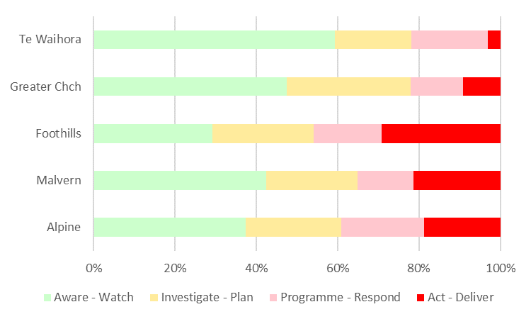
Wai-Inu – Where Are The Challenges?
Low but increasing NO3-N levels
Increasing NO3-N & energy use, E-coli (source)
Cyanobacteria & energy use, E-coli (risk in network), high demand
High NO3-N & energy use, E-coli (risk in network), high use
High ILI, reactive work
Notes:
Slide delivered by: Hugh
Max Time: 2 minute
Current Actions: - nil
Cover:
This is a summary of # of indicators within each geographic group at the risk exposure level. I’ve listed some of the current emerging issues and challenges for wai-inu. Each of these challengens relates to some or all parts of the drinking water system, and may also consequencially have an impact on wastewater, groundwater (springs) and stormwater systems.
For example -
So what is the response?

Slide 9
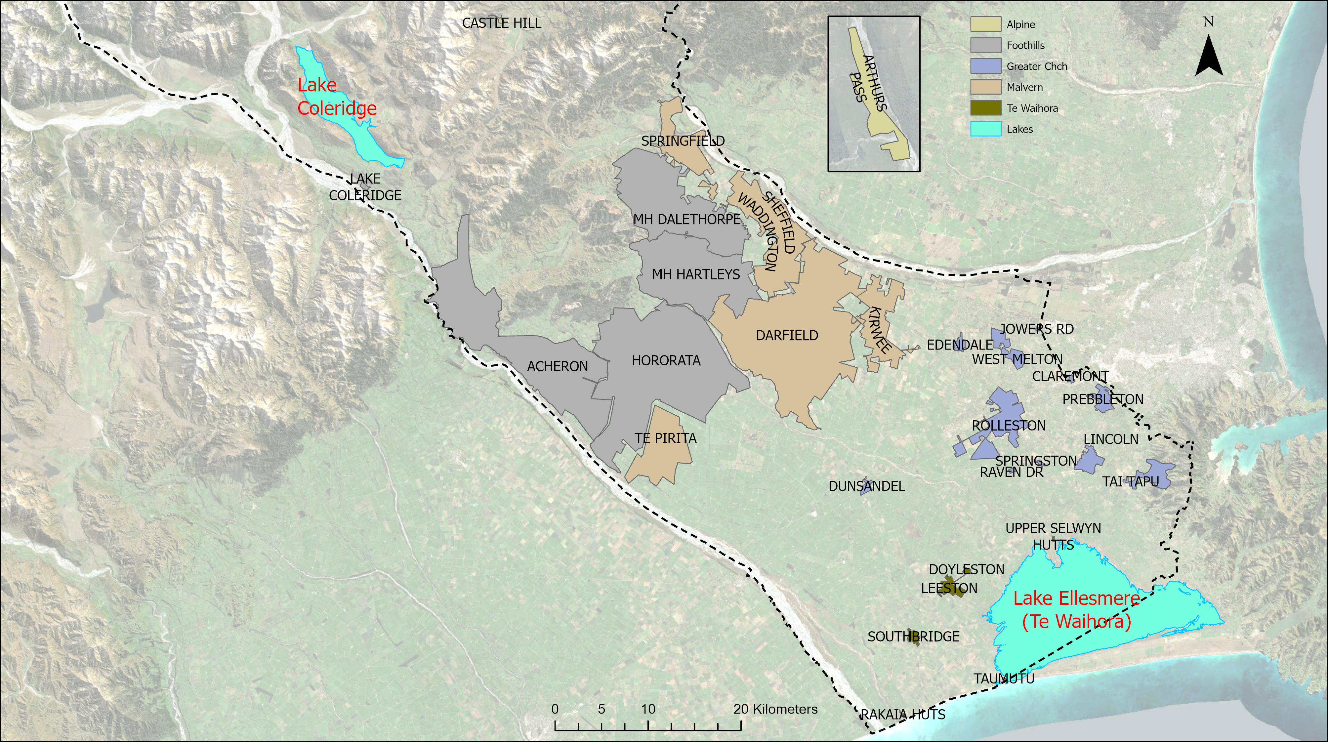
Wai-Inu – Where Are The Challenges?
40,000 people
Notes:
Slide delivered by: Hugh
Max Time: 2 minute
Current Actions: - nil
Cover:
Lets look at the Greater Christchuch geographich area. The majority of the population live here, and it is growing rapidly. While their drinking water needs may be small in comparision to others taking water, as a combined total, each person has an average daily use of 514 litres and collectively extract 7.1 million cubic metres of water per year.
Nitrate-nitrogen levels are increasing in some schemes, while per capita use is increasing.
Reflecting back on the 6 principles of safe drinking water – a duty of care and Te Mana o Te Wai (care and respect for the health of the nation) – we need to start planning for a new future.
So what is the response?
Hand over to Murray

Slide 10
Response
Source & Treatment Consolidation
Cost Area | Standalone per site | Consolidated
Capital ($M) | $156-$234 | $69-$207
Operation & Maintenance ($M) | $8.6-$63.6 | $8.2-$12.3
Notes:
Slide delivered by: ME
Max Time: 2 minute
Current Actions: - newer image
Cover:
- To be completed

Slide 11
The Wai-Inu Blueprint - Recap
Supports the One-Water Co-Design Strategy
Connects mātauranga māori and european scientific systems
Reveals key risks, uncertainties
Signals actions through data & local knowledge
Highlights critical interactions with other waters - wastewater
Blueprint
Provides evidence for budgets and critical path projects
Thanks – Questions?
Water New Zealand 2022 | Ōtautahi
Notes:
Slide delivered by: ME
Max Time: 2 minute
Current Actions: - ME to check this captures and summarises the presentation
Cover:
Tell them what we told them
Relevance to NZ
What next and when
Close – thankyou for listening – we welcome questions.

