Slide 1
Innovation through collaboration -Community friendly wingwalls-
May 2019

Slide 2
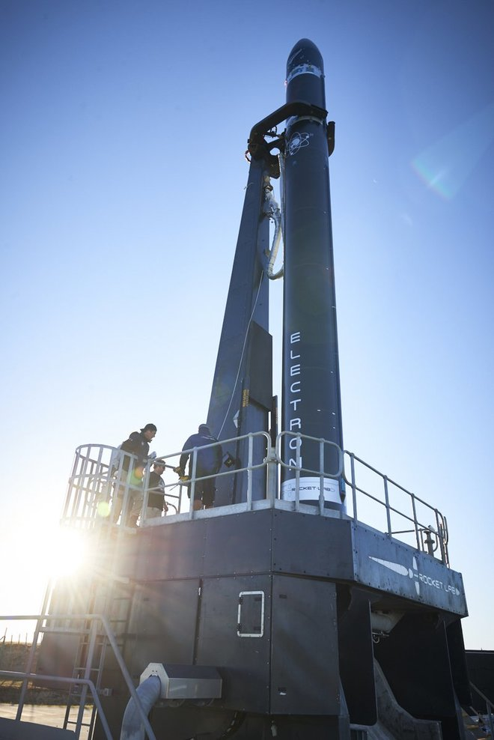
How we define innovation?
The ability to create value by scalable business models
Desirability: do customers want it?
Feasibility: can we build it?
Viability: can we make more money than we spend?
© 2019 – Hynds Pipe Systems Ltd

Slide 3
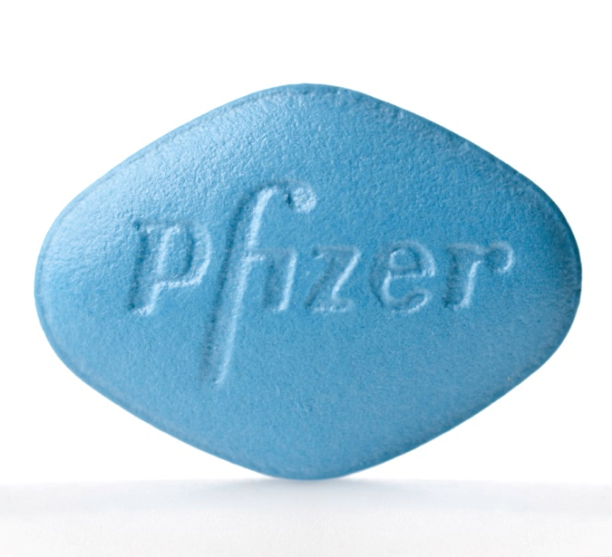
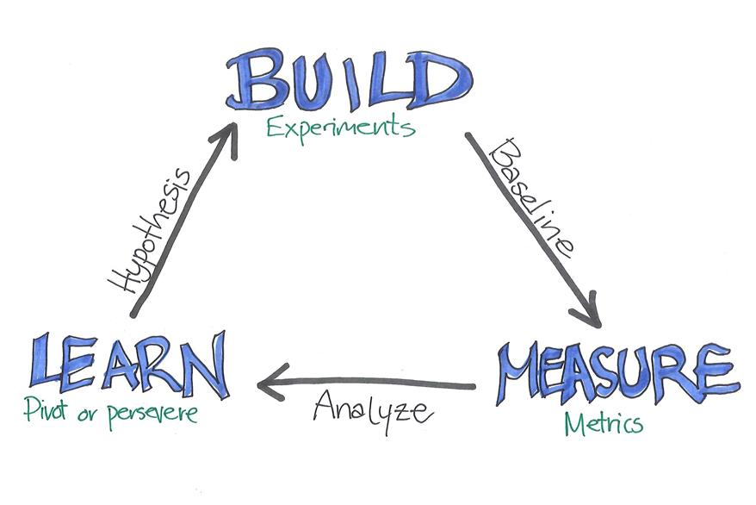
How innovation happens?
Eureka (I found it) moments
Serendipity
Lean Startup
© 2019 – Hynds Pipe Systems Ltd

Slide 4
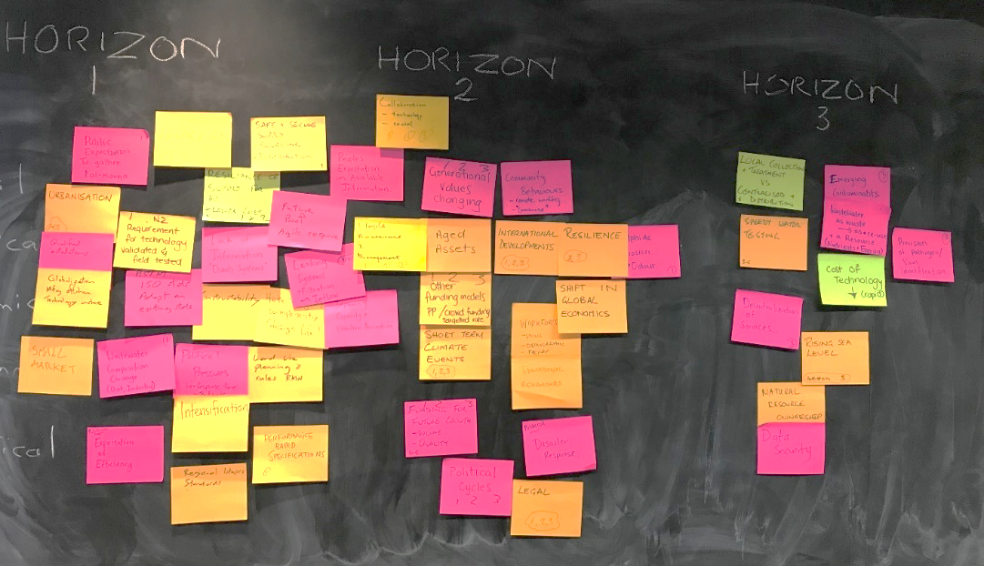
Innovation Culture + Systematic process approach
Horizon #1
The “here and now”
what we are most familiar with
Horizon #2
Emerging opportunities
new models / pilot tests
Horizon #3
Blue sky thinking
& disruptive models
© 2019 – Hynds Pipe Systems Ltd

Slide 5
Hynds Values: Connecting with customers + the Focus Group
© 2019 – Hynds Pipe Systems Ltd

Slide 6
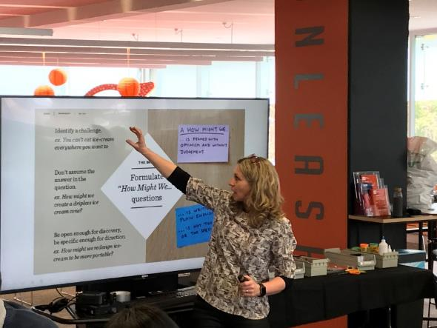
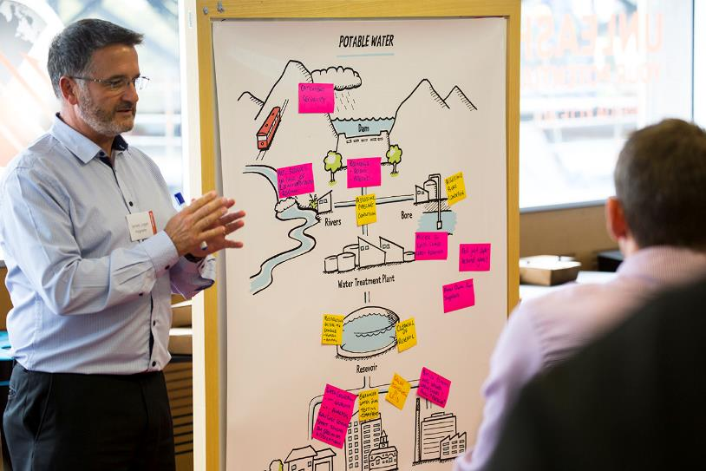
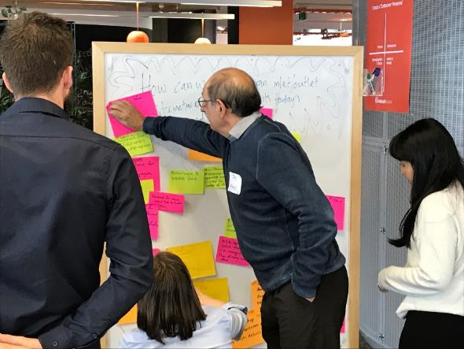
Not “sales pitch” oriented
Facilitated by UoA Professors
“Neutral” environment
© 2019 – Hynds Pipe Systems Ltd

Slide 7
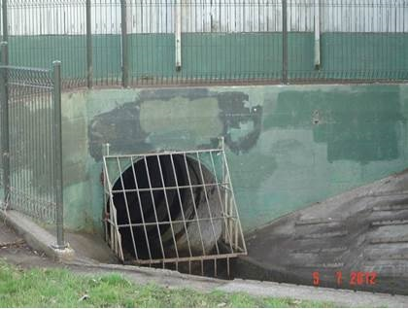
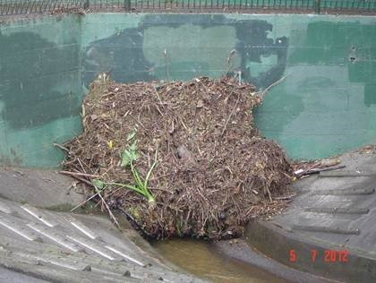
Research question
How to reduce the visual impact of concrete structures in the urban environment?
© 2019 – Hynds Pipe Systems Ltd

Slide 8
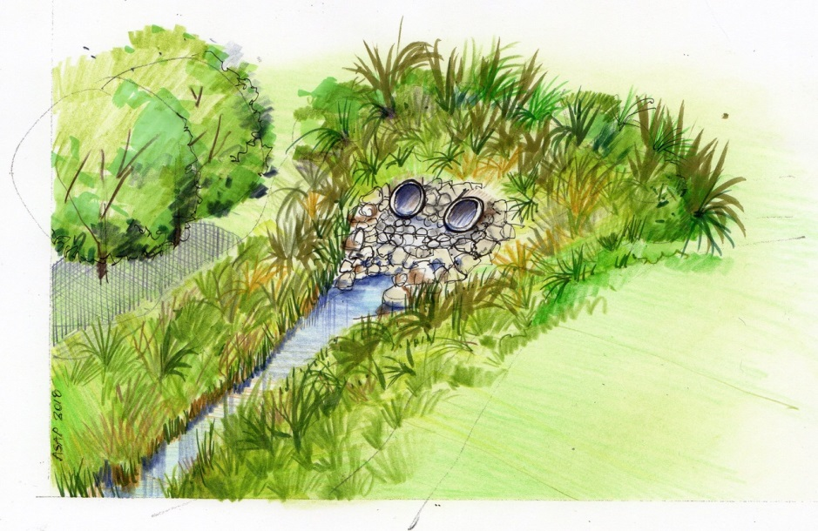
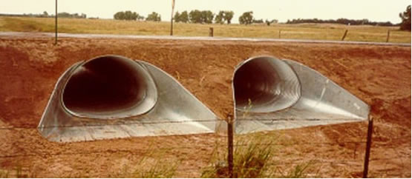
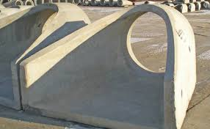
Some non-traditional alternatives
© 2019 – Hynds Pipe Systems Ltd

Slide 9
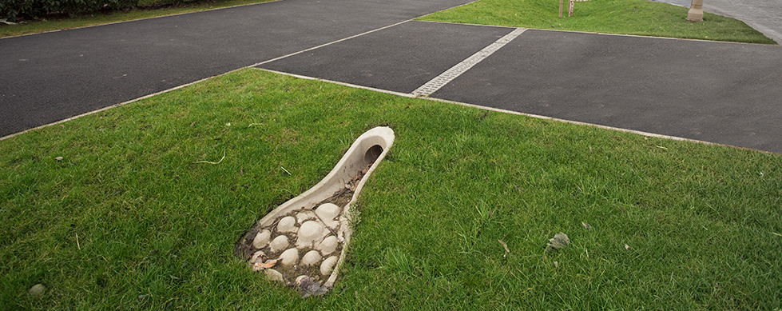
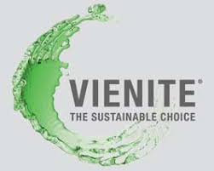
Vienite® is a new polymeric based recycled material with performance characteristics equal to the polymer concrete that ACO has used in the manufacture of some of its products
© 2019 – Hynds Pipe Systems Ltd

Slide 10
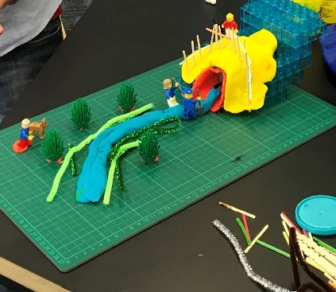
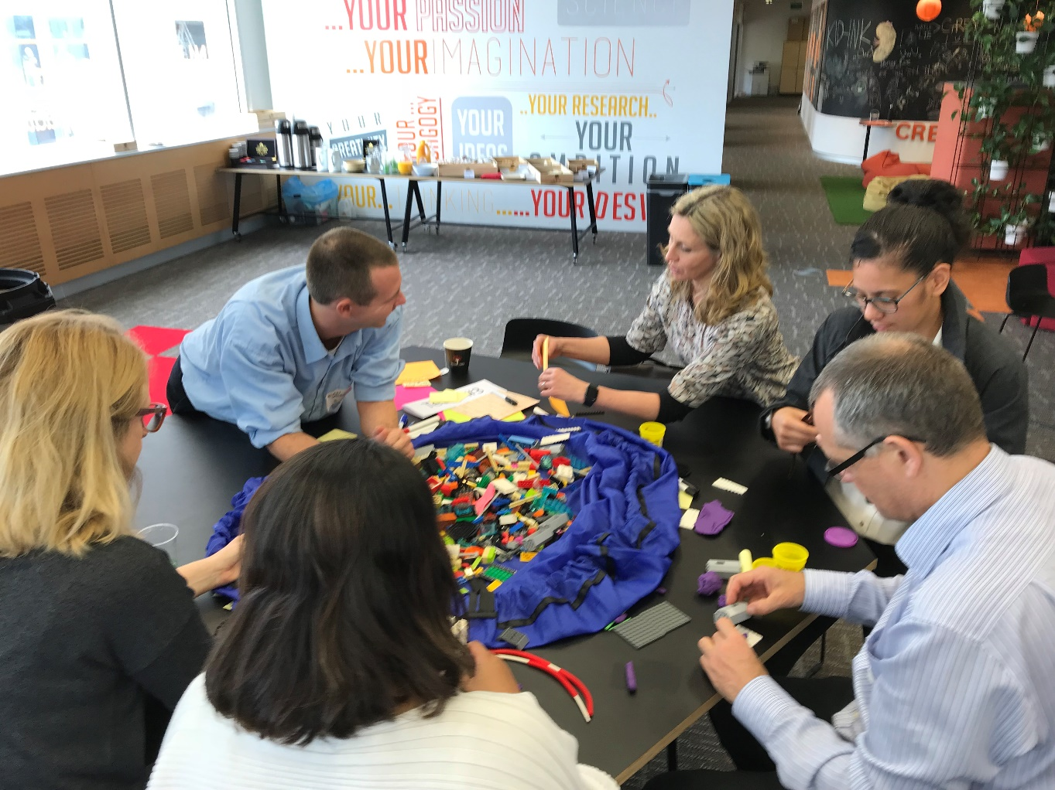
Initial discussions + LEGO serious play
© 2019 – Hynds Pipe Systems Ltd

Slide 11
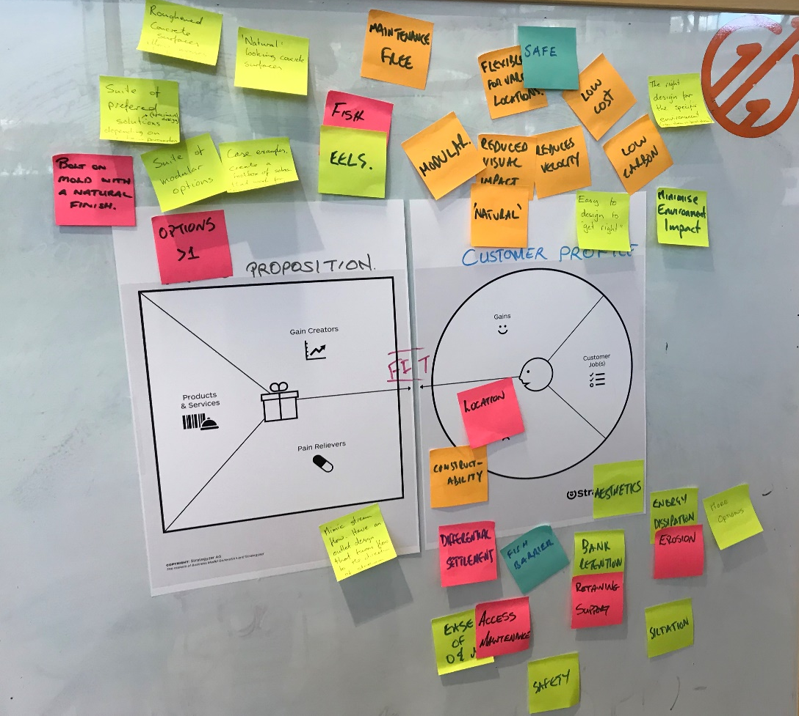
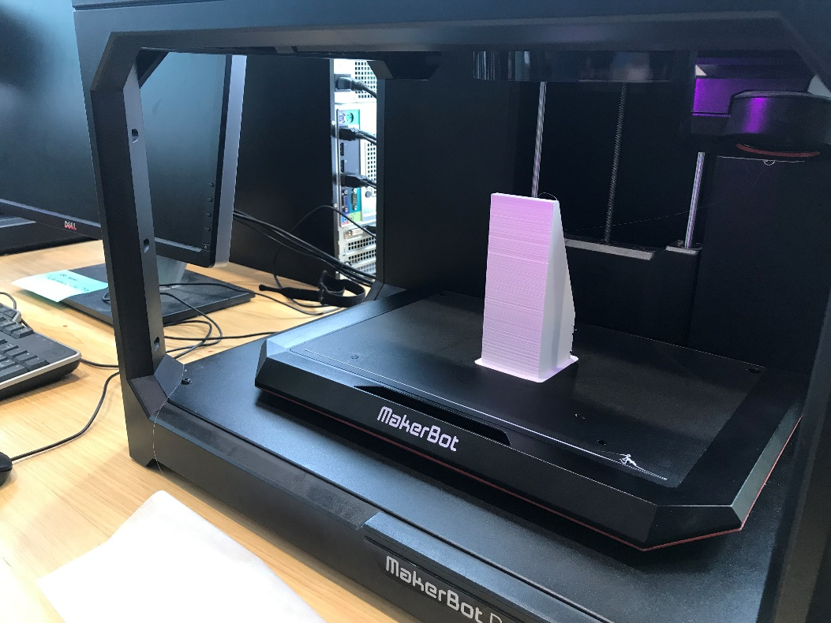
Some more iterations > Value proposition design + 3D printing
© 2019 – Hynds Pipe Systems Ltd

Slide 12
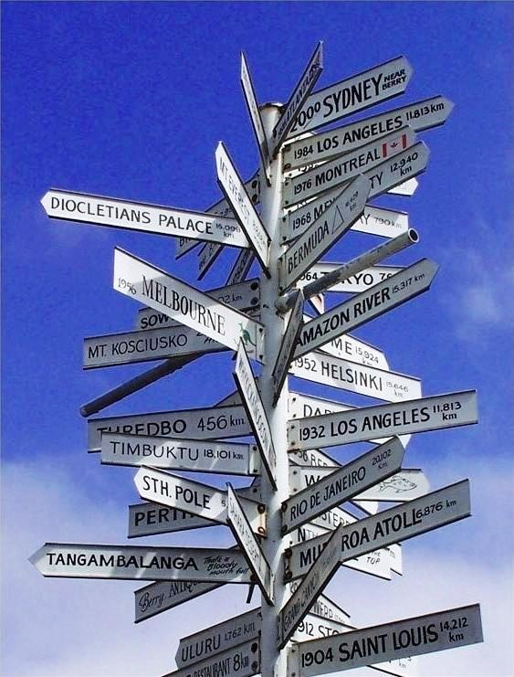
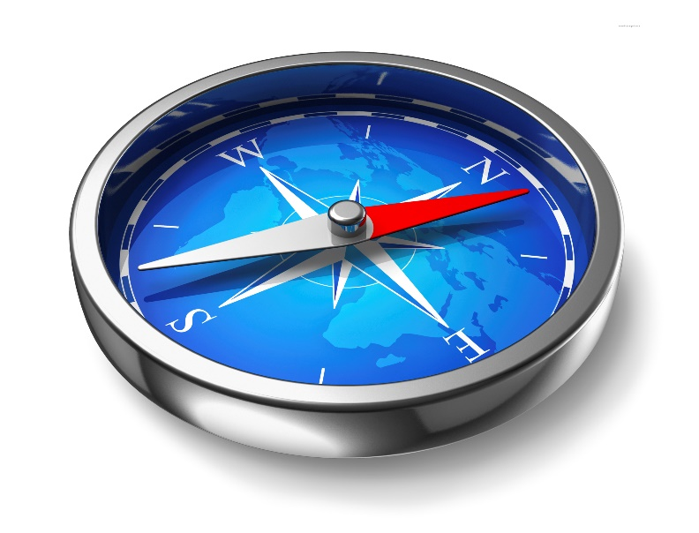
Learnings, where to from here?
Increase participation of relevant stakeholders
Select pilot sites for the selected alternative
Make a quick prototype to test assumptions on real setting
© 2019 – Hynds Pipe Systems Ltd

Slide 13
Would you like to join us?
© 2019 – Hynds Pipe Systems Ltd

Slide 14
Q&As
Joe.brenan@hynds.co.nz
Patrick.Barciela@hynds.co.nz
© 2019 – Hynds Pipe Systems Ltd

