Slide 1
PFAS —
A Case Study of Innovative
and Effective Treatment
Technology
Water New Zealand Conference and Expo 2022
Afrooz Bayat

Slide 2
PFAS
Per- and poly-fluoroalkyl substances (PFAS)
Manufactured substances/ synthetic substances
More than 9000 PFAS chemicals have been detected and manufactured
Fully fluorinated carbon-chain “tail”
Functional group “head”

Slide 3
PFAS Structure
Strong C-F bond
Hydrophobic “tail” of different length: increasing sorption with increasing length
Branched versus linear isomers: branched compounds sorb less and migrate further
Hydrophilic “head” can have different ionic charges: variable solubility, volatility, sorption characteristics
Fully fluorinated carbon-chain “tail”
Functional group “head”
Notes:
C-F bond energy 485 kj/mol
It the strongest bond amongst carbon and other atoms
Hydrogen bond 4 to 50 kj/mol

Slide 4
Sources of PFAS
Stain Resistant
Cleaning Products
Personal Care Products
Pesticides
Sources
of PFAS
Paints, Sealant, and Varnishers
Fire Extinguishing Foam
Food Packaging
Water Resistant Clothing

Slide 5
PFAS characteristics
PFOS
PFOA
PFOS
PFOA
Significantly mobile and soluble in water-impacting many stakeholders
Exceptional stability resists degradation. They are called “forever chemicals”
Affinity for media interfaces (particularly air-water)
Persistence and potential toxicity
at low concentrations
Bio-accumulative
and prevalent
in the environment, detected in plants, animals and humans
Notes:
Perfluorooctanoic acid
Perfluorooctane sulfonic acid

Slide 6
PFAS in the Environment
Water
Waste sludge/ landfill
Soil
Concrete and Infrastructure
Fire Training Grounds (AFFF)

Slide 7
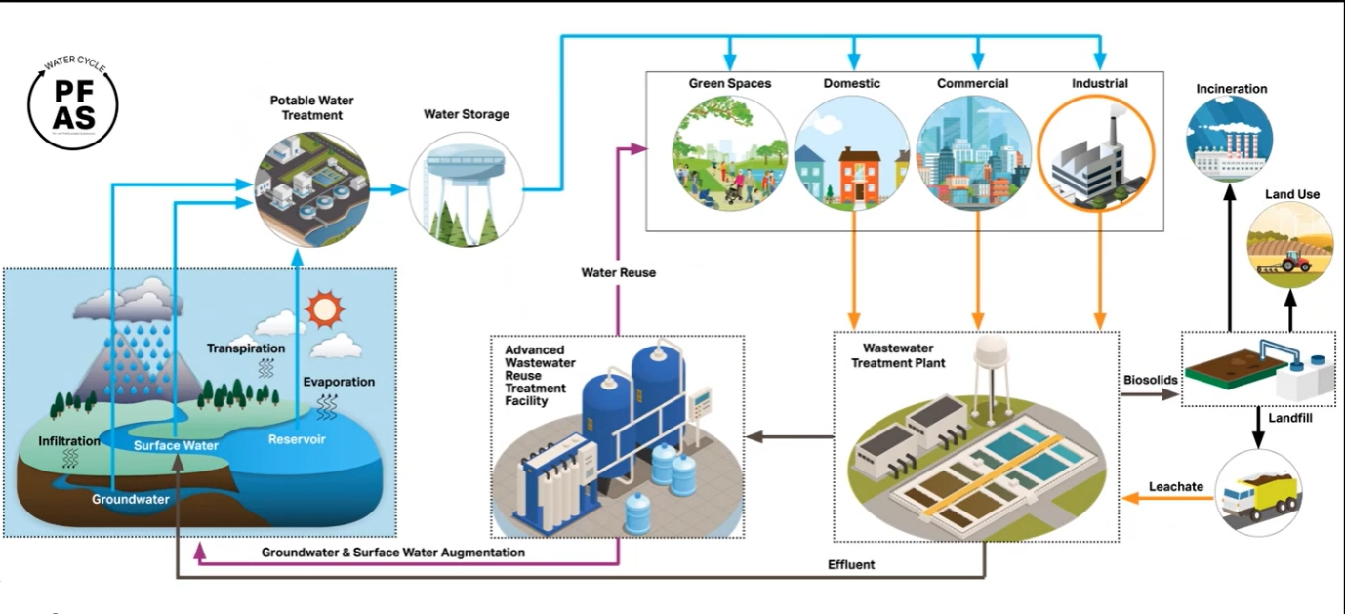

Slide 8
PFAS in New Zealand
Ohakea Base
RNZAF Base Woodbourne
Wastewater Treatment Plant in North Island, NZ
PFAS was reported in some bores and surface water
PFOS
+
PFHxS
PFAS plume of 1100 – 1600 ha
PFOS
+
PFHxS
Total PFAS concentration of 0.1 -13 ng/L in all wastewater samples
Long- , short- and ultrashort-chain PFAS detected
in WWTPs
The plume currently
Contains
50 – 70 kg
of PFAS
The majority
of PFAS
remains
on the Base
69 out of 159 groundwater
samples were contaminated
15 out of 30 surface water
samples were contaminated
Ultrashort-chain PFPrA detected
in treated
tap water
PFOS detected
in biosolids
no significant public
health risk was reported
no significant
public health risk

Slide 9
Maximum acceptable values for PFOA and PFOS for Drinking Water and Recreation
Notes:
Ministry of Health (MoH, 2017), Interim guidance level for drinking water PFOA, PFOS, PFHxS
Australian Government Department of Health (AGDoH, 2017). Health based guidance values for PFAS for use in site investigations in Australia
Site specific screening values from livestock update modelling and screening criteria development for PFAS, EnRisks. Screening values calculated using a scenario of 10% of the tolerable daily intake

Slide 10
Maximum acceptable values for PFOA and PFOS for stock watering
Notes:
Ministry of Health (MoH, 2017), Interim guidance level for drinking water PFOA, PFOS, PFHxS
Australian Government Department of Health (AGDoH, 2017). Health based guidance values for PFAS for use in site investigations in Australia
Site specific screening values from livestock update modelling and screening criteria development for PFAS, EnRisks. Screening values calculated using a scenario of 10% of the tolerable daily intake

Slide 11
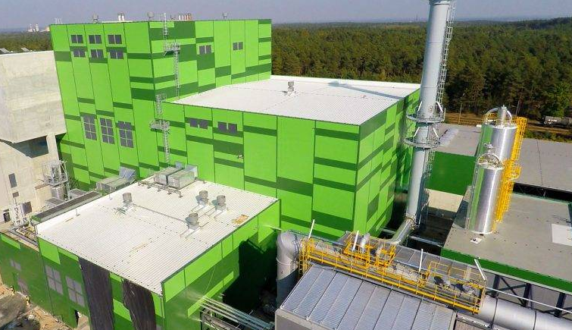
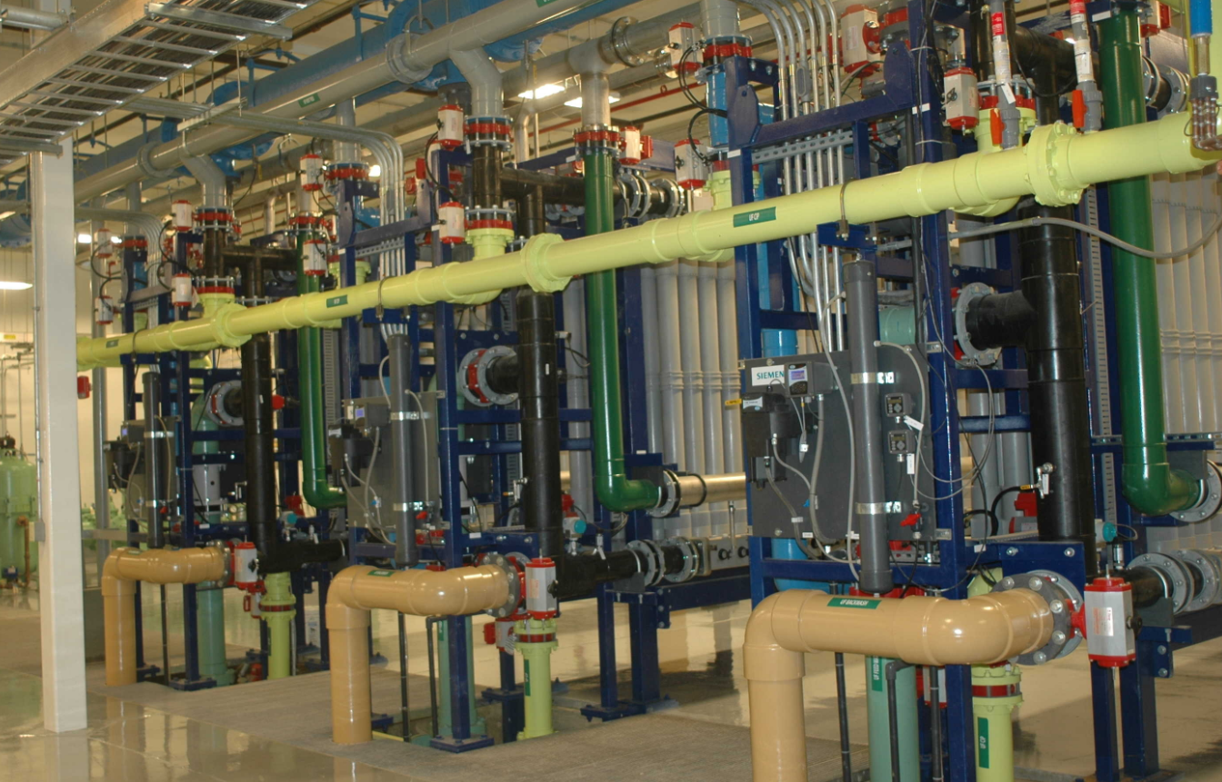
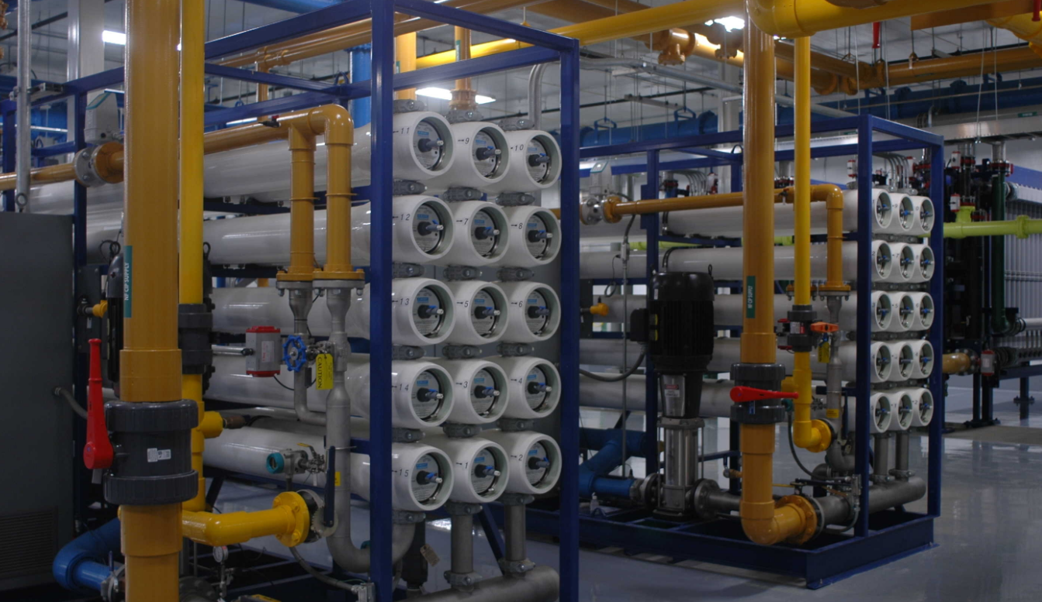
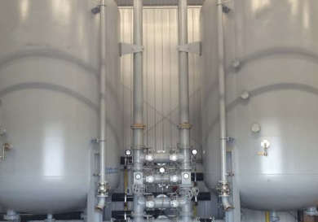
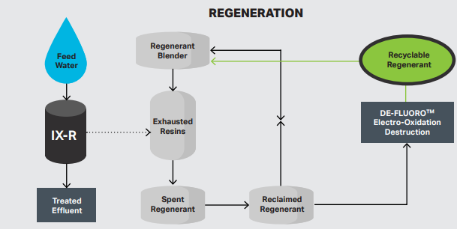
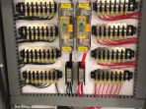
PFAS Treatment Technologies
Incineration
Nanofiltration (NF)
Reverse Osmosis (RO)
Granular Activated Carbon (GAC)
Ion Exchange Resin (IXR)
Electro-oxidation (EC)

Slide 12
DE-FLUOROTM
Degradation and Electrochemical Oxidation
of per- and polyfluoroalkyl substances
Notes:
DE-FLUOROTM is a bit a of an acronym, it stands for degradation and electrochemical oxidation of per and poly fluoroalkyl substances

Slide 13
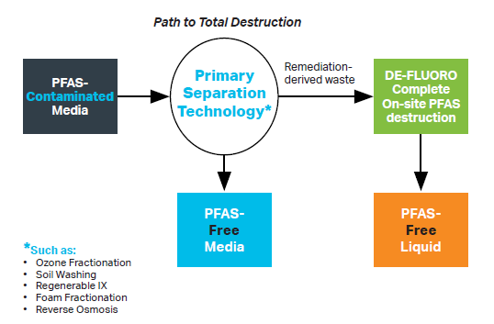
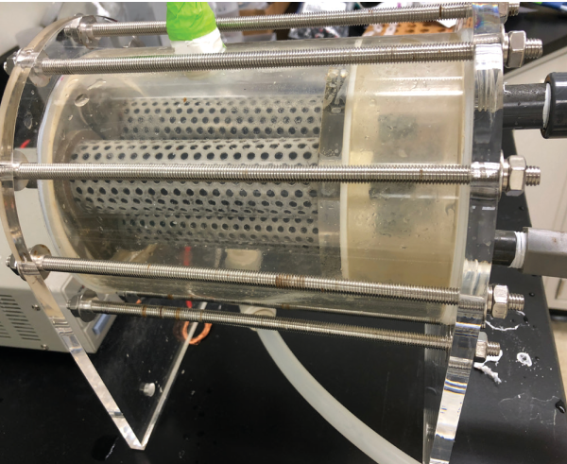
DE-FLUOROTM ^{PFAS Destruction Technology}
Reject
Coupling Approach
Separate
Concentrate
Destruct
Notes:
Coupling technology - separation
DE-FLUORO™: Degradation via Electrochemical oxidation / reduction of per- and polyfluoroalkyl substances
DE-FLUORO™ utilizes a proprietary, high durability and low-cost electrode that can be in different sizes, forms and shapes for different applications
Sending electrical current between anode and cathode that will create oxidizing conditions within the vessel
Field pilots with RIX and RO ongoing
AUS – coupling with SAFF – actively working on studies now, but also testing coupling with many scenarios mentioned to identify best application

Slide 14
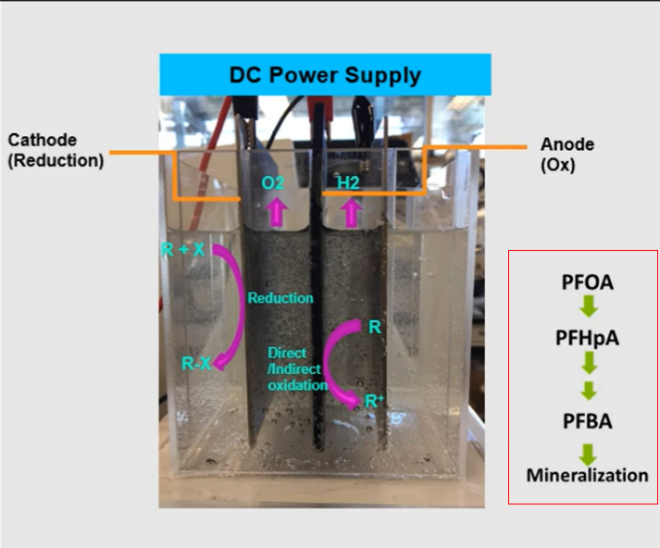
DE-FLUOROTM ^{PFAS Destruction Technology}
Lower volumes, larger concentrations
Proprietary high durability, low-cost electrode
Different sizes, forms and shapes
Current between electrodes creates oxidising conditions
Destroys PFAS on-site
Avoids off-site disposal
Notes:
Coupling technology - separation
DE-FLUORO™: Degradation via Electrochemical oxidation / reduction of per- and polyfluoroalkyl substances
DE-FLUORO™ utilizes a proprietary, high durability and low-cost electrode that can be in different sizes, forms and shapes for different applications
Sending electrical current between anode and cathode that will create oxidizing conditions within the vessel
Field pilots with RIX and RO ongoing
AUS – coupling with SAFF – actively working on studies now, but also testing coupling with many scenarios mentioned to identify best application
PFAS destruction happens in a system such as the one in the photo, the system comprises of electrodes, the one in the middle is the anode and ones on the sides are the cathodes, the anode is the proprietary electrodes. PFAS removal occurs via two different mechanisms, one on the surface of the anode via direct oxidation of PFAS and second which occurs in the aqueous phase via indirect mechanisms that is generation of oxidising species that are hydroxyl radicals.
PFOA degrades to shorter chain carboxylic acids and then they are mineralised to carbon dioxide and fluoride and sulphate if sulphonate was present in the substance

Slide 15
DE-FLUOROTM Potentials
Permanent Solution
Flexible
with the Initial Concentration of PFAS
Permanent
or Temporary Installation
DE-FLUOROTM Potentials
Can be Retrofitted
Energy Efficient
Name
Role
Air
Emission Control
Safety of Use
Notes:
Permanent solution
Unlike other separation techniques this technology is a permanent solution that offers complete destruction.
Permanent or temporary installation
It can be used and installed permanently where there is an ongoing PFAS problem on-site, it can also be used as a mobile solution to be installed temporarily until the PFAS contamination removal is complete and then removed from the site for use on another site.
Flexible with the initial concentration of PFAS
It is very flexible in terms of the strength of the waste, which means that it has the capability of removing PFAS from concentrated waste streams as well as low-strength wastes such as drinking water.
Can be retrofitted
It is flexible in that it can be used on site where there are other separation technologies, where it can be installed downstream of the processes to successfully destroy the compounds to a safe level before discharge to the environment.
Safety of use
It is fully automated and equipped with alarm systems to ensure safe performance of the treatment system.
Air emission control
Treated water and air emissions are monitored continuously to ensure safe discharge of any off-gas and the effluent
Energy efficient
It can be powered by renewable energy sources such as solar systems to minimize energy needs for operation of the system

Slide 16
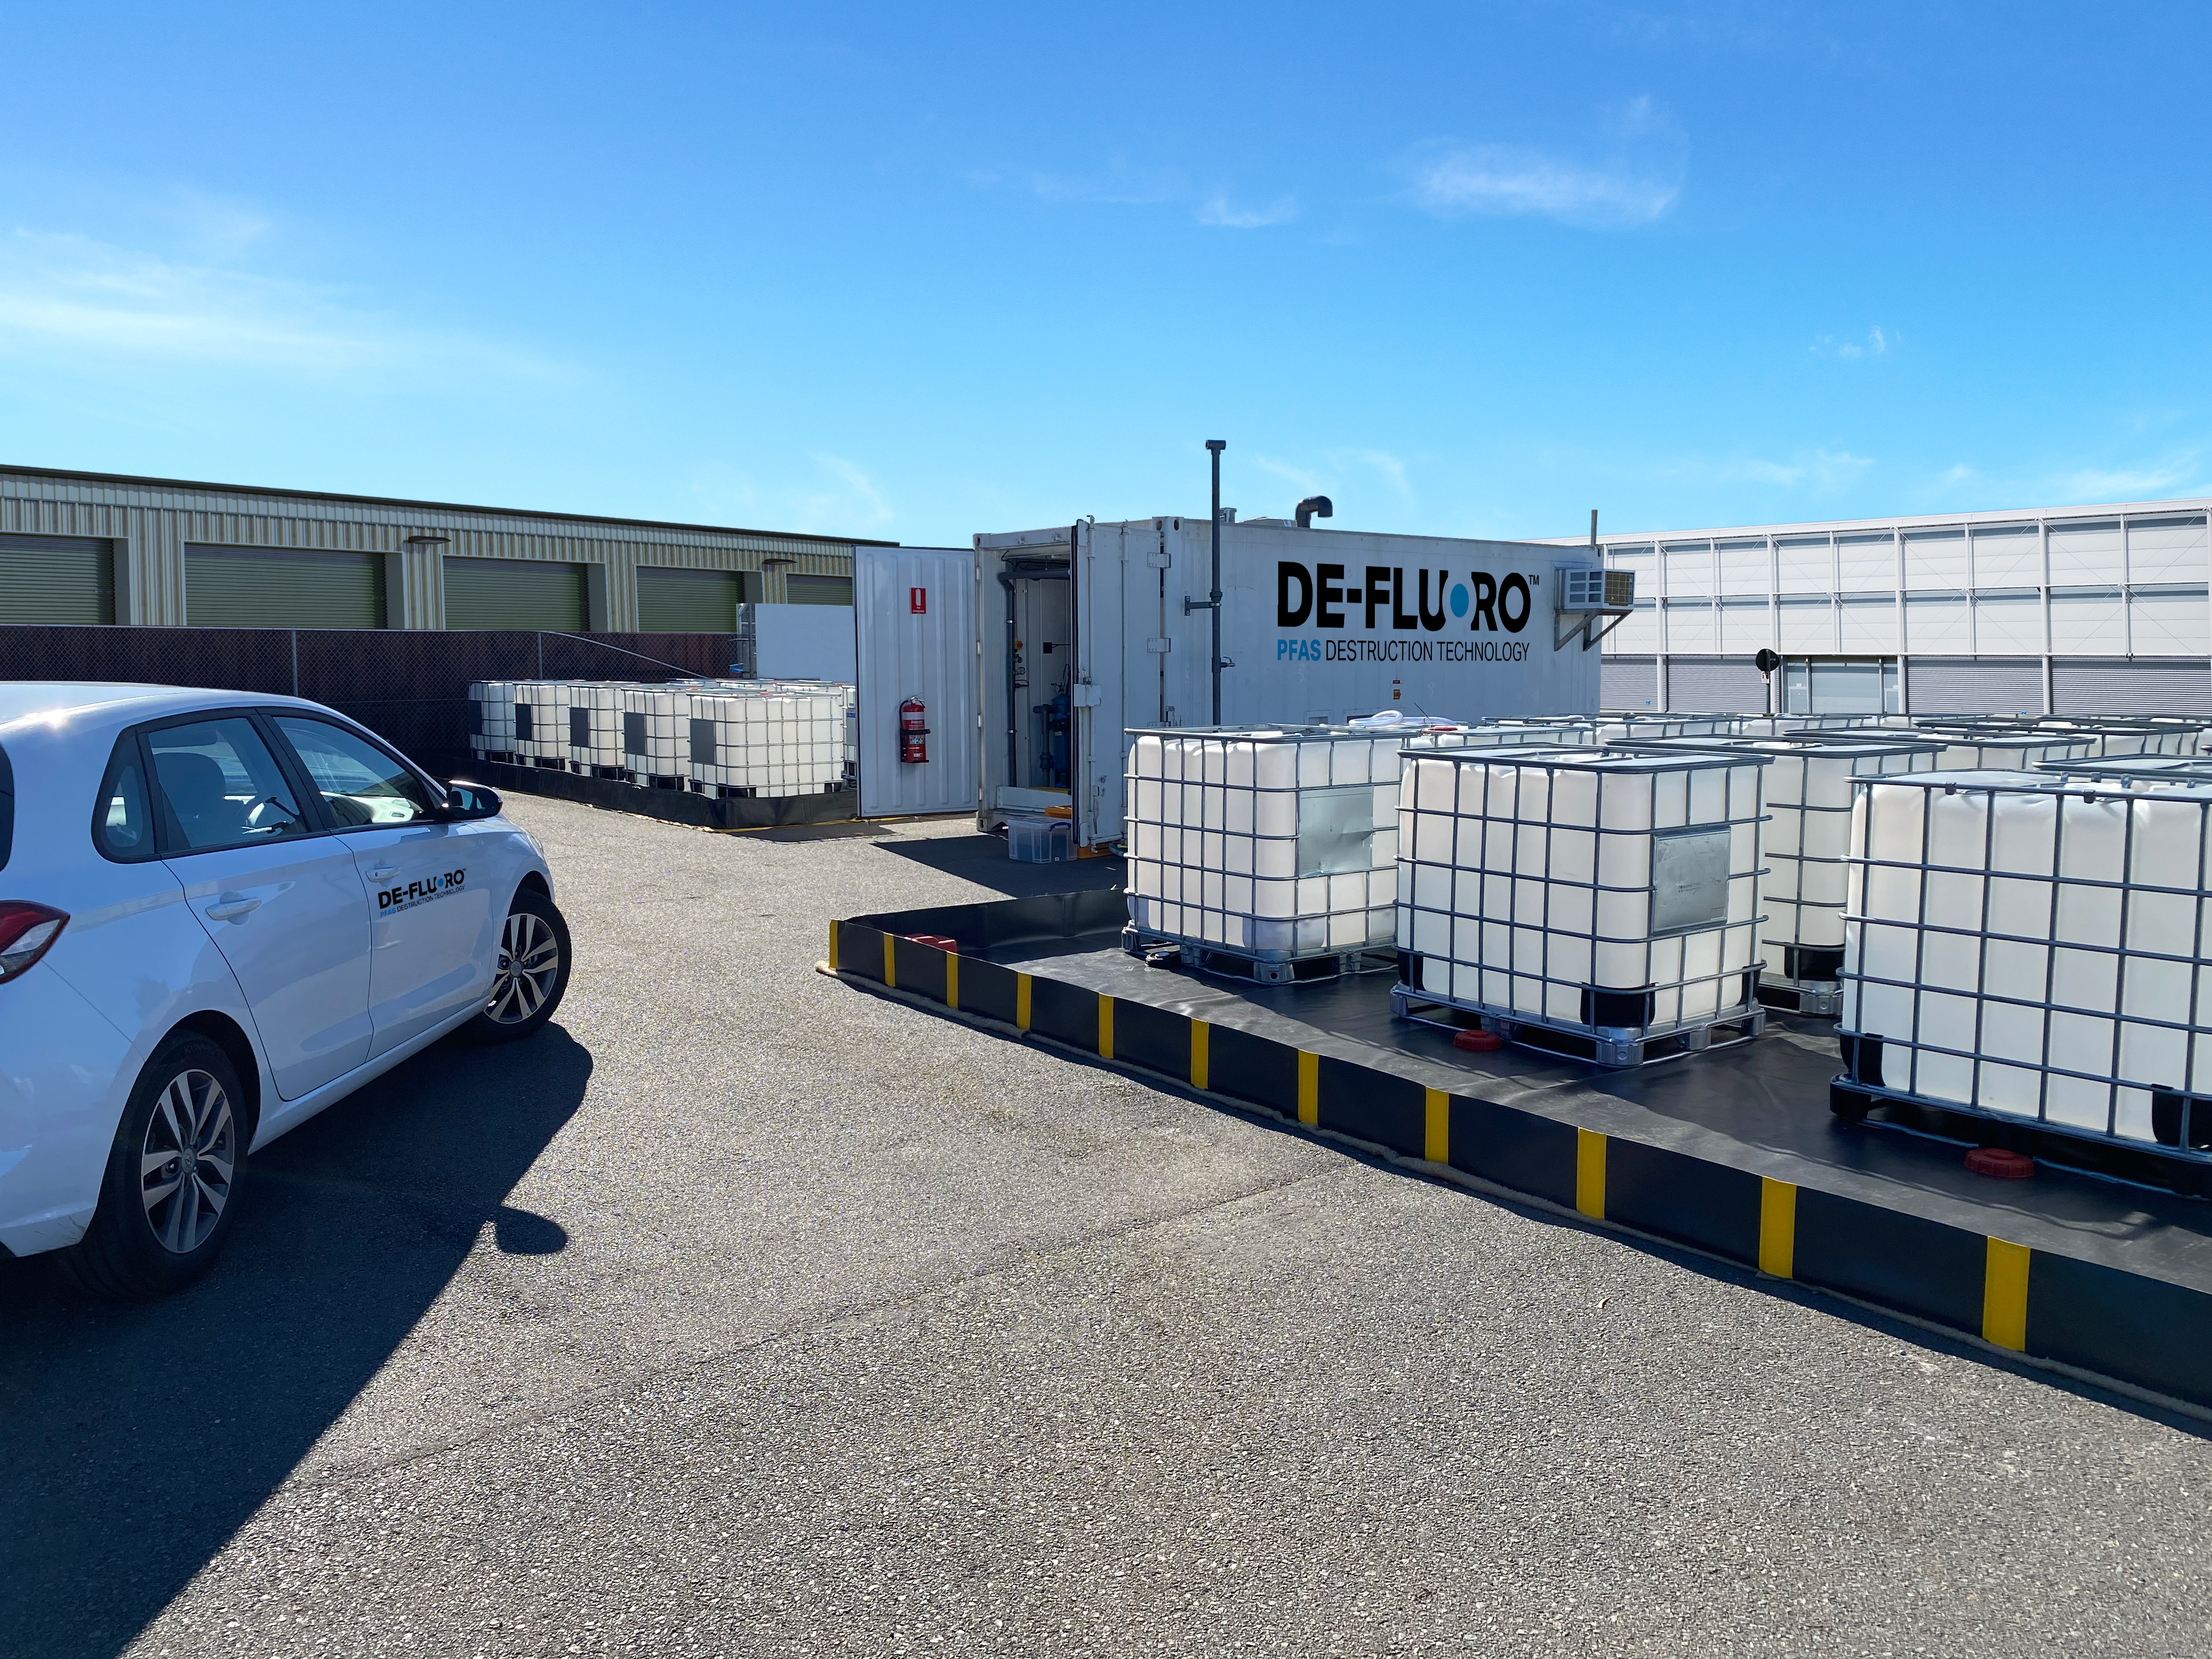
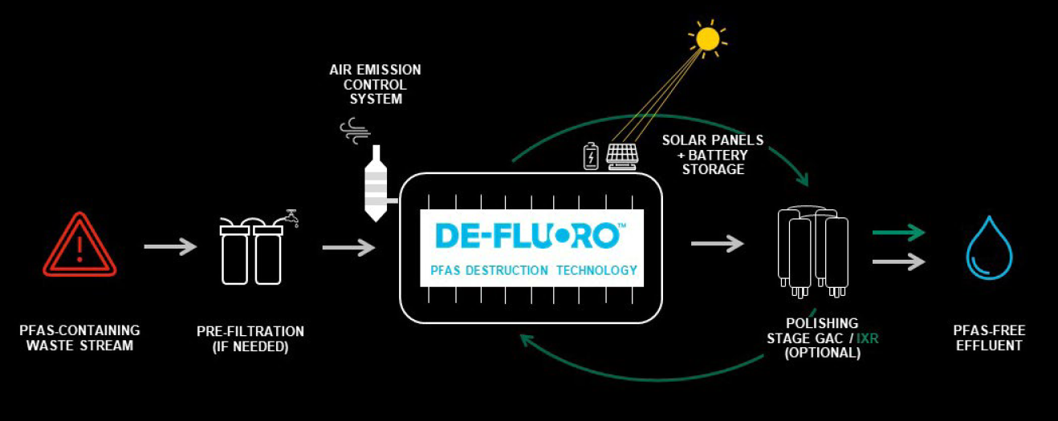
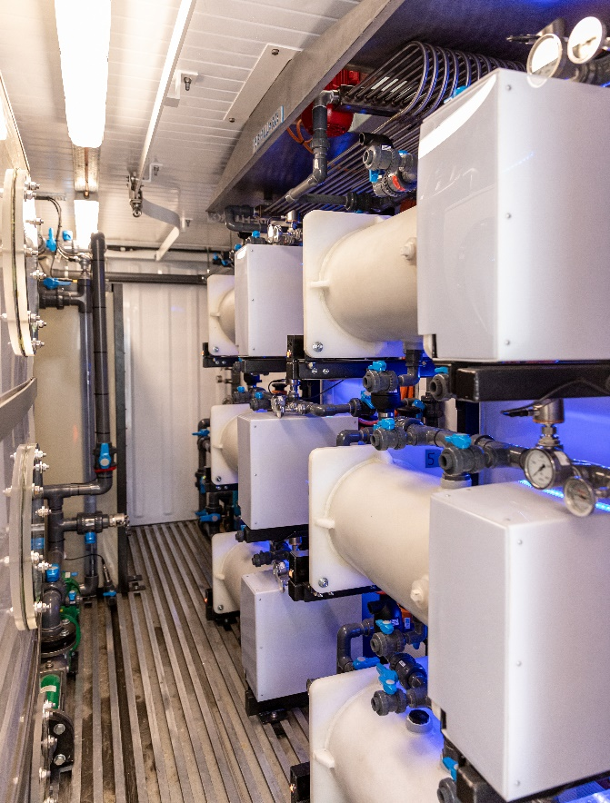
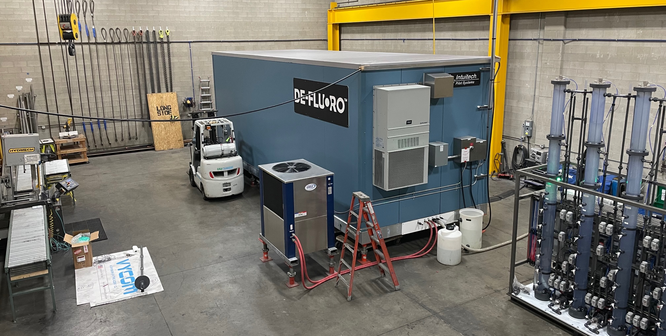
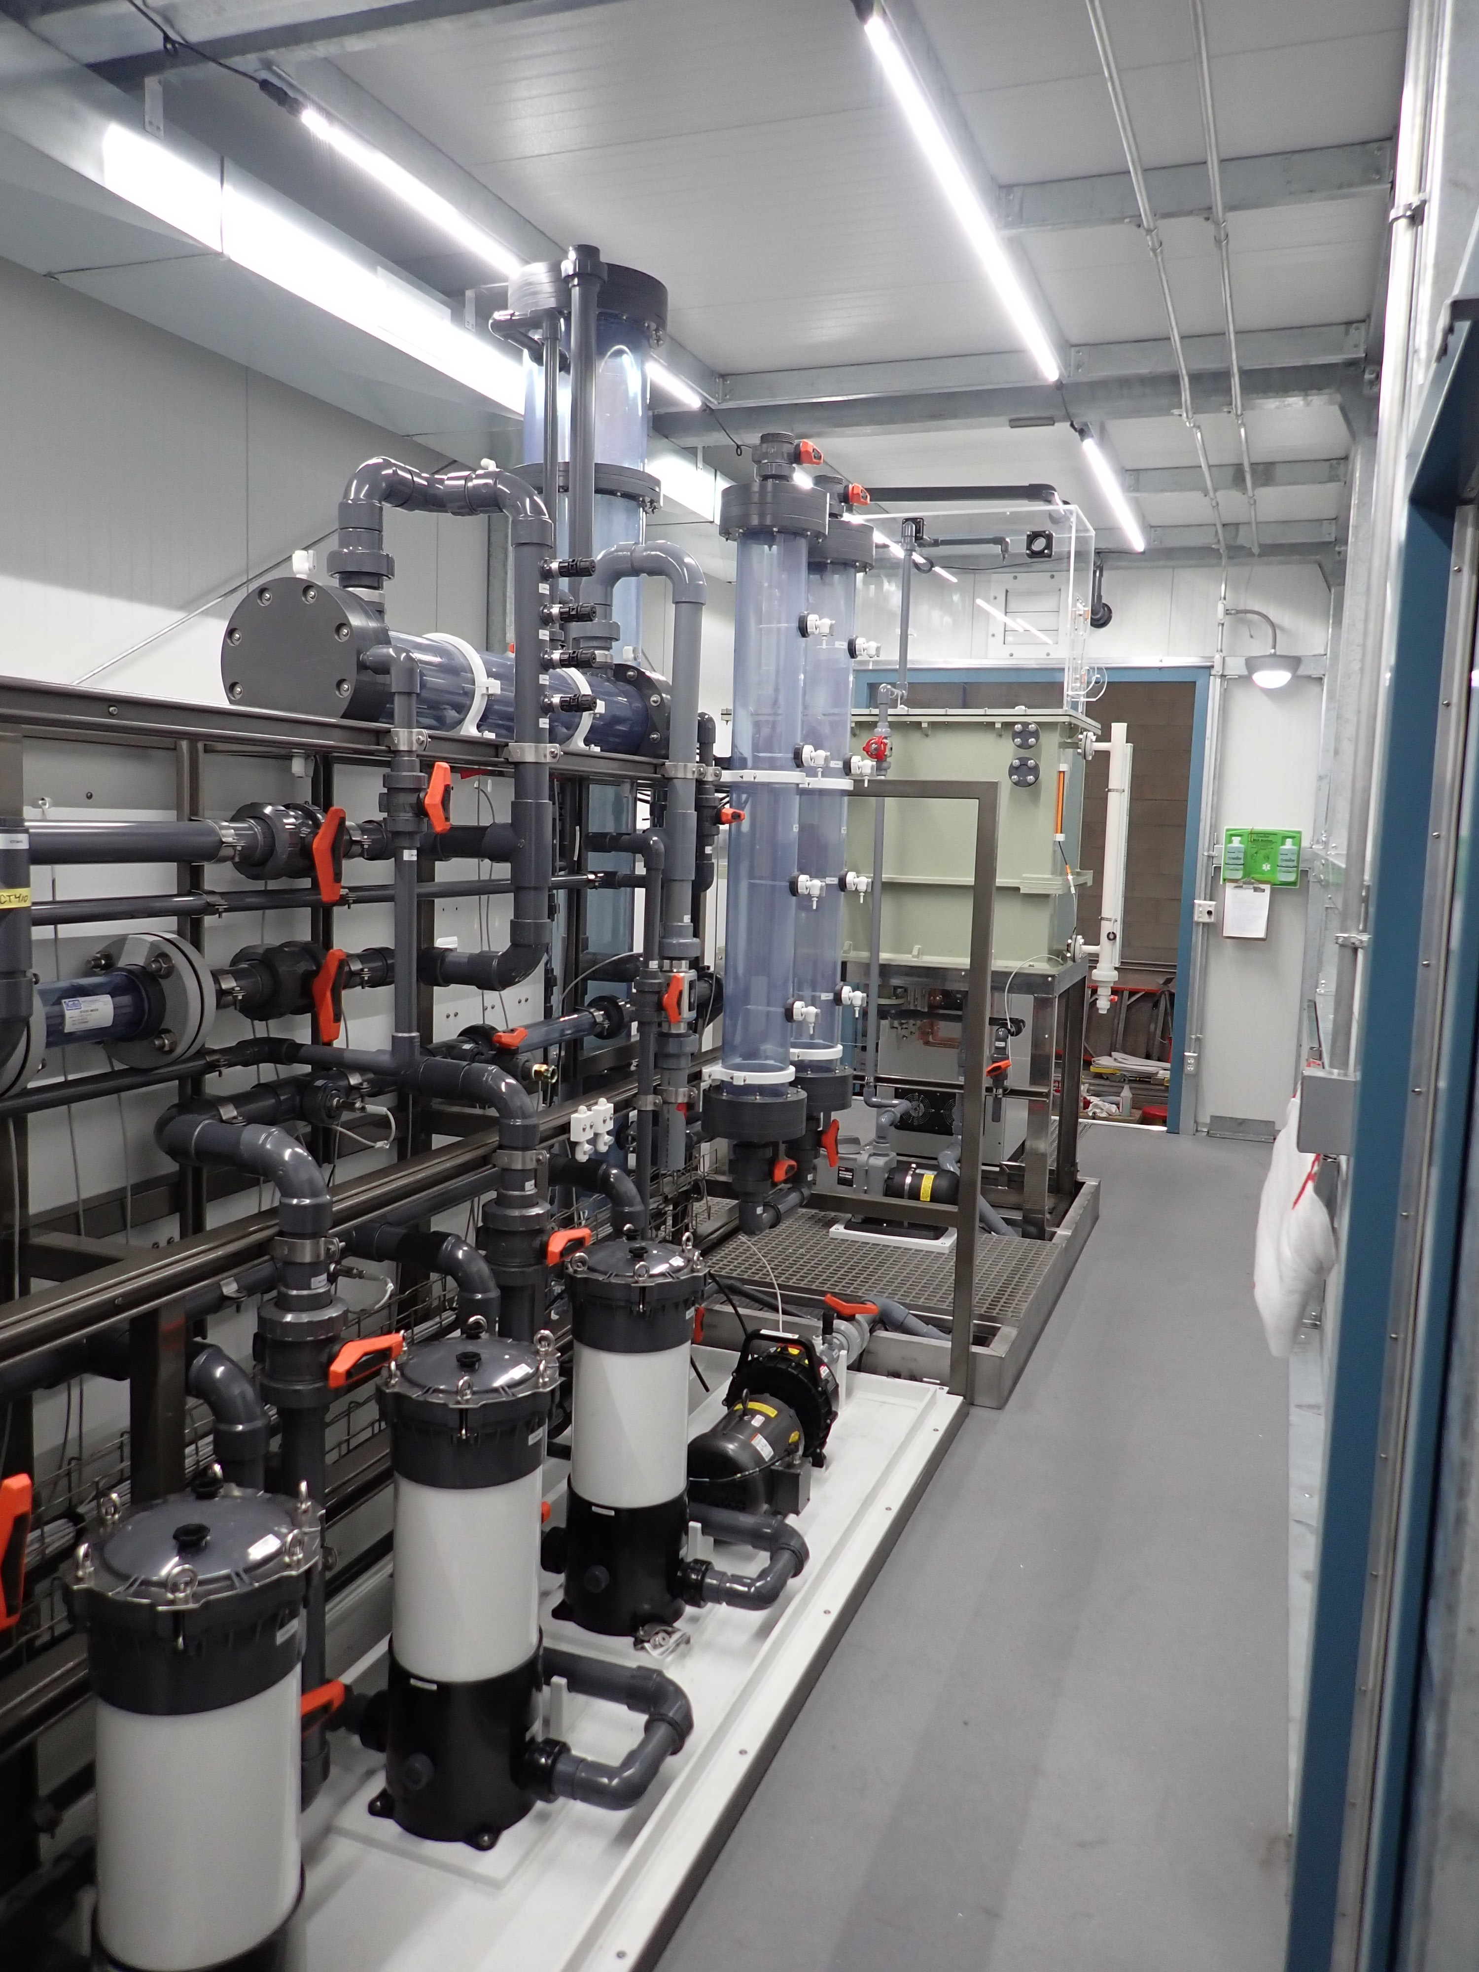
DE-FLUORO on-site
Australian Based Field Pilot - 2021
U.S. Based Field Pilot - 2022

Slide 17
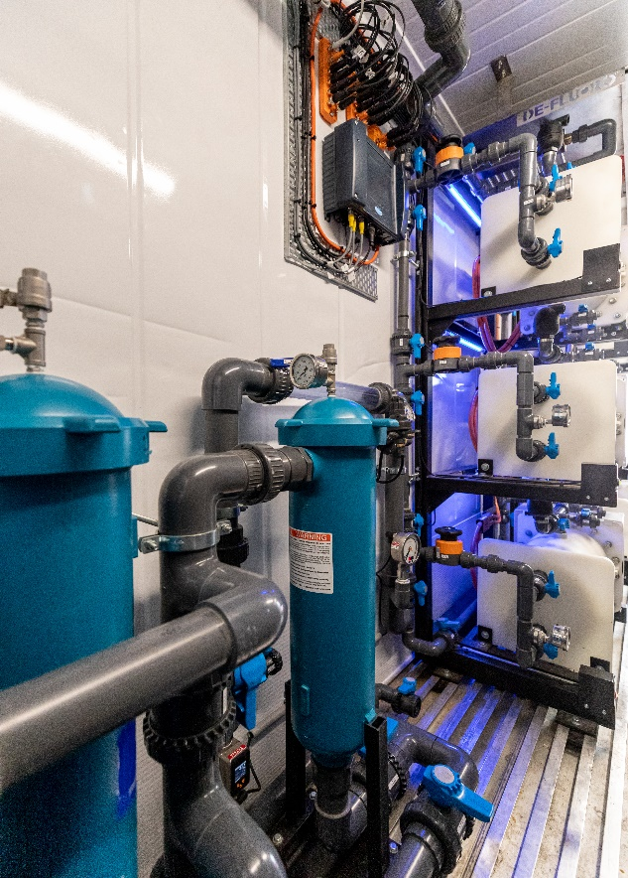
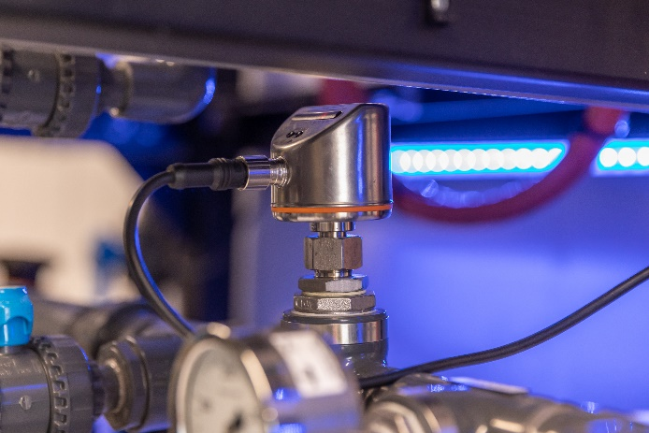
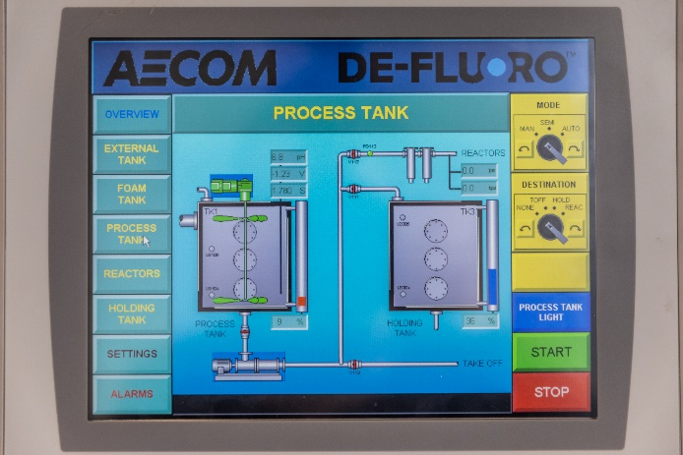
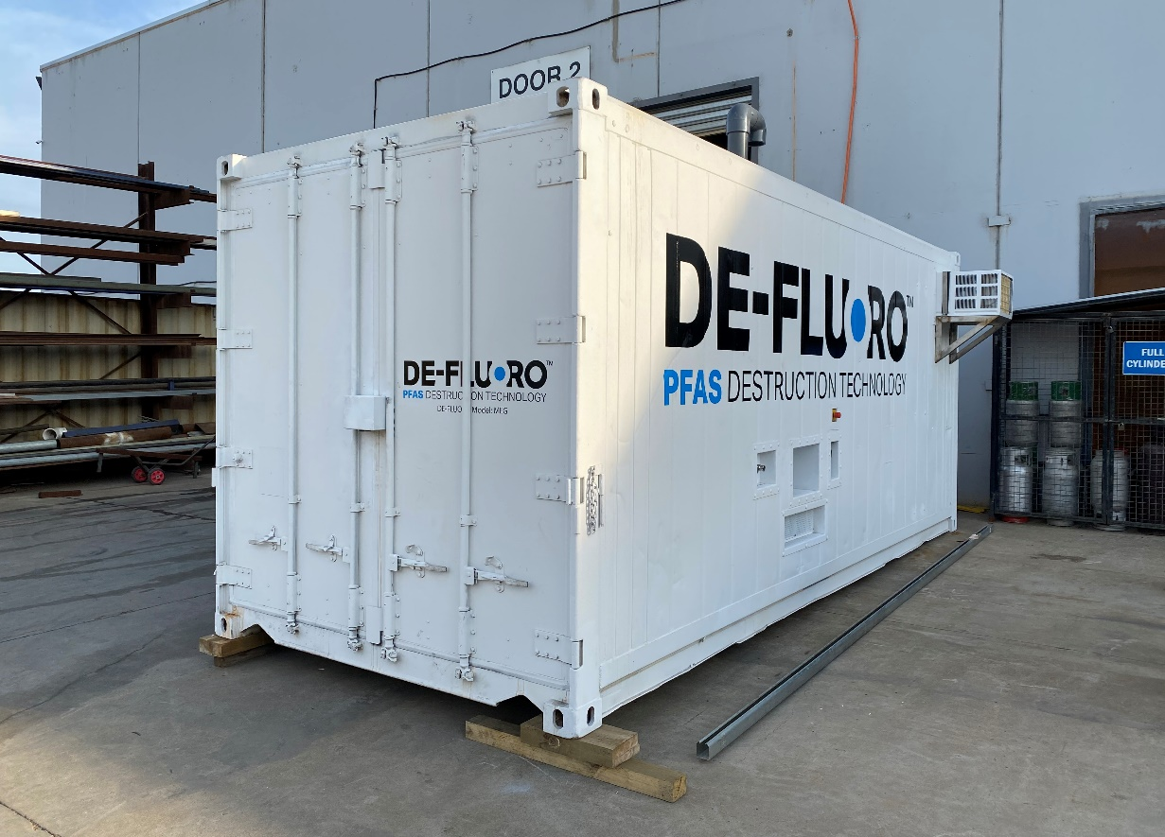
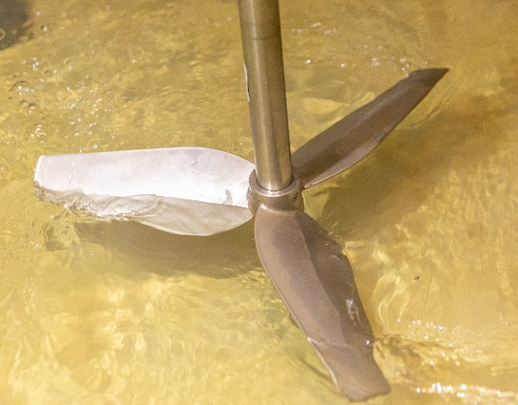
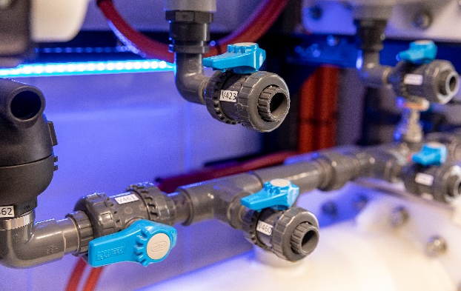
DE-FLUORO on-site

Slide 18
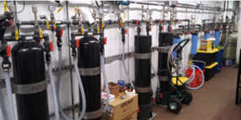
DE-FLUOROTM Field Pilot Test
Sites:
Hanger and Fire Training Area (FTA)
Elevated PFAS concentration at both sites
IX-R groundwater treatment flow rate:
2 - 5 gpm
Designed to treat 7000 – 15000 ppt total PFAS
Treatment goals:
Hanger: PFOS + PFOA < 70ppt
FTA: PFOS ND
Results:
98% PFOS destruction
99% PFOA destruction
Notes:
We have demonstrated the effectiveness of DE-FLUORO technology for groundwater treatment at an air force base.
Regenerable ion exchange was used to remove PFAS from the groundwater.
The resin was then regenerated and the regenerant waste containing concentrated PFAS was treated by the DE-FLUORO process.
The effluent from the ion exchange treatment system was non-detect for PFOS and PFOA.
The DE-FLUORO process achieved 98% destruction of PFOS and 99% destruction of PFOA.
2 - 5 gpm = 8 - 19 L/min

Slide 19
Demonstration Status
“Megalodon” Batch System Demonstration
Site:
Department of Defence (Australia)
Location:
Air Force Base, New South Wales
Duration:
June – September 2021
Waste Streams:
AFFF concentrate
First flush solution
Results:
Demonstrated high efficiency in destroying PFAS in first flush; effluent met client objective for discharge
Notes:
We performed a batch system demonstration for the Australian Department of Defence at an Air Force Base in New South Wales last summer.
We treated two different waste streams:
AFFF concentrate
First-flush solution generated from cleaning the AFFF system
The results showed that we were able to achieve 90% overall mass reduction of PFAS in the first-flush waste stream.
We achieved between 94% and 99% removal of all regulated PFAS, meeting the discharge criteria for the site.
The AFFF concentrate proved a little more challenging, and steps have been taken in the design of our next pilot system to address those challenges.

Slide 20
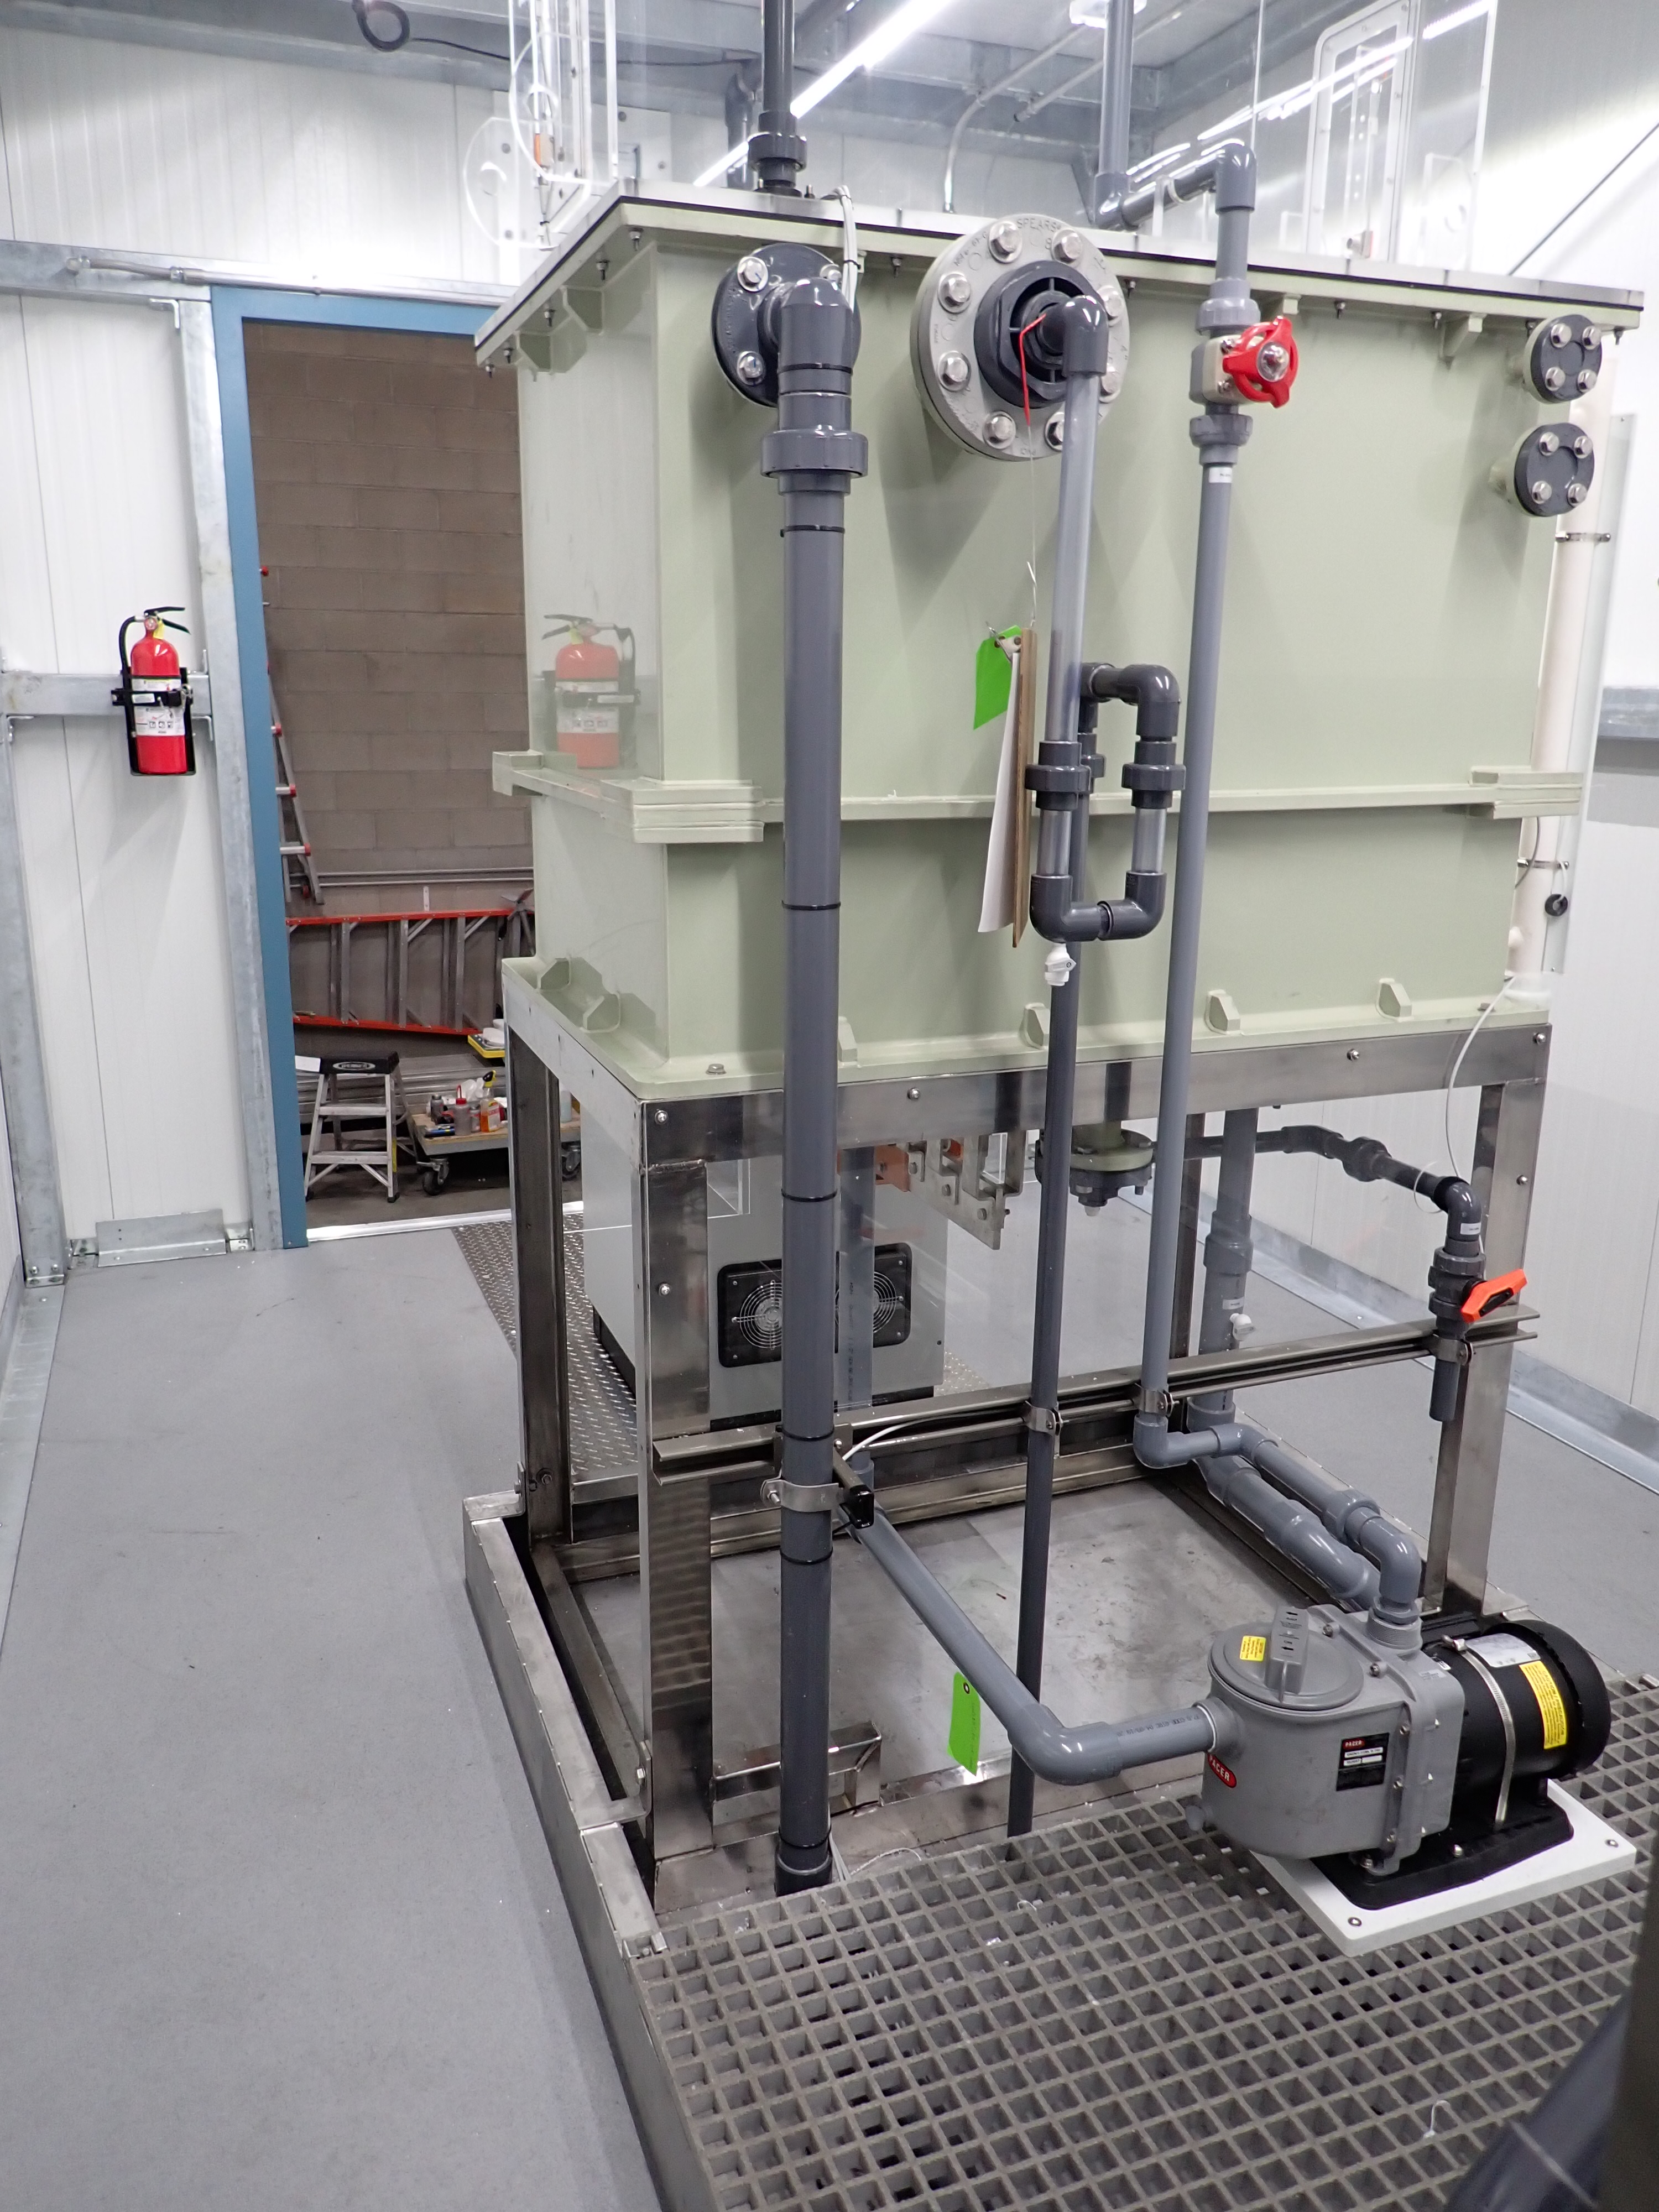
Demonstration Status
“Orca” Continuous Flow System Demonstration
Site:
U.S. Air Force Civil Engineer Centre (AFCEC)
Location:
Air Force Base
Duration:
March – May 2022
Waste Streams:
AFFF concentrate
Fire training wastewaters
Notes:
Our newest US DE-FLUORO pilot system builds upon what we learned from our previous US and Australian pilot systems.
It is a continuous-flow treatment system, and we have just started our first pilot demonstration at an Air Force Base in the southeastern US.
We are currently treating a wastewater generated from fire training operations with over 100 ppb of PFAS.
Other waste streams to be tested included evaporator concentrate and AFFF solution.
The system is running well so far, and we will be excited to share the data when the tests are complete.

Slide 21
Thank you.
Afrooz.bayat@aecom.com
Chris.curran@aecom.com
Rachael.casson@aecom.com

