Slide 1

The Future of Modelling
Personnel Views from Non Practitioners
By Philip Mcfarlane & Martin Osborne

Slide 2
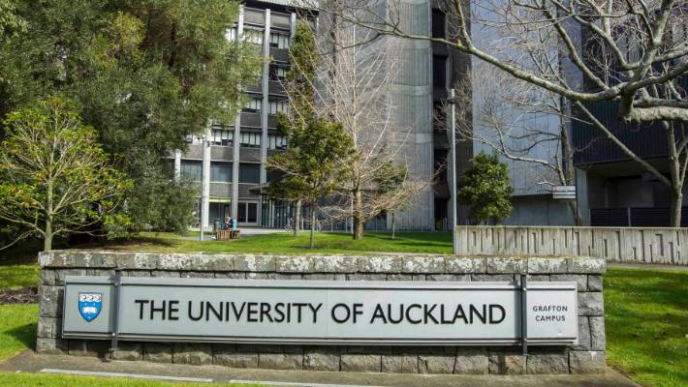
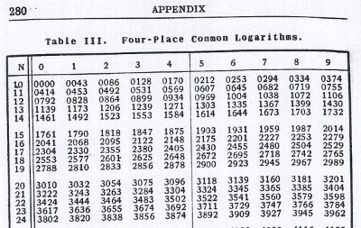
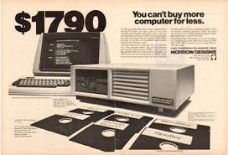
Looking Back to Look Forward - 1984

Slide 3
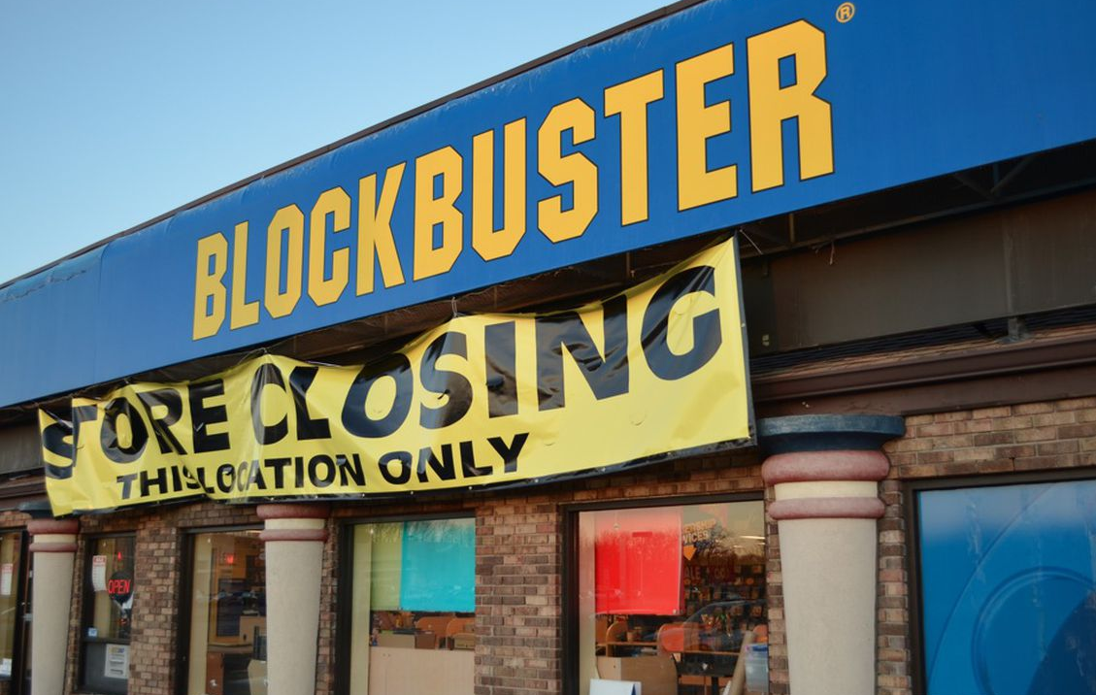
Notes:
1984 – 15,000, 1990 70,000, 2000 – 28,000, 2017 2,000

Slide 4
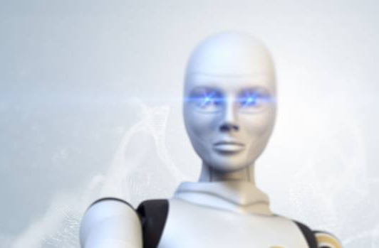
New Zealand's financial advice landscape set to be transformed

Slide 5
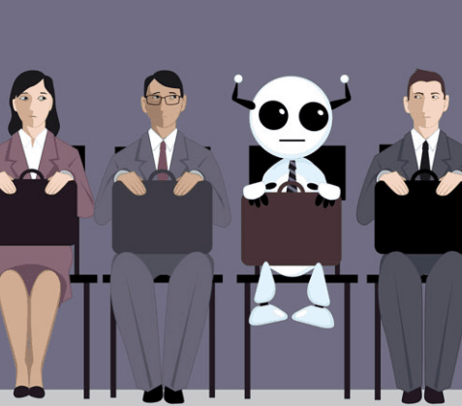
75 million jobs obsolete by the year 2022
How Secure is Modelling as a Profession?
Notes:
one-fifth of the global work force will be affected

Slide 6
More Modelling Needed to Address Infrastructure Challenges

Slide 7
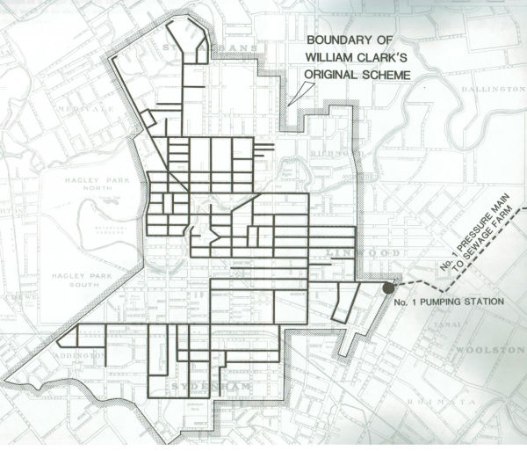
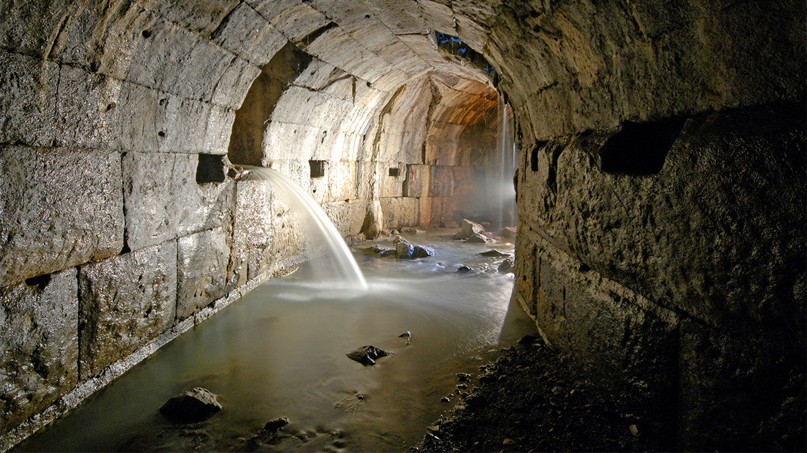
Aging Infrastructure – Changed Design Requirements
Romans constructed sewers in 800AD
Sewer System Constructed in Christchurch in 1882

Slide 8
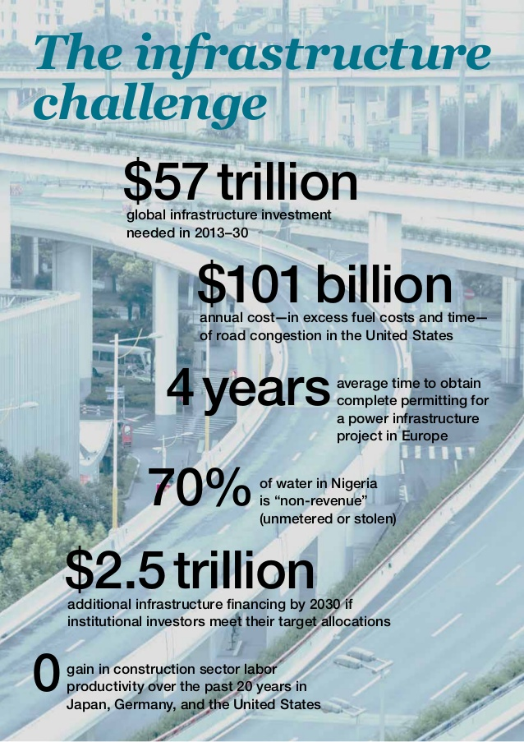
Greater Need for Hydraulic Modelling
Modelling helps us build the right infrastructure at the right time
McKinsey Global Institute

Slide 9
But the Way Models Are Used Will Change

Slide 10
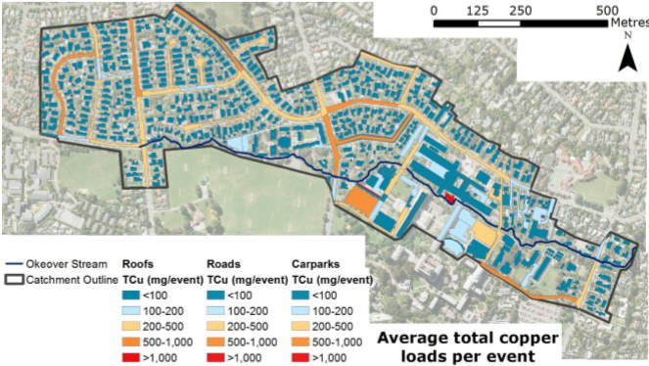
Greater Focus on Contaminate Modelling
MEDUSA

Slide 11
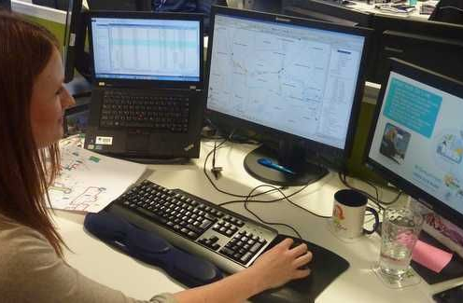
Modelling Will No Longer Solely be the Domain of Specialists

Slide 12

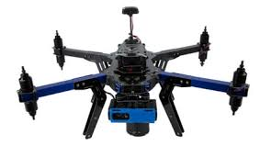
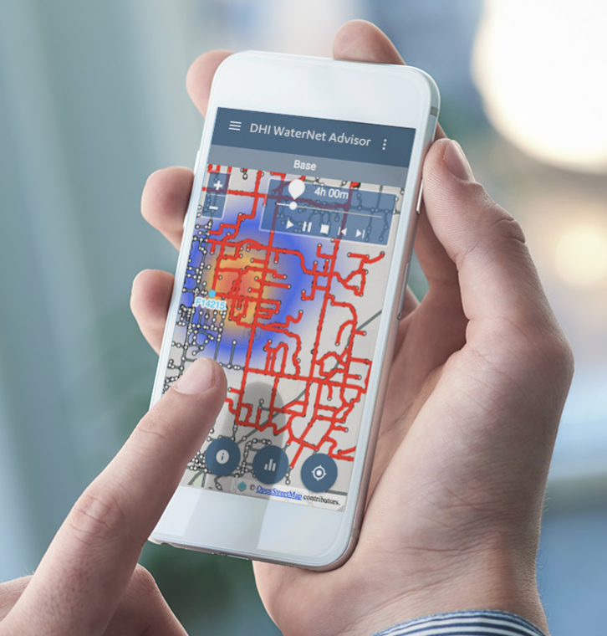
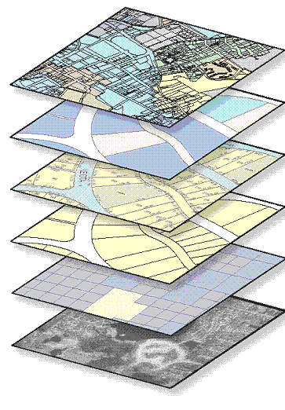
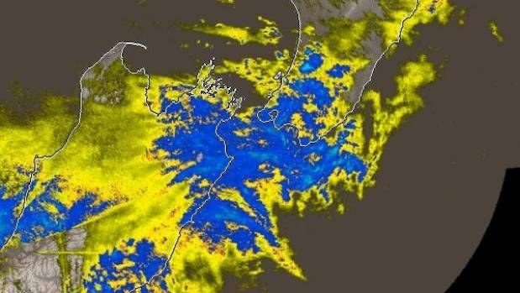
Operationalising Models
Real time dynamic linking of spatial information with publicly available portals, which are linked to the cloud’s hydraulic engines

Slide 13
Greater Engagement Through Visualisation

Slide 14
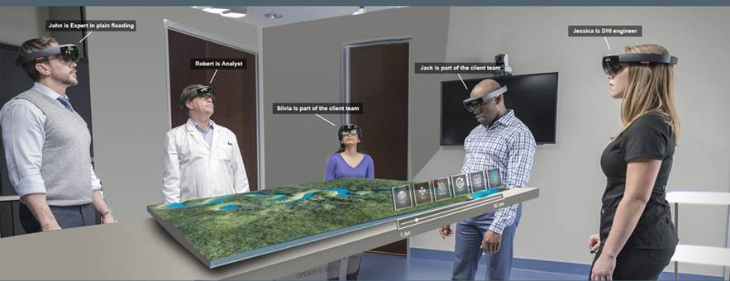
Augmented Reality For Improved Visualisation

Slide 15
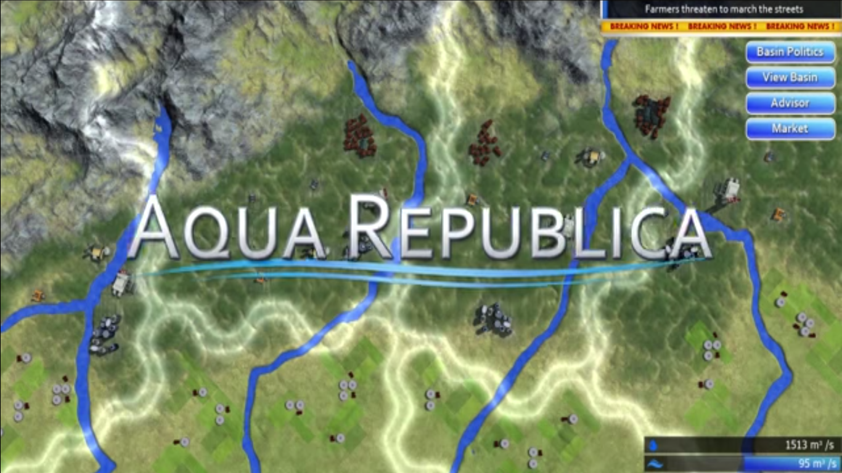
Next Level Engagement
Using models to simulate the impact of decisions in realtime

Slide 16
Modelling & Optimisation Software Turns the Design Process on its Head

Slide 17
Traditional Design Approach
Specify Required Level of Service
Longlist Options
Shortlist Options
Design
Shortcomings
What level of Service is affordable?
Only a few options considered.
Options might be overlooked
Addresses only one issue at a time

Slide 18
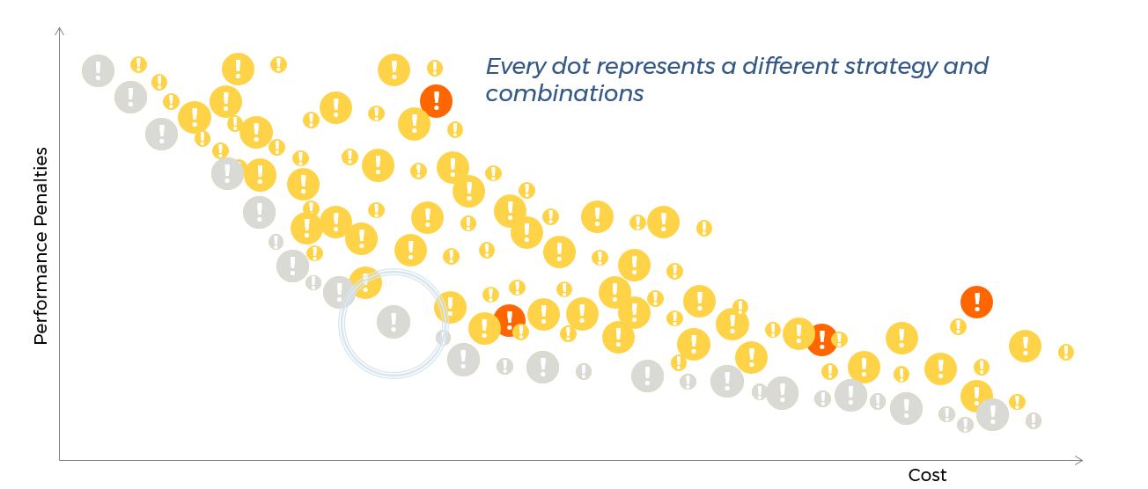
What if we considered millions of alternatives and selected the optimal strategy

Slide 19

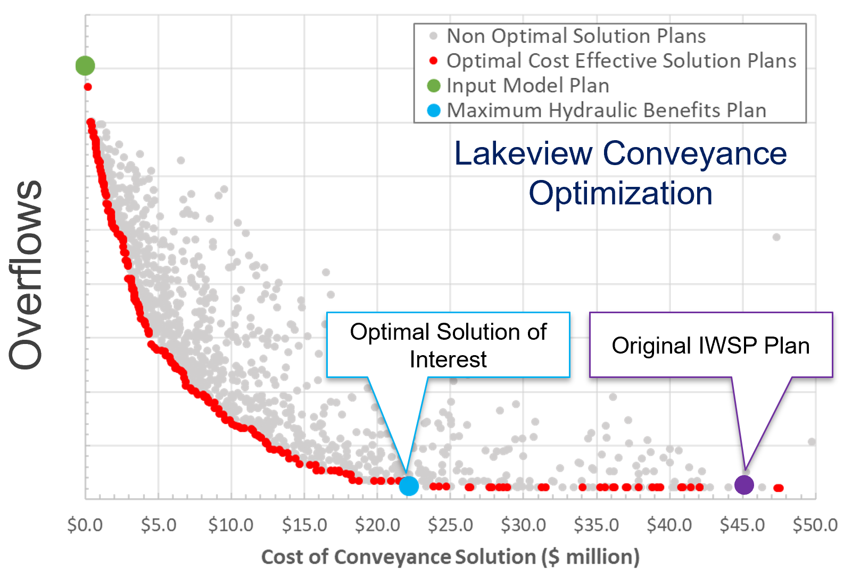
UPDATING SD1’s WATERSHED PLAN
Sanitary District No. 1 of Northern Kentucky
Optimizer filtered down hundreds of alternative locations and options to handful of best performing strategies
50% cost reduction from previously developed plan
Transparent and defensible approach

Slide 20
Modelling Underpins Smart Networks

Slide 21

Technology Unchanged for 2500 years

Slide 22
Active System Management
Integrating:
Monitoring
Management
Modelling
To provide smarter water systems that deliver improved performance at less cost
WaterNZ 2018

Slide 23
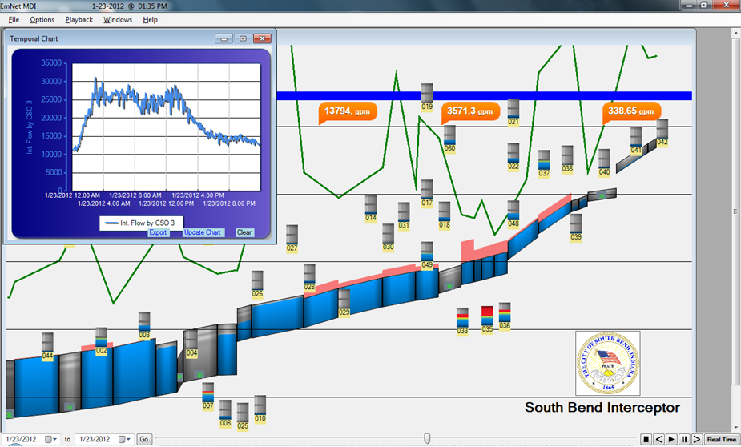
South Bend - Indiana (Area rules, Global Data Analysis)
Overflow volume reduced by 70 percent, for less than one tenth of the original budget
WaterNZ 2018
Notes:
South Bend’s sewerage system drains to a main interceptor tunnel running along the bank of the St Joseph river with CSOs discharging to the river. CSO discharges were impacting on the river water quality.
EmNet was formed in 2004 in partnership with the City of South Bend, Ind., and the University of Notre Dame for the specific purpose of solving South Bend’s combined sewer overflow problem using advanced control systems theory and civil engineering.
The South Bend ASM consists of electrically actuated valves that balance flows from nine drainage areas to a large interceptor sewer. The valves are automatically controlled by a distributed control scheme. Each CSO discharge has a damage cost allocated depending on the impact of the spill. The CSOs “bid” for the available downstream capacity. Damage costs and control rules are designed and optimized using an off-line model
The comprehensive real-time decision support system has reduced South Bend overflow volume by 70 percent, for less than one tenth of the original budget.

Slide 24
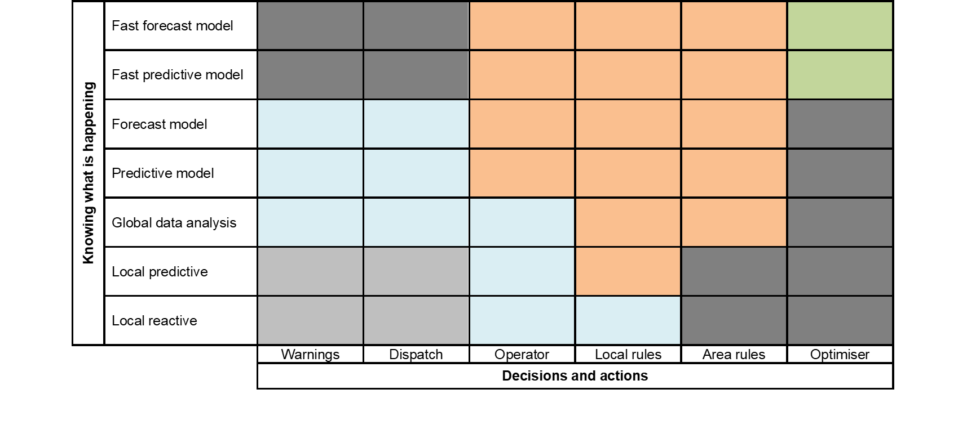
Classification of Active System Management
Keep the solution as simple as possible
WaterNZ 2018

Slide 25
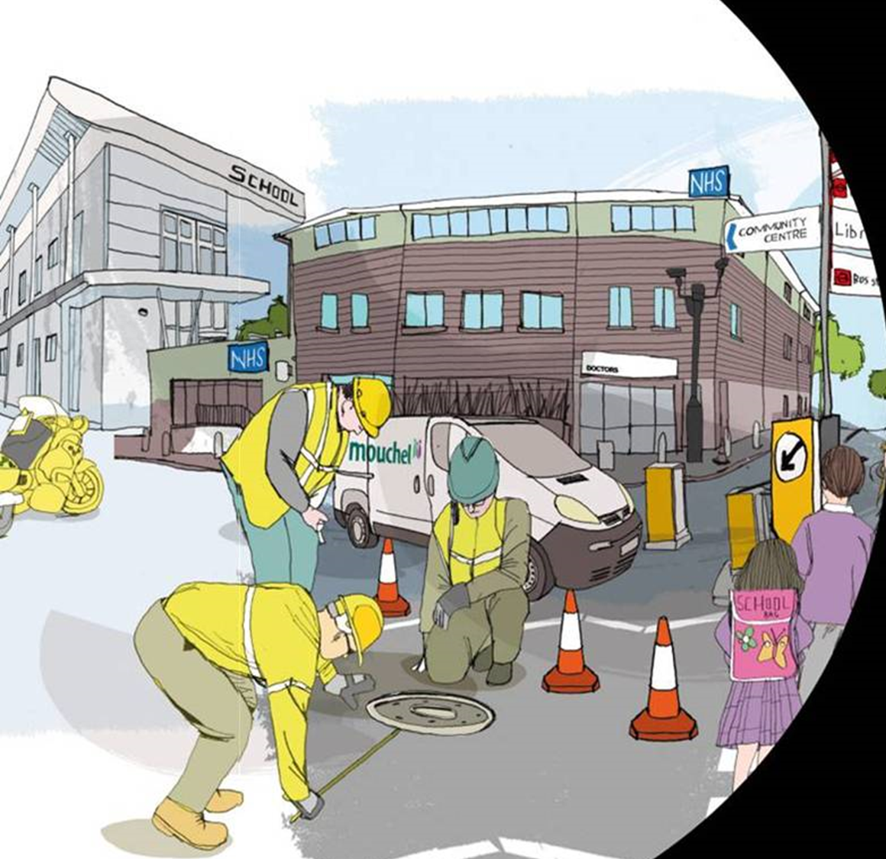
Thames Water - London (Dispatch, Forecast)
WaterNZ 2018
Notes:
Thames Water set up a system using an on-line live model to cover the Hammersmith and Fulham area of west London, where there had been repeated flooding. Alerts are defined so that if flooding is predicted at key locations, or if one or more key Combined Sewer Overflows (CSOs) are predicted to spill, then staff are alerted by email. Standard rules set out what the operations staff should do for each alert. The system has helped Thames Water to proactively deal with the on-going flooding problems.

Slide 26
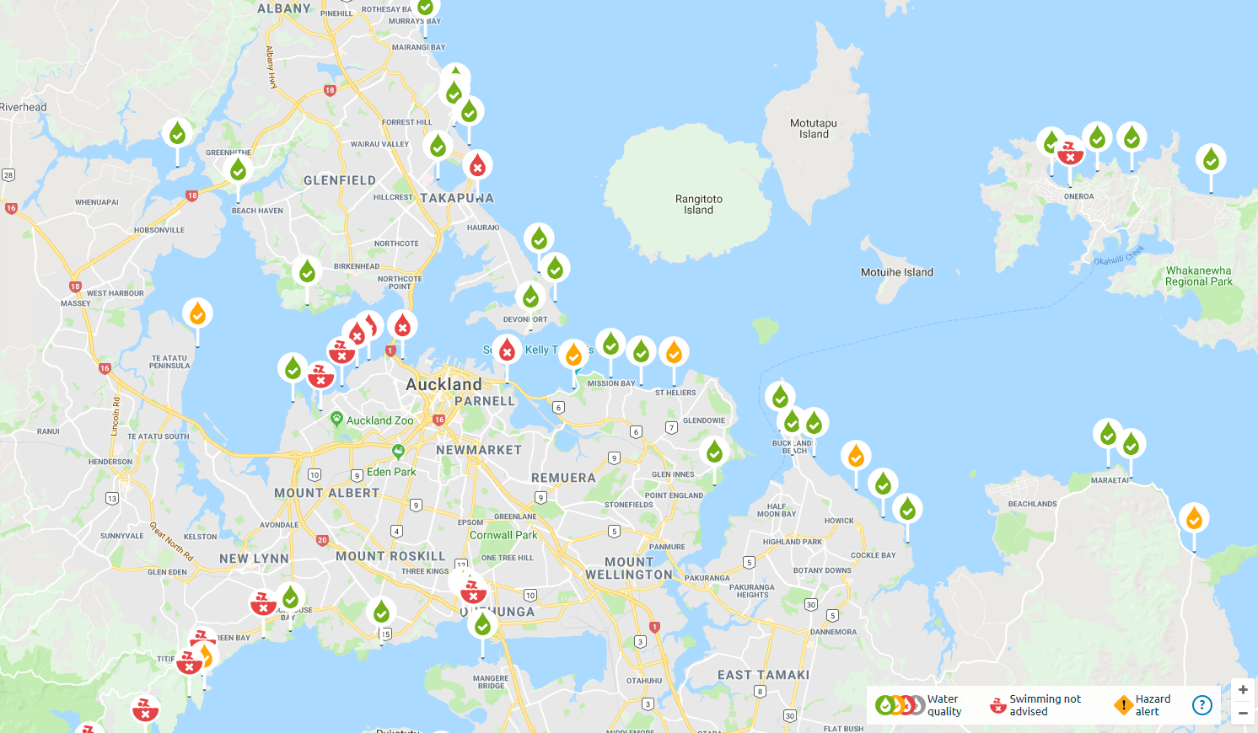
Safeswim (Warning, Predictive)
WaterNZ 2018
Notes:
Safeswim provides water quality forecasts and up-to-date information on risks to health and safety at 84 beaches and 8 freshwater locations around Auckland. It utilizes a predictive model based on past monitoring results, historical weather and other data. Real-time weather, tide and wastewater system data is fed into the model to predict current and future water quality risk, providing forecasts up to two days into the future. The forecasts are updated regularly as weather and other conditions change.
Safeswim is a joint initiative between Auckland Council, Watercare, Surf Lifesaving Northern Region and the Auckland Regional Public Health Service. Public awareness that it is sometimes unsafe to swim due to pollution has increased since the site was upgraded in November 2017. It has proved good opportunities to engage and inform the public on water quality issues.

Slide 27
Addressing an Uncertain Future

Slide 28
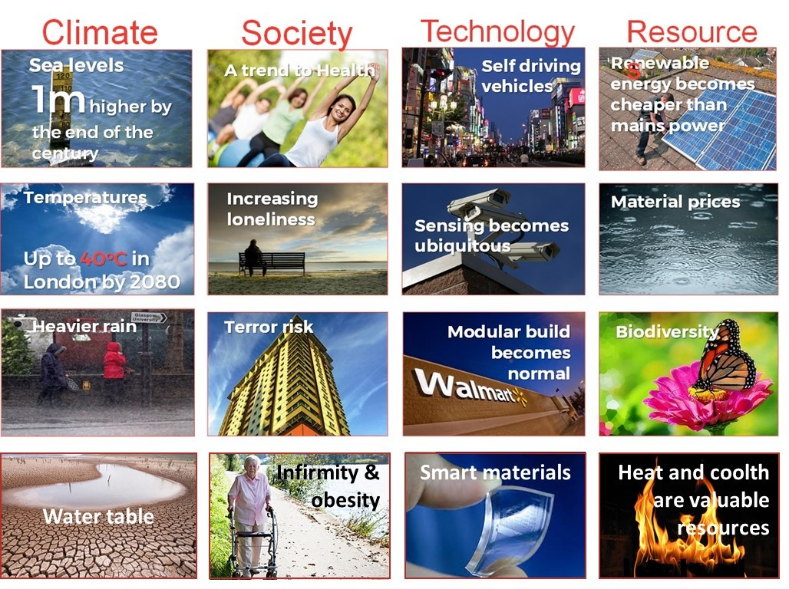
Future Ready

Slide 29
How Certain is the Future?
What Rainfall Intensity Do We Use for Design
UKWIR report on rainfall for urban drainage design

Slide 30
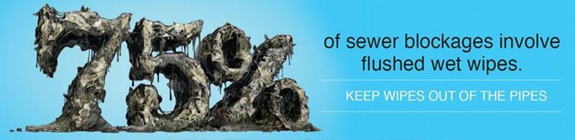
Changing Customer Behaviours

Slide 31
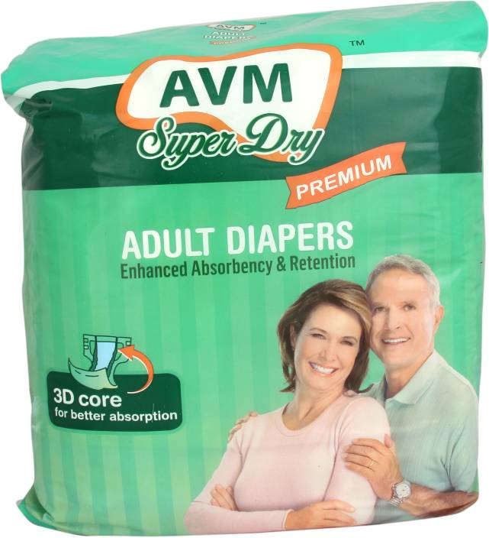
What Will Cause Problems in the Future?

Slide 32
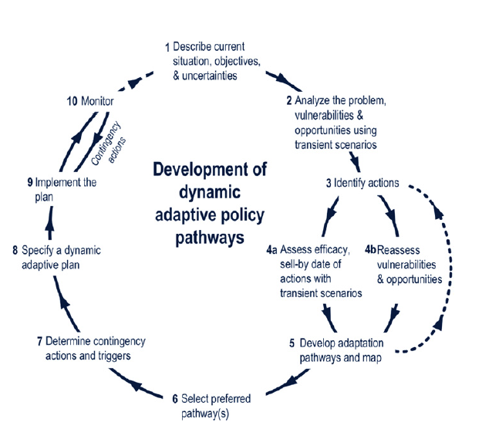
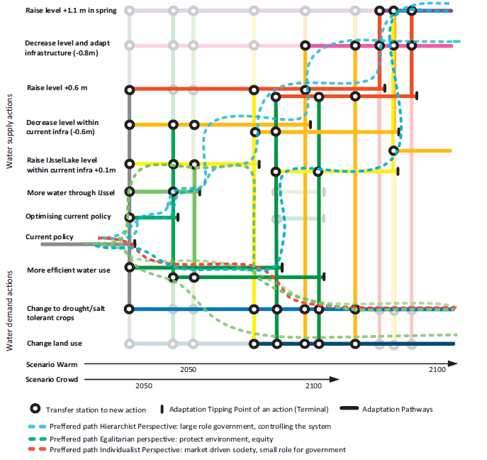
Dynamic Adaptive Policy Pathways
M. Haasnoot et al. / Global Environmental Change 23 (2013)

Slide 33
Summary

Slide 34
133 million New Jobs will be Created by 2022
The Future of Jobs Report 2018
Notes:
one-fifth of the global work force will be affected

Slide 35
The Future of Modelling is Bright
Needed to Address the Infrastructure Challenge – building the right infrastructure at the right time
Greater focus on Contaminant Modelling
Operationalisation of Models
Greater Engagement through Modelling
Optimisation Generates More for Less
Smart Networks Underpinned by Modelling
Dynamic Approach Needed to Address an Uncertain Future

Slide 36
Thank you!
wsp-opus.co.nz

