Slide 1
Growing Pains: The Western Water Story
Tim Hatt (Western Water)
Heath Miles (Western Water)
Dan Stevens (Beca)

Slide 2
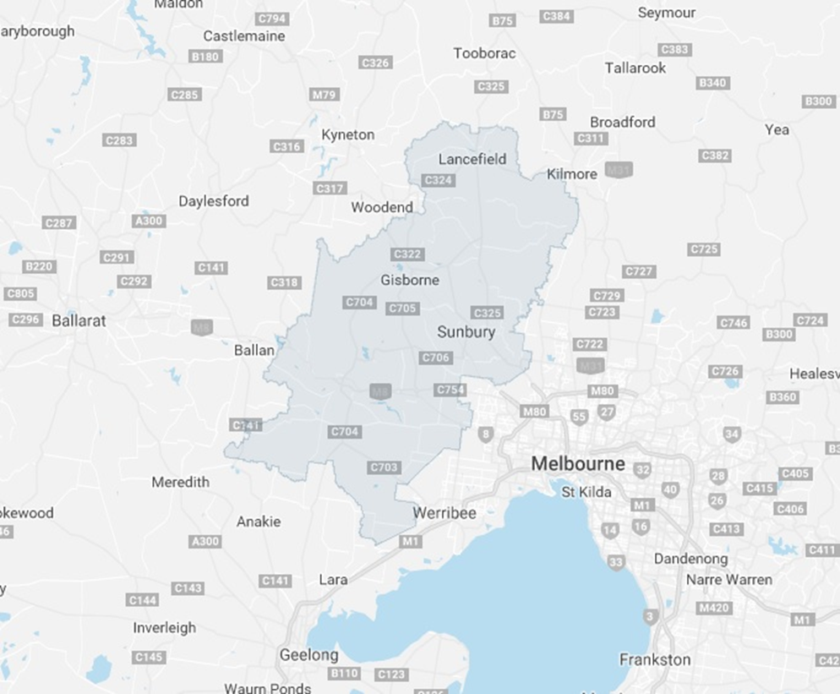
The Western Water Service Area
Less than twenty years ago Western Water supplied a number of outer suburban and small towns through a combination of conventional surface and groundwater sources.
Notes:
KB

Slide 3
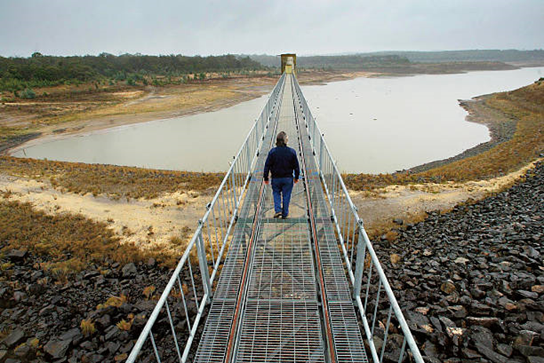
Impact of the Millennium Drought
The millennium drought placed a significant strain on supplies, requiring:
bulk supply from Melbourne Water,
development of recycled water plants and a non-potable transfer network,
investment in a more inter-connected potable water transfer network.
Notes:
KB

Slide 4
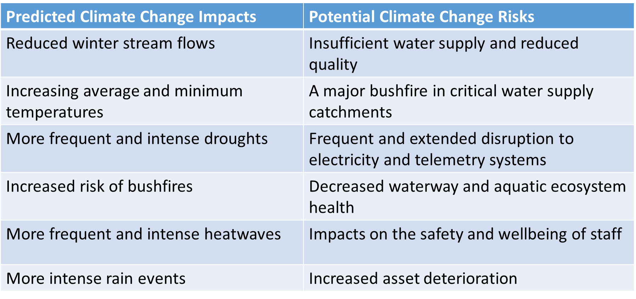
Future Impact of Climate Change

Slide 5
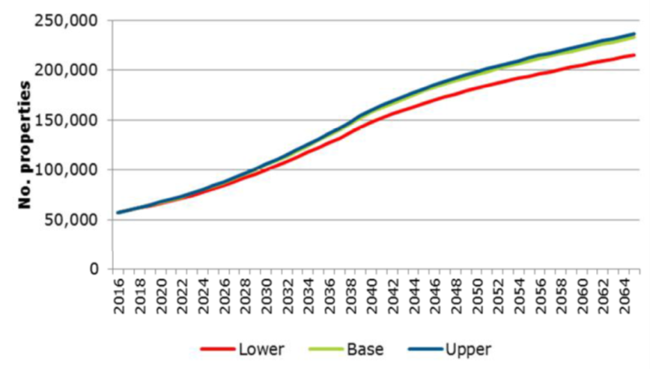
One of the fastest growing regions in Australia
Today Western Water provides water, recycled water and sewerage services to:
65,776 properties
a population of 153,358
an area of 3,000 km²
Over the next twenty years the population set to treble
(Victoria in the Future, 2016).

Slide 6
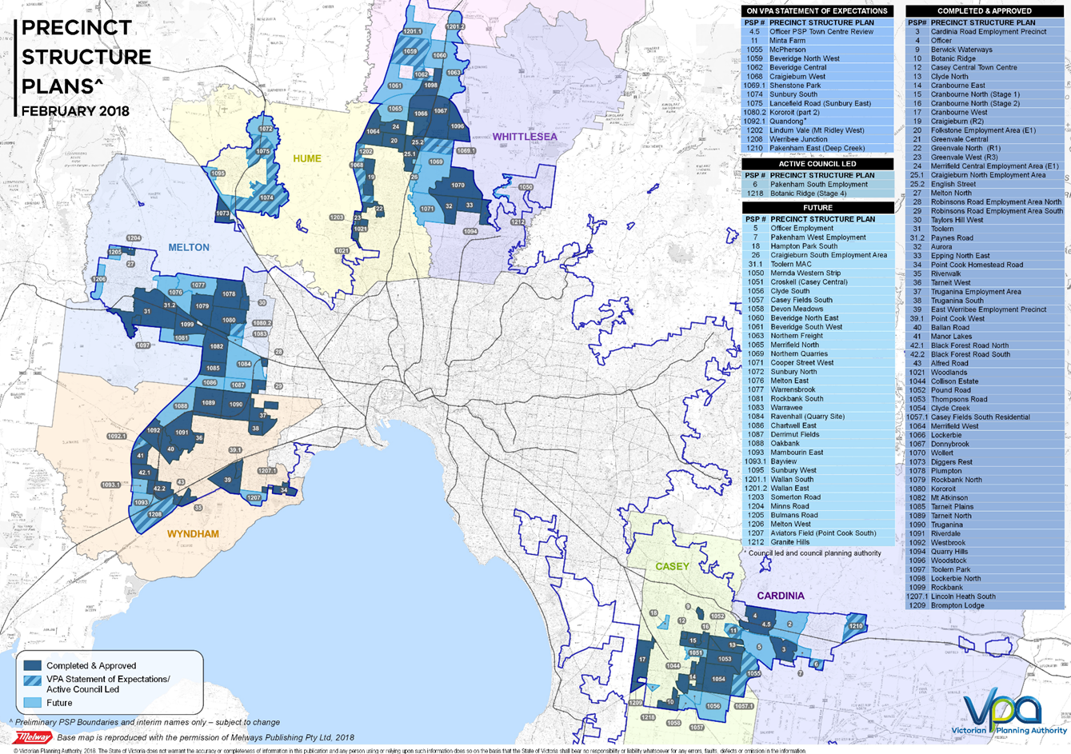
Melbourne – Precinct Structure Plans

Slide 7
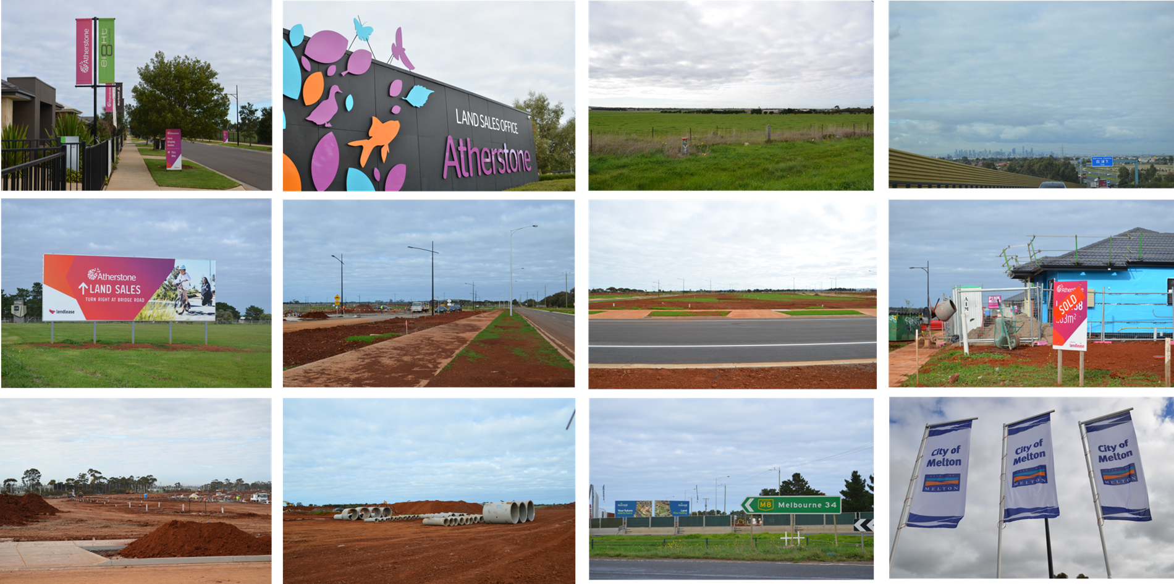
A changing landscape
In 2018 Western Water granted connection compliance certificates at a rate of 1,000 per month

Slide 8
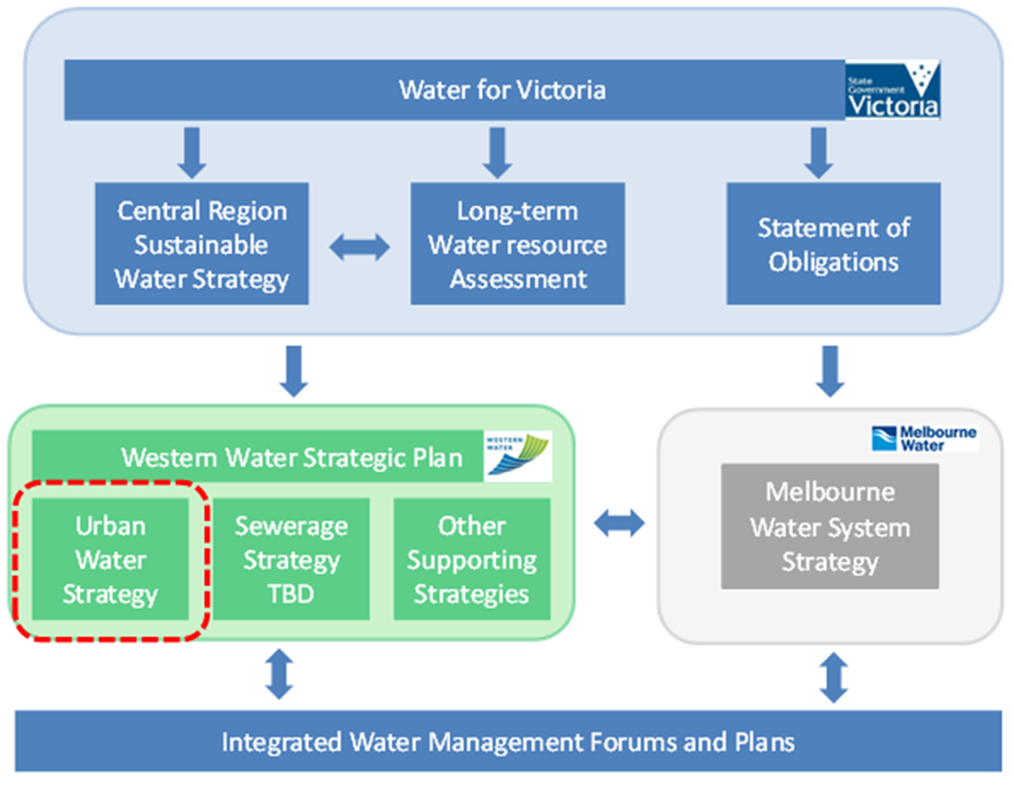
An Integrated Response

Slide 9

Water For Victoria
“Water is fundamental to our communities. We will manage water to support a healthy environment, a prosperous economy and thriving communities, now and into the future.”
sets the long-term direction for managing Victoria’s water resources.
builds on previous Victorian Government plans and policies,
draws on the lessons learned from the millennium drought and 2010/11 flood events.

Slide 10


An Integrated Response - Connectivity
Water For Victoria
Urban Water Strategy
Integrated Water Management Strategy
Grid Expansion Project
(Master Planning)

Slide 11
How is modelling helping?
Modelling to support the planning process:
Water Master Planning -
SOURCE & InfoWorks WS Pro
Operational Modelling and Energy Optimisation -
InfoWorks WS Pro & BalanceNet
Wastewater Master Planning -
InfoWorks ICM
Irrigation and Recycled Water Network Design
SOURCE & InfoWorks WS Pro

Slide 12
Water Master Planning
SOURCE – mass balance model
Assess supply vrs demand balance and determine bulk transfer requirements
InfoWorks WS Pro used to assess hydraulic performance and design and test system upgrades
Very much an iterative process

Slide 13
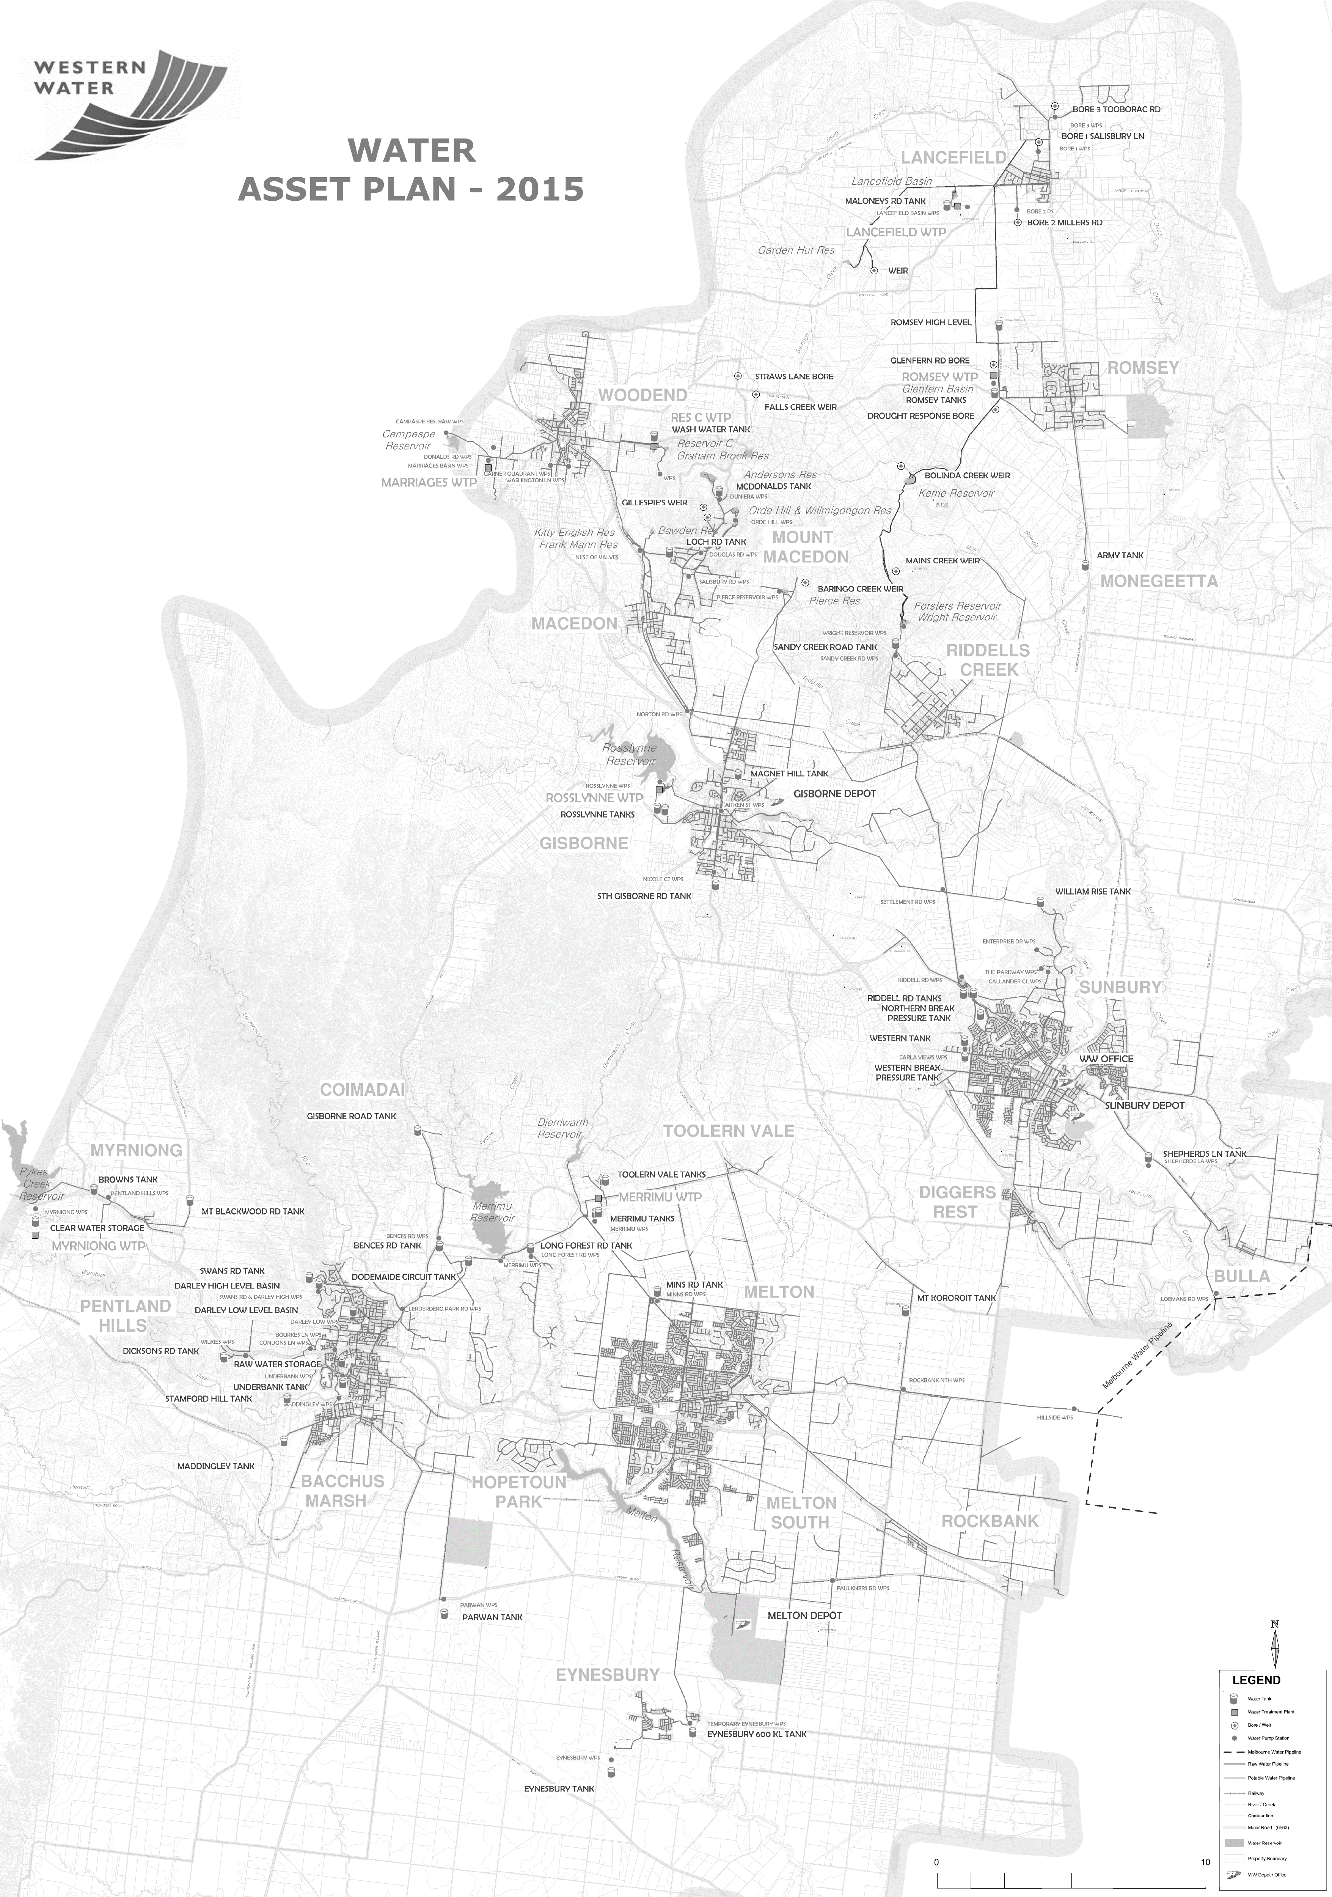
Supply/Demand Balancing
Lancefield
Romsey
Woodend
Demand | 1.0 GL/yr
Local Resource | 0.8 GL/yr | (0.2 GL/yr)
Supply Limits | 0.8 GL/yr | (0.2 GL/yr)
Lancefield & Romsey
Demand | 1.1 GL/yr
Local Resource | 1.1 GL/yr | (0 GL/yr)
Supply Limits | 0.7 GL/yr | (0.4 GL/yr)
Woodend
Groundwater Bore
Reservoir
Water Filtration Plant
Clear Water Tank
Raw Water Pump Station
Potable Water Pump Station
Raw Water Pipeline
Potable Water Pipeline
Macedon
Riddells
Creek
Rosslynne
Demand | 12.4 GL/yr
Local Resource | 2.9 GL/yr | (9.5 GL/yr)
Supply Limits | 11.3 GL/yr | (1.1 GL/yr)
Merrimu
Demand | 18.9 GL/yr
Local Resource | 5.1 GL/yr | (13.8 GL/yr)
Supply Limits | 16.2 GL/yr | (2.7 GL/yr)
Gisborne
Sunbury
TOTAL (excl. Holden)
Demand | 33.4 GL/yr
Local Resource | 9.9 GL/yr | (23.5 GL/yr)
Supply Limits | 29 GL/yr | (4.4 GL/yr)
Myrniong
Bacchus
Marsh
Melton
Existing Asset Capacity & 2067 Demand
Holden etc
Demand | 15.9 GL/yr

Slide 14
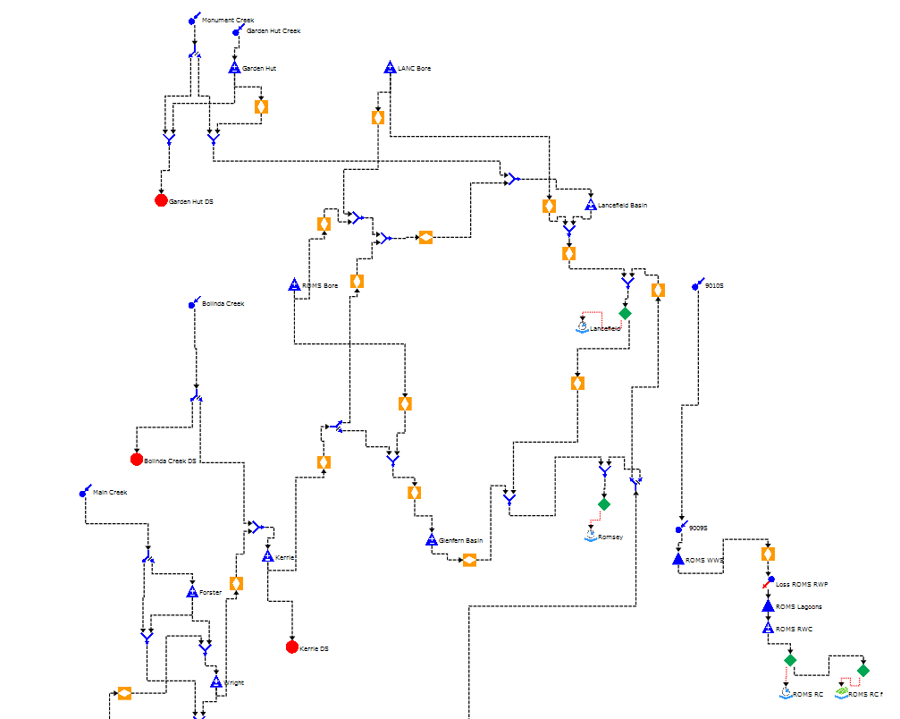
SOURCE Mass Balance Modelling
Review supply vrs demand balance across a range of scenarios
Considers a variety of water sources – local and imported
Up to 50 year runs with different climate cycles
Determine bulk transfer requirements

Slide 15
InfoWorks WS Pro modelling
Determine system upgrades – Trunk system and localised upgrades
24hrs-7 days runs
Consider operational requirements
Bulk transfers and meeting local demands
Establish supply and pressure zones
Staging for investment

Slide 16
Option Development
Lancefield
Woodend
Romsey
Rosslynne
Lancefield Romsey
Transfer to Rosslynne via Loemans WPS
Merrimu
Transfer to Merrimu via Hillside WPS
Centralised Lancefield WFP
Woodend
Campaspe upgrade
Transfer system upgrade
Macedon-Woodend transfer upgrade
Rosslynne WFP -> Gisborne, Macedon & Riddells Creek
Merrimu WFP -> Bacchus Marsh
Hillside WPS -> Melton
Holden Tank -> Melton growth areas
Loemans WPS -> Sunbury
Groundwater Bore
Reservoir
Water Filtration Plant
Clear Water Tank
Raw Water Pump Station
Potable Water Pump Station
Raw Water Pipeline
Potable Water Pipeline
New Assets / Upgrades
Recycled Water (Class A)
Stormwater Harvesting
Macedon
Riddells
Creek
Gisborne
Sunbury
Myrniong
Bacchus
Marsh
Melton

Slide 17
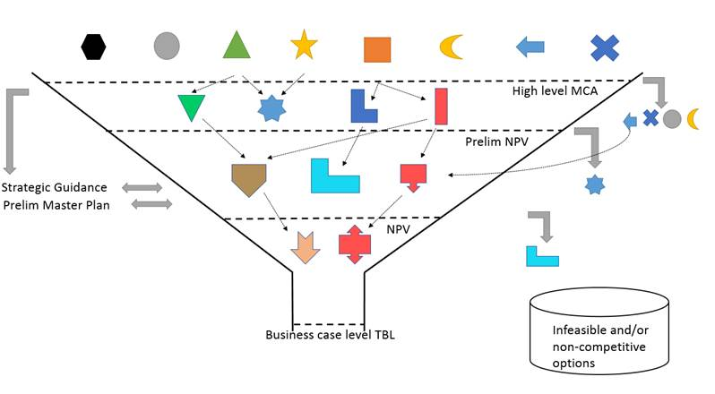
Optioneering and Optimisation Process
First Assessment Filter
Identify long-list of sub-regional options
Develop MCA criteria, sub-criteria & weighting
Eliminate non-feasible sub-regional options; Trivial Options are “parked”
Generate system wide options
Populate MCA
Second Assessment Filter
Shortlist Options
Develop shortlisted options
Third Assessment Filter
Test sensitivity of options
Recombine Trivial Options
Cost/benefit and detail shortlist
Fourth Assessment Filter
Preferred Option
Notes:
Shane/Heath

Slide 18
Ranking of Options
 |  |  |  | Cost/risk |  | Enviro |  | Customer |  | Stakeholder |  | capex |  | community perception |  | regulatory barriers
Option | Description | Weighted score | Default ranking | Sensitivity 1 Score / Rank |  | Sensitivity 2 Score / Rank |  | Sensitivity 3 Score / Rank |  | Sensitivity 4 Score / Rank |  | Sensitivity5 Score / Rank |  | Sensitivity 6 Score / Rank |  | Sensitivity 7 Score / Rank |  | Sum score
Option S0 | Base Options combined UWS aligned | 0.00 | 5 | 0.00 | 3 | 0.00 | 5 | 0.00 | 5 | 0.00 | 5 | 0.00 | 5 | 0.00 | 4 | 0.00 | 5 | 37
Option S1 | Base options combined with Class A (M3, plus Class A for Bacchus Marsh, Sunbury) | 0.04 | 3 | -0.23 | 4 | 0.06 | 3 | 0.13 | 3 | 0.13 | 2 | 0.08 | 3 | -0.02 | 5 | 0.05 | 4 | 27
Option S2 | Localised stormwater (M1, R1) combined with R4, W0, L1, E5, E16b | 0.13 | 2 | 0.02 | 2 | 0.18 | 2 | 0.17 | 2 | 0.12 | 3 | 0.14 | 2 | 0.13 | 2 | 0.16 | 2 | 17
Option S3 | All IWM options Stormwater (M1, M2, R1, R6) in combination with Class A (M3, plus Class A for Bacchus Marsh, Sunbury) and with W0, L1, E16b, E5a | 0.35 | 1 | -0.34 | 6 | 0.57 | 1 | 0.58 | 1 | 0.42 | 1 | 0.45 | 1 | 0.28 | 1 | 0.44 | 1 | 13
Option S4 | Drastic changes to regional transfers: L2, R2 W1 and M6, E17 | 0.04 | 4 | 0.03 | 1 | 0.03 | 4 | 0.06 | 4 | 0.04 | 4 | 0.06 | 4 | 0.04 | 3 | 0.05 | 3 | 27
Option S5 | Coliban to Western pipeline : M7, R3, W2, L5, E5a (ranked well in acquisition study) | -0.13 | 6 | -0.27 | 5 | -0.10 | 6 | -0.09 | 6 | -0.11 | 6 | -0.08 | 6 | -0.13 | 6 | -0.13 | 6 | 47

Slide 19
Operational Model and Energy Optimisation
To meet peak summer demand in the northern part of the network WW need to transfer water from the Melbourne Water bulk system to Rosslynne Reservoir during the “off-season”.
With a total distance of 35km and an elevation change of approximately 250m this transfer will require a considerable amount of power and the pump stations will be operating close to their peak summer loads at 35MLd.
Modelling was used to identify actions that can be taken to minimise the cost of transferring the required volume of water whilst meeting system demand and achieving level of service targets in the network.

Slide 20
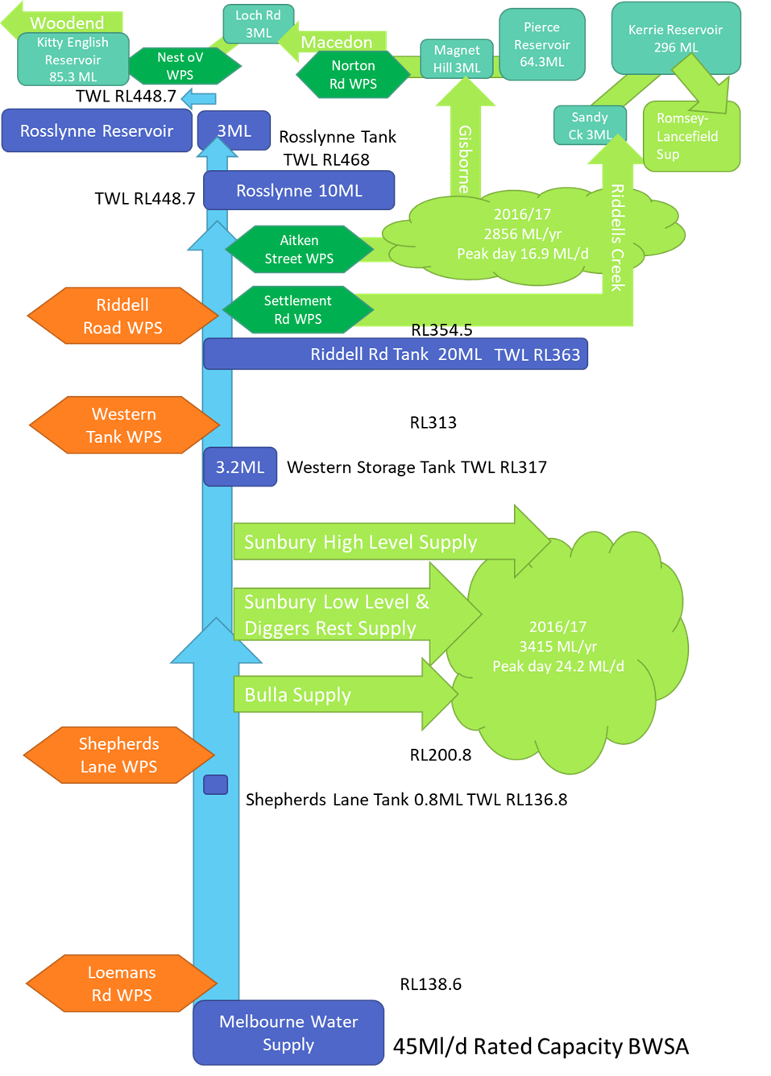
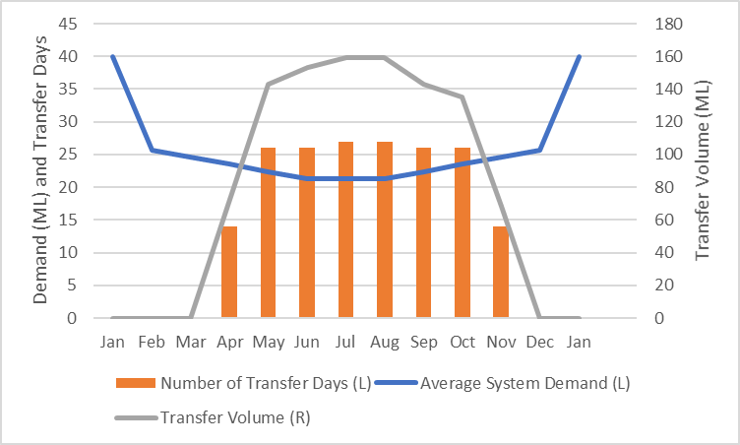
Optimisation & Scheduling

Slide 21
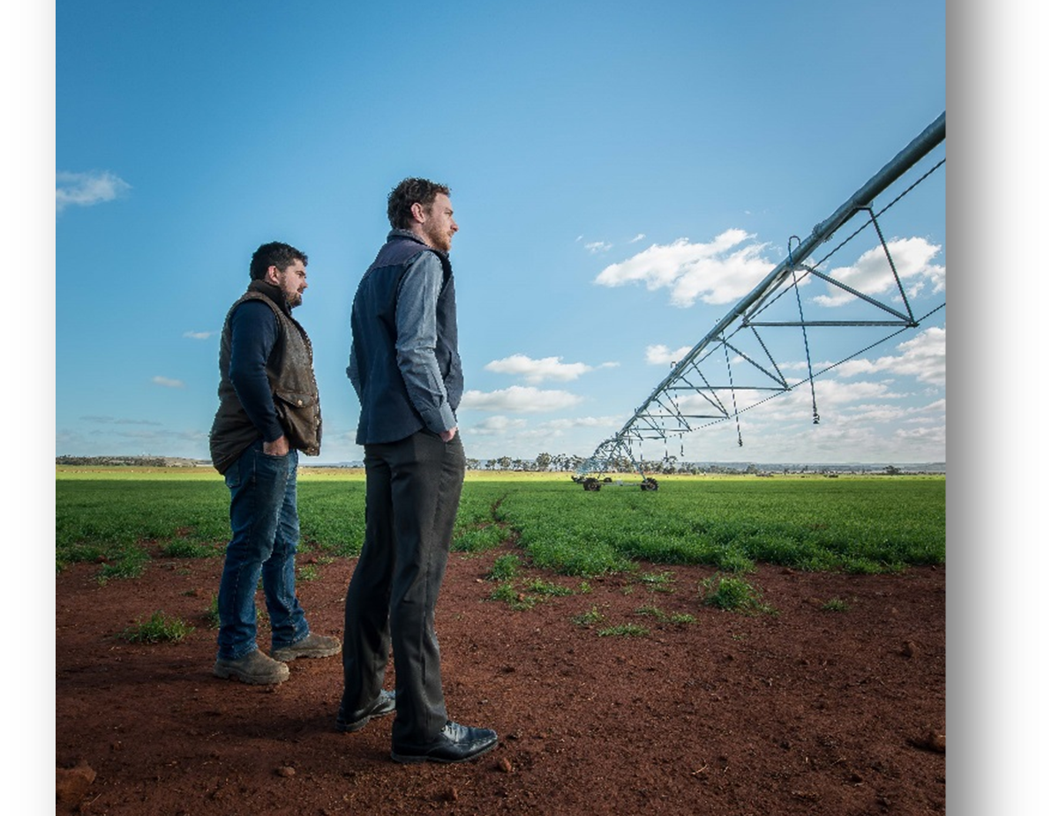
Western Irrigation Network (WIN)
Existing discharge licenses from Western Water’s recycled water plants at Melton and Sunbury will either expire or be exceeded over time, therefore a recycled water disposal is required.
A lack of reliable water supply is constraining agriculture to the West of Melbourne and a secure and reliable alternative water supply through an irrigation network will allow existing farmers to improve the yield from crops currently grown, and eventually switch into crops that are suited to irrigation.

Slide 22
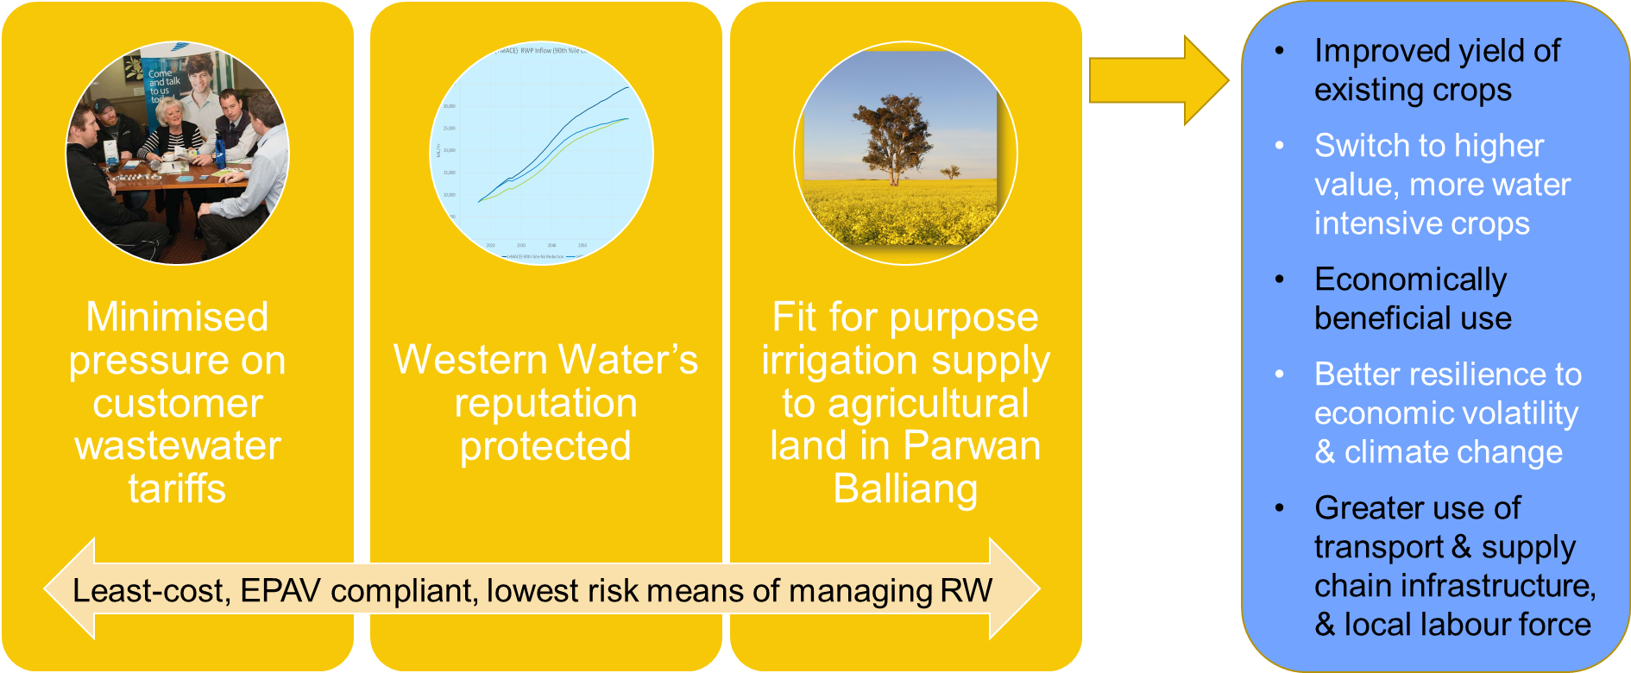
Benefits of WIN – The Business Case

Slide 23
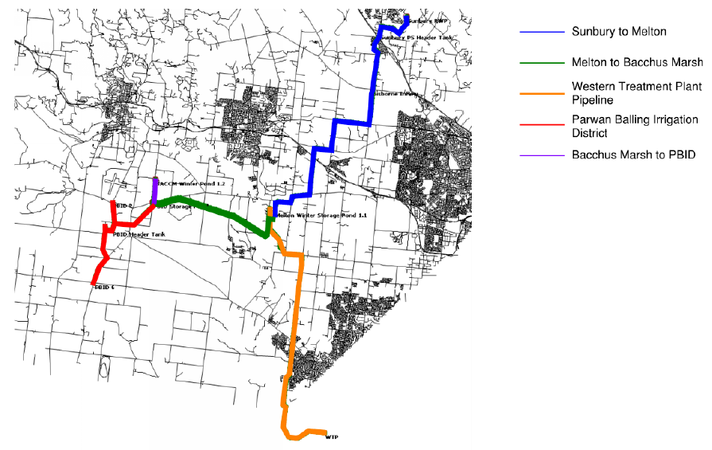
Western Irrigation Network - Recycled Water

Slide 24
WIN Modelling
Use InfoWorks WS Pro and SOURCE model outputs for a range of different supply & demand scenarios to;
Optimise scheme present value costs by analysing pipe diameters, pumping costs, staging options, pipe alignments and pumping times
Input to the development of the energy minimisation strategy for the WIN and investigate energy recovery potential (turbines)

Slide 25
Wastewater Master Planning
Similar process to Water Master Planning
Understanding current system performance and plan for significant growth
Option development – gravity sewer and pressure sewer solutions – a lot of hard rock that is close to the surface makes deep sewers very expensive in some areas
Growth driving significantly larger volumes of treated wastewater coinciding with consents to discharge to streams expiring or being exceeded
Quantifying wastewater volumes available for recycling (WIN plus wider residential and commercial re-use in development areas)

Slide 26
Wastewater Master Planning

Slide 27
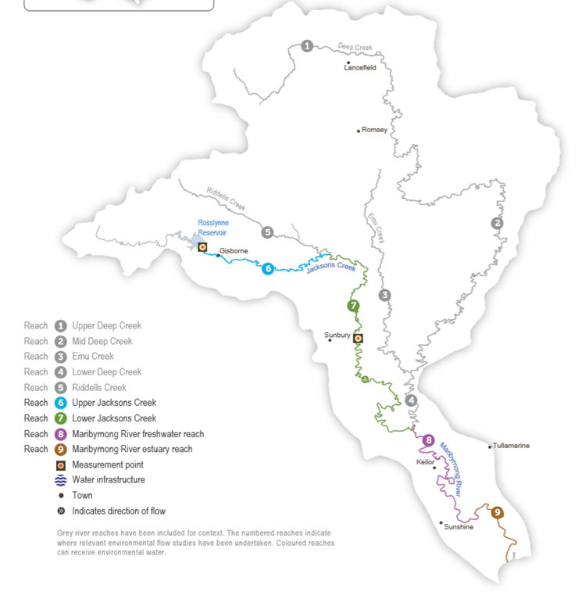
Stormwater
Stormwater harvesting from new developments is being considered as a supplementary water source
either for transfer to the main raw water storage reservoirs or for treatment and release to meet environmental flow shortfalls in key rivers and streams

Slide 28

Lancefield
Romsey
Rosslynne
Lancefield Romsey
Rosslynne WFP -> Gisborne & Macedon
Merrimu
Transfer to Merrimu from Pykes Creek
Serviced by Holden Tank
Woodend
Transfer system upgrade
Holden Tank -> Riddells Creek & Sunbury growth areas
Merrimu WFP -> Bacchus Marsh & Melton
Transfer to Rosslynne via Loemans WPS
Loemans WPS -> Sunbury
Hillside WPS -> Melton
Holden Tank -> Melton growth areas
Eflow release
Eflow release
Woodend
Macedon
Riddells
Creek
Gisborne
Sunbury
Myrniong
Bacchus
Marsh
Melton
Options to increase e-flows

Slide 29

Lancefield
Rosslynne
Lancefield Romsey
Transfer to Rosslynne via Holden Tank
Merrimu
Stormwater harvesting at Bacchus Marsh growth areas & Toolern
Transfer system upgrade
Woodend
Same as Base Option
Stormwater harvesting at Sunbury & Gisborne
Eflow release at Rosslynne
Recycled water to SRW customers
Increase Rosslynne entitlement
Increase Pykes Creek entitlement and transfer to Merrimu
Woodend
Romsey
Groundwater Bore
Reservoir
Water Filtration Plant
Clear Water Tank
Raw Water Pump Station
Potable Water Pump Station
Raw Water Pipeline
Potable Water Pipeline
New Assets / Upgrades
Recycled Water (Class A)
Stormwater Harvesting
Macedon
Riddells
Creek
Entitlement
Gisborne
Sunbury
Entitlement
Myrniong
Bacchus
Marsh
Melton
Stormwater Harvesting & Pykes Creek transfer to Merrimu (irrigation trade)

Slide 30
Summary –
The benefits of Modelling to Western Water
Western Water are using modelling to support:
Development of sub-regional water master plans and a transfer network master plan
Optimising the off-season transfer of water from Melbourne Water to Rosslynne Reservoir
Developing sub-regional wastewater master plans
Developing options for recycled water for agricultural & public outdoor spaces irrigation, commercial and domestic re-use
Developing options for stormwater harvesting as an additional source of water for consumption or e-flows

Slide 31
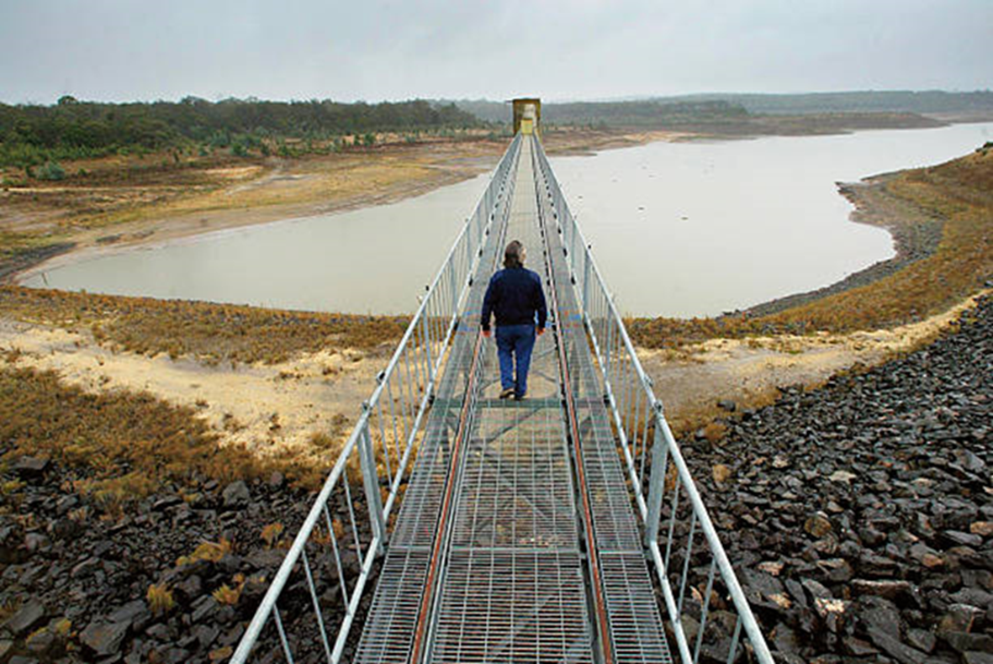
Conclusion
Modelling is giving Western Water confidence to plan the significant investment in 3 waters infrastructure required to meet the combined challenges of growth and climate change.

Slide 32


