Slide 1
Climate Change Group
AGM
26th May 2022

Slide 2
Agenda
Work over the last year
Overview of the emissions guidance
Areas of focus for next year
Committee structure and members

Slide 3
Our mission
This Special Interest Group’s (SIG) mission is to provide leadership across the New Zealand water sector to enable it to act to limit climate change to 1.5 degrees.

Slide 4
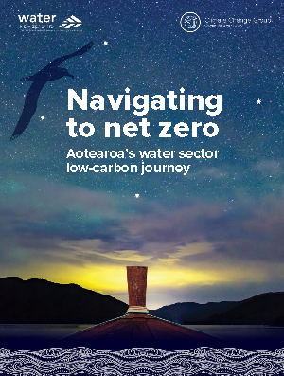
Our work over 2021 and 2022
Comms
Webinars
Symposium
Low carbon journey
Adaptation
Technical mitigation

Slide 5
Technical mitigation
Biogenic emissions challenge: CH₄ and N₂0
Steering committee: Water NZ, Watercare, Silver Fern Farms, Christchurch, Hamilton & Wellington City Council(s)
Notes:
- Process emissions guidelines for WW treatment Methane and Nitrous oxide

Slide 6
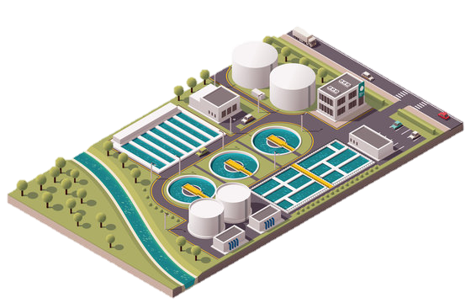
GHGs from WWTPs
Relative Global Warming Potential (AR5)
CO₂ 1
CH₄ 28
N₂O 265
Nitrification / dentification reactions
Treatment plant
Effluent disposal to land/water
Biosolids disposal to land
Sludge treatment
Sewer
Anaerobic conditions or treatment processes
Sludge/biosolids treatment
Biosolids disposal
Effluent disposal to water
N₂O
CH₄
Nitrogen
CO₂
Carbon (BOD)
Biogenic CO₂ accounted for separately
Transport, fuel use, chemical production, soap feed stocks (incl. non-biogenic)
Notes:
Assessment Report (AR) AR4 increase in AR5 – Introduced climate carbon feedbacks. Increases CH4 to 34 and N2O to 298.
Not all of these are covered by the guidelines. Biogenic for example. Sewers
Guidelines and this presentation focussed on N2O and CH4 not CO2

Slide 7
MfE
IPCC 2006/2019
Water NZ 2021
Level 1: Population Based
Level 2: Plant Specific
Level 3: Direct Measurement
Notes:
We have a huge knowledge gap in what our biogenic emissions look like from WWTP, and through inventories it has become increasingly clear that Councils were finding that WWTP biogenic emissions were a huge part of their operational emissions.
However, there was a lack of consistency in how this was calculated.
MfE’s guidance document has, very high level emission factors – tonnes of CO2 per m3 of wastewater treated.
This meant many Council’s were turning to the IPCC Guidelines for National GHG inventories and using the wastewater emission factors from there to estimate their emissions, However in 2019, a large change was made to the N2O EF – meaning lots of Council’s emissions estimates increased by a large margin , in the order of 30-45 fold, which is certainly a challenge when you’re trying to track towards net zero.
This is when our piece of work comes in – a review of the IPCC guidelines and other international guidelines including Australian NGER guidelines – to standarise and recommend what was most applicable for NZ.
The ultimate goal is that we all have measured values- but realistically we aren’t there yet. So the guidance has been written to set a level playing field depending on where you are with your data.
Level 1 is the most high level and is population based for plants that don’t have their own activity data (or a good range of data), so default per person loads are recommended.
Level 2 uses plant specific influent and effluent flow and load data, but still uses default and generic emission factors. David is shortly going talk through some of the development of the methodology and EF values.
Level 3 is about direct measurement – not the focus of this guideline but is really a placeholder for plants to move away from default Efs when they are doing their own on-site emissions monitoring. This is something that has happened and is happening around the world, including in Australia, but only a few plants are just starting to do this in NZ.

Slide 8
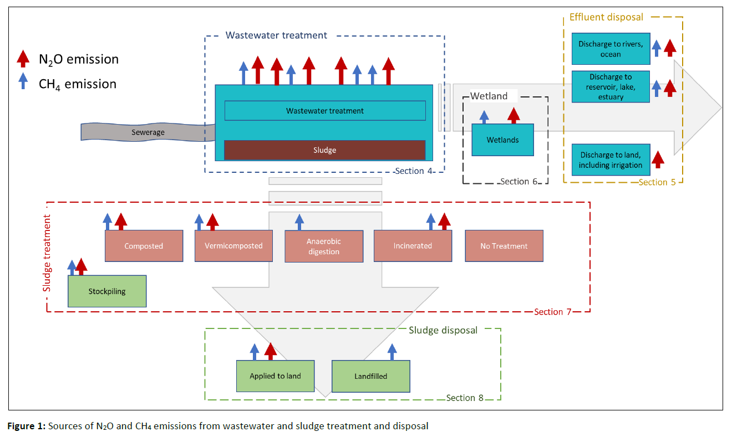
Notes:
The scope of the guidelines is shown on the screen. It covers CH4 and N2O from different types of wastewater treatment plants, downstream process such as wetlands, effluent disposal to land or to water bodies. It covers emissions from various types of sludge sludge treatment and also from sludge disposal.

Slide 9
Knowledge gaps
Direct measurement protocols & utilising data for mitigation
Using process models for prediction
Fraction of influent fossil (non-biogenic) carbon
CH₄ release from sewers
Specific treatment type N₂O EFs
Better understanding of pond-based systems
Notes:
And finally, just want to close with some looking forward, specific examples of knowledge gaps that we have identified.
• Beginning direct measurement of N2O emissions from WWTPs around NZ
• Better understanding N2O emissions from non-BNR and BOD only removal plants
• Better understanding of emissions from pond based systems and tertiary wetlands (rather than constructed wetlands).
• The amount of methane released from sewer networks – it’s the large elephant in the room with these international guidelines
• Understanding the fraction of influent which is fossil carbon in NZ.
• How do we standardise GHG monitoring methods across NZ to best utilise the data generated for mitigation strategies – that’s the next horizon – this is about analysis and reporting but this is all in effort to work towards better mitigation.

Slide 10
Next Steps
→ Updates
Ongoing updates based on feedback and new research
Water NZ Climate Change SiG
Continued involvement with the Mitigation Sub-Committee.
Next step = on-site testing methodology.
Data protocols.
International Collaboration
WaterNZ joined industry bodies around the world to tackle process emissions from wastewater.
https://www.waternz.org.nz/Story?Action=View&Story_id=1585

Slide 11
Areas of focus – comms and policy

Slide 12
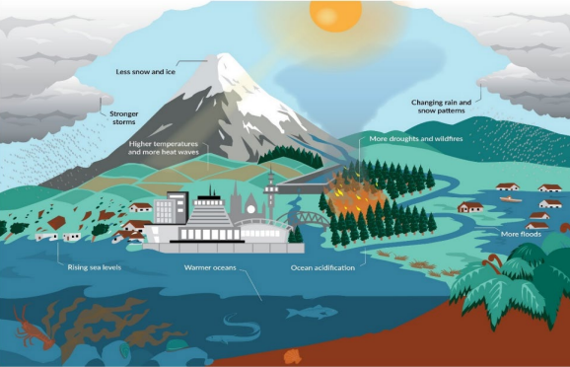
Areas of focus - adaptation
Climate change will dramatically alter the environment that we as an industry work in
Plenty of guidance, but what exactly does the NZ water industry need to succeed?

Slide 13
Areas of focus - mitigation
Low carbon journey – next steps from this workshop
Technical mitigation

Slide 14
Committee structure
Chair
Jon Reed Beca
Low carbon journey
Comms / policy
Deputy Chair
Nick Dempsey Mott MacDonald
Technical / mitigation
Adaptation
Other committee members who actively support these four areas

Slide 15
Committee
Existing
Jon Reed, Beca
Catherine Taiapa, Armatec
Andrew Springer, WSP
James Hughes, Tonkin & Taylor
Nick Dempsey, Mott MacDonald
Chris Thurston, Watercare
Hannah Edmond, Mott MacDonald
New members
Mathew Jackson, alimentary systems
Chris Cameron, PDP
Nicci Wood, LGNZ
Stephany Pandrea, Eliot Sinclair & Partners
Katherine Cowper-Heays, Tonkin & Taylor
Naresh Singhal, Auckland University
Evie Wallace, Beca
Fraser Clark, Wellington Water
Geoff Bennett, Carbon EMS
Thanks to
Rita Whitfield, Stantec
Robert Blakemore, Wellington Water
Calum Pringle, Queenstown Lakes
Apra Boyle-gotla, Watercare

Slide 16
Thank you
Questions/Pātai

Slide 17
