Slide 1
Shining a light on drinking water
through data
Katy Te Amo | Head of Strategy and Insights
Michael Howden | Data + Insights Manager
Notes:
Katy
Tēnā koutou katoa
Ko Maugawhau te maugna
Ko Anawhata te awa
Nō Tamaki Makaurau ahau
Ko Te Whanganui-a-Tara taku kāinga
Ko tepa o mahi ia Taumata Arowai
Ko Michael Howden taku ingoa

Slide 2
Ko wai, ko au, ko tātou
2
Ko te wai ahau, ko ahau te wai.
He whakaaturanga tātau nō te wai.
Ko te ora te wai ko te ora o te tangata.
He taonga te wai me tiaki.
Ko wai tātou.
Ko wai tātou.
I am water, water is me.
We are reflections of our water.
The health of the water is the health of the people.
Water is a treasure that must be protected.
We are water.
Water is us.

Slide 3
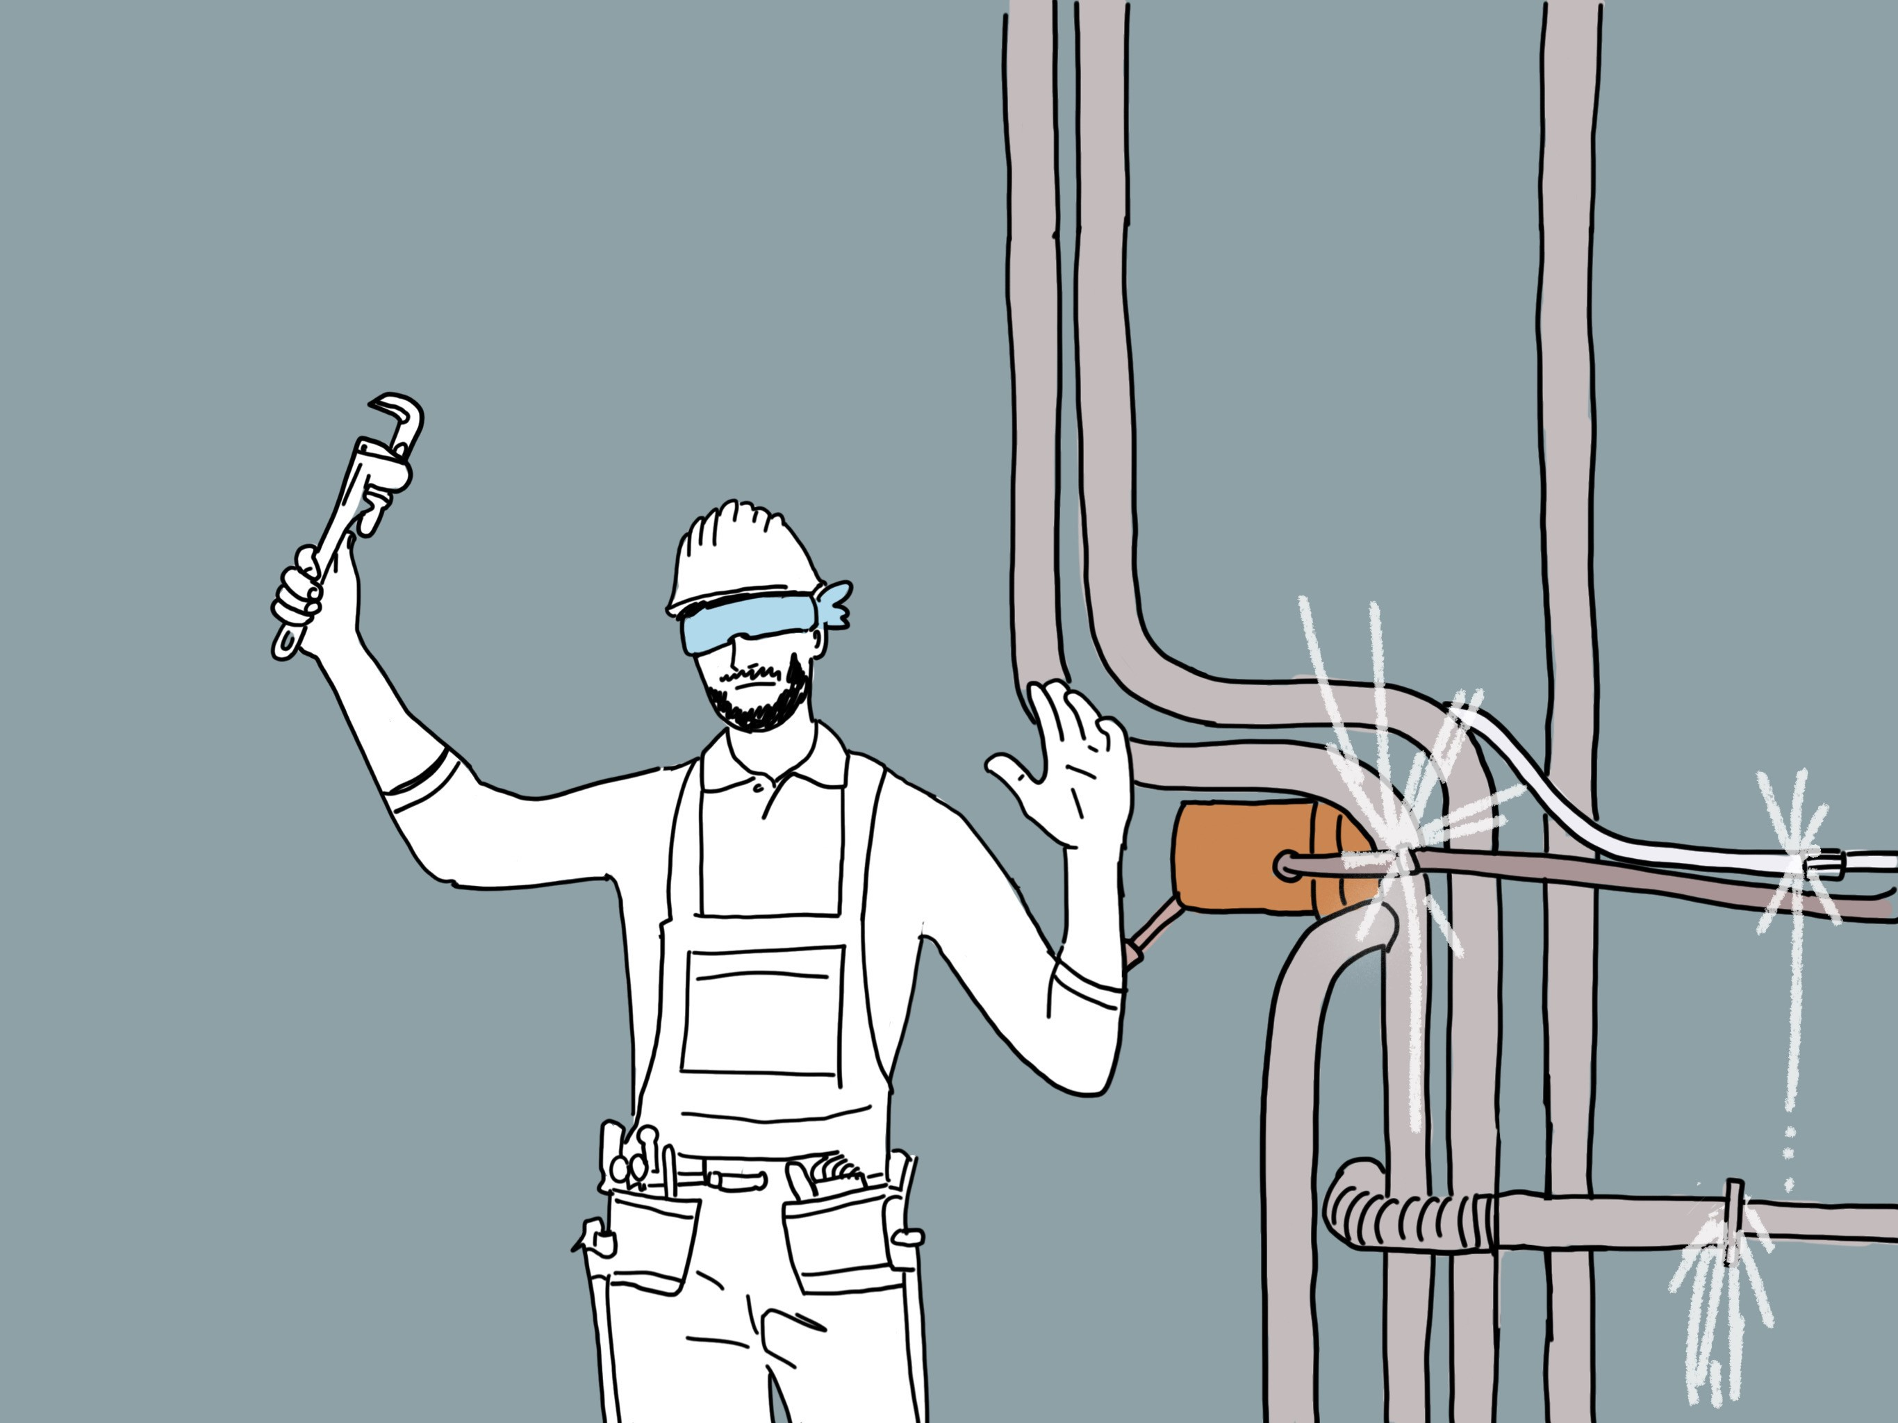
You can’t fix what you can’t see
Notes:
Our drinking water supplies are delightfully complex system, they connect us to our environment, via a range of sophisticated processes and infrastructure, and different perspectives. – but you already know this.
And we also know that this complex system isn’t behaving the way that we like
From a recent survey we conducted, 81% of NZers think that the quality of their drinking water is good or better, based on the data we have, only 64% of NZer drink water that meets the standards
And half of you are here because you want to help spend some of the $120 - 185B that it is estimated to cost to fix this probably
From the surface it seems pretty clear that there is a problem, and as the saying “You can’t fix what you can’t see” – but how can we dive a bit deeper?
And while I’m a data geek, and I could keep throwing numbers at you for the next 20 minutes, but Katy told me that normal people find that boring, and we need to tell you a story – but where do we start…

Slide 4
Compliance, Monitoring and Enforcement Strategy
4
Notes:
There are many ways we could talk about shining a light on drinking water with data,
but in our role as the regulator, and aligning with the narrative of our colleagues, we will tell this story around the key concepts in our CME Strategy
Our regulatory approach is built on four key concepts:
Taumata Arowai tikanga and whakapapa define our way of working and what people can expect from us in terms of our behaviour and approach.
Duty of Care legal obligation for suppliers to make drinking water safe and to take immediate action to protect public health if it is not
Our Risk-based approach to regulation which details how we identify, prioritise and treat risks
Te Mana o te Wai which draws on a Te Ao Māori perspective to recognise the whole-of-system approach to wai, of maunga to moana, or ki uta ki tai
So what does this mean how we shine a light on drinking water with data?

Slide 5
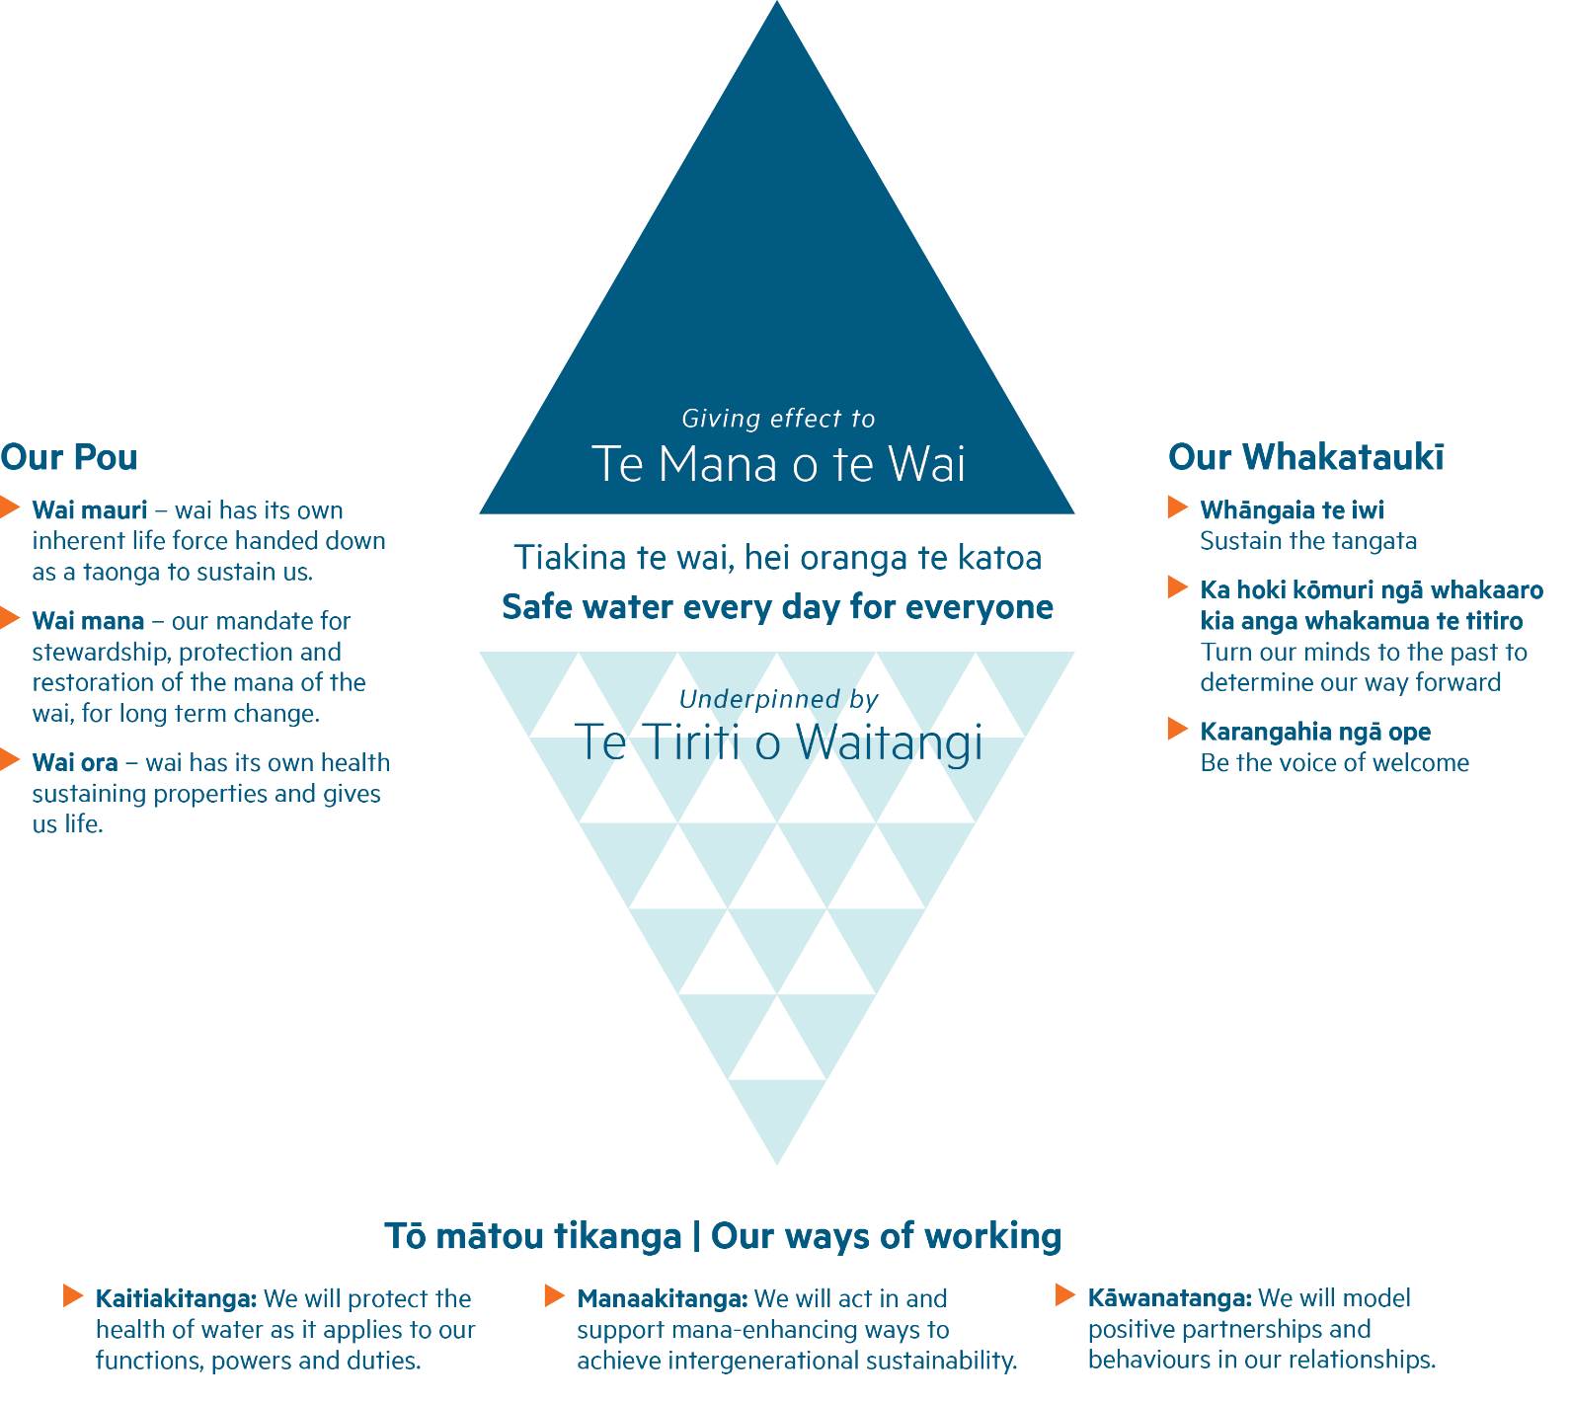
Our Whakapapa
5
Notes:
Our Whakapapa defines our way of working and what people can expect from us in terms of our behaviour and approach.
Giving effect to Te Mana o te Wai, our vision ‘safe water every day for everyone’, underpinned by Te Tiriti o Waitangia
Our Pou are about protecting and upholding the mauri (spirit), mana (integrity) and ora (health) of water
Our Tikanga describe how we will how we work and interact with others to protect the health of our water.
Our Whakataukī are built into our ways of working and influence our decisions in their own unique way.
Our Whakapapa makes Taumata Arowai very different from any organisation which I’ve worked with before, and certainly a different type of regulator

Slide 6
6
Notes:
Our Pou shifts our focus from water “services”, to water in it’s own right.
This forces us to think differently about what data we collect and how we treat that data.
We can no longer looked a water with a view, blinkered by our regulatory or operational siloS
WSA has some interesting requirements for sharing data about source water between WS, RC and us.
How would you feel if your doctor didn’t share your medical records with a specialist you were seeing? Or worst - told you that they lost them?
We need to treat data about water quality in the same light

Slide 7
7
Notes:
Kaitiakitanga – We will need to know how healthy our how water is throughout the country as well as how well others are carrying out their duties to protect it.
Manaakitanga – How can we use data in a waythat enhances everyone’s mana? We don’t want you to feel that reporting to us this just an unnecessary burden, Instead, we hope it could add more focus and importance to data that you’re recording… or help you to know how you compare to others.
Kāwanatanga – We have no intention of doing this in isolation. We want to be working together to set up systems that are better, stronger, faster. While keeping in mind that we’re still the regulatory.

Slide 8
8
Notes:
Our Whakapapa defines our way of working and what people can expect from us in terms of our behaviour and approach.
Giving effect to Te Mana o te Wai, our vision ‘safe water every day for everyone’, underpinned by Te Tiriti o Waitangia
Our Pou are about protecting and upholding the mauri (spirit), mana (integrity) and ora (health) of water
Our Whakataukī are built into our ways of working and influence our decisions in their own unique way.

Slide 9
Our Whakapapa
9
Notes:
Our Whakapapa defines our way of working and what people can expect from us in terms of our behaviour and approach.
Giving effect to Te Mana o te Wai, our vision ‘safe water every day for everyone’, underpinned by Te Tiriti o Waitangia
Our Pou are about protecting and upholding the mauri (spirit), mana (integrity) and ora (health) of water
Our Whakataukī are built into our ways of working and influence our decisions in their own unique way.

Slide 10
Turning our minds to the past…
10
1,969 Registered supplies
12 Years of Annual Reports on Drinking Water Quality
225 Annual survey questions per supply
1.6 million Test results recorded
1,088 Registered supplies without up to date contact details
63.9% Of New Zealanders drink water from compliant supplies in 2020/21
8 Weeks to complete the annual survey
19% Of councils did not share any test results
Notes:
Ka hoki kōmuri ngā whakairo kia anga whakamua te titiro
Turn our minds to the past to determine our way forward
Before working at Taumata Arowai, I had the benefit of supporting MoH with Drinking Water Online. But this was by no means prefect, but it gives me an appreciation of where we have come from – which might help to determine our way forward.
Taumata Arowai inheritied a total of 1,969 supplies which were compiled from various registered.
HOWEVER: over half of these registered supplies didn’t have up to date contact details and we still haven’t been able to verify them
Before Taumata Arowai, there were 12 years of annual reports, reporting on the compliance of water supplies serving over 100 people
BUT despite that, there was no marked improvement, and when you look across the total population of NZ, less than 2/3 drink water from compliant supplies.
This annual report what based on an Annual Survey, which required every supply to answer up to 225 questions – and in some cases more.
This ended up taking 8 weeks to complete (8 weeks of hell), and it was often close to a year before the report was released.
Through this process there were 1.6 million test samples recorded for the last 3 years alone
However, these records were not compulsory, 19% of councils didn’t share any, and there isn’t enough data to support meaning research around emerging issues.
So what does this tell us:
We need to keep our data current – this is not going to be a set and forget regime.
We need to make our data meaningful to engage people and drive change
We need to consider the effort it will take to report data
And finally more data doesn’t always mean useful data.
Most importantly we will be shifting our focus beyond compliance to look at if suppliers are taking responsibility for their duty of care.

Slide 11
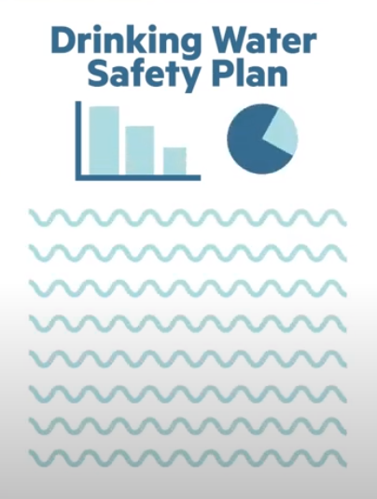
What data shines a light on your Duty of Care?
Notes:
What tells us you are filling your Duty of Care?
Whether you have submitted your DWSP is a very simple data point for us to know if you’re taking responsibility for your supply.
These plans don’t need to be gold standard, but they do need to be submitted by 15-Nov-22
Now I’m sure that most of the rest of you already have these drafted up, some might be waiting for the templates and acceptable solutions we’re releasing, but we’re looking forward to getting all of the rest of these to us by 15-Nov-22

Slide 12
So much more than just a plan…
Diagram
Links to Notification response
Links to Monitoring
Links to infrastructure projects (NTU)
Links to capacity
DWSP is your plan – and we are using this to develop our understanding to influennce the systemic changes that are required
Our DWSP summary form…
A shared understanding is key
12
Register
Notifications
Monitoring
Source Water Risk Management
Emergency Management
Capacity Development
Infrastructure Investments
Notes:
DWPS are important because they are so much more than a plan.
You can’t prepare and implement a good DWPS without using a whole HEAP of data to shine a light on your own supply!
So we’re really interested to see this and use it to build out our shared understanding through all the things it reveals:
Break it down:
Register: As a starter, your DWSP should verify what we already known about your supply from the register, especially the source type and treatment barriers. If these don’t line up, well, that’s a bit of a worry. This is one of the first things we’re going to be looking at.
Notifications: Secondly, what’s in your DWSP should match up with any conversations we’ve already had with you about these.
Monitoring: Your DWSP could describe your monitoring,
Source Water: …include your SWRMP
Emergency Management: ..describe how you respond to emergencies
Capacity Development: You DWSP may also start to reveal broader issues around capacity and infrastructure.
Infrastructure: The DWSP might be a valuable source of data to help inform nationwide initiatives and future infrastructure investments.

Slide 13
What data do we have about risk?
13
1,260 Notifications have been sent to us
415,198 People drink water from supplies which have detected E. Coli
244 Consumer Advisories have been issued (Boil Water, Do Not Drink, Do Not Use Notices)
117 Supplies did NOT notify us when a Lab detected unsafe drinking water
Notes:
So if the DSWP give us data about duty of care you are taking, what about the actual risks right now?
Well, I didn’t want to let you walk away from a presentation on data without any data – so here’s a bunch of numbers:
We’ve received 1,260 notifications. - Not all of these mean that there is unsafe drinking water, some are for planned outages, or our of precaution – which is a great way to demostate that you’re actively managing your risks.
What’s not great is that 415,198 people have drank water from supplies that have detected E. Coli. This indicates that there could be real issues with there supplies and those suppliers need to be taking active steps to address these issues – not just assuming that it is a lab error and trying to sample your way out of it – that’s not how the rules will work anymore
244 Consumer Advisories
That’s 3x the number reported to the ministry of health, but they only included supplies <100. We’re shining our light much further down the bore shaft.
not great – but at least - ambulance at the bottom of the cliff
Probably more concerning at the 117 supplies for whom lab’s have notified us of something in their samples, but who haven’t told us
In case you weren’t aware, any lab that finds a DW sample that doesn’t meet the standards needs to tell us about it. - They need to be notifying us!
But what about all the supplies who are not taking samples at all?

Slide 14
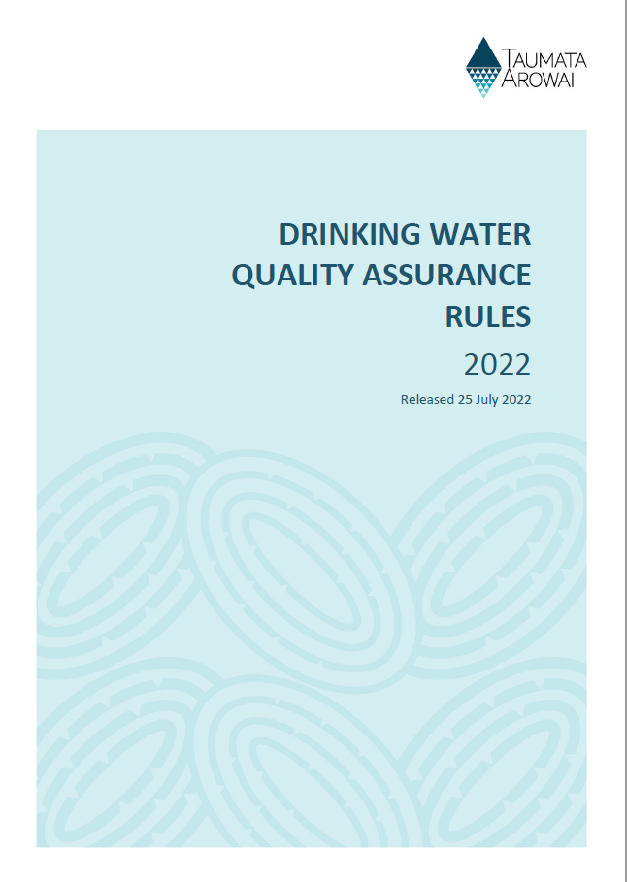
Knowing the unknown unknowns…
14
Notes:
So how will we find out about supplies who aren’t even monitoring their supplies?
This is where the Drinking Water Quality Assurance rules come into play – from 15 Nov 2022.
They set out all the different parameters which different types of supplies will need to monitor and report to us.

Slide 15
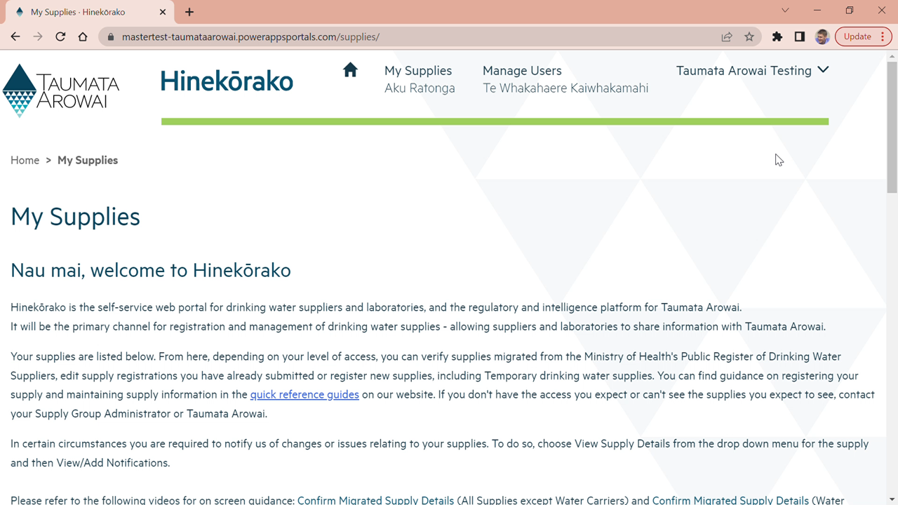
Knowing the unknown unknowns…
15
Notes:
To help you understand exactly what rules you will need to follow, we’ve even implement a “Build-My-Rules” tool into Hinekōrako, that will allow you to easily see which rules modules could apply. If you want a hands on demo, please head down to the Taumata Arowai stand.

Slide 16
Knowing the unknown unknowns…
16

Slide 17
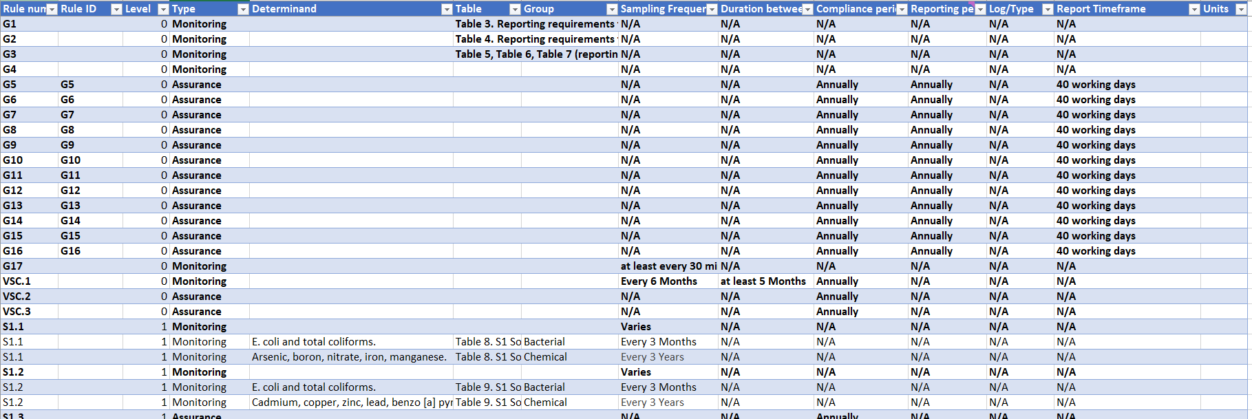
Knowing the unknown unknowns…
17
Notes:
Now because I’m in charge of data and insights, I’m the one who’s going to have to wade through the 100,000s of these reports that you’ll be sending through to us to work out who has done the monitoring, and what risks these might reveal.
Don’t worry, this will all be automated.
We have already translated all of the rules to this structured data sheet to make checking easy.
We have also been designing our reporting approach to allow you to send us data directly
From you Compliance Systems via an API, or an Excel template if you’re a bit more old school.
We’ve had initial conversation with a number of water suppliers, as well as Infrastructure Data and Water Outlook – so if you are using either of
We’re going to be launching a targeted engagement with water suppliers to get feedback on how this reporting approach aligns with the current systems used by different drinking water suppliers. I would be very happy to discuss this further with any of you at the conference.
We are expecting suppliers to start their reporting year from 1 Jan 2023, so from the first of Feb, I’m looking forward to receiving our first batches of monitoring data to full out our picture of risk across the sector.
And although I totally geek out about the volume and velocity of the data we will be receiving, this isn’t the important thing.
The important part is that YOU are monitoring this data and YOU are using it to actively manage your risks and provide safe drinking water – I can’t do that!

Slide 18
Knowing the unknown unknowns…
18
Sharing Data
Unsafe drinking water
Safe drinking water
Not Sharing Data
Notes:
So once we have all of this data from DWSP, Notifications and monitoring, we’ll be able to form a better understanding of where our supplies sit along this quadrant.
Now we’re hoping that that suppliers will be in the top right – you usually want to be in the top right…
Your providing safe drinking water – and you’re telling us
Some of you may not be able to provide safe drinking water – in some cases you might be waiting on infrastructure to be built or simply not
But if you tell us about it this demonstrates your duty of care – although I’m not promising that this won’t lead to some conversations to make sure that you’re taking the steps
And then there’s those water suppliers who aren’t sharing data with us – or maybe you’ve only shared some of it with us.
The problem here is that we might not know if you’re providing safe drinking water or not.
What we do know is that you’re failing to carry out some of your legislative functions, so who knows what else you’re missing

Slide 19
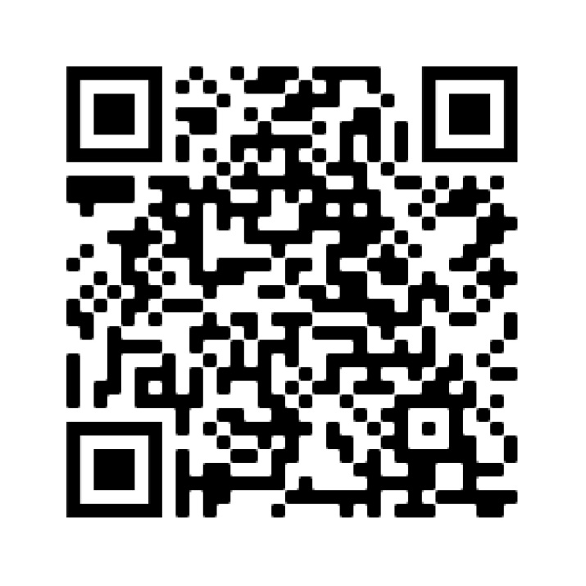
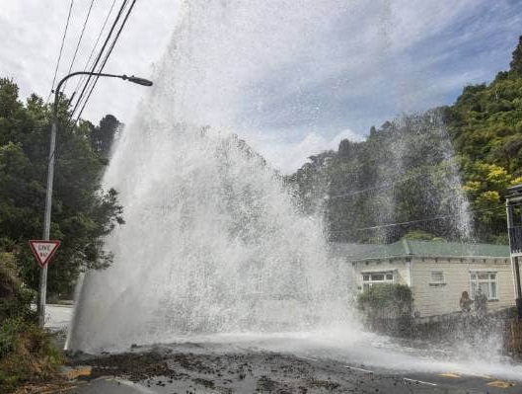
Beyond the pipes
19
Network Environmental
Performance Measures
next stage of consultation
Visit our team at the Taumata Arowai Expo stand
Water outside the pipes Kevin Stent/Stuff (2021)
Notes:
We’re broadening our scope outside of the pipes
The Water Services Act requires us to shine a light on environmental performance
We see this report as an evolution of the NPR – with a few more regulatory teeth.
Big difference from the drinking water regulation data is that the requirements only apply to network operators (councils (and in the future WSEs), CCOs, government departments and NZDF)
It became mandatory for network operators to collect data for drinking water networks on 1 July 2022, this data needs to be reported by the end of September 2023 – Regulatory requirements now!
We are now consulting on the next phase of NEPM drinking water requirements and on our approach to collecting information on wastewater
The information we collect will go into our annual Network Environmental Performance Report, starting from the end of next year.
Visit our stall for further information on consultation – we want to hear from you! Links to the discussion document can also be found on our website.

Slide 20
Te Mana o te Wai
Notes:
KATY
You mean a data geek who used to think that the world could be represented in ones and zeros,
So we‘ll have the register, notifications, DWSP, monitoring data, NEPM, we’ll have more data than we ever have before – we’ll have our data torch on high beam!
But how do we make this data meaningful, how does this data inform actions to lift the performance of the sector.
We will need to look systemically, across multiple data points which are constantly changing, with additional local context that might not be captured in our data. And we’re going to need to make decisions on how we prioritise our actions.
If only there was some sort framework to help us…
Te Mana o te Wai offers a valuable framework for making sense of all of this data.
Holistic – Te Mana o te Wai requires us to look holistically at water as a whole – we need to bring together multiple datasets to inform our decisions
Hierarchy – It provides a hierarchy Water – People – Communities. And it’s going to be really interested when we start putting water at the center of our decision making
Local – Te Mana o te Wai acknowledges the important of local knowledge when it comes to making decisions about water.
I’ve studied enough about complexity to know that there are things that we can know, and things that we can’t know.
Esp. when we’re trying to aggregate a national picture from Wellington.
You’ll need to talk to your Mana Whenua in your region. Each iwi and hapu has their own data, their own pūrakau, mātautange, whakapapa that will be able to speak to the health and value of the water.
“The quality of the data collected will come down to the quality of the relationships we all hold with Māori. Invest in it, it’s the Te Mana o Te Wai difference in data”.
And with the stories that come along with this data, Te Mana o Te Wai offers us a way to be convincing and compelling

Slide 21
Register
Surveys
Network Environmental Performance Measures
Drinking Water Safety Plans
Pūrakau
Research
Mātauranga Māori
Audits
Consumer concerns
Whakapapa
Maturity Model
Notifications
Monitoring
Lessons from Incidents
Local data
Notes:
So how is this going to come together?
I find it interesting to thing about out name
Taumata is used to refer to a summit or gathering around an important area of focus
Arowai gives that focus to water
Just as high peaks collect rain, so to I hope that we can collect data, which will then flow across of the motu.
Some of these flows will join mighty rivers, making a pathway for system wide change throughout Aotearoa.
But these flows may also combine will smaller tributaries, carrying rich local knowledge that may sensitive, unique or sacred, but still valuable to a particular community.
We all have a roll to play - SWIG
So how is this going to come together?
Collecting together a wide range of data…
Including data you don’t even know about yet.
As well as sharing some of it with us, so
You will using this data to drive your own performance,
And also to guide your conversations with others, where through which you will hopefully uncover stories to help you

Slide 22
Summary
22
Our Whakapapa
Duty of Care
Risk Based Approach
Te Mana of Te Wai
Notes:
Our Whakapapa
Means that there’s going to be a unique flavour as we start shining the light.
The torch is going to be pointing at the water a lot, and you’re going to find that more often than not, you’re going to be the one holding it.
Duty of Care
We’re looking forward to seeing your DWSP
This is going to reveal some great insights about how you take responsibility for your DWP
Risk Based Approach
We already know some things from suppliers who are testing
And with the DWQAR, we’re going to find out who isn’t
Along with the NEPM, this is going to give us a huge set of data to start to understand the risks across the country
Te Mana of Te Wai
Regardless of how must data we pump up, we’re going to need to take a holistic, hierarchical and local approach to turn this into action
You will need to engage with local communities and mana whenua develop your shared understanding to determine your path forward.

Slide 23
Pātai | Questions
23

