Slide 1
Water New Zealand Conference & Expo
18 October 2022
Liz Brown, Te Rūnanga o Ngāi Tahu Councillor Craig Pauling, Environment Canterbury

Slide 2
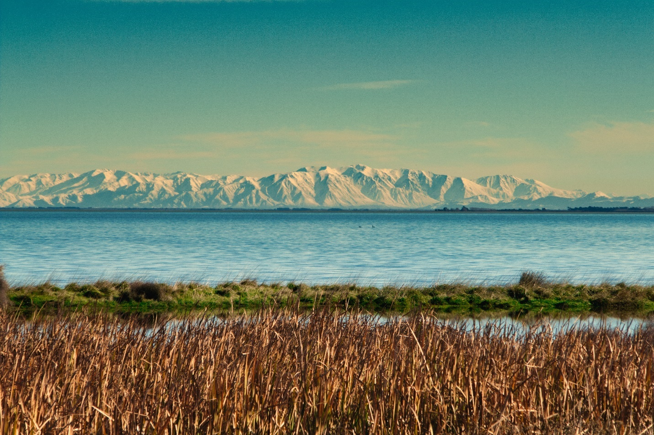
Whakaora Te Waihora
A Co-Governance Story

Slide 3
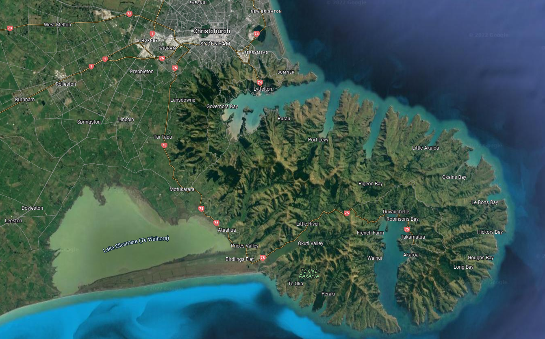
Te Kete Ika a Rākaihautū / Te Waihora

Slide 4
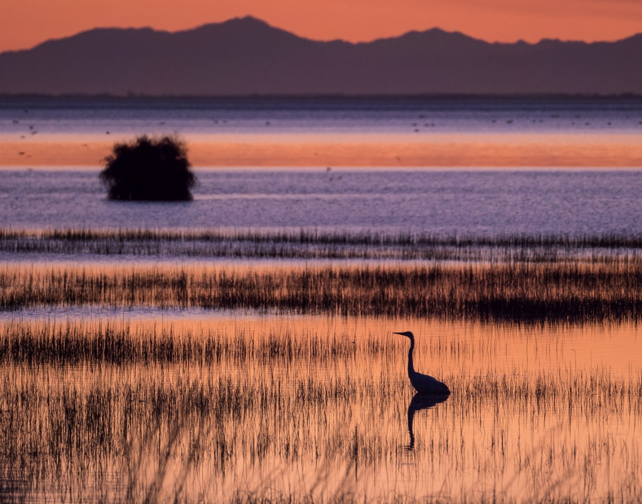
Te Waihora Taonga on our Doorstep
Culturally significant to Ngāi Tahu as a tribal taonga and a major mahinga kai
Nationally ecologically significant for its aquatic and wetland ecosystems, over 40,000 birds, range of habitats, rare and endemic species
Internationally ecologically significant, large habitat on the East Asian – Australasian Flyway
Economically significant fisheries

Slide 5
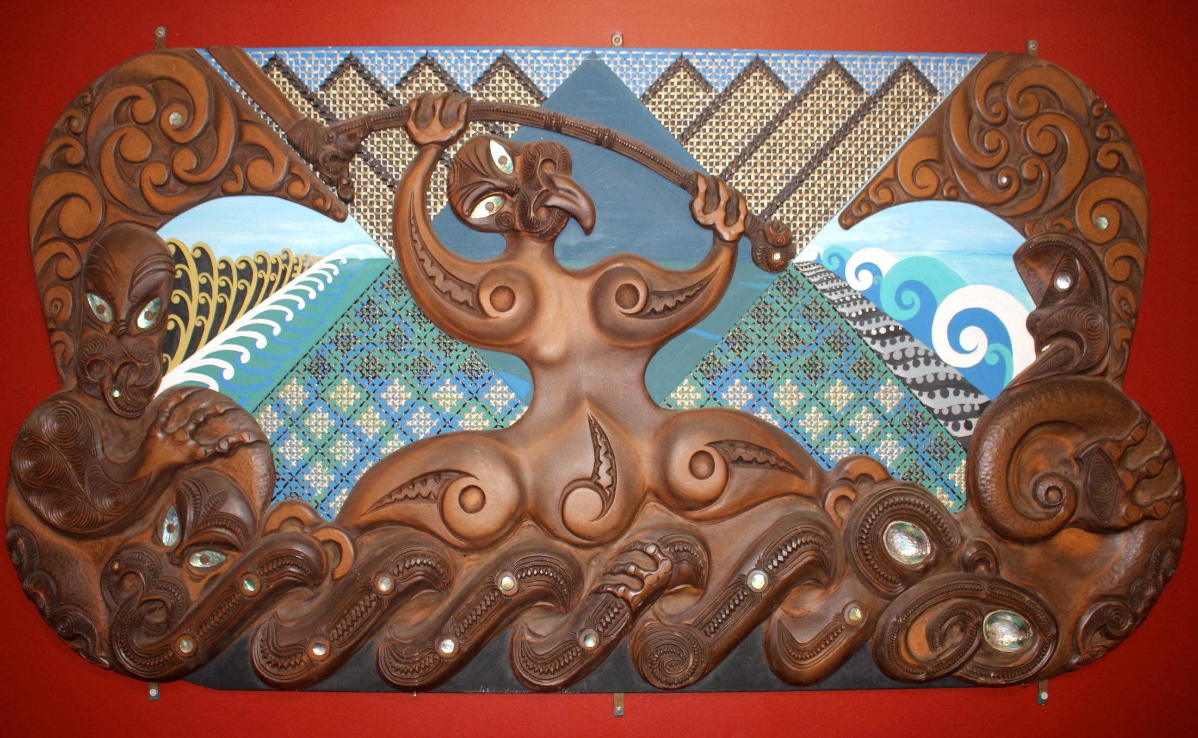
Te Kete Ika a Rākaihautū

Slide 6
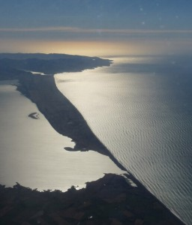
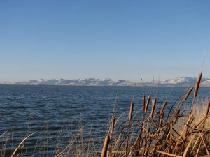
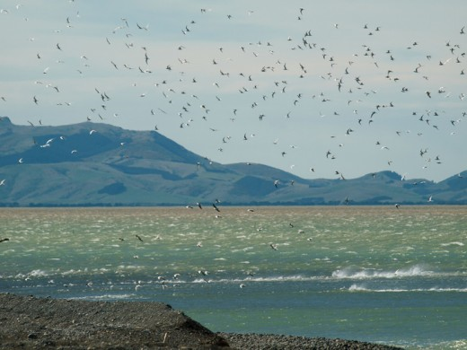
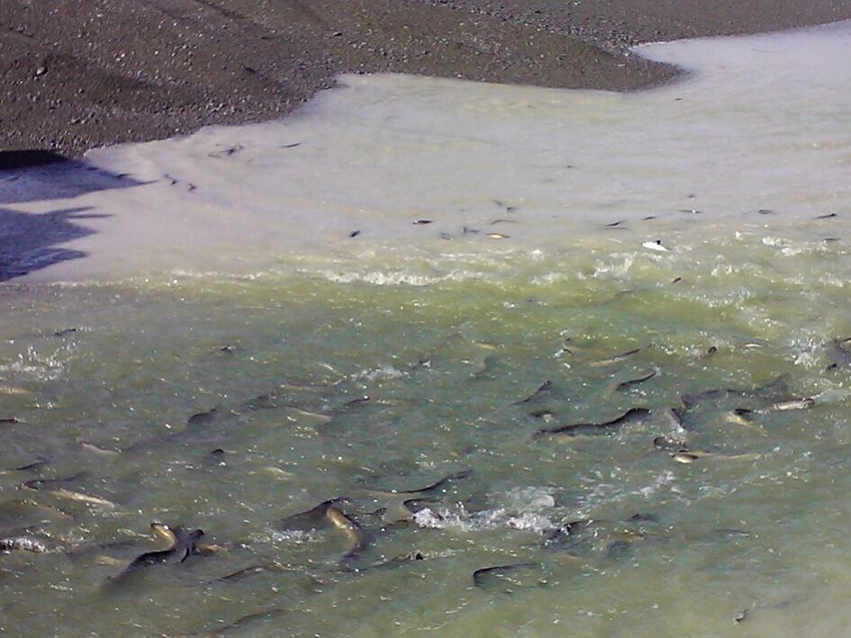
“Ko Taku Kāika Ko Orariki”

Slide 7
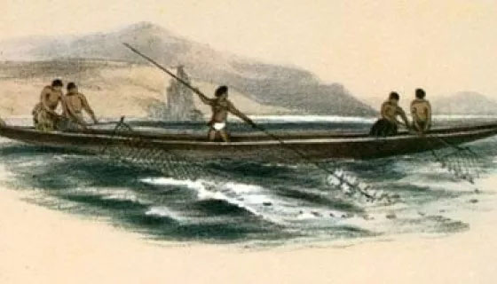
A loss of control
European settlement from 1830s
Kemp’s Purchase 1848
1865 – drainage works start for agricultural development, dire impacts on water quality and mahinga kai
Ngāi Tahu petitions start in regard to drainage and loss of mahinga kai
The full story: tewaihora.org/about-the-lake/history

Slide 8
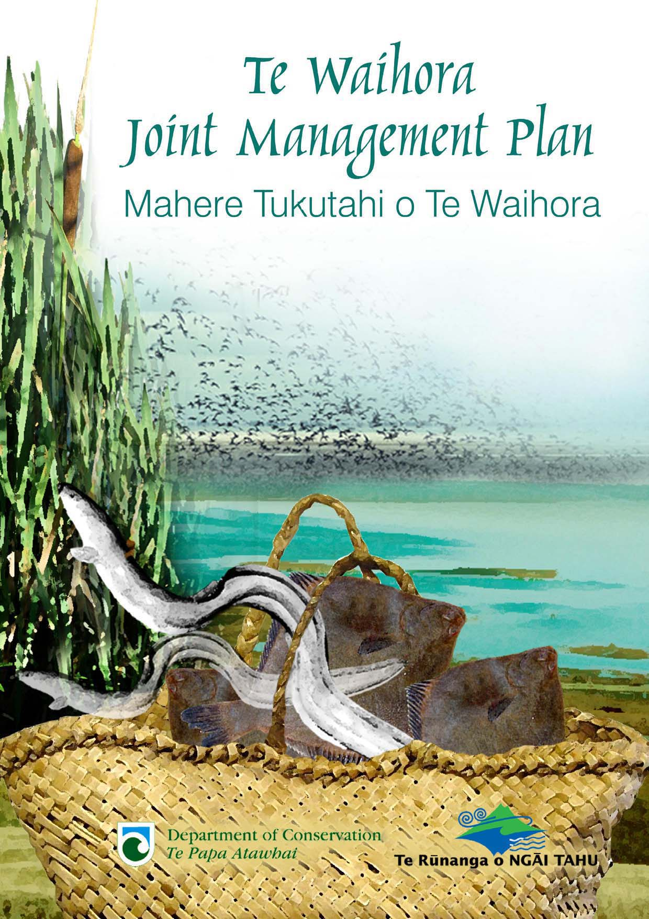
Picking up the pieces
Ngāi Tahu Land Report, Wai 27 (Waitangi Tribunal, 1991)
Ngāi Tahu Claims Settlement Act 1998 – lake bed agreement
Te Waihora Joint Management Plan between Te Rūnanga o Ngāi Tahu and the Department of Conservation (2005) for enhancement and protection of Te Waihora, includes policies for addressing water quality issues

Slide 9
Collaboration via a co-ordinated approach
Tuia relationship agreement
Joint commitment to restore mauri and ecosystem health of Te Waihora

Slide 10
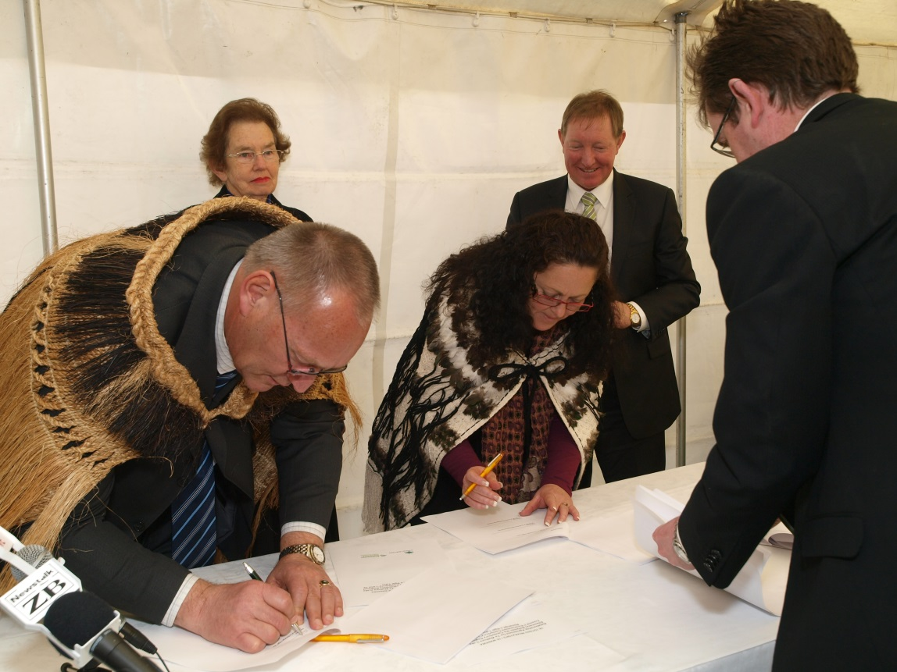
Key Dates
2011 Relationship initiated, interim co-governance agreements
2012 Co-governance agreement signed
2014 Selwyn District Council joins
2016 Christchurch City Council joins
2019 Department of Conservation joins

Slide 11
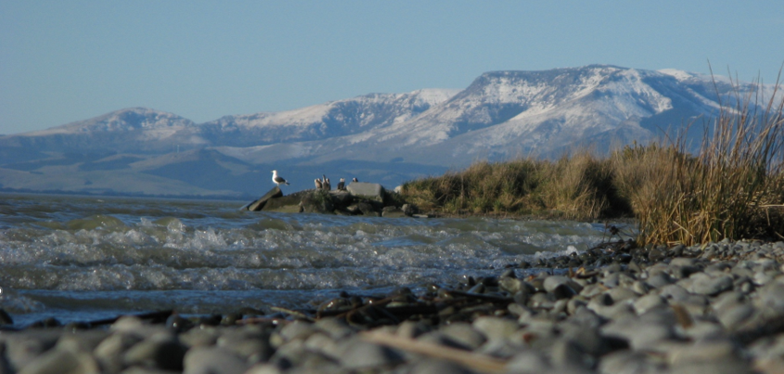
Moemoeā
Our Vision
To restore and rejuvenate the mana, mauri and ecosystem health of Te Waihora and its catchment.

Slide 12
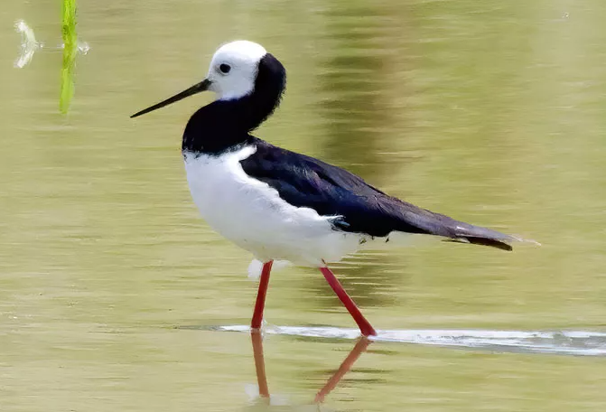
Whakaora Te Waihora programme
Operational programme to restore Te Waihora
Multiple projects funded and/or delivered by the programme
In partnership with others

Slide 13
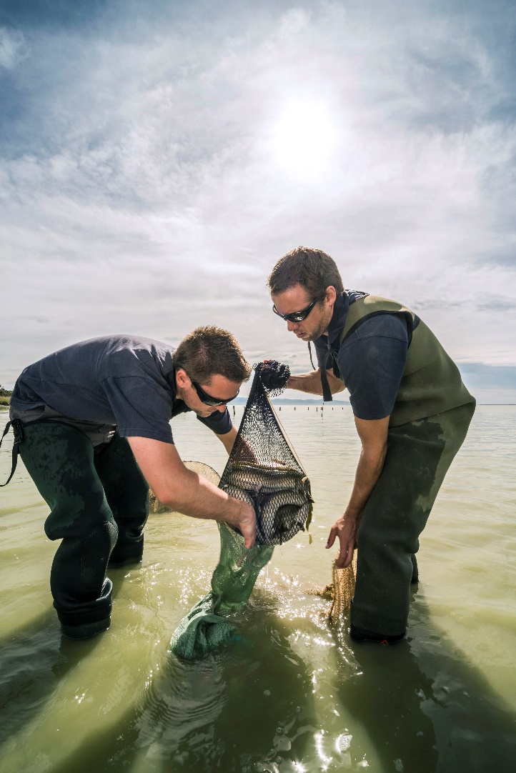
Whakaora Te Waihora aims
Accelerate restoration of ecosystem health
Restore and enhance cultural sites, mahinga kai
Protect and restore wetland and riparian habitats, indigenous vegetation, wildlife
Improve lake and catchment management practices
Establish robust monitoring, investigations programme

Slide 14
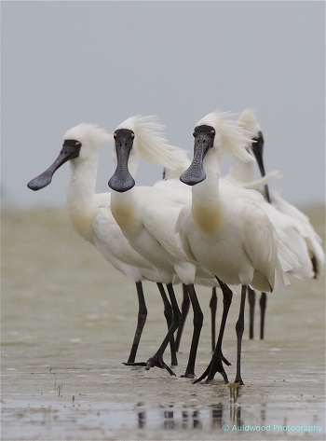
Whakaora Te Waihora Phase 1 (2012-2017)
Funded by MfE Fresh Start for Freshwater, Environment Canterbury and Te Rūnanga o Ngāi Tahu
Purpose to establish the programme and initiate works towards achieving the aims

Slide 15
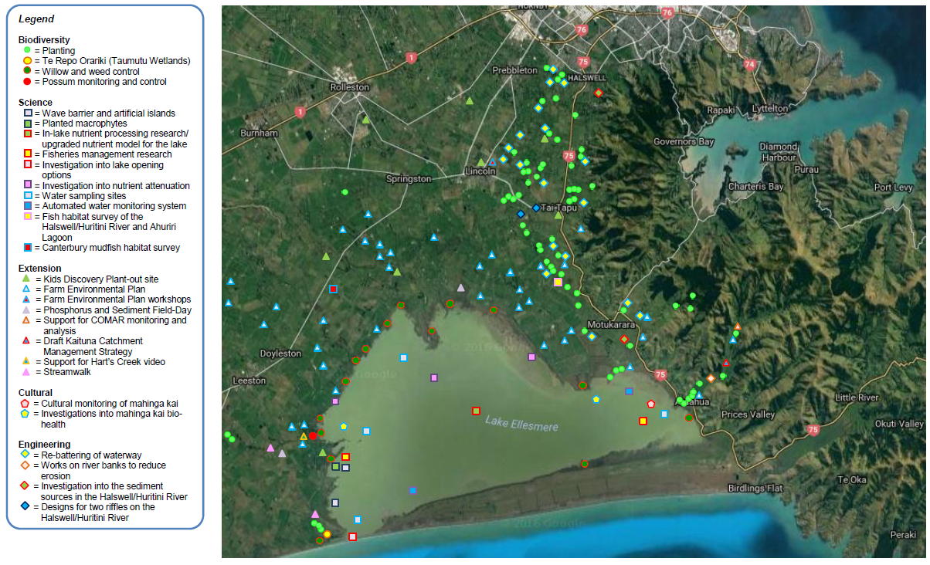
Whakaora Te Waihora Phase 1 Achievements

Slide 16
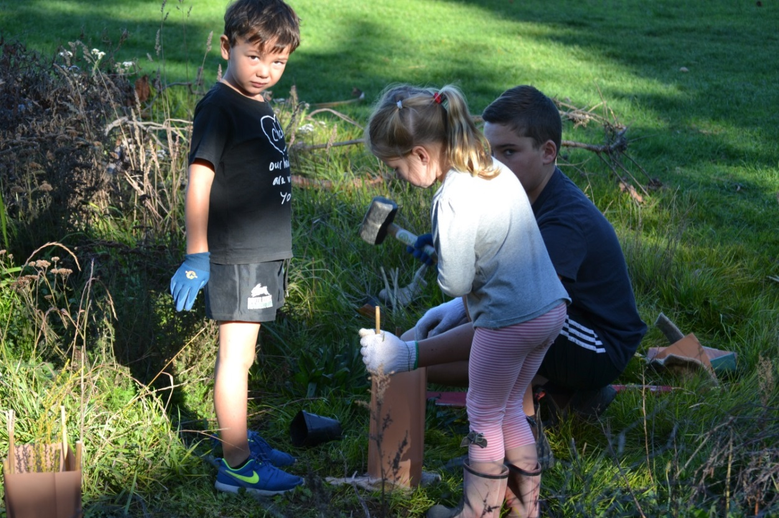
Kids Discovery Plant-Out
Delivered by Te Ara Kākāriki and Enviroschools
Planting days with local schools to learn about water, ecology, and Ngāi Tahu cultural values
Delivered by Te Ara Kākāriki and Enviroschools
Planting days with local schools to learn about water, ecology, and Ngāi Tahu cultural values

Slide 17
Regulatory intervention
Selwyn Te Waihora Water Plan
Developed by the local water zone committee with mana whenua representation
Strict nitrogen leaching rules – further reductions coming soon
Cultural Landscape Values Management Area – a unique set of rules to protect Te Waihora

Slide 18
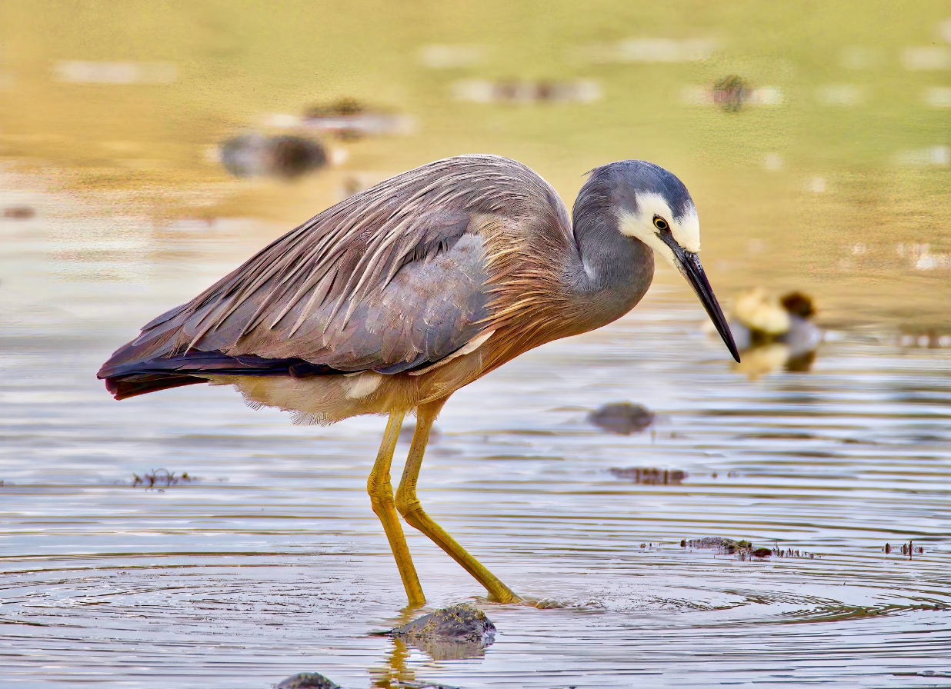
Whakaora Te Waihora Phase 2
(2017-2027)
Build on previous achievements, work towards the vision
DOC projects eg Weed Strikeforce

Slide 19
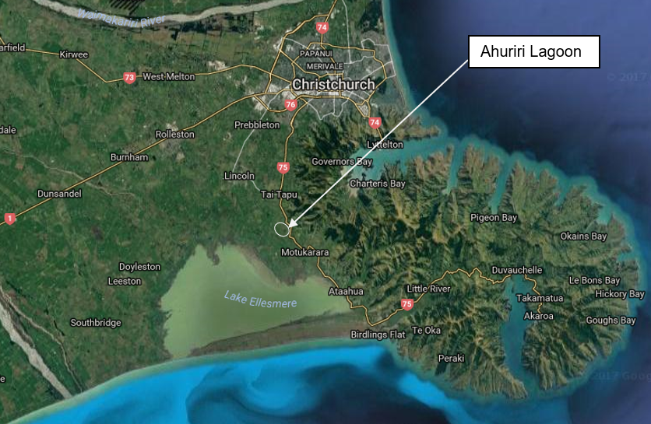
Whakaora Te Ahuriri

Slide 20
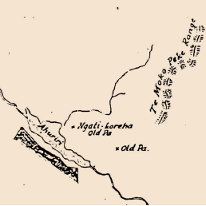
Ahuriri Lagoon
Once a significant mahinga kai
Wetlands drained for farming - 19th century
Environment Canterbury endowment land
Strong desire from the community to restore the site
Mana whenua driven, community supported, Council facilitated, Crown funded

Slide 21
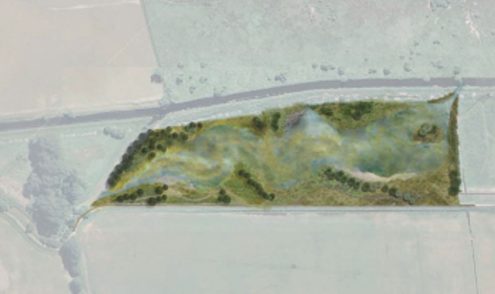
Whakaora Te Ahuriri objectives
Develop a constructed wetland to improve:
Water quality
Mahinga kai values
Biodiversity values
…and deliver to best practice standards

Slide 22
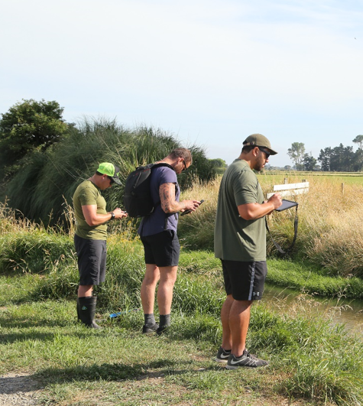
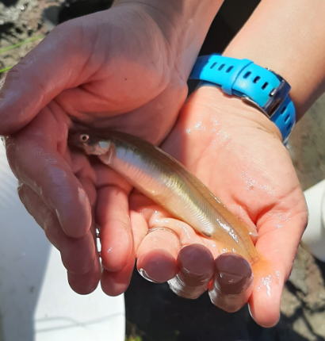
Whakaora Te Ahuriri
Mātauranga Māori monitoring programme
Water quality monitoring

Slide 24
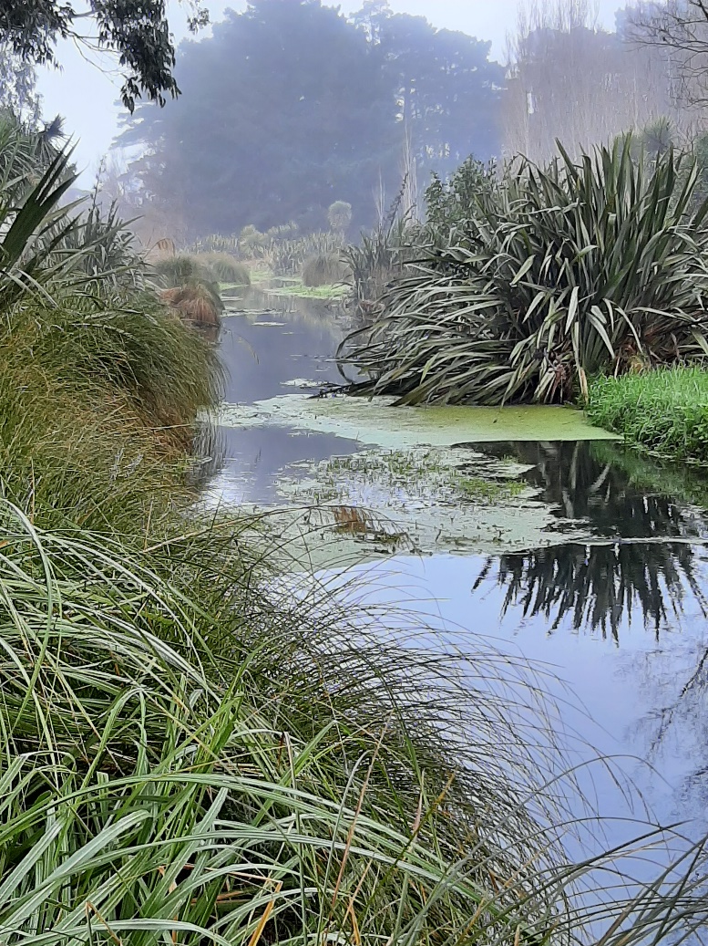
Whakaora Te Waikēkēwai
Partnership led by Te Taumutu Rūnanga, co-managed with Environment Canterbury
Restoration of Te Waikēkēwai, a culturally significant waterway
Phase 1: Wetland restoration (Te Repo Orariki), riparian planting
Phase 2: $4.16m FIF and Environment Canterbury funded project to restore the rest of the stream

Slide 25
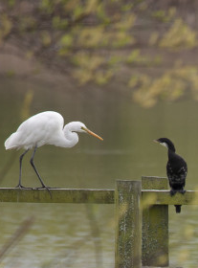
Community collaboration
Whakakōhanga Kōrero is a forum of the various organisations delivering projects to restore Te Waihora
Purpose to work together in order to be more strategic and effective in this restoration work

Slide 26
Imagine … The Future
There is much more to do (we need a lot more wetland areas restored) …
… and we must be innovative, tapping into new funding sources (private as well as public)
We have a vision and a long-term strategy …
… involving several flagship projects
Phosphorus recovery and a wetland / mahinga kai park are key Potential for economic benefit, climate change action (blue carbon)

Slide 27
A new dawn
Patai/questions?
Visit our new website at www.tewaihora.org

Slide 28
Mō tātou, ā, mō kā uri ā muri ake nei
For us and our children after us.

