Slide 1
Reusing assets to create capacity and resilience:
Can you teach an old pipe new tricks?

Slide 2
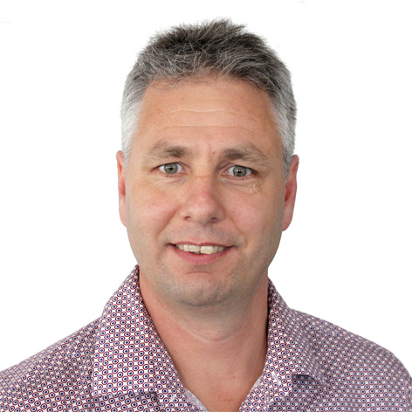
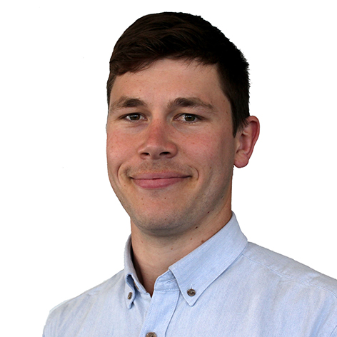
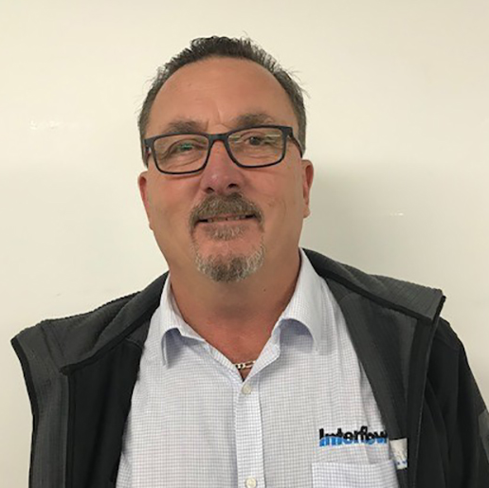
Presenters
Nathan Clarke
General Manger Regional Services
Concept Development
William Nieuwenhuis
Civil Engineer
Design and MSQA
John Adamo
Operations Manager
Solution design and delivery
Notes:
No reira, tena koutau katoa
Nga mihi ki a Blaier thanks for the intro
Ko William toku ingoa
Ko te tai-o-aorere te moana e mahea nei aku maharahara.
Te tai-o-aorere – tasman bay - is the body of water that makes my worries go away.
Today we are speaking about a relining project in Nelson.
My main role in this project was the detailed design of the enabling works and the MSQA through delivery.
Presenting with me is Nathan, our client and asset owner, who developed the concept
Additionally we have John from Interflow, he oversaw the project installation, he will be available to answer any questions at the end

Slide 3
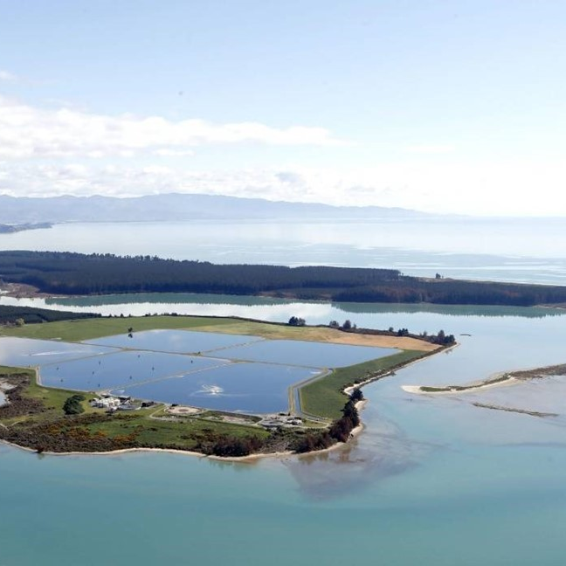
Agenda
What are our key messages?
- Right project –define objectives first
- Collaboration/planning
- Make use of existing assets and new technology first size length, planned so it went well
Background
History, Key Issues, Desired Outcomes
Why this project?
Project concept, critical constraints, why we thought this was the right project.
Doing the Project Right
Optioneering & Investigations
Delivery
Lessons
Notes:
So, Can we teach an old pipe new tricks? Today we are talking about a trenchless project that is part of a wider duplication program for the NRSBU
Nathan is going to share the background, why we needed this project
I will talk how we did it.
And finally Nathan will close with how this experience could benefit you.

Slide 4
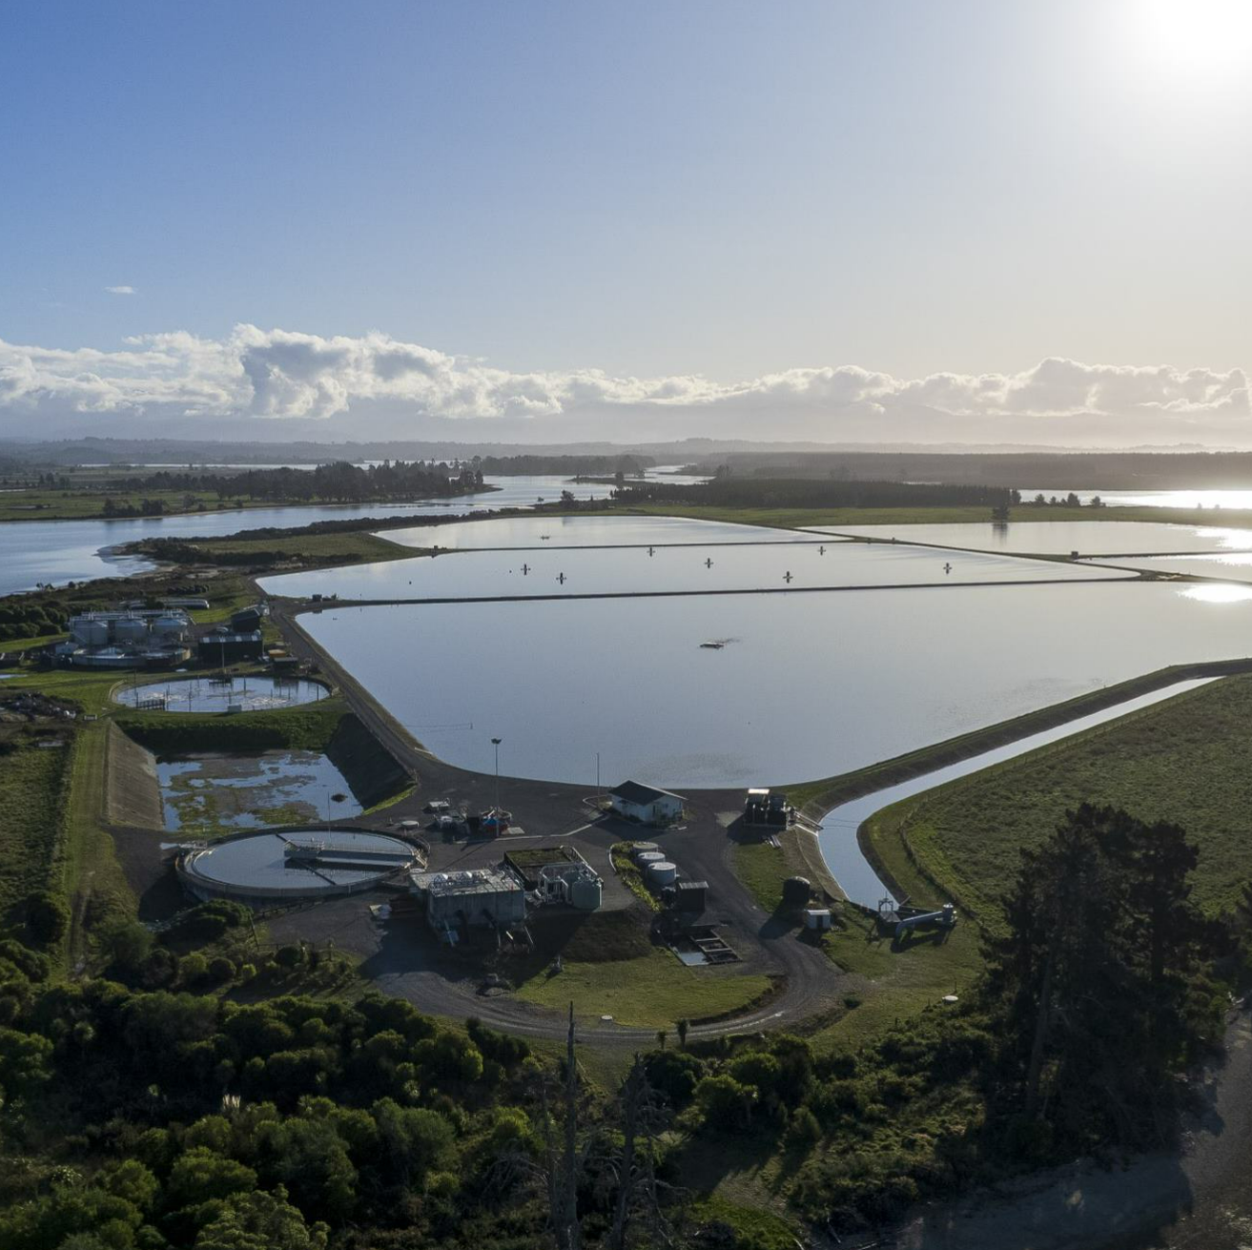
Background
Who's the NRSBU?
Regional Rising mains
Wastewater treatment
Wastewater reuse
Biosolids treatment and reuse.
Network capacity and resilience upgrade project.
NRSBU goal is Zero Overflows.
Finding the "Right Project".

Slide 5
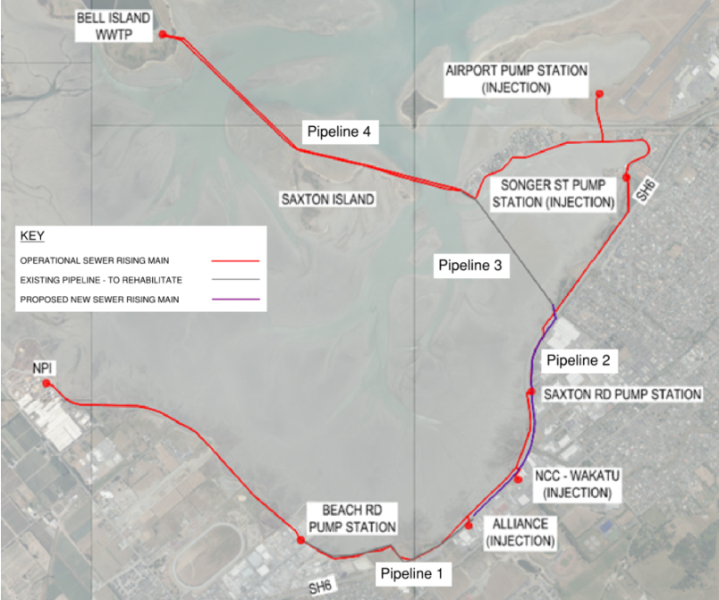
Network history
1984: Regional Scheme with pumpstations and AC, concrete and PE pipes
Late 1990s: AC pipes in Richmond end of network were failing due to corrosion
2000: Replaced Beach to Saxton part of highway upgrade
2005: Saxton to Martin Point for resilience and capacity
2012: Martin Point to Bell Is, Resilience risk. Concrete kept for PWWF
2020: capacity issues need to be resolved ASAP
Notes:
Bit more detail on how the system works and the history.
Firstly to describe some of the old pipes.
Beca Carter Hollings and Ferner designed the original regional sewerage scheme.
There are three key pump stations: with a Y at Monaco.
Beach Rd built in 1984 collects flows for Richmond there was an AC rising main from there to Saxton PS..
Saxton PS picks up Nelson flows and sent them across the estuary where they combined at martin point with airport flows and then there is a concrete pipe from here across to the treatment plant.
Now the current pipes, shown in red.
Beach to Saxton, they AC pipe was given a hard time by some of the industrial flows from NPI.
When the state highway was built 20 years ago the NRSBU replaced this section with PE.
Shortly after that the Saxton to Martin Point line was replaced with a DN800 pipe which follows the coast.
This was when our project host pipe was abandoned.
Finally 10 years ago a new harbour crossing was installed from Martin Point over to Bell Island, thought the concrete pipe was keep in service and gets used for wet weather events.

Slide 6
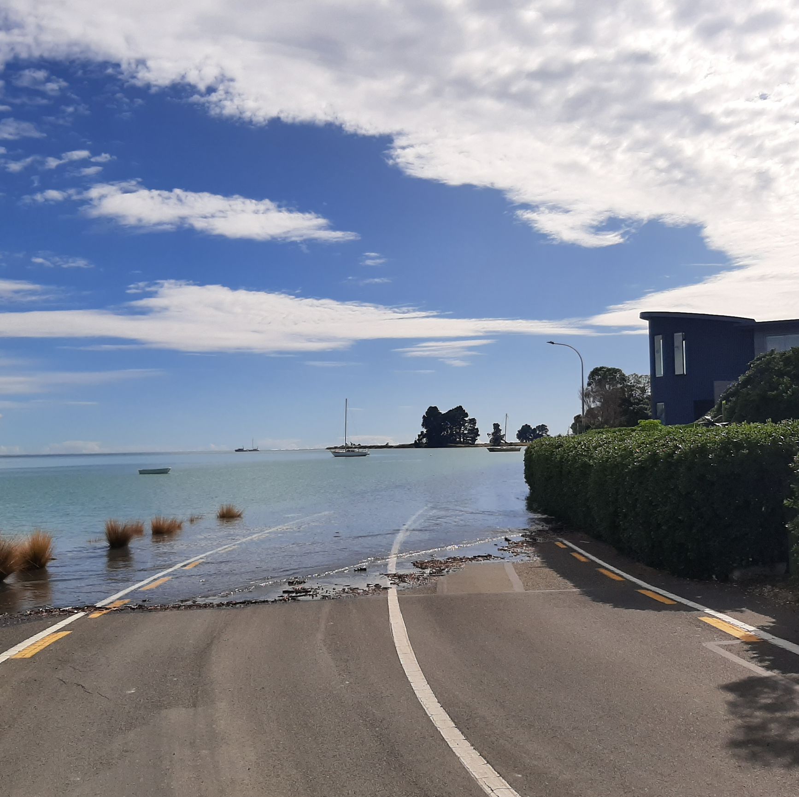
Key network issues
Current capacity limitations
Almost no network storage
Poor maintainability of the network
Poor network resilience
High growth in Tasman
Route through sensitive estuary
Sea level rise
Climate change
Notes:
The key objective was to increase the capacity of the network to improve reliability and reduce the frequency of overflows, particularly around the Inlet. An upgrade had been proposed historically that had an estimated cost of more than twice the available funding, leading to the resolution being delayed.
And in mean time overflows occuring – public risk and enviro damage.
NRSBU objectives in rehabilitating this existing pipeline are:
1. To increase the networks capacity to convey storm flows from Beach Rd to Bell Island to reduce the frequency of overflows to the inlet. NRSBU is seeking to provide as much additional capacity as possible and at least an additional 300L/s of capacity is sought from this project. This can be achieved by sending flow through duplicate pipelines between Beach Rd and Bell Island.
2. To provide operational improvements through the provision of duplicate pipelines between Beach Rd and Bell Island. This would allow the pipelines to operate in a duty/standby pipe mode (during dry weather), allowing operational maintenance to be undertaken on the standby pipeline without disrupting service. During wet weather the pipelines would operate in a duty/assist mode to convey the higher flows associated with wet weather events, thus reducing the frequency of overflows.
3. To implement capacity improvements to the network in a short period that allows the elimination of capacity-based overflows to the Waimea Inlet. This allows NRSBU time to develop its 50 year Master Plan for the regional facilities and schedule and budget for any significant and costly network changes in a way that integrates with the 50 year Master Plan

Slide 7
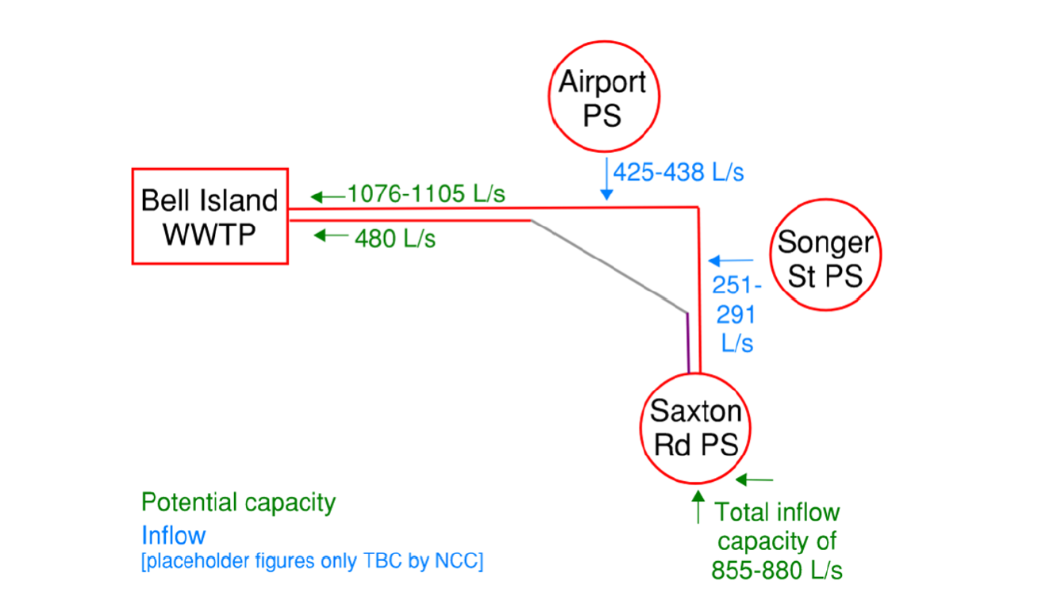
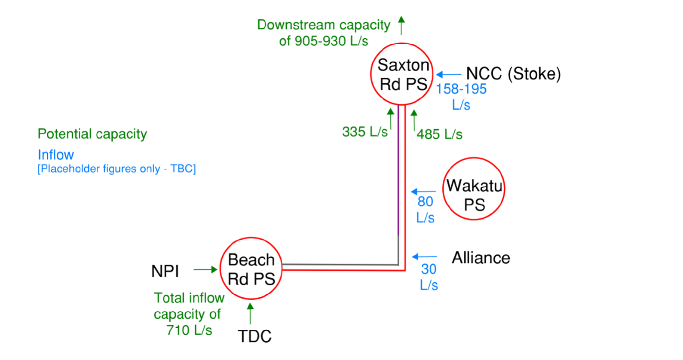
Key outcomes desired
Must Have:
Increase capacity (~2050)
Design life (~2050)
Fit into long term plans
Rapid Implementation
Below capital allowances
Improved maintainability (>ADWF)
Nice to Have:
Increased resilience – duplication, spatial separation
Allow recycle water pipework implementation
Notes:
The key objective was to increase the capacity of the network to improve reliability and reduce the frequency of overflows, particularly around the Inlet. An upgrade had been proposed historically that had an estimated cost of more than twice the available funding, leading to the resolution being delayed.
NRSBU objectives in rehabilitating this existing pipeline are:
1. To increase the networks capacity to convey storm flows from Beach Rd to Bell Island to reduce the frequency of overflows to the inlet. NRSBU is seeking to provide as much additional capacity as possible and at least an additional 300L/s of capacity is sought from this project. This can be achieved by sending flow through duplicate pipelines between Beach Rd and Bell Island.
2. To provide operational improvements through the provision of duplicate pipelines between Beach Rd and Bell Island. This would allow the pipelines to operate in a duty/standby mode (during dry weather), allowing operational maintenance to be undertaken on the standby pipeline without disrupting service. During wet weather the pipelines would operate in a duty/assist mode to convey the higher flows associated with wet weather events, thus reducing the frequency of overflows.
3. To implement capacity improvements to the network in a short period that allows the elimination of capacity-based overflows to the Waimea Inlet. This allows NRSBU time to develop its 50 year Master Plan for the regional facilities and schedule and budget for any significant and costly network changes in a way that integrates with the 50 year Master Plan

Slide 8
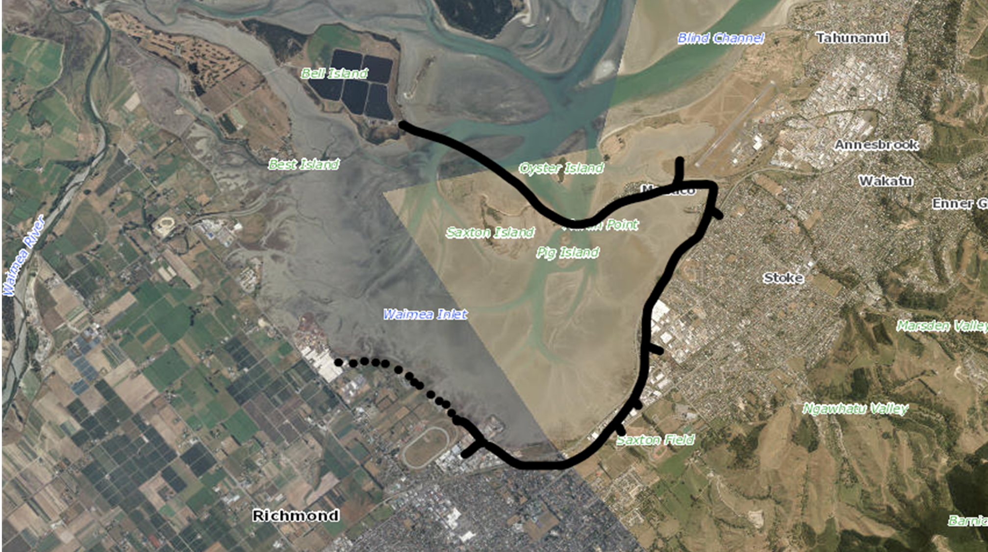
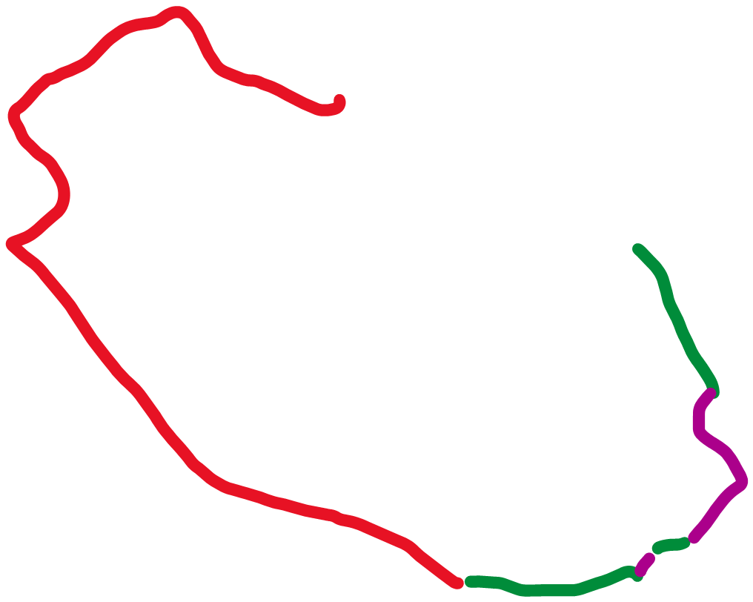
Original Plan $30 - $40 million
Available Budget - <$16 million
Potential Option - $12- $14 Million
Notes:
Black line is current rising main alignment
Original plan – 10+ Km new pipe in high traffic road with services, septicity due the volume, additional pumpstation, sensitive archeological route.~ $30-40M
Identified unused pipes as part of the review of alternatives.
Identified an alternative concept shown in Green and Purple ( green existing abandoned pipes that could be sleeved < purple is proposed new laid pipe)
Needed to sense check the potential option, but significant benefit to be gained.

Slide 9
Project concept
9 -10 km – Total Beach to Bell Is, either direction
6 km – Beach to Martin Point
4 km – If shortcut via pipeline 3
Rehabilitate save cost and disruption
Duplication benefits:
Redundancy
Reduced septicity
Resilience
Maintainability
Is the pipe still there?
What condition is it in?
Can we reline it?
How can we be confident that there isn't an issue in the middle?
Notes:
So hopefully that makes some sense so now I can explain the concept.
From Beach to Bell Is is 11km in the current system. Duplicating this pipework and pump stations costs a fortune.
From Beach to Martin Point via the old pipes is 6km, the objective was to see how much capacity we could get out of using the old pipes and buy time additional to develop a master plan solution.
Recognised we dont have a clear understanding of sea level rise, climate change effects on flows, and implications to pipes and to the Bell Island WWTP
Hence a plan that was low cost and resolves the immediate and short / medium term issues was a good fit.
The plan was contingent on the presence and condition of the pipes, in this case largely dependent on this section (Pipeline 3) as it provides a convenient shortcut, saves 2km.
Though its very long a 1.1km under an estuary so we weren’t even sure if we could rehabilitate it if we found the pipe to be not collapsed.
A duplicate pipe also has the benefits of redundancy. Resilience allowing maintenance and reduced septicity.
The next phase happen in parallel we looked at options for the pipe crossing but also investigated to see its condition.

Slide 10
Critical project constraints
Pipeline 3 was critical for success.
Rehabilitating ~1200m of 525 AC under the Waimea Estuary removed from service in 2007.
Condition unknown at time of removal.
Considered range of methods.
Any option that required more than minor disturbance to the estuary would not be acceptable.
If the rehabilitation could be done from shore to shore, then it would be within permitted activity rules.
Notes:
Again Pipe 3 Critical to the project being affordable.
Did some concept assessments of lining options to sense check.
Considered Slip lining, Swage lining, and other methods, but none seemed appropriate.
Reached out to tech suppliers around the world, is part of this we identified Primus line as one of the options for a relining project of this length.
We met with the Primus liner representative to discuss the potential of this technology.
This lead to looking at other similar products.

Slide 11
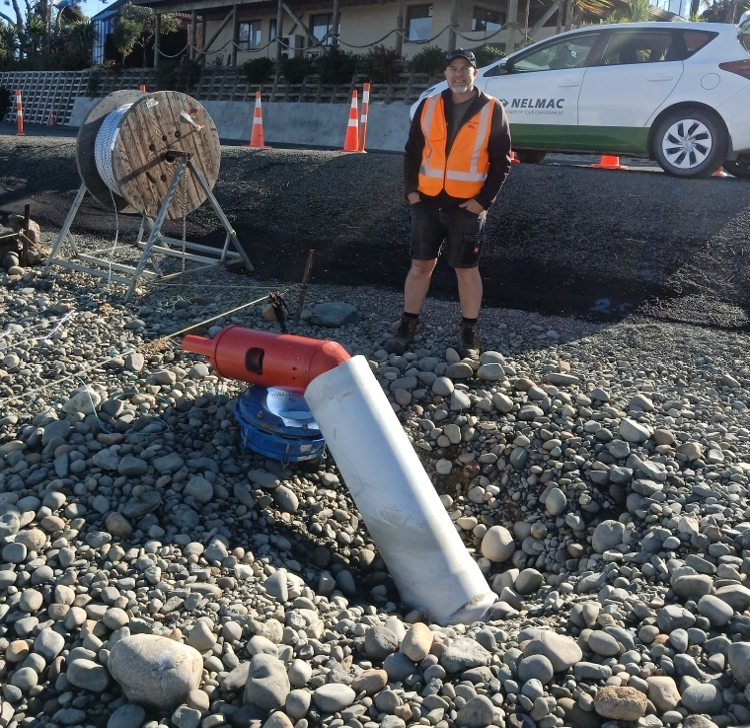
Early investigations
Preliminary CCTV work ~ 100m either way from each shore looked fine
"Sewer shark"
Confirmed project was a permitted activity.
Risk review and contractor discussions
Highlighted that we needed to reduce risks associated with unknown pipe condition
Concluded it was worth the risk of moving further
Believed we found the Right Project... now had to do the Project Right
Notes:
Before we could be confident that this project could be undertaken, we needed to do some sense checks.
It was a great Idea, but we didn’t know whether it would actually be feasible technically.
The critical aspect was a check to see whether the pipe had the potential to be OK, or whether it was highly degraded.
Cut into the pipe and did some quick and short CCTV work – showed the AC to be in better than expected condition. Check the pipe water level under different sea levels which didn’t really change ( suggested the pipe was intact)
Couldn’t fine anyone nationally who could readily CCTV 1100m through the pipe to check, so while we looked around for options, we let our O&M contractor see whether they could pull a rope through the pipe. They came up with the Sewer Shark ( a diving thruster in a sleeve) which would tow the rope through the pipe.
It towed the rope a few hundred meters but kept stopping. It turned out there was an air pocket in the pipe (subsidence of sections over time trapped air) that meant it could not push it self through.
It did show that the pipe was

Slide 12
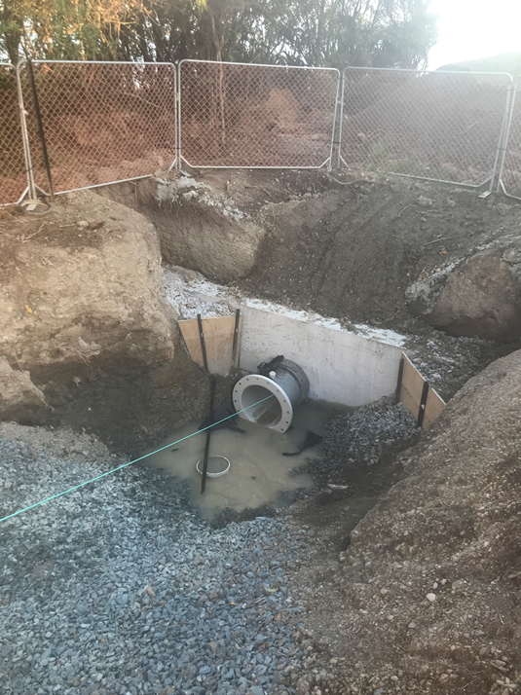
Why the right project?
Relining Pipeline 3 would allow a network upgrade which gave:
30 years future capacity within budget available
Acceptable design life.
Rapid install - key section a permitted activity.
Reuse of the assets would reduce environmental impacts
Some remaining budget for water reuse pipework installation in other parts of network.
Improved spatial separation and resilience.
Duplication which enabled >AWDF to continue while sections out for maintenance
Notes:
This project hits most of the desired outcomes, particularly the must haves. The Cost was critical as we couldn’t implement a solution in a timely fashion if we had to source more funding.
The One area that was compromised compared to a new PE pipe was the expected life of the solution.
PRIMUS LINE indicate a design life of 50 years, but this does rely on the host pipe.
For this project we needed to develop capacity to 2050 ( ~ 30 year) which is well within the primus line design life, and which we believe the AC host pipe will also last ( albeit severely degraded at the end.)
This option resolves the capacity, resilience and maintainability issues rapidly within the budget, and also gives time for climate change knowledge and implications to evolve.
It allowed the key section to be implemented without any significant work within the Estuary, which meant that the project was permitted activity, and therefore could be implemented rapidly.
It also allows sufficient time for regional strategies likely to arise from 3 Waters to be developed which might significantly change the current council long term plans.
Finally it was below the available budget which allowed some funding to be available for additional reuse pipework to be installed.

Slide 13
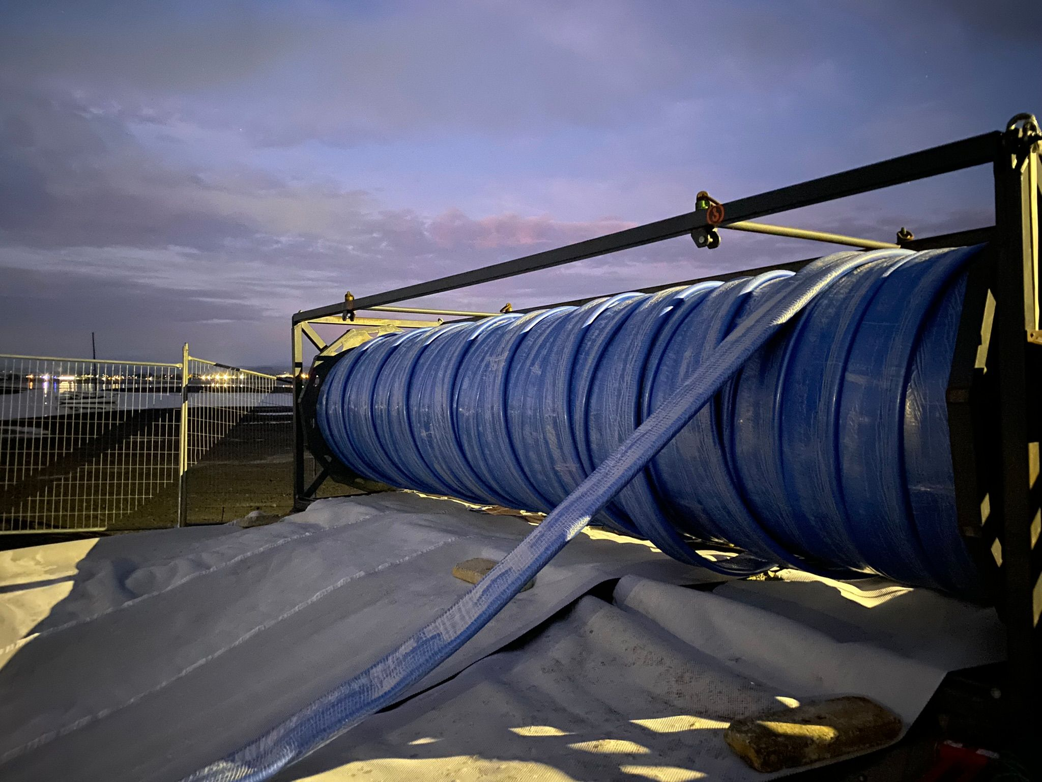
Doing the right project
Notes:
Thanks Nathan
I’ll now share the journey delivering of this complex project, that Beca was fortunate to tackle and to be able to deliver for the NRSBU and the Nelson community.

Slide 14
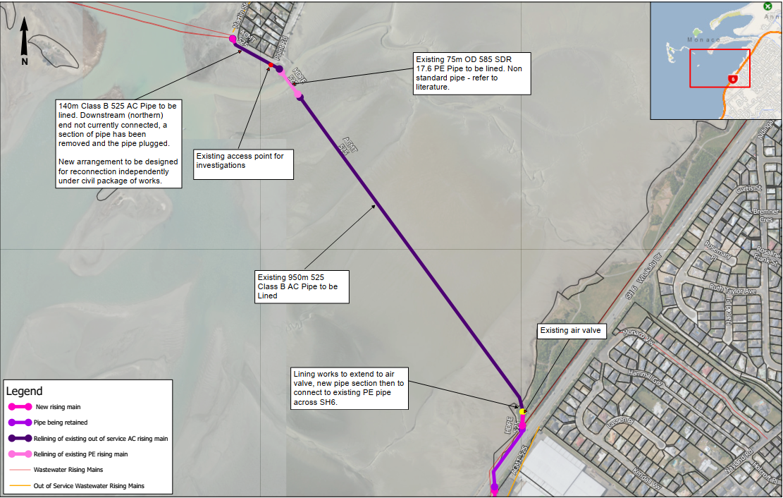
Optioneering
Strategy – write it down
Bends, length, size
Contractor involvement options
Notes:
We had the concept but how would it work?
There were still some major questions to work through.
The first thing we did was write a project strategy this was really useful as a way to engage with specialists.
This strategy communicated the objectives, the site constraints and planning requirements.
This graphic was a part of the strategy and illustrates some of those constraints.
In addition to size and length, this pipe was difficult to line for the following reasons:
This pipe had two 22 deg bends close to each end but within the estuary.
Bends are typically an issue for liners. Getting past these requires more pulling force and can increase the chance of liners wrinkly.
There was a PE section through the main tide channel so we had material change to consider. We weren’t sure how the internal diameter would line up with the AC pipe and how this may impact options for lining.
As builts were all suggesting a non standard size, 585 OD Pe what? just to add more uncertainty.
We engaged with potential contractors and suppliers to gain a deeper understanding of their capabilities and assess proposed costs and methodologies to achieve our project objectives.
The contractors were very helpful. Both Hadlee and Brunton and Interflow recommended a "pull in" fold form solution as the best option for our project. Its useful that these contractors offer a range of solutions so aren’t too bias too a particular option.

Slide 15
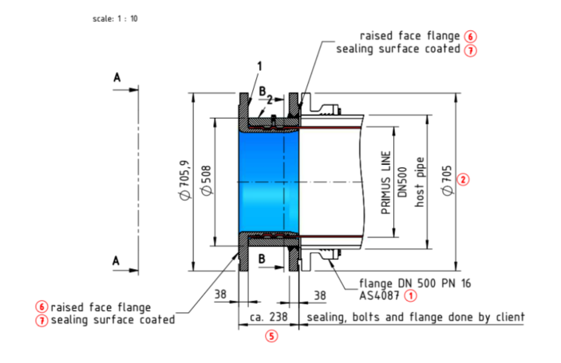
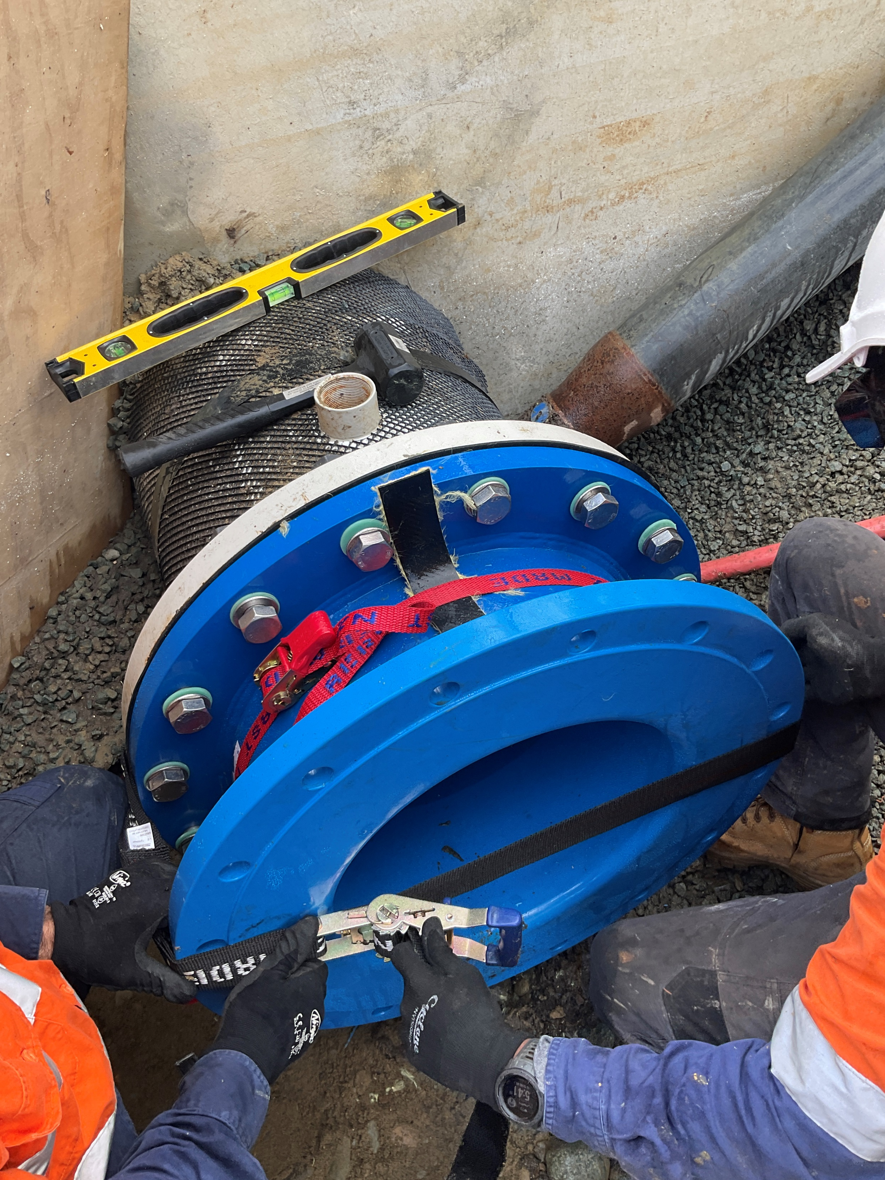
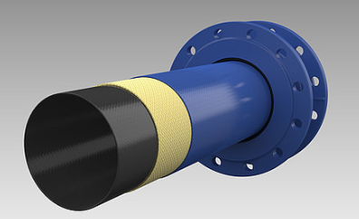
Product selection
Capacity, bends and length
Procurement
Primus Line system – 3 layers
Restraint and connection
Risk management
Notes:
We needed a product that would
- provide the required capacity
- and most importantly cross the estuary in a single length.
The two options available for us were Primus Line by Interflow and Sanitube by Hadlee and Brunton.
As these are propriety products we used a design and construct contract. The enabling works were excluded from their offers so we arranged to have these done by a local civil works contractor, Chings Contacting Ltd.
However, we still didn’t know if we had a suitable host pipe. So we structured this contract as two separable portions, stage 1 investigations, stage 2 install.
And we awarded the contract to Interflow
So what is Primus Line?
We had no idea, it not been used in Nelson and it took a while to fully understand the details.
I would recommend you head over to Interflows stand in the foyer.
Primus Line is specifically designed for pressure pipelines and it comprises of three layers.
It has a smooth PE inner layer, a mid-layer made from Kevlar, and a PE outer layer. These layers work together to create a liner that is strong but flexible enough to get around bends up to 45 degrees. It’s like a fire hose.
Note that bends do cause pressure derating and it is not a structural solution.
The liner is clamped into a special german coupler which can be configured for the required connections.
This here is a flanged coupler that we used.
The coupler needs to be restrained as you can see, we attached it to a thrust wall which was installed as part of the enabling works.
Primusline and Interflow were very helpful as we worked with them to understand the product and installation methodology. They are happy to chat and share knowledge and this really helped us with our risk management.

Slide 16
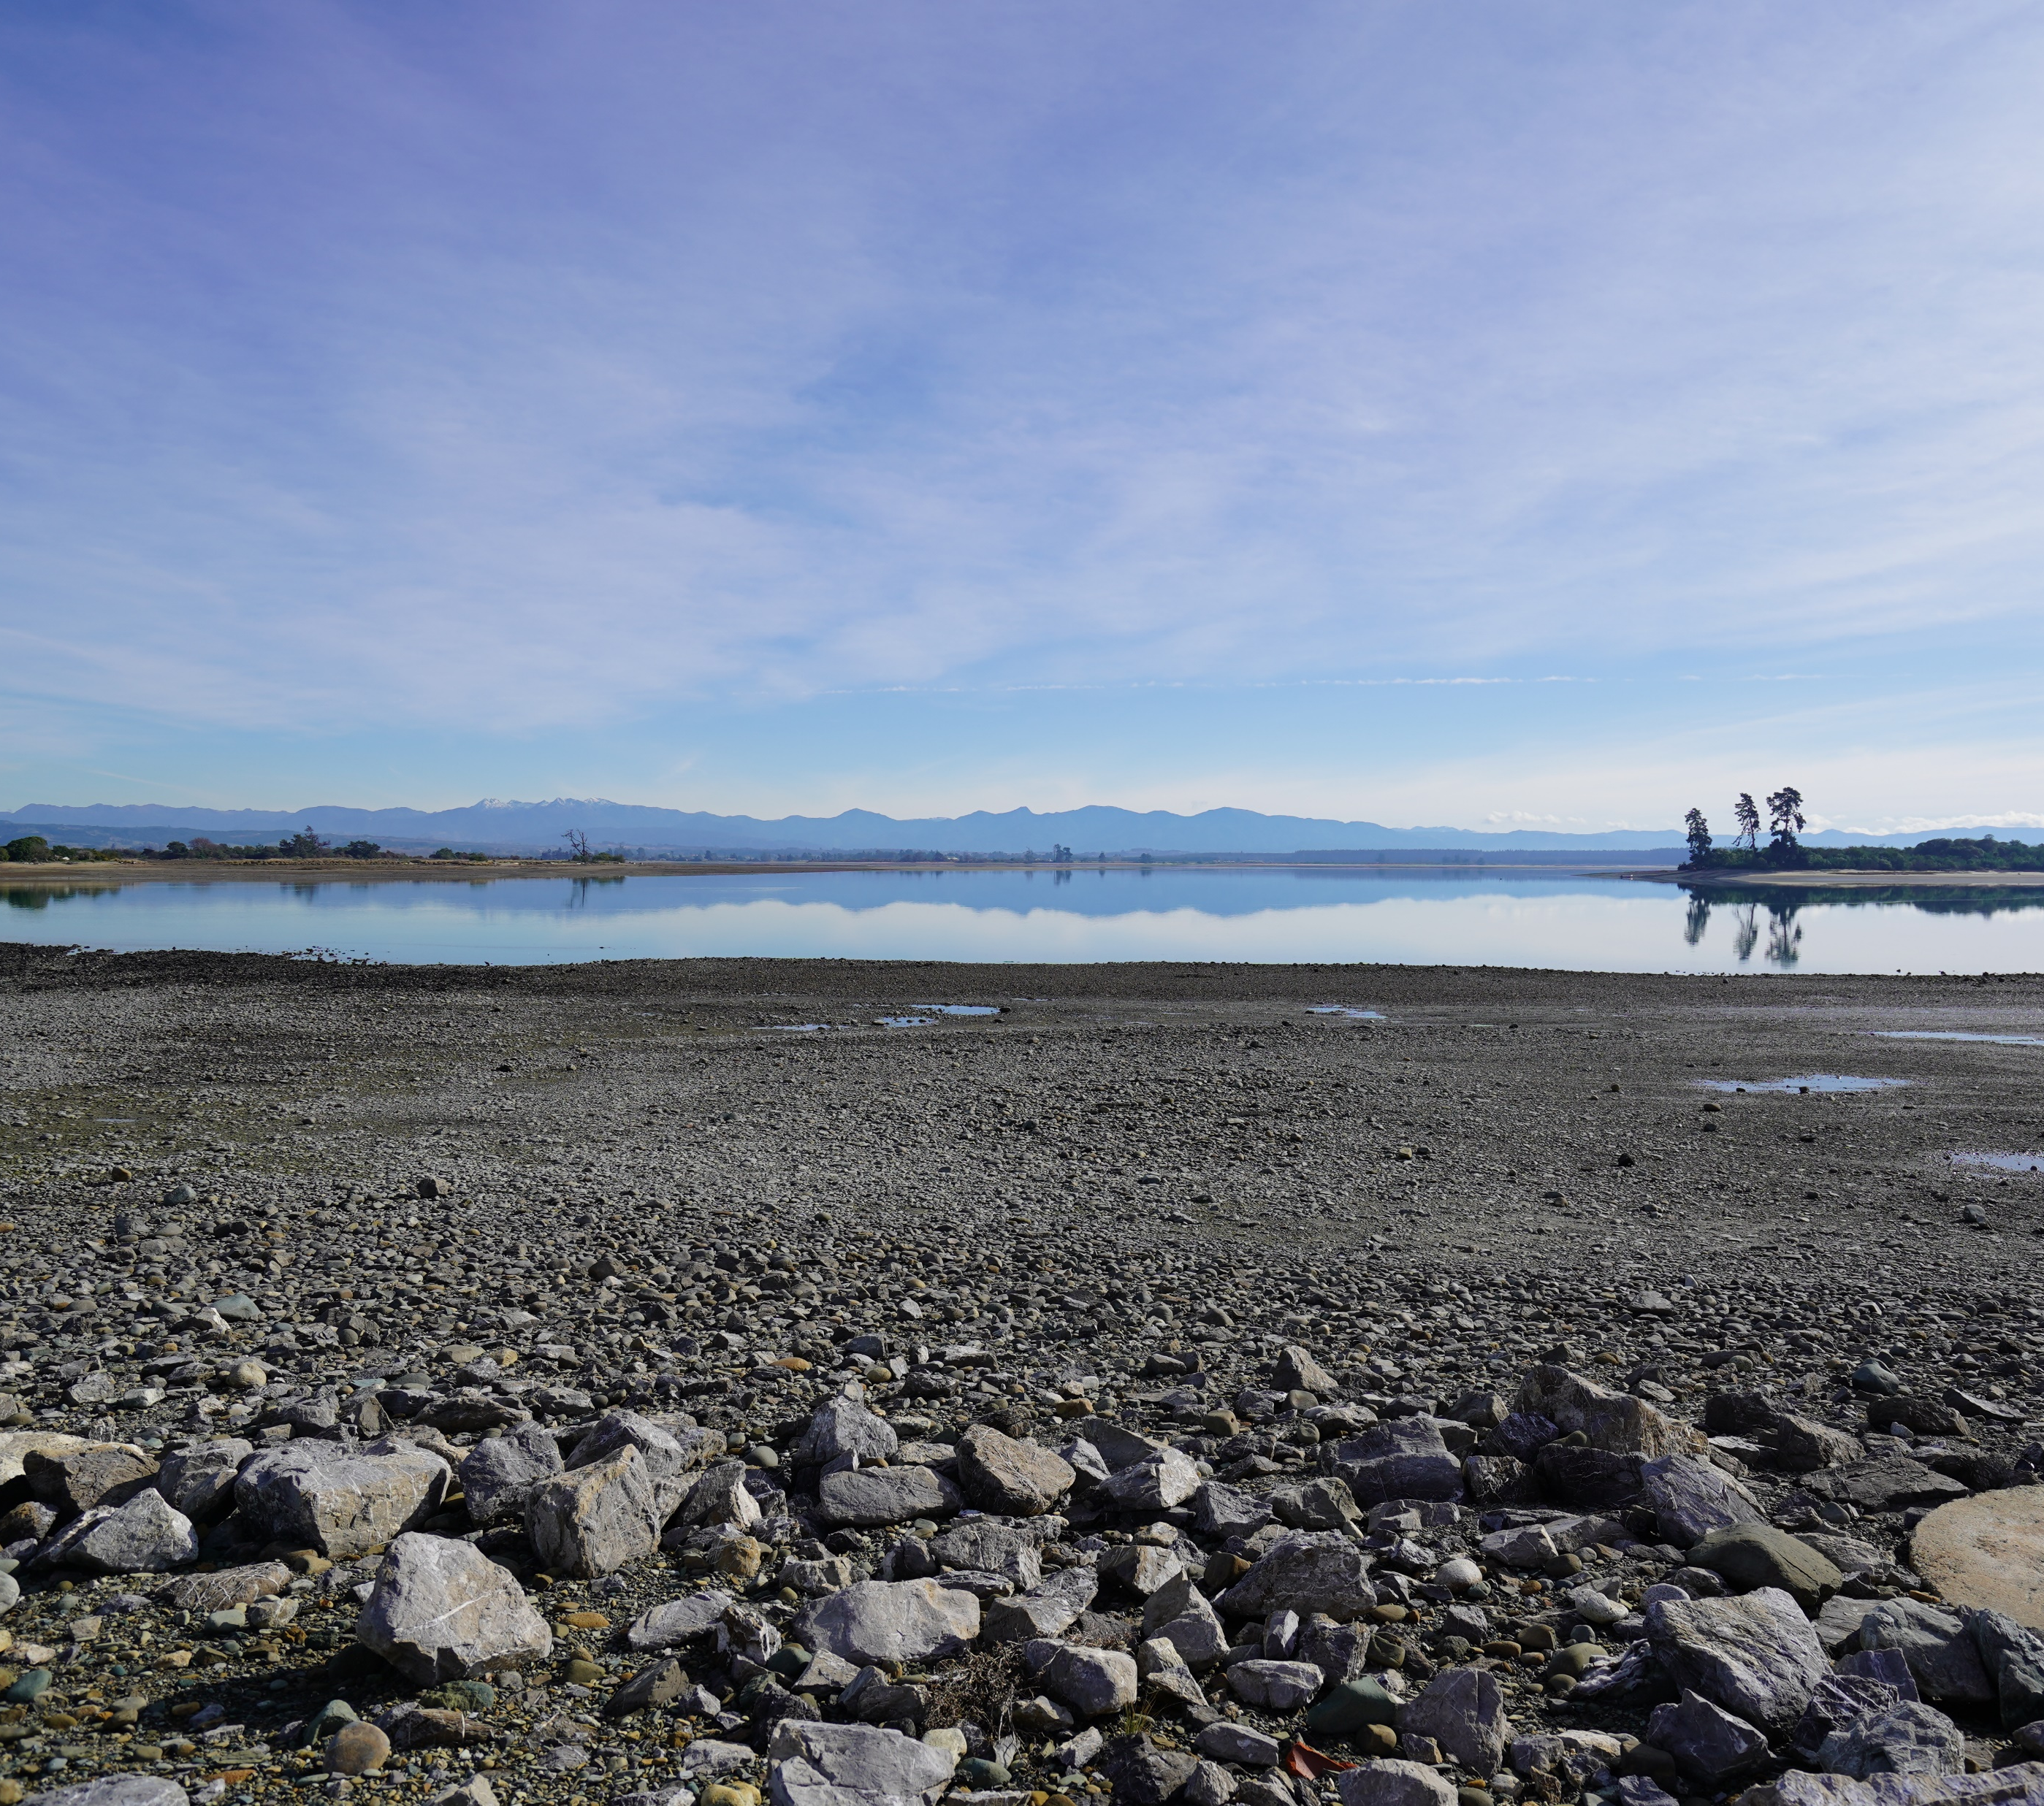
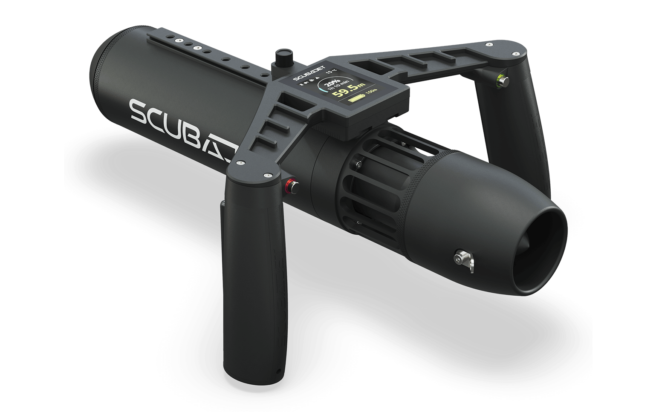
Investigations
Long way - 1.1km
Scuba trials
America CCTV camera
Rope install
Notes:
The pipes condition was our biggest uncertainty.
This pipe was fundamental to the pipeline duplication concept working within the current budget.
For the project to proceed, the entire length of pipe needed to be inspected to confirm it was suitable. The catch was technology capable of communicating at such a range and in an underwater pipeline was not available locally. The Interflow team identified specialised CCTV equipment in the USA that could perform this important job, while also towing through the guide rope for the installation.
It was risky to assume that the pipe was intact after more than 15 years out of service and the cost for the large camera to establish was scary.
So prior to committing to the contract we tried to float a go pro camera down the line and launched a scuba jet like the one shown.
Unfortunately the jet it didnt get to far before clogging with leaves, but we think it was worth the risk trying it out before committing to be big spend.
We knew this was the right project, so we committed and brought in the right tool in the end aka this camera.

Slide 17
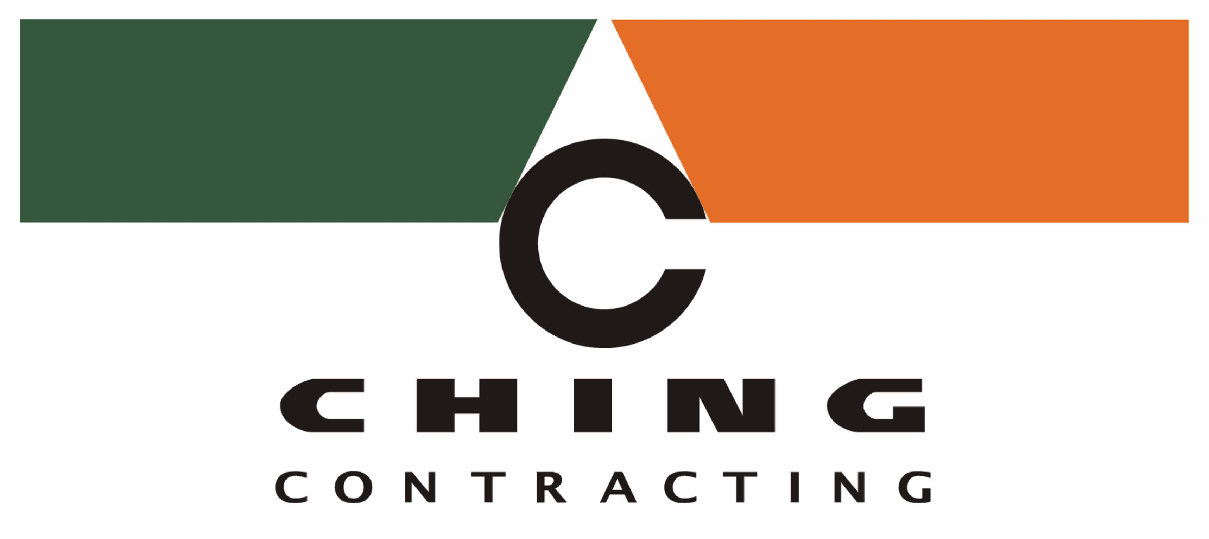
Key players
Notes:
This project was a collaborative effort between several players.
All these organisations had input into the methodology which helped when it came to construction as we were all on the same page.

Slide 18
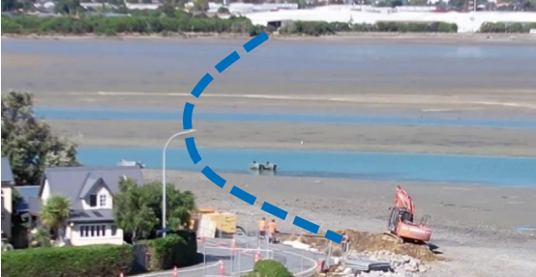
Enabling works
Notes:
As this is a pressure sewer there weren’t any manholes to access and line from.
We designed the anchor spools for this project working with Interflow to understand their requirements and adapt these for our local standards and future connection requirements.
Ching’s the local enabling works contractor developed a construction methodology and proposed to precast thrust walls to reduce the construction timeframes and make the works safer.
Here you can see Chings installing these thrust walls and access pits.
It was a big hole but still a lot less digging than laying a new pipe.

Slide 19
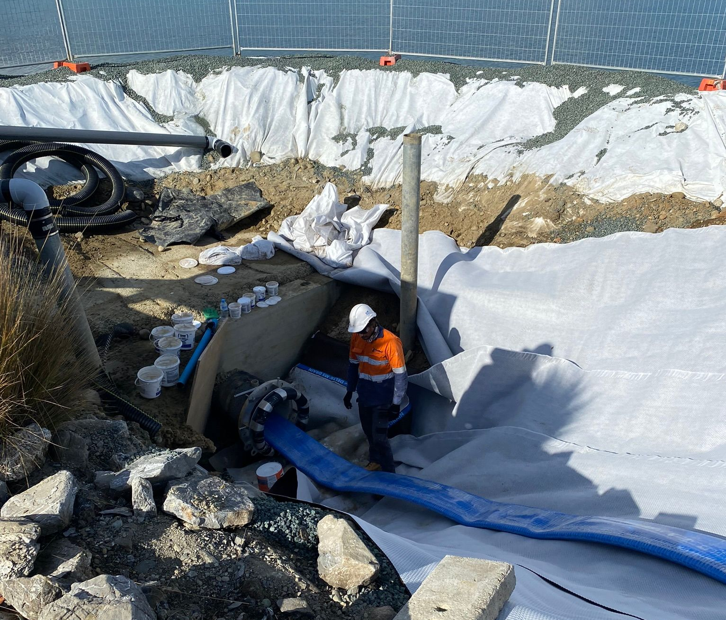
Project delivery
Notes:
With the thrust walls installed the first step was to pig the line.
This pulled out the muck but most importantly the twin rubber disks came through undamaged so we were happy nothing sharp was lerking in the pipe to damage the liner.
This image here shows 1200m of DN500 liner, new pipe rganised on a spool ready to roll out into the line.
Imagine instead if that was a stack of new PE pipe.
Liner installation went smoothly. We had the right team and a solid plan.

Slide 20
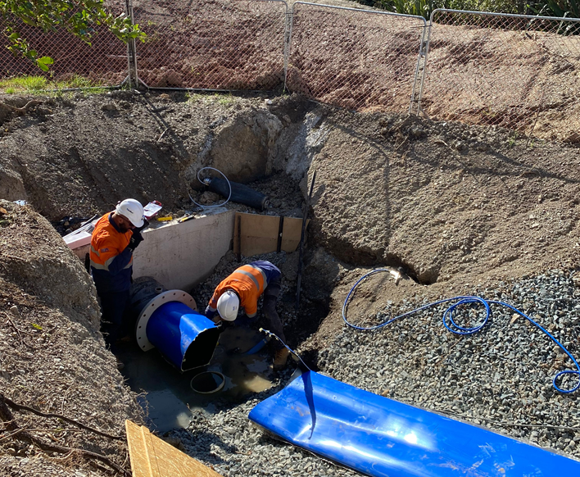
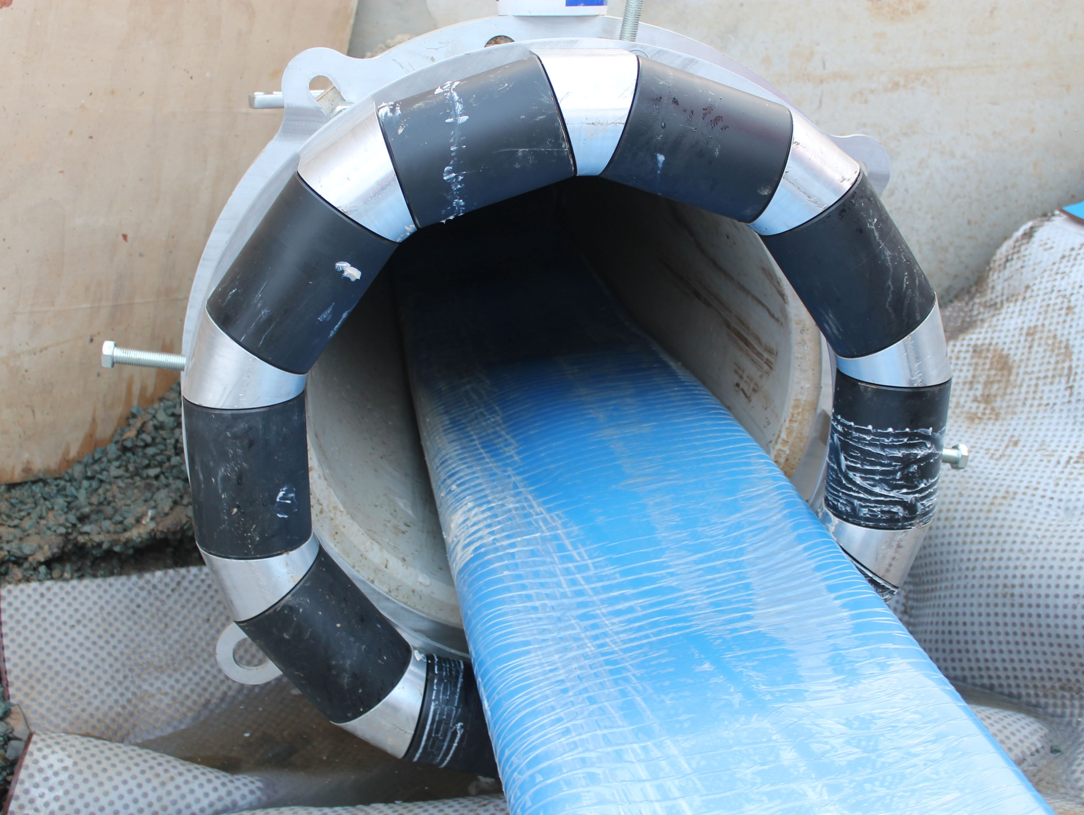
Project delivery
Notes:
Here a couple more pictures of the installation. The project is a record length primus sewer main for Interflow.
The project was a success because all parties approached the problem openly and collaborated to reach an outcome that solved the technical problem.
We improved outcomes for the community, and protected the sensitive environment surrounding the pipeline by using a trenchless solution.

Slide 21
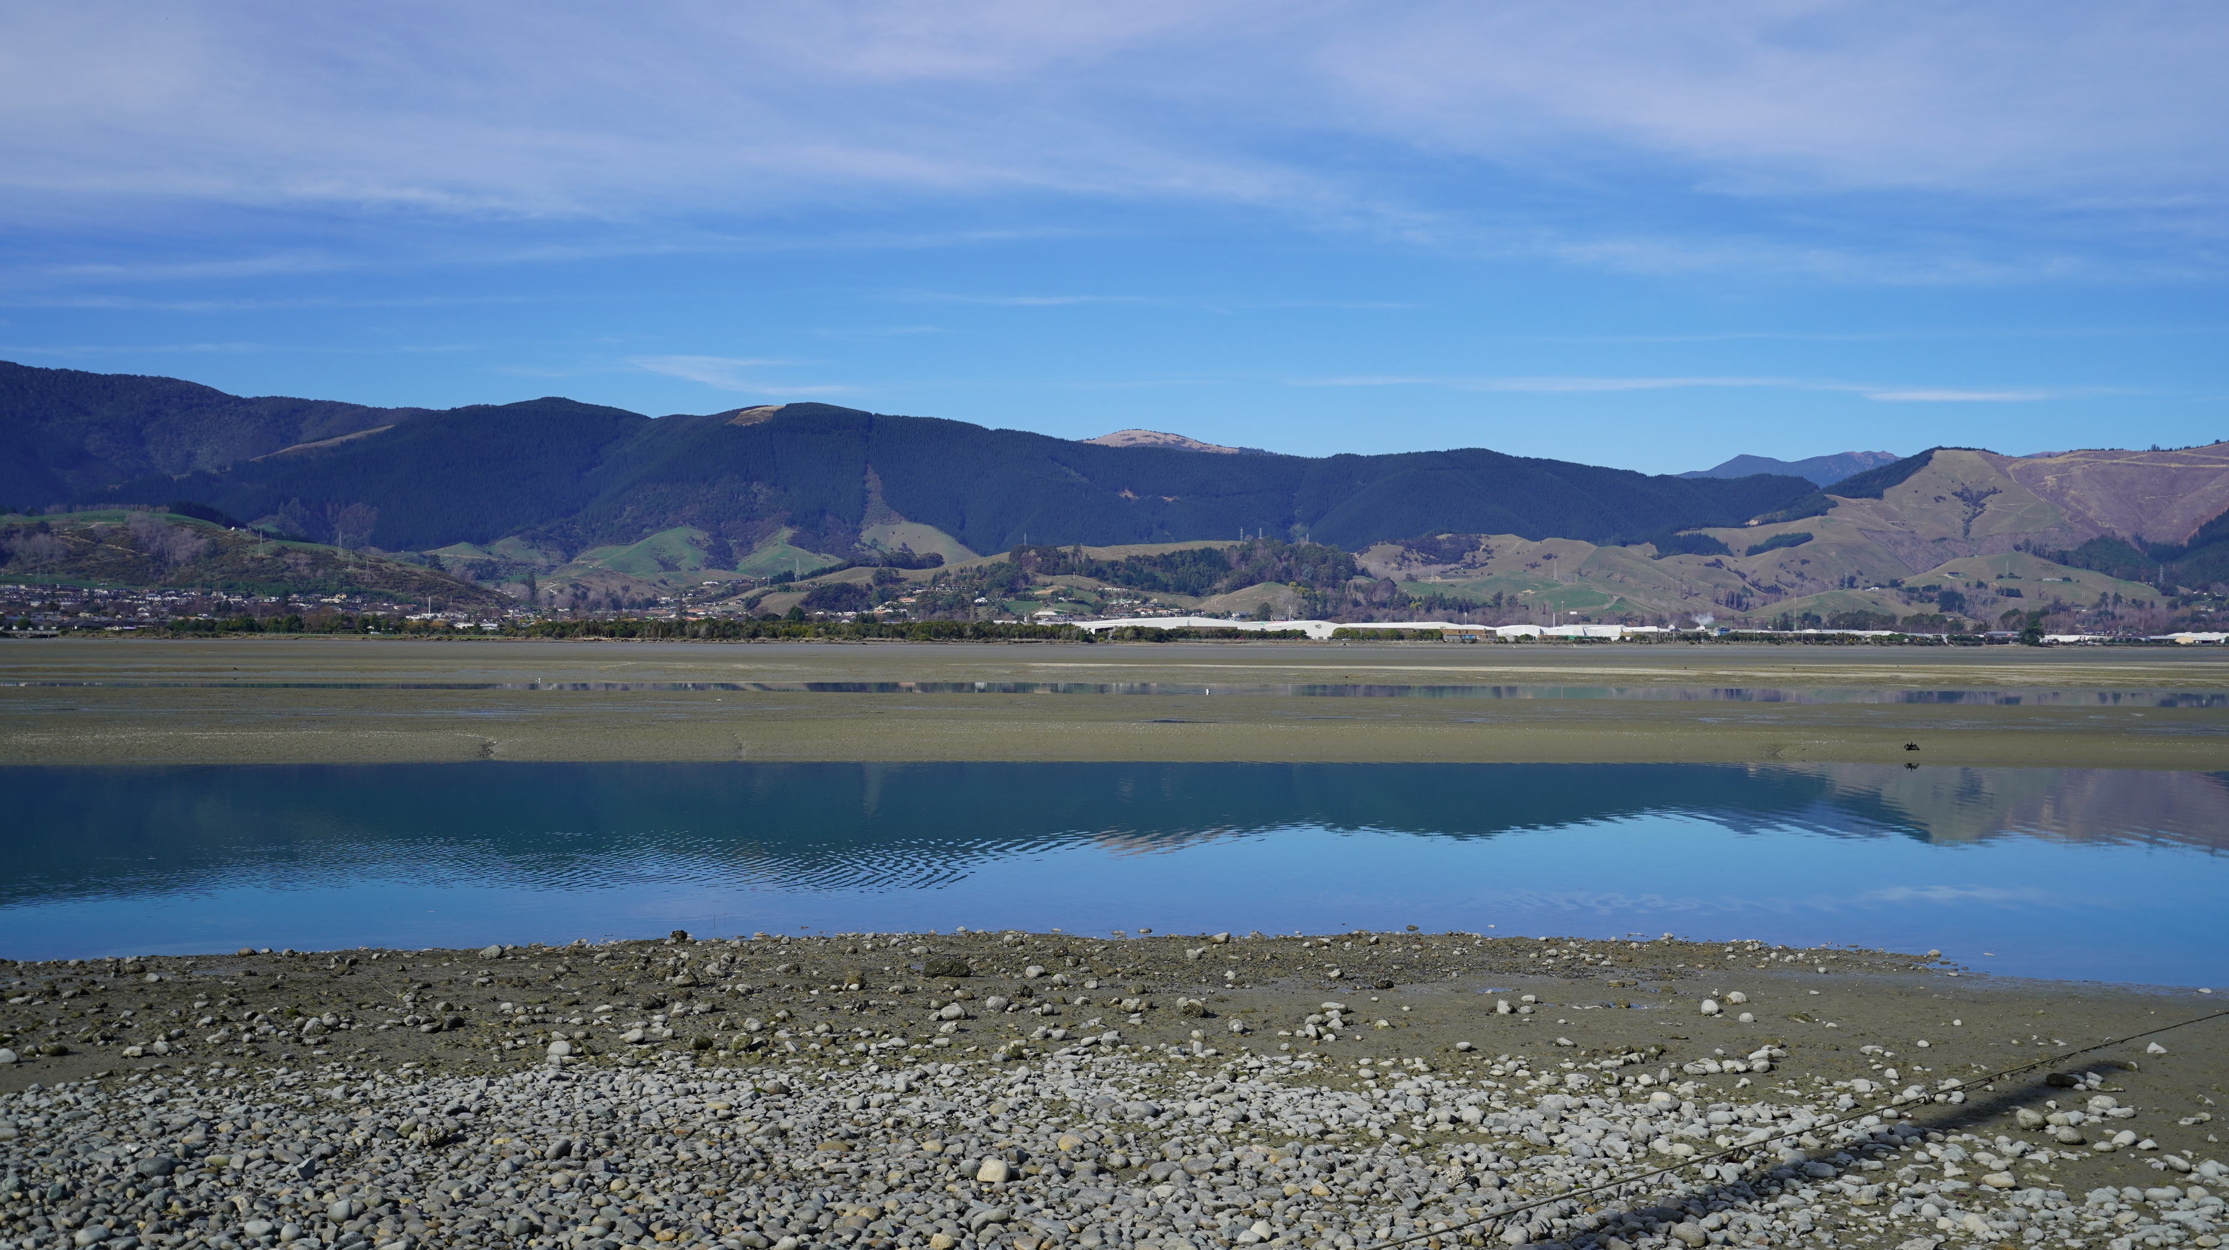
Outcome
Notes:
This photo sums it up for me, there is a new pipe under there thanks to a practical idea and solution.
And that pipe will help towards preventing overflows and protecting this beautiful place.
My te moana e mahea nei aku maharahara

Slide 22
NRSBU's perspective
The project when installed made it look easy... almost "what were we worried about" easy.
Installation was so quick I hardly got any photos!
I would be comfortable doing a much longer or more technical relining using the Primus Line product.
A collaborative approach and the emphasis on getting the planning done upfront enabled us to do the Project Right.
Notes:
The out of service pipe was critical to NRSBU being able to implement its Zero Overflows goal.
We did need to try something that hadn't been done in NZ before, but it required NRSBU to take some risk, and try something new.
We couldn’t have done this project without taking some risk and we therefore worked on an iterative risk management strategy to try to limit risk exposure.
Using a collaborative approach we were able to tease out issues early so that installation went well. And it did. It really looked very easy.
Installation was so quick I hardly got any photos!

Slide 23
Future Benefits for Aotearoa New Zealand
Don’t underestimate the value of a hole.
New technologies create new opportunities.
Options may be available now that could significantly alter the methods previously considered.
I recommend considering new technical solutions and doing so with a focus on managing the risks.
Ngā pātai?
Notes:
For NRSBU relining pipeline 3 was critical... . An old hole saved NRSBU millions on its capacity upgrade program.
The out of service pipe was critical to NRSBU being able to implement its Zero Overflows goal.
We couldn’t have done this project without the technology enabling relining from shore to shore.
Because it was new and we knew we were taking some risk and we therefore worked on an iterative risk management strategy to try to limit risk exposure.
The NRSBU?BECA team identified available technologies that made the project feasible. The work and the identification of the new technology allowed this to be the "Right Project."
I think this project shows what can be done, and I'm pretty sure that similar issues will be faced by others around NZ. I recommend considering this technology alongside other options. It worked for NRSBU.

