Slide 1
Julian Williams
Thinking about Te Mana o te Wai
Te Huia Natural Resources Limited

Slide 2
What do I want you to absorb today?
‘Wai’ is a taonga
YOU are part of a collective responsibility to ‘Te Mana o te Wai’
You can support Iwi Maaori to implement their aspirations; and
To know that you are already contributing to ‘Te Mana o te Wai’

Slide 3
Te Timatanga
The Beginning
Te Kore The formless void
Kotahi te kī The one unspoken thought
Kotahi te kōrero The one spoken word
Kotahi te wānanga The one sacred assembly
Te kore whiwhia The intangible formless void
Te Kore makiki hī rere The formless void pierced by a line extending into space
Makaka The sacred curve
Ka puta ō Io The supreme being
Notes:
It is said that the first word was a sound, and may have become the foundation for our language. A sigh, a drawing in of a sound, and expulsion out, but ina cosmic scale. Wheeeeee ----- Whuuuuu.
Io is said to have existed for all time. We have seen how he brought the universe into existence from chaos. He was never born, hence his name of Io-matua-te-kore (Io the Parentless), even as he shall know not death. He took no wife and had no offspring, yet through him all things came into being. As old Tutakangahau, of Tuhoe, once said to the writer, ("Nana i whakaputa i nga atua katoa; koia te timatanga o nga atua"). "He caused all gods to appear; he was the beginning of the gods"
During this conception, two elements were introduced and merged in Io, namely;
Te Ira Tane, or the male essence, which was personified in the celestial being named Hani, or the questing one.
Te Ira Wahine, or the female essence, which was personified under the name of Puna, the spring well.
Already, as part of the evolving process of creation, the association between wai and woman, through the female essence is revealed. I firmly believe that we should treat water and woman the same, with the highest level of care and respect, because of their natural ability to create and sustain life.
At their creation Hani and Puna were separated in the heavens. They searched for a place where they could embrace eachother.
In their ceaseless search for a place to be together, it was not until the appearance of Ranginui e tuu iho nei (the great sjy that stands above)) and Papa tuu aa nuku (the earth that lies beneath) that Hani and Puna found the one place in the whole of creation where they could come together.

Slide 4
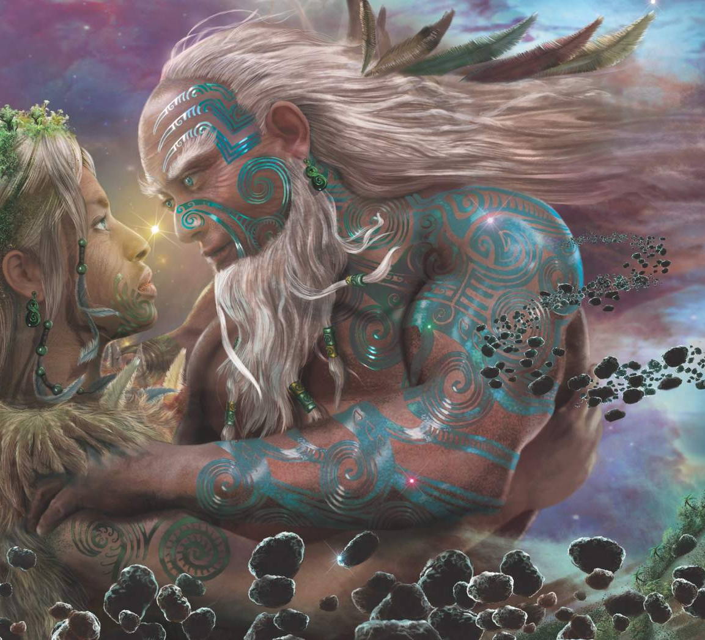
Rangi raaua ko Papa
With the separation of Rangi and Papa, Wai is used through a new expression. An expression of aroha, and a yearning for loved ones.
Naa shanstudio
Notes:
After Rangi and Papa were separated by their sons, Rangi cried, and his tears flooded the land. To stop this, the sons decided to turn Papa face down, so Rangi and Papa could no longer see each other's sorrow. Rūaumoko was at his mother's breast when this happened, so he was carried into the world below. He was given fire for warmth by Tama-kaka, and his movements below the earth cause earthquakes and volcanoes.
It is said that Māori attitudes to water stem from whakapapa that traces our beginnings to the separation of the primordial parents Ranginui (Sky Father) and Papa-tūā-nuku (Earth Mother).
There is a perpetual grief between the two lovers. It is my view that when Rangi mourns for Papa, he cries to express his pain. As his tears falls to the earth, they begin to trickle through the crevices and body of Papa. When his tears are embraced by Papa, and as it runs through her body, the tears/waters become sanctified. The essence of both male and female are joined and the mauri of wai is at its highest potential.
When the parents of the gods were parted thus, there came the Light, Awatea, Ao-Marama,

Slide 5
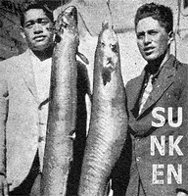
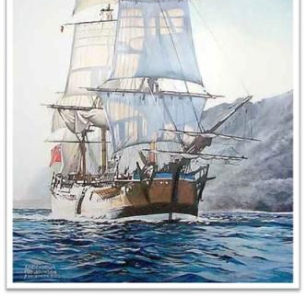
Te Ao Marama
World of Light

Slide 6
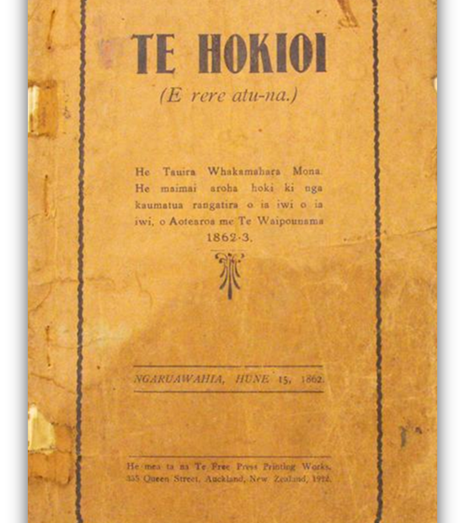
Te Ao Marama
World of Light

Slide 7
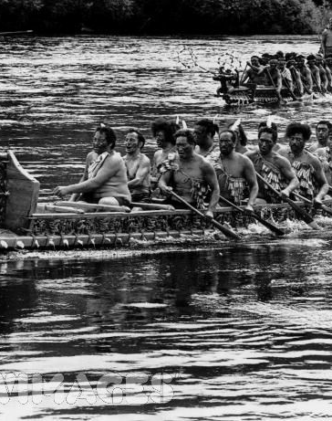
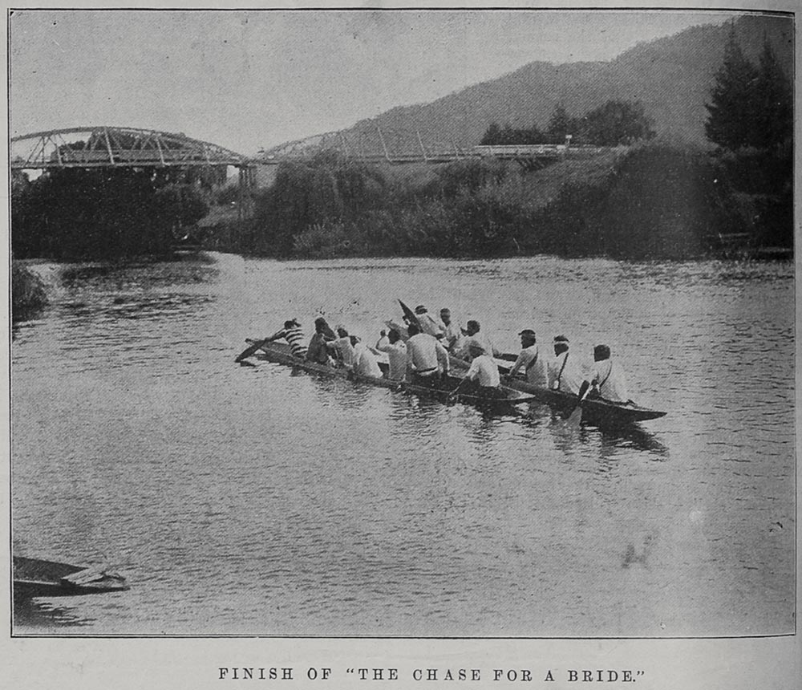
Te Ao Marama
World of Light

Slide 8
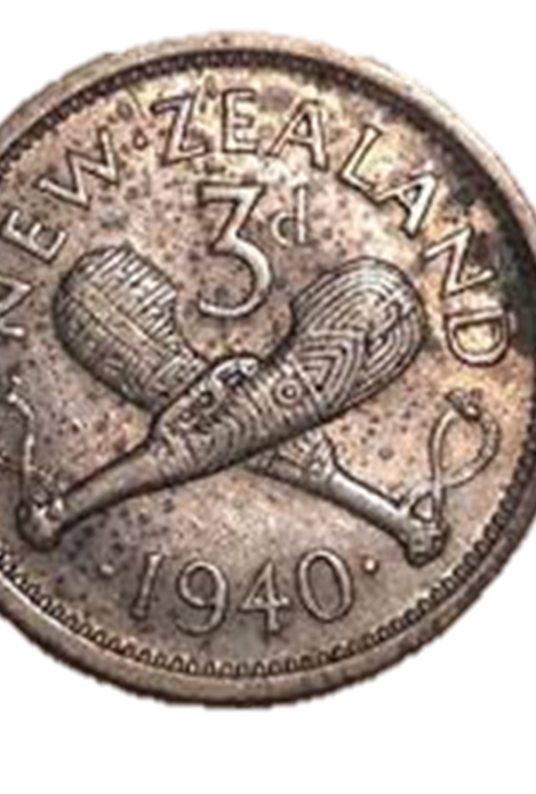
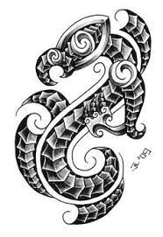
Te Ao Marama
World of Light

Slide 9
Resource Management Act 1991
All persons exercising functions and powers under the Resource Management Act must:
‘recognise and provide’ for 6(e) the relationship of Maori and their culture and traditions with their ancestral lands, water, sites, waahi tapu, and other taonga.
'have particular regard to’ section 7(a) kaitiakitanga.
‘take into account’ the principles of the Treaty of Waitangi.
Avoid, Remedy, Mitigate

Slide 10
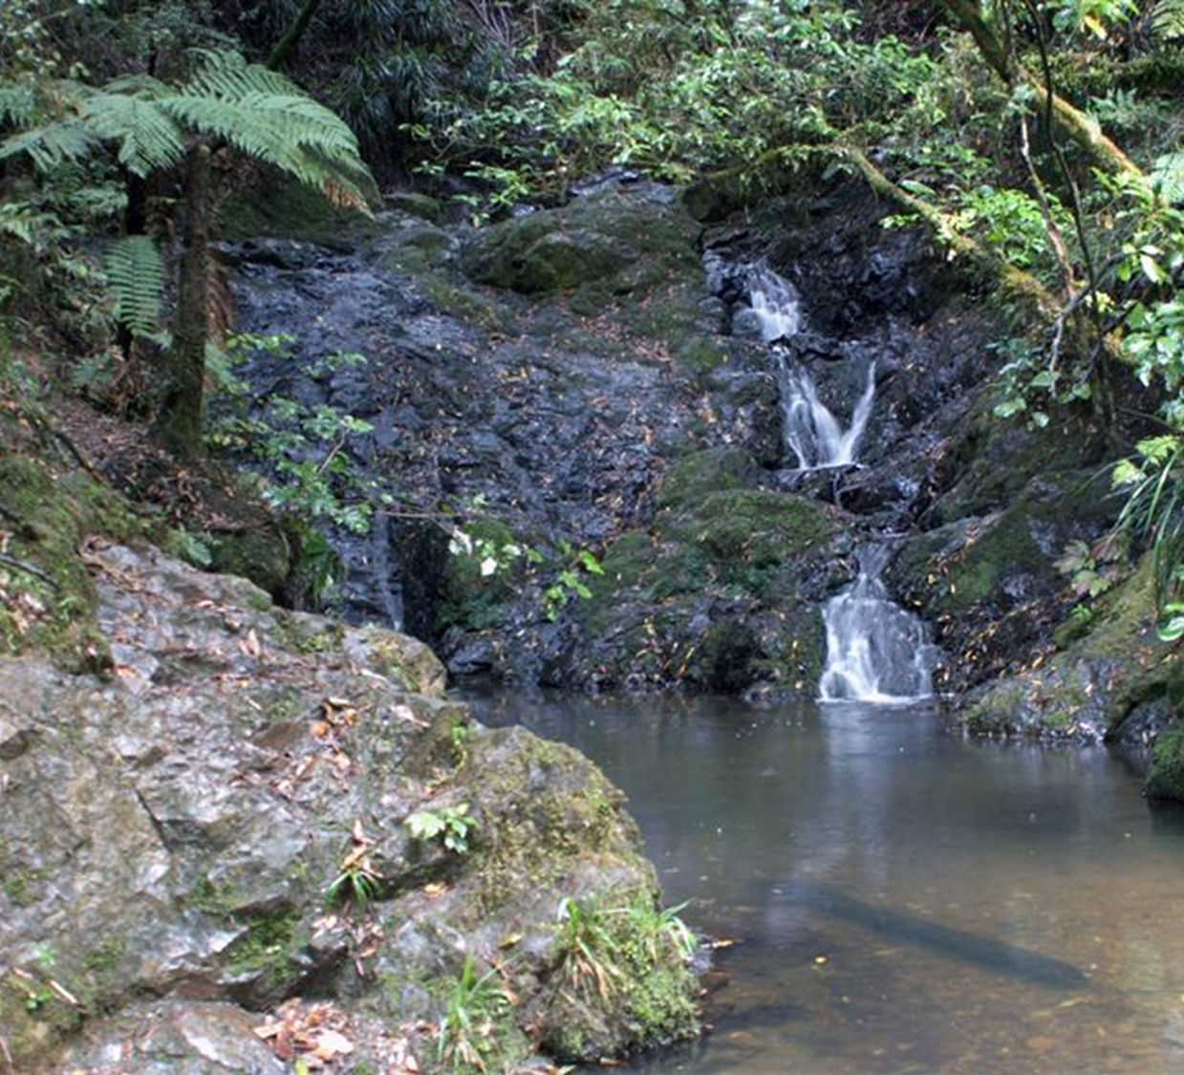
Treaty of Waitangi Settlements
Te Arawa Lakes 2008
Waikato River 2010
Waipaa River 2012
Tuhoe Claims Settlement 2014
Tuupuna Maunga o Taamaki Makaurau 2014
Whanganui River (Te Awa Tupua) 2017

Slide 11
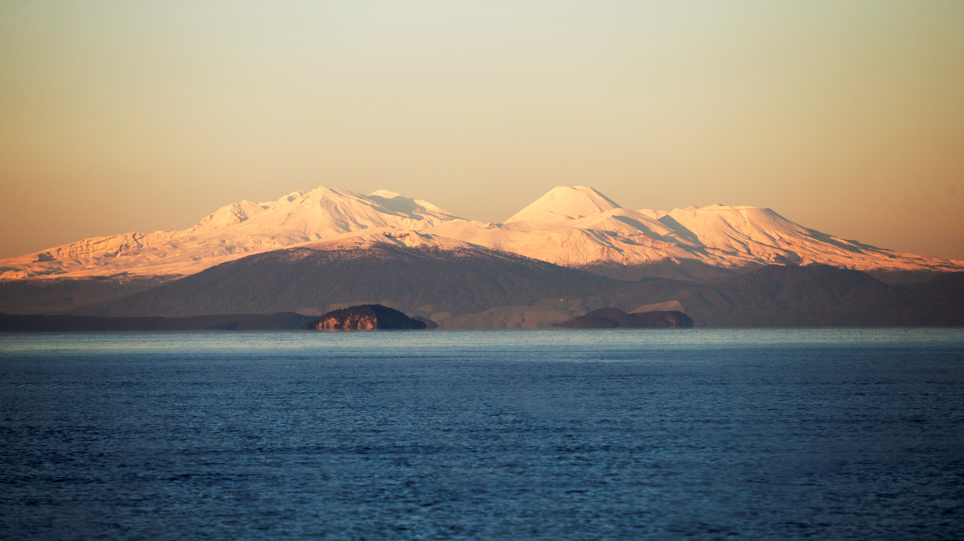
Te mana o te wai
National policy statement for freshwater 2014/2020
Te Mana o te Wai
Te Mauri o te Wai
Te Mauri o te Tangata
Te Mauri o te Taiao
Ngaa Matapono ki te Wai
Mana o te Wai
Te Tiriti te taahuhu o te Wai
Te mana Motuhake o ia wai o ia iwi ki te wai
Te kaitiakitanga o ngaa hapuu me ngaa iwi ki te wai
Te mana whakahaere o ngaa iwi me ngaa hapuu ki te wai
The six principles
Mana whakahaere
Kaitiakitanga
Manaakitanga
Governance
Stewardship
Care and respect
Notes:
Te mana o te Wai didn’t happen overnight.
Te Mana o te Wai refers to the vital importance of water. When managing freshwater, it ensures the health and well-being of the water is protected and human health needs are provided for before enabling other uses of water. It expresses the special connection all New Zealanders have with freshwater.
By protecting the health and well-being of our freshwater we protect the health and well-being of our people and environments.
Te Mana o te Wai imposes a hierarchy of obligations by prioritising the health and wellbeing of waterbodies and freshwater ecosystems first. The second priority is the health needs of people (such as drinking water) and the third is the ability of people and communities to provide for their social, economic and cultural wellbeing.
Mana whakahaere: the power, authority, and obligations of tangata whenua to make decisions that maintain, protect, and sustain the health and well-being of, and their relationship with, freshwater
Kaitiakitanga: the obligation of tangata whenua to preserve, restore, enhance, and sustainably use freshwater for the benefit of present and future generations
Manaakitanga: the process by which tangata whenua show respect, generosity, and care for freshwater and for others
Governance: the responsibility of those with authority for making decisions about freshwater to do so in a way that prioritises the health and well-being of freshwater now and into the future
Stewardship: the obligation of all New Zealanders to manage freshwater in a way that ensures it sustains present and future generations
Care and respect: the responsibility of all New Zealanders to care for freshwater in providing for the health of the nation

Slide 12
Wai Ora, Wai Rua, wai ata
Te Arawa
WAI ORA
Te mā o te wai e rite ana kia kite i ngā tapuwae ā te kōura.
The quality of the water is such that you can see the foot steps of the koura.
WAI RUA
Ko ngā roto ko au, ko au ngā roto - I am the Lakes and the Lakes are me
WAI ATA
Waiata relates to the “rhythm of wai as embodied and transmitted through waiata”.

Slide 13
Te mana o te wai
Kai Tahu ki Otakou (Otago rohe)
Water descends from our creation beliefs. The first mention of water is Te Mākū (moisture).
Kāi Tahu is therefore bound to the waters of Te Wai Pounamu through whakapapa.
Kāi Tahu are connected through spiritual beliefs with the atua and the environment created by those atua. The mana and hauora of Kāi Tahu is inextricably interwoven with the mana and hauora of waterways.
A water body with an intact mauri is able to sustain healthy ecosystems. Therefore, the well-being of our people depends on the well-being of river, stream and wetland ecosystem.
Notes:
Life came into being when Te Mākū mated with Mahoranuiātea, another form of water, and of this Rakinui was born. Rakinui had two wives, Poharuatepō and Papatūānuku. From the unions of Rakinui came the flora and fauna, the mountains and people. Kāi Tahu descends from Raki and his wives.
Kāi Tahu classified water in a number of ways. Some of these categories include:
▪Wai-Māori – pure water, water rich in mauri, used for cleansing and for ceremonial purposes.
▪Wai-tai – sea water.
▪waimanawa-whenua – water from under the land,aquifer /springs.
▪waikarakia – water for ritual purposes.
▪waitapu – sacred water, waters used for ceremonial purposes
Waterways embody the mana of Kāi Tahu, regardless of the extent to which they have been manipulated.
The lakes are the source of the South Island‟s water and the traditions link the earliest ancestors discovering and naming these great sources of pure water.
Further to these discovery associations are many tales of personification of the waterways with legendary and ancestral beings. For example the Clutha River is known as the Mata-au which is also the name of the taniwha who resided in Lake Wakatipu; and Waitaki, which means “waters crying”, was considered by many to be a reference to the tears of Aoraki.
Other waterways have direct association with ancestors who have resided within or adjacent to them and it is important to note that every spring that was known to Kāi Tahu was named and recorded in the oral map of the South Island.
in one water system, which was viewed as a single entity, there would be areas set aside for food gathering during the appropriate season, another area would be dedicated for religious rituals whilst yet another area may be for daily bathing. Such dedications could be repeated along the course of a single long river.

Slide 14
Te mana o te wai
Ngaati hine
Ngati Hine see water as having a specific life force that sustains all others. This life force, called “mauri”, must be kept healthy if that water is to uphold the ecosystem around it.
The mauri of one body of water is not the same as that of another. Thus, if mauri from one body were to mix with that of another, both risk damage to themselves and the surrounding environment.
As it pertains to waterways, nature’s word is final. Water is to be left where nature put it and as pure as nature made it.
All natural water has value and sustains some form of life. Water is a sacred resource to Ngāti Hine, to be given the highest level of protection.

Slide 15
Te mana o te AWA
Waikato-Tainui
“The Waikato River is our tupuna (ancestor) which has mana (spiritual authority and power) and in turn represents the mana and mauri (life force) of Waikato-Tainui.
The Waikato River is a single indivisible being that flows from Te Taheke Hukahuka to Te Puuaha o Waikato (the mouth) and includes its waters, banks and beds (and all minerals under them) and its streams, waterways, tributaries, lakes, aquatic fisheries, vegetation, flood plains, wetlands, islands, springs, water column, airspace and substratum as well as its metaphysical being…”
Notes:
Kāi Tahu classified water in a number of ways. Some of these categories include:
▪Wai-Māori – pure water, water rich in mauri, used for cleansing and for ceremonial purposes.
▪Wai-tai – sea water.
▪waimanawa-whenua – water from under the land,aquifer /springs.
▪waikarakia – water for ritual purposes.
▪waitapu – sacred water, waters used for ceremonial purposes
Waterways embody the mana of Kāi Tahu, regardless of the extent to which they have been manipulated.
The lakes are the source of the South Island‟s water and the traditions link the earliest ancestors discovering and naming these great sources of pure water.
Further to these discovery associations are many tales of personification of the waterways with legendary and ancestral beings. For example the Clutha River is known as the Mata-au which is also the name of the taniwha who resided in Lake Wakatipu; and Waitaki, which means “waters crying”, was considered by many to be a reference to the tears of Aoraki.
Other waterways have direct association with ancestors who have resided within or adjacent to them and it is important to note that every spring that was known to Kāi Tahu was named and recorded in the oral map of the South Island.
in one water system, which was viewed as a single entity, there would be areas set aside for food gathering during the appropriate season, another area would be dedicated for religious rituals whilst yet another area may be for daily bathing. Such dedications could be repeated along the course of a single long river.

Slide 16
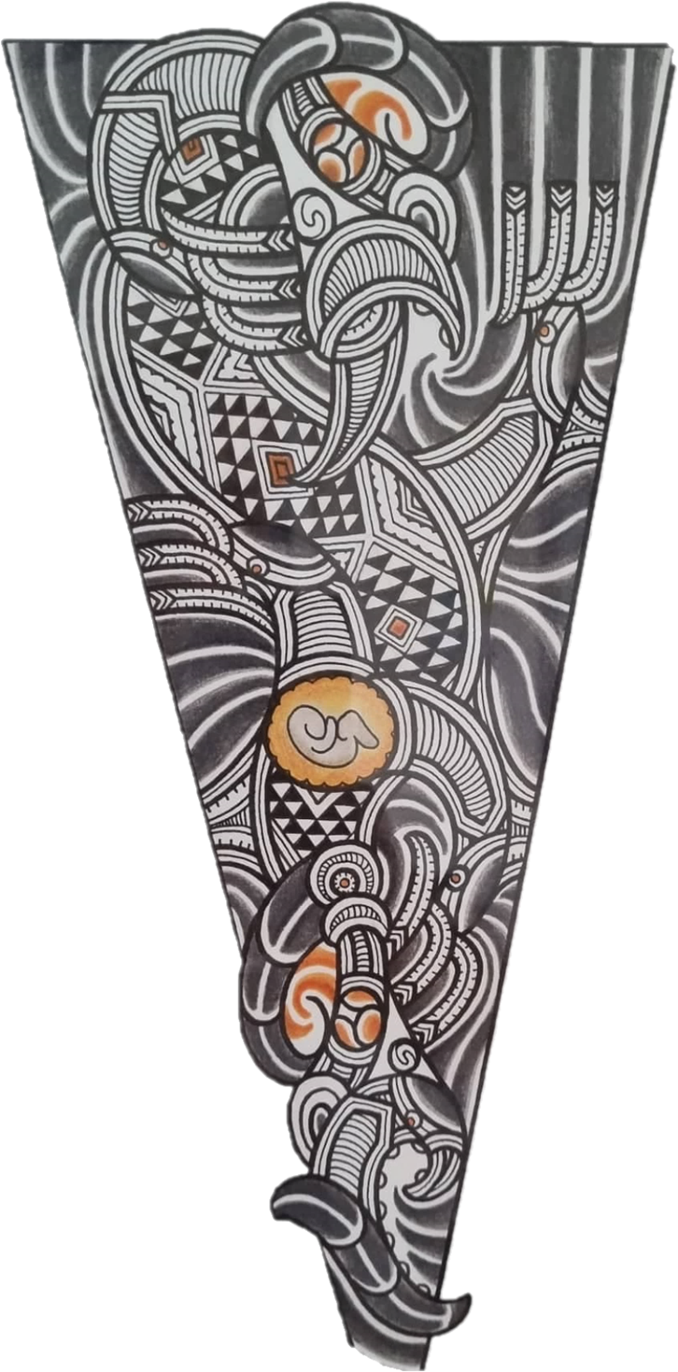
General Advice
Protect the mauri of wai
Make it swimmable
Access to healthy kai
Preserve rights and interests to freshwater
Cultural matters

Slide 17
COMMUNICATION
He aha te kai o te rangatatira? He koorero, he koorero
Do your homework before making contact
What are current issues in their space
Who do I need to talk to, who can give guidance
Establish a connection – focus on context before content
Early consultation and engagement is good practice
No surprises approach
Full disclosure of information
Quality of information to support decisions
Koha atu – Koha mai
Resourcing

Slide 18
ABSTRACTION
Ask for an appropriate area to be designated for ‘take’
Consider surroundings e.g waahi tapu, other activities
Historical context to area e.g. flooding, erosion
Apply tikanga to support water use, if an inappropriate space.
Consider preferred area by Iwi Maaori i.e. river, lake, stream, puna
Acknowledging anomalies, acknowledging unexplained
Consider seasonal or periodic events
Provide for customary activities
Acknowledge whakapapa, taniwha, ingoa tūturu, urupa etc

Slide 19
DISCHARGE
Ask for an appropriate area to discharge to
Seek cultural designation for discharge
Eliminate discharges of contaminants to waterways, wetlands, springs
Don’t rely on mixing zones – creates exclusive areas
Environmental purification versus cultural/spiritual purification
Consider tikanga to be applied to make matters “noa”
Minimise discharge structures. They are akin to objects piercing the veins of an ancestor
Manage discharge energy i.e. reverberation, bruising

Slide 20
CONVEYANCE
Pipes to be conducive to the environment
Maximise gradients to minimise energy loss
Construction, earthworks and laying of pipes to consider historic space
Digging
Directional drilling
Protocols
Impervious surfaces limit natural cycle of water to pass through Papa
Mapping of water truck supply areas
Preferably not on Maaori owned land, unless agreed
Low impact materials
Notes:
Respect water while in your custodianship

Slide 21
WASTEWATER
Human waste is “tapu” (unsafe/dirty/bad) and this needs to be converted to noa (safe/clean/good) prior to water contact
Mortuary waste to be separated from general wastewater
Best available forms of treatment
Trucked mortuary waste to avoid cultural spaces
Wastewater discharges are regarded as “offensive” and “disgusting”
Kaitangata principle – Mahinga Kai
Tikanga to provide for cultural/spiritual purficiation
Notes:
Respect water while in your custodianship

Slide 22
Julian Williams
Thinking about Te Mana o te Wai
Te Huia Natural Resources Limited

