Slide 1
Allan MacMaster
Transition and Transformation – Lived Experiences

Slide 2
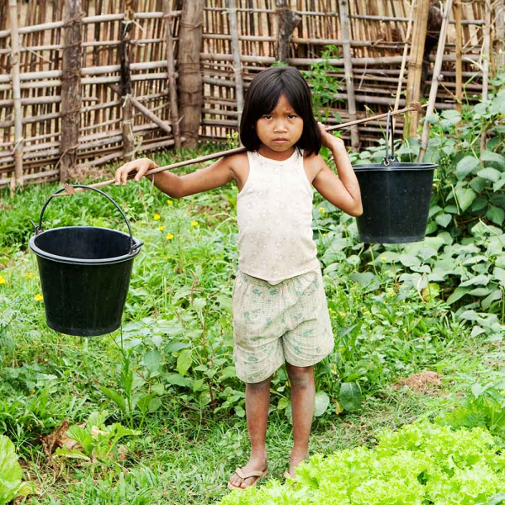
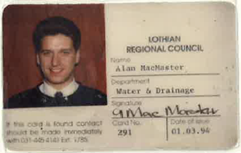
Trusted to care for the water on which we depend
771 million people lack access to safe water
200 million people walk >5km to gather water
By 2050 half the world population face water shortages
How far would you walk for water?

Slide 3
Transition and Transformation
1990-2002
Transformation
Storming
Forming
Norming
Performing
Transforming
Transition
2002-2010
Bruce Tuckman – 1965, Stages of group development

Slide 4
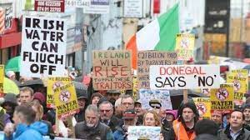
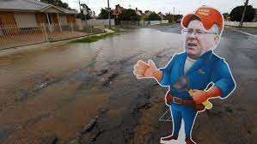
Themes from Water Reforms
Scotland
Ireland
South Australia
Referendum
Water Charges
Failing Assets

Slide 5
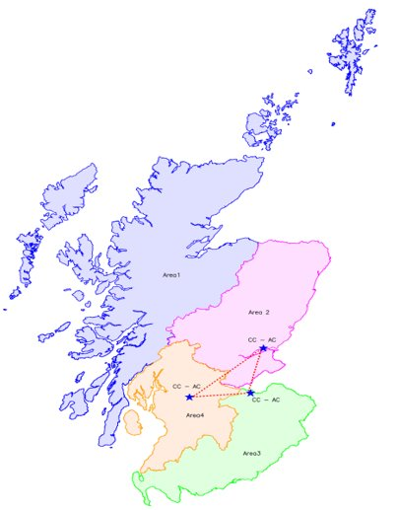
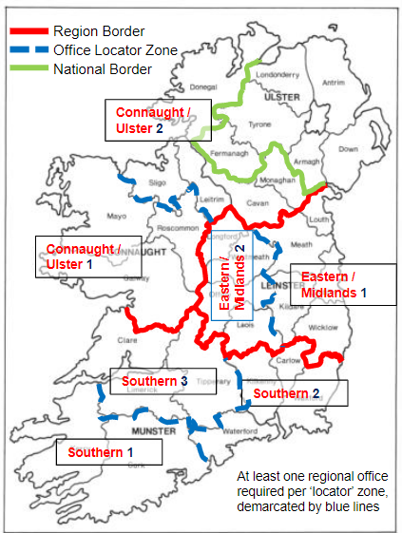
Organisational Context
National (Direction)
Driving standards and consistency
Regional (Management)
Target performance and best practice
Local (Delivery)
Front line ownership of customer and assets

Slide 6
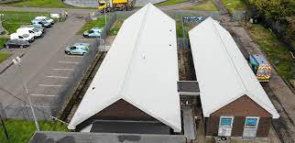
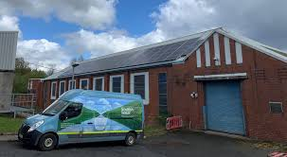
Delivery in Local Communities
2/3rd of our people are locally based
15 Workplaces for >30 people throughout Scotland

Slide 7
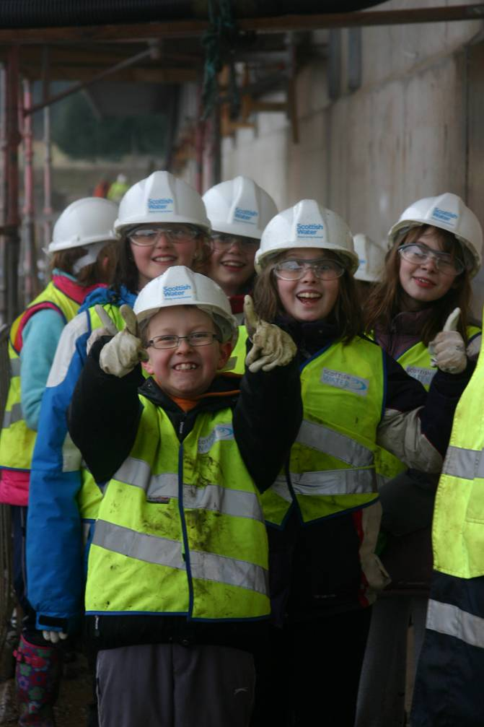
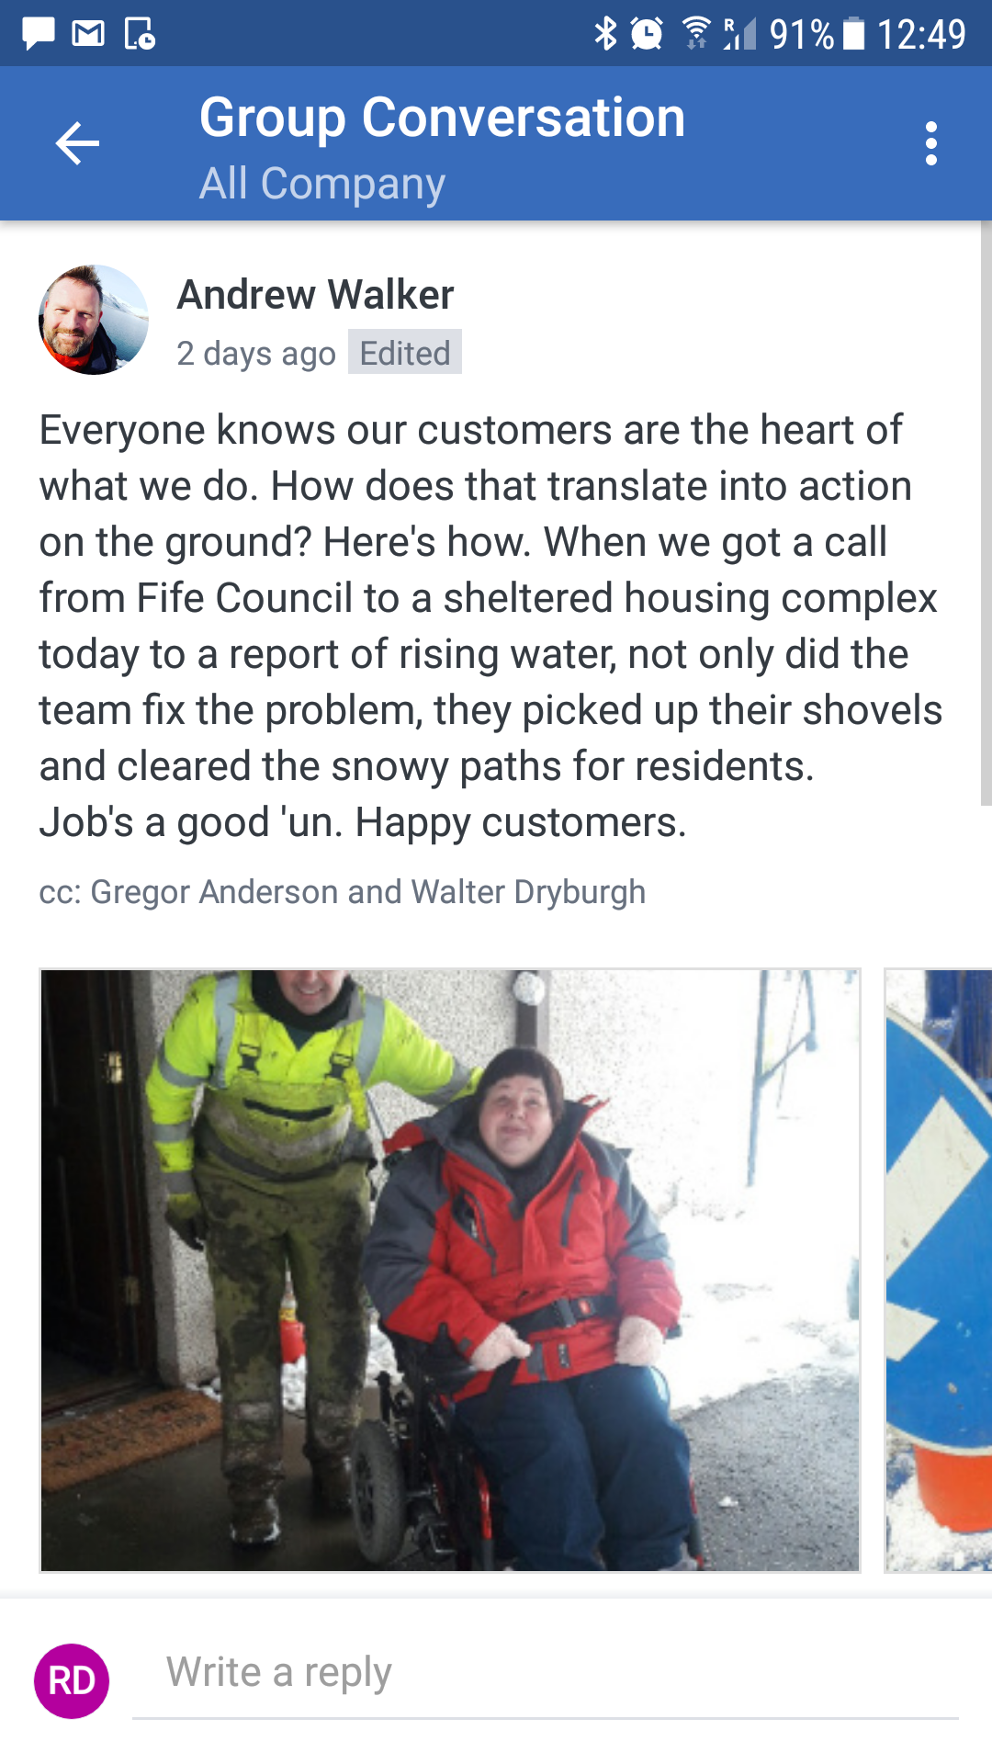
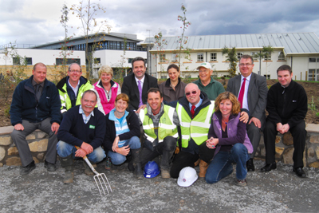
Delivery for Local Communities
Volunteering Environmental / Conservation
Volunteering
Knowledge of Vulnerable Customer
School Education

Slide 8
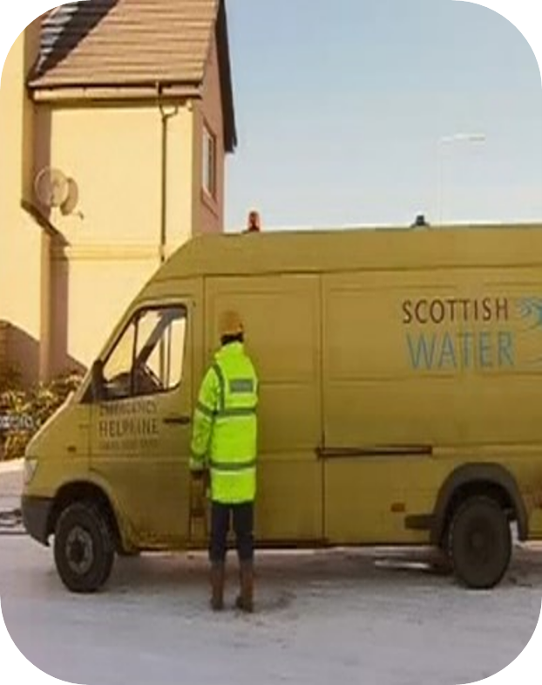
Performance improvement and collaboration

Slide 9
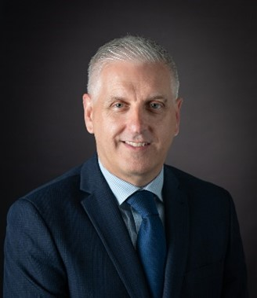
Trusted to care for the water on which we depend

Slide 10
Questions

